Slide 1
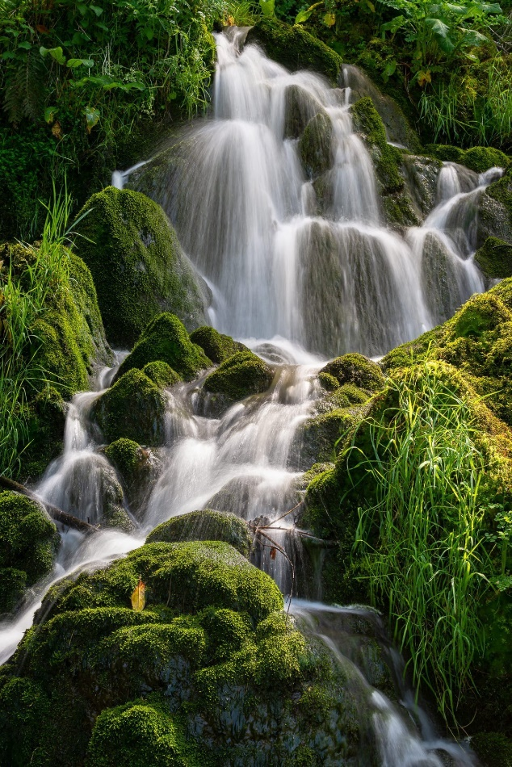
Cascade and Vortex: PlatformS for
Intelligent edge computing and RAG LLMs
Ken Birman

Slide 2
The promise of edge intelligence
Can “real world” artificial intelligence be as accurate and as fast as human intelligence?

Slide 3
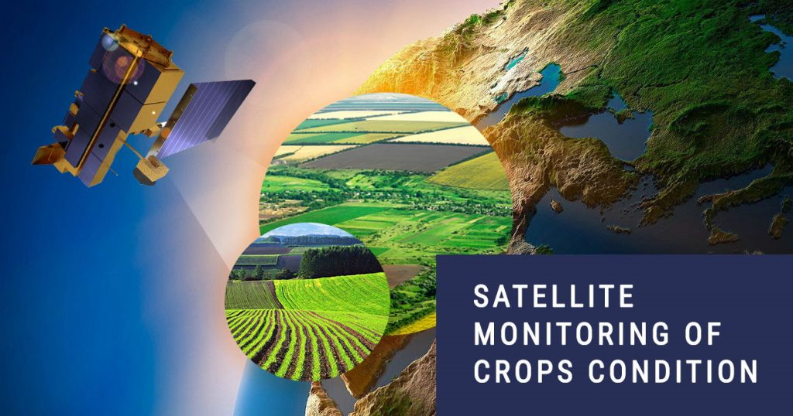
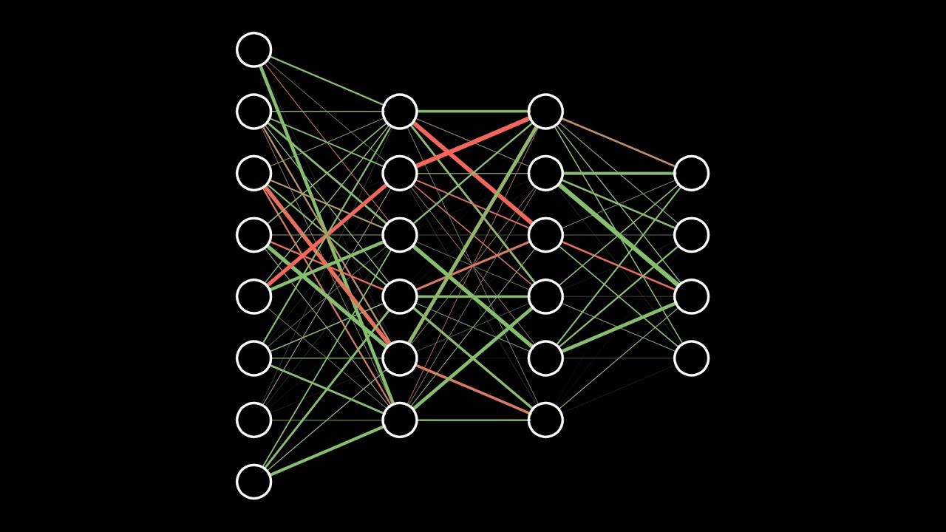
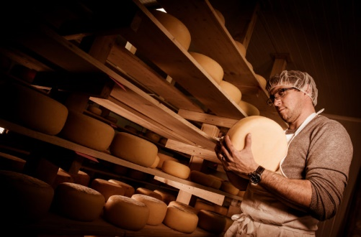
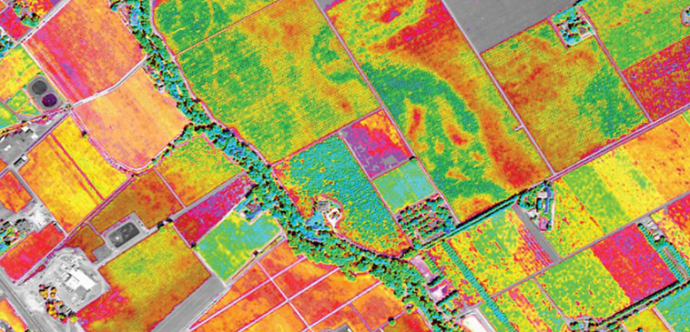
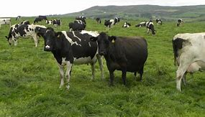
What will Real-world AI look like?
Data sources Cooperative ML Smart
Distributed AI Queries
How much should I budget for raw milk purchases in March for my cheese factory?”

Slide 4
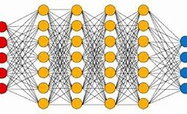
WHAT WOULD REAL-WORLD AI LOOK LIKE?
Data sources Cooperative ML Smart
Distributed AI Queries
How much should I budget for raw milk purchases in March for my cheese factory?”

Slide 5
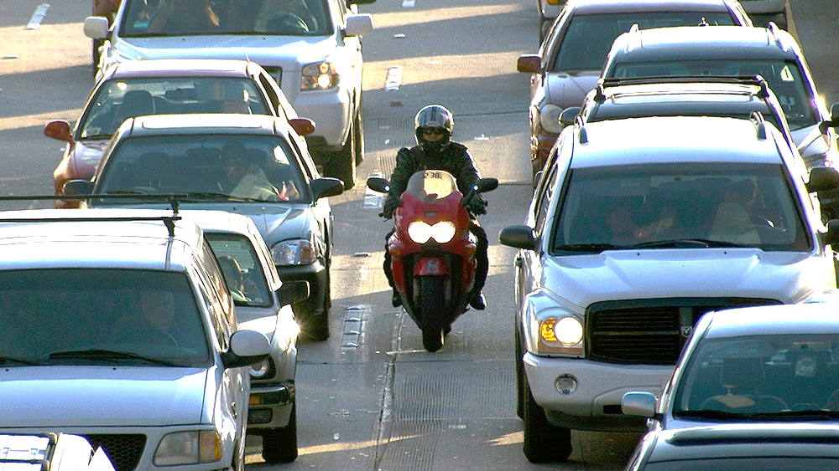
Some uses have demanding deadlines, like smart urban infrastructures
A smart intersection or roadway must send warnings within 25-30ms!

Slide 6
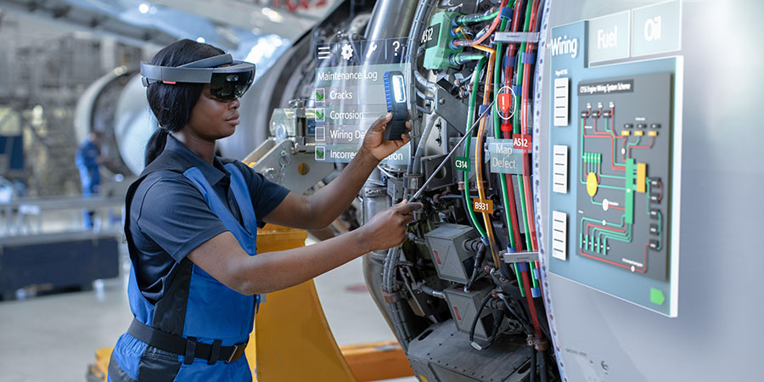
… servicing equipment

Slide 7

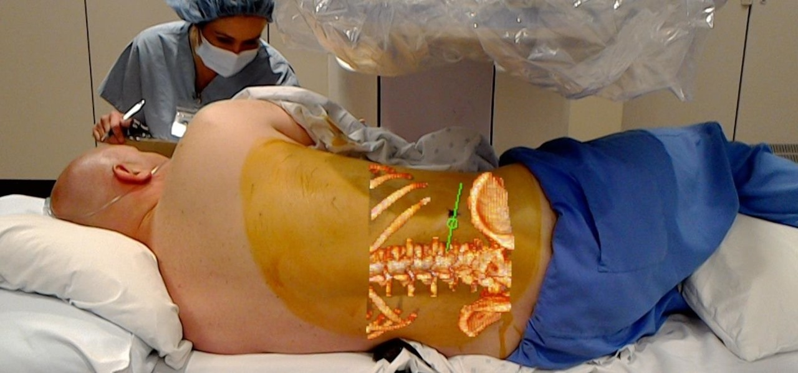
… medical AR

Slide 8
VORTEX: VECTOR DATABASE ARCHITECTURE FOR ACCELERATING RAG-LLM QUERIES
Ken Birman

Slide 9

RAG LLM: The Winning Story
For Generative AI!
Generative AI is trained offline: today’s models learned from 2020 data and hence need help from “current events” data!
RAG LLMs form prompts by combining queries with relevant documents:
Start with documents, chunks of text, or data of other kinds.
Embed each object as a point in a high-dimensional space.
Given a query, embed it too, then search for the nearest neighbors

Slide 10
… but there can be many AI components on the RAG LLM pipeline
For example, updates and queries for one approach employ:
Document chunking, using a transformer
Document and query embedding, again via a transformer
Formation of point-clouds representing clusters
Approximate nearest neighbor search
Enlarged prompt formation
Actual generative response (and sanity/toxicity check)

Slide 11
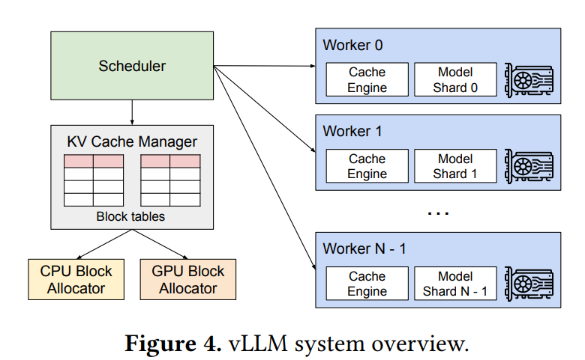
Individual components might themselves be distributed programs
This LLM inference system is from a
UC Berkeley 2023 SOSP publication.
It proposes a way of parallelizing the
deployment of an ML inference model and uses
custom CUDA kernels for extra performance.
vLLM is coded in PyTorch, but might be
integrated with other components built in
TensorFlow, Julia, MXNET, etc…
Efficient Memory Management for Large Language Model Serving with PagedAttention. Kwon et. al., SOSP 2023

Slide 12
Our idea: One platform to support these diverse AI (and ML) components
Imagine a distributed service able to host the data on which AI and ML systems depend (a diversity of objects and data types)
But rather than being rigid, extensible to create entire families of AI or ML servers, each using its own special methods/algorithms
Each of these user-defined extensions would benefit

Slide 13
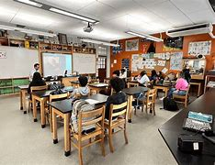
déjà vu: Cloud
Microservices?
Study-hall chatbot could answer questions about illustrations seen in a biology class or a science textbook….
Strong similarities: we have a pipeline or data-flow graph in which each “node” is an AI triggered by an upstream AI, and developers need control over deployment choices. But:
Models and RAG databases are too big to move rapidly. Dynamic
contextualiztion can produce high RAG database update rates
Requires GPU (or FPGA) accelerators, which have high setup overheads.
Thus we can’t reconfigure elastically (rapidly).
Need to use RDMA networking, an “imported” HPC technology.
… so our problem has familiar elements yet differs in many details.

Slide 14
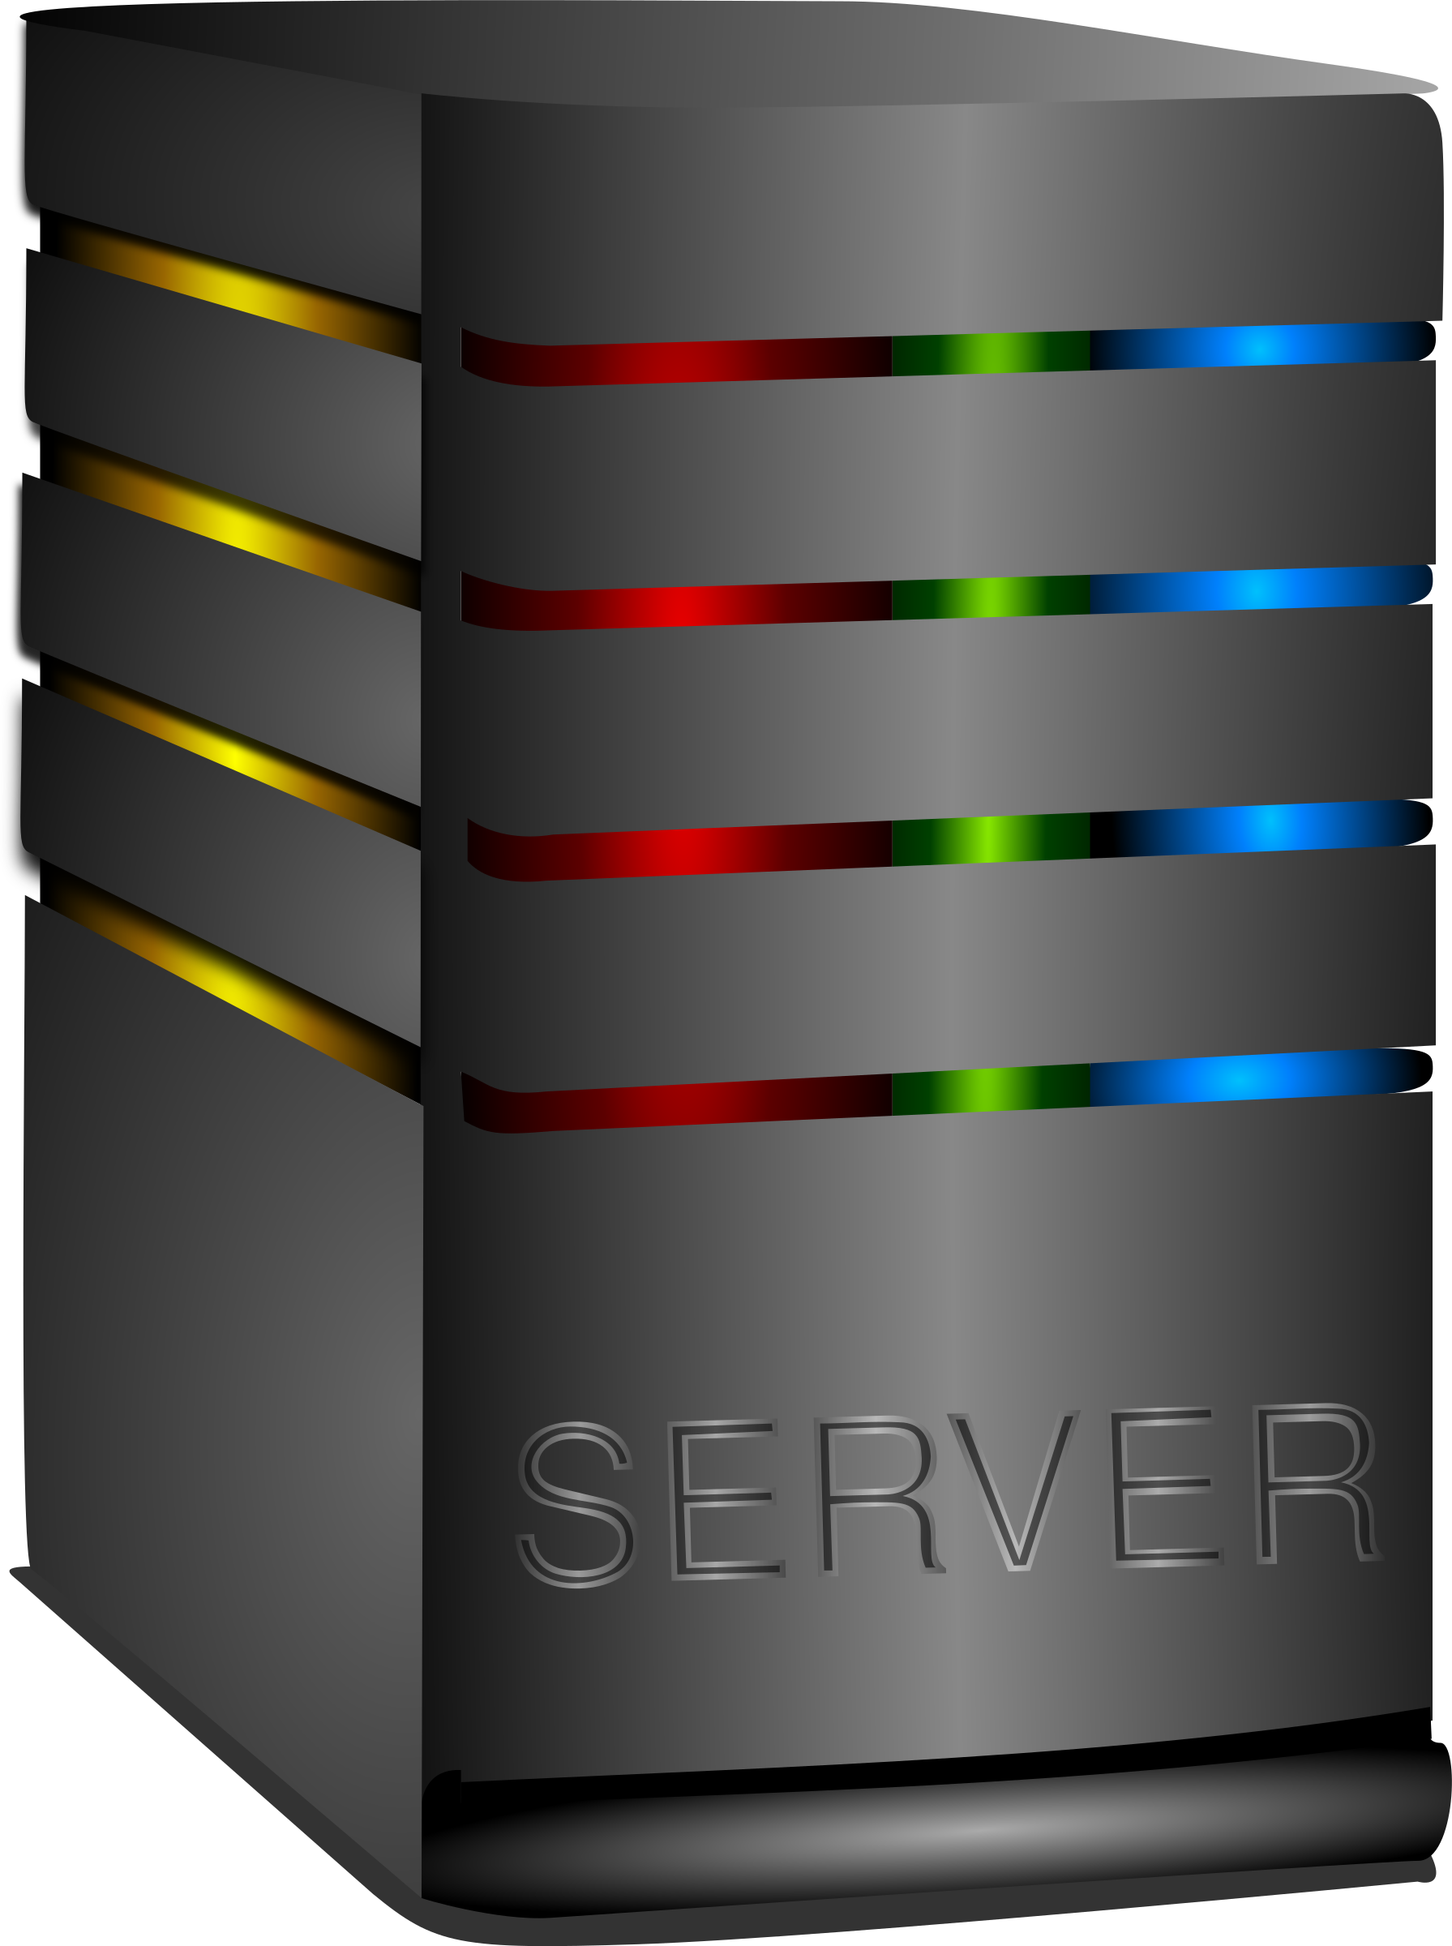
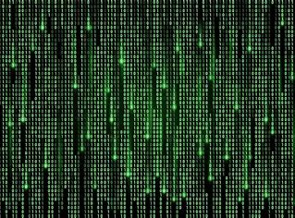

déjà vu: model server?
Prompts
AI models
Classifications
TorchServe
Yes, same idea! But model servers don’t deal with complex AI components aimed at distributed deployments that wish to control scaling and have varied, perhaps idiosyncratic, hardware needs.
Model servers tend to be AI-platform specific and aren’t normally used for AI pipelines/DAGs.
Vortex is not a commercial product… but our research is free and fully open: commercial products could adopt our ideas.

Slide 15
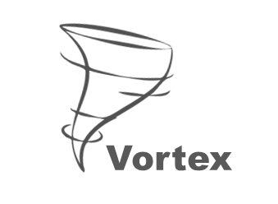
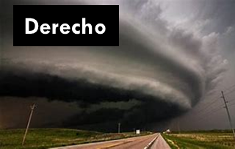
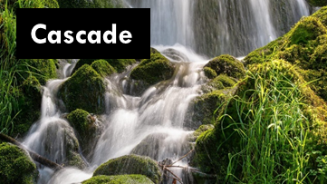
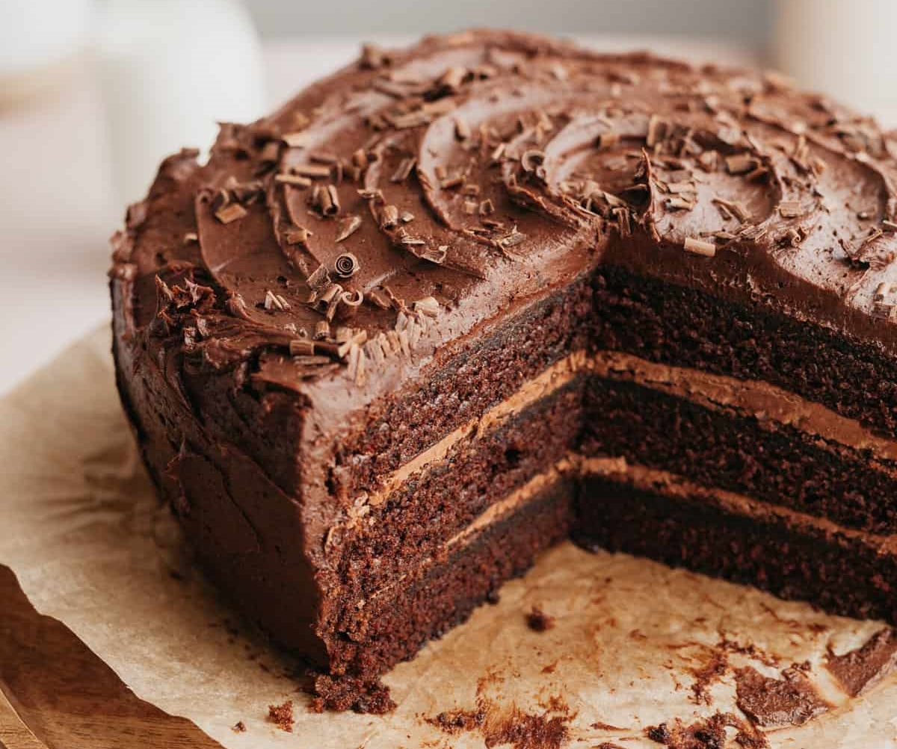
We think of this as three problems…
Vortex: A scalable vector database, our
focus today due to time constraints.
Cascade: a KV infrastructure that
combines data and compute hosting
[ArXiV 2023]
Derecho: World’s fastest atomic multicast
and Paxos, will leverage RDMA if available
[ACM TOCS 2019]
Vortex
Cascade
Derecho
Open source: https://GitHub.com/Derecho-Project

Slide 16
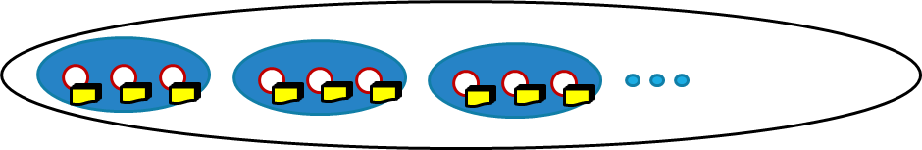
Vortex
Vortex is built on Cascade, which hosts a sharded key-value store
(KV* store). This deployment has 9 servers in shards of size 3.
It can be accessed like a
file system, or via KV
get, put operations
Cascade in turn leverages Derecho for data replication. Each member of a shard has an identical replica of the data it hosts.
Scalable sharded KV store (shards of size 3)
Scalable sharded KV store (shards of size 3)

Slide 17
Vortex
Vortex is built on Cascade, which hosts a sharded key-value store
(KV* store). This deployment has 9 servers in shards of size 3.
It can be accessed like a
file system, or via KV
get, put operations
Each member of a given shard has a complete, identical replicas
of the data it hosts. We can spread load, tolerate failures
*A KV pair is like a filename and its bytes. Not to be confused with the Q, K,V matrices arising in the transformer self-attention computation.
Scalable sharded KV store (shards of size 3)
Scalable sharded KV store (shards of size 3)

Slide 18
Extending Vortex with a UDL
User-Defined Logic (UDL)
for approximate search in
a point-cloud cluster
We extend the Vortex server
by installing an add-on “UDL”
that turns it into a “smart”
scalable service
The code in the UDL could use any popular AI coding framework or simply be in C++, Java, Python, C#, etc.
Scalable sharded KV store (shards of size 3)

Slide 19
Extending Vortex with a UDL
The UDL runs in the address space where the KV data is hosted.
User-Defined Logic (UDL)
for approximate search in
a point-cloud cluster
User-Defined Logic (UDL)
for approximate search in
a point-cloud cluster
Scalable sharded KV store (shards of size 3)

Slide 20
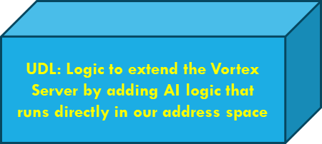
Extending Vortex with a UDL
The UDL runs in the address space where the KV data is hosted.
Scalable sharded KV store (shards of size 3)
Approximate Search in Clustered Vector Space

Slide 21
Extending Vortex with a UDL
Also, notice that we can extend the same service more than once. Here, one Vortex server is playing 3 roles.
Data is kept in separate data pools (like separate file systems)
Approximate Search in Clustered Vector Space
Enlarged prompt formation
Smart Result Aggregation

Slide 22
Let’s drill down on one or two examples of what these AI components might implement
We’ll touch on two data structures useful in RAG LLMs, thinking about ways one platform might offer general functionality.
Each would be implemented as a plug-in module or program yet integrated with the general platform.
In practice, modern RAG LLMs might employ many such modules!

Slide 23
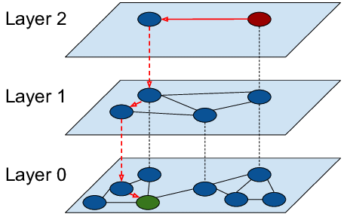
Example: HNSW: Organizes docs into a graphical structure, Search via graph-walk.
Hierarchical Navigable Small Worlds
Strengths:
For individual queries, extremely fast
Concept is simple and elegant
Limitations:
Scales poorly if each server sees high volume query workloads
Hard to distribute a single HNSW index over multiple servers if the
document repository exceeds capacity of the individual servers.
No practical GPU acceleration options

Slide 24
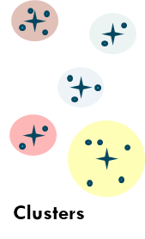
IVFFLAT: Transform documents to points, cluster for fast search
Inverted Files with Flat (uncompressed) vectors
Similar concept, but with a multi-stage search
Map documents to points (vectors) in high-dimensional space
Run a clustering algorithm, create a list of centroids
Query is similarly mapped (“embedded”), then find closest
centroids, then search those clusters for closest documents
Sometimes combined with codebooks: “query compression via quantization,” can improve performance at the cost of an extra (but purely local) table indexing operation.

Slide 25
INVFLAT also has strengths and limitations
Strengths:
Quite simple. Point-cloud representations “shard” nicely for KV storage
K-NN in this representation has a linear algebraic formulation.
Computation can be accelerated by a GPU: many queries in parallel!
Limitations:
Higher overheads for singleton queries
If KV get/put interactions run over a network, could be slow

Slide 26



Top: IVFFLAT Doc. Upload, bottom: Query
Document upload stage (can occur offline, or continuously)
Chunks
Documents
Chunks
Chunks
Scalable sharded KV store (shards of size 3)
Embeddings
Clusters
Query and LLM result generation phase
Queries
Chunks
Aggregate
Select most relevant chunks, form LLM prompt
Generate
response, check
for toxicity
K-NN on cluster
centroids
K-NN within
nearest clusters

Slide 27
… Yet there are commonalities that point to features which could benefit many AIs!
They both employ key-value storage of transient or persistent data.
Frequent KV get operations. Some do KV updates (put operations)
The modules run on a path from query to generative LLM, but
different stages might be coded in different languages and stages
could have parallelism: a “data flow” computing graph
Depend on GPU acceleration, RDMA networking, etc. Many use
huge models or vector databases. This differentiates our problem
from cloud-style elastic microservices, which are very lightweight.

Slide 28
More details about Vortex

Slide 29
The Vortex layer is…
A universal runtime compatible with Linux, but offering optimized AI pipeline support coupled to KV data management. Compatible with many vector database concepts and RAG LLM approaches.
Designed to be back-compatible: Porting an AI into Vortex is easy
Insanely low latencies, high throughput, supports dynamic database updates with strong consistency guarantees.

Slide 30
User Defined AI logic: UDLs
Could be a program running in a docker container or a dynamically loaded plug-in, like a device driver.
In either case, they would use the identical programming API to talk to our platform layer
Each UDL configuration turns Vortex into a different “bespoke” AI supporting a distinct functionality on the LLM pipeline

Slide 31
The quest for ultimate performance
Why these goals? Speed translates to user satisfaction, just like for web sites
Speed also determines how many RAG LLM queries the AI can issue (and the “modes” of those queries: text, image, graphs, etc)
And speed shapes the power profile and throughput, determining the bottom line cost per query for the system owner

Slide 32
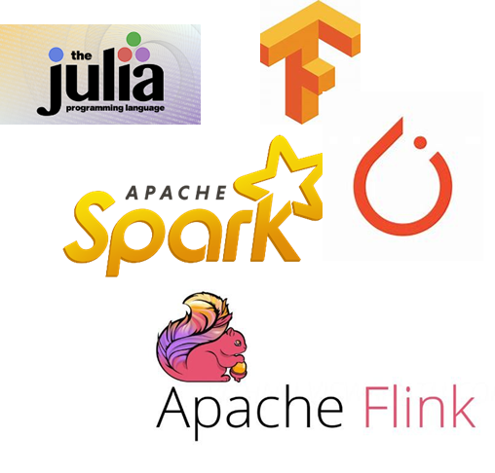
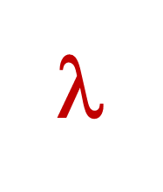
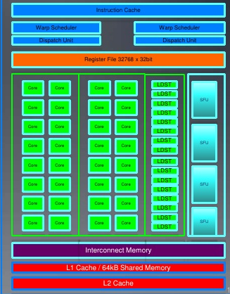
Traditional Approach
Computer, visualize nerve pathways on this patient’s right
shoulder, using red to highlight possible nerve compression points?
Request objects one by one
Your logic
File system or
Key-Value Store
Runtime copies data into GPU
Accelerator Layer
Objects copied over datacenter TCP network
GPU
The AI code probably runs on a different computer

Slide 33
Traditional Approach
Computer, visualize nerve pathways on this patient’s right
shoulder, using red to highlight possible nerve compression points?
Reminder: with today’s standard platforms:
Data paths are optimized for batch processing, not real-time
Noisy, inconsistent data visible to the doctor
Hard to support AIs that mix components from different AI programming environments… most developers use Kafka, but its stage-to-stage handoffs are particularly slow, as we will see…
Request objects one by one
Your logic
File system or
Key-Value Store
Runtime copies data into GPU
Accelerator Layer
Objects copied over datacenter TCP network
GPU
The AI code probably runs on a different computer

Slide 34
Our approach
Vortex, could you visualize nerve pathways on this patient’s right
shoulder, using red to highlight possible nerve compression points?
Upload data via direct path into GPU memory
Vortex data selectively (and securely) revealed through mapped memory shared with and managed by Cascade
User logic, unmodified; runs in a standard docker container
Vortex’s Key-Value Storage Layer: Cascade
Focus on one server and on a UDL (AI extension) loaded on that same machine
Accelerator Layer
Objects/files
GPU
UDL
ML model, hyperparameters, GEMM kernels preloaded into GP
The UDL runs on the same machines where Vortex is deployed.
Here we see one, but the UDL itself is present at every Vortex server.

Slide 35
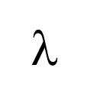
UDL-UDL “Handoffs” with 100G network
A simple cooperative ML pipeline
Vortex is close to ideal efficiency on our hardware and 100 to 10,000x faster than common options like Kafka or Apache Flink
Downstream action
Downstream action
GPU
Input event
GPU
GPU
Hyperparameters, models, cloud data
Latency: 33us
Throughput: 8GB/s
Hyperparameters, models, cloud data
Hyperparameters, models, cloud data

Slide 36
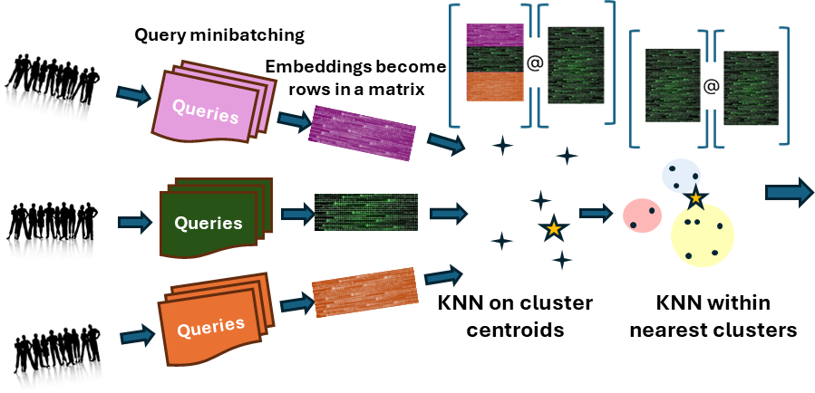
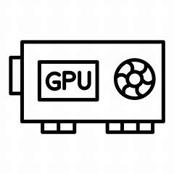
Now Squeeze even more Speed VIA A novel use of opportunistic aggregation
Opportunistic aggregation: Forms minibatches but only if a group of requests accumulates because of delay at some same stage
Concatenated to leverage efficient gemm kernels
These stages are all UDLs running in Vortex servers.
What happens when such a UDL is
triggered by an incoming event
that needs “AI compute”?
Vortex
upcall
UDL

Slide 37

Now Squeeze even more Speed VIA A novel use of opportunistic aggregation
Opportunistic aggregation: Forms minibatches but only if a group of requests accumulates because of delay at some same stage
Concatenated to leverage efficient gemm kernels
Here, GPU is lightly loaded so the AI can run instantly. This example might be a step used in a transformer, when computing the self-attention matrix
Vortex
upcall
UDL

Slide 38
Now Squeeze even more Speed VIA A novel use of opportunistic aggregation
Opportunistic aggregation: Forms minibatches but only if a group of requests accumulates because of delay at some same stage
Concatenated to leverage efficient gemm kernels
What if new embeddings arrive, but the UDL is busy waiting for GPU to finish a prior task? Requests accumulate…
… so we batch them into a host or cuda memory buffer while waiting
Vortex
upcall
UDL

Slide 39
Data Consistency matters too, especially with continuous updates
RAG LLM systems increasingly support dynamic updates
Cascade’s KV layer offers update consistency guarantees based on state machine replication, resulting in a data access model called “strongly serializable snapshot isolation”.
Probably easiest to appreciate “in action”

Slide 40
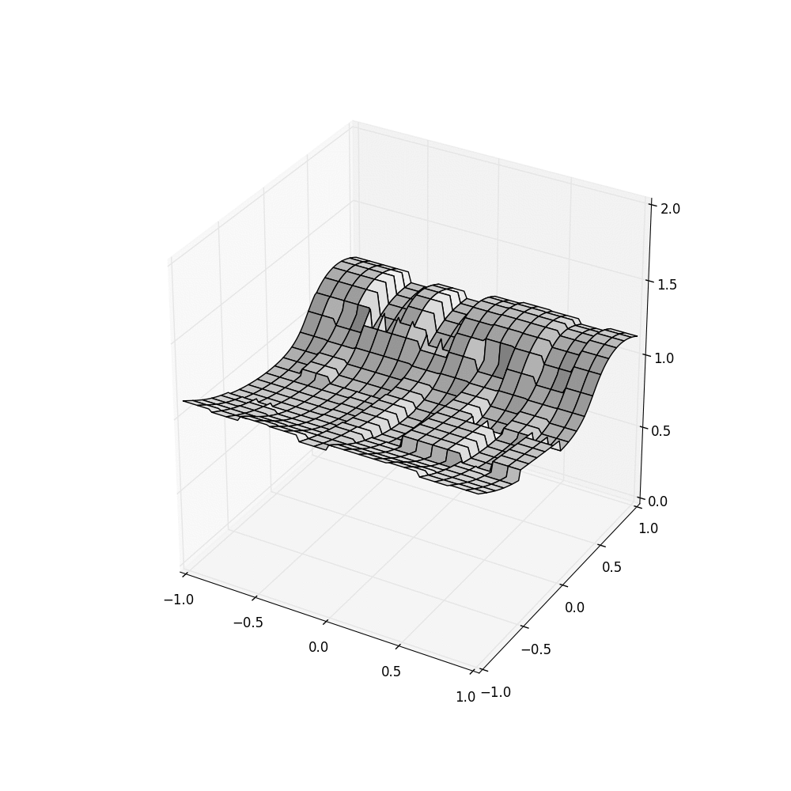
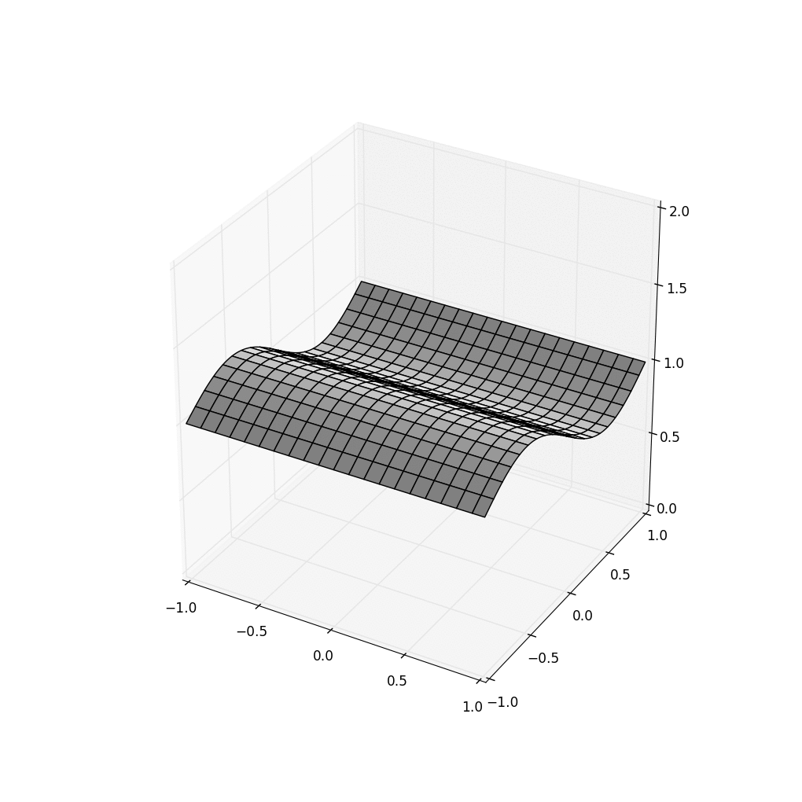

InConsistency Threatens correct behavior!
HDFS Cascade using Server clocks… and with SENSOR Clocks
Think of the self-driving cars that experience accidents… was the AI at fault, or could the AI have been exposed to “corrupted” data (as we see on the left)?

Slide 41
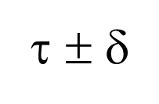
How does Cascade do so much better?
λ²
λ¹
λ⁴
λ³
Put(k’,v)
Each Vortex shard has its own Paxos-based log
Put(k,v)
Put(k’’,v)
(ε, τ)
Stable portion
Put(k,v)
λ¹
Put(k’’’,v)
λ²
λ³
time
λ⁴
Each λ is triggered by an upcall
from a “watcher” monitoring some
key (or pattern)
Unstable tail
A temporal query for time τ sees a consistent cut at τ ± δ_{clock}.
Queries to unstable data must wait, but updates are stable within 50us.

Slide 42
How does Cascade do it? State machine replication plus consistent cuts
Queries occur along a stable (durable) consistent cut
Put(k,v)
Put(k,v)
Put(k,v)
Each Cascade shard has its own Paxos-based log
Put(k,v)
Put(k,v)
Stable portion
(ε, τ)
Stable portion
Put(k,v)
λ
λ
Put(k,v)
λ
λ
time
λ
λ
time
λ
Each λ is triggered by an upcall
from a “watcher” monitoring some
key (or pattern)
λ
Unstable tail
Unstable tail
A temporal query for time τ sees a consistent cut at τ ± δ_{clock}.
Queries to unstable data must wait, but updates are stable within 50us.

Slide 43
What we just saw
Relatively “old” ideas sufficed to fix the HDFS issue that caused dynamic updates to “confuse” an AI trying to detect the wave
HDFS was inattentive to data stability, sequential order. You wouldn’t notice this except that we took snapshots in real-time.
The issue isn’t that HDFS is broken… it simply wasn’t created for use cases like the example I showed

Slide 44
Performance Microbenchmarks, mostly for the Cascade KV layer and AI classifier pipelines

Slide 45
so… does All of this work?
“In theory, theory and practice are the same.
In practice, they are not.” -- Albert Einstein
Fortunately, Cascade really does work, amazingly well:
1.5x to as much as 100x speedups
Stage to stage handoffs as low as 33us
Pays off for reliable multicast but also for things like AllReduce
Even benefits complex tasks like “smart traffic intersections”

Slide 46
Derecho atomic multicast is twice as fast as the non-atomic Open MPI RDMA multicast
Derecho is stable over a wide range of scenarios
Derecho is
twice as fast
Notes:
Comments: the 100MB and 1MB data series is from Jonathan’s RDMA evaluation. While the 10KB data is from Lorenzo’s spindle evaluation, which is atomic broadcast.
Please note that on the right, OpenMPI 100MB and OpenMPI

Slide 47
Reminder: Vortex can “mimic” Kafka
In this example, the AI components used a Kafka API
… how does this stack up “against” Kafka?
Downstream action
Downstream action
GPU
Input event
GPU
GPU
Hyperparameters, models, cloud data
Latency: 33us
Throughput: 8GB/s
Hyperparameters, models, cloud data
Hyperparameters, models, cloud data

Slide 48
Cascade DDS compared to Kafka-Direct.
Both use the same API.
Smaller is better
Tighter is better
Logarithmic Y axis
Milliseconds vs. Seconds

Slide 49
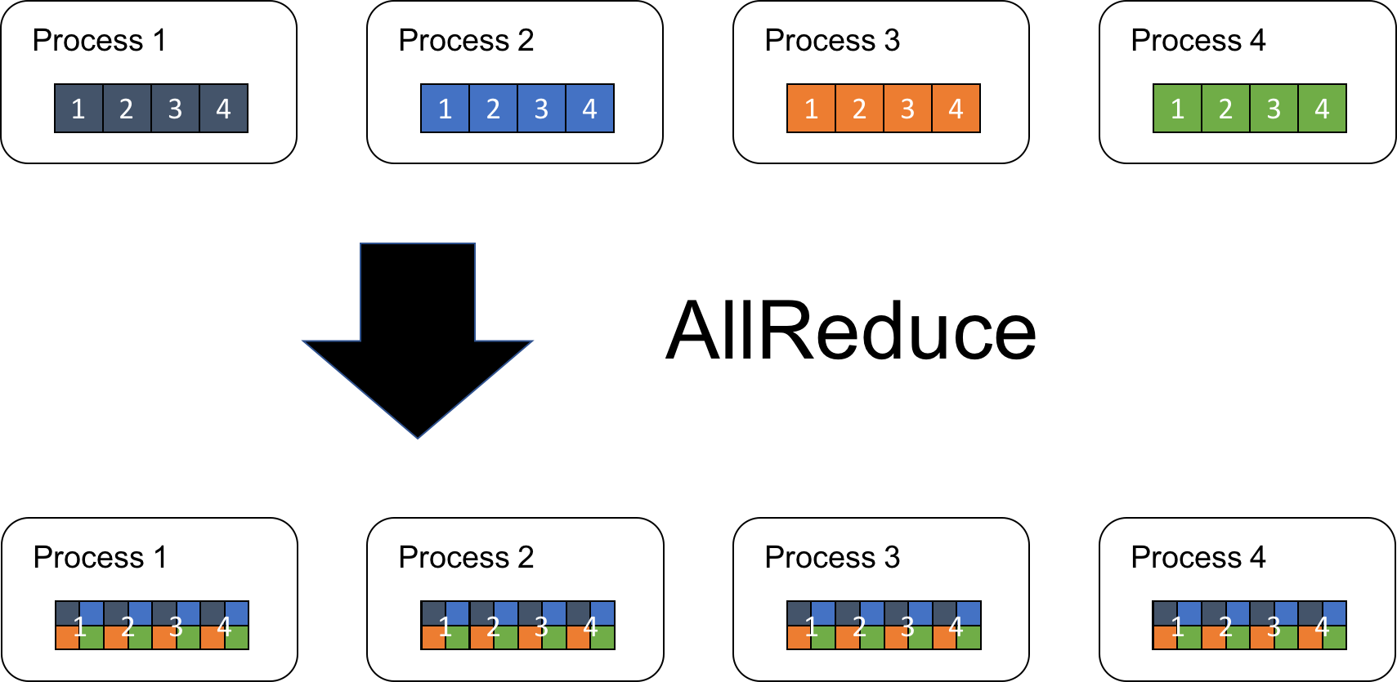
Cascade speeds up computation, too.
DCCL and Experiments by Weijia Song
Notes:
We use AllReduce to show DCCL’s performance as it is one of the most important operation in distributed model training.
It allows collecting data from different processing units to combine them into a global result by a chosen operator. In turn, the result is distributed back to all processing units.

Slide 50
AlLReduce Example: 1.5x-2x speedups!
Derecho is nearly
2x faster
than OMPI/UCX
Open MPI is widely viewed as the state-of-the-art for AllReduce. UCX and OB1 are two OMPI communication options.

Slide 51
Performance for real applications

Slide 52
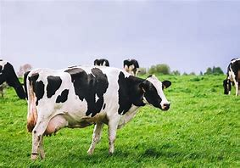
Cascade V. Apache Flink IN A cow
Body Condition Scoring Application
10x faster
Animal body condition scoring: Cascade (gray), Flink (orange). Lower is better.
Same experiment: Cascade achieves higher throughput across the board

Slide 53
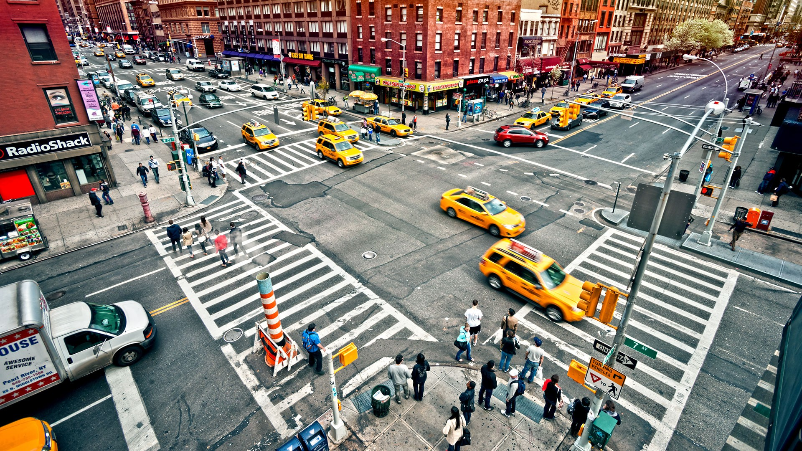
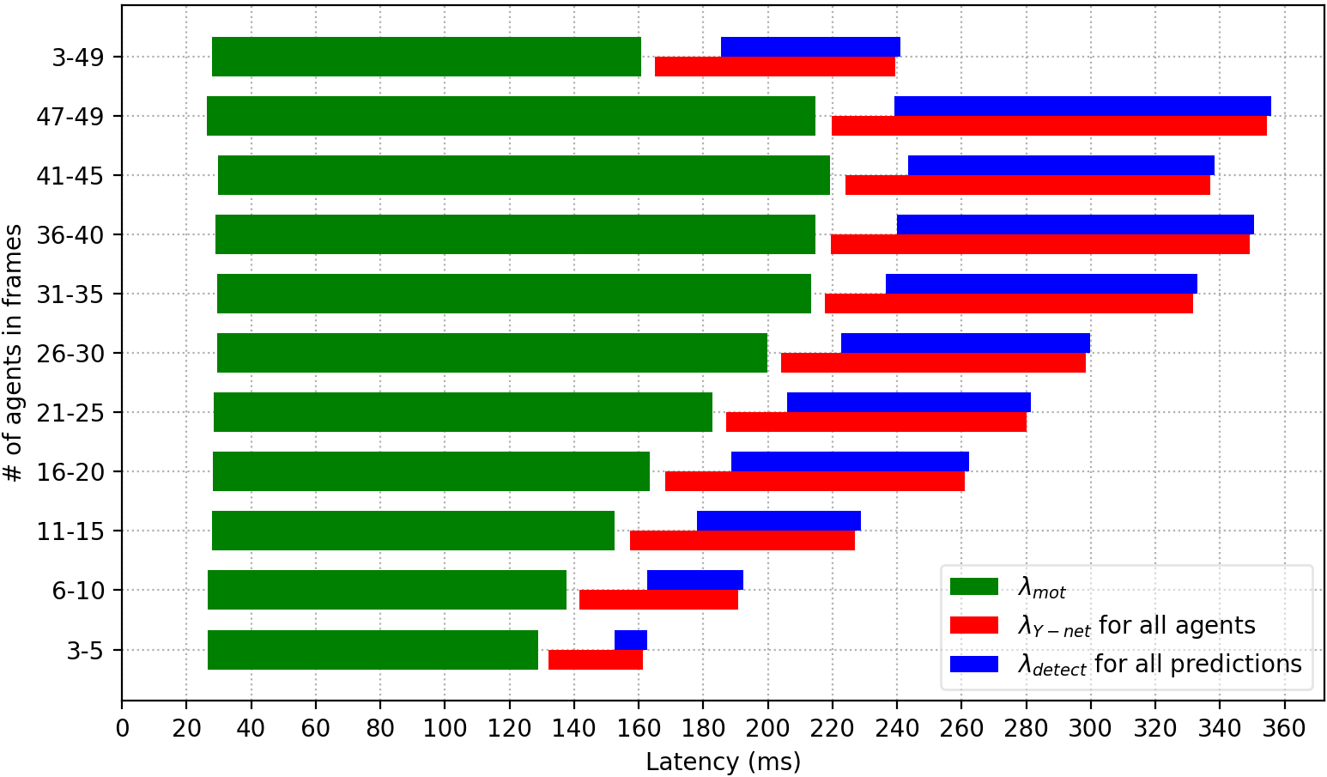
Cascade V. Azure sensIng traffic hazards
This application uses
affinity sets.
Payoff is dramatic
Azure: Seconds. Cascade: Milliseconds

Slide 54
Performance for llm applications

Slide 55
RAG LLM latency On Vortex for IVFFLAT

Slide 56
Generative LLM throughput experiments
(a). Language translation pipeline
(c). Q&A dialogue pipeline
(b). Image reading pipeline
(d). 3D perception pipeline

Slide 57
Navigator: Our Customized scheduler
Low-load scheduling performance
Different loads scheduling performance
Navigator cuts delays by a further 2x-6x
(and runs the job with just ½ the servers!)
High-load scheduling performance

Slide 58
Summary
Cornell has created a powerful framework for hosting AIs that rely on scalable KV data collections, and is now pivoting to tackle RAG LLMs where ideas such as graph walks, clustering, codebooks and multimodal interactions are common themes.
Cascade, our new KV store for AI, is mature, open source and really impressive. Vortex, the extension of Cascade for RAG LLM use cases takes the same ideas even further.
Open source: https://GitHub.com/Derecho-Project

Slide 59
Shout-out to the team…
Alicia Yang (lead Vortex developer)
Weijia Song (lead Cascade developer)
TC Yuan, Ben Ladrum, Jamal Hashim, Thiago Garrett and Yifan Wang (AI and LLM expertise, core system contributors)
… And to our generous funding sources, including Siemens, Cisco, Microsoft and NVIDIA.

Slide 60
The promise of edge intelligence
Can “real world” artificial intelligence be as accurate and as fast as human intelligence?
Real world” artificial intelligence can be as accurate and as fast as human intelligence!

