Slide 1
Kernel Bypass
Sujay Jayakar (dsj36)
11/17/2016

Slide 2
Kernel Bypass
Background
Why networking?
Status quo: Linux
Papers
Arrakis: The Operating System is the Control Plane. Simon Peter, Jialin Li, Irene Zhang, Dan R. K. Ports, Doug Woos, Arvind Krishnamurthy, and Thomas Anderson, Timothy Roscoe. OSDI 2014.
IX: A Protected Dataplane Operating System for High Throughput and Low Latency. Adam Belay, George Prekas, Ana Klimovic, Samuel Grossman, and Christos Kozyrakis, Edouard Bugnion. OSDI 2014.

Slide 3
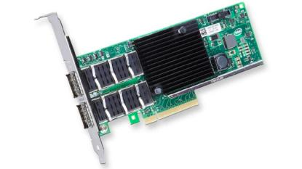
Why networking?
Bigger pipes: Intel XL710 chipset (40 Gbps)
http://www.intel.com/content/www/us/en/ethernet-products/converged-network-adapters/ethernet-xl710.html
Notes:
we want networking to have higher throughput and lower latency. why networking?
bandwidth AND latency important! bounded queue depth => latency affects bandwidth
actually programmed against this card for diskotech
100 gbps coming! mellanox qsfp+ card, intel not ready for market yet IIRC

Slide 4
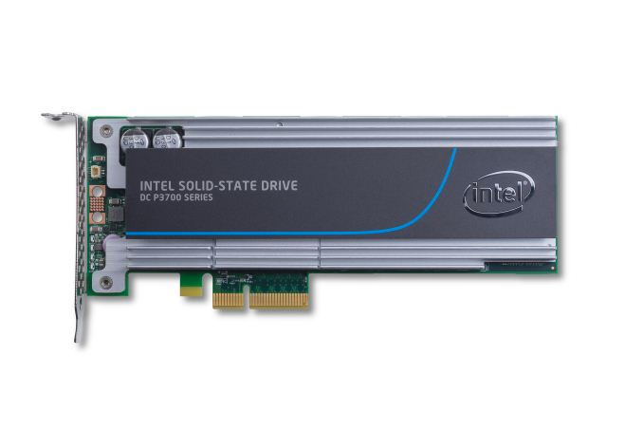
Why networking?
Faster storage: Intel P3700 (20 Gbps, 100 µs reads)
Notes:
http://www.anandtech.com/show/8104/intel-ssd-dc-p3700-review-the-pcie-ssd-transition-begins-with-nvme/3
apparently the intel P3608 can do 40 gbps!!
also, it’s pretty common to have many (~100?) disks/node in storage tiers, (~100 mb/s sequential reads adds up pretty quickly!)

Slide 5
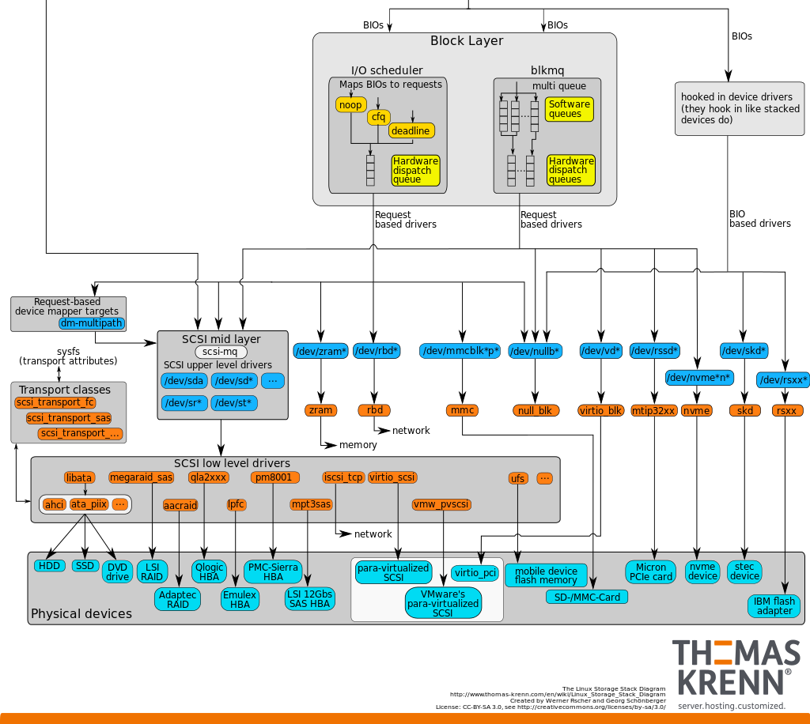
Why networking?
Notes:
https://www.thomas-krenn.com/en/wiki/Linux_Storage_Stack_Diagram
current storage architecture in kernel assumes spinning disk (high latency, “single threaded,” scheduling important)
IO scheduler/SCSI drivers/ata translation/disk controller
replaced with NVMe

Slide 6
Why networking?
Software requirements
Notes:
memcache, redis, etc., tiny packets (1mqps/node, keys < 50b, values < 500b)
big flows (analytics, object storage), large bandwidth
https://chris.lu/upload/images/redis.png
http://idroot.net/wp-content/uploads/2015/08/Memcached-logo.jpg

Slide 7
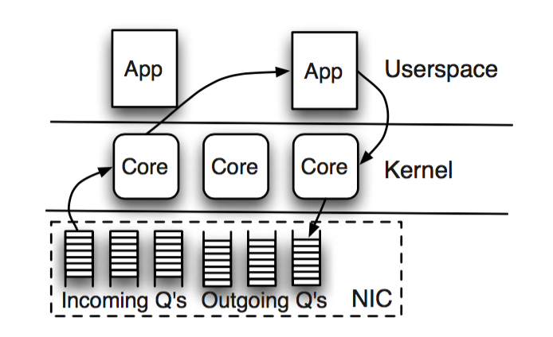
Status Quo: Linux
Notes:
NIC owned by kernel, kernel multiplexes userspace processes onto singleton network stack, uses SMP for sharing the network stack

Slide 8
Status Quo: Linux
0.34 µs
0.54 µs
1.26 µs
1.05 µs
= 3.36 µs (+2.23µs to 6.19 µs if off-core)
Notes:
from arrakis paper
1.26 µs: network stack
0.34 µs: 0.24 µs for packet copy + 0.10 µs for syscall return
0.54 µs: 0.44 µs for packet copy + 0.10 µs for syscall
1.05 µs: transmit network stack
= 3.36 µs/packet (with additional 2 µs for context switch in if descheduled)
previously, packet arrival times >> interrupt/syscall latency
-> focus on fine-grained resource scheduling

Slide 9
Status Quo: Linux
Ethernet frame: 84 bytes to 1538 bytes (1500 MTU)
10 Gb/s = 1.25 GB/s = 800K to 15M packets/sec
Service time is only 67 ns to 1.25 µs per packet!
Notes:
even in the best setting, we’ve way blown through our budget
we understand copies & syscall boundaries, why is the network stack slow?
http://netoptimizer.blogspot.com/2014/05/the-calculations-10gbits-wirespeed.html
10

Slide 10
Status Quo: Linux
Ethernet frame: 84 bytes to 1538 bytes (1500 MTU)
40 Gb/s = 5 GB/s = 3.25M to 60M packets/sec
Service time is only 17 ns to 307 ns per packet!
Notes:
even in the best setting, we’ve way blown through our budget
we understand copies & syscall boundaries, why is the network stack slow?
http://netoptimizer.blogspot.com/2014/05/the-calculations-10gbits-wirespeed.html
10

Slide 11
Status Quo: Linux
Ethernet frame: 84 bytes to 1538 bytes (1500 MTU)
100 Gb/s = 12.5 GB/s = 8M to 150M packets/sec
Service time is only 6.7 ns to 125 ns per packet!
Notes:
even in the best setting, we’ve way blown through our budget
we understand copies & syscall boundaries, why is the network stack slow?
http://netoptimizer.blogspot.com/2014/05/the-calculations-10gbits-wirespeed.html
10

Slide 12
Status Quo: Linux
Network stack: demultiplexing, checks, scheduling synchronization needed for multi-core
POSIX limitations
Copy required for send(2) and recv(2)
File descriptor migration among processes
Context switch overhead
Notes:
can’t DMA for network API (filesystem okay though)
hard to affinitize in general, sockets can migrate among processes
upon receiving interrupt, scheduler has to context switch into waiting process. blocking API does not help here, since process will get descheduled often.
IX makes interesting point here. the scheduler is very fine-grained in that it receives control whenever a syscall blocks, subsequently requiring an interrupt and context switch in. this design makes sense when the packet arrival rate is >> interrupt/syscall latency

Slide 13
Arrakis: The Operating System is the Control Plane. Simon Peter, Jialin Li, Irene Zhang, Dan R. K. Ports, Doug Woos, Arvind Krishnamurthy, Thomas Anderson, and Timothy Roscoe. OSDI 2014.
Notes:
won best paper!
UW crew:
Simon Peter: post doc
Jialin Li, Irene Zhang, Doug Woos: PhD students
Dan Ports, Arvind Krishnamurthy, Tom Anderson: professors at UW
Timothy Roscoe: professor at ETH Zurich
main takeaway: moving multiplexing into the NIC (using virtualization) is much more efficient than doing it in the kernel.

Slide 14
Network virtualization
VNICs managed by “control plane” in kernel
NIC responsible for bandwidth allocation & demultiplexing
Intel 82599 chipset
Only supports filtering by MAC address, want arbitrary header fields
Weighted round-robin bandwidth allocation
At most 64 VNICs
Notes:
Pretty weak part of the paper, if you ask me.
SR-IOV: standard for making a single physical PCI express device look like multiple devices for a single root.
VT-d (intel): implementation + IOMMU + interrupt virtualization

Slide 15
Storage virtualization
VSIC: SCSI/ATA queue with rate limiter
Virtual Storage Area (VSA): Persistent disk segment
Each VSIC has many VSAs, and each VSA can be mapped into many VSICs (for interprocess sharing)
Don’t have a device like this, emulated in software with a dedicated core
Notes:
is this really as bogus as I read it to be? they’re comparing their custom log data structure with ext4/btrfs, apples to ferraris. redis could pretty much do the exact same thing with direct IO if they wanted.

Slide 16
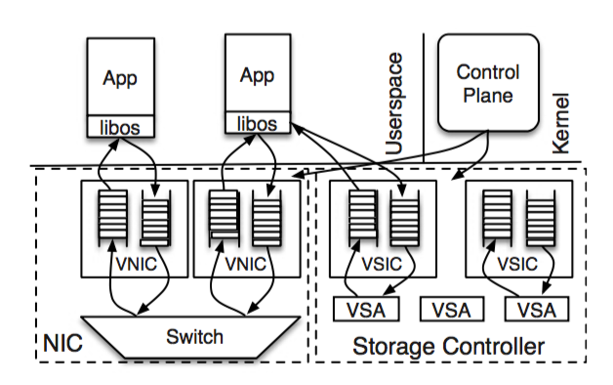
Arrakis
Notes:
differences
driver and network stack now live in libos within userspace
network stack no longer needs to demultiplex
fewer security checks? less worried about data leaking?
kernel is no longer on hot path

Slide 17
Arrakis: Control Plane
VIC management: queue pair creation & deletion
Doorbells: IPC endpoint for VIC notifications
Hardware control
Demultiplexing filters (just layer 2 for now)
Rate specifiers for rate limiting

Slide 18
Arrakis: Doorbells
SR-IOV virtualizes the MSI-x interrupt registers
libOS driver handles interrupts in user space if on-core, otherwise goes through control plane
API is just a regular POSIX file descriptor
Notes:
how do interrupts on a descheduled VM work? is redirection to the hypervisor part of the VMENTER/VMEXIT setup/teardown?
ARP sharing among guests/hypervisor? maybe not? the more modern XL710 assigns a new MAC address to each VF, routing through “the virtual machine switch”

Slide 19
Arrakis: User APIs
Extaris
Arrakis/N
Zero-copy rings
POSIX sockets
send_packet(queue, array)
receive_packet(queue)→ packet
packet_done(packet)
doorbells on completion
Ethernet
Notes:
extaris: another planet in dune
full posix support! they run memcache & redis unmodified
pretty slight changes for arrakis/N (only 130 LOC for memcache)

Slide 20
IX: A Protected Dataplane Operating System for High Throughput and Low Latency. Adam Belay, George Prekas, Ana Klimovic, Samuel Grossman, Christos Kozyrakis, and Edouard Bugnion. OSDI 2014.
Notes:
another paper from OSDI ’14! and another fucking planet from dune jesus
also won best paper!
Adam Belay, Ana Klimovic, Samuel Grossman: PhD student Stanford
Christos Kozyrakis: Professor at Stanford
George Prekas: PhD student EPFL
Edouard Bugnion: Professor at EPFL
takeaway: use CPU virtualization as well to get protection between user & network stack.

Slide 21
IX: More protection
Network stack in user-space unacceptable
Firewall, ACL management in data plane
Sending raw packets requires root
Does zero-copy send require memory protection?
Approach: use CPU virtualization to get three-way protection between kernel, networking, and user

Slide 22
IX: Protection can be cheap
FlexSC (OSDI ’10): Why are syscalls expensive?
Direct effects: User-mode pipeline flush, mode switch, stashing registers. Only ~150 cycles!
Notes:
direct: they implemented a
indirect: syscalls are slow (on x86_64) because they blow out the cache (backend stalls) and slow down subsequent user code. L2/L3 more affected since they prefetch, unlike L1. (units are 64 byte cache line evictions, 24kb/32kb of L1-d flushed, 200kb of L3 flushed)

Slide 23
IX: Protection can be cheap
FlexSC (OSDI ’10): Why are syscalls expensive?
Direct effects: User-mode pipeline flush, mode switch, stashing registers. Only ~150 cycles!
Indirect effects: TLB flush (if no tagged TLB), cache pollution with kernel instructions/data
 | IPC | i-cache | d-cache | L2 | L3 | d-TLB
pwrite(2) | 0.18 | 50 | 373 | 985 | 3160 | 44
Notes:
direct: they implemented a
indirect: syscalls are slow (on x86_64) because they blow out the cache (backend stalls) and slow down subsequent user code. L2/L3 more affected since they prefetch, unlike L1. (units are 64 byte cache line evictions, 24kb/32kb of L1-d flushed, 200kb of L3 flushed)

Slide 24
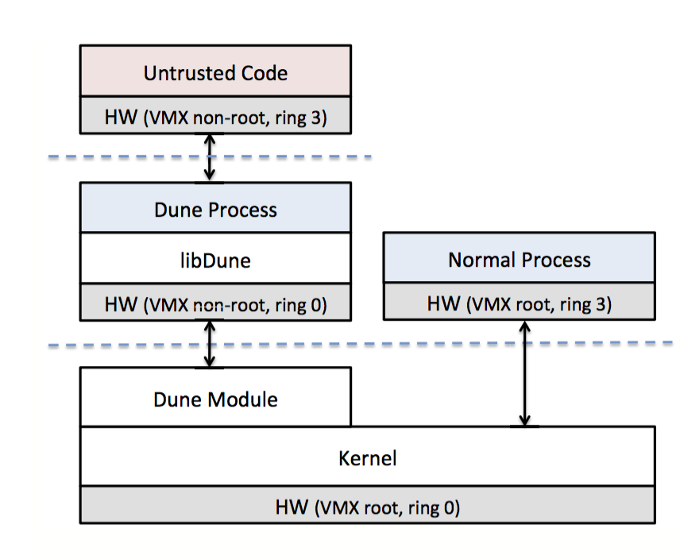
IX: Protection can be cheap
Dune (OSDI ’12): Run Linux processes as VMX non-root ring0 with syscalls replaced with hypercalls
Untrusted code can run in ring3, can cheaply mode switch back into ring0
Processes can then manipulate page tables, interrupts, hardware, privilege, …
Notes:
memory safety has a bad rap
main idea: keep user-space and kernel-space similar. requires VPID (tagged TLB)

Slide 25
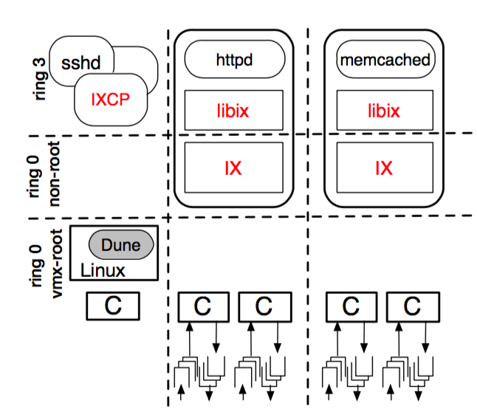
IX: More protection
Notes:
differences from arrakis
libix is a lot simpler, just glue to expose posix-like async API
all network stack code is in ring0
otherwise, same idea

Slide 26
Why not both?
IX’s use of VMX non-root ring0 is clever.
Its embedding in Linux (with Dune) is nice.
But if they used SR-IOV, they wouldn’t have needed the Toeplitz hash hack and monopolizing a queue.
And then they would have gotten (fast!) virtualized interrupts to not have to poll.
Notes:
could IX authors have used their fancy pants DUNE features to simulate a full blocking POSIX API?
(fun fact: Cornell grad Greg Hill, working on PhD at stanford, added SR-IOV support to IX in 2015)

Slide 27
Arrakis: Evaluation
0.34 µs
0.54 µs
1.26 µs
1.05 µs
= 3.36 µs (+2.23µs to 6.19 µs if off-core)
Notes:
old linux packet processing time

Slide 28
Arrakis: Evaluation
0.21 µs
0.17 µs
= 0.38 µs
Notes:
packet service time 10x faster!
all time is in network stack: 6x faster (no demultiplexing, better cache utilization, no synchronization, fewer checks?)
no scheduler, interrupts delivered to the right core, no context switch
no copy
no kernel crossing

Slide 29
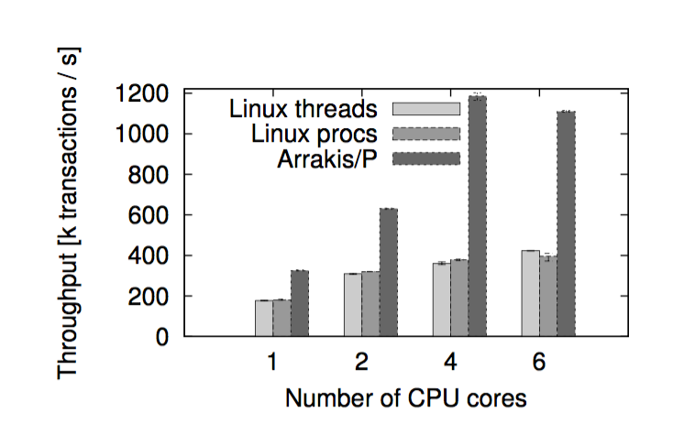
Arrakis: memcached
Notes:
modified memcached to use Arrakis/N, only 74 LOC!
top of chart is 10gbps
biased towards linux: TCP/UDP segmentation offload, header splitting

Slide 30
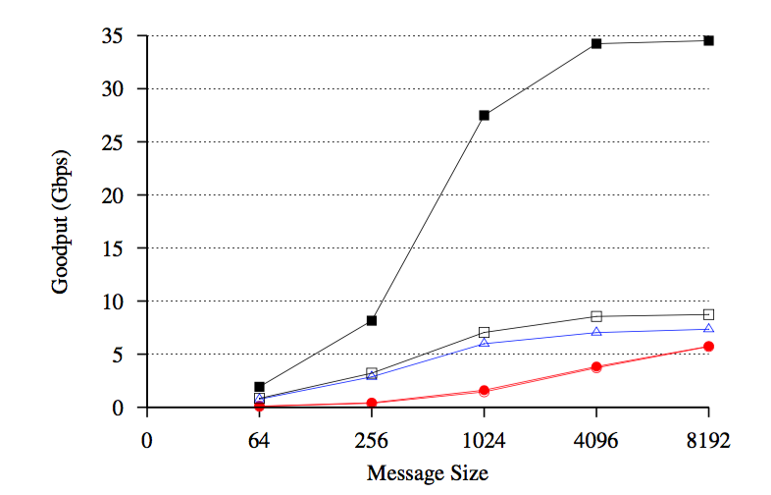
IX: Evaluation

Slide 31
IX: Give up on POSIX
No to POSIX: Non-blocking API with batching
Packets processed to completion
“Elastic” vs. “background” threads
No internal buffering
Slow consumers lead to delayed ACKs
Notes:
say no to posix (and rewrite the network stack)
run to completion: slow processing means slow ACKs and smaller sender window.
adaptive batching: continue going until you block (no waiting for batches) or until you hit a max batch size. helps cache locality & amortize mode switch
elastic threads: pinned to a CPU, handle network events
background threads: timeshared among reserved CPU
elastic/background threading not that strange: elastic is event loop, background threads are workers

Slide 32
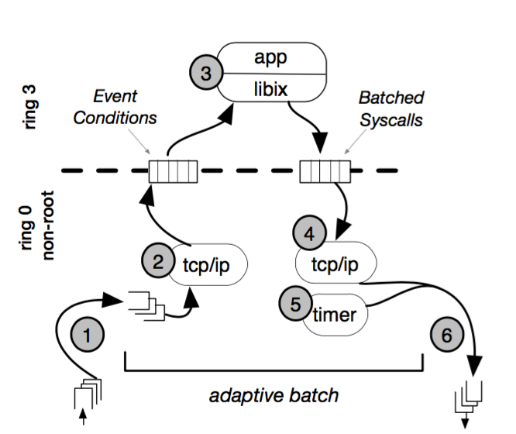
IX: Packet processing

