Slide 1
Classic Systems:
Unix and THE
Presented by Hakim Weatherspoon
Notes:
Deniz,
Hari,
Jared
Petko
Taiyen
Bo
Yin
Srivant
Robert

Slide 2
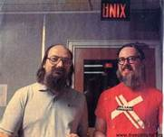
The UNIX Time-Sharing System
Dennis Ritchie and Ken Thompson
Background of authors at Bell Labs
  Both won Turing Awards in 1983
Dennis Ritchie
  Key developer of The C Programming Lanuage, Unix, and Multics
Ken Thompson
  Key developer of the B programming lanuage, Unix, Multics, and Plan 9
  Also QED, ed, UTF-8
Notes:
“UNIX is basically a simple operating system, but you have to be a genius to understand the simplicity.” – Dennis Ritchie

Slide 3
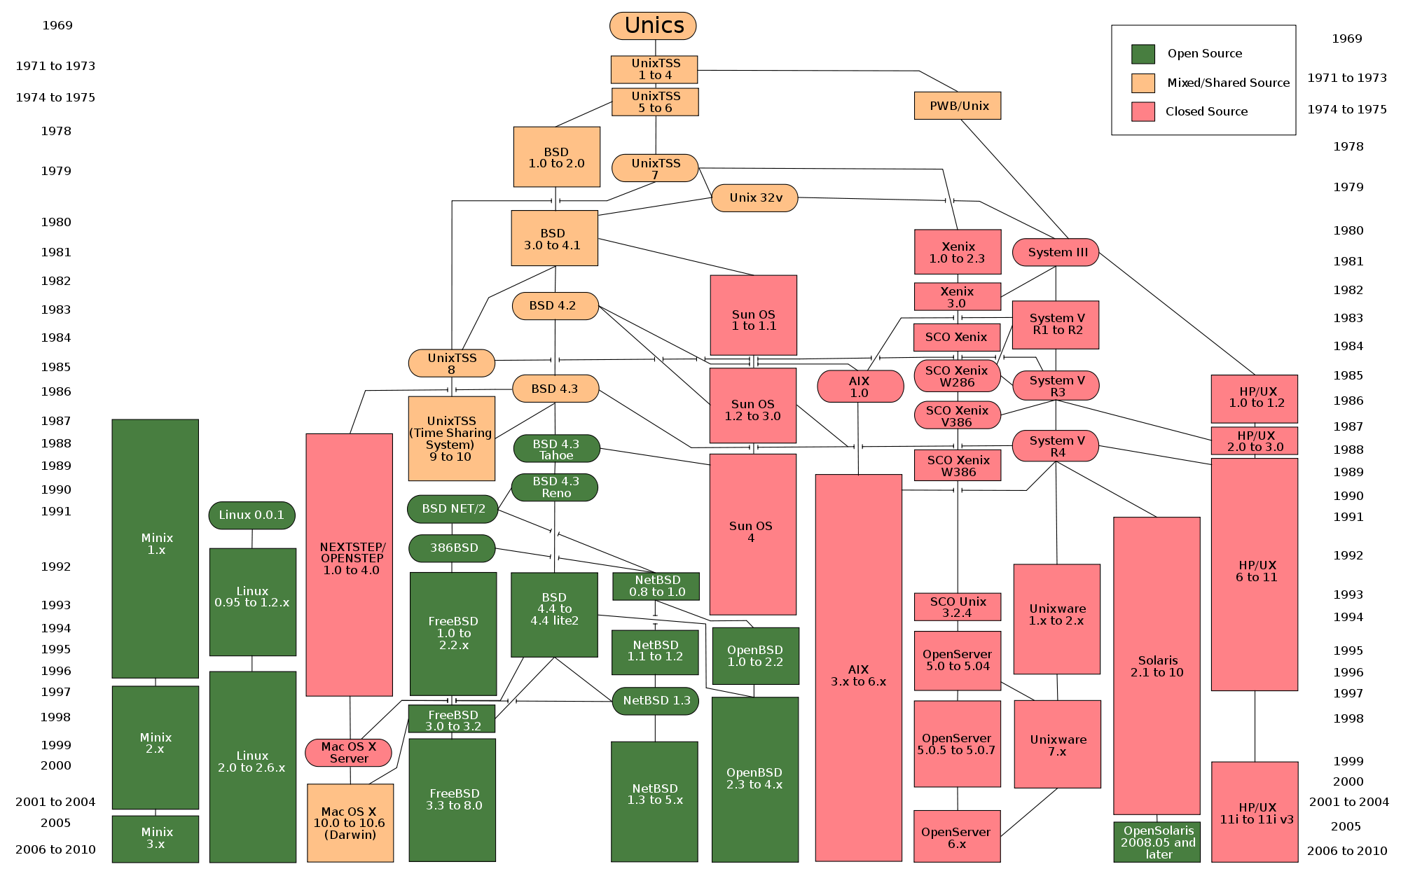
The UNIX Time-Sharing System
Dennis Ritchie and Ken Thompson

Slide 4
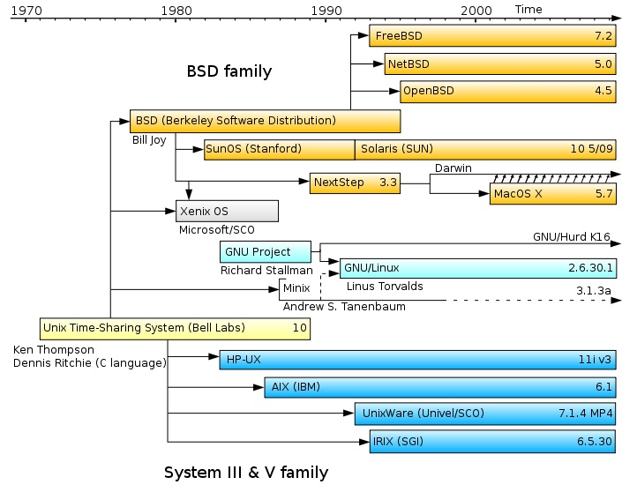
The UNIX Time-Sharing System
Dennis Ritchie and Ken Thompson

Slide 5
The UNIX Time-Sharing System
Dennis Ritchie and Ken Thompson
Classic system and paper
  described almost entirely in 10 pages
Key idea
  elegant combination of a few concepts that fit together well
  API deliberately small
    Instead of collection of specialized API’s for each device/abstraction

Slide 6
System features
Time-sharing system
Hierarchical file system
Device-independent I/O
Shell-based, tty user interface
Filter-based, record-less processing paradigm
Major early innovations:
  “fork” system call for process creation, file I/O via a single subsystem, pipes, I/O redirection to support chains

Slide 7
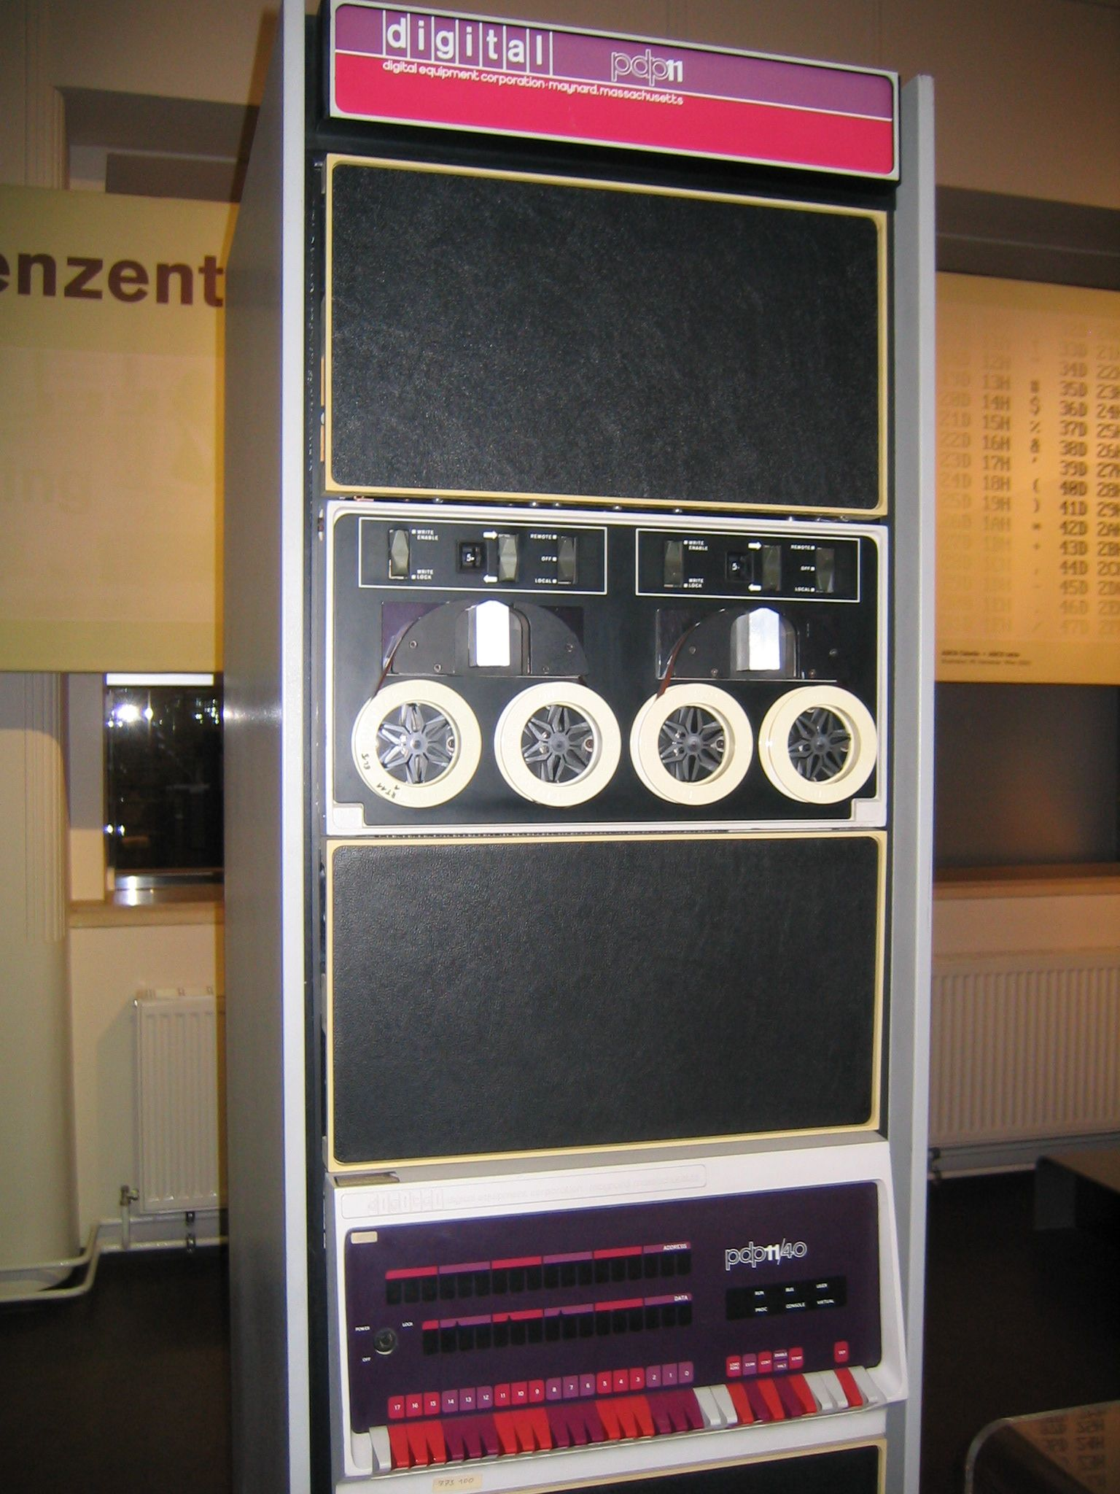
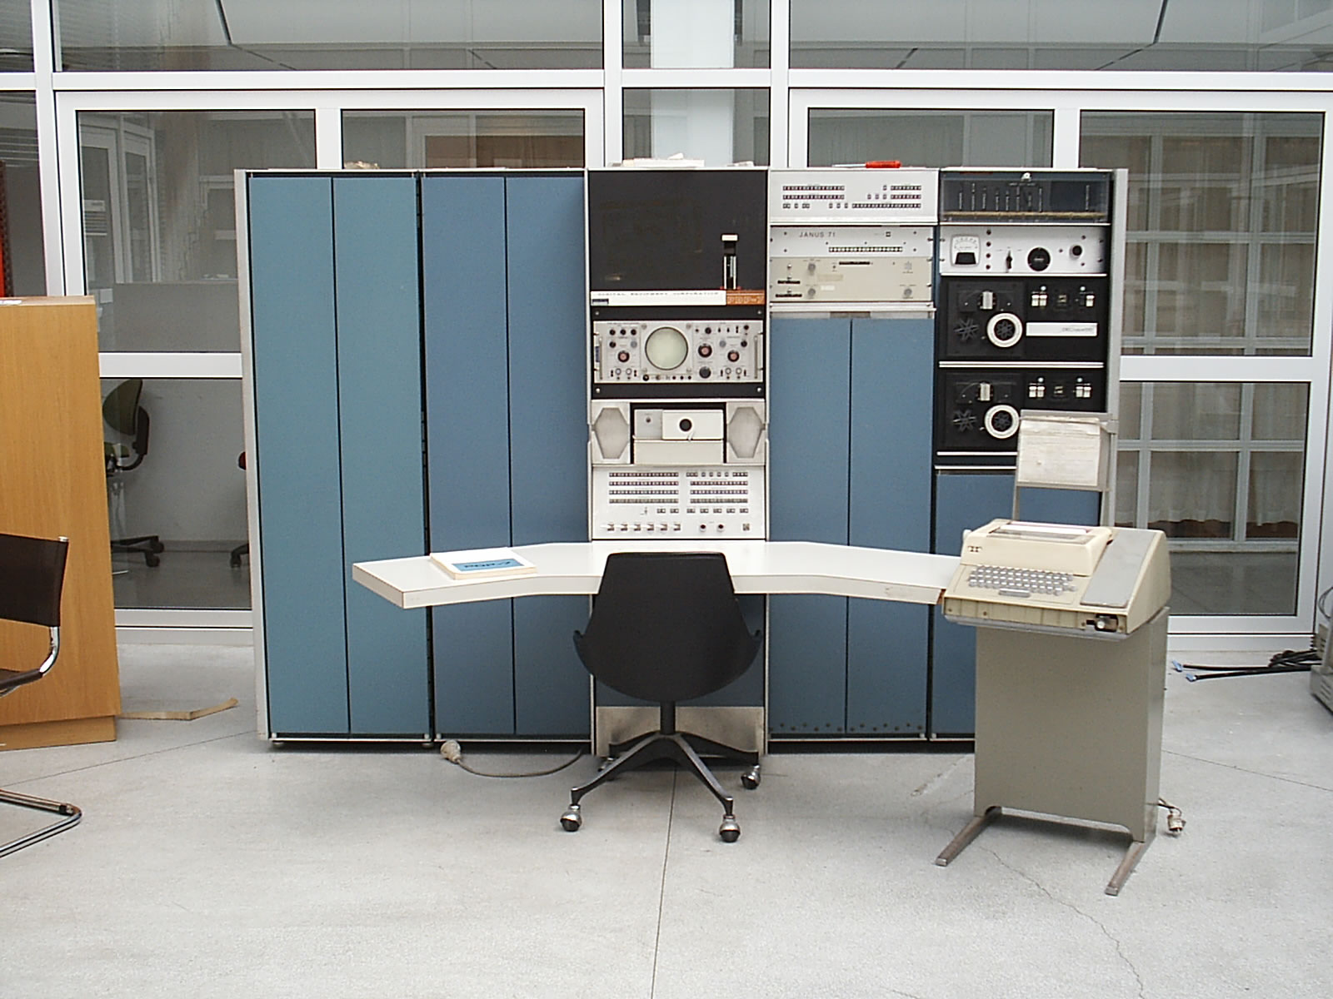
Version 3 Unix
1969: Version 1 ran PDP-7
1971: Version 3 Ran on PDP-11’s
  Costing as little as $40k!
< 50 KB
2 man-years
to write
Written in C
PDP-7
PDP-11

Slide 8
File System
Ordinary files (uninterpreted)
Directories (protected ordinary files)
Special files (I/O)

Slide 9
Uniform I/O Model
open, close, read, write, seek
  Uniform calls eliminates differences between devices
other system calls
  close, status, chmod, mkdir, ln
bytes, no records

Slide 10
Directories
root directory
path names
rooted tree
current working directory
back link to parent
multiple links to ordinary files

Slide 11
Special Files
Uniform I/O model
  Each device associated with at least one file
  But read or write of file results in activation of device
Advantage: Uniform naming and protection model
  File and device I/O are as similar as possible
  File and device names have the same syntax and meaning, can pass as arguments to programs
  Same protection mechanism as regular files

Slide 12
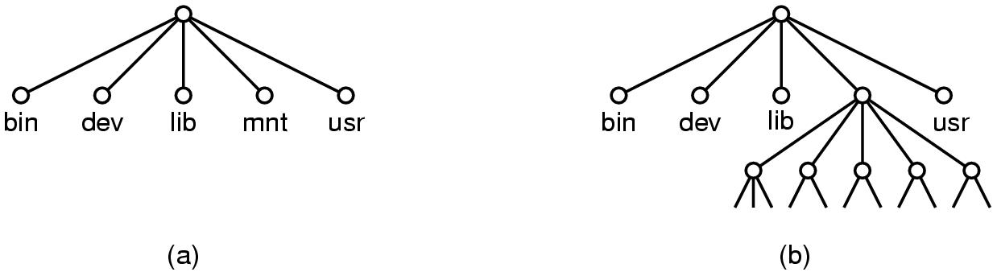
Removable File System
Tree-structured
Mount’ed on an ordinary file
  Mount replaces a leaf of the hierarchy tree (the ordinary file) by a whole new subtree (the hierarchy stored on the removable volume)
  After mount, virtually no distinction between files on permanent media or removable media

Slide 13
Protection
User-world, RWX bits
set-user-id bit
super user is just special user id

Slide 14
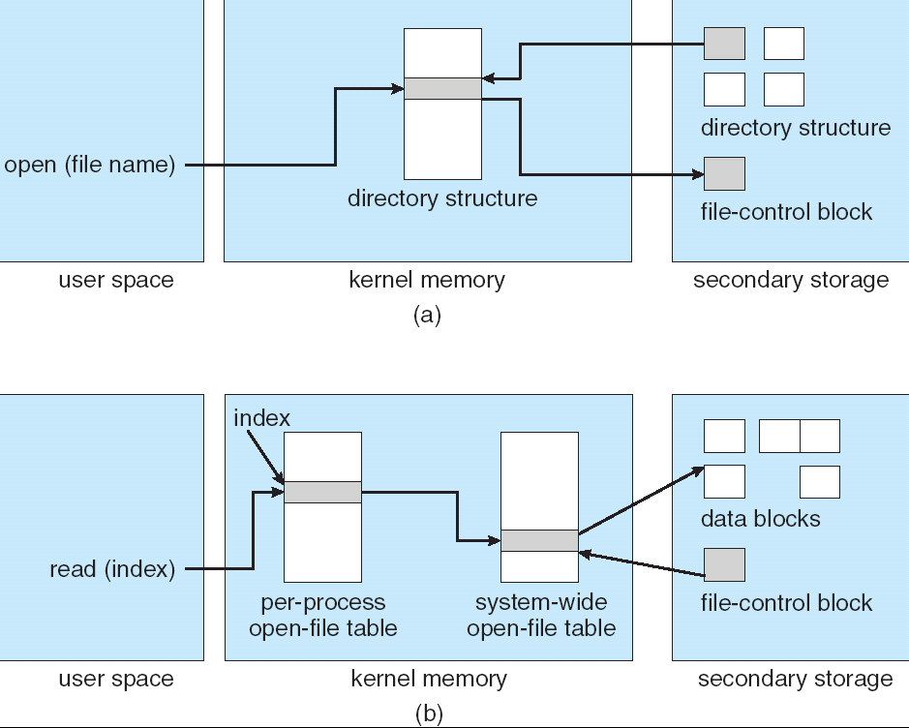
File System Implementation
System table of i-numbers (i-list)
i-nodes
path name scanning
mount table
buffered data
write-behind

Slide 15
I-node Table
short, unique name that points at file info.
allows simple & efficient fsck
cannot handle accounting issues
Inode
File name
Inode#

Slide 16
Many devices fit the block model
Disks
Drums
Tape drives
USB storage
Early version of the ethernet interface was presented as a kind of block device (seek disabled)
But many devices used IOCTL operations heavily

Slide 17
Processes and images
text, data & stack segments
process swapping
pid = fork()
pipes
exec(file, arg1, ..., argn)
pid = wait()
exit(status)

Slide 18
Easy to create pipelines
A “pipe” is a process-to-process data stream, could be implemented via bounded buffers, TCP, etc
One process can write on a connection that another reads, allowing chains of commands
  % cat *.txt | grep foo | wc
In combination with an easily programmable shell scripting model, very powerful!

Slide 19
The Shell
cmd arg1 ... argn
stdio & I/O redirection
filters & pipes
multi-tasking from a single shell
shell is just a program
Trivial to implement in shell
  Redirection, background processes, cmd files, etc

Slide 20
Traps
Hardware interrupts
Software signals
Trap to system routine

Slide 21
Perspective
Not designed to meet predefined objective
Goal: create a comfortable environment to explore machine and operating system
Other goals
  Programmer convenience
  Elegance of design
  Self-maintaining

Slide 22
Perspective
But had many problems too. Here are a few:
  File names too short and file system damaged on crash
  Didn’t plan for threads and never supported them well
  “Select” system call and handling of “signals” was ugly and out of character w.r.t. other features
  Hard to add dynamic libraries (poor handling of processes with lots of “segments”)
  Shared memory and mapped files fit model poorly
...in effect, the initial simplicity was at least partly because of some serious limitations!

Slide 23
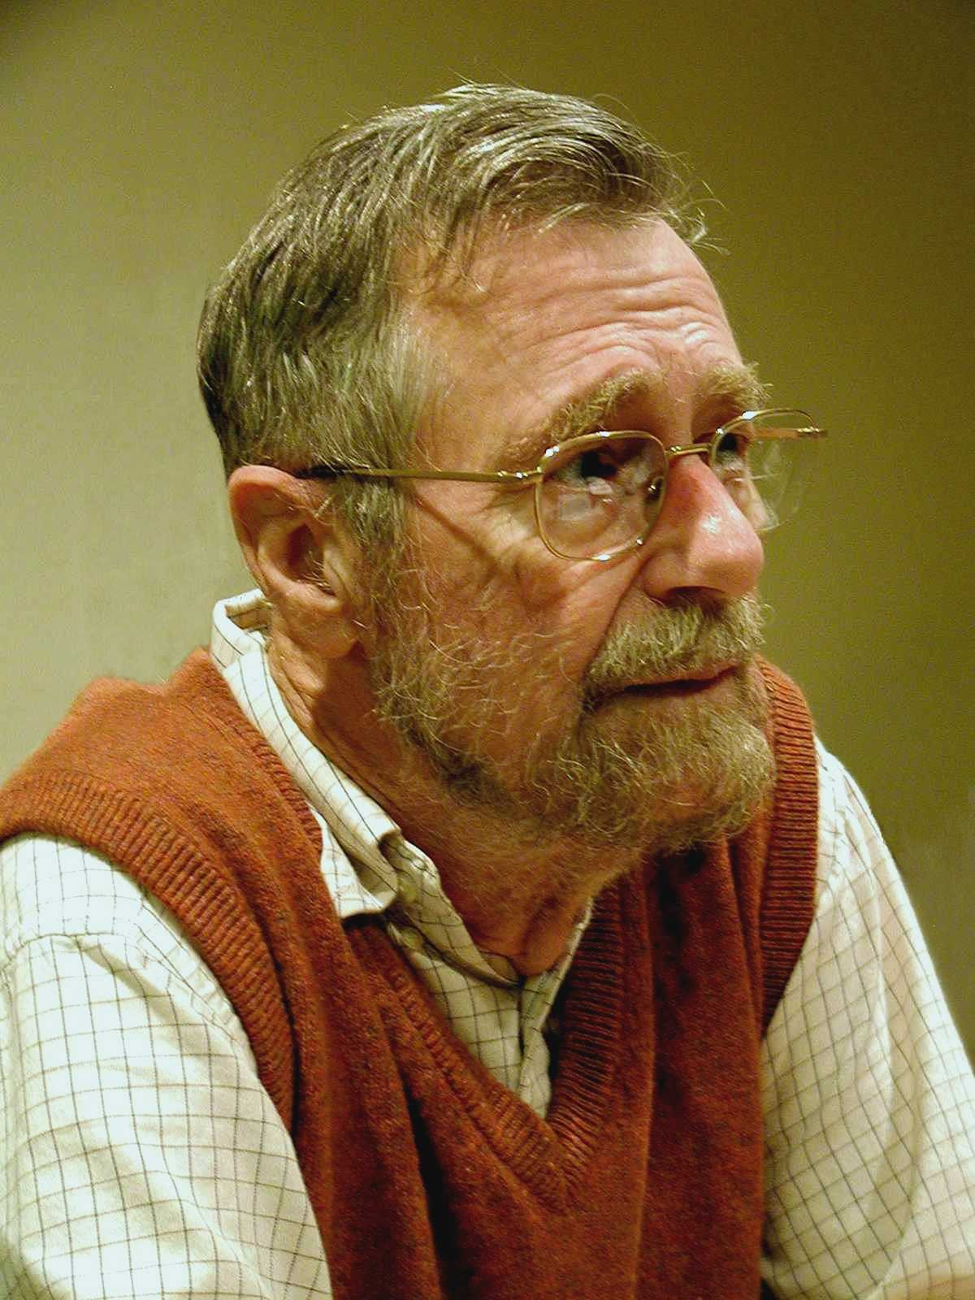
“THE”-Multiprogramming System
Edsger W. Dijkstra
Received Turing Award in 1972
Contributions
  Shortest Path Algorithm, Reverse Polish Notation, Bankers algorithm, semaphore’s, self-stabilization
Known for disliking ‘goto’ statements and using computers!

Slide 24
“THE”-Multiprogramming System
Edsger W. Dijkstra
Never named “THE” system; instead, abbreviation for "Technische Hogeschool Eindhoven”
Batch system (no human intervention) that supported multitasking (processes share CPU)
  THE was not multiuser
Introduced
  software-based memory segmentation
  Cooperating sequential processes
  semaphores

Slide 25
Design
Layered structure
  Later Multics has layered structure, ring segmentation
Layer 0 – the scheduler
  Allocated CPU to processes, accounted for blocked proc’s
Layer 1 – the pager
Layer 2 – communication between OS and console
Layer 3 – managed I/O
Layer 4 – user programs
Layer 5 – the user
  “Not implemented by us”!

Slide 26
Perspective
Layered approach
  Design small, well defined layers
  Higher layers dependent on lower ones
    Helps prove correctness
    Helps with debugging
Sequential process and Semaphores

Slide 27
Next Time
Read and write review:
  SEDA: An Architecture for Well Conditioned, Scalable Internet Services, Matt Welsch, David Culler, and Eric Brewer. Proceedings of the Eighteenth ACM Symposium on Operating Systems Principles (Banff, Alberta, Canada, 2001), pages 230--243
  On the duality of operating system structures, H. C. Lauer and R. M. Needham. ACM SIGOPS Operating Systems Review Volume 12, Issue 2 (April 1979), pages 3--19.

Slide 28
Next Time
Read and write review:
Lab 0 – finish today
Lab 1 – available later today and due next Friday
Project Proposal due in two weeks
  talk to me and other faculty and email and talk to me
Check website for updated schedule

