Slide 1
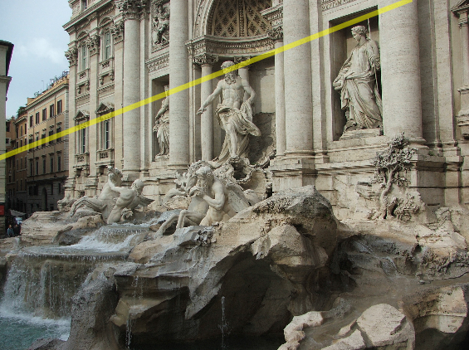
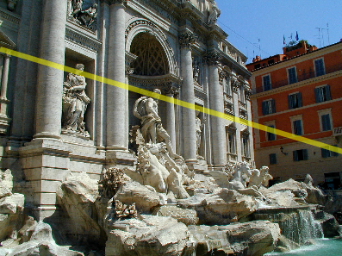
Two-view geometry
CS5670: Computer Vision

Slide 2
Reading
Reading: Szeliski (2nd Edition), Chapter 11.3 and 12.1

Slide 3
Announcements
Project 4 (stereo) due this Friday, March 29, at 8pm

Slide 4
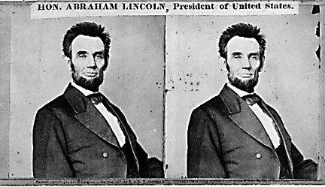
Back to stereo
Where do epipolar lines come from?

Slide 5
Two-view geometry
Where do epipolar lines come from?
0
Image 1
Image 2

Slide 6
Two-view geometry
Where do epipolar lines come from?
3D point lies somewhere along r
epipolar line
(projection of r)
0
Image 1
Image 2

Slide 7
Two-view geometry
Where do epipolar lines come from?
3D point lies somewhere along r
epipolar line
(projection of r)
0
Image 1
Image 2

Slide 8
Two-view geometry
Where do epipolar lines come from?
3D point lies somewhere along r
epipolar line
epipolar line
(projection of r)
epipolar plane
0
Image 1
Image 2

Slide 9
Fundamental matrix
3D point lies somewhere along r
epipolar line
epipolar line
(projection of r)
epipolar plane
0
Image 1
Image 2
This epipolar geometry of two views is described by a very special 3x3 matrix, called the fundamental matrix

Slide 10
Fundamental matrix
3D point lies somewhere along r
epipolar line
epipolar line
(projection of r)
epipolar plane
0
Image 1
Image 2
Epipolar geometry, very special 3x3 fundamental matrix
maps (homogeneous) points in image 1 to lines in image 2!

Slide 11
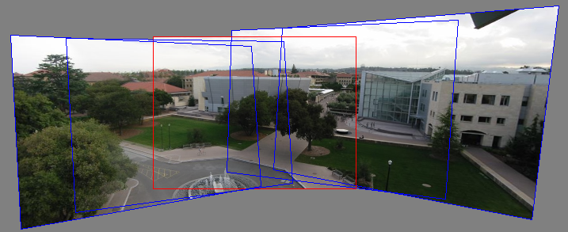
Relationship between F matrix and homography?
Images taken from the same center of projection? Use a homography!

Slide 12
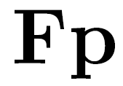
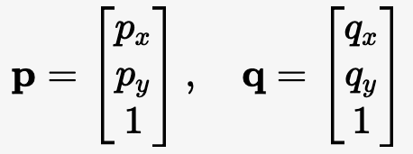
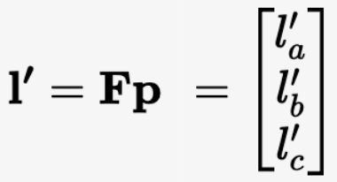
Fundamental matrix
3D point lies somewhere along r
epipolar line
epipolar line
(projection of r)
epipolar plane
0
Image 1
Image 2
Epipolar geometry, very special 3x3 fundamental matrix
maps (homogeneous) points in image 1 to lines in image 2!
The epipolar line (in image 2) of point p is:

Slide 13
Fundamental matrix
3D point lies somewhere along r
epipolar line
epipolar line
(projection of r)
epipolar plane
0
Image 1
Image 2
Epipolar geometry, very special 3x3 fundamental matrix
maps (homogeneous) points in image 1 to lines in image 2!
The epipolar line (in image 2) of point p is:
Epipolar constraint on corresponding points:

Slide 14
Fundamental matrix
epipolar line
epipolar line
(projection of ray)
epipolar plane
0
Two Special points: e₁ and e₂ (the epipoles): projection of one camera into the other

Slide 15
Fundamental matrix
0
Two Special points: e₁ and e₂ (the epipoles): projection of one camera into the other
All of the epipolar lines in an image pass through the epipole
Epipoles may or may not be inside the image

Slide 16
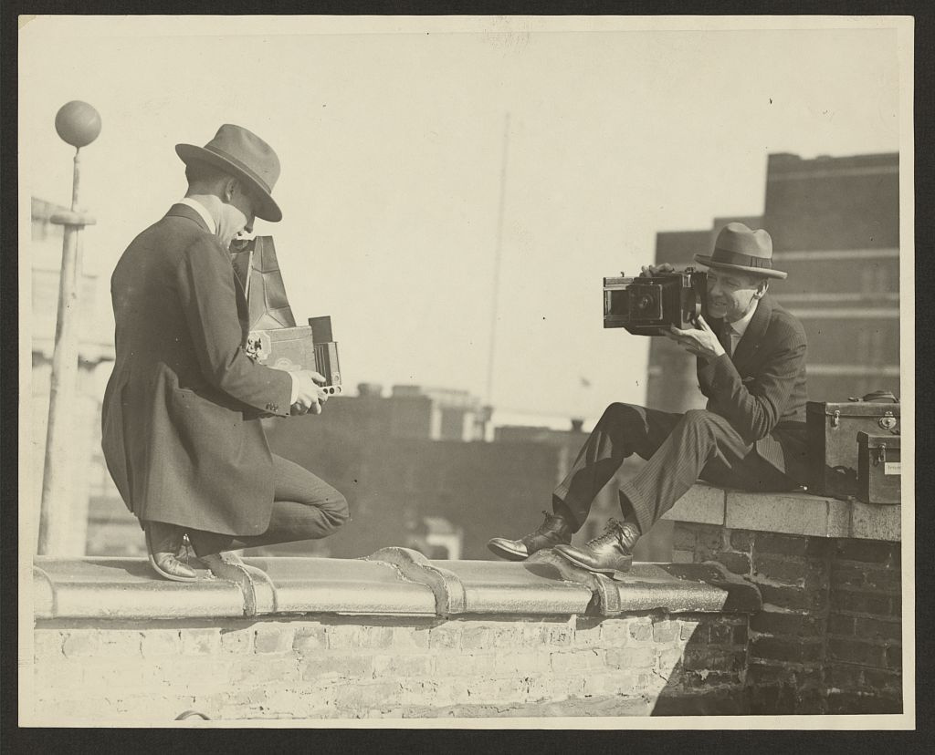
Epipoles
B
A
📷
C

Slide 17
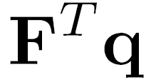
Properties of the Fundamental Matrix
is the epipolar line associated with
is the epipolar line associated with
T
epipolar line
epipolar line
(projection of ray)
epipolar plane
0
Image 1
Image 2

Slide 18
Properties of the Fundamental Matrix
is the epipolar line associated with
is the epipolar line associated with
and
T

Slide 19
Properties of the Fundamental Matrix
is the epipolar line associated with
is the epipolar line associated with
and
is rank 2
T

Slide 20
Properties of the Fundamental Matrix
is the epipolar line associated with
is the epipolar line associated with
and
is rank 2
Q: How many parameters (degrees of freedom) does have?
T
7 degrees of freedom

Slide 21
Example

Slide 22
Demo
https://www.cs.cornell.edu/courses/cs5670/2023sp/demos/FundamentalMatrix/?demo=demo1

Slide 23
Fundamental matrix
0
Why does exist?
Let’s derive it…

Slide 24
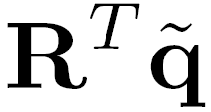
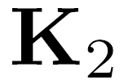
Fundamental matrix – calibrated case
0
: intrinsics of camera 1
: intrinsics of camera 2
: rotation of image 2 w.r.t. camera 1
: ray through p in camera 1’s (and world) coordinate system
: ray through q in camera 2’s coordinate system

Slide 25
Fundamental matrix – calibrated case
0
, , and are coplanar
epipolar plane can be represented as with its normal

Slide 26
Fundamental matrix – calibrated case
0

Slide 27
Fundamental matrix – calibrated case
0
One more substitution:
Cross product with (on left) can be represented as a 3x3 matrix

Slide 28
Fundamental matrix – calibrated case
0

Slide 29
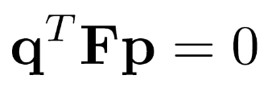
Fundamental matrix – calibrated case
0
: ray through p in camera 1’s (and world) coordinate system
: ray through q in camera 2’s coordinate system
{
the Essential matrix

Slide 30
Fundamental matrix – uncalibrated case
0
: intrinsics of camera 1
: intrinsics of camera 2
: rotation of image 2 w.r.t. camera 1
the Fundamental matrix

Slide 31
Rectified case

Slide 32
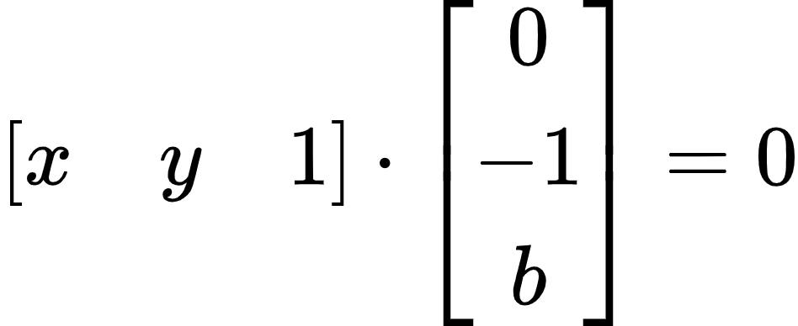
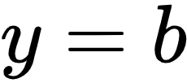
Working out the math
For a point [a, b, 1]^{T} in image 1:
Its corresponding point [x, y, 1]^{T} in image 2 must satisfy:

Slide 33
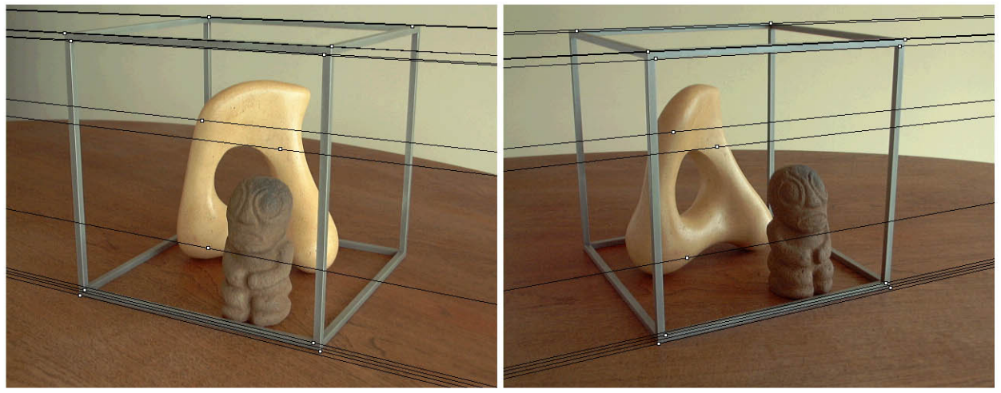
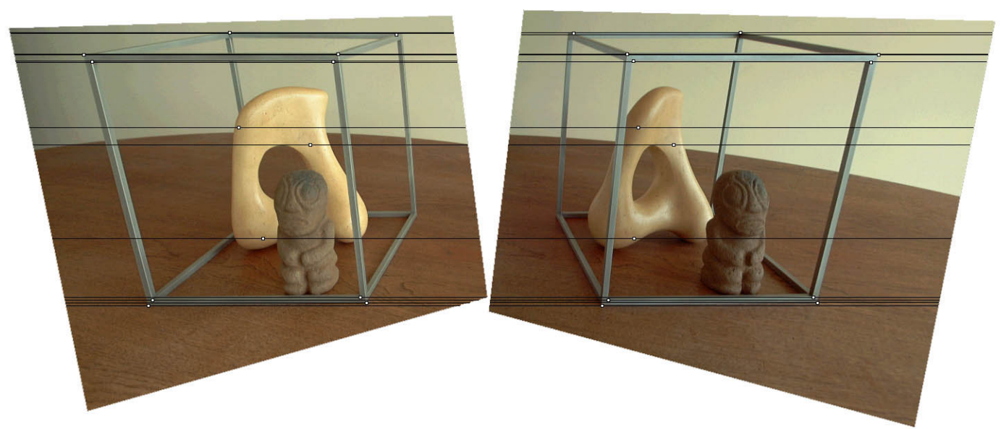
Original stereo pair
After rectification

Slide 34
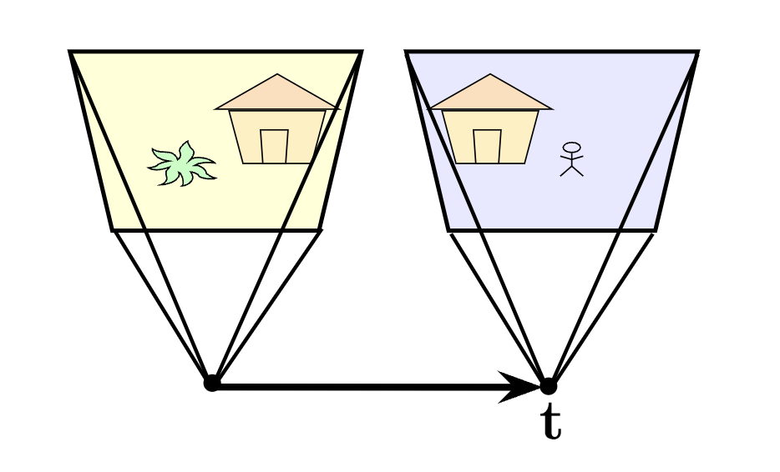
Rectified case

Slide 35
Stereo image rectification
Reproject image planes onto a common plane
Plane parallel to the line between optical centers
Pixel motion is horizontal after this transformation
Two homographies, one for each input image
C. Loop and Z. Zhang. Computing Rectifying Homographies for Stereo Vision. CVPR 1999.

Slide 36
Questions?

Slide 37
Estimating F
If we don’t know K₁, K₂, R, or t, can we estimate F for two images?
Yes, given enough correspondences

Slide 38
Estimating F – 8-point algorithm
The fundamental matrix F is defined by
for any pair of matches x and x’ in two images.
Let x=(u,v,1)^{T} and x’=(u’,v’,1)^{T},
each match gives a linear equation

Slide 39
8-point algorithm
Like with homographies, instead of solving ,
we seek unit length f to minimize || Af || : least eigenvector of .

Slide 40
8-point algorithm – Problem?
F should have rank 2
To enforce that F is of rank 2, F is replaced by F’ that minimizes subject to the rank constraint.
This is achieved by SVD. Let , where
, let
then is the solution (closest rank-2 matrix to F)

Slide 41
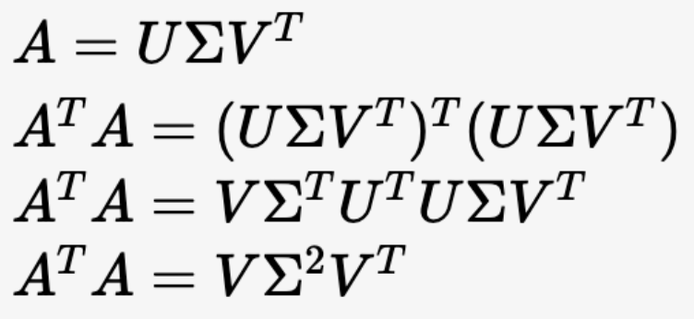
8-point algorithm
% Build the constraint matrix
A = [x2(1,:)'.*x1(1,:)' x2(1,:)'.*x1(2,:)' x2(1,:)' ...
x2(2,:)'.*x1(1,:)' x2(2,:)'.*x1(2,:)' x2(2,:)' ...
x1(1,:)' x1(2,:)' ones(npts,1) ];
[U,D,V] = svd(A);
% Extract fundamental matrix from the column of V
% corresponding to the smallest singular value.
F = reshape(V(:,9),3,3)';
% Enforce rank2 constraint
[U,D,V] = svd(F);
F = U*diag([D(1,1) D(2,2) 0])*V';
SVD of A (V is orthogonal)
Eigen decomposition of A^{T}A

Slide 42
8-point algorithm
Pros: linear, easy to implement and fast
Cons: sensitive to noise

Slide 43
Problem with 8-point algorithm
~10000
~10000
~100
~10000
~10000
~100
~100
~100
1
Orders of magnitude difference
between column of data matrix
→ least-squares yields poor results

Slide 44
Normalized 8-point algorithm
normalized least squares yields good results
Transform image to ~[-1,1]x[-1,1]
(0,500)
(700,500)
(-1,1)
(1,1)
(0,0)
(0,0)
(700,0)
(-1,-1)
(1,-1)

Slide 45
Normalized 8-point algorithm
Transform input by ,
Call 8-point on to obtain

Slide 46
Normalized 8-point algorithm
[x1, T1] = normalise2dpts(x1);
[x2, T2] = normalise2dpts(x2);
A = [x2(1,:)'.*x1(1,:)' x2(1,:)'.*x1(2,:)' x2(1,:)' ...
x2(2,:)'.*x1(1,:)' x2(2,:)'.*x1(2,:)' x2(2,:)' ...
x1(1,:)' x1(2,:)' ones(npts,1) ];
[U,D,V] = svd(A);
F = reshape(V(:,9),3,3)';
[U,D,V] = svd(F);
F = U*diag([D(1,1) D(2,2) 0])*V';
% Denormalise
F = T2'*F*T1;

Slide 47
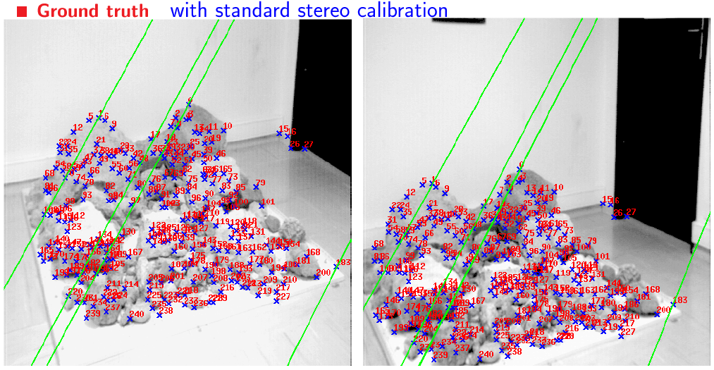
Results (ground truth)

Slide 48
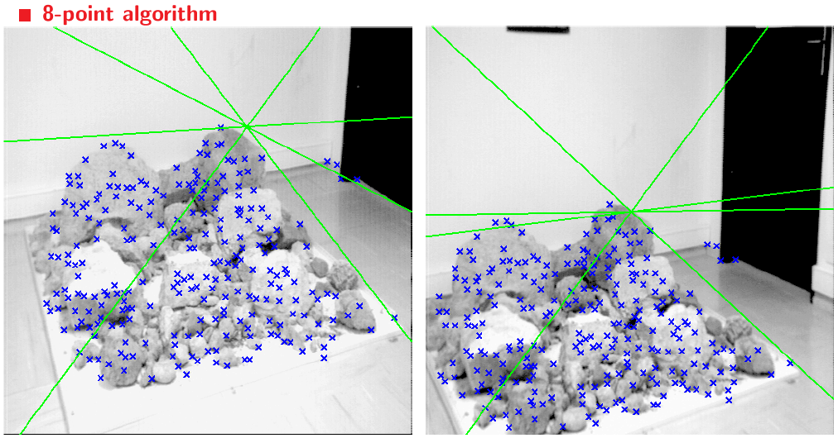
Results (8-point algorithm)

Slide 49
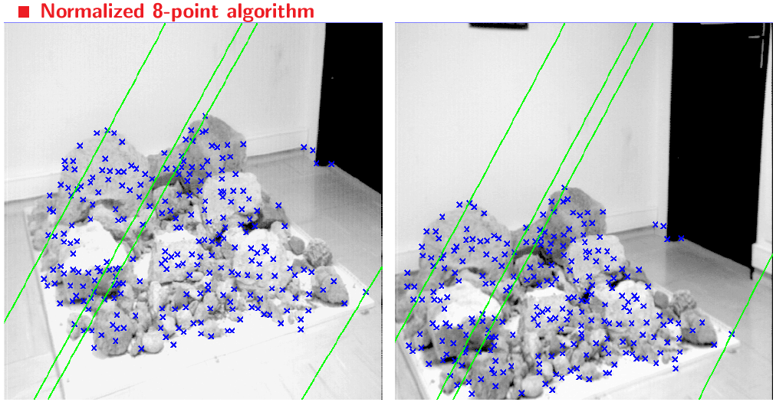
Results (normalized 8-point algorithm)

Slide 50
What about more than two views?
The geometry of three views is described by a 3 x 3 x 3 tensor called the trifocal tensor
The geometry of four views is described by a 3 x 3 x 3 x 3 tensor called the quadrifocal tensor
After this it starts to get complicated…

Slide 51
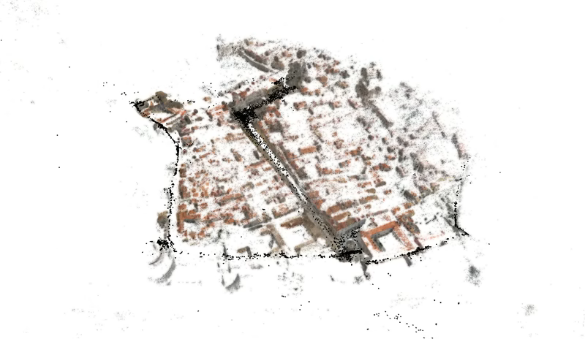
Next time: Large-scale structure from motion
Dubrovnik, Croatia. 4,619 images (out of an initial 57,845).
Total reconstruction time: 23 hours
Number of cores: 352

Slide 52
Fundamental matrix song
http://danielwedge.com/fmatrix/

Slide 53
Questions?

