Slide 1
Quiz 10 (on Canvas)
Ends at 1:06pm

Slide 2
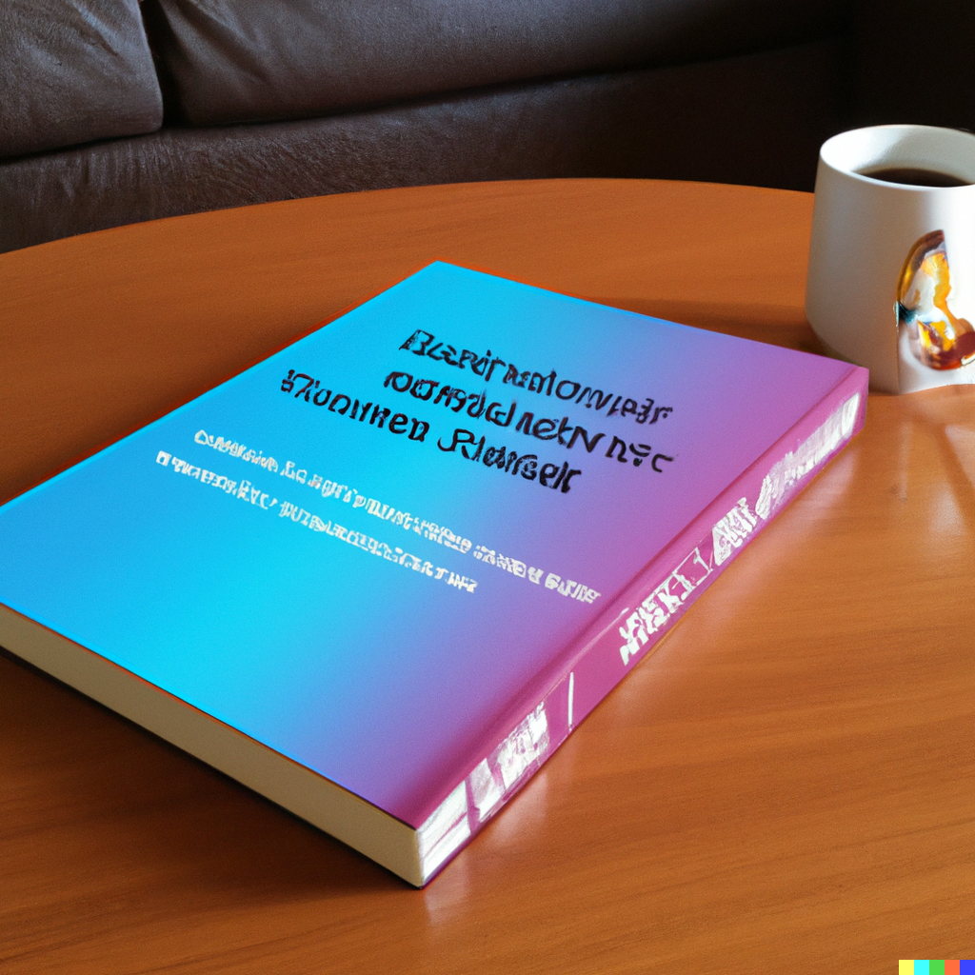
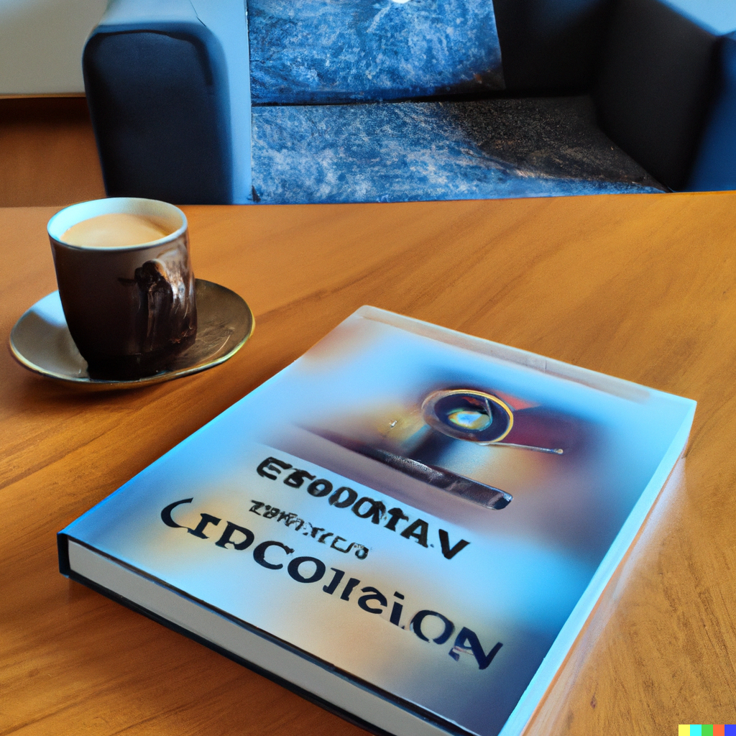
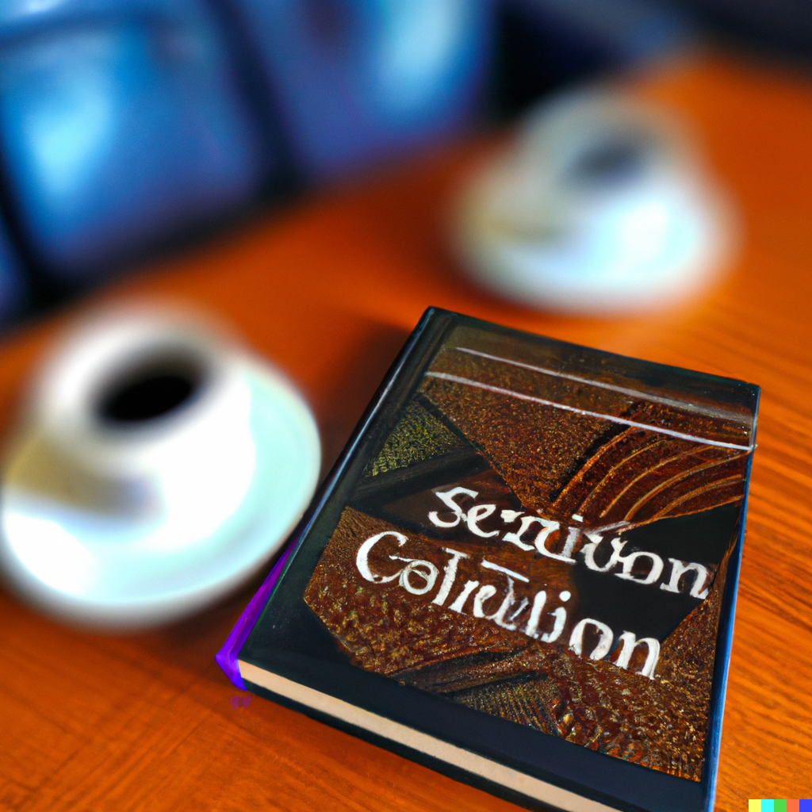
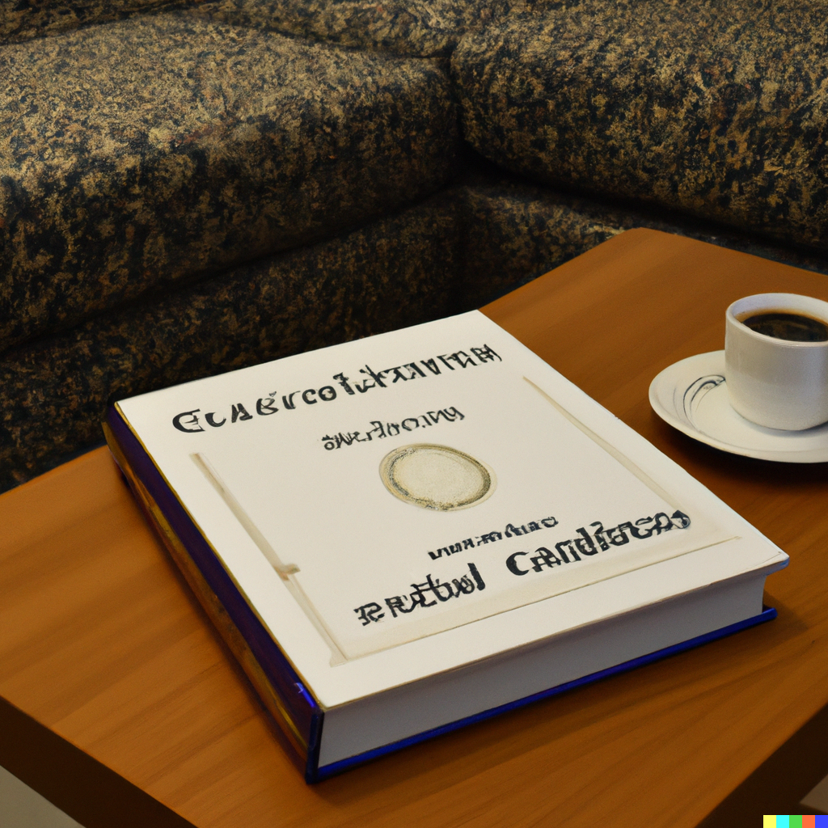
Diffusion models
CS5670: Computer Vision
“A copy of a computer vision textbook entitled ‘Szeliski 2nd Edition’ sitting on a beautiful coffee table”
(according to DALL-E 2)

Slide 3
Announcements
In class final this coming Tuesday, May 9
  Open book, open note
  “Notes” are meant to be notes you write up yourself – they will be limited to 15 pages front and back (although you likely won’t need anywhere near that many pages)
Course evaluations are open
  We would love your feedback!
  Small amount of extra credit for filling out
    What you write is still anonymous; instructors only see if students filled it out
  https://apps.engineering.cornell.edu/CourseEval/

Slide 4
Readings
5-Minute Graphics from Steve Seitz:
  Large Language Models from scratch
  Large Language Models: Part 2
  Text to Image in 5 minutes: Parti, Dall-E 2, Imagen
  Text to Image: Part 2 -- how image diffusion works in 5 minutes

Slide 5
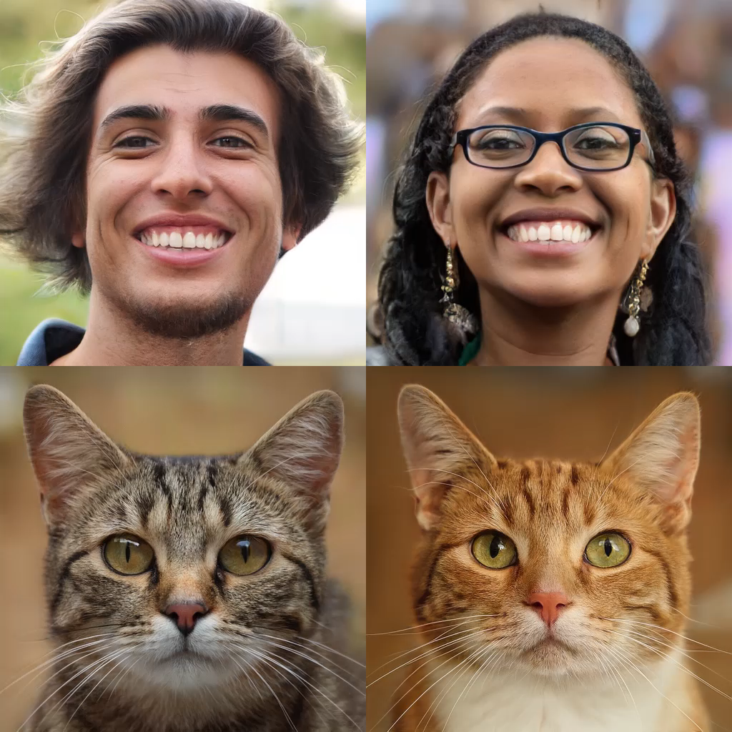
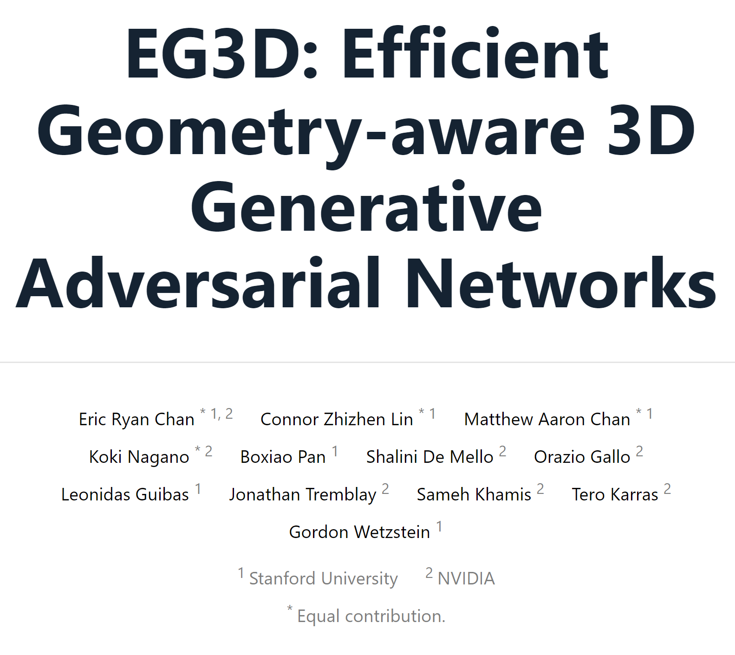
Last time: GANs
Example of GANs for 3D
https://nvlabs.github.io/eg3d

Slide 6

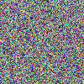
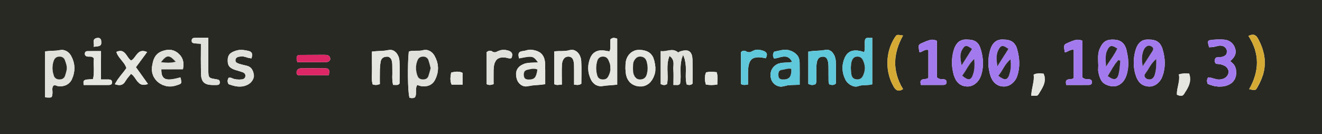
Recall: The Space of All Images
Lets consider the space of all 100x100 images
Now lets randomly sample that space…
Conclusion: Most images are noise
Question:
What do we expect a random uniform sample of all images to look like?

Slide 7
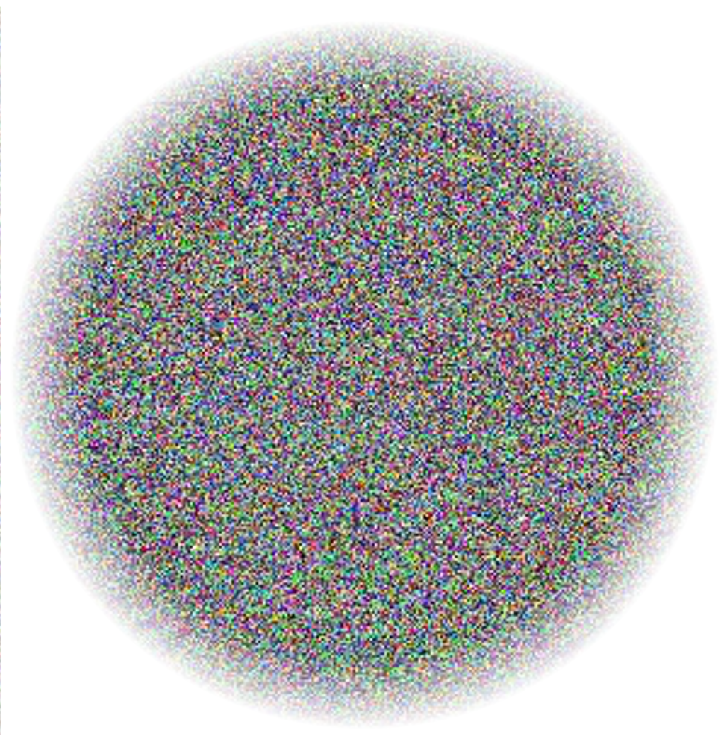
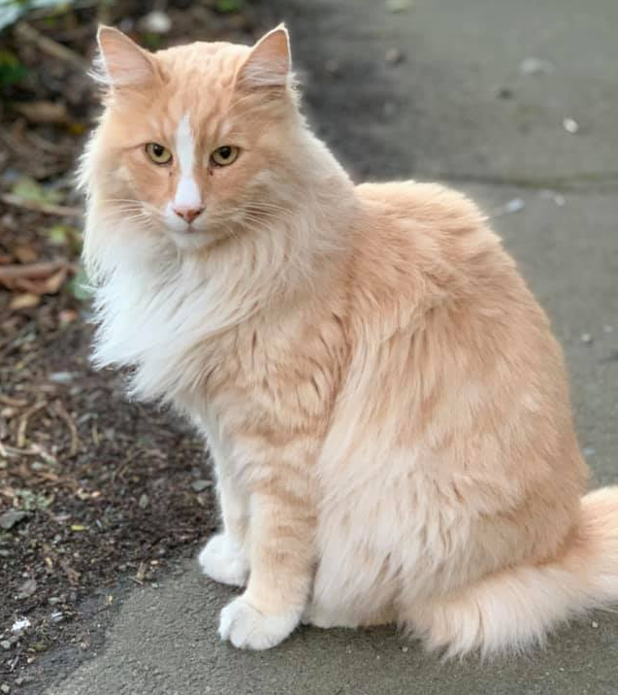
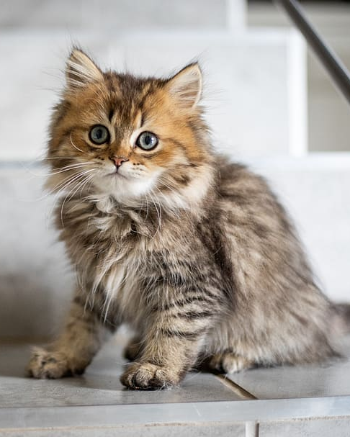
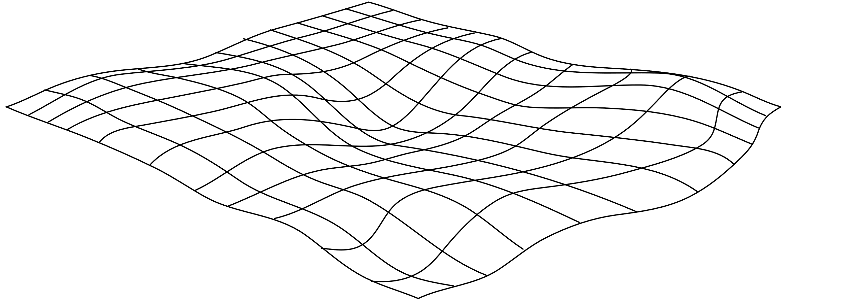
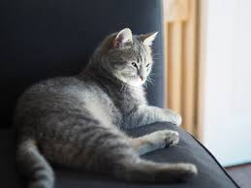
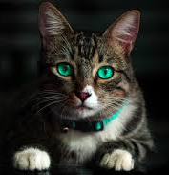
Recall: Natural Image Manifolds
Most images are “noise”
“Meaningful” images tend to form some manifold within the space of all images
Images of a particular class fall on manifolds within that manifold…
The Space of All Images

Slide 8
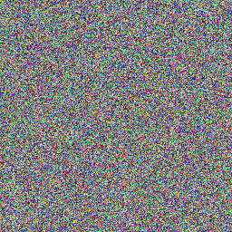
Diffusion
Manifold of cat images
Random images
Slide concept: Steve Seitz

Slide 9
Forward mapping (noise to cats) is hard
Manifold of cat images
Random images
Slide concept: Steve Seitz

Slide 10
Reverse mapping (cats to noise) is easy
Manifold of cat images
Random images
Slide concept: Steve Seitz

Slide 11
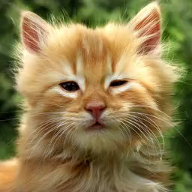
Manifold of cat images
Random images
Slide concept: Steve Seitz

Slide 12
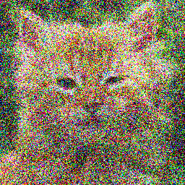



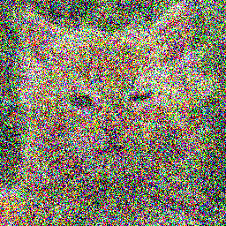
Manifold of cat images
Random images
Slide concept: Steve Seitz

Slide 13
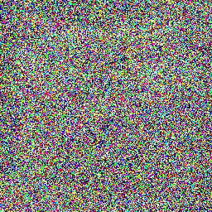
Manifold of cat images
Random images
Slide concept: Steve Seitz

Slide 14
Manifold of cat images
Random images
Slide concept: Steve Seitz

Slide 15
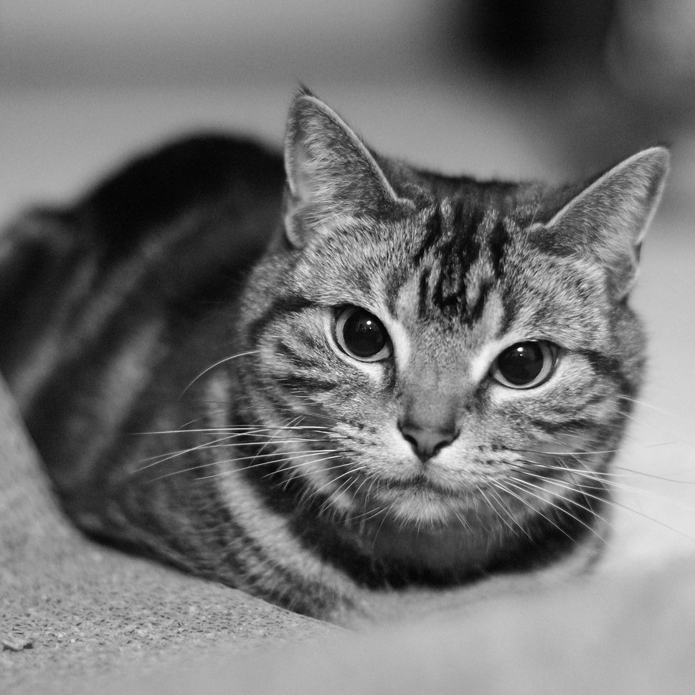
Manifold of cat images
Random images
Slide concept: Steve Seitz

Slide 16
Manifold of cat images
Random images
Slide concept: Steve Seitz

Slide 17
Manifold of cat images
Random images
Slide concept: Steve Seitz

Slide 18
Key idea: train a neural network to take an image, and predict the arrows above; that is, predict to convert a noisy image to a slightly less noisy image that is closer to the desired image manifold, using the example above to train.
Manifold of cat images
Random images
Slide concept: Steve Seitz

Slide 19
Denoising diffusion neural network
Diffusion neural network
This network can be a U-Net or other suitable image-to-image network

Slide 20
Generating new images
Once diffusion network has been trained, generate new images by starting with a random noise image, and iteratively applying the network to slowly remove noise, for some number of steps (e.g., 1,000 for DALL-E 2)
“Walking from random images towards the manifold of natural images”

Slide 21
cat images
How can we avoid training a separate diffusion network for each concept?
dog images
llama images
Random images
Slide concept: Steve Seitz

Slide 22
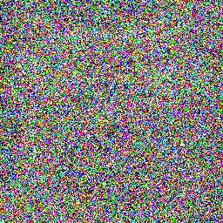
Idea 1: add a text label as conditioning
“cat”
Diffusion neural network

Slide 23
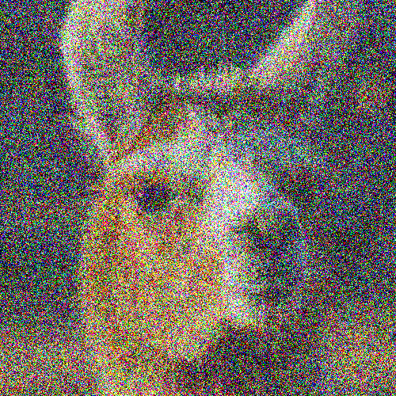
Idea 1: add a text label as conditioning
“llama”
Diffusion neural network

Slide 24
Idea 2: condition using large language model
language representation
Large Language Model
Diffusion neural network
“llama riding a skateboard”

Slide 25
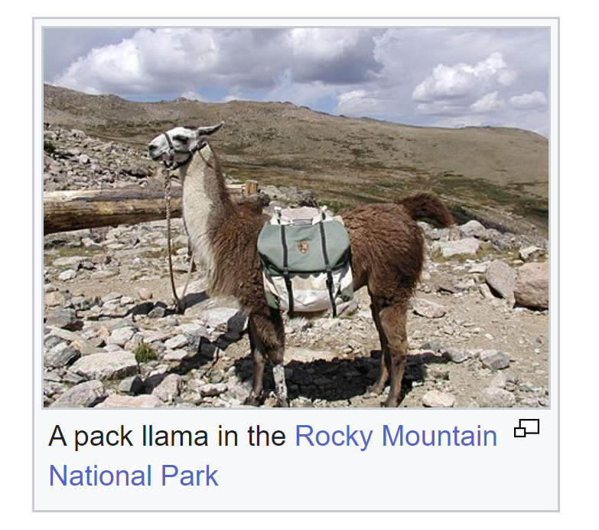
Training on images + captions
https://en.wikipedia.org/wiki/Llama

Slide 26
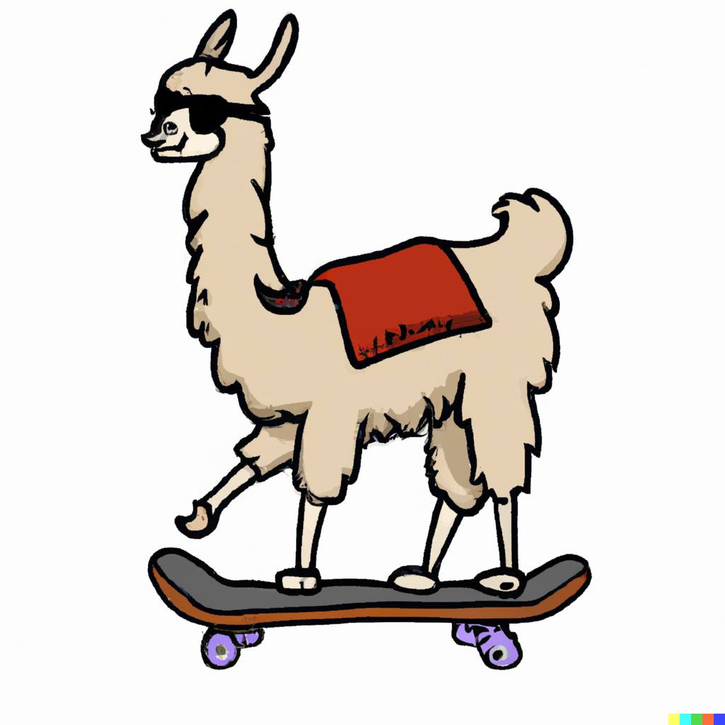
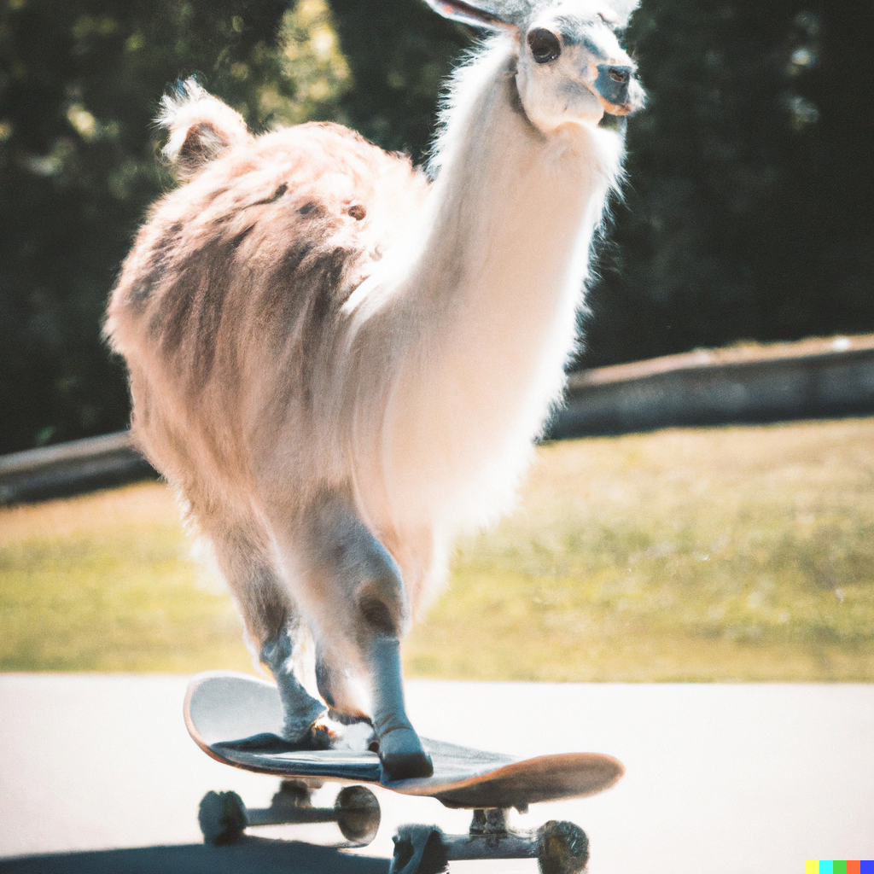
DALL-E 2
“A llama riding a skateboard”
“A llama riding a skateboard captured with a DSLR”

Slide 27
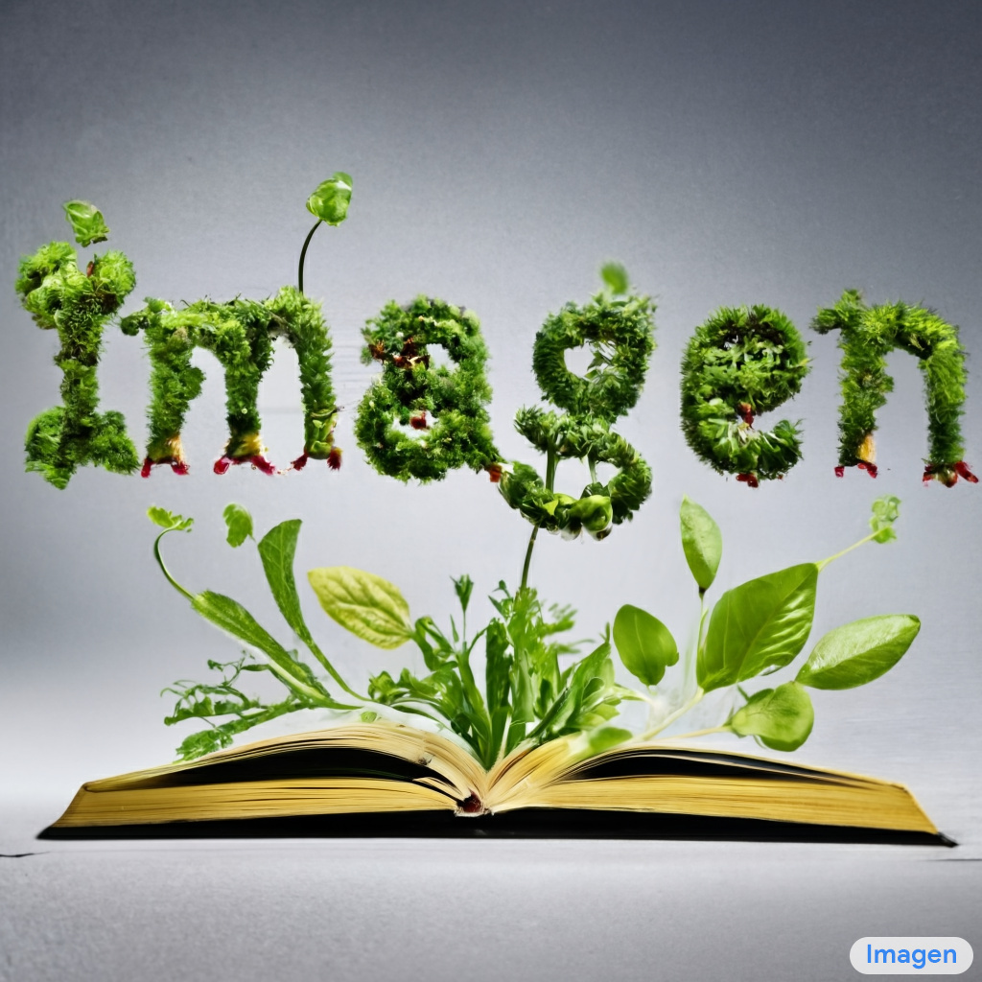
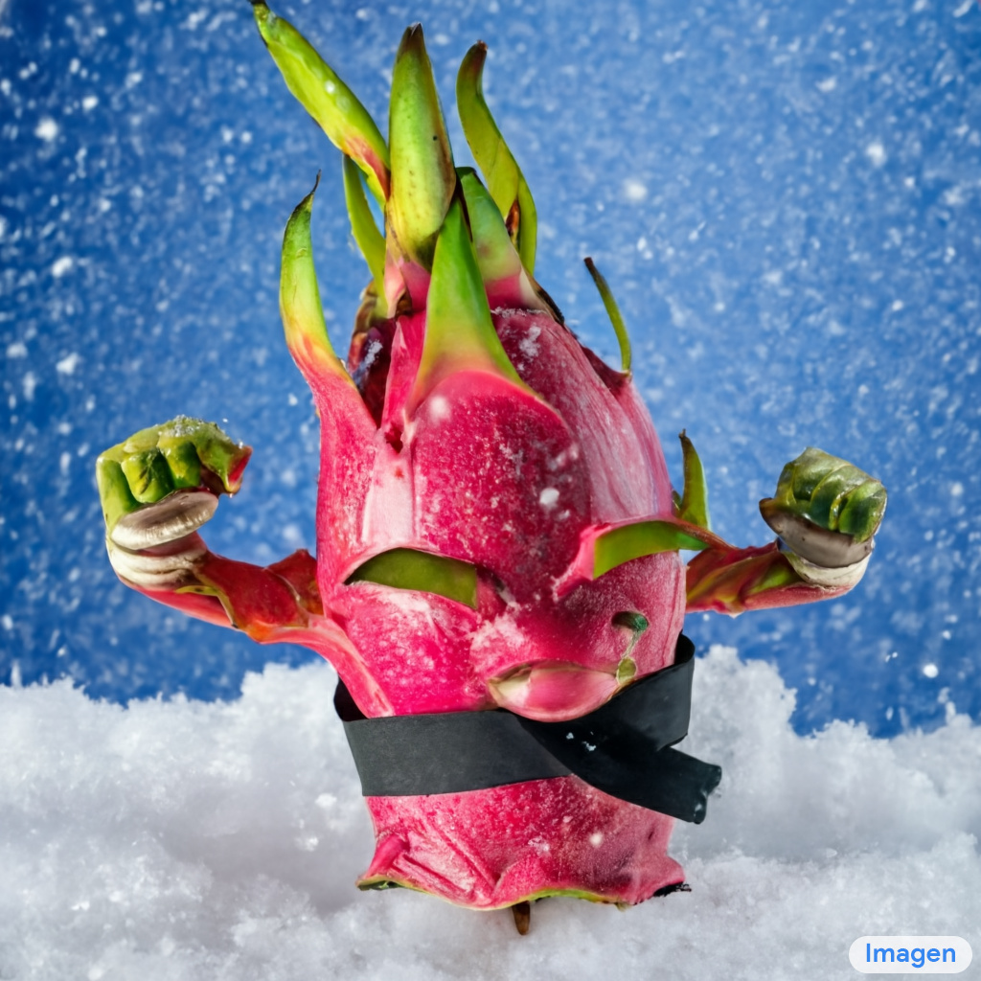
Imagen
“Sprouts in the shape of text 'Imagen' coming out of a fairytale book.”
“A dragon fruit wearing karate belt in the snow.”

Slide 28
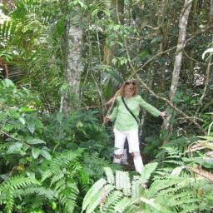
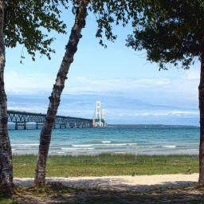
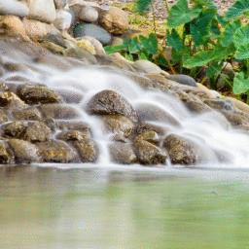
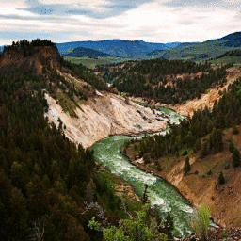
Other applications of diffusion models
Uncropping
Progressively zooming out. The most zoomed-in image is the input
Palette: Image-to-Image Diffusion Models
Saharia et al. arXiv 2022.

Slide 29
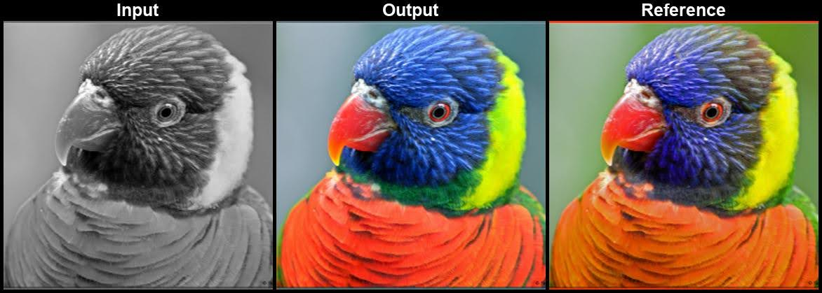
Other applications of diffusion models
Colorization
Palette: Image-to-Image Diffusion Models
Saharia et al. arXiv 2022.

Slide 30
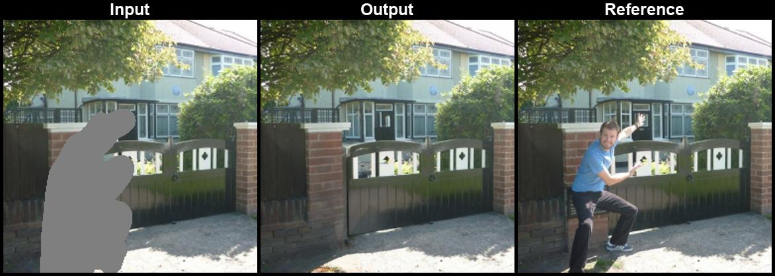
Other applications of diffusion models
Inpainting
Palette: Image-to-Image Diffusion Models
Saharia et al. arXiv 2022.

Slide 31
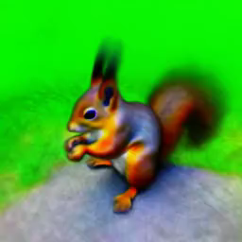
DreamFusion: Text-to-3D using 2D Diffusion
“a DSLR photo of a squirrel”
https://dreamfusion3d.github.io/

Slide 32
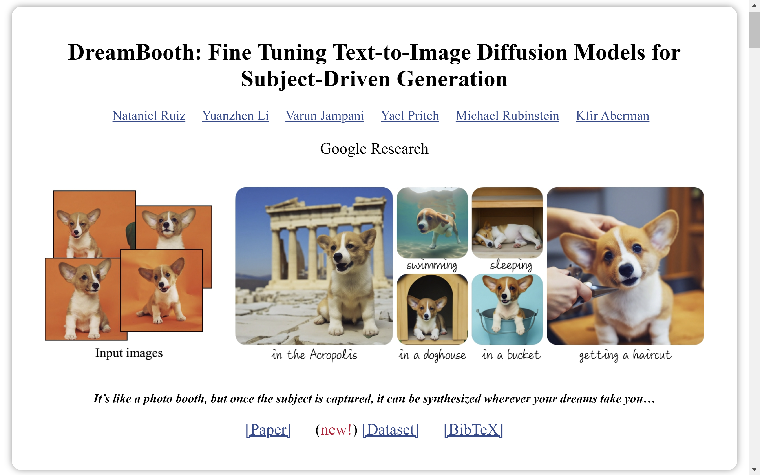

Slide 33
Comparison with GANs
Diffusion models tend to be easier to train and more scalable
Diffusion models tend to be slower – often many iterations of denoising are required
However, recent work is mitigating some of these issues (with both GANs and diffusion models)

Slide 34
Text-to-image model zoo
Diffusion models
  DALL-E 2, Imagen, Stable Diffusion
Transformer-based models
  DALL-E, Parti, MUSE

Slide 35
Questions?

