Slide 1
Quiz 9 (on Canvas)
Ends at 1:08pm

Slide 2
Computer Vision, Society, and Ethics
CS5670: Computer Vision

Slide 3
Announcements
Project 5 (Neural Radiance Fields) due Weds, May 3 by 8pm
In class final on May 9
  Open book, open note
Course evaluations are open starting Monday, May 1
  We would love your feedback!
  Small amount of extra credit for filling out
    What you write is still anonymous, instructors only see whether students filled it out
  Link coming soon

Slide 4
Additional Resources
FATE (Fairness Accountability Transparency and Ethics) in Computer Vision Tutorial
  Timnit Gebru and Emily Denton
  https://sites.google.com/view/fatecv-tutorial/schedule
https://exposing.ai/
  Adam Harvey and Jules LaPlace

Slide 5
Advances in computer vision
Sometimes we think of technological development as a uniform positive
But computer vision exists in a societal context, and can have both good and bad consequences – need to be mindful of both
Example: as computer vision gets better, our privacy gets worse (e.g., through improved face recognition)

Slide 6
Today
Examples of bias in computer vision and beyond
Datasets and unintended consequences
DeepFakes and image synthesis methods

Slide 7
Questions
Should I be working on this problem at all?
Does a given vision task even make sense?
What are the implications if it doesn’t work well?
What are the implications if it does work well?
What are the implications if it works well for some people, but not others?
Who benefits and who is harmed?
(About datasets) How was it collected? Is it representative?
(For any technology) Who is it designed for?

Slide 8
More questions
Does the application align with your values?
Does the task specification / evaluation metric reflect the things you care about?
For recognition:
  Does the collected training / test set match your true distribution?
Are the algorithm’s errors biased?
Are you being honest in public descriptions of your results?
Is the accuracy/correctness sufficient for public release?
Slide credit: Bharath Hariharan

Slide 9
Bias in computer vision and beyond
What follows are a number of examples of bias from the last 100 years

Slide 10
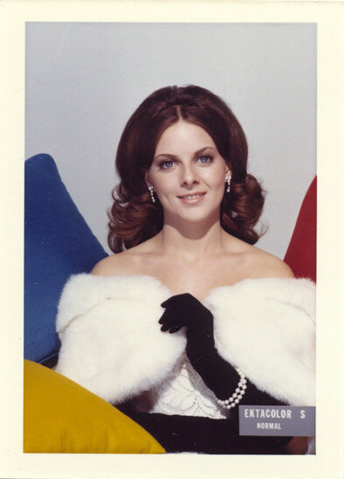
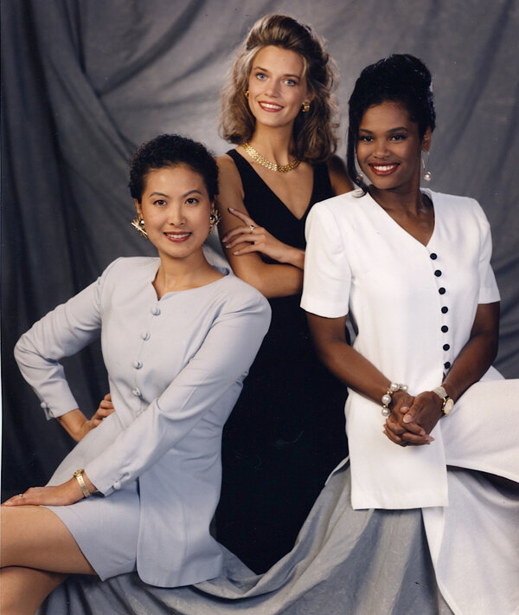
Shirley cards
Example Kodak Shirley Card, 1950s and beyond
Kodak’s Multiracial Shirley Card, North America. 1995.
How Kodak's Shirley Cards Set Photography's Skin-Tone Standard
https://www.npr.org/2014/11/13/363517842/for-decades-kodak-s-shirley-cards-set-photography-s-skin-tone-standard
The Racial Bias Built Into Photography
https://www.nytimes.com/2019/04/25/lens/sarah-lewis-racial-bias-photography.html

Slide 11
Face recognition
Probably the most controversial vision technology
Three different versions:
  Face verification: “Is this person Noah Snavely?” (e.g., Apple’s Face Unlock)
  Face clustering: “Who are all the people in this photo collection”? (e.g., Google Photos search)
  Face recognition: “Who is this person”? (e.g., identify a person from surveillance footage of a crime scene)
Applications can suffer from bias (working well for some populations but not others) and misuse

Slide 12
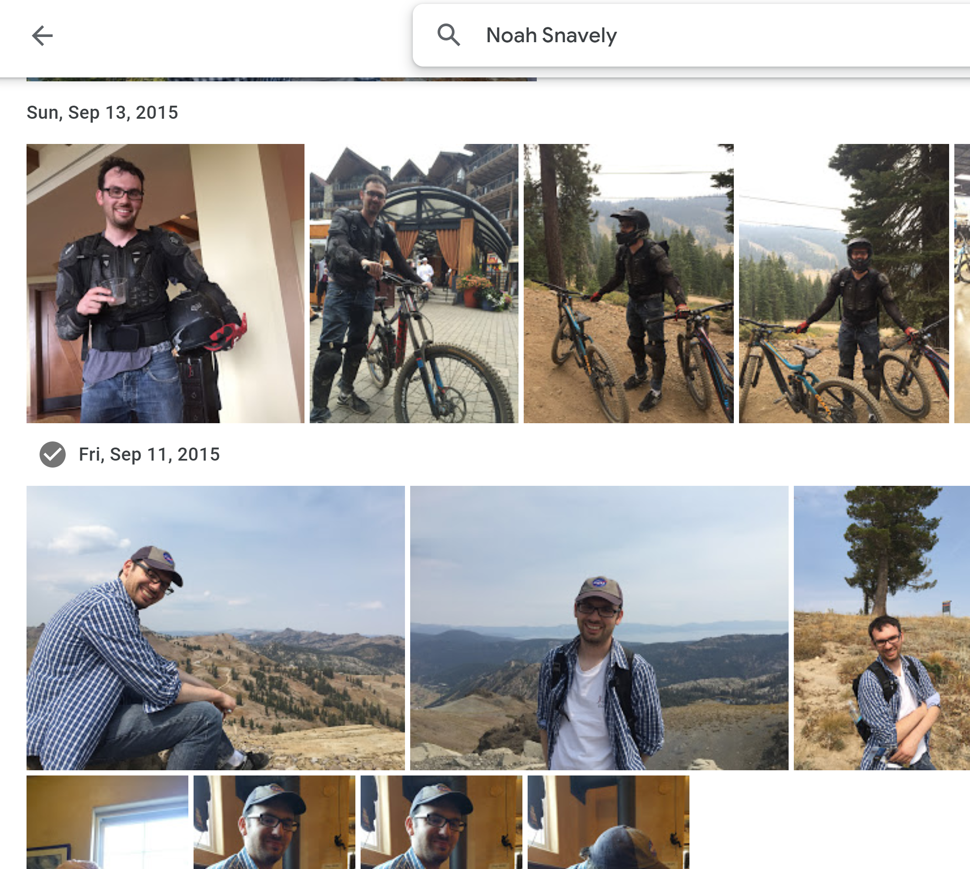
Google Photos automatic face clustering and recognition

Slide 13
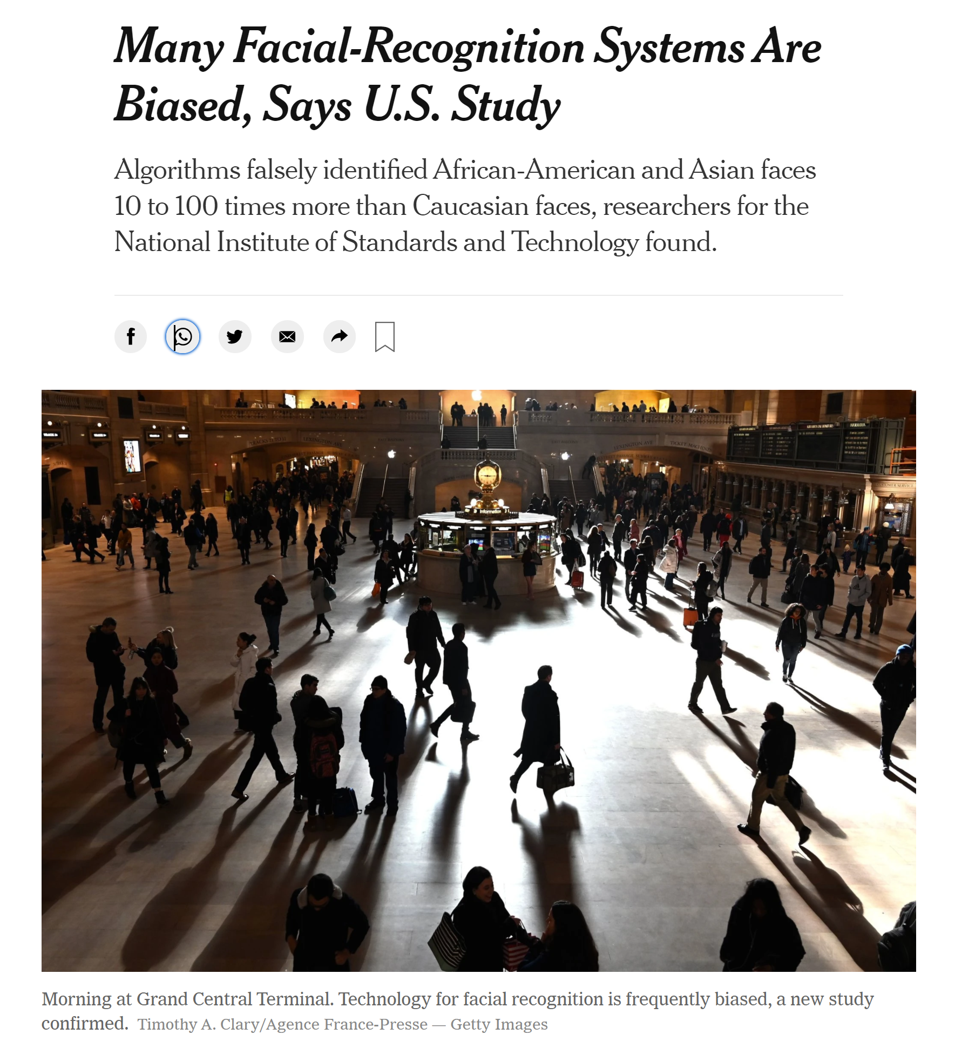
NYT, 12/20/19
https://www.nytimes.com/2019/12/19/technology/facial-recognition-bias.html

Slide 14
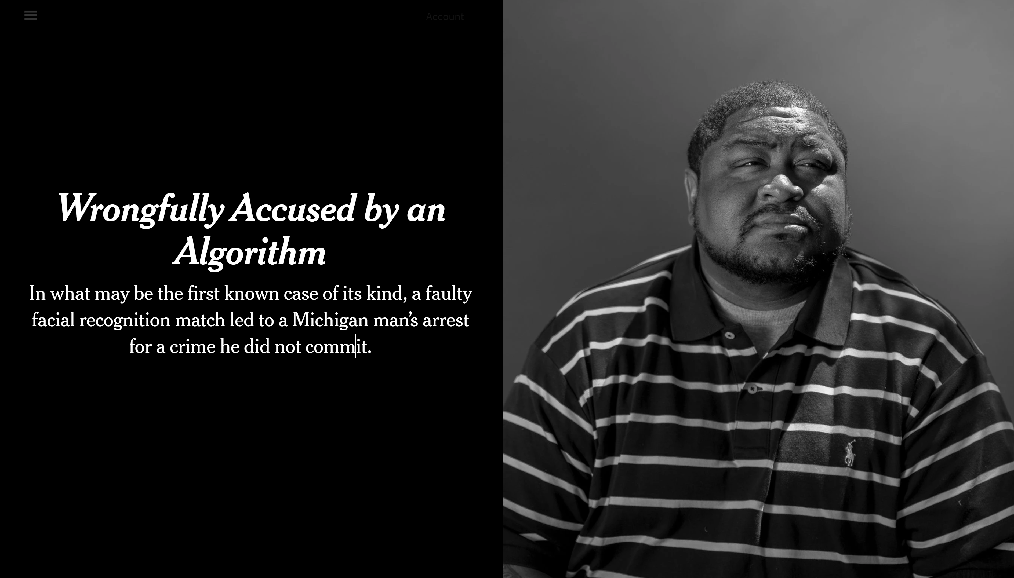
New York Times, June 24, 2020
https://www.nytimes.com/2020/06/24/technology/facial-recognition-arrest.html

Slide 15
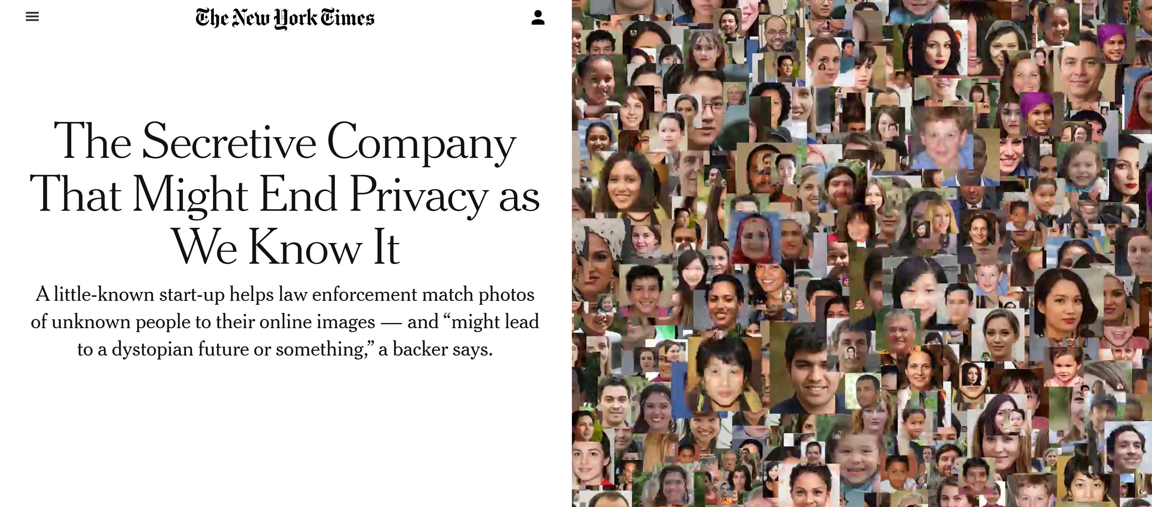
https://www.nytimes.com/2020/01/18/technology/clearview-privacy-facial-recognition.html

Slide 16
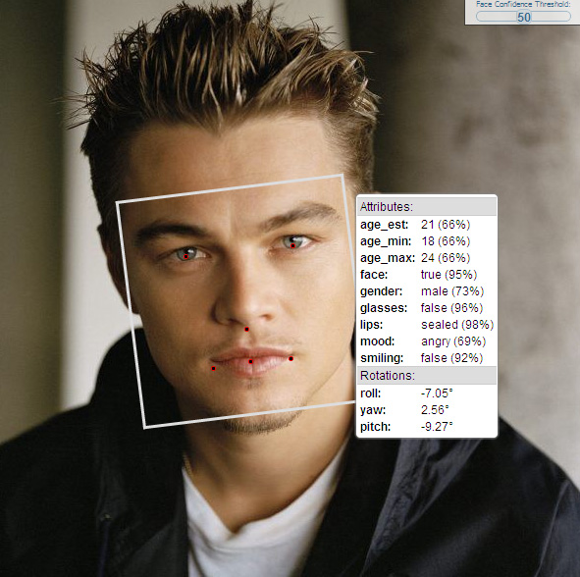
Face analysis
Gender classification
Age regression
Expression classification
Ethnicity classification

Slide 17
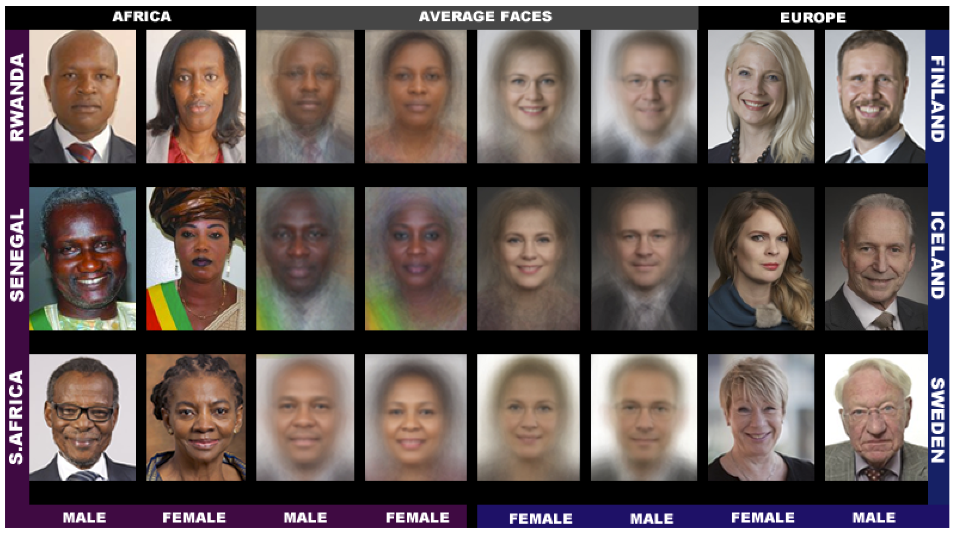
Gender Shades – Evaluation of bias in Gender Classification
Images from the Pilot Parliaments Benchmark
Joy Buolamwini and Timnit Gebru. Gender shades: Intersectional accuracy disparities in commercial gender classification. Conference on Fairness, Accountability and Transparency. 2018.

Slide 18
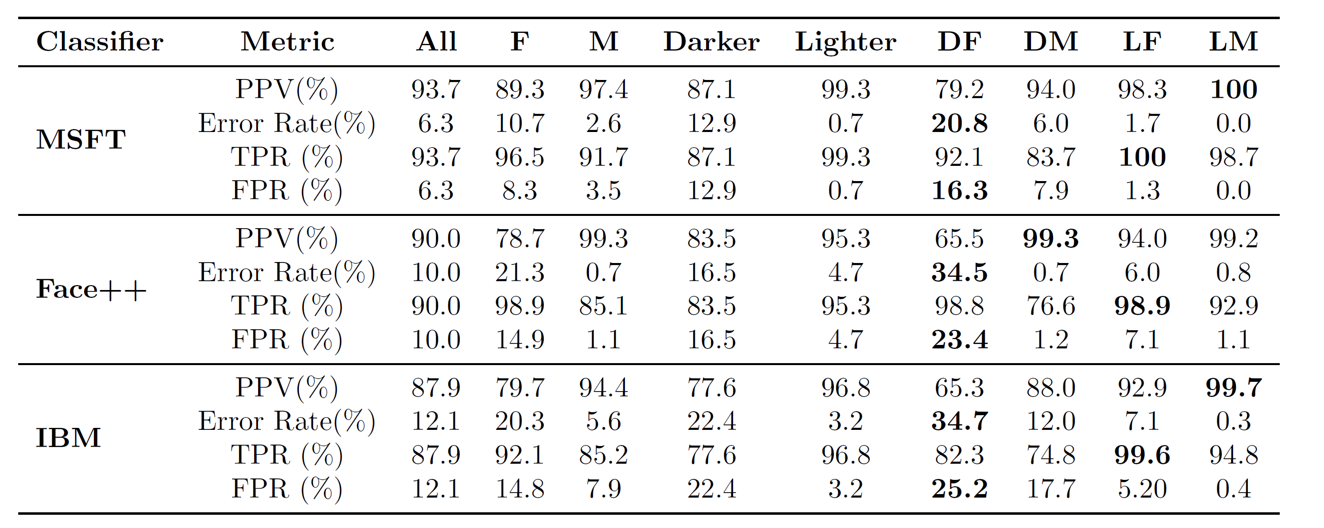
Joy Buolamwini and Timnit Gebru. Gender shades: Intersectional accuracy disparities in commercial gender classification. Conference on Fairness, Accountability and Transparency. 2018.

Slide 19
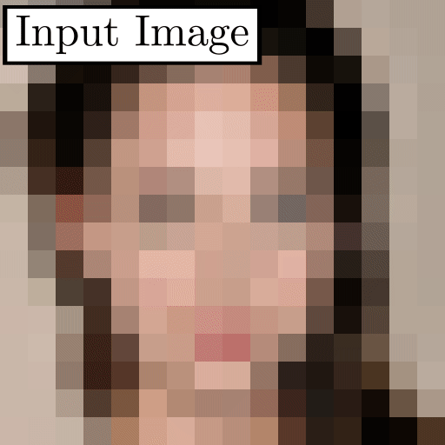
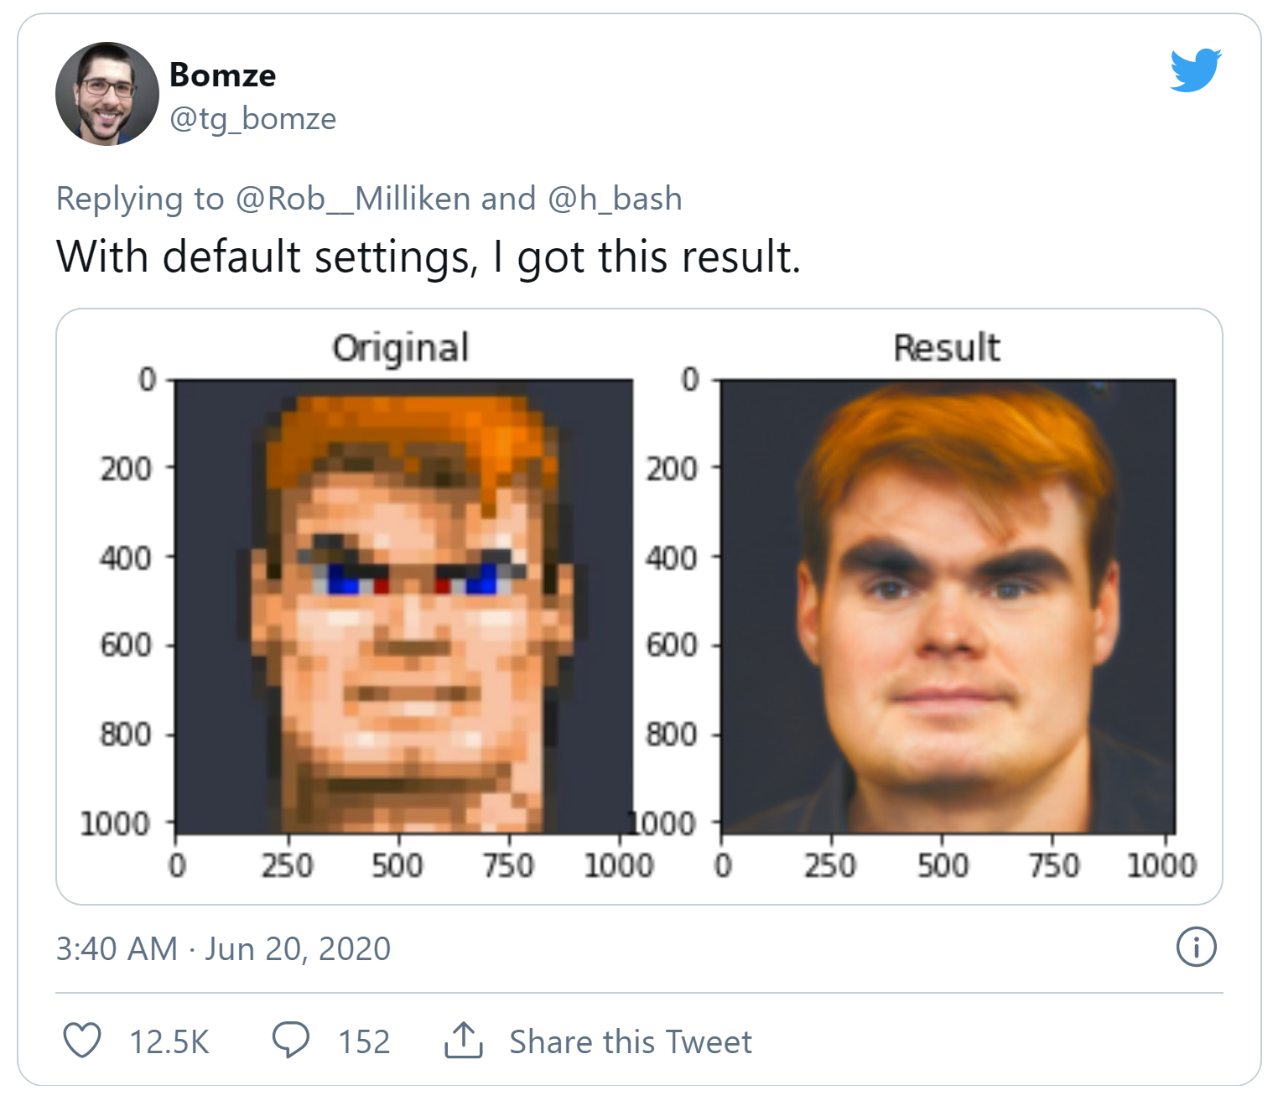
Case study – upsampling faces
PULSE: Self-Supervised Photo Upsampling via Latent Space Exploration of Generative Models
Sachit Menon, Alexandru Damian, Shijia Hu, Nikhil Ravi, and Cynthia Rudin
https://arxiv.org/abs/2003.03808
https://github.com/tg-bomze/Face-Depixelizer

Slide 20
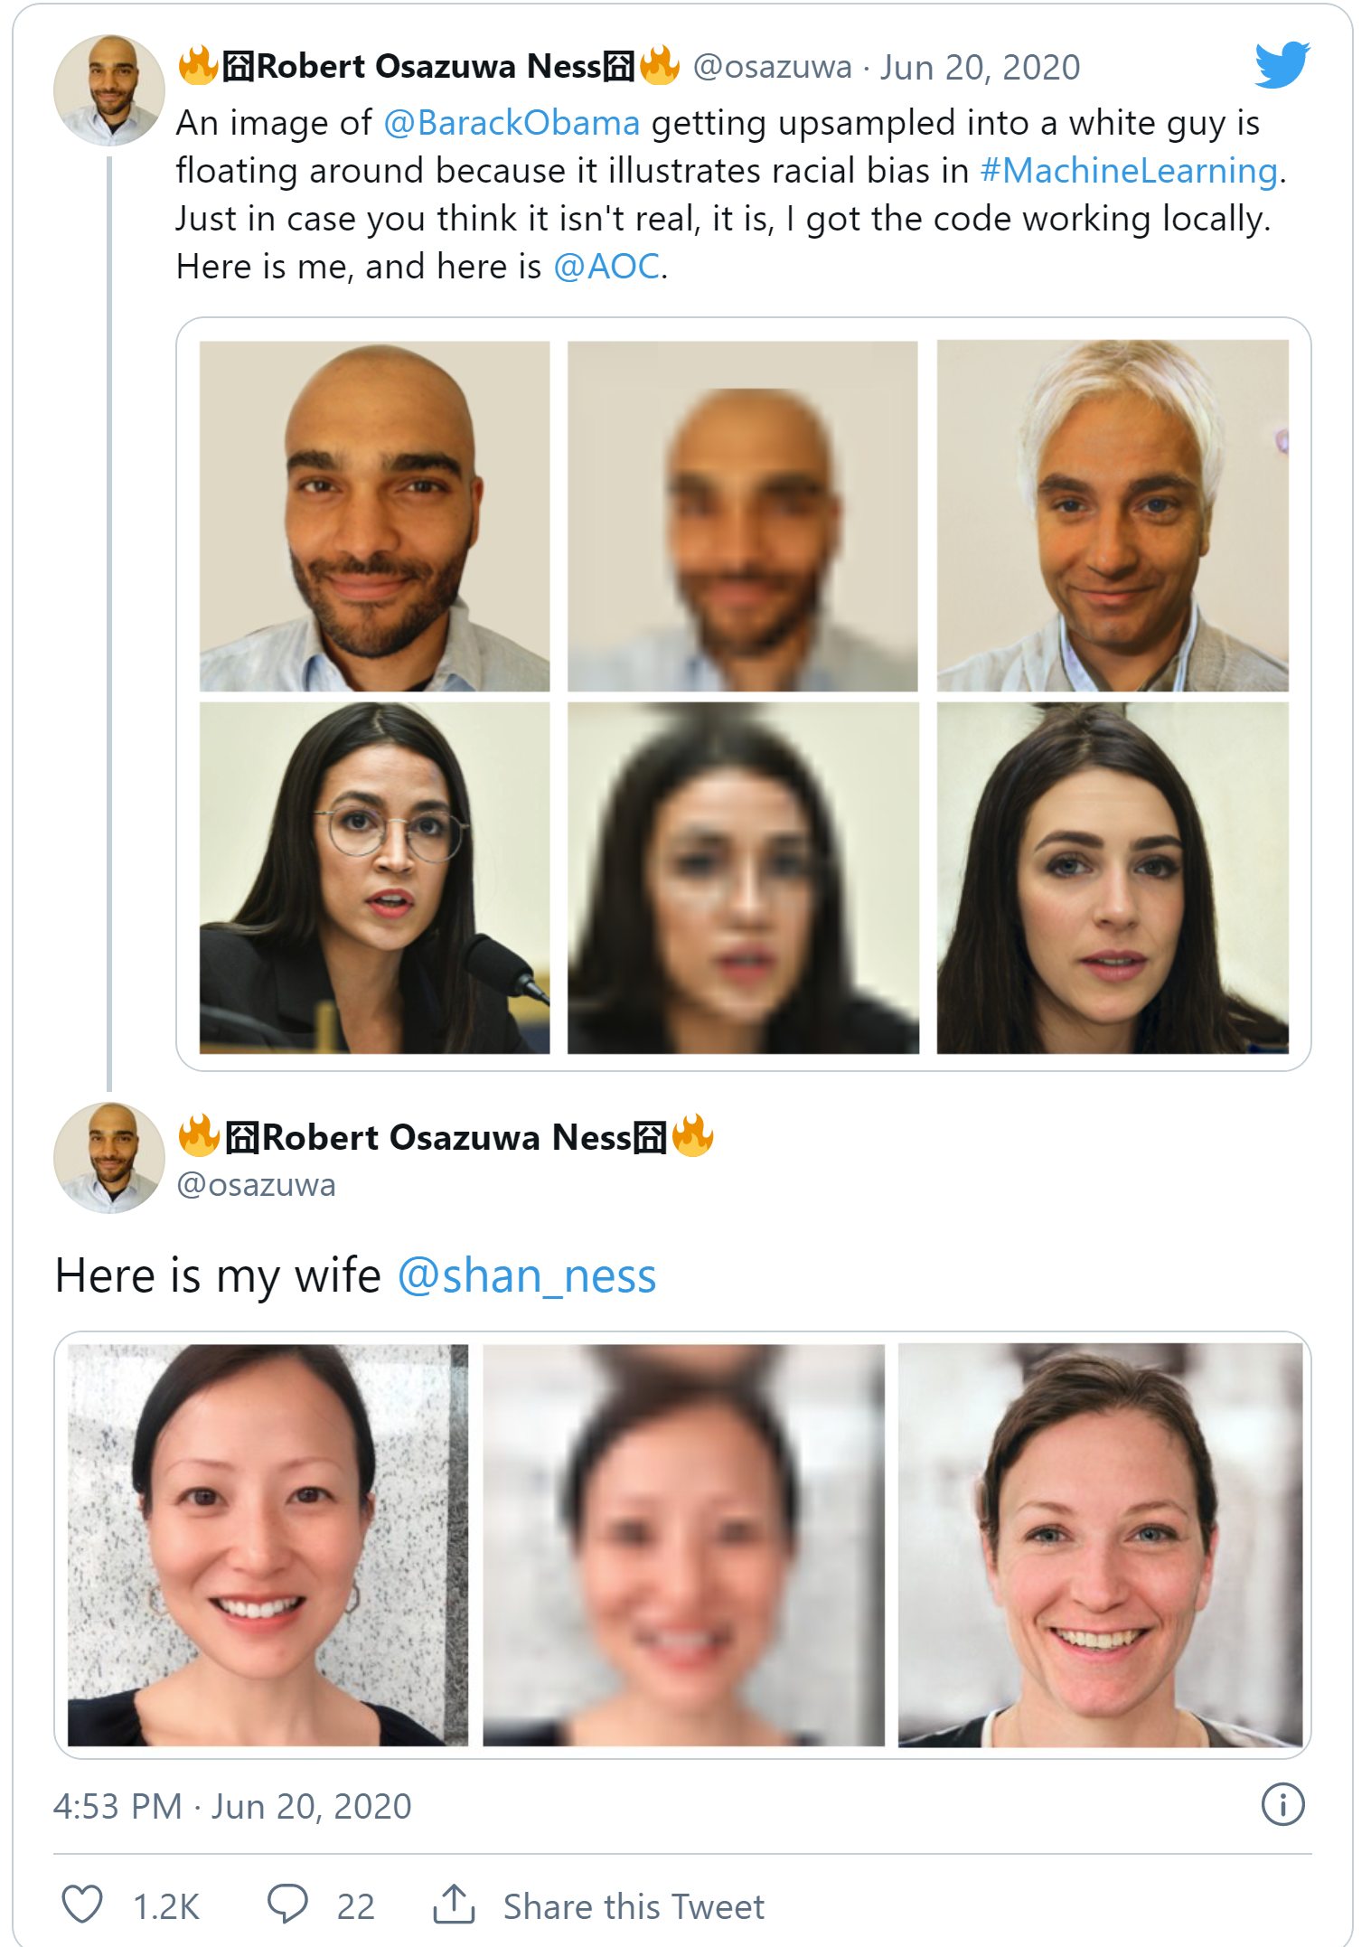
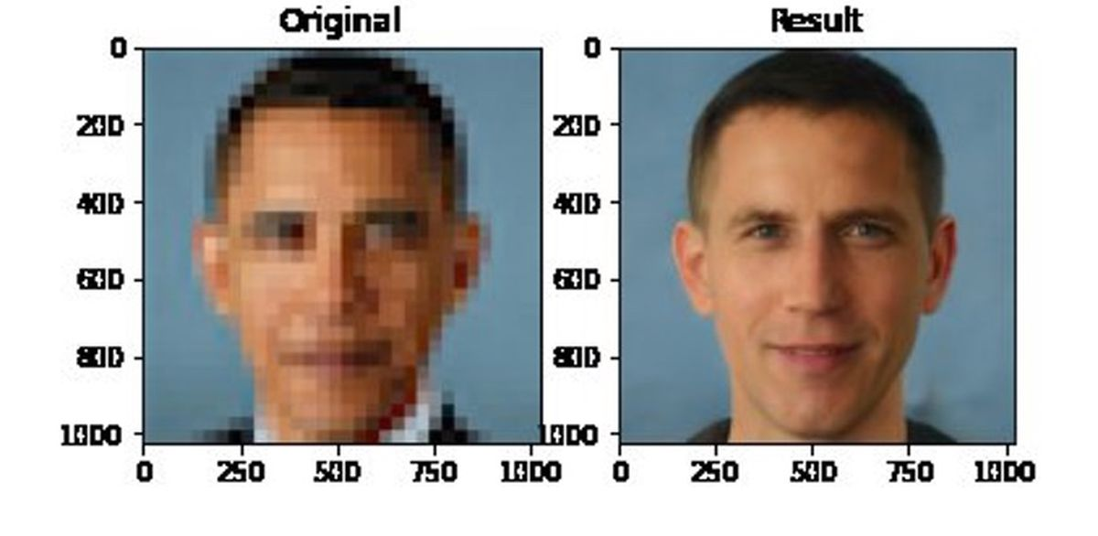
Case study – upsampling faces
https://www.theverge.com/21298762/face-depixelizer-ai-machine-learning-tool-pulse-stylegan-obama-bias

Slide 21
Case study – upsampling faces
“We have noticed a lot of concern that PULSE will be used to identify individuals whose faces have been blurred out. We want to emphasize that this is impossible - PULSE makes imaginary faces of people who do not exist, which should not be confused for real people. It will not help identify or reconstruct the original image.
We also want to address concerns of bias in PULSE. We have now included a new section in the paper and an accompanying model card directly addressing this bias.”
https://github.com/tg-bomze/Face-Depixelizer, accessed May 4, 2021

Slide 22
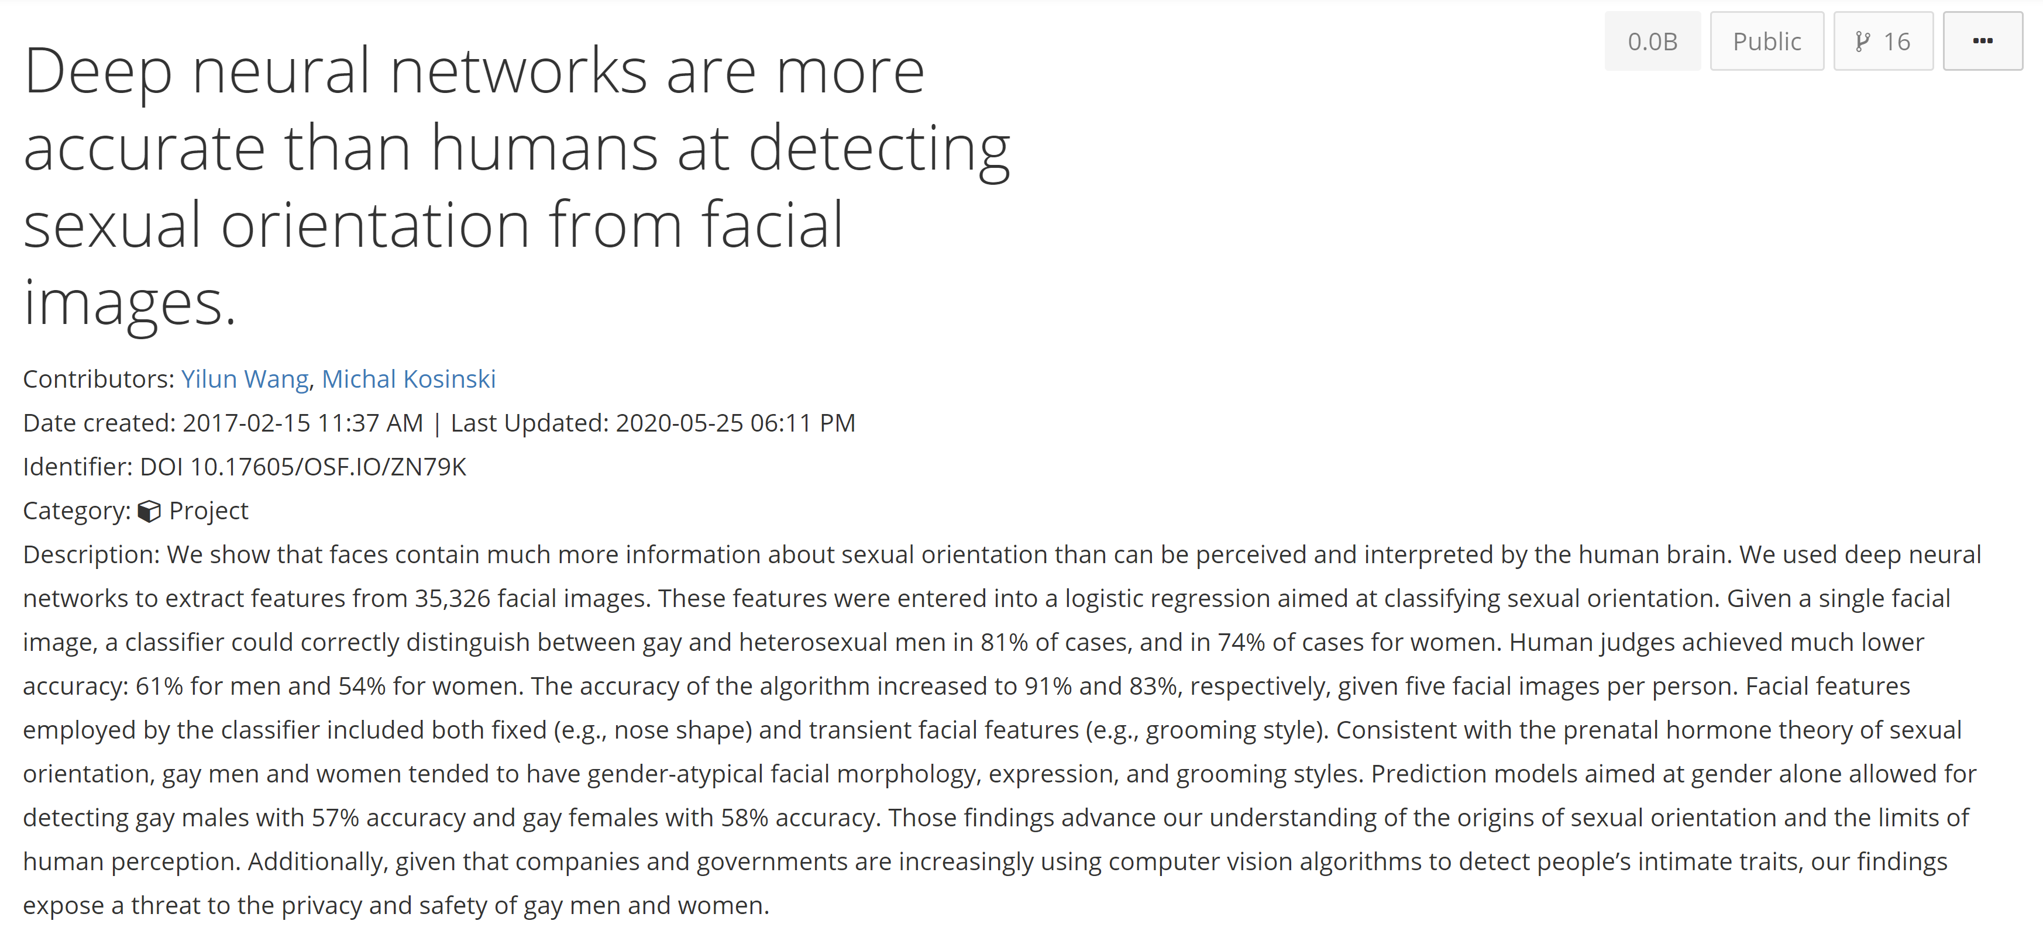
Case study – classifying sexual orientation

Slide 23
“We show that faces contain much more information about sexual orientation than can be perceived and interpreted by the human brain… Given a single facial image, a classifier could correctly distinguish between gay and heterosexual men in 81% of cases, and in 74% of cases for women. … Consistent with the prenatal hormone theory of sexual orientation, gay men and women tended to have gender-atypical facial morphology, expression, and grooming styles … our findings expose a threat to the privacy and safety of gay men and women.”
Wang & Kosinski 2017

Slide 24
More questions
Does the application align with your values?
Does the task specification / evaluation metric reflect the things you care about?
For recognition:
  Does the collected training / test set match your true distribution?
Are the algorithm’s errors biased?
Are you being honest in public descriptions of your results?
Is the accuracy/correctness sufficient for public release?
Slide credit: Bharath Hariharan

Slide 25
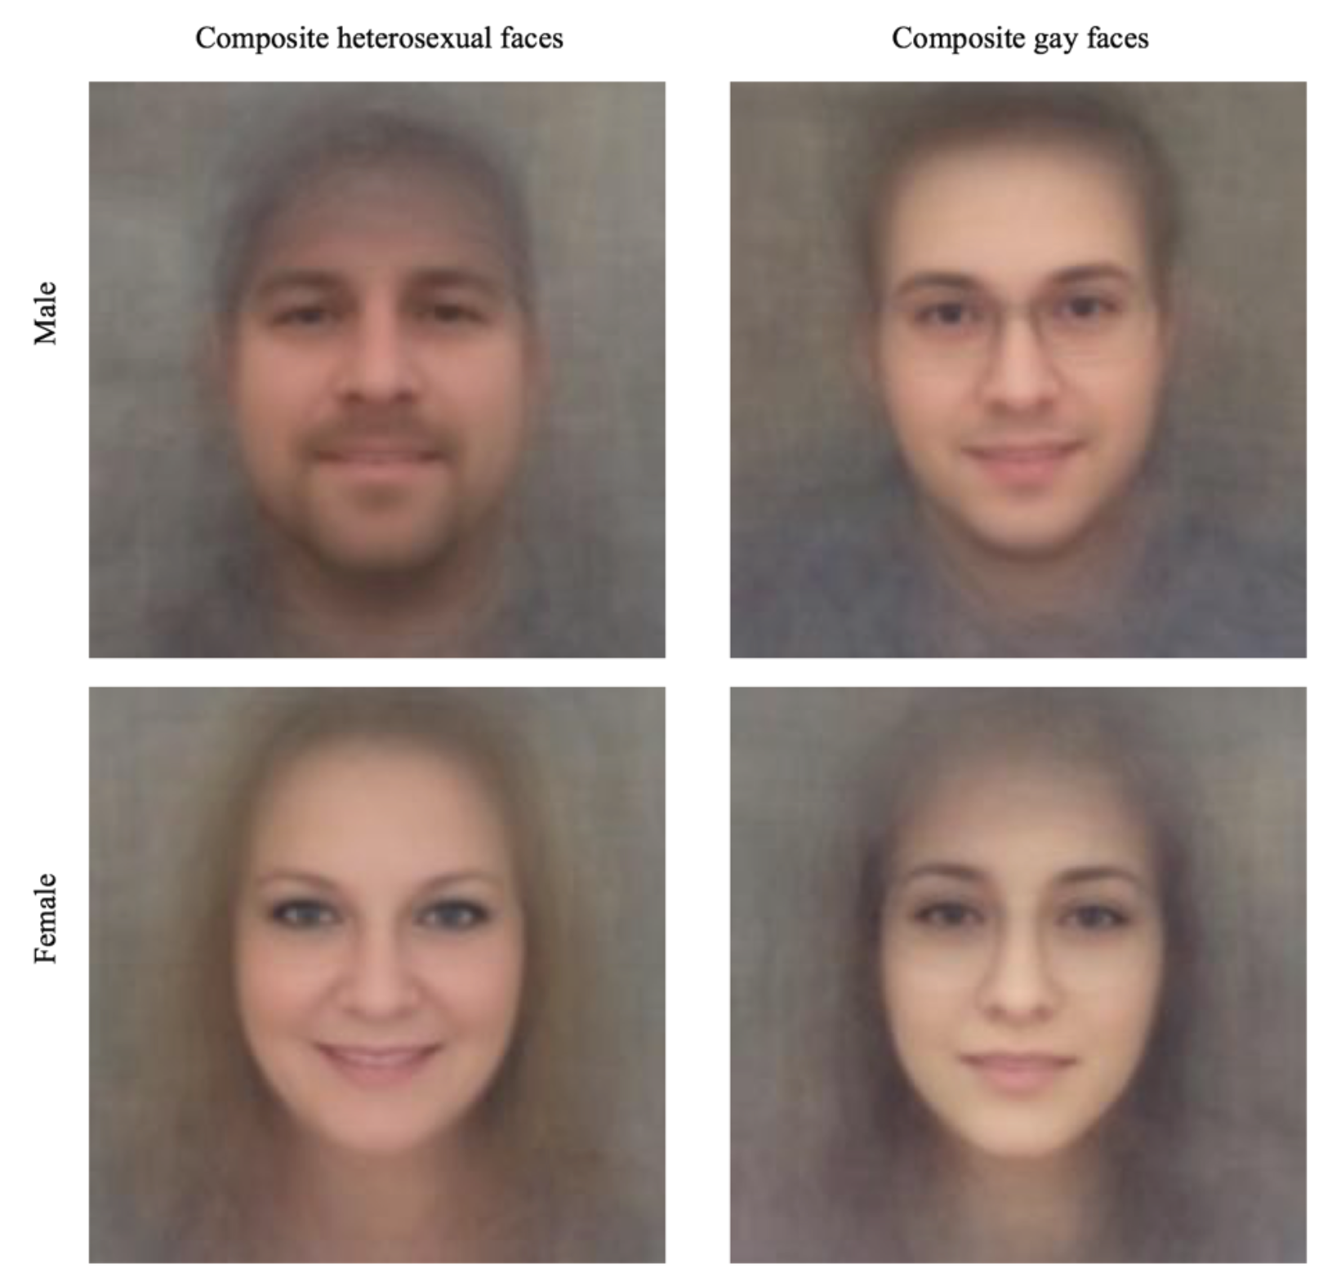
Answers
Training / test set?
  35,326 images from public profiles on a US dating website
”average” images of straight/gay people:
Question:
  Are differences caused by actual differences in faces
  Or how people choose to present themselves in dating websites?
Slide credit: Bharath Hariharan

Slide 26
Answers
Goal: raise privacy concerns.
Side-effects?
  Reinforces potentially harmful stereotypes
  Provides ostensibly “objective” criteria for discrimination
Slide credit: Bharath Hariharan

Slide 27
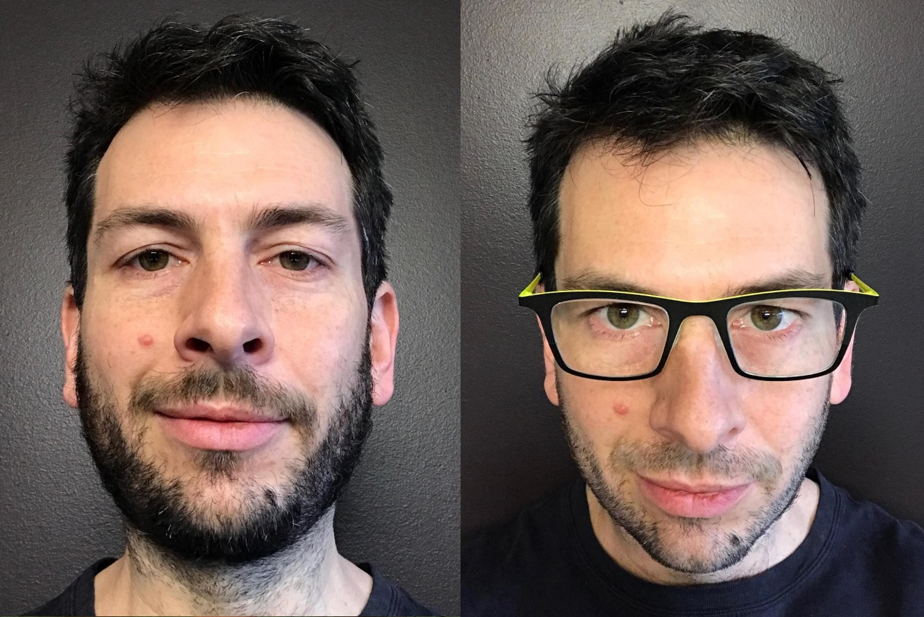
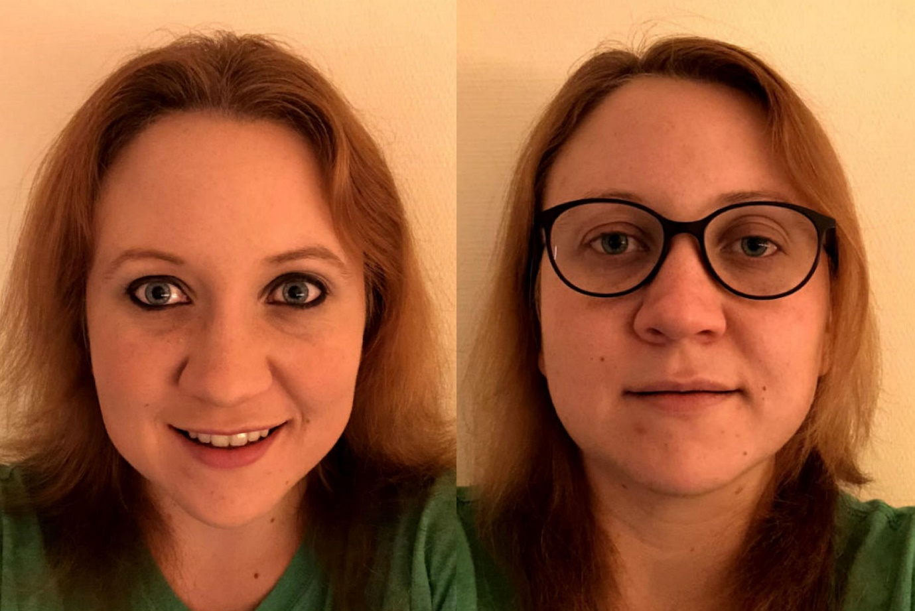
Do algorithms reveal sexual orientation or just expose our stereotypes?
Blaise Agüera y Arcas, Alexander Todorov and Margaret Mitchell
https://medium.com/@blaisea/do-algorithms-reveal-sexual-orientation-or-just-expose-our-stereotypes-d998fafdf477

Slide 28
Datasets – Potential Issues
Licensing and ownership of data
Consent of photographer and people being photographed
Offensive content
Bias and underrepresentation
  Including amplifying bias
Unintended downstream uses of data

Slide 29
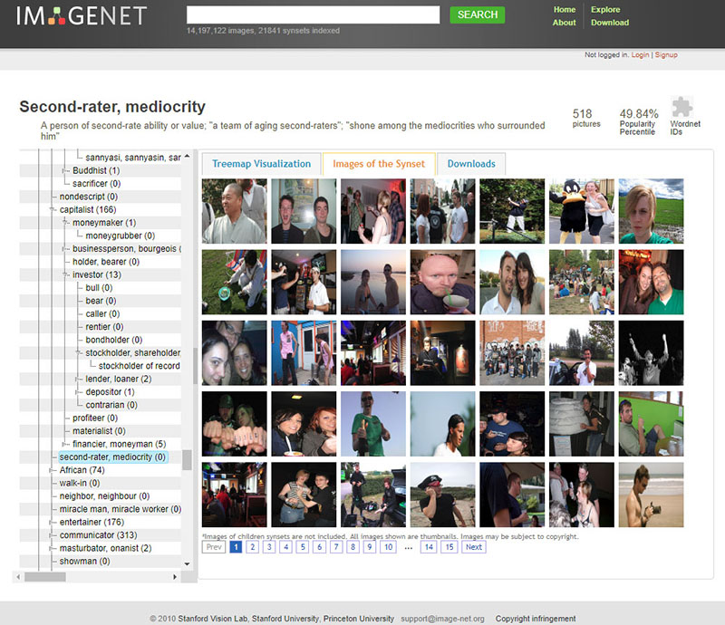
Case study – ImageNet
Serious issues with the People subcategory
  Offensive content, non-visual categories
Pointed out by https://excavating.ai/ (Crawford & Paglen, 2019)

Slide 30
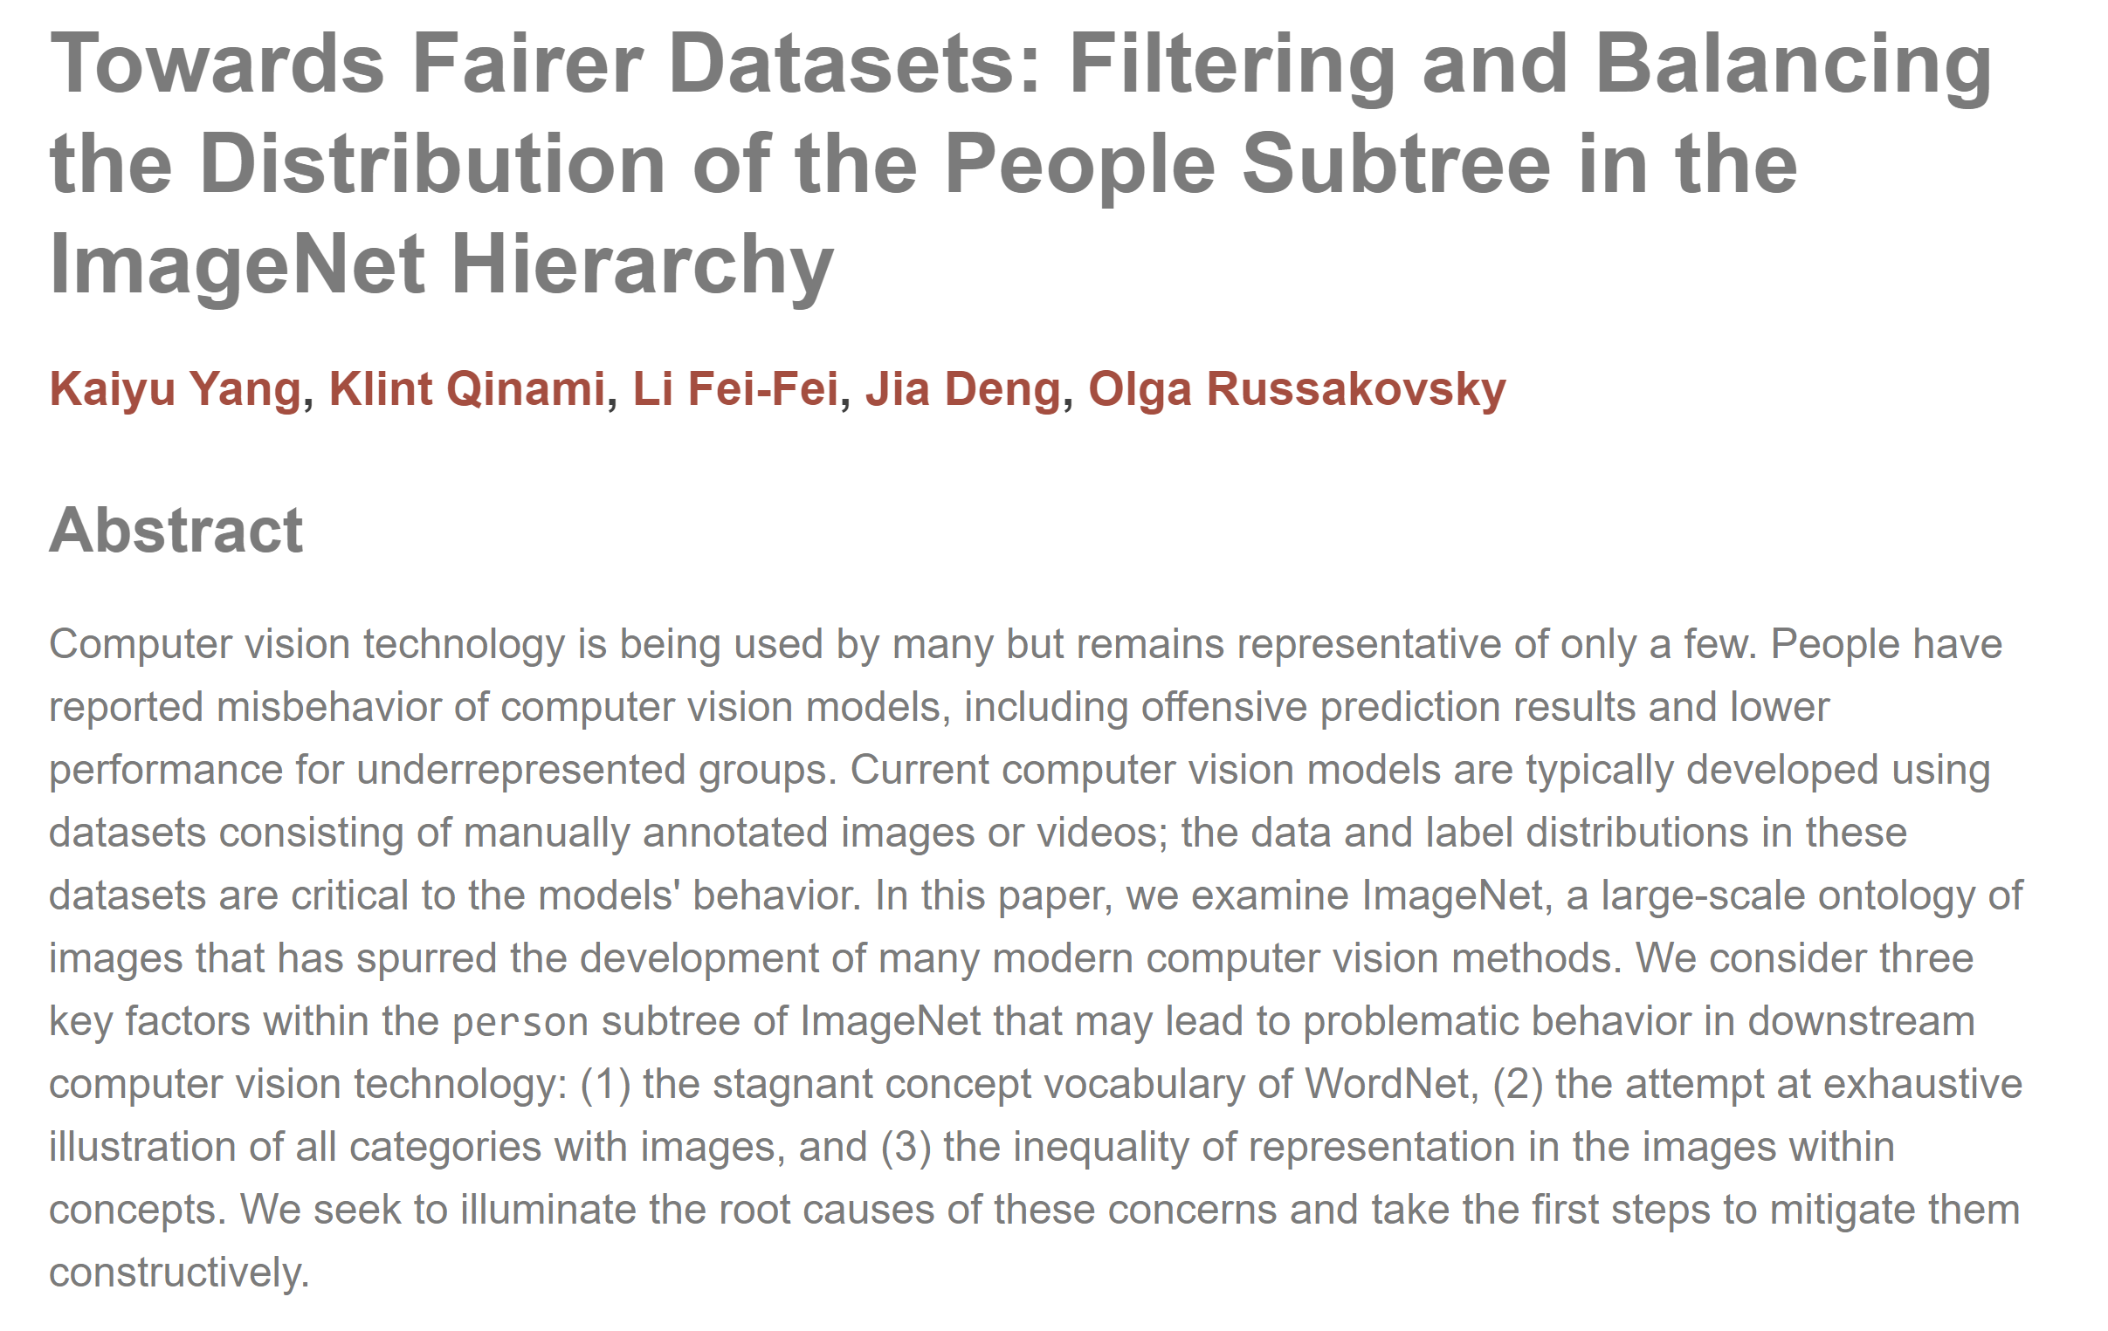

Slide 31
Case study – Microsoft Celeb
Microsoft Celeb (MS-Celeb-1M): dataset of 10 million face images harvested from the Internet for the purpose of developing face recognition technologies.
From http://exposing.ai: “While the majority of people in this dataset are American and British actors, the exploitative use of the term ‘celebrity’ extends far beyond Hollywood. Many of the names in the MS Celeb face recognition dataset are merely people who must maintain an online presence for their professional lives: journalists, artists, musicians, activists, policy makers, writers, and academics. Many people in the target list are even vocal critics of the very technology Microsoft is using their name and biometric information to build.”

Slide 32
Case study – Microsoft Celeb
Microsoft Celeb taken down May 2019
However, dataset still can be found online
Case brings up questions of consent and privacy of individuals in a dataset, as well as uses of large-scale face recognition and “runaway datasets”

Slide 33
Some “sunsetted” datasets
Microsoft Celeb (MS-Celeb-1M)
ImageNet (partial – people category)
MIT Tiny Images
MegaFace
Duke MTMC Dataset
See https://exposing.ai/datasets/ for more information
Additional reference:
  Large image datasets: A pyrrhic win for computer vision? Vinay Uday Prabhu & Abeba Birhane. https://arxiv.org/abs/2006.16923

Slide 34
Datasheets for Datasets
“The ML community currently has no standardized process for documenting datasets, which can lead to severe consequences in high-stakes domains. To address this gap, we propose datasheets for datasets. In the electronics industry, every component, no matter how simple or complex, is accompanied with a datasheet that describes its operating characteristics, test results, recommended uses, and other information. By analogy, we propose that every dataset be accompanied with a datasheet that documents its motivation, composition, collection process, recommended uses, and so on.”
Timnit Gebru, Jamie Morgenstern, Briana Vecchione, Jennifer Wortman Vaughan, Hanna Wallach, Hal Daumé III, Kate Crawford. 2018

Slide 35
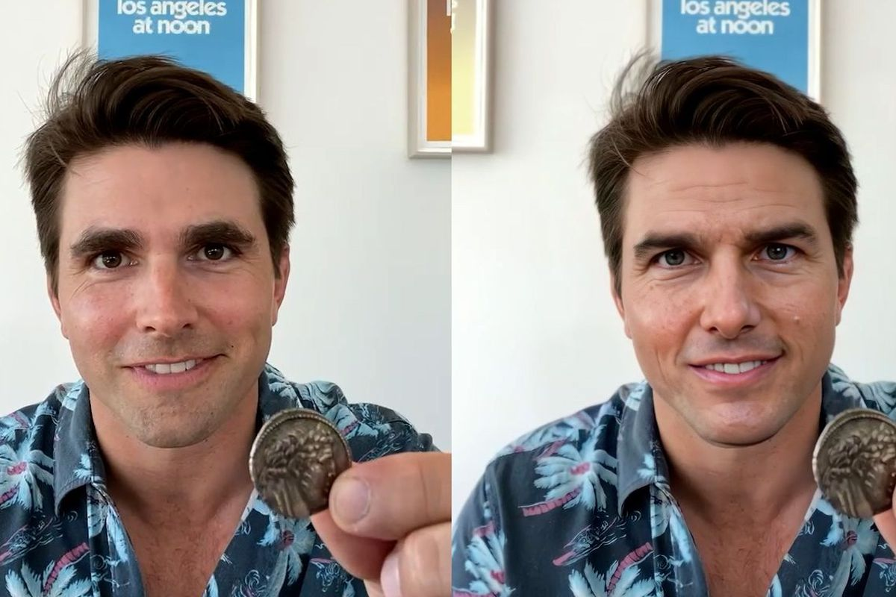
DeepFakes
https://www.theverge.com/2021/3/5/22314980/tom-cruise-deepfake-tiktok-videos-ai-impersonator-chris-ume-miles-fisher

Slide 36
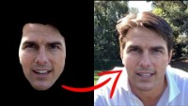
DeepFakes

Slide 37
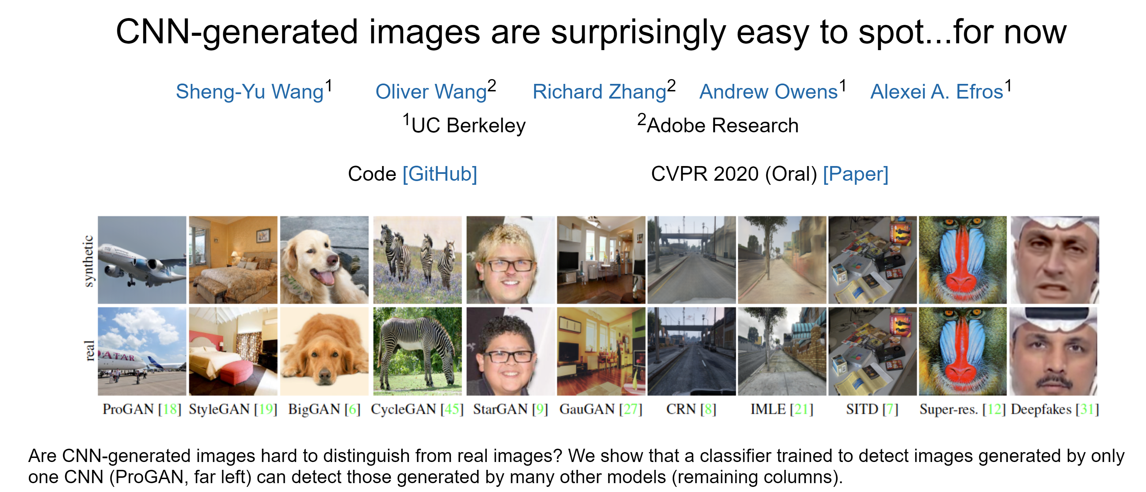
DeepFakes
Active research on both better and better image/video generation and detection of fake images
Representative work:
https://peterwang512.github.io/CNNDetection/

Slide 38
Text-to-image models
Often trained on datasets that contain copyrighted material

Slide 39
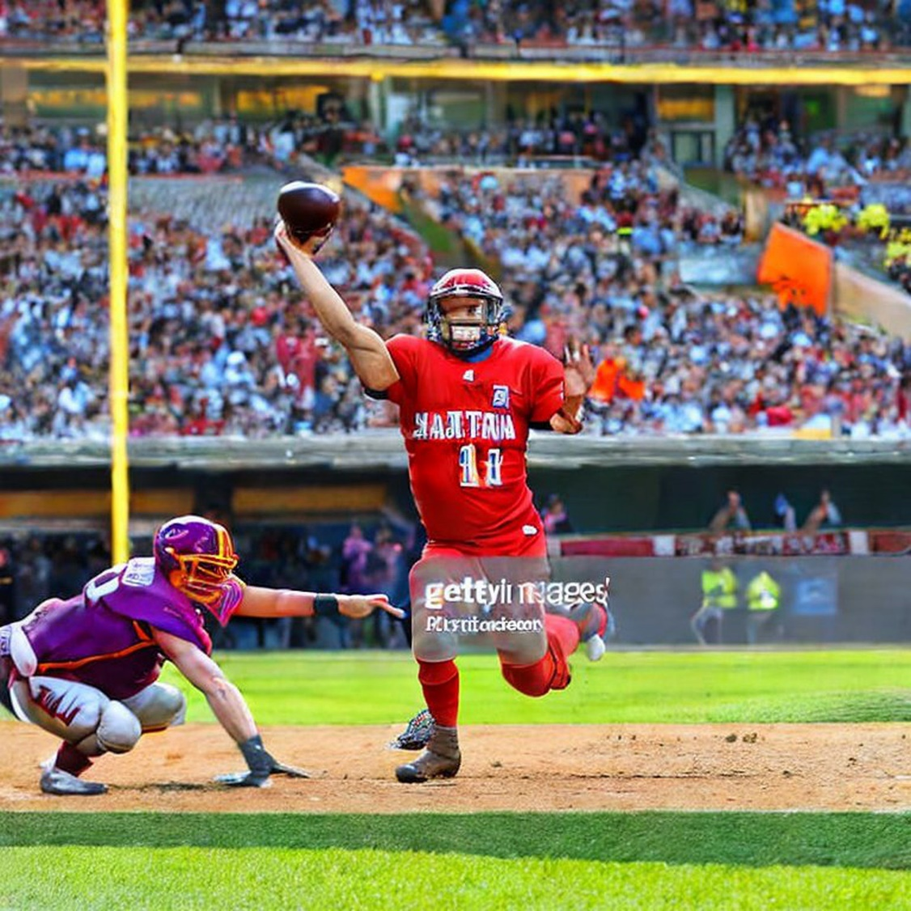
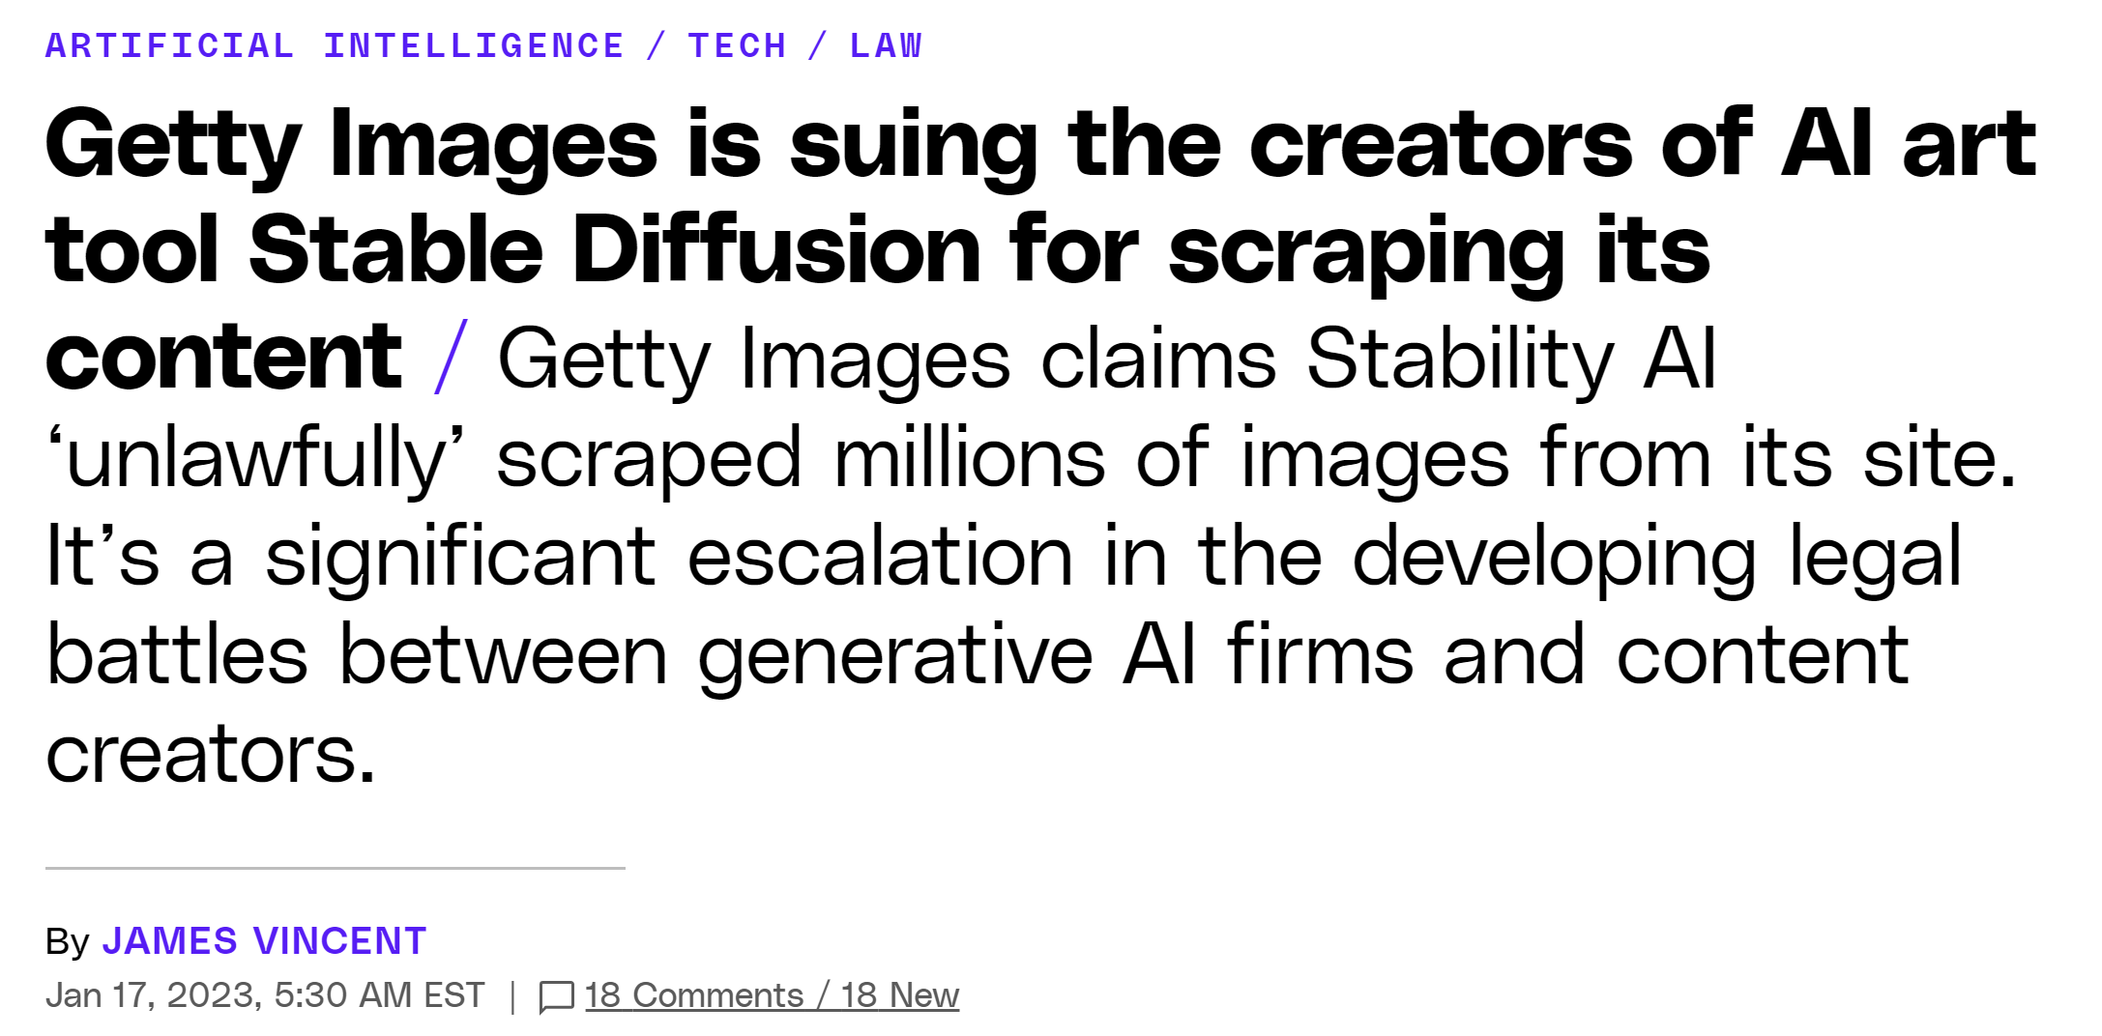
https://www.theverge.com/2023/1/17/23558516/ai-art-copyright-stable-diffusion-getty-images-lawsuit

Slide 40
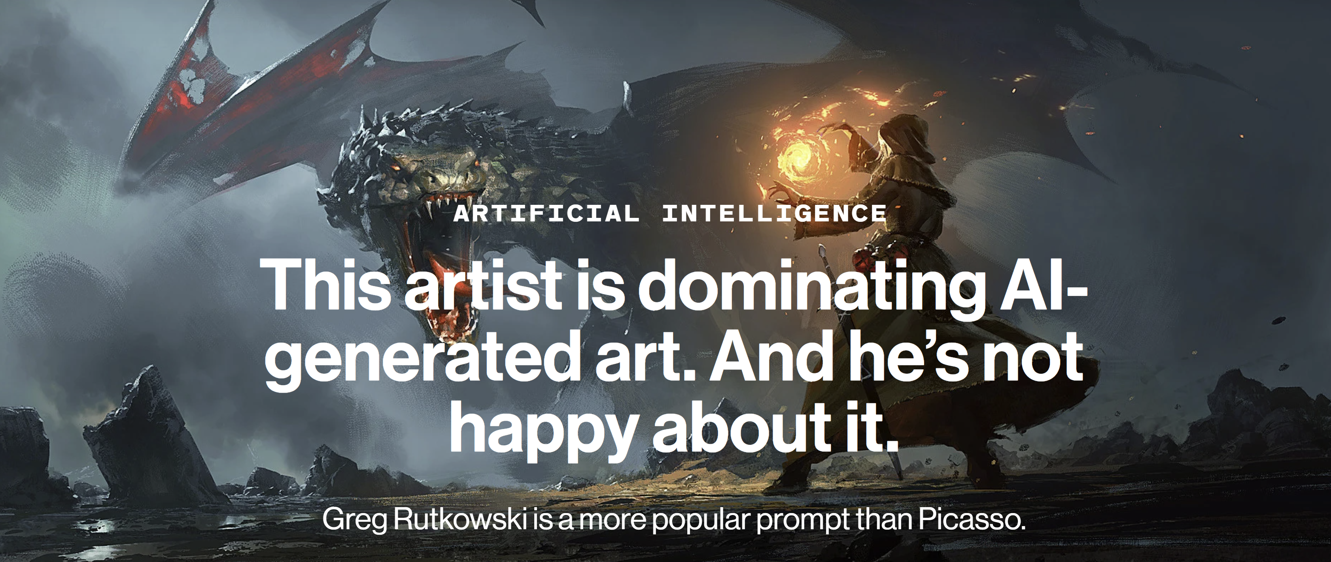
“Dragon Cave”
GREG RUTKOWSKI
Example Text-to-image prompt: “Wizard with sword and a glowing orb of magic fire fights a fierce dragon Greg Rutkowski,”
https://www.technologyreview.com/2022/09/16/1059598/this-artist-is-dominating-ai-generated-art-and-hes-not-happy-about-it/

Slide 41
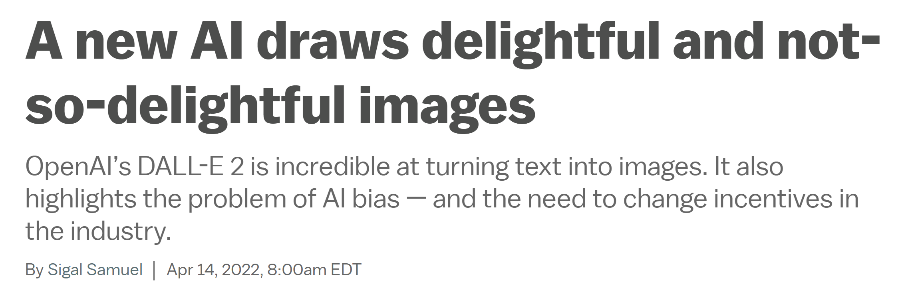
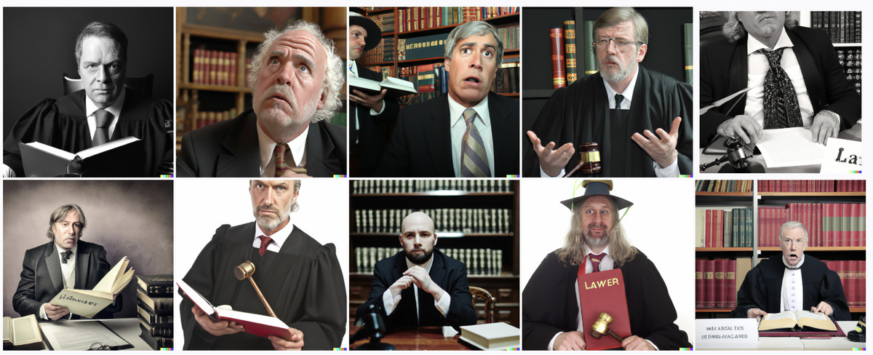
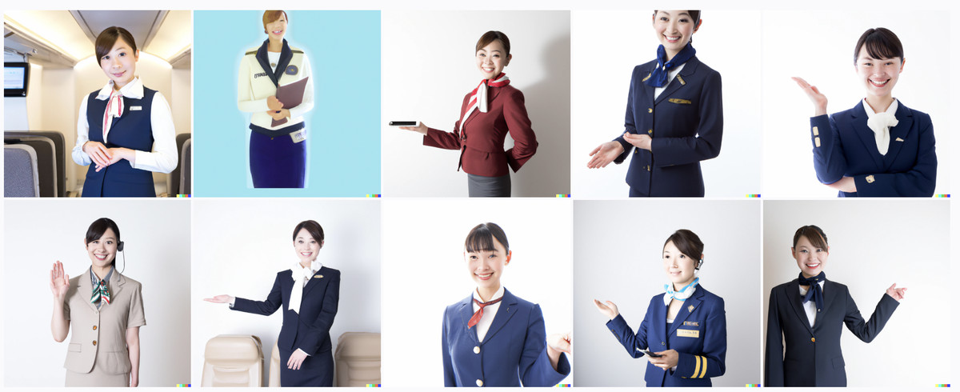
Generated images of lawyers
Generated images of flight attendants
https://www.vox.com/future-perfect/23023538/ai-dalle-2-openai-bias-gpt-3-incentives

Slide 42
Some tools
Policy and regulation
  e.g., a number of cities have banned the use of face recognition by law enforcement
Transparency
  e.g., studies on bias in face recognition have led to reforms by tech companies themselves
  e.g., datasheets can help downstream users of datasets
Awareness (when you conceive of or build a technology, be aware of the questions we’ve discussed)

Slide 43
Questions?

