Slide 1
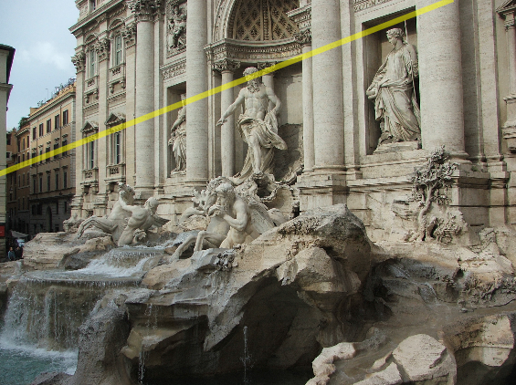
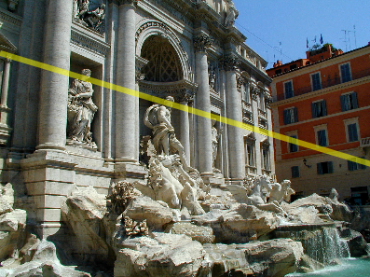
Two-view geometry
CS5670: Computer Vision

Slide 2
Reading
Reading: Szeliski (2nd Edition), Chapter 11.3 and 12.1

Slide 3
Fundamental matrix song
http://danielwedge.com/fmatrix/

Slide 4
Announcements
Project 4 (stereo) due this Friday, March 31, at 8pm
Project 3 artifact voting will close on Wednesday

Slide 5
Announcements
Project 4 (Stereo) released today, due 4/20 by 7pm
To be done in groups of 2
Two more topics on geometry, then on to recognition and deep learning
Please enter any midterm regrade requests by this Wednesday
Questions? sli.do, enter code #cs5670

Slide 6
Should I cover the quiz solutions right after the quiz?
ⓘ Start presenting to display the poll results on this slide.

Slide 7
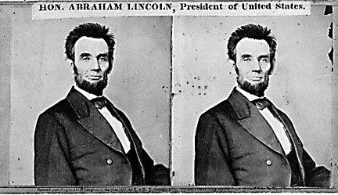
Back to stereo
Where do epipolar lines come from?

Slide 8
Two-view geometry
Where do epipolar lines come from?
3D point lies somewhere along r
epipolar line
epipolar line
(projection of r)
epipolar plane
0
Image 1
Image 2

Slide 9
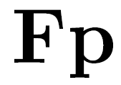
Fundamental matrix
epipolar line
epipolar line
(projection of ray)
epipolar plane
0
Image 1
Image 2
This epipolar geometry of two views is described by a Very Special 3x3 matrix , called the fundamental matrix
maps (homogeneous) points in image 1 to lines in image 2!
The epipolar line (in image 2) of point p is:
Epipolar constraint on corresponding points:

Slide 10
Fundamental matrix
epipolar line
epipolar line
(projection of ray)
epipolar plane
0
Two Special points: e₁ and e₂ (the epipoles): projection of one camera into the other

Slide 11
Fundamental matrix
0
Two Special points: e₁ and e₂ (the epipoles): projection of one camera into the other
All of the epipolar lines in an image pass through the epipole
Epipoles may or may not be inside the image

Slide 12
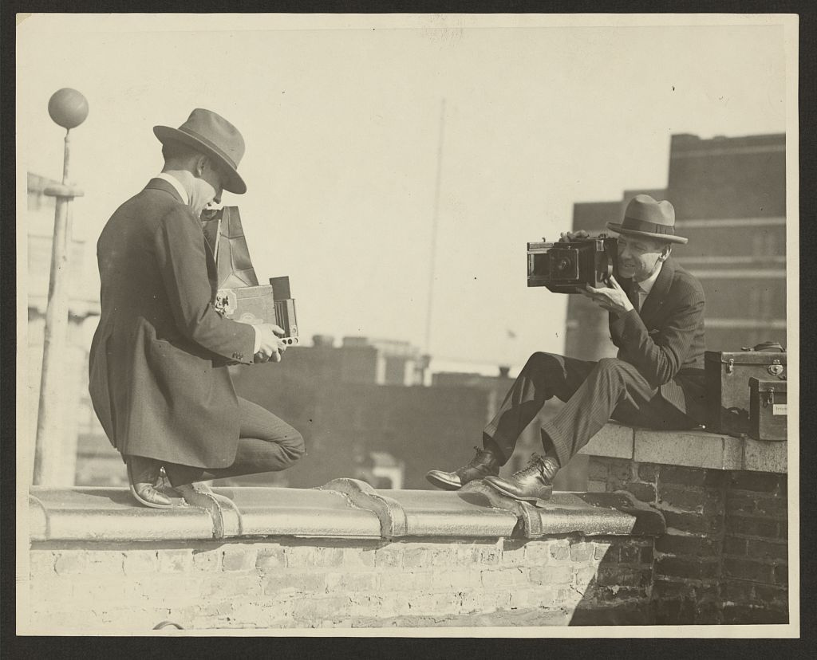
Epipoles

Slide 13
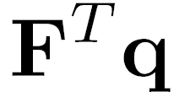
Properties of the Fundamental Matrix
is the epipolar line associated with
is the epipolar line associated with
and
is rank 2
How many parameters does have?
T

Slide 14
Example

Slide 15
Demo
https://www.cs.cornell.edu/courses/cs5670/2022sp/demos/FundamentalMatrix/?demo=demo1

Slide 16
Fundamental matrix
0
Why does F exist?
Let’s derive it…

Slide 17
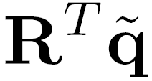
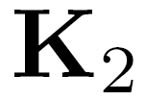
Fundamental matrix – calibrated case
0
: intrinsics of camera 1
: intrinsics of camera 2
: rotation of image 2 w.r.t. camera 1
: ray through p in camera 1’s (and world) coordinate system
: ray through q in camera 2’s coordinate system

Slide 18
Fundamental matrix – calibrated case
0
, , and are coplanar
epipolar plane can be represented as with its normal

Slide 19
Fundamental matrix – calibrated case
0

Slide 20
Fundamental matrix – calibrated case
0
One more substitution:
Cross product with t (on left) can be represented as a 3x3 matrix

Slide 21
Fundamental matrix – calibrated case
0

Slide 22
Fundamental matrix – calibrated case
0
: ray through p in camera 1’s (and world) coordinate system
: ray through q in camera 2’s coordinate system
{
the Essential matrix

Slide 23
Cross-product as linear operator
Useful fact: Cross product with a vector t can be represented as multiplication with a (skew-symmetric) 3x3 matrix

Slide 24
Fundamental matrix – uncalibrated case
0
: intrinsics of camera 1
: intrinsics of camera 2
: rotation of image 2 w.r.t. camera 1
the Fundamental matrix

Slide 25
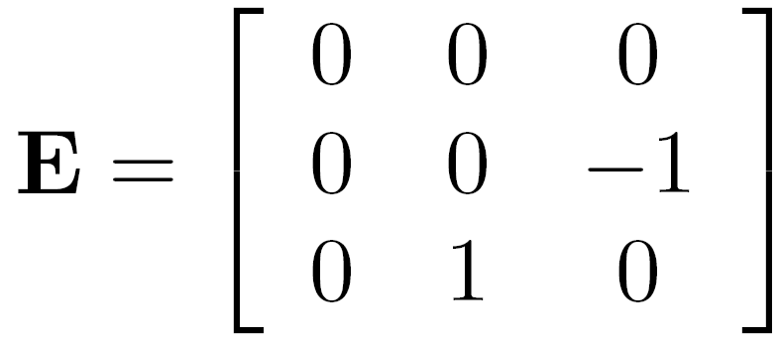
Rectified case

Slide 27
Working out the math

Slide 28
Stereo image rectification
reproject image planes onto a common plane
plane parallel to the line between optical centers
pixel motion is horizontal after this transformation
two homographies, one for each input image reprojection
C. Loop and Z. Zhang. Computing Rectifying Homographies for Stereo Vision. CVPR 1999.

Slide 29
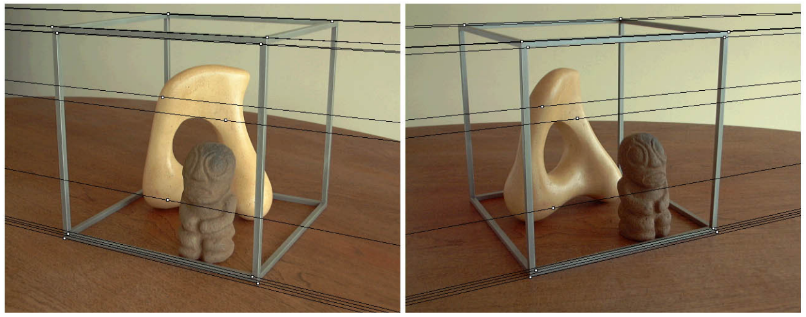
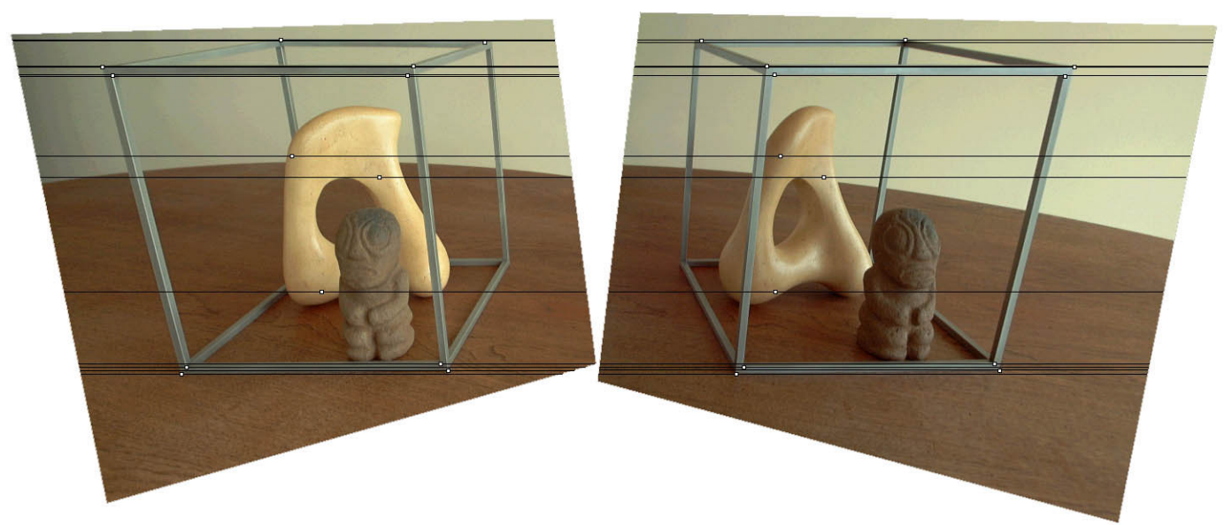
Original stereo pair
After rectification

Slide 30
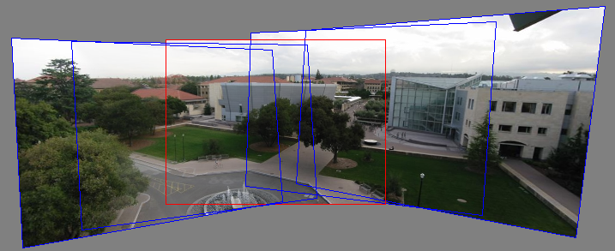
Relationship between F matrix and homography?
Images taken from the same center of projection? Use a homography!

Slide 31
Questions?

Slide 32
Estimating F
If we don’t know K₁, K₂, R, or t, can we estimate F for two images?
Yes, given enough correspondences

Slide 33
Estimating F – 8-point algorithm
The fundamental matrix F is defined by
$$x′^{Τ}Fx=0$$
for any pair of matches x and x’ in two images.
$$F=\left[\begin{matrix}f_{11} & f_{12} & f_{13} \\ f_{21} & f_{22} & f_{23} \\ f_{31} & f_{32} & f_{33}\end{matrix}\right]$$
Let x=(u,v,1)^{T} and x’=(u’,v’,1)^{T},
each match gives a linear equation
$$uu′f_{11}+vu′f_{12}+u′f_{13}+uv′f_{21}+vv′f_{22}+v′f_{23}+uf_{31}+vf_{32}+f_{33}=0$$

Slide 34
8-point algorithm
$$\left[\begin{matrix}u_{1}u_{1}´ & v_{1}u_{1}´ & u_{1}´ & u_{1}v_{1}´ & v_{1}v_{1}´ & v_{1}´ & u_{1} & v_{1} & 1 \\ u_{2}u_{2}´ & v_{2}u_{2}´ & u_{2}´ & u_{2}v_{2}´ & v_{2}v_{2}´ & v_{2}´ & u_{2} & v_{2} & 1 \\ ⋮ & ⋮ & ⋮ & ⋮ & ⋮ & ⋮ & ⋮ & ⋮ & ⋮ \\ u_{n}u_{n}´ & v_{n}u_{n}´ & u_{n}´ & u_{n}v_{n}´ & v_{n}v_{n}´ & v_{n}´ & u_{n} & v_{n} & 1\end{matrix}\right]\left[\begin{matrix}f_{11} \\ f_{12} \\ f_{13} \\ f_{21} \\ f_{22} \\ f_{23} \\ f_{31} \\ f_{32} \\ f_{33}\end{matrix}\right]=0$$
Like with homographies, instead of solving , we seek unit length f to minimize : least eigenvector of .
$$Af=0$$
$$\left\|Af\right\|$$
$$A^{Τ}A$$

Slide 35
8-point algorithm – Problem?
F should have rank 2
To enforce that F is of rank 2, F is replaced by F’ that minimizes subject to the rank constraint.
$$\left\|F−F′\right\|$$
$$F=UΣV^{Τ}$$
This is achieved by SVD. Let , where
, let
then is the solution (closest rank-2 matrix to F)
$$Σ=\left[\begin{matrix}σ_{1} & 0 & 0 \\ 0 & σ_{2} & 0 \\ 0 & 0 & σ_{3}\end{matrix}\right]$$
$$\text{Σ}\text{′}=\left[\begin{matrix}σ_{1} & 0 & 0 \\ 0 & σ_{2} & 0 \\ 0 & 0 & 0\end{matrix}\right]$$
$$F′=U\text{Σ}\text{′}V^{Τ}$$

Slide 36
8-point algorithm
% Build the constraint matrix
A = [x2(1,:)'.*x1(1,:)' x2(1,:)'.*x1(2,:)' x2(1,:)' ...
x2(2,:)'.*x1(1,:)' x2(2,:)'.*x1(2,:)' x2(2,:)' ...
x1(1,:)' x1(2,:)' ones(npts,1) ];
[U,D,V] = svd(A);
% Extract fundamental matrix from the column of V
% corresponding to the smallest singular value.
F = reshape(V(:,9),3,3)';
% Enforce rank2 constraint
[U,D,V] = svd(F);
F = U*diag([D(1,1) D(2,2) 0])*V';

Slide 37
8-point algorithm
Pros: linear, easy to implement and fast
Cons: susceptible to noise

Slide 38
Problem with 8-point algorithm
$$\left[\begin{matrix}u_{1}u_{1}´ & v_{1}u_{1}´ & u_{1}´ & u_{1}v_{1}´ & v_{1}v_{1}´ & v_{1}´ & u_{1} & v_{1} & 1 \\ u_{2}u_{2}´ & v_{2}u_{2}´ & u_{2}´ & u_{2}v_{2}´ & v_{2}v_{2}´ & v_{2}´ & u_{2} & v_{2} & 1 \\ ⋮ & ⋮ & ⋮ & ⋮ & ⋮ & ⋮ & ⋮ & ⋮ & ⋮ \\ u_{n}u_{n}´ & v_{n}u_{n}´ & u_{n}´ & u_{n}v_{n}´ & v_{n}v_{n}´ & v_{n}´ & u_{n} & v_{n} & 1\end{matrix}\right]\left[\begin{matrix}f_{11} \\ f_{12} \\ f_{13} \\ f_{21} \\ f_{22} \\ f_{23} \\ f_{31} \\ f_{32} \\ f_{33}\end{matrix}\right]=0$$
~10000
~10000
~100
~10000
~10000
~100
~100
~100
1
Orders of magnitude difference
between column of data matrix
→ least-squares yields poor results

Slide 39
Normalized 8-point algorithm
normalized least squares yields good results
Transform image to ~[-1,1]x[-1,1]
(0,500)
(700,500)
(-1,1)
(1,1)
$$\left[\begin{matrix}\frac{2}{700} & 0 & −1 \\ & \frac{2}{500} & −1 \\ & & 1\end{matrix}\right]$$
(0,0)
(0,0)
(700,0)
(-1,-1)
(1,-1)

Slide 40
Normalized 8-point algorithm
Transform input by ,
Call 8-point on to obtain
$${\hat{x}}_{i}=Tx_{i}$$
$${\hat{x}}_{i}^{′}=Tx_{i}^{′}$$
$${\hat{x}}_{i},{\hat{x}}_{i}^{′}$$
$$\hat{F}$$
$$F=T′^{Τ}\hat{F}T$$
$$x′^{Τ}Fx=0$$
$$\hat{x}′^{Τ}T′^{−Τ}FT^{−1}\hat{x}=0$$
$$\hat{F}$$

Slide 41
Normalized 8-point algorithm
[x1, T1] = normalise2dpts(x1);
[x2, T2] = normalise2dpts(x2);
A = [x2(1,:)'.*x1(1,:)' x2(1,:)'.*x1(2,:)' x2(1,:)' ...
x2(2,:)'.*x1(1,:)' x2(2,:)'.*x1(2,:)' x2(2,:)' ...
x1(1,:)' x1(2,:)' ones(npts,1) ];
[U,D,V] = svd(A);
F = reshape(V(:,9),3,3)';
[U,D,V] = svd(F);
F = U*diag([D(1,1) D(2,2) 0])*V';
% Denormalise
F = T2'*F*T1;

Slide 42
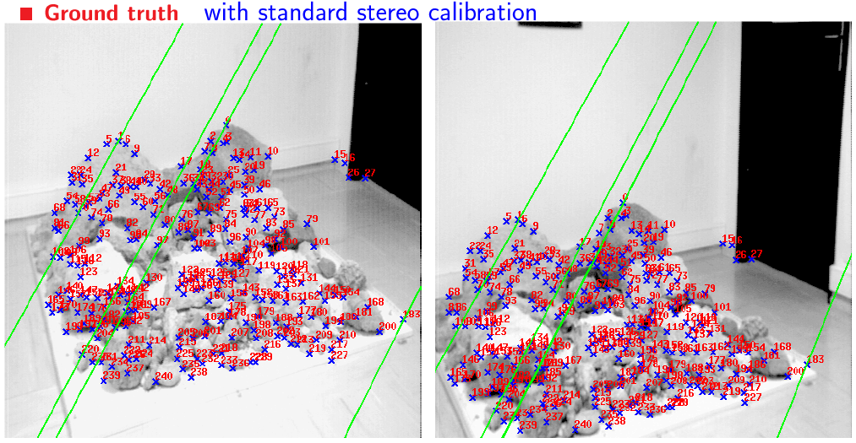
Results (ground truth)

Slide 43
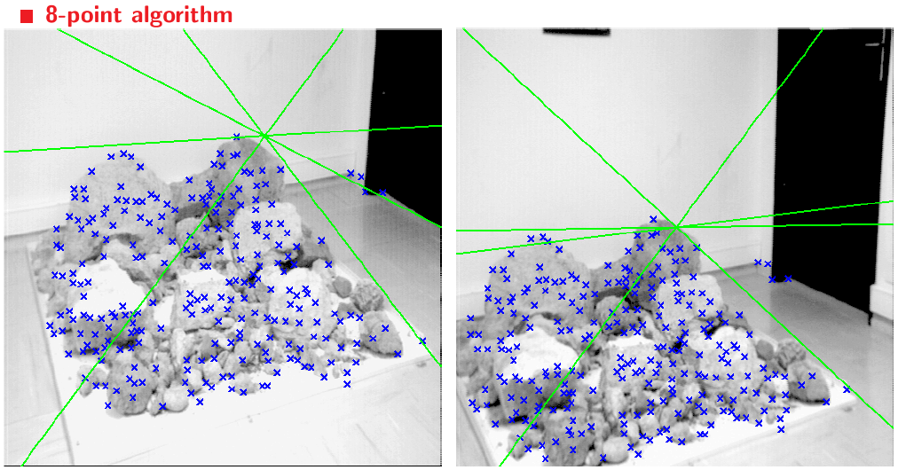
Results (ground truth)

Slide 44
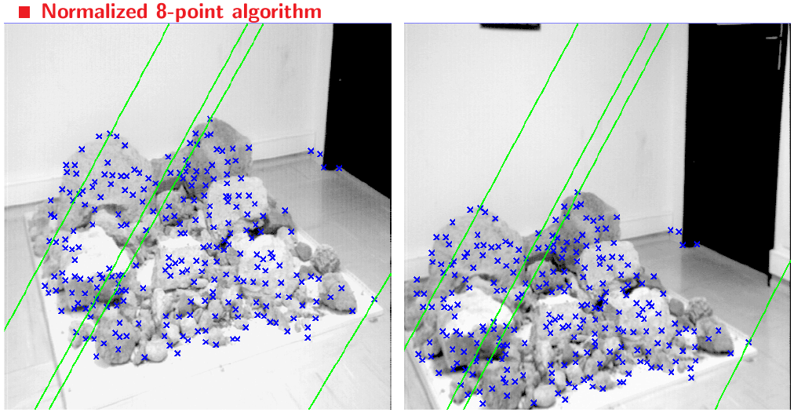
Results (normalized 8-point algorithm)

Slide 45
What about more than two views?
The geometry of three views is described by a 3 x 3 x 3 tensor called the trifocal tensor
The geometry of four views is described by a 3 x 3 x 3 x 3 tensor called the quadrifocal tensor
After this it starts to get complicated…

Slide 46
Next time: Large-scale structure from motion
Dubrovnik, Croatia. 4,619 images (out of an initial 57,845).
Total reconstruction time: 23 hours
Number of cores: 352

Slide 47
Questions?

