Slide 1
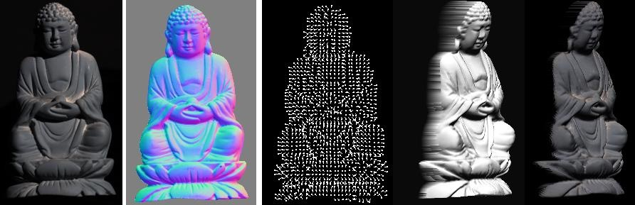
Reflectance & Photometric stereo
CS5670 : Computer Vision

Slide 2
Reading
Szeliski 2nd Edition: Chapter 2.2 & 13.1

Slide 3
Announcements
Project 3 (Panorama) artifact due tonight at 8pm
Project 4 (Stereo) released today due Friday, March 31, at 8pm
  To be done in groups of 2

Slide 4
Roadmap for the rest of the course
The next three lectures will finish up geometry and image formation
  Next up (after Spring Break): deep learning, image recognition, neural radiance fields, image synthesis
Coming up
  Reflectance and Photometric Stereo (today)
  Two-view geometry
  Multi-view geometry

Slide 5
Project 4 Demo

Slide 6
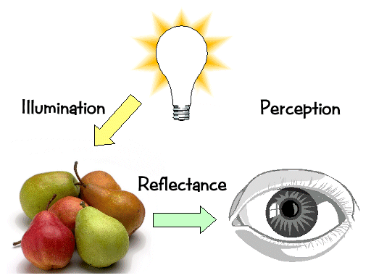
Last time: Light & Perception
Now: Reflectance

Slide 7
Light sources
Basic types
  point source
  directional source
    a point source that is infinitely far away
  area source
    a union of point sources
More generally
  a light field can describe *any* distribution of light sources
What happens when light hits an object?

Slide 8
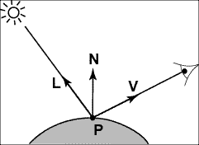
Modeling Image Formation
We need to reason about:
  How light interacts with the scene
  How a pixel value is related to light energy in the world
Track a “ray” of light all the way from light source to the sensor

Slide 9
Directional Lighting
Key property: all rays are parallel
Equivalent to an infinitely distant point source

Slide 10
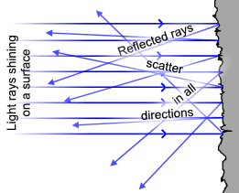


Lambertian Reflectance
Image intensity
Surface normal
Light direction
Image intensity
cos(angle between N and L)

Slide 11
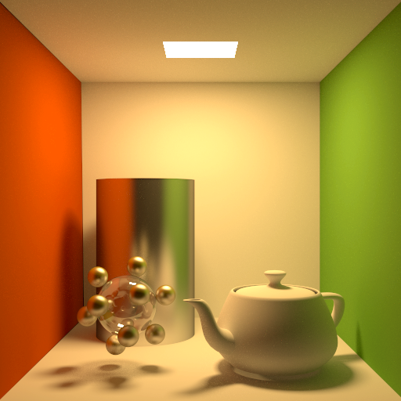
Materials - Three Forms
Ideal diffuse (Lambertian)
Ideal
specular
Directional
diffuse
© Kavita Bala, Computer Science, Cornell University
Notes:
There are several types of surfaces that are assumed to make up the world.
Ideal diffuse. It is similar to the diffuse emitter in that it emits all incident light equally in all outgoing directions. When light hits the surface it is reflected uniformly anywhere in the hemisphere above the surface.
Ideal specular (perfect mirrors). Light is reflected exactly in the mirror direction of the incoming light. A perfect mirror is such a surface.
Directional diffuse (almost all materials in the world). Incoming light is reflected into the hemisphere to different extents. If the object is more glossy then more of the incoming energy reflects close to the mirror direction. If it is more diffuse then the reflection is more uniform.

Slide 12
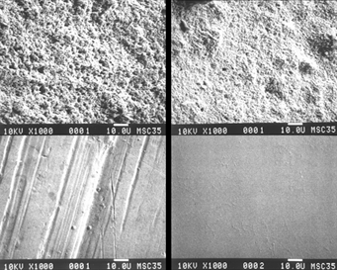
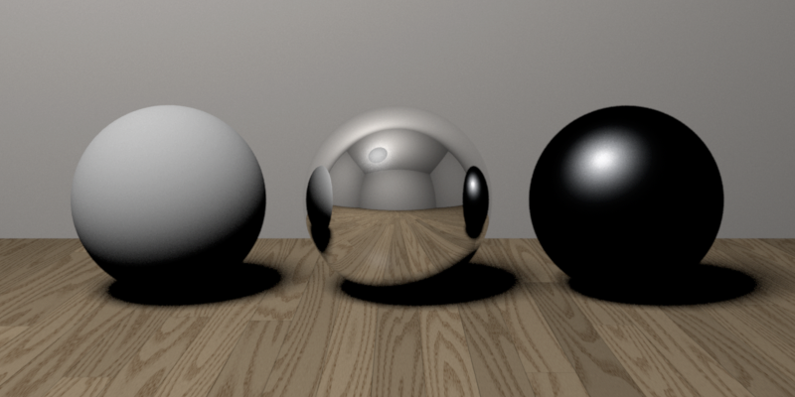
Reflectance—Three Forms
Ideal diffuse (Lambertian)
Ideal
specular
Directional
diffuse
© Kavita Bala, Computer Science, Cornell University
Notes:
Why spheres?!

Slide 13
Ideal Diffuse Reflection
Characteristic of multiple scattering materials
An idealization but reasonable for matte surfaces
© Kavita Bala, Computer Science, Cornell University

Slide 14
Lambertian Reflectance
Reflected energy is proportional to cosine of angle between L and N (incoming)
Measured intensity is viewpoint-independent (outgoing)

Slide 15
Lambertian Reflectance: Incoming
Reflected energy is proportional to cosine of angle between L and N

Slide 16
Lambertian Reflectance: Incoming
Reflected energy is proportional to cosine of angle between L and N

Slide 17
Lambertian Reflectance: Incoming
Reflected energy is proportional to cosine of angle between L and N
Light hitting surface is proportional to the cosine

Slide 18
Lambertian appearance is view-independent
Number of photons reflected to a given angle θ is proportional to cos(θ)
Lambert's cosine law:
Notes:
Emission rate of photons: B0 cos theta
Radiance: (Photons/second)/(area steradian)
Looking down get B0/dA
Looking at angle get B0 cos theta/(dA cos theta)
Pixel=\mathbf{B}_{0}\mathbf{A}_{0}\frac{\cos{\theta}}{\cos{\theta}}

Slide 19
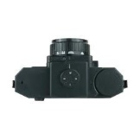
Lambertian appearance is view-independent
But appearance is the same from every angle due to larger pixel footprint at larger angles
Number of photons reflected to a given angle θ is proportional to cos(θ)
Lambert's cosine law:
Notes:
Emission rate of photons: B0 cos theta
Radiance: (Photons/second)/(area steradian)
Looking down get B0/dA
Looking at angle get B0 cos theta/(dA cos theta)
Pixel=\mathbf{B}_{0}\mathbf{A}_{0}\frac{\cos{\theta}}{\cos{\theta}}

Slide 20
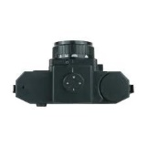
Lambertian appearance is view-independent
But appearance is the same from every angle due to larger pixel footprint at larger angles
Number of photons reflected to a given angle θ is proportional to cos(θ)
Lambert's cosine law:
Notes:
Emission rate of photons: B0 cos theta
Radiance: (Photons/second)/(area steradian)
Looking down get B0/dA
Looking at angle get B0 cos theta/(dA cos theta)
Pixel=\mathbf{B}_{0}\mathbf{A}_{0}\frac{\cos{\theta}}{\cos{\theta}}

Slide 21
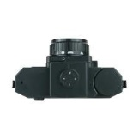
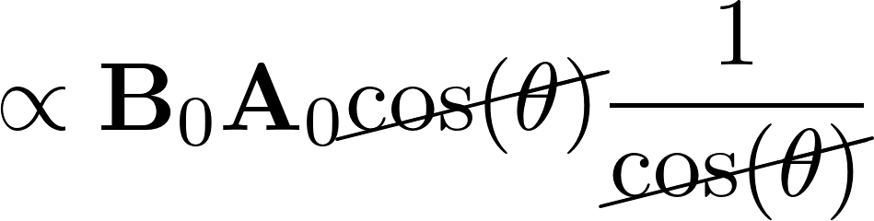
Lambertian appearance is view-independent
But appearance is the same from every angle due to larger pixel footprint at larger angles
Number of photons reflected to a given angle θ is proportional to cos(θ)
Lambert's cosine law:
Radiance
(what eye sees)
Notes:
Emission rate of photons: B0 cos theta
Radiance: (Photons/second)/(area steradian)
Looking down get B0/dA
Looking at angle get B0 cos theta/(dA cos theta)
\begin{align*}
\propto \mathbf{B}_0 \mathbf{A}_0
\cancel{\cos(\theta)} \frac{1}{\cancel{\cos(\theta)}}
\end{align*}
Pixel=\mathbf{B}_{0}\mathbf{A}_{0}\frac{\cos{\theta}}{\cos{\theta}}

Slide 22
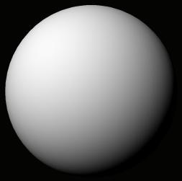
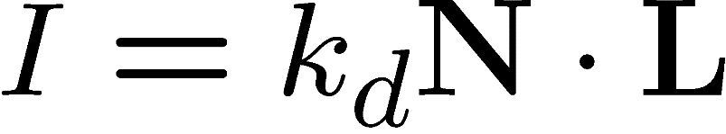

Final Lambertian image formation model
Diffuse albedo: what fraction of incoming light is reflected?
  Introduce scale factor
Light intensity: how much light is arriving?
  Compensate with camera exposure (global scale factor)
Camera response function
  Assume pixel value is linearly proportional to incoming energy (perform radiometric calibration if not)

Slide 23
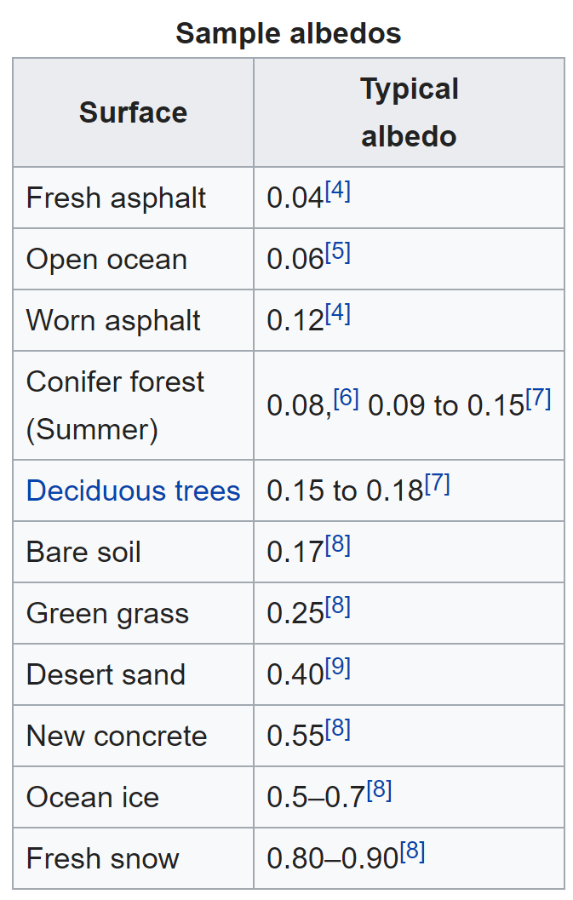
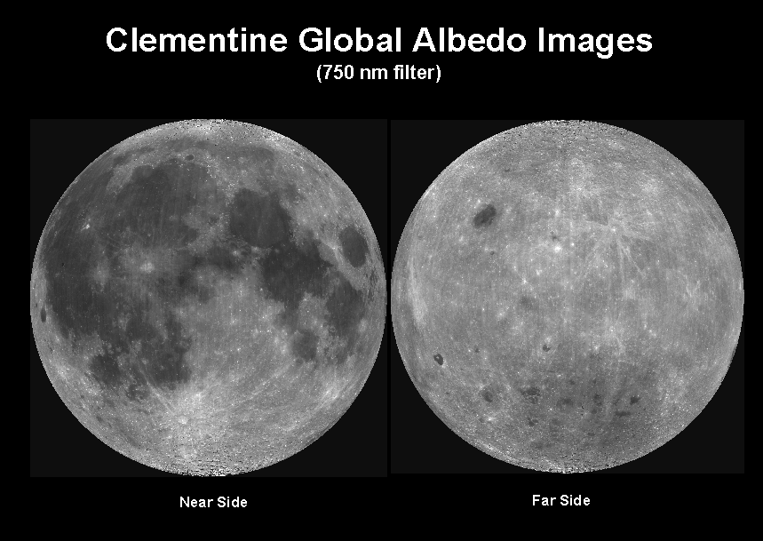
Albedo
Objects can have varying albedo and albedo varies with wavelength
Source: https://en.wikipedia.org/wiki/Albedo

Slide 24
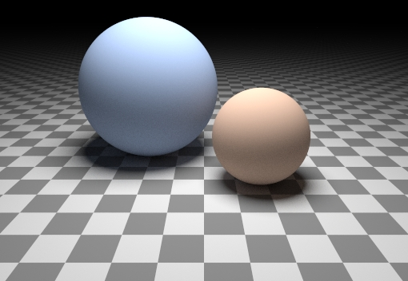
Can we determine shape from lighting?
Are these spheres?
  Or just flat discs painted with varying albedo?

Slide 25

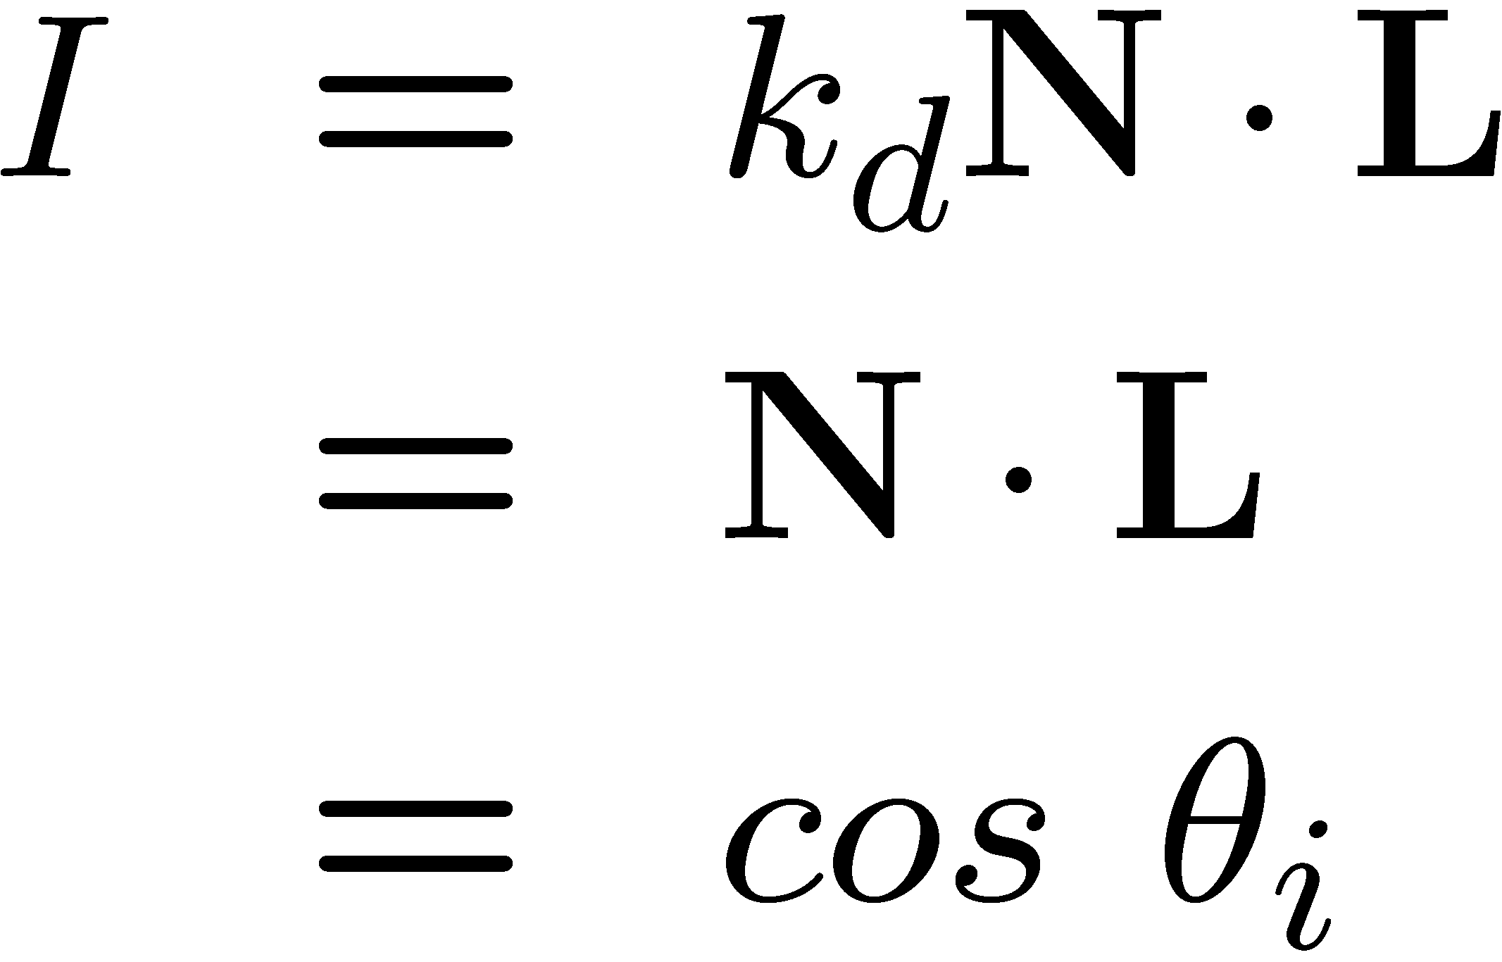

A Single Image: Shape from shading
Suppose (for now)
You can directly measure angle between normal and light source
  Not quite enough information to compute surface shape
  But can be if you add some additional info, for example
    assume a few of the normals are known (e.g., along silhouette)
    constraints on neighboring normals—“integrability”
    smoothness
  Hard to get it to work well in practice
    plus, how many real objects have constant albedo?
    But, deep learning can help

Slide 26
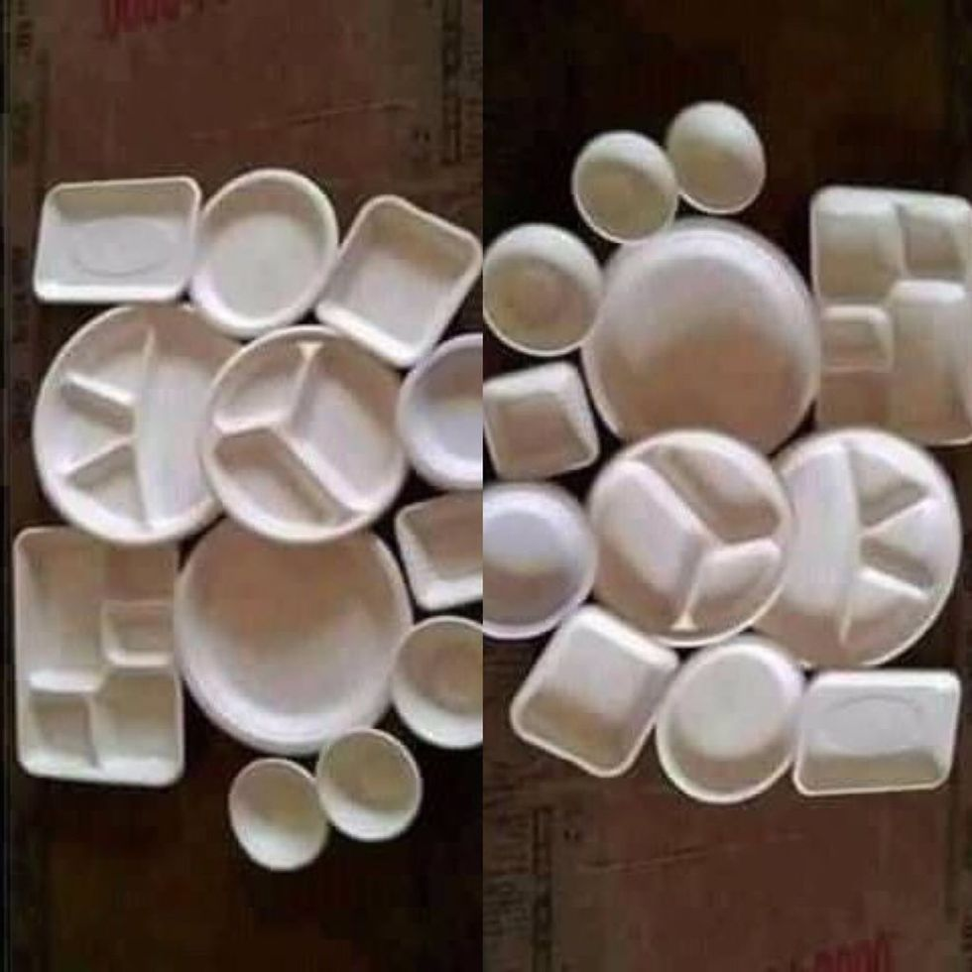
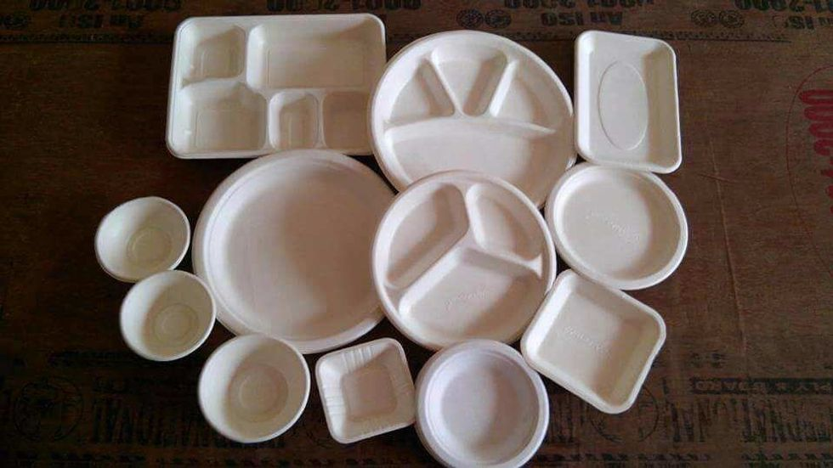
https://www.good.is/optical-illusion-plates-and-bowls-upside-down-or-not

Slide 27
Let’s take more than one photo!

Slide 28






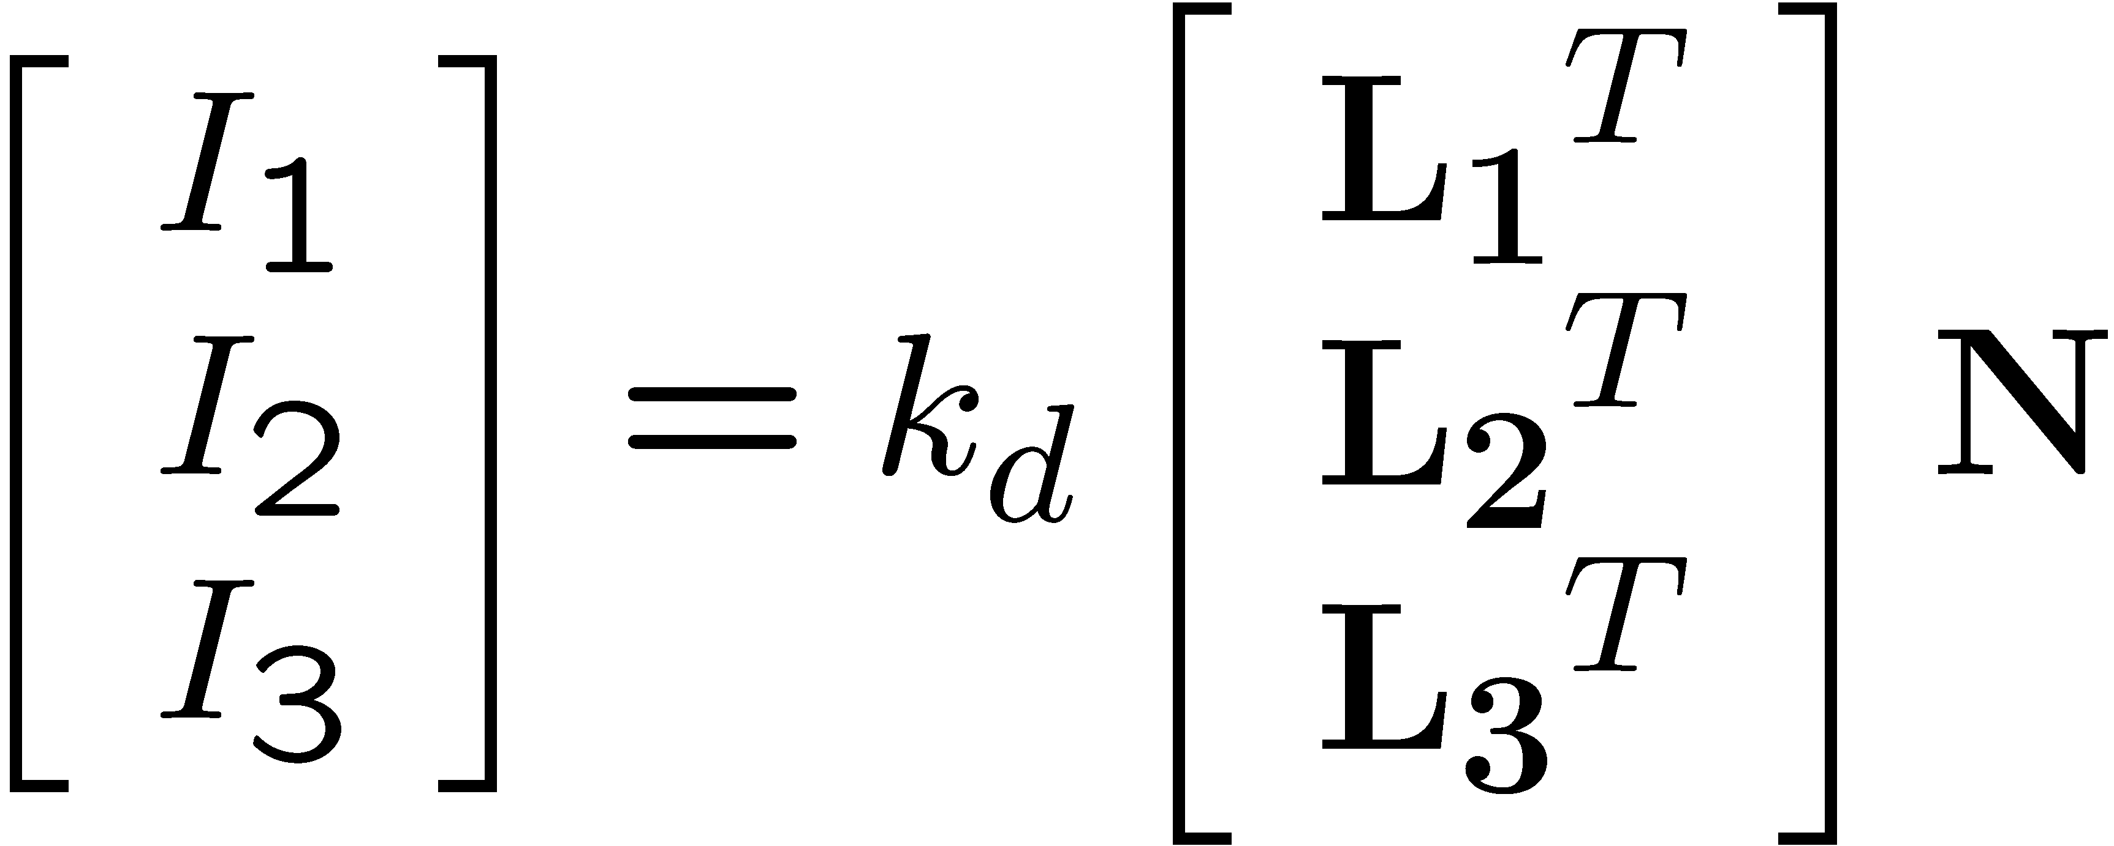
Photometric stereo
N
L₃
L₂
L₁
V
Can write this as a matrix equation:

Slide 29
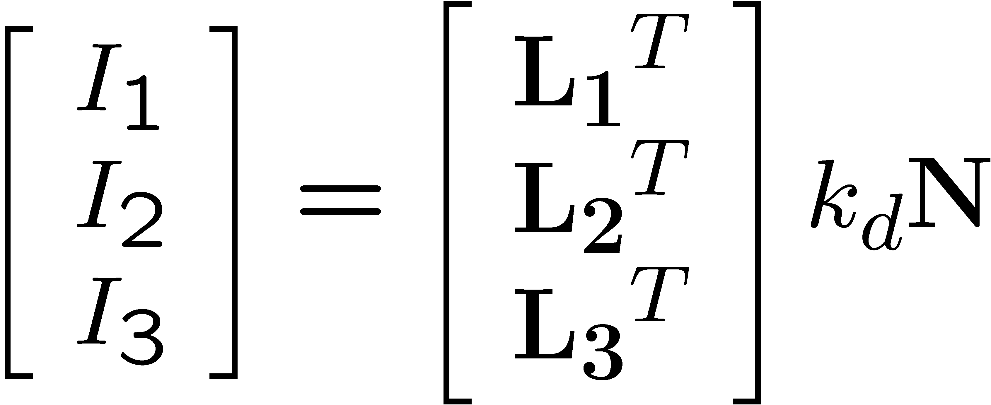


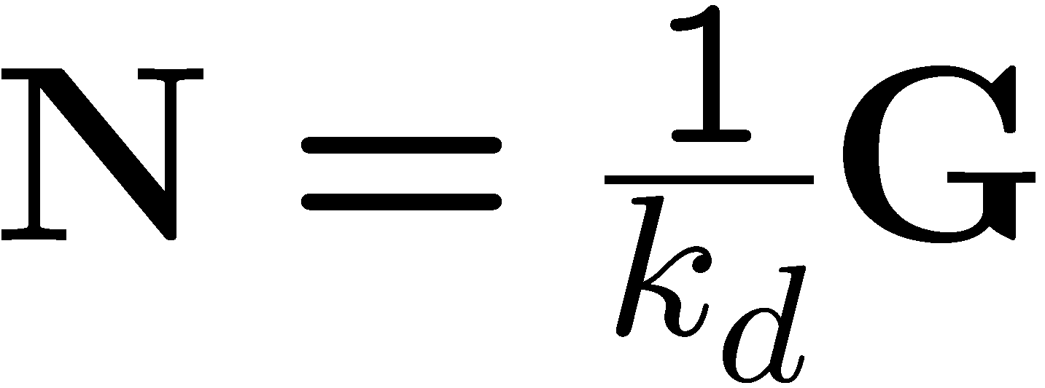





Solving the equations
Solve one such linear system per pixel to solve for that pixel’s surface normal

Slide 30
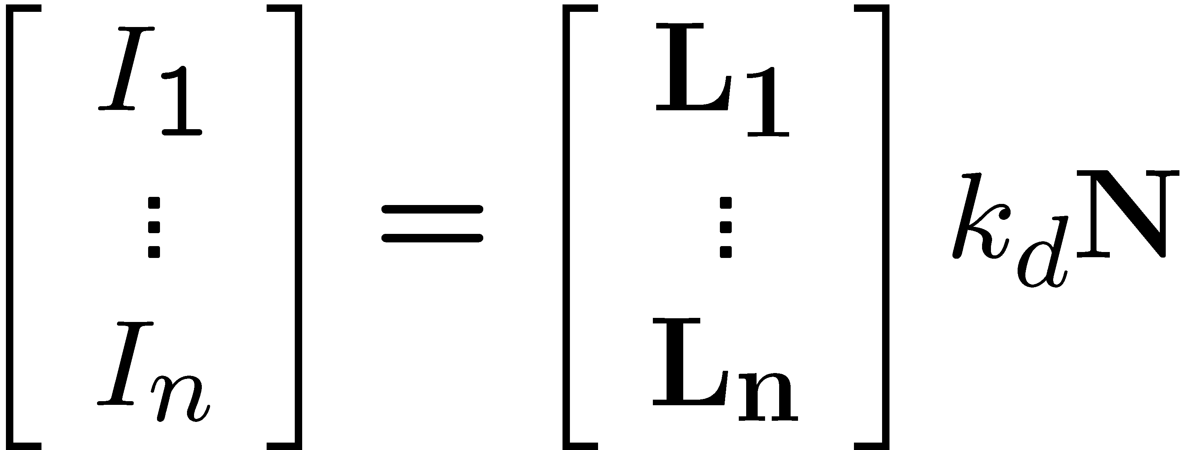
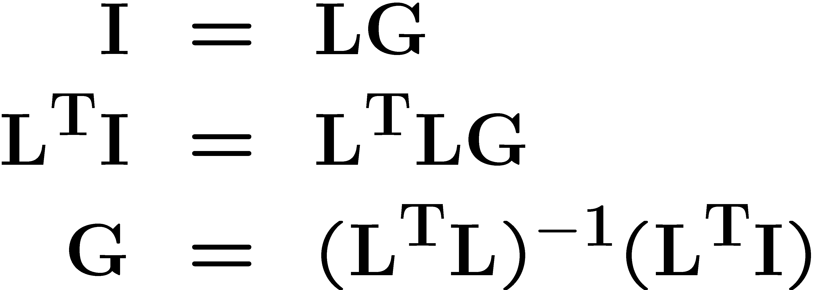
More than three lights
Can get better results by using more than 3 lights
Least squares solution:
Solve for N, k_{d} as before
What’s the size of L^{T}L?

Slide 31
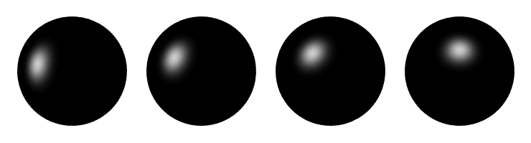
Computing light source directions
Trick: place a chrome sphere in the scene
  the location of the highlight tells you where the light source is

Slide 32
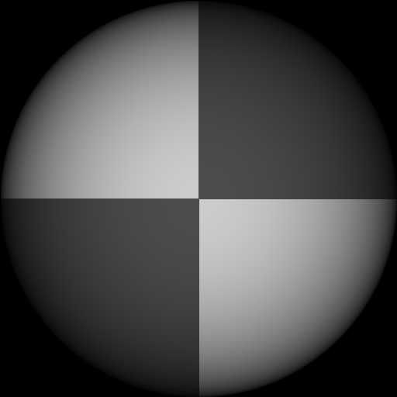
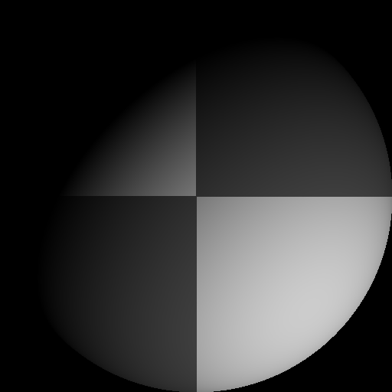
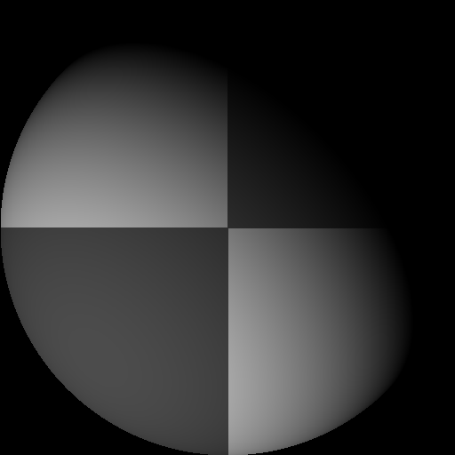
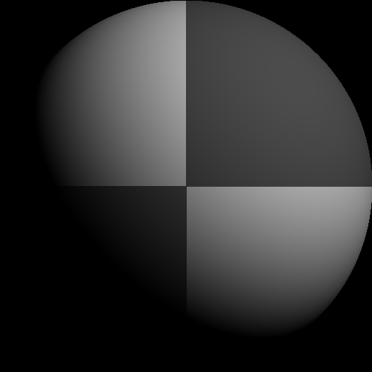
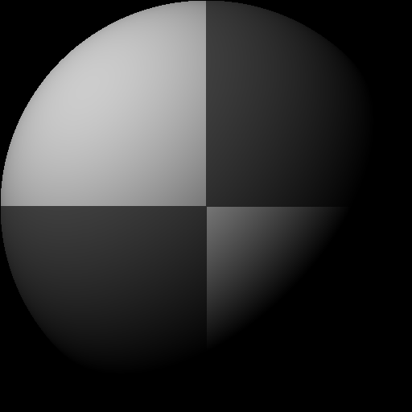
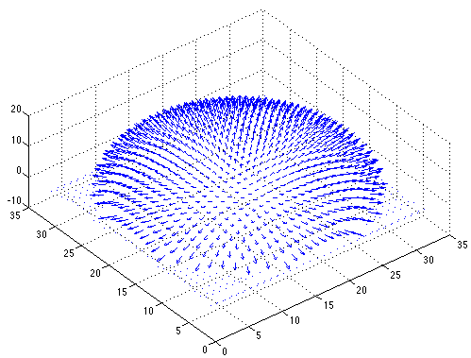

Example
Input views
Recovered albedo
Recovered normal field
Forsyth & Ponce, Sec. 5.4

Slide 33

Depth from normals
Solving the linear system per-pixel gives us an estimated surface normal for each pixel
How can we compute depth from normals?
  Normals are like the “derivative” of the true depth
Input photo
Estimated normals
Estimated normals (needle diagram)

Slide 34
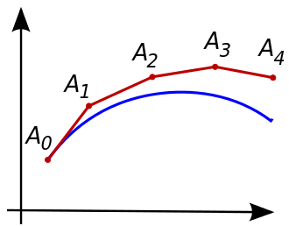
Normal Integration
Integrating a set of derivatives is easy in 1D
  (similar to Euler’s method from diff. eq. class)
Could integrate normals in each column / row separately
  Wouldn’t give a good surface
Instead, we formulate as a linear system and solve for depths that best agree with the surface normals

Slide 35

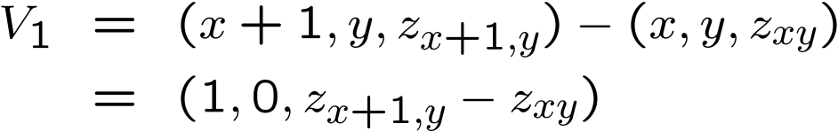


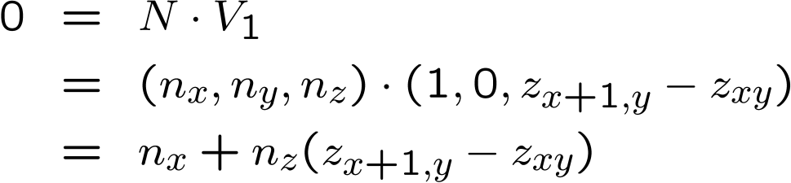

Depth from normals
V₂
V₁
N
Get a similar equation for V₂
  Each normal gives us two linear constraints on z
  compute z values by solving a matrix equation

Slide 36
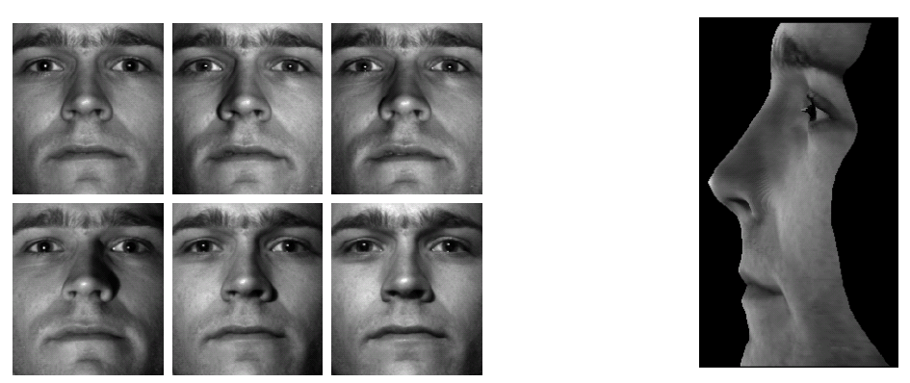
Results
from Athos Georghiades

Slide 37
Results

Slide 38
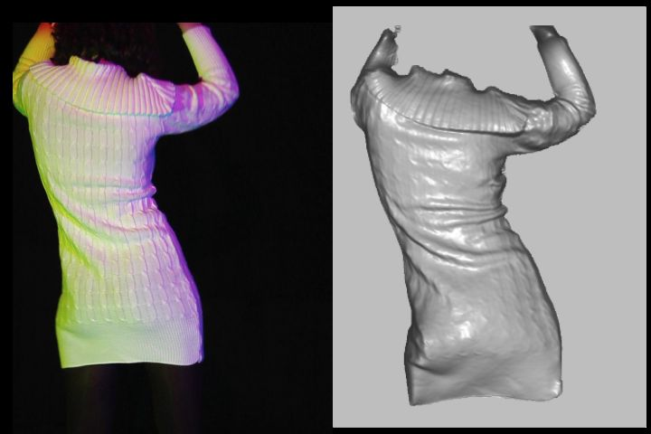
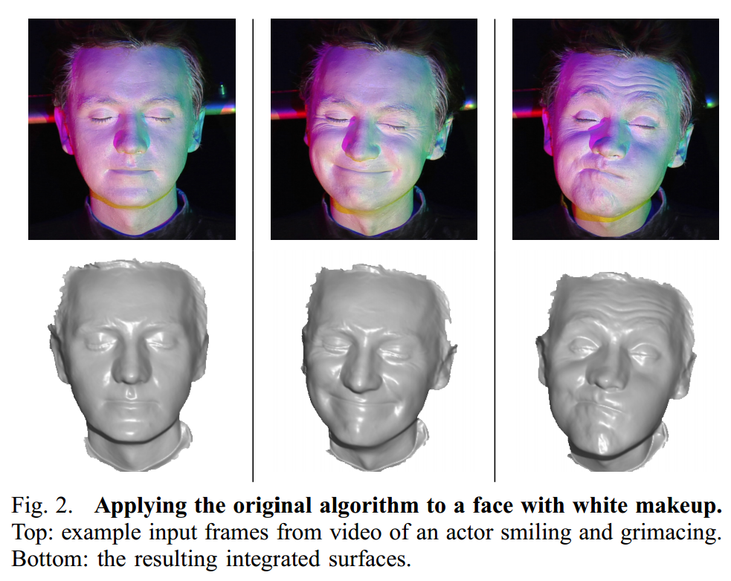
Extension
Photometric Stereo from Colored Lighting
Video Normals from Colored Lights
Gabriel J. Brostow, Carlos Hernández, George Vogiatzis, Björn Stenger, Roberto Cipolla
IEEE TPAMI, Vol. 33, No. 10, pages 2104-2114, October 2011.

Slide 39
Questions?

Slide 40
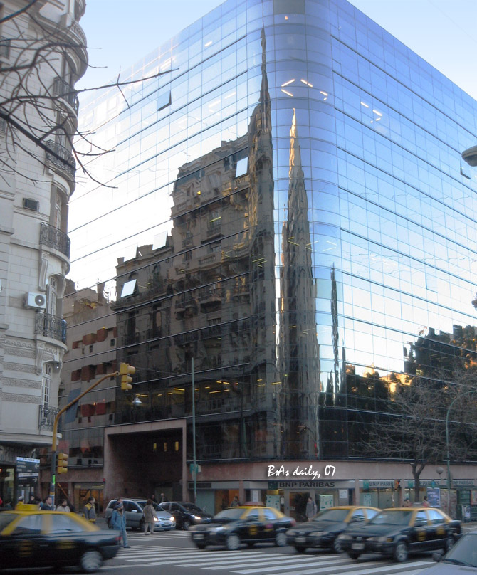
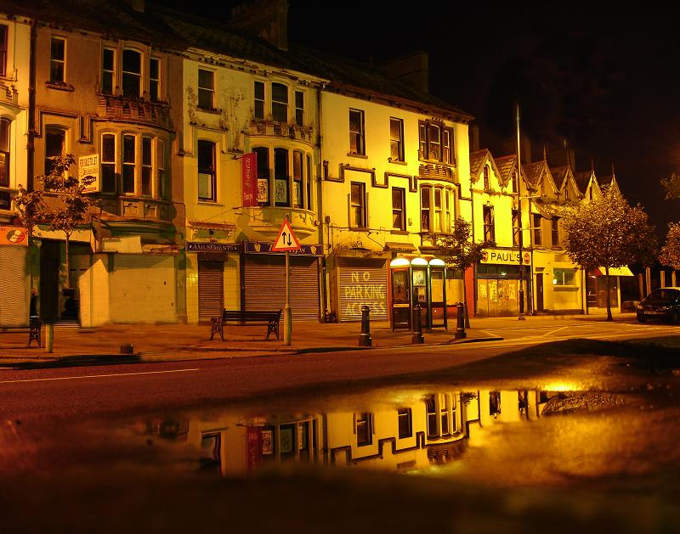
For now, ignore specular reflection
Slides from Photometric Methods for 3D Modeling, Matsushita, Wilburn, Ben-Ezra
Notes:
reflection

Slide 41
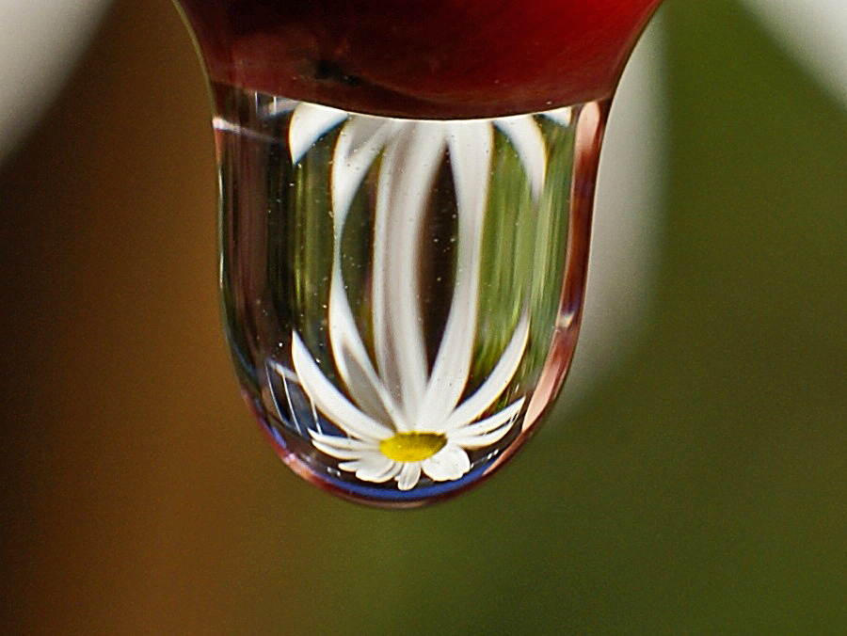
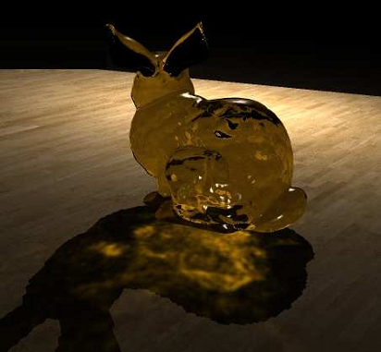
And Refraction…
Slides from Photometric Methods for 3D Modeling, Matsushita, Wilburn, Ben-Ezra

Slide 42
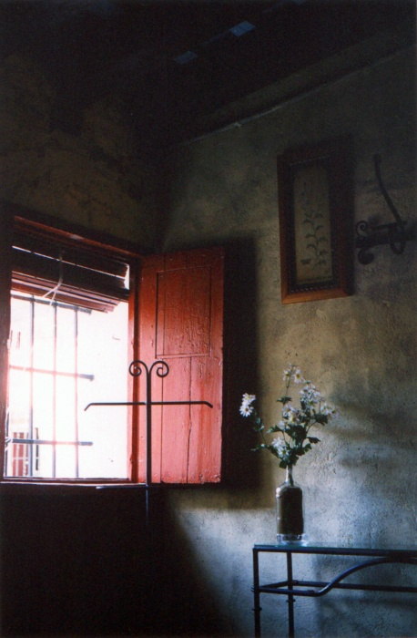
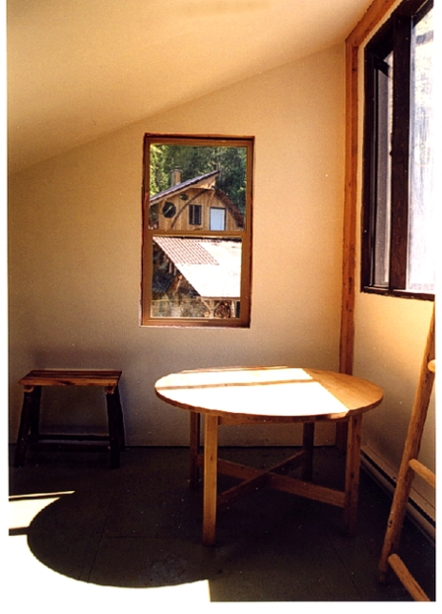
And Interreflections…
Slides from Photometric Methods for 3D Modeling, Matsushita, Wilburn, Ben-Ezra

Slide 43
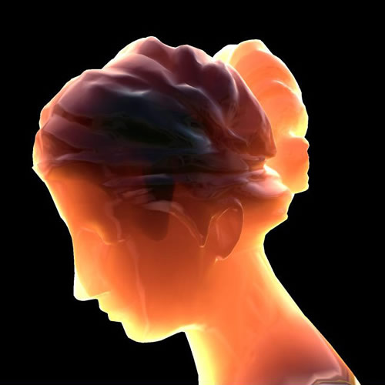
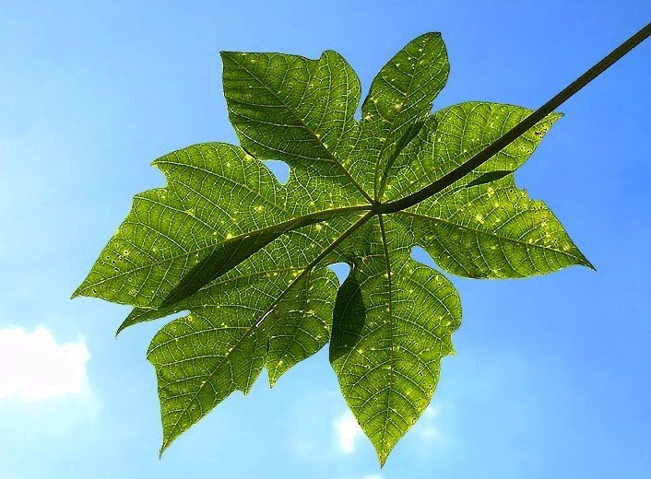
And Subsurface Scattering…
Slides from Photometric Methods for 3D Modeling, Matsushita, Wilburn, Ben-Ezra

Slide 44
Limitations
Bigger problems
  doesn’t work for shiny things, semi-translucent things
  shadows, inter-reflections
Smaller problems
  camera and lights have to be distant
  calibration requirements
    measure light source directions, intensities
    camera response function
Newer work addresses some of these issues
Some pointers for further reading:
  Zickler, Belhumeur, and Kriegman, "Helmholtz Stereopsis: Exploiting Reciprocity for Surface Reconstruction." IJCV, Vol. 49 No. 2/3, pp 215-227.
  Hertzmann & Seitz, “Example-Based Photometric Stereo: Shape Reconstruction with General, Varying BRDFs.” IEEE Trans. PAMI 2005

Slide 45
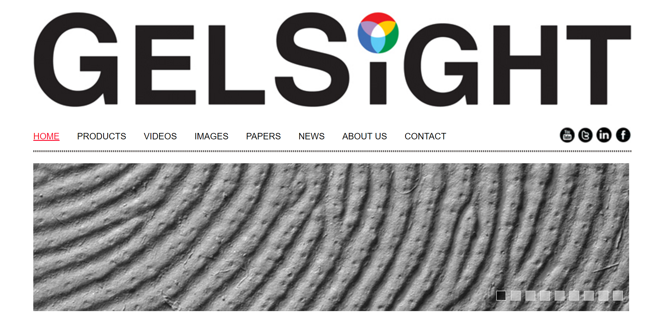
Johnson and Adelson, 2009

Slide 46
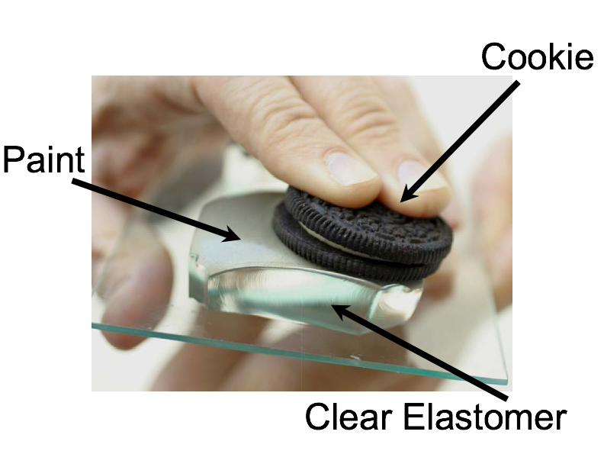
Johnson and Adelson, 2009

Slide 47
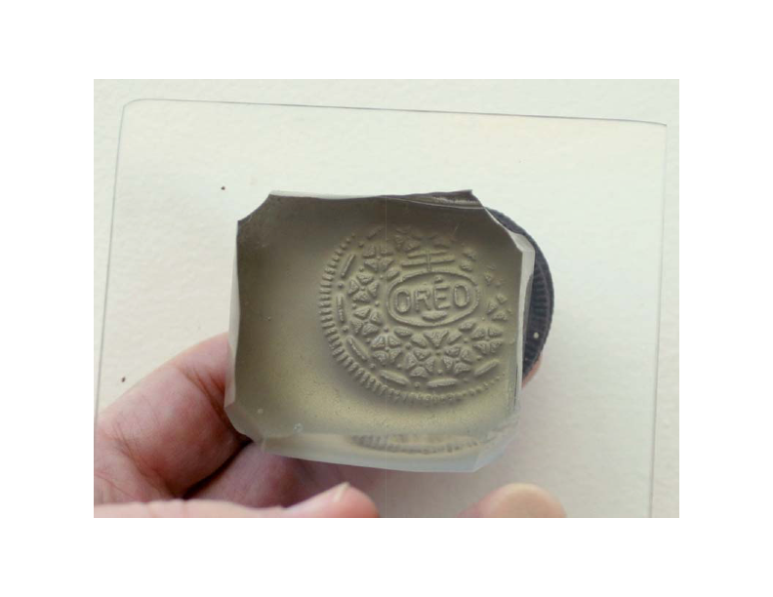

Slide 48
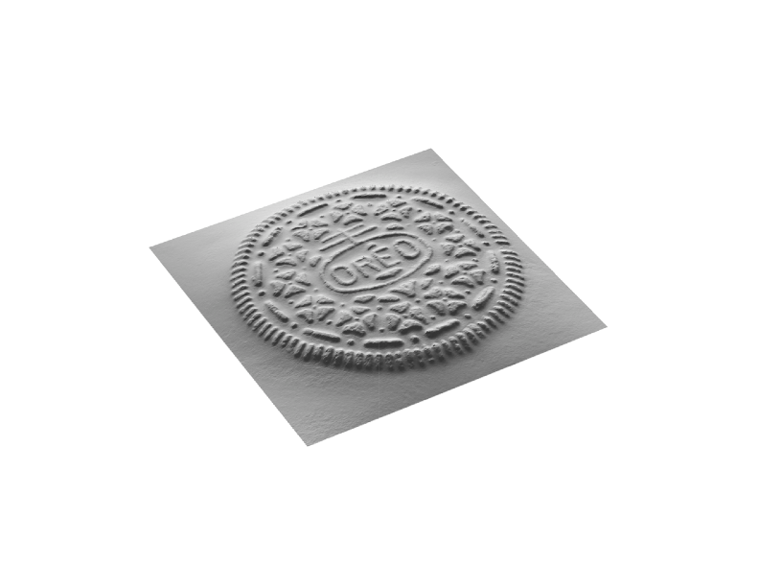

Slide 49
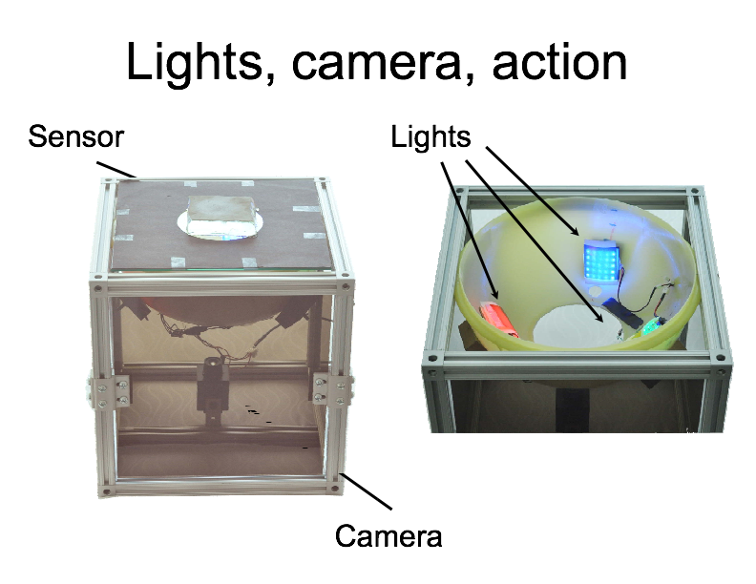

Slide 50


Slide 51



Slide 52


Slide 53

https://www.youtube.com/watch?v=S7gXih4XS7A

Slide 54


Slide 55
Questions?

