Slide 1
Quiz 5 (on Canvas)
Closed book / closed note
Ends at 1:08pm

Slide 2
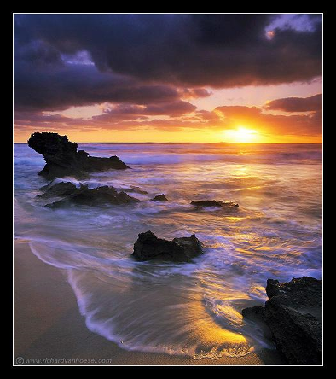
Light & Perception
CS5670: Computer Vision

Slide 3
Announcements
Project 3 code due Monday, March 20, by 8pm to GitHub Classroom
Project 3 artifact (panorama) due Tuesday, March 21, by 8pm to CMSX
Project 4 to be released on Tuesday, March 21, due Friday, March 31 by 8pm
Final exam is planned to be in class during the last lecture on Tuesday, May 9

Slide 4
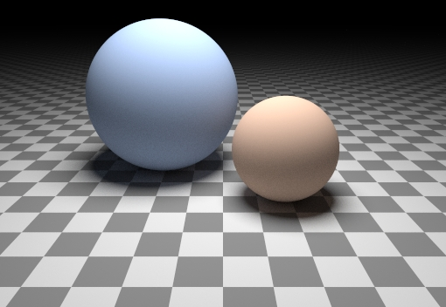
Can we determine shape from lighting?
Are these spheres?
  Or just flat discs painted with varying color (albedo)?
  There is ambiguity between shading and reflectance
  But still, as humans we can understand the shapes of these objects

Slide 5
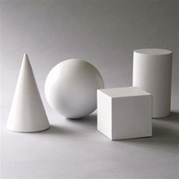
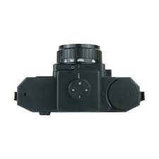
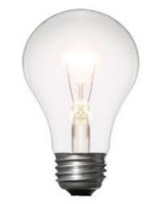
What we know: Stereo
Key Idea: use camera motion to compute shape

Slide 6
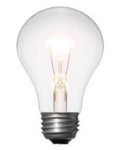
Next: Photometric Stereo
Key Idea: use pixel brightness to understand shape

Slide 7
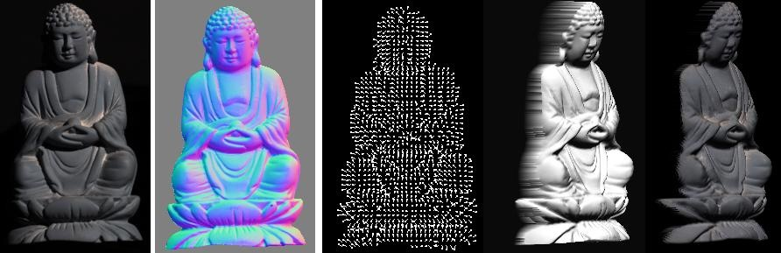
Photometric Stereo
What results can you get?
Input
(1 of 12)
Normals (RGB colormap)
Normals (vectors)
Shaded 3D
rendering
Textured 3D
rendering

Slide 8
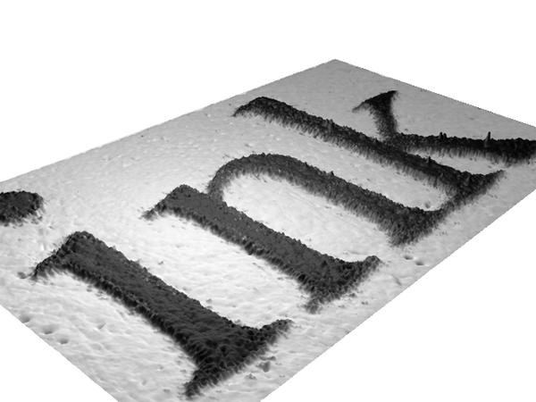

Slide 9
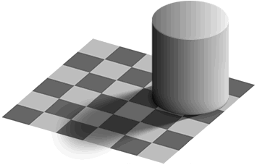
Light
by Ted Adelson
Readings
  Szeliski, 2.2, 2.3

Slide 10
Light
by Ted Adelson
Readings
  Szeliski, 2.2, 2.3

Slide 11
Properties of light
Today
  What is light?
  How do we measure it?
  How does light propagate?
  How does light interact with matter?

Slide 12
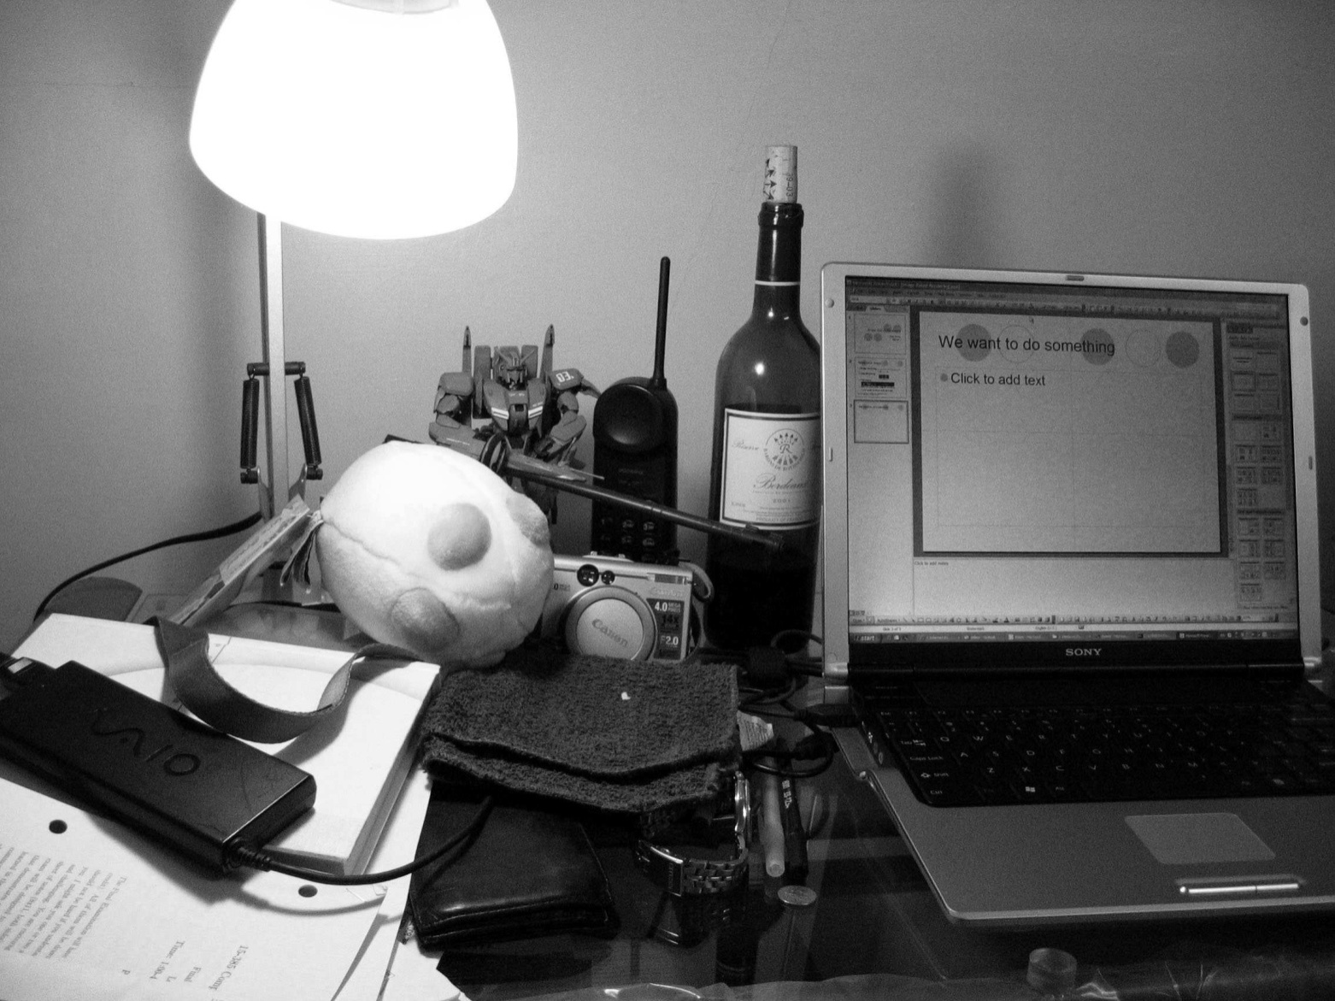
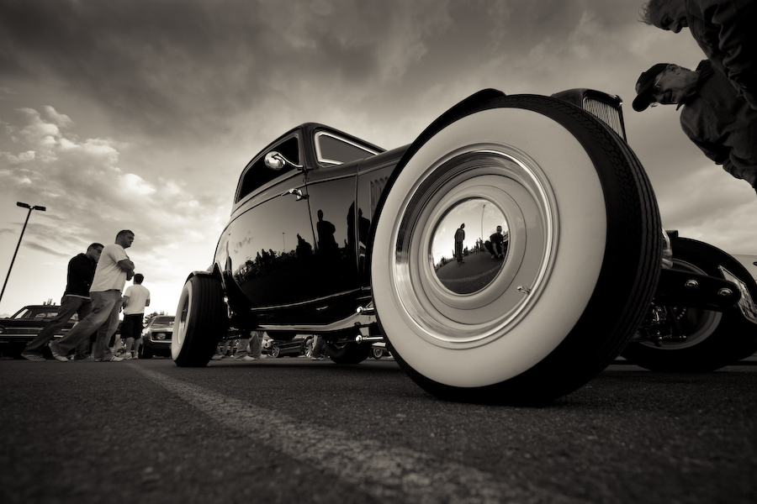
Radiometry
What determines the brightness of a pixel?
Light source properties
Surface properties
Surface properties

Slide 13
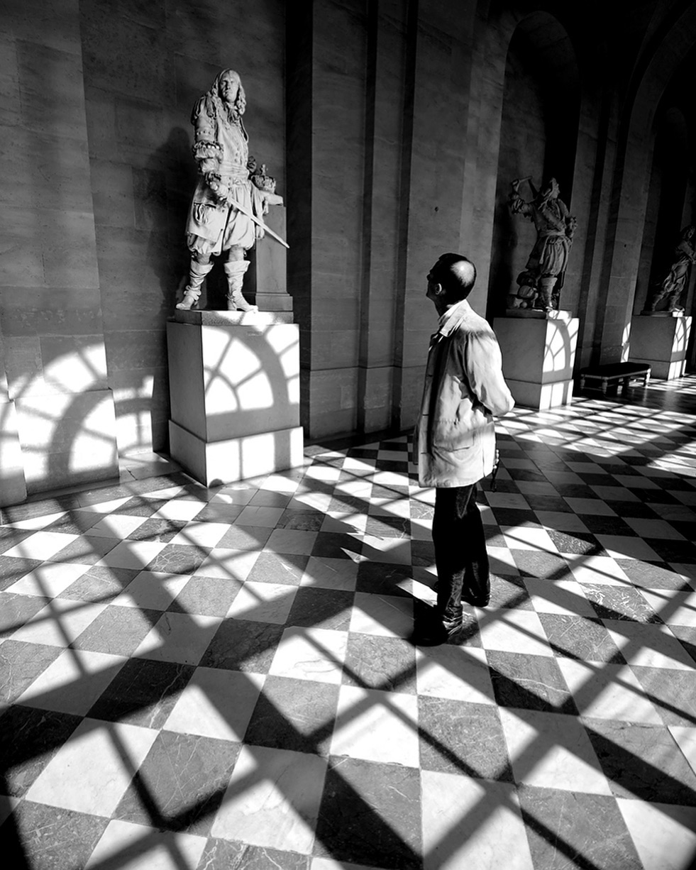
Radiometry
What determines the brightness of a pixel?
@robertwestonbreshears
https://www.instagram.com/p/BtgX55ZBhU-/

Slide 14
Radiometry
What determines the brightness of a pixel?

Slide 15
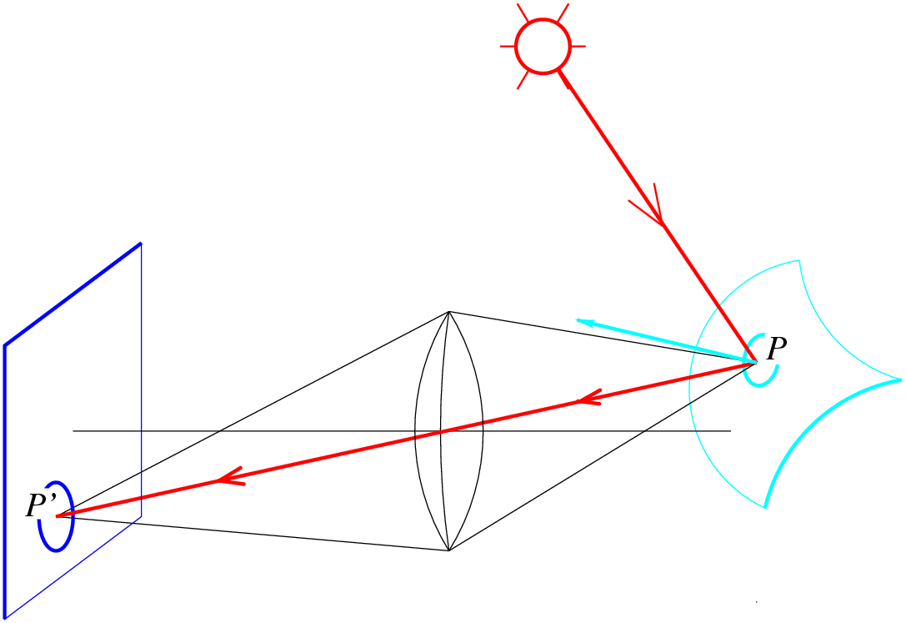
Radiometry
What determines the brightness of a pixel?
Light source
properties
Sensor characteristics
Surface
shape
Exposure
Surface reflectance
properties
Optics
Slide by L. Fei-Fei

Slide 16

What is light?
Electromagnetic radiation (EMR) moving along rays in space
  R(λ) is EMR, measured in units of power (watts)
    λ is wavelength
Light field
  We can describe all of the light in the scene by specifying the radiation (or “radiance” along all light rays) arriving at every point in space and from every direction
The plenoptic function describes all of this light:

Slide 17
Color perception
Electromagnetic radiation (EMR) moving along rays in space
  R(λ) is EMR, measured in units of power (watts)
    λ is wavelength
Perceiving light
  How do we convert radiation into “color”?
  What part of the spectrum do we see?

Slide 18
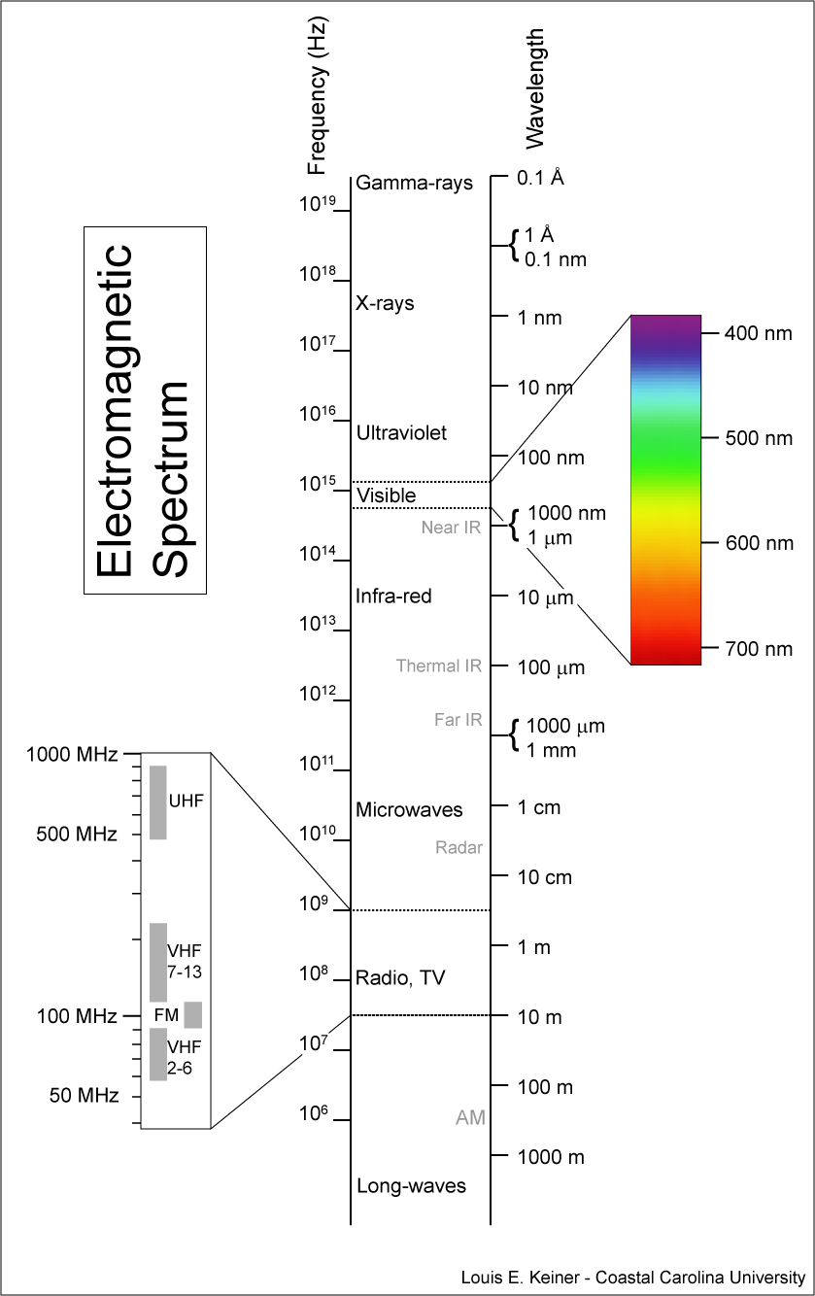
Visible light
We “see” electromagnetic radiation in a range of wavelengths

Slide 19
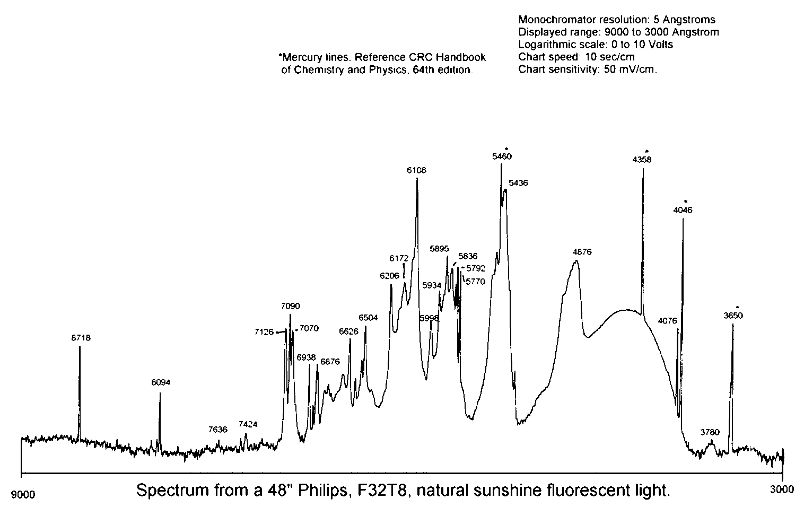
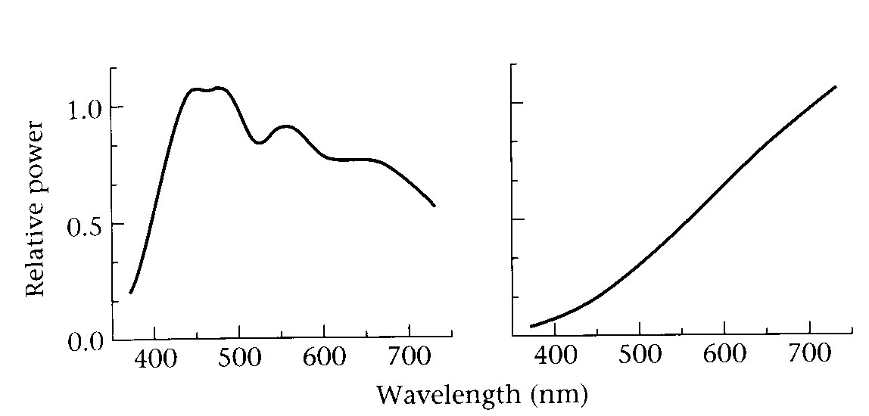
Light spectrum
The appearance of light depends on its power spectrum
  How much power (or energy) at each wavelength
daylight
tungsten bulb
fluorescent bulb
Our visual system converts a light spectrum into “color”
  This is a rather complex transformation

Slide 20
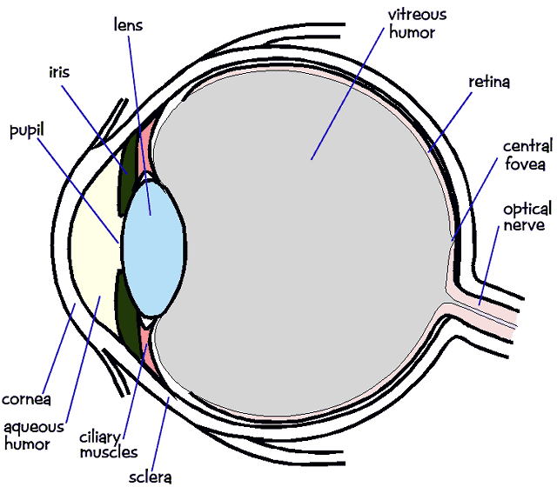
The human visual system
Color perception
  Light hits the retina, which contains photosensitive cells
    rods and cones
  These cells convert the spectrum into a few discrete values

Slide 21
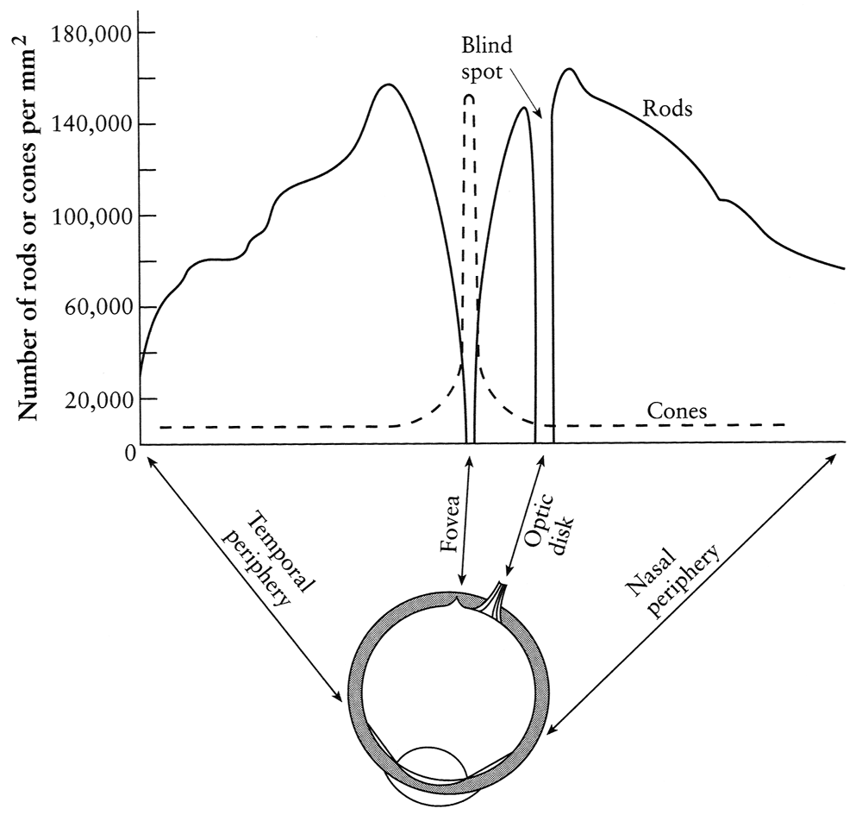
Density of rods and cones
Rods and cones are non-uniformly distributed on the retina
  Rods responsible for intensity, cones responsible for color
  Fovea: Small region (1 or 2°) at the center of the visual field containing the highest density of cones (and no rods).
  Less visual acuity in the periphery—many rods wired to the same neuron

Slide 22
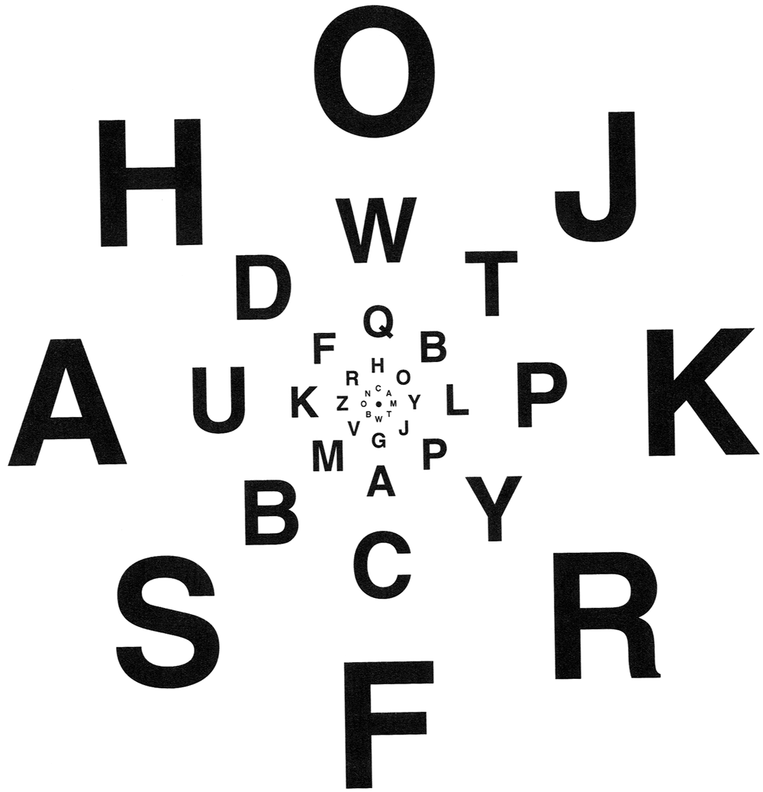
Demonstrations of visual acuity
With one eye shut, at the right distance, all of these letters should appear equally legible (Glassner, 1.7).

Slide 23
Demonstrations of visual acuity
With left eye shut, look at the cross on the left. At the right distance, the circle on the right should disappear (Glassner, 1.8).

Slide 24

Brightness contrast and constancy
The apparent brightness depends on the surrounding region
  brightness contrast: a constant colored region seems lighter or darker depending on the surrounding intensity
  brightness constancy: a surface looks the same under widely varying lighting conditions.

Slide 25
Light response is nonlinear
Our visual system has a large dynamic range
  We can resolve both light and dark things at the same time
  One mechanism for achieving this is that we sense light intensity on a logarithmic scale
    an exponential intensity ramp will be seen as a linear ramp
  Another mechanism is adaptation
    rods and cones adapt to be more sensitive in low light, less sensitive in bright light.

Slide 26
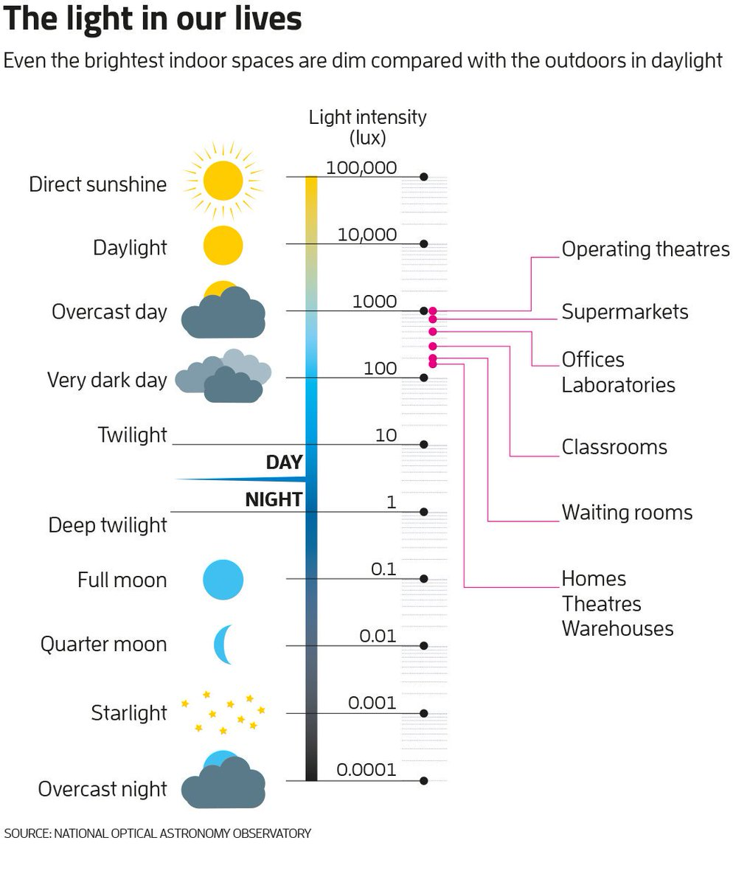
Visual dynamic range
A piece of white paper can be 1,000,000,000 times brighter in outdoor sunlight than in a moonless night.
BUT in a given lighting condition, light perception ranges over only about two orders of magnitude.
https://threader.app/thread/1134003178515701762

Slide 27
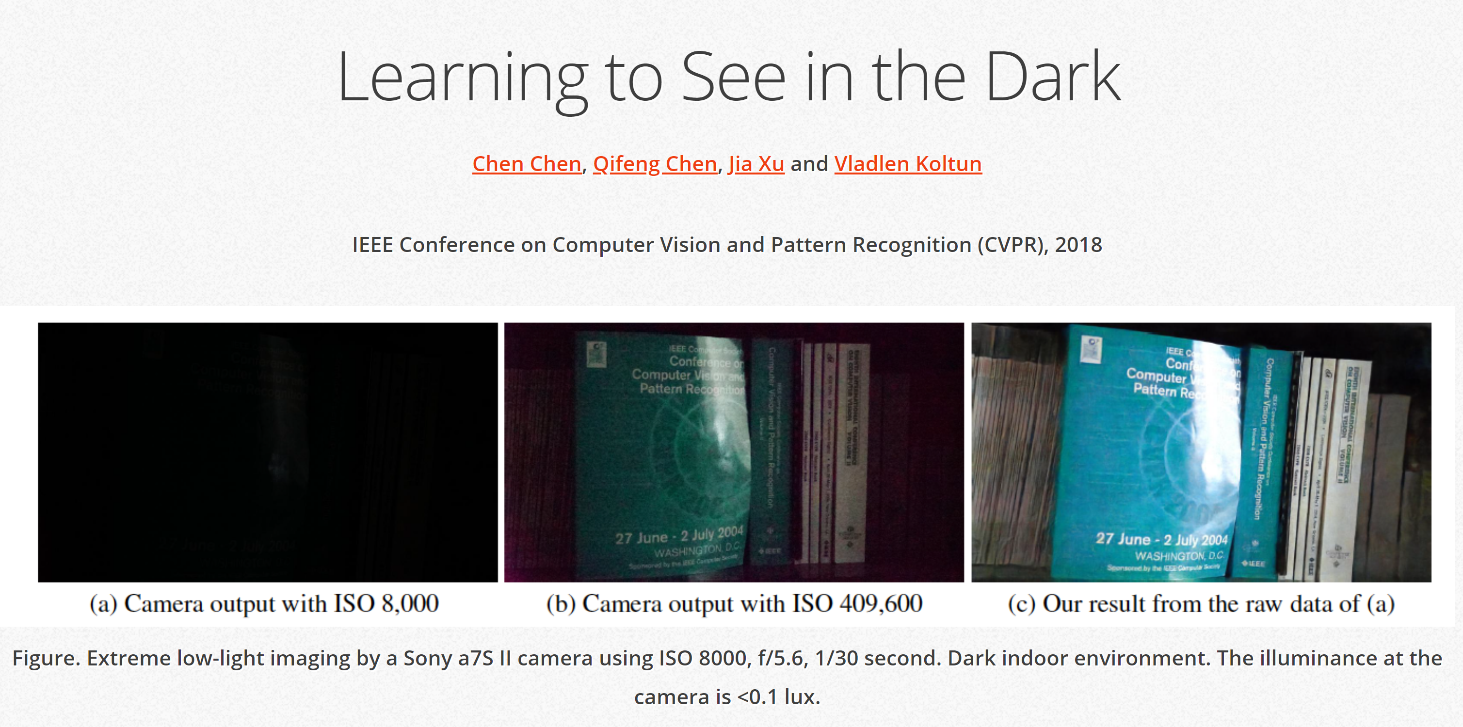
http://cchen156.web.engr.illinois.edu/SID.html

Slide 28
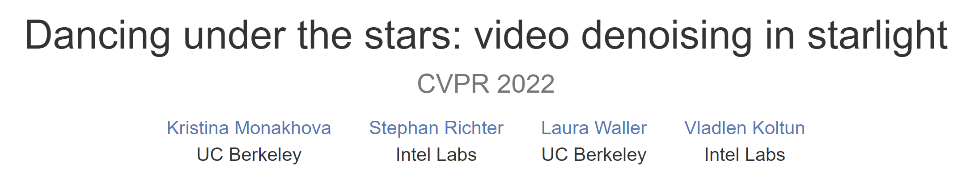
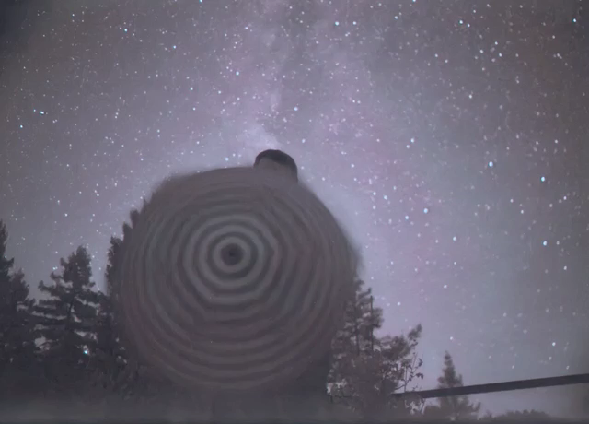

Slide 29



Visual dynamic range
Dark night
Indoor lighting
Cloudy day
Sunny day
If we were sensitive to this whole range all the time, we wouldn’t be able to
discriminate lightness levels in a typical scene.
The visual system solves this problem by restricting the ‘dynamic range’ of its
response to match the current overall or ‘ambient’ light level.
Dark night
Indoor lighting
Cloudy day
Sunny day
Dark night
Indoor lighting
Cloudy day
Sunny day

Slide 30
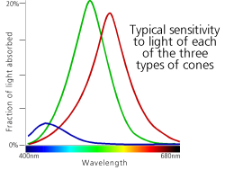
Color perception
Three types of cones
  Each is sensitive in a different region of the spectrum
    but regions overlap
    Short (S) corresponds to blue
    Medium (M) corresponds to green
    Long (L) corresponds to red
  Different sensitivities: we are more sensitive to green than red
    varies from person to person (and with age)
  Colorblindness—deficiency in at least one type of cone
L response curve

Slide 31
Color perception
M
L
Power
S
Wavelength
Rods and cones act as filters on the spectrum
  To get the output of a filter, multiply its response curve by the spectrum, integrate over all wavelengths
    Each cone yields one number
  Q: How can we represent an entire spectrum with 3 numbers?
  A: We can’t! Most of the information is lost
    As a result, two different spectra may appear indistinguishable
      such spectra are known as metamers

Slide 32
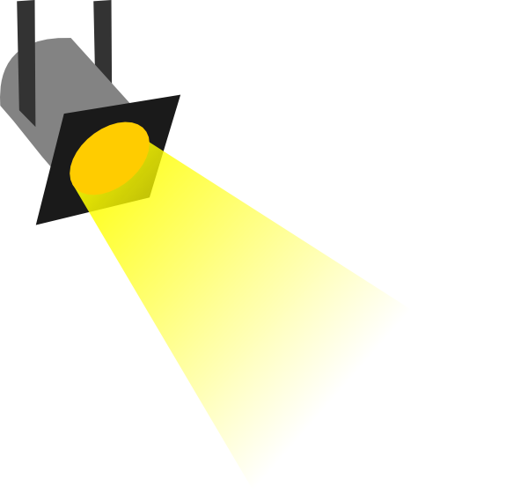
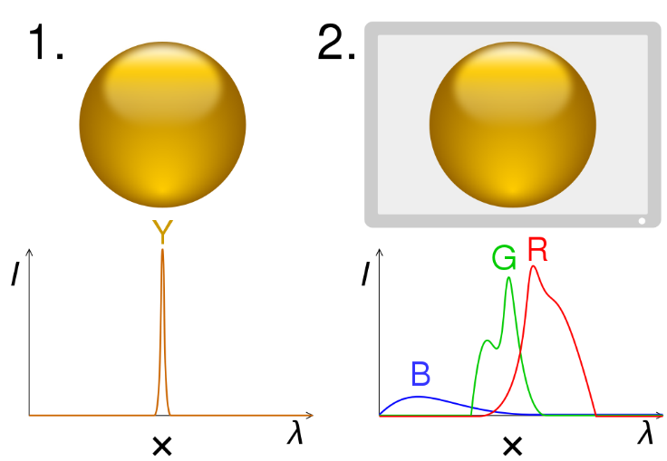
Metamers
1. Combined light spectrum

Slide 33

Metamers
1. Combined light spectrum
2. Cone sensitivity (S, M, L)
3. Multiplication of 1 and 2

Slide 34
Metamers
1. Combined light spectrum
2. Cone sensitivity (S, M, L)
3. Multiplication of 1 and 2
4. Observed color (yellow)

Slide 35
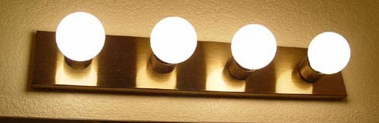
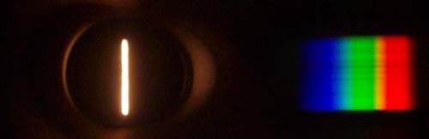
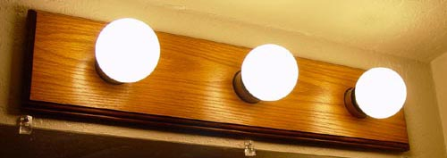
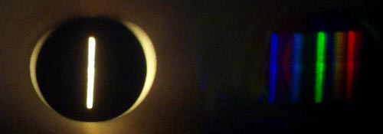
What kind of bulb is it?
http://www.chemistryland.com/CHM107Lab/Exp7/Spectroscope/Spectroscope.html

Slide 36
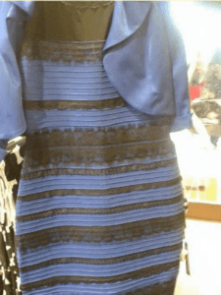
What color is the dress?
White and gold?
Black and blue?

Slide 37
Reflectance and Illumination In Popular Culture…

Slide 38

What color is the center ball?

Slide 39
What color is the center ball?

Slide 40
Perception summary
The mapping from radiance to perceived color is quite complex!
  We throw away most of the data
  We apply a logarithm
  Brightness affected by pupil size and adaptation of rods/cones
  Brightness contrast and constancy effects
The same is true for cameras
  But we have tools to correct for these effects
    (Computational Photography)

Slide 41
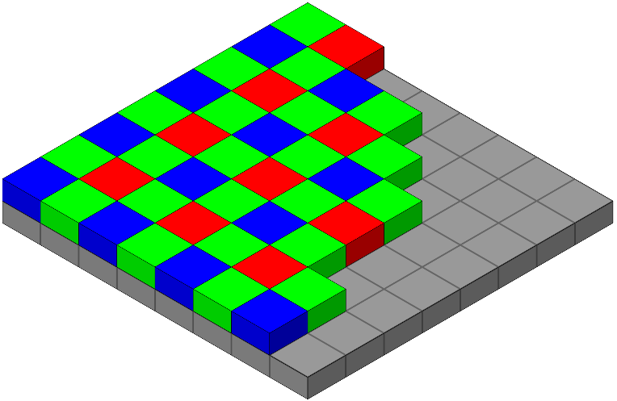
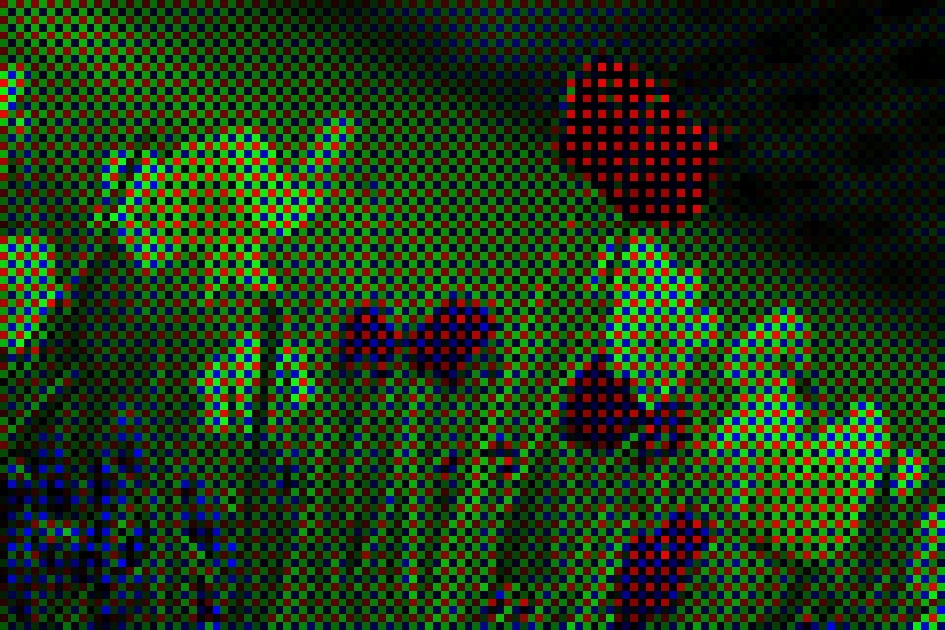

Cameras also see color
Common technique is to place a mosaic of color filters (a Bayer filter) in front of the sensor
Colors are interpolated to create a full-resolution “demosaicked” color image
Bayer filter pattern in front of sensor
What the camera sees
(“raw” image)
Demosaicked image
https://en.wikipedia.org/wiki/Bayer_filter

Slide 42
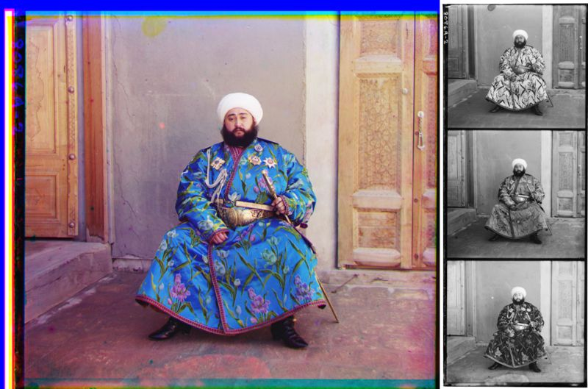
Early color photography
Prior to the invention of color film, Sergey Prokudin-Gorsky took three separate exposures with three different color filters
Blue, Green, Red exposures
Combined color image (1911)

Slide 43
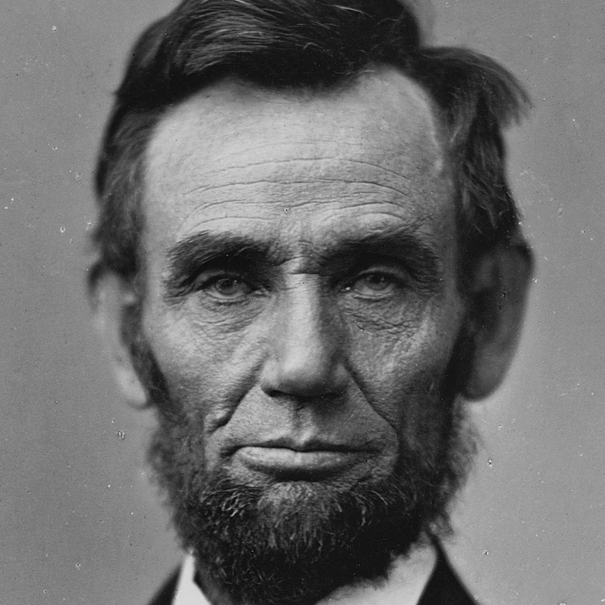
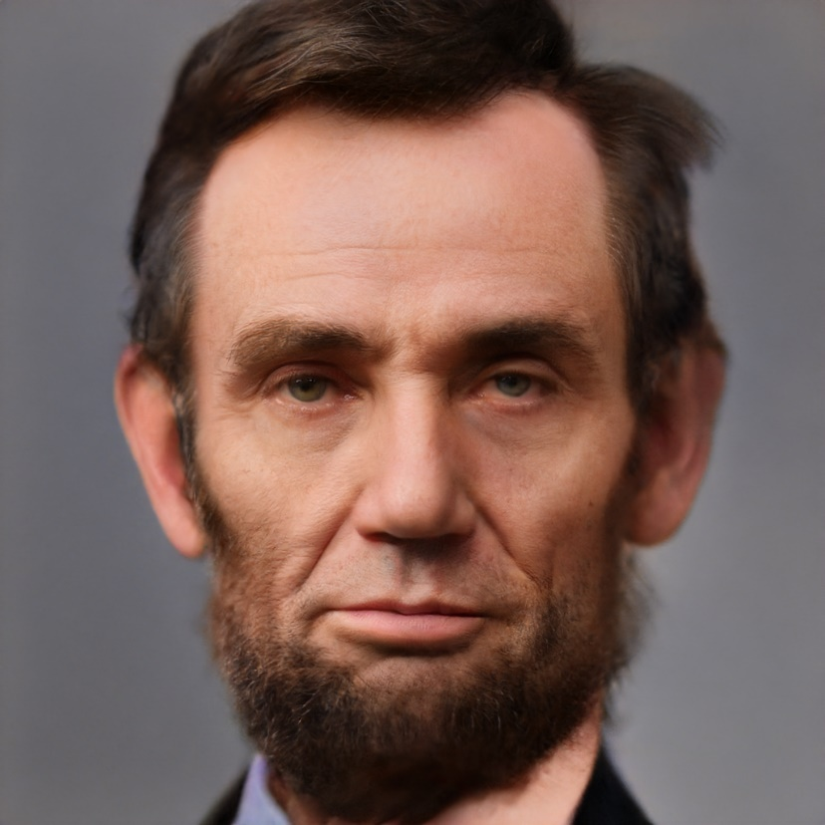
Film has its own sensitivity
“… the film of Lincoln’s era was sensitive only to blue and UV light, causing cheeks to appear dark, and overly emphasizing wrinkles by filtering out skin subsurface scatter which occurs mostly in the red channel. Hence, the deep lines and sharp creases that we associate with Lincoln’s face are likely exaggerated by the photographic process of the time.”
Time-Travel Rephotography
Xuan Luo, Xuaner Zhang, Paul Yoo, Ricardo Martin-Brualla, Jason Lawrence, Steven M. Seitz
SIGGRAPH Asia 2021

Slide 44
Questions?

Slide 45
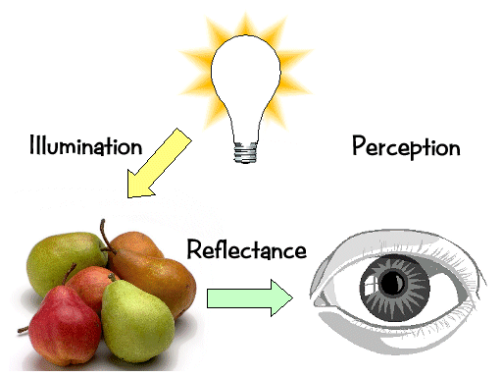
Light transport

Slide 46
Light sources
Basic types
  point source
  directional source
    a point source that is infinitely far away
  area source
    a union of point sources
More generally
  a light field can describe *any* distribution of light sources
What happens when light hits an object?

Slide 47
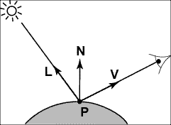
Modeling Image Formation
We need to reason about:
  How light interacts with the scene
  How a pixel value is related to light energy in the world
Track a “ray” of light all the way from light source to the sensor

Slide 48
Directional Lighting
Key property: all rays are parallel
Equivalent to an infinitely distant point source

Slide 49
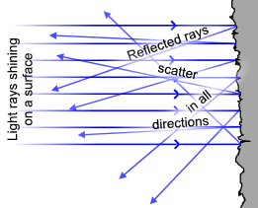


Lambertian Reflectance
Image intensity
Surface normal
Light direction
Image intensity
cos(angle between N and L)

Slide 50
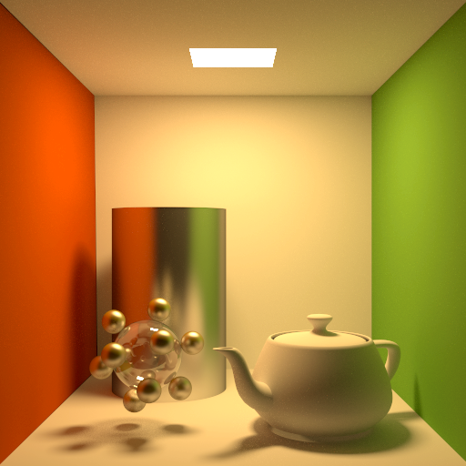
Materials - Three Forms
Ideal diffuse (Lambertian)
Ideal
specular
Directional
diffuse
© Kavita Bala, Computer Science, Cornell University
Notes:
There are several types of surfaces that are assumed to make up the world.
Ideal diffuse. It is similar to the diffuse emitter in that it emits all incident light equally in all outgoing directions. When light hits the surface it is reflected uniformly anywhere in the hemisphere above the surface.
Ideal specular (perfect mirrors). Light is reflected exactly in the mirror direction of the incoming light. A perfect mirror is such a surface.
Directional diffuse (almost all materials in the world). Incoming light is reflected into the hemisphere to different extents. If the object is more glossy then more of the incoming energy reflects close to the mirror direction. If it is more diffuse then the reflection is more uniform.

Slide 51
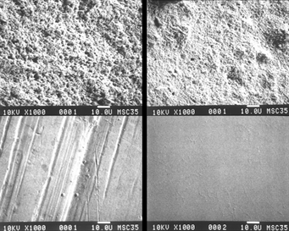
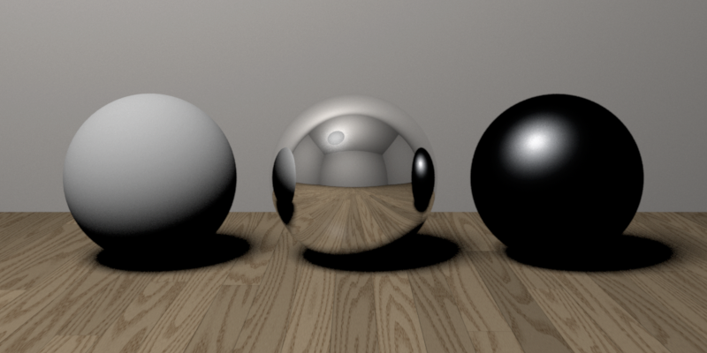
Reflectance—Three Forms
Ideal diffuse (Lambertian)
Ideal
specular
Directional
diffuse
© Kavita Bala, Computer Science, Cornell University
Notes:
Why spheres?!

Slide 52
Ideal Diffuse Reflection
Characteristic of multiple scattering materials
An idealization but reasonable for matte surfaces
© Kavita Bala, Computer Science, Cornell University

Slide 53
Lambertian Reflectance
Reflected energy is proportional to cosine of angle between L and N (incoming)
Measured intensity is viewpoint-independent (outgoing)

Slide 54
Lambertian Reflectance: Incoming
Reflected energy is proportional to cosine of angle between L and N

Slide 55
Lambertian Reflectance: Incoming
Reflected energy is proportional to cosine of angle between L and N

Slide 56
Lambertian Reflectance: Incoming
Reflected energy is proportional to cosine of angle between L and N
Light hitting surface is proportional to the cosine

Slide 57
Lambertian appearance is view-independent
Number of photons reflected to a given angle θ is proportional to cos(θ)
Lambert's cosine law:
Notes:
Emission rate of photons: B0 cos theta
Radiance: (Photons/second)/(area steradian)
Looking down get B0/dA
Looking at angle get B0 cos theta/(dA cos theta)
Pixel=\mathbf{B}_{0}\mathbf{A}_{0}\frac{\cos{\theta}}{\cos{\theta}}

Slide 58
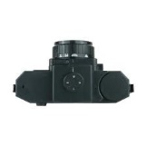
Lambertian appearance is view-independent
But appearance is the same from every angle due to larger pixel footprint at larger angles
Number of photons reflected to a given angle θ is proportional to cos(θ)
Lambert's cosine law:
Notes:
Emission rate of photons: B0 cos theta
Radiance: (Photons/second)/(area steradian)
Looking down get B0/dA
Looking at angle get B0 cos theta/(dA cos theta)
Pixel=\mathbf{B}_{0}\mathbf{A}_{0}\frac{\cos{\theta}}{\cos{\theta}}

Slide 59
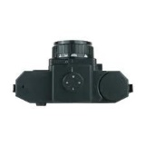
Lambertian appearance is view-independent
But appearance is the same from every angle due to larger pixel footprint at larger angles
Number of photons reflected to a given angle θ is proportional to cos(θ)
Lambert's cosine law:
Notes:
Emission rate of photons: B0 cos theta
Radiance: (Photons/second)/(area steradian)
Looking down get B0/dA
Looking at angle get B0 cos theta/(dA cos theta)
Pixel=\mathbf{B}_{0}\mathbf{A}_{0}\frac{\cos{\theta}}{\cos{\theta}}

Slide 60
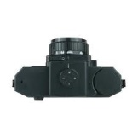
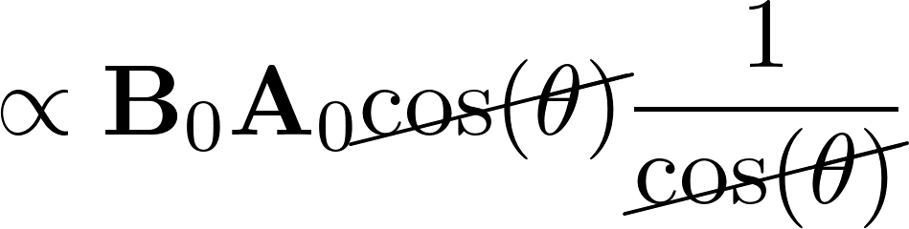
Lambertian appearance is view-independent
But appearance is the same from every angle due to larger pixel footprint at larger angles
Number of photons reflected to a given angle θ is proportional to cos(θ)
Lambert's cosine law:
Radiance
(what eye sees)
Notes:
Emission rate of photons: B0 cos theta
Radiance: (Photons/second)/(area steradian)
Looking down get B0/dA
Looking at angle get B0 cos theta/(dA cos theta)
\begin{align*}
\propto \mathbf{B}_0 \mathbf{A}_0
\cancel{\cos(\theta)} \frac{1}{\cancel{\cos(\theta)}}
\end{align*}
Pixel=\mathbf{B}_{0}\mathbf{A}_{0}\frac{\cos{\theta}}{\cos{\theta}}

Slide 61
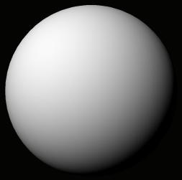
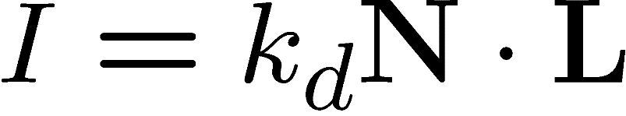

Final Lambertian image formation model
Diffuse albedo: what fraction of incoming light is reflected?
  Introduce scale factor
Light intensity: how much light is arriving?
  Compensate with camera exposure (global scale factor)
Camera response function
  Assume pixel value is linearly proportional to incoming energy (perform radiometric calibration if not)

Slide 62
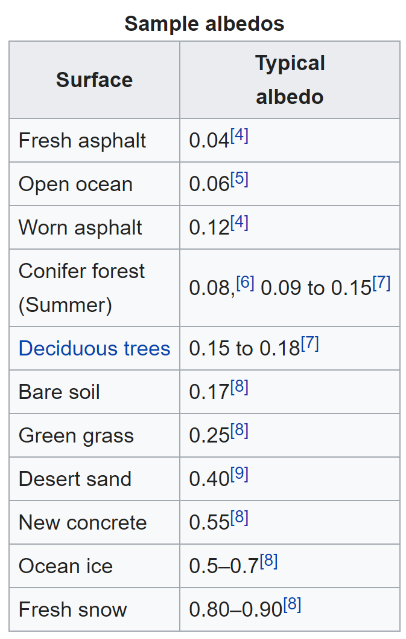
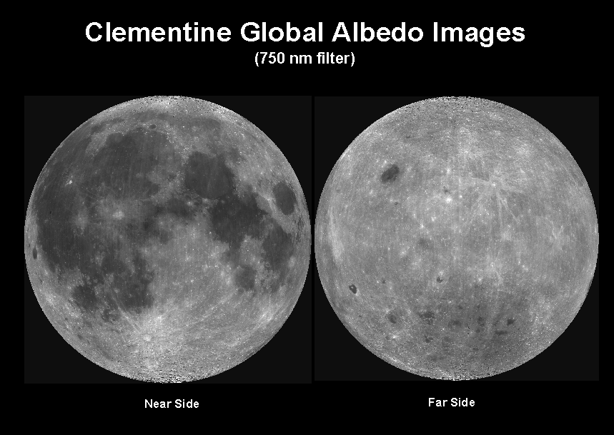
Albedo
Objects can have varying albedo and albedo varies with wavelength
Source: https://en.wikipedia.org/wiki/Albedo

Slide 63



A Single Image: Shape from shading
Suppose (for now)
You can directly measure angle between normal and light source
  Not quite enough information to compute surface shape
  But can be if you add some additional info, for example
    assume a few of the normals are known (e.g., along silhouette)
    constraints on neighboring normals—“integrability”
    smoothness
  Hard to get it to work well in practice
    plus, how many real objects have constant albedo?
    But, deep learning can help

Slide 64


https://www.good.is/optical-illusion-plates-and-bowls-upside-down-or-not

Slide 65

Application: Detecting composite photos
Real photo
Fake photo

Slide 66
Questions?

