Slide 1

Binocular Stereo
CS5670: Computer Vision
What is this?
Single image stereogram, https://en.wikipedia.org/wiki/Autostereogram

Slide 2
Announcements
Project 3 due this Friday, March 17 at 8pm (code), Monday, March 20 at 8pm (artifact)
Project 4 (Stereo) to be released on Tuesday, March 21, due Friday, April 31, by 8pm
  To be done in groups of two

Slide 3
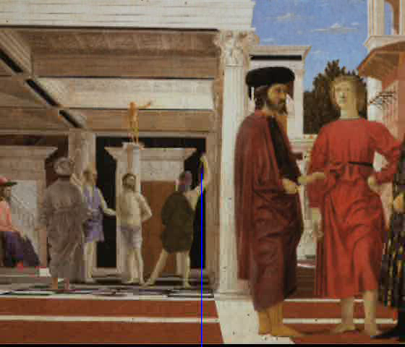
From last time: 3D modeling from a photograph
video by Antonio Criminisi

Slide 4
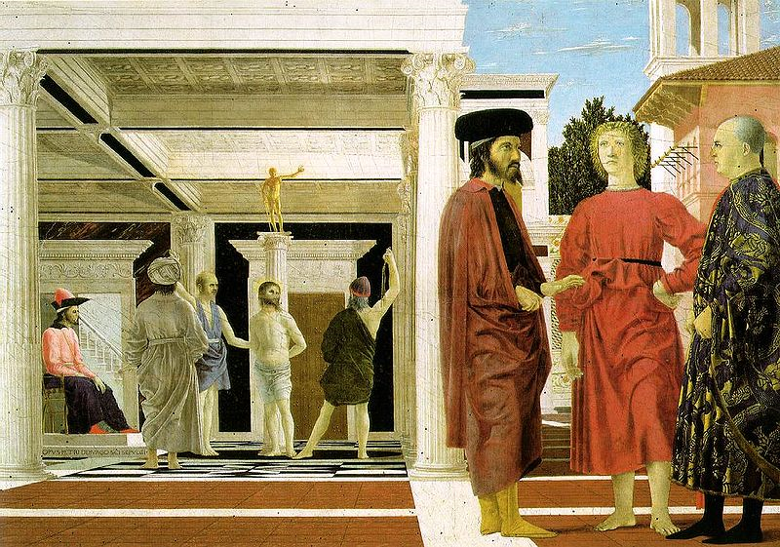

3D modeling from a photograph
Flagellation. Piero della Francesca. c1453.

Slide 5
Related problem: camera calibration
Goal: estimate the camera parameters
  Version 1: solve for 3x4 projection matrix
  Version 2: solve for camera parameters separately
    intrinsics (focal length, principal point, pixel size)
    extrinsics (rotation angles, translation)
    radial distortion

Slide 6
Vanishing points and projection matrix
= v_{x} (X vanishing point)
similarly,
π
=
v
,
π
=
v
2
Y
3
Z
Not So Fast! We only know v’s up to a scale factor
  Can fully specify by providing 3 reference points with known coordinates

Slide 7
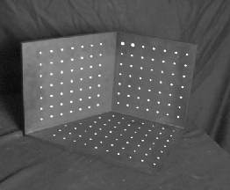
Calibration using a reference object
Place a known object in the scene
  identify correspondence between image and scene
  compute mapping from scene to image
Issues
  must know geometry very accurately
  must know 3D -> 2D correspondence

Slide 8
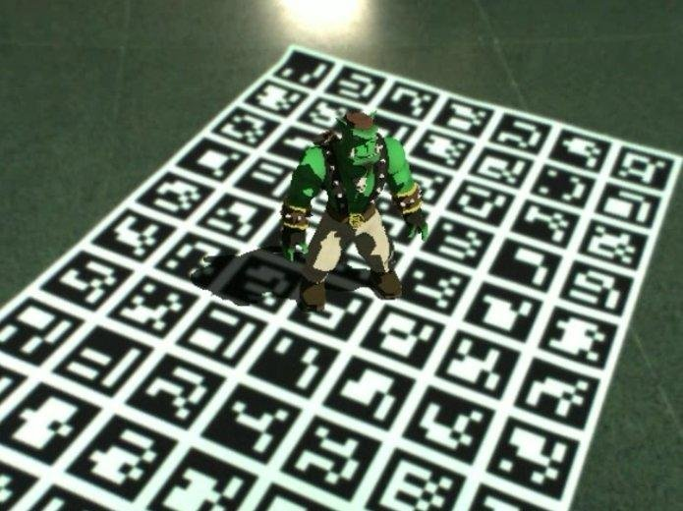
AR codes
ArUco

Slide 9
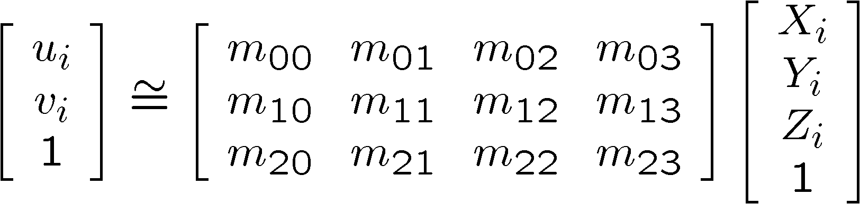
Estimating the projection matrix
Place a known object in the scene
  identify correspondence between image and scene
  compute mapping from scene to image

Slide 10
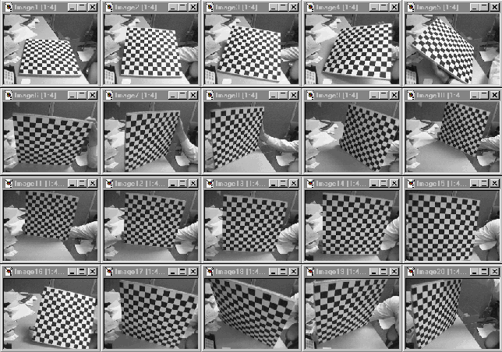
Alternative: multi-plane calibration
Images courtesy Jean-Yves Bouguet
Advantage
  Only requires a plane
  Don’t have to know positions/orientations
  Good code available online! (including in OpenCV)
    Matlab version by Jean-Yves Bouget: http://www.vision.caltech.edu/bouguetj/calib_doc/index.html
    Amy Tabb’s camera calibration software: https://github.com/amy-tabb/basic-camera-calibration

Slide 11
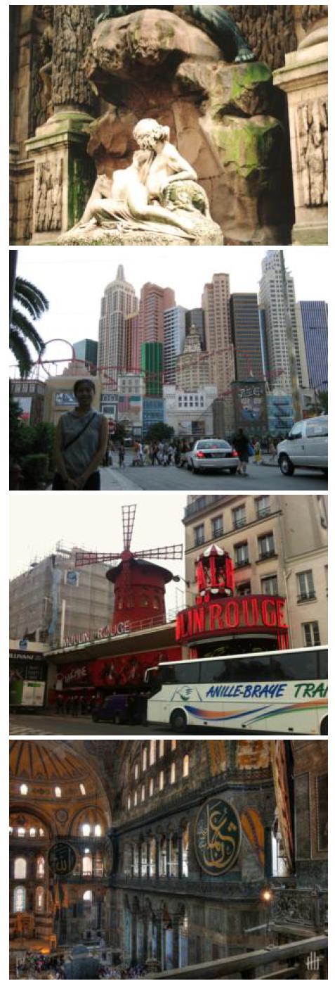
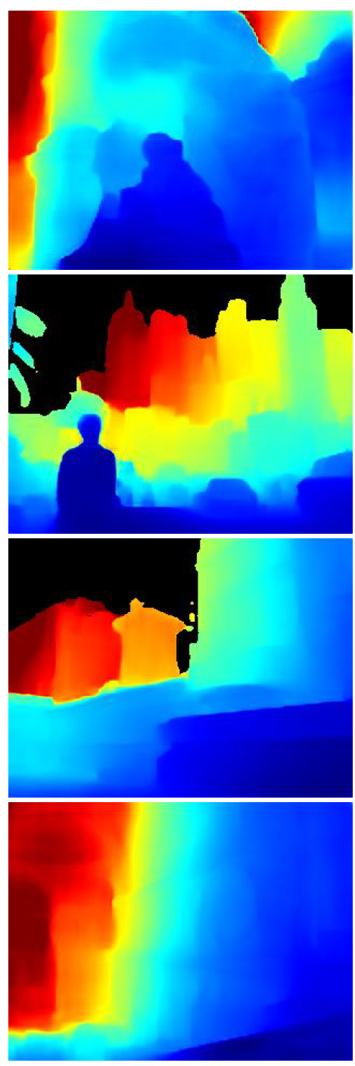
Single-image depth prediction using deep learning
Deep learning
Li and Snavely. Megadepth: Learning single-view depth prediction from internet photos. CVPR 2018.
Image
Depth map

Slide 12
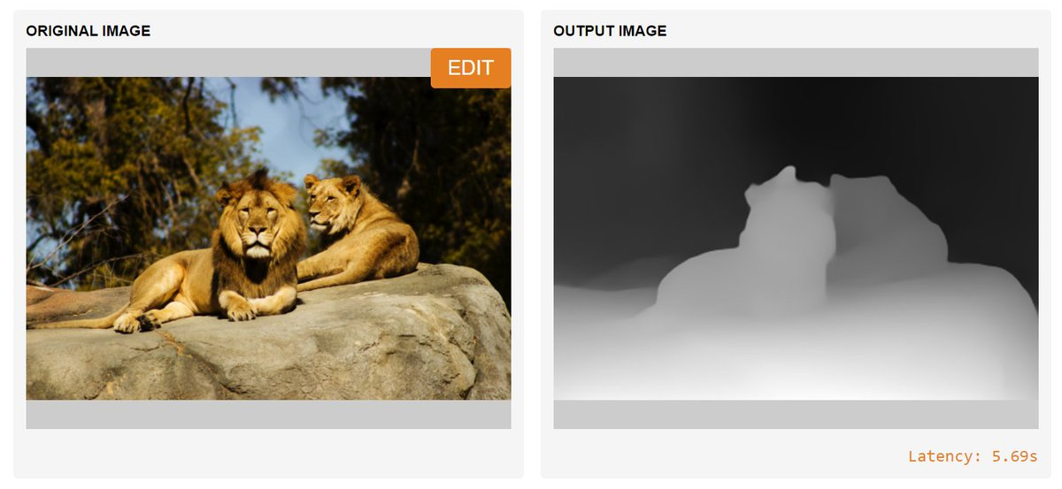
MiDaS depth prediction
Ranftl et al. Towards Robust Monocular Depth Estimation: Mixing Datasets for Zero-shot Cross-dataset Transfer.
https://gradio.app/g/AK391/MiDaS
https://github.com/intel-isl/MiDaS

Slide 13
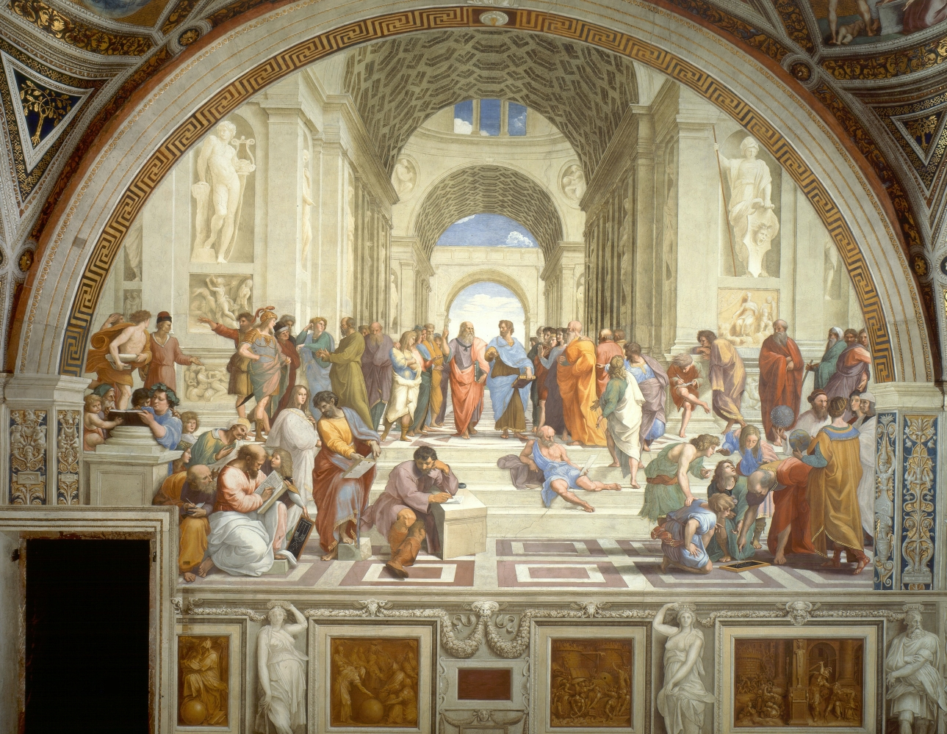
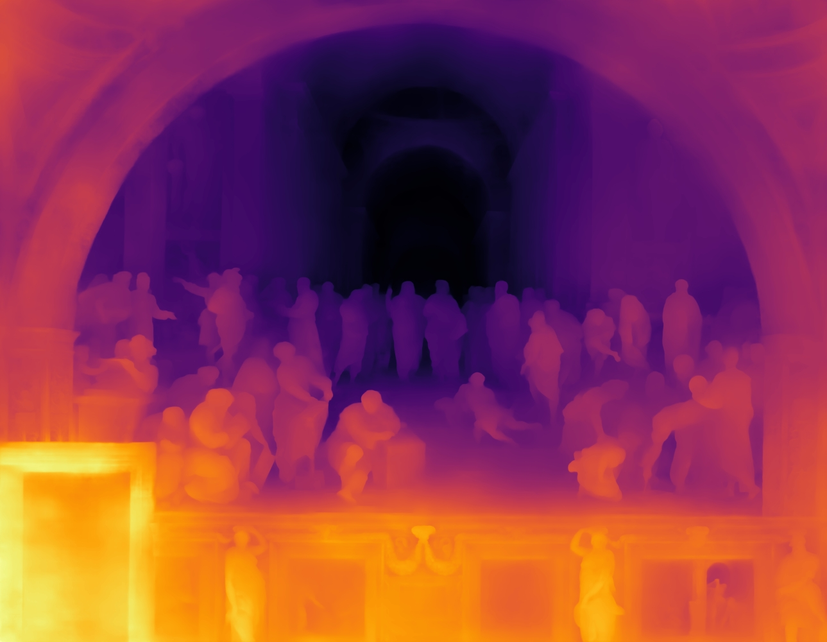
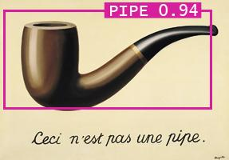
Single-image depth prediction
Picture credit: Magritte, The Treachery of Images, and the Berkeley Computer Vision Group
Miangoleh*, Dille*, Mai, Paris, and Aksoy.
Boosting Monocular Depth Estimation Models to High-Resolution via Content-Adaptive Multi-Resolution Merging.
CVPR 2021.
Notes:
So where to go from here? I think there are a lot of very interesting open directions. Of all of these Im2Scene tasks, single-view depth prediction is one of the most mature.
Beautiful ambiguity of perception.
Yağız Aksoy, SFU

Slide 14
Deep geometry prediction
More on this topic later!

Slide 15
Questions?

Slide 16
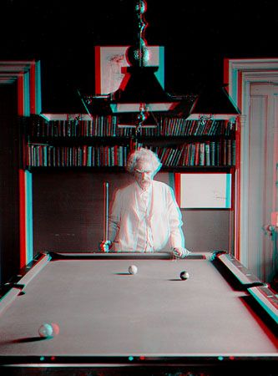
“Mark Twain at Pool Table", no date, UCR Museum of Photography

Slide 17
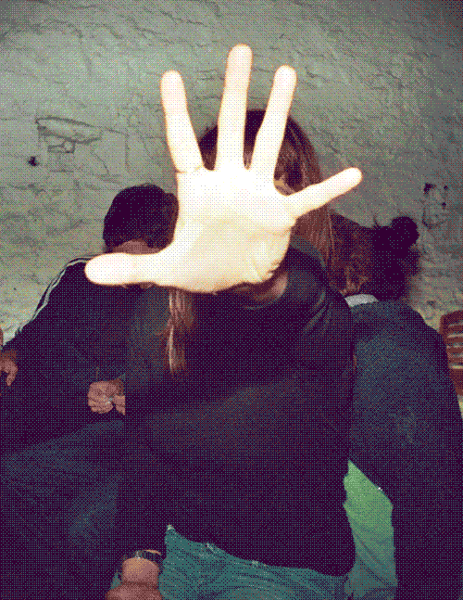
https://giphy.com/gifs/wigglegram-706pNfSKyaDug

Slide 18

Stereo Vision as Localizing Points in 3D
An object point will project to some point in our image
That image point corresponds to a ray in the world
Two rays intersect at a single point, so if we want to localize points in 3D we need 2 eyes

Slide 19
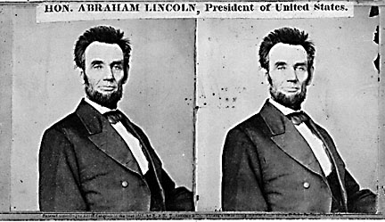
Stereo
Given two images from different viewpoints
  How can we compute the depth of each point in the image?
  Based on how much each pixel moves between the two images

Slide 20
Epipolar geometry
epipolar lines
(x₁, y₁)
(x₂, y₁)
Two images captured by a purely horizontal translating camera
(rectified stereo pair)
x₂ - x₁ = the disparity of pixel (x₁, y₁)

Slide 21
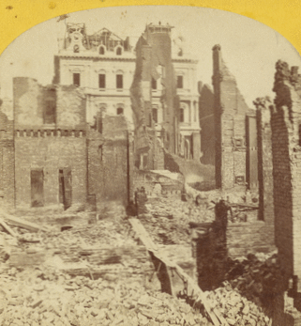
Disparity = inverse depth
http://stereo.nypl.org/view/41729
(Or, hold a finger in front of your face and wink each eye in succession.)

Slide 22
Your basic stereo matching algorithm
Match Pixels in Conjugate Epipolar Lines
  Assume brightness constancy
  This is a challenging problem
  Hundreds of approaches
    A good survey and evaluation: http://www.middlebury.edu/stereo/

Slide 23
Your basic stereo matching algorithm
For each epipolar line
For each pixel in the left image
    compare with every pixel on same epipolar line in right image
    pick pixel with minimum match cost
Improvement: match windows

Slide 24
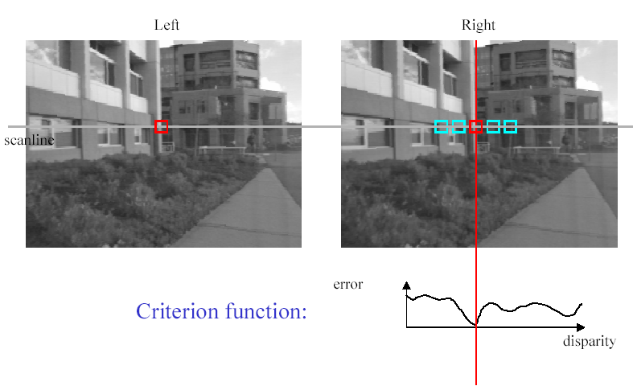
Stereo matching based on SSD
SSD
^{d}min d
Best matching disparity

Slide 25
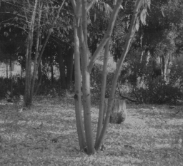
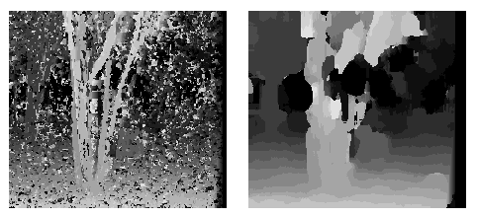
Window size
W = 3
W = 20
Effect of window size
Better results with adaptive window
  T. Kanade and M. Okutomi, A Stereo Matching Algorithm with an Adaptive Window: Theory and Experiment, ICRA 1991.
  D. Scharstein and R. Szeliski. Stereo matching with nonlinear diffusion. IJCV, July 1998
  Smaller window
    more detail
    - more noise
  Larger window
    less noise
    - less detail
Notes:
smaller window: more detail, more noise
bigger window: less noise, more detail

Slide 26
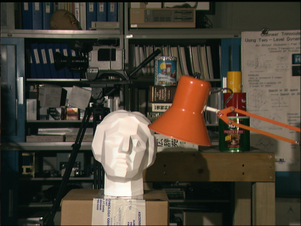

Stereo results
  Data from University of Tsukuba
  Similar results on other images without ground truth
Scene
Ground truth

Slide 27
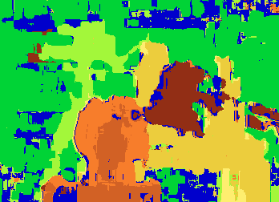

Results with window search
Window-based matching
(best window size)
Ground truth

Slide 28

Better methods exist...
Graph cuts-based method
  Boykov et al., Fast Approximate Energy Minimization via Graph Cuts,
  International Conference on Computer Vision 1999.
Ground truth
    For the latest and greatest: http://www.middlebury.edu/stereo/

Slide 29
Stereo as energy minimization
What defines a good stereo correspondence?
  Match quality
    Want each pixel to find a good match in the other image
  Smoothness
    If two pixels are adjacent, they should (usually) move about the same amount

Slide 30

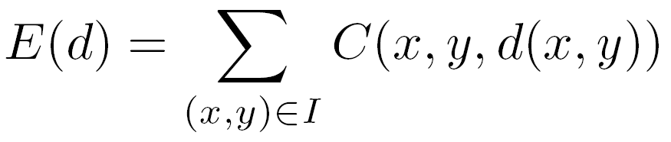

Stereo as energy minimization
Find disparity map d that minimizes an energy function
Simple pixel / window matching
=
SSD distance between windows I(x, y) and J(x + d(x,y), y)

Slide 31
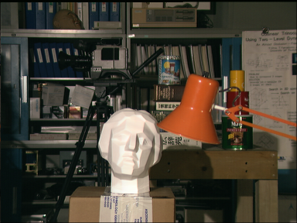
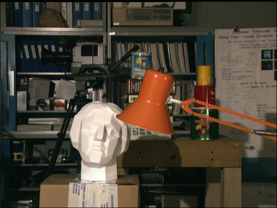
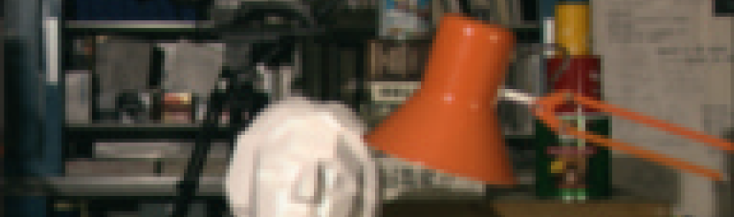
Stereo as energy minimization
y = 141
d
x
C(x, y, d); the disparity space image (DSI)

Slide 32
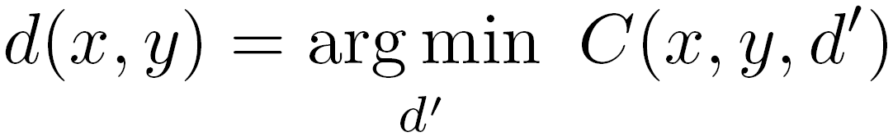
Stereo as energy minimization
y = 141
d
x
Simple pixel / window matching: choose the minimum of each column in the DSI independently:

Slide 33
Greedy selection of best match

Slide 34
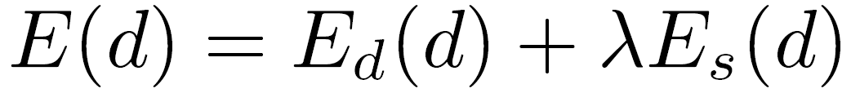
Stereo as energy minimization
Better objective function
{
{
match cost
smoothness cost
    Want each pixel to find a good match in the other image
    Adjacent pixels should (usually) move about the same amount

Slide 35
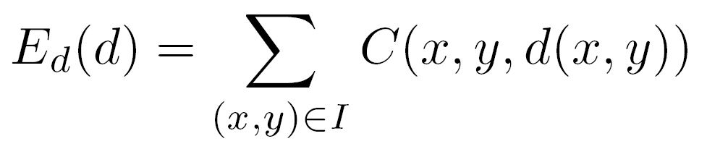
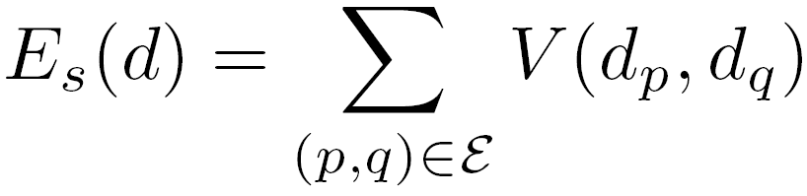

Stereo as energy minimization
match cost:
smoothness cost:
: set of neighboring pixels
4-connected neighborhood
8-connected neighborhood

Slide 36
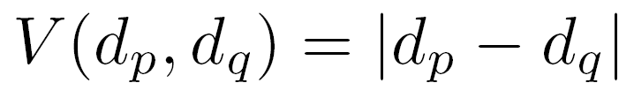
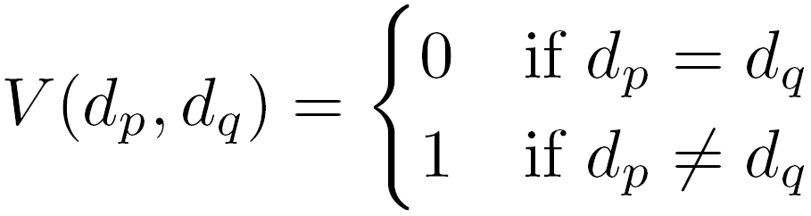
Smoothness cost
How do we choose V?
L₁ distance
“Potts model”

Slide 37
Smoothness cost
If λ = infinity, then we only consider smoothness
Optimal solution is a surface of constant depth/disparity
  Fronto-parallel surface
In practice, want to balance data term with smoothness term

Slide 38
Dynamic programming
Can minimize this independently per scanline using dynamic programming (DP)

Slide 39
Dynamic programming
y = 141
d
x
Finds “smooth”, low-cost path through DPI from left to right
Visiting a node incurs its data cost, switching disparities from one column to the next also incurs a (smoothness) cost

Slide 40
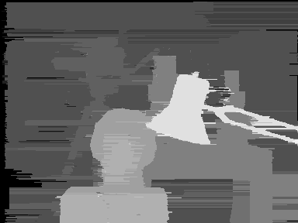
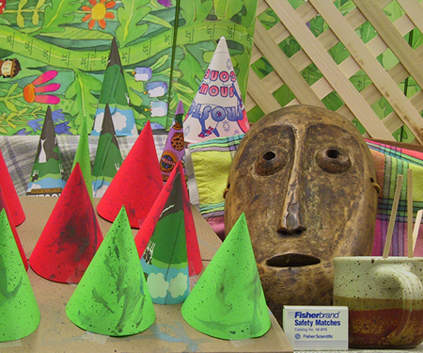
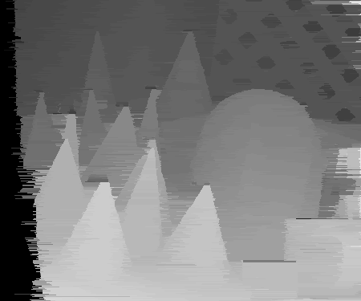
Dynamic Programming

Slide 41
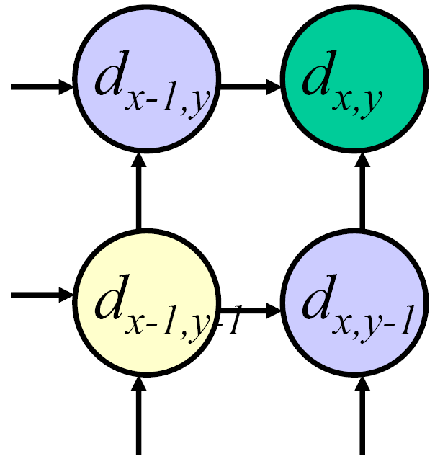
Dynamic programming
Can we apply this trick in 2D as well?
No: the shortest path trick only works to find a 1D path
Slide credit: D. Huttenlocher

Slide 42
Stereo as a minimization problem
The 2D problem has many local minima
  Gradient descent doesn’t work well
And a large search space
  n x m image w/ k disparities has k^{nm} possible solutions
  Finding the global minimum is NP-hard in general
Good approximations exist (e.g., graph cuts algorithms)

Slide 43
Questions?

Slide 44
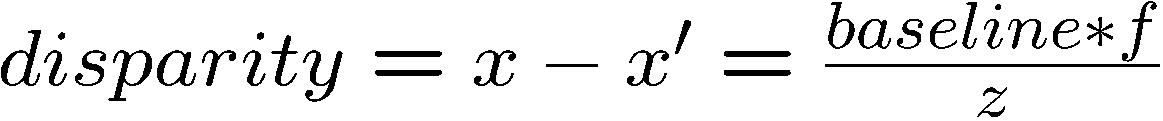
Depth from disparity
X
z
x
x’
f
f
C
baseline
C’

Slide 45
Stereo reconstruction pipeline
Steps
  Calibrate cameras
  Rectify images
  Compute disparity
  Estimate depth
What will cause errors?
  Camera calibration errors
  Poor image resolution
  Occlusions
  Violations of brightness constancy (specular reflections)
  Large motions
  Low-contrast image regions

Slide 46
Variants of stereo

Slide 47
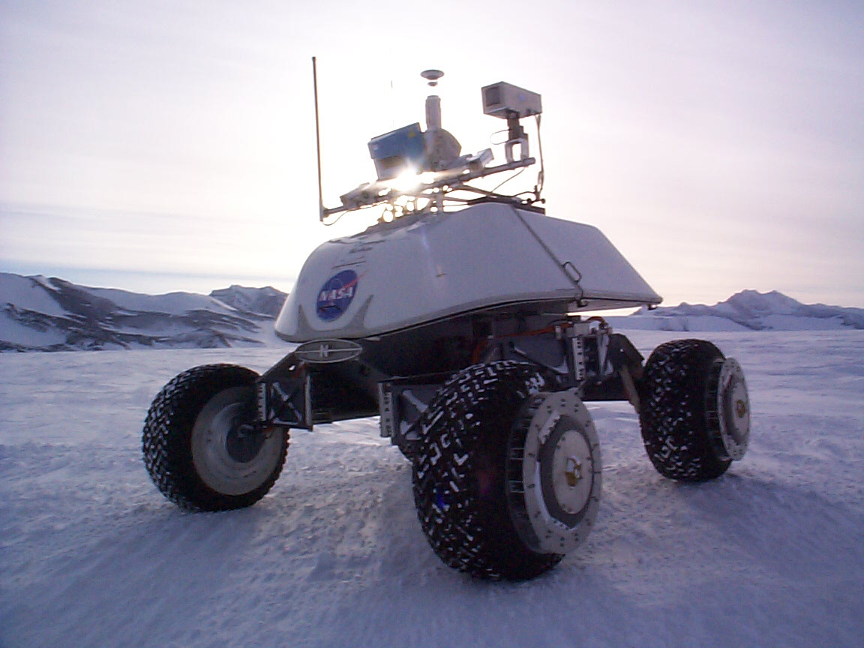
Real-time stereo
Nomad robot searches for meteorites in Antartica
Used for robot navigation (and other tasks)
  Several real-time stereo techniques have been developed (most based on simple discrete search)

Slide 48
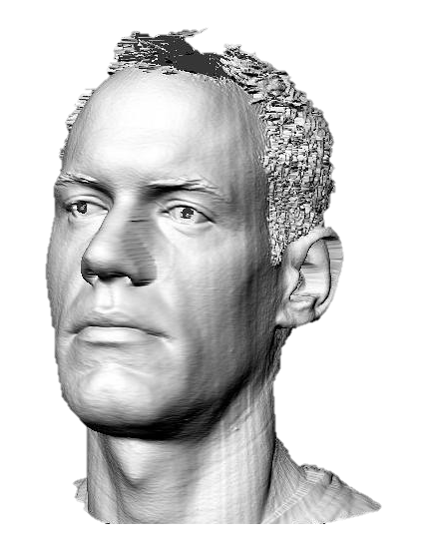
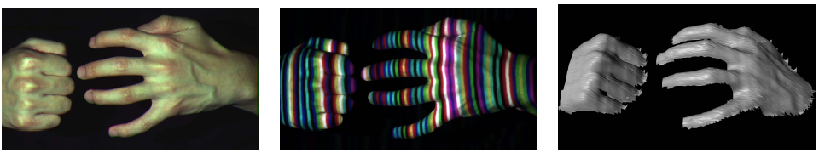
Active stereo with structured light
Li Zhang’s one-shot stereo
camera 1
camera 1
projector
projector
camera 2
Project “structured” light patterns onto the object
  simplifies the correspondence problem
  basis for active depth sensors, such as Kinect and iPhone X (using IR)

Slide 49
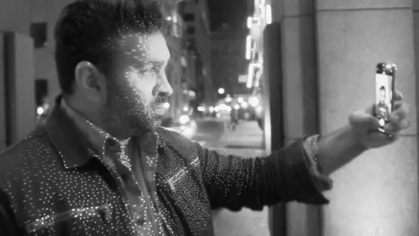
Active stereo with structured light
https://ios.gadgethacks.com/news/watch-iphone-xs-30k-ir-dots-scan-your-face-0180944/

Slide 50
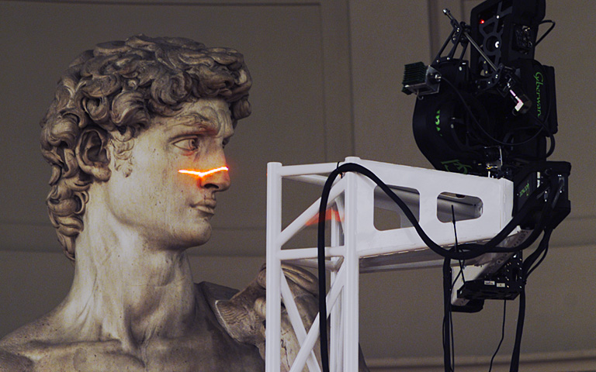
Laser scanning
Digital Michelangelo Project
http://graphics.stanford.edu/projects/mich/
Optical triangulation
  Project a single stripe of laser light
  Scan it across the surface of the object
  This is a very precise version of structured light scanning

Slide 51

Laser scanned models
  The Digital Michelangelo Project, Levoy et al.

Slide 52
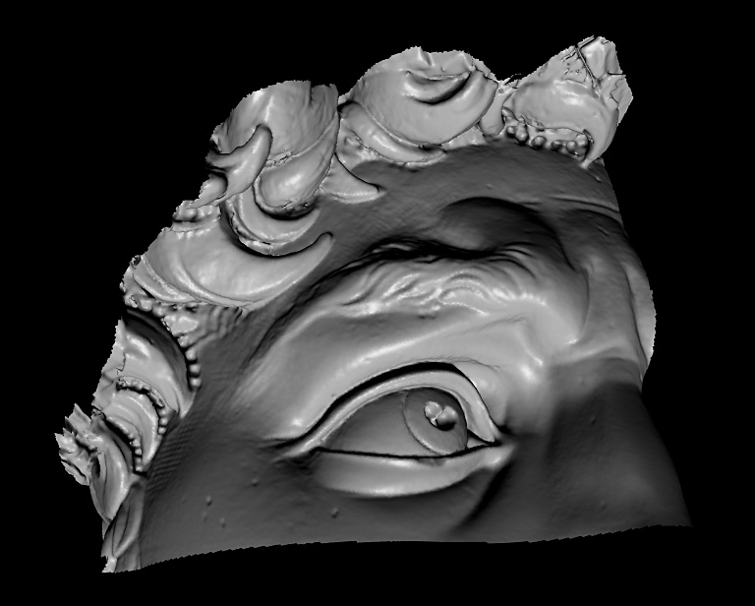
Laser scanned models
  The Digital Michelangelo Project, Levoy et al.

Slide 53
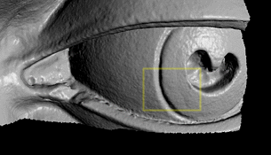
Laser scanned models
  The Digital Michelangelo Project, Levoy et al.

Slide 54
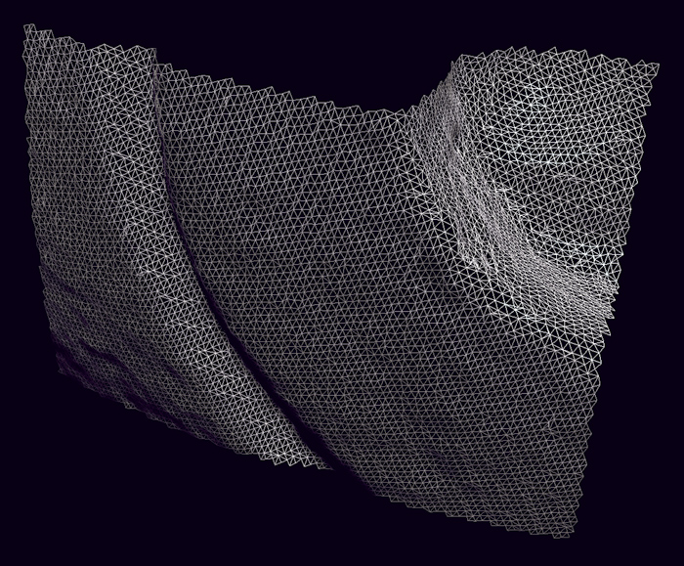
Laser scanned models
  The Digital Michelangelo Project, Levoy et al.

Slide 55
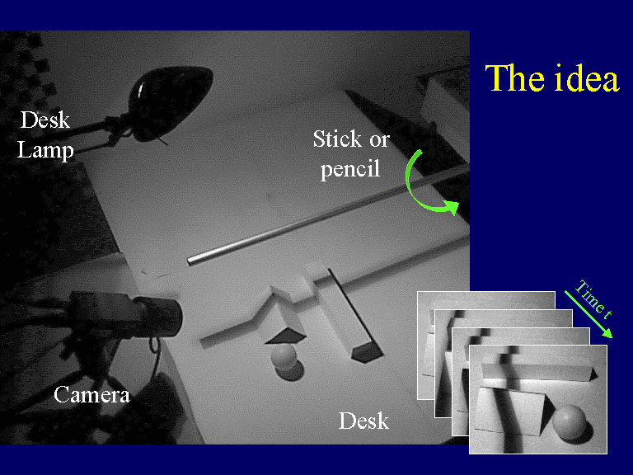


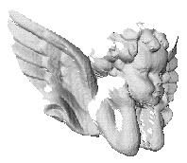
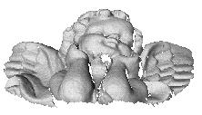
3D Photography on your Desk
http://www.vision.caltech.edu/bouguetj/ICCV98/

Slide 56
Questions?

