Slide 1
Quiz 1 (on Canvas)
Ends at 1:10pm

Slide 2

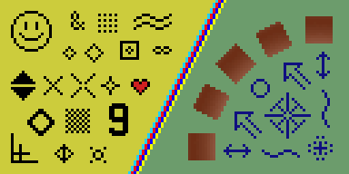
Image Resampling & Interpolation
CS5670: Computer Vision

Slide 3
Announcements
Project 1 released, due Friday, February 10 by 8pm on GitHub Classroom
  Project to be done solo (teams of one)
  Artifact due Monday, Feb 13 by 8pm

Slide 4
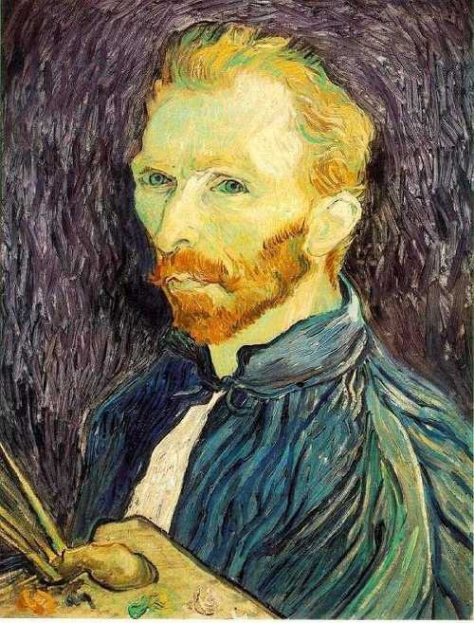
Image scaling
This image is too big to fit on the screen. How can we generate a half-sized version?
Source: S. Seitz

Slide 5

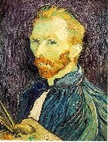

Image sub-sampling
1/8
1/4
Throw away every other row and column to create a 1/2 size image
  - called image sub-sampling
Source: S. Seitz

Slide 6
Image sub-sampling
1/2
1/4 (2x zoom)
1/8 (4x zoom)
Why does this look so crufty?
Source: S. Seitz

Slide 7
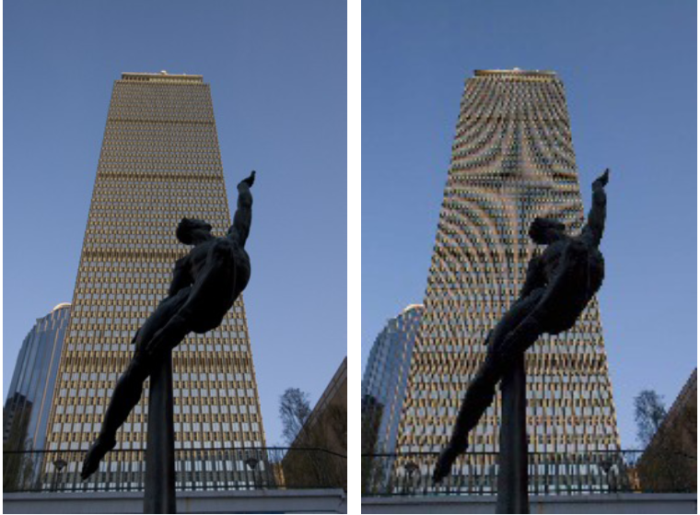
Image sub-sampling – another example
Source: F. Durand

Slide 8
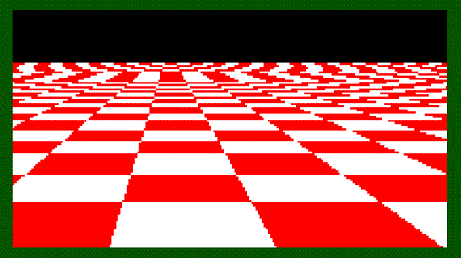
Even worse for synthetic images
Source: L. Zhang

Slide 9
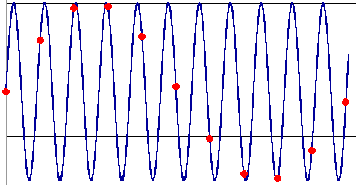
Aliasing
Occurs when your sampling rate is not high enough to capture the amount of detail in your image
Can give you the wrong signal/image—an alias
To do sampling right, need to understand the structure of your signal/image
Enter Monsieur Fourier…
  “But what is the Fourier Transform? A visual introduction.” https://www.youtube.com/watch?v=spUNpyF58BY
To avoid aliasing:
  sampling rate ≥ 2 * max frequency in the image
    said another way: ≥ two samples per cycle
  This minimum sampling rate is called the Nyquist rate
Source: L. Zhang

Slide 10
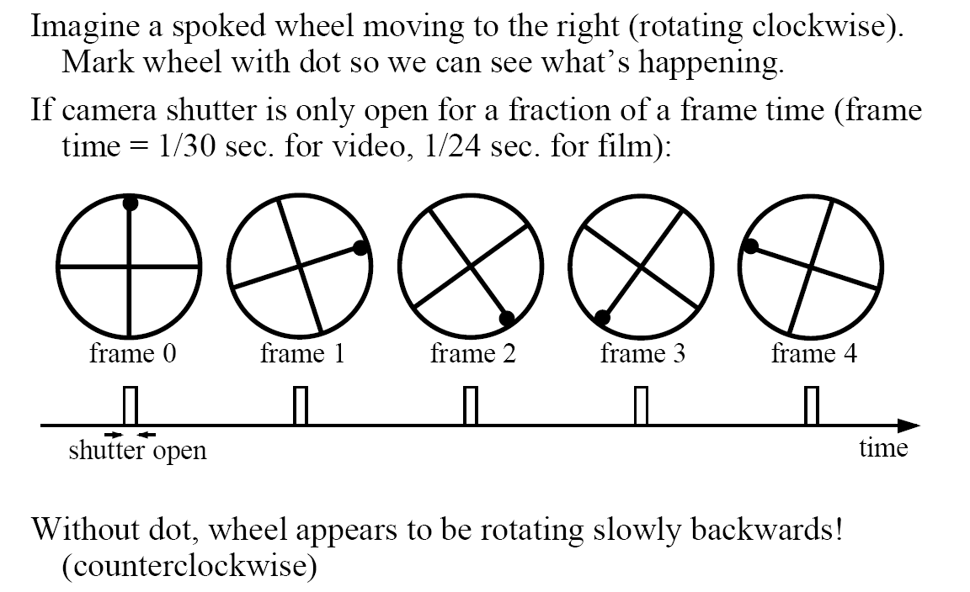
Wagon-wheel effect
(See http://www.michaelbach.de/ot/mot-wagonWheel/index.html)
Source: L. Zhang

Slide 11

Wagon-wheel effect
https://en.wikipedia.org/wiki/Wagon-wheel_effect

Slide 12
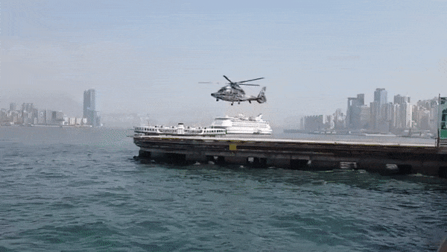
Temporal aliasing – helicopter blades
https://www.youtube.com/watch?v=yr3ngmRuGUc

Slide 13
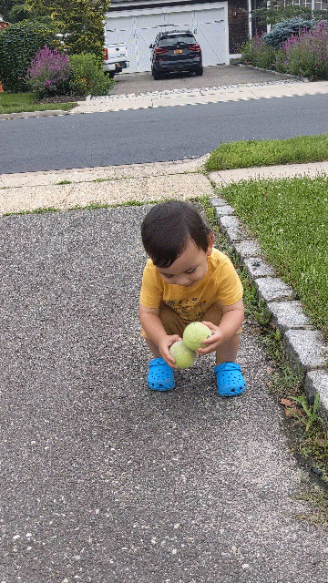
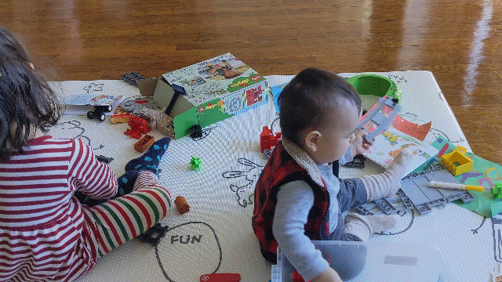
Aliasing in practice

Slide 14
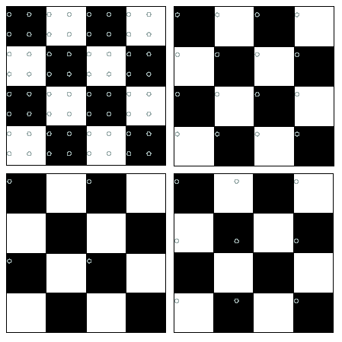
Nyquist limit – 2D example
Good sampling
Bad sampling

Slide 15
Aliasing
When downsampling by a factor of two
  Original image has frequencies that are too high
How can we fix this?

Slide 16



Gaussian pre-filtering
G 1/8
G 1/4
Gaussian 1/2
Solution: filter the image, then subsample
Source: S. Seitz

Slide 17
Subsampling with Gaussian pre-filtering
Gaussian 1/2
G 1/4
G 1/8
Solution: filter the image, then subsample
Source: S. Seitz

Slide 18
Compare with...
1/2
1/4 (2x zoom)
1/8 (4x zoom)
Source: S. Seitz

Slide 19
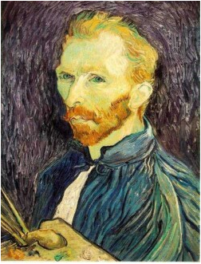







Gaussian pre-filtering
Solution: filter the image, then subsample
F₀
F₁
F₂
…
blur
subsample
blur
subsample
F₀ H
F₁ H
*
*

Slide 20
{
Gaussian pyramid
F₀
F₁
F₂
…
blur
subsample
blur
subsample
F₀ H
F₁ H
*
*

Slide 21
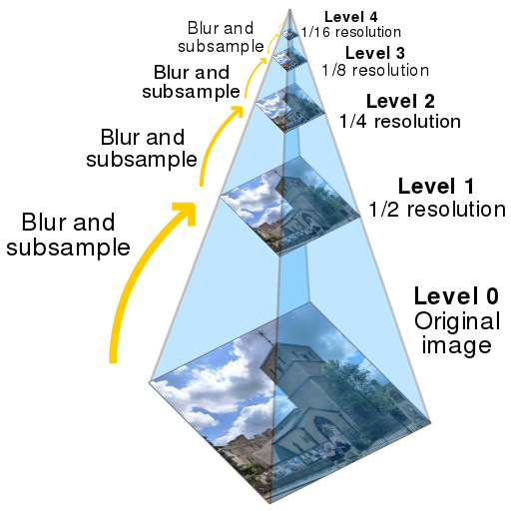

Slide 22
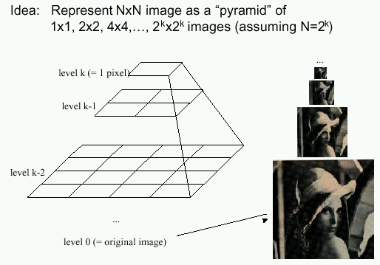
Gaussian pyramids [Burt and Adelson, 1983]
In computer graphics, a mip map [Williams, 1983]
A precursor to wavelet transform
Gaussian Pyramids have all sorts of applications in computer vision
Source: S. Seitz

Slide 23
Gaussian pyramids [Burt and Adelson, 1983]
How much space does a Gaussian pyramid take compared to the original image?
Source: S. Seitz

Slide 24
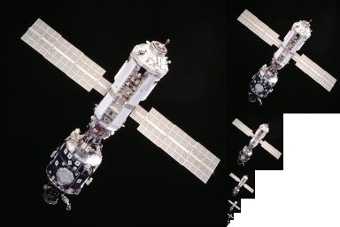
Gaussian pyramid

Slide 25


How much space (number of pixels) does a Gaussian pyramid of an image take compared to the original image?
ⓘ Start presenting to display the poll results on this slide.

Slide 26
Gaussian pyramid
Answer: 4/3 the amount of space as the original image alone

Slide 27
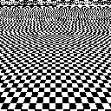
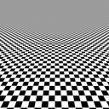
Back to the checkerboard
What should happen when you make the checkerboard smaller and smaller?
Image turns grey! (Average of black and white squares, because each pixel contains both.)
Naïve subsampling
Proper prefiltering
(“antialiasing”)

Slide 28
Questions?

Slide 29

Upsampling
This image is too small for this screen:
How can we make it 10 times as big?
Simplest approach:
repeat each row
and column 10 times
(“Nearest neighbor
interpolation”)

Slide 30


Image interpolation
d = 1 in this
example
1
2
3
4
5
Recall that a digital images is formed as follows:
  It is a discrete point-sampling of a continuous function
  If we could somehow reconstruct the original function, any new image could be generated, at any resolution and scale
Adapted from: S. Seitz

Slide 31
Image interpolation
d = 1 in this
example
1
2
3
4
5
Recall that a digital images is formed as follows:
  It is a discrete point-sampling of a continuous function
  If we could somehow reconstruct the original function, any new image could be generated, at any resolution and scale
Adapted from: S. Seitz

Slide 32




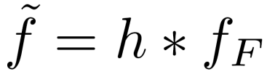
Image interpolation
1
d = 1 in this example
1
2
2.5
3
4
5
What if we don’t know ?
  Guess an approximation:
  Can be done in a principled way: filtering
  Convert to a continuous function:
  Reconstruct by convolution with a reconstruction filter, h
Adapted from: S. Seitz

Slide 33
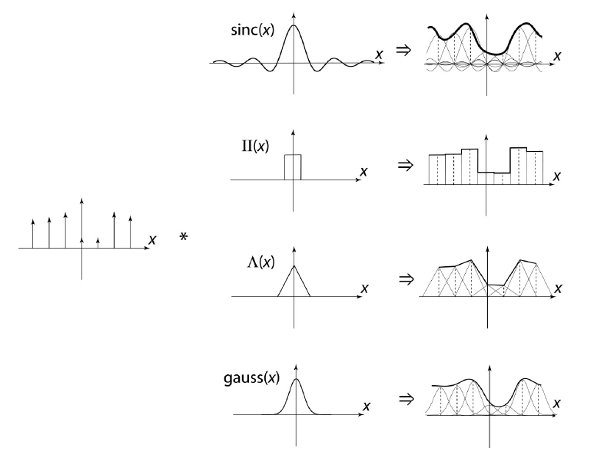
Image interpolation
“Ideal” reconstruction
Nearest-neighbor interpolation
Linear interpolation
Gaussian reconstruction
Source: B. Curless

Slide 34
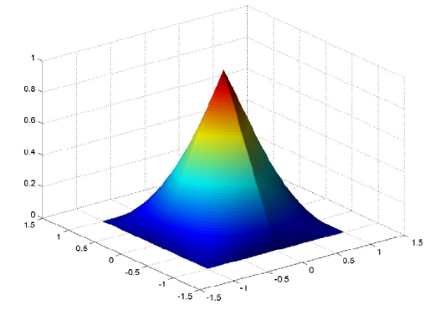



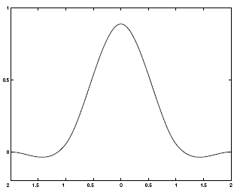
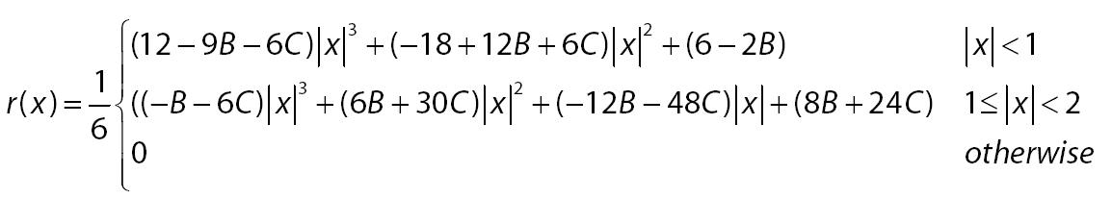
Reconstruction filters
What does the 2D version of this hat function look like?
performs
linear interpolation
(tent function) performs
bilinear interpolation
Often implemented without cross-correlation
  E.g., http://en.wikipedia.org/wiki/Bilinear_interpolation
Better filters give better resampled images
  Bicubic is common choice
Cubic reconstruction filter

Slide 35


Image interpolation
Original image: x 10
Nearest-neighbor interpolation
Bilinear interpolation
Bicubic interpolation

Slide 36
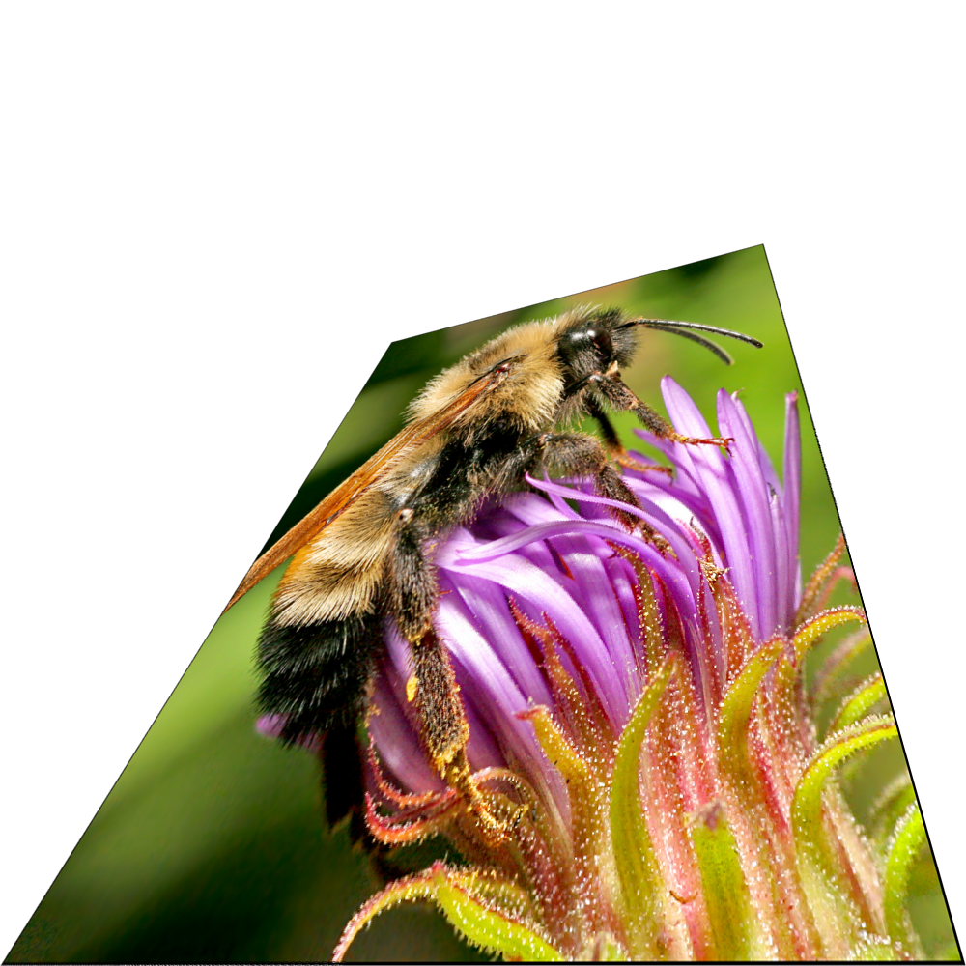
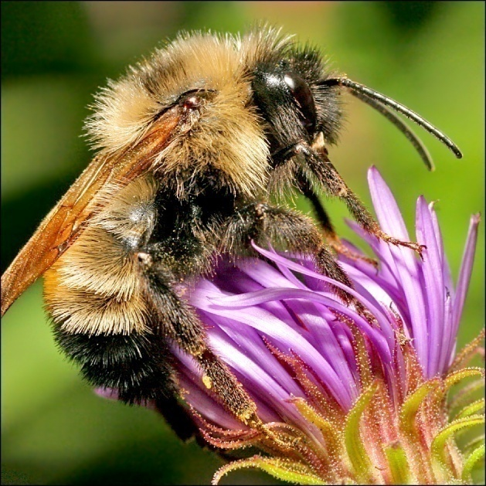
Image interpolation
Also used for resampling

Slide 37


Raster-to-vector graphics

Slide 38
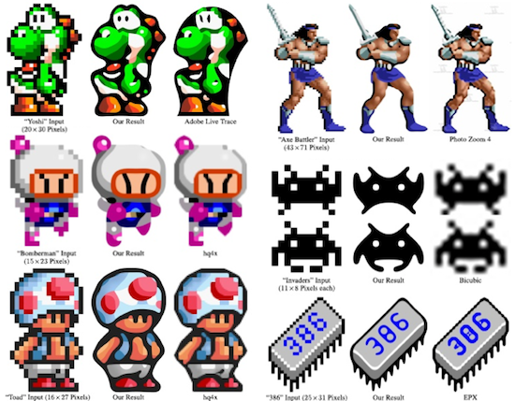
Depixelating Pixel Art

Slide 39
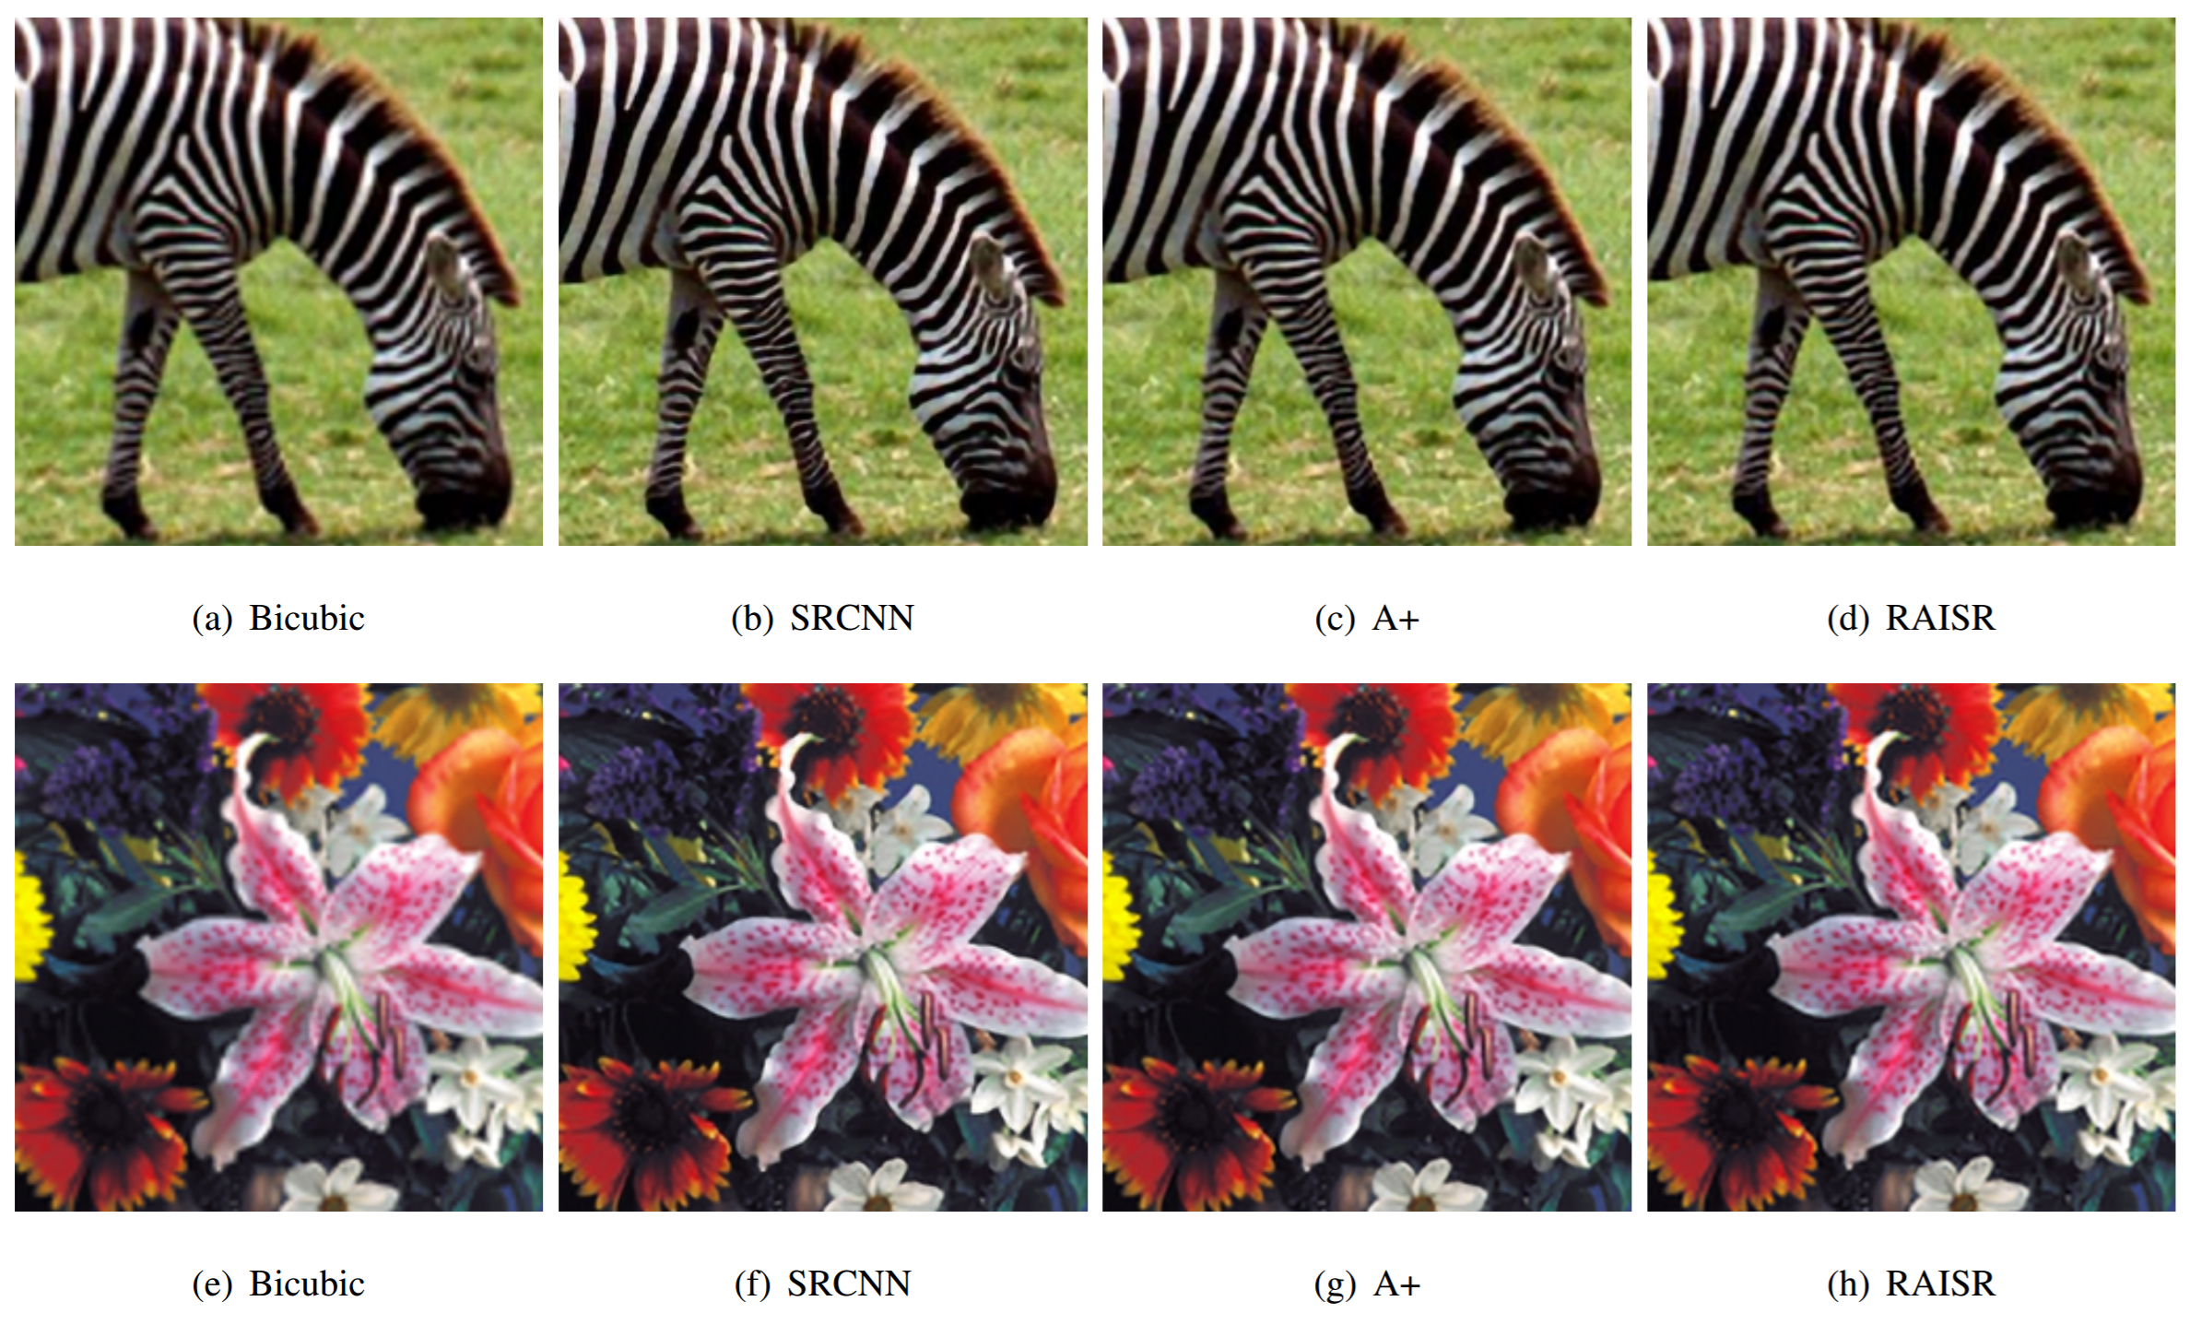
Modern methods
From Romano, et al: RAISR: Rapid and Accurate Image Super Resolution, https://arxiv.org/abs/1606.01299

Slide 40
Super-resolution with multiple images
Can do better upsampling if you have multiple images of the scene taken with small (subpixel) shifts
Some cellphone cameras (like the Google Pixel line) capture a burst of photos
Can we use that burst for upsampling?

Slide 41
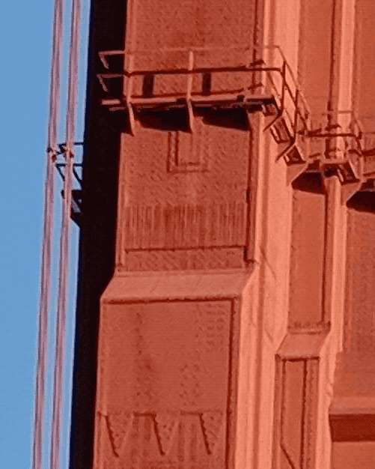
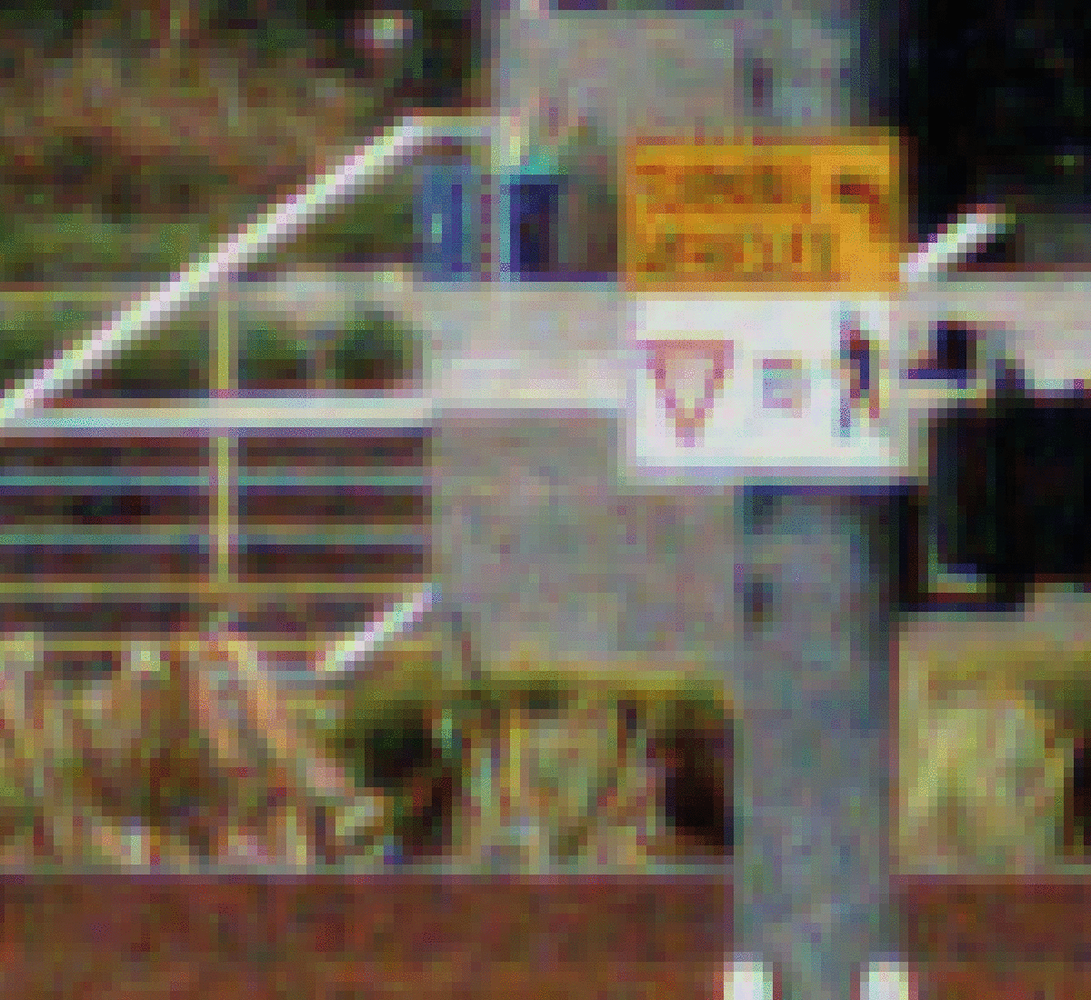
Google Pixel 3 Super Res Zoom
Effect of hand tremor as seen in a cropped burst of photos, after global alignment
Example photo with and without super res zoom (smart burst align and merge)
https://ai.googleblog.com/2018/10/see-better-and-further-with-super-res.html

Slide 42
Summary
Key points:
  Subsampling an image can cause aliasing. Better is to blur (“pre-filter”) to remote high frequencies then downsample
  If you repeatedly blur and downsample by 2x, you get a Gaussian pyramid
  Upsampling an image requires interpolation. This can be posed as convolution with a “reconstruction kernel”

Slide 43
Questions?

