Slide 1
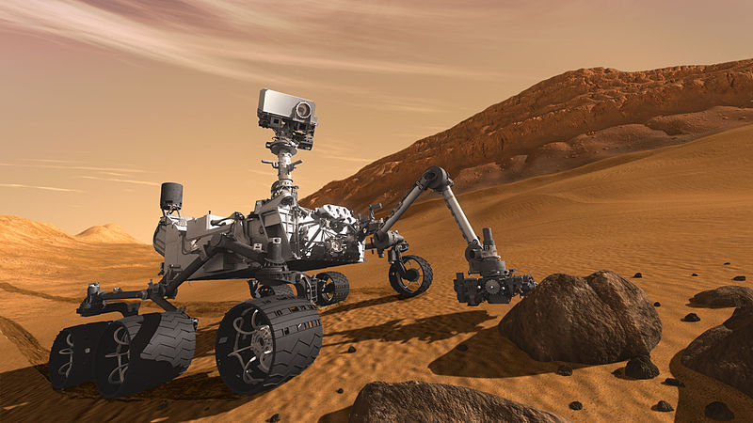
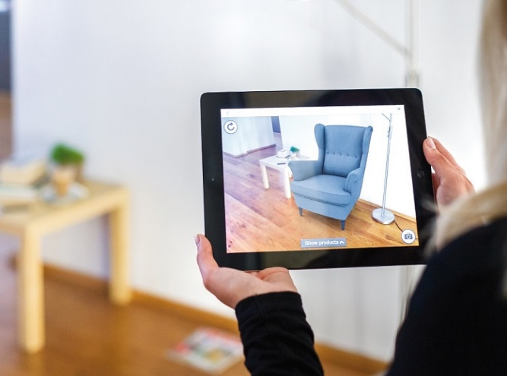
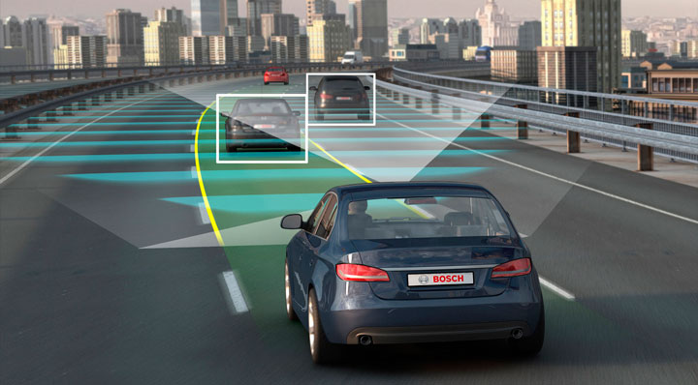
CS5670: Intro to Computer Vision (Cornell Tech)
Instructor: Noah Snavely

Slide 2
Instructor
Noah Snavely (snavely@cs.cornell.edu)
Research interests:
Computer vision and graphics
3D reconstruction and visualization of Internet photo collections
Deep learning for computer graphics
Virtual and augmented reality

Slide 3
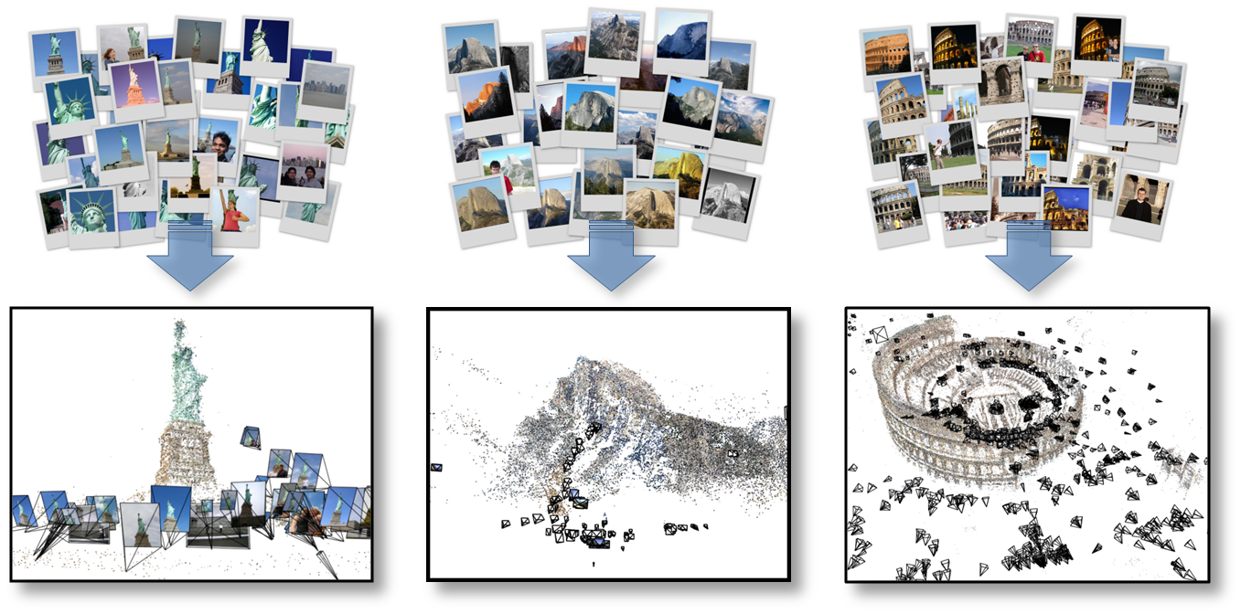
Noah’s work
Automatic 3D reconstruction from Internet photo collections
“Statue of Liberty”
“Half Dome, Yosemite”
“Colosseum, Rome”
Flickr photos
3D model

Slide 4
City-scale 3D reconstruction
Reconstruction of Dubrovnik, Croatia, from ~40,000 images

Slide 5
Depth from a single image

Slide 6
Visualizing scenes from tourist photos

Slide 7
Teaching assistants
Rui Qian
rq49@cornell.edu
Ruojin Cai
rc844@cornell.edu
Wenqi Xian
wx97@cornell.edu
Qianqian Wang
qw246@cornell.edu
Please check course webpage for office hours
https://www.cs.cornell.edu/courses/cs5670/2023sp/

Slide 8
Important information
Textbook:
Rick Szeliski, Computer Vision: Algorithms and Applications online at: http://szeliski.org/Book/
Course webpage: http://www.cs.cornell.edu/courses/cs5670/2023sp/
Canvas Page: https://canvas.cornell.edu/courses/49751
Announcements/discussion via Ed Discussions (via Canvas)
Assignment turnin via GitHub Classroom and CMSX: https://cmsx.cs.cornell.edu

Slide 9
Today
What is computer vision?
Why study computer vision?
Course overview
Images & image filtering [time permitting]

Slide 10
Today
Readings
Szeliski, Chapter 1 (Introduction)

Slide 11
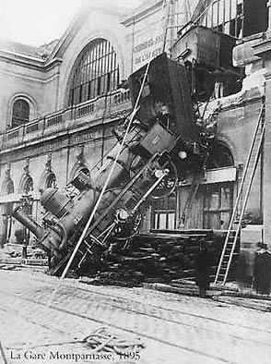
Every image tells a story
Goal of computer vision: perceive the “story” behind the picture
Compute properties of the world
3D shape
Names of people or objects
What happened?

Slide 12
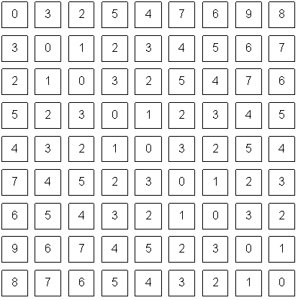
The goal of computer vision

Slide 13
Can computers match human perception?
Yes and no (mainly no)
computers can be better at “easy” things
humans are better at “hard” things
But huge progress
Accelerating in the last five years due to deep learning
What is considered “hard” keeps changing

Slide 14
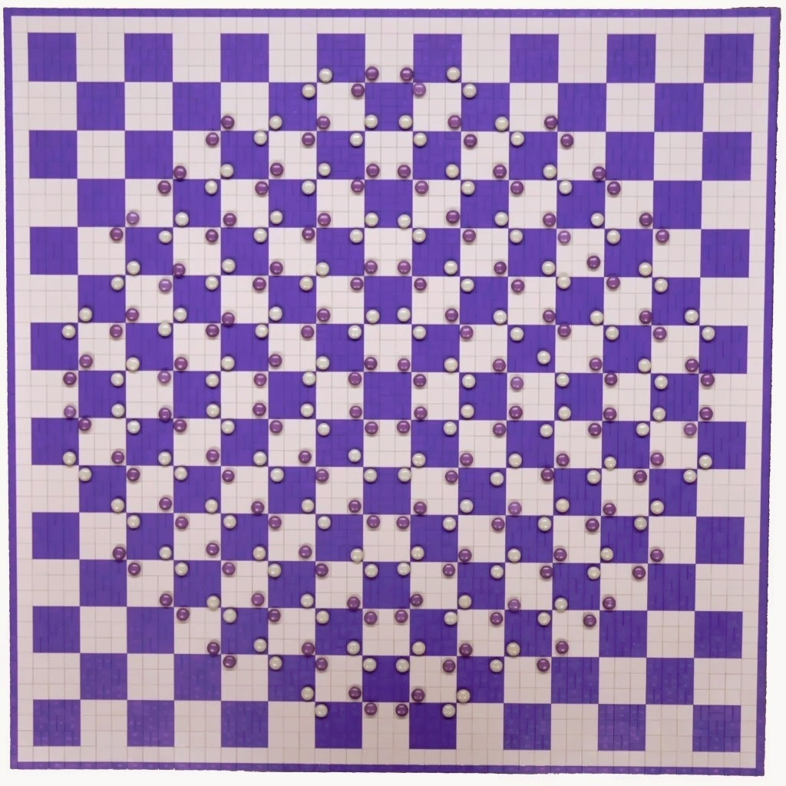
Human perception has its shortcomings
https://twitter.com/pickover/status/1460275132958662657/

Slide 15
But humans can tell a lot about a scene from a little information…
Source: “80 million tiny images” by Torralba, et al.

Slide 17
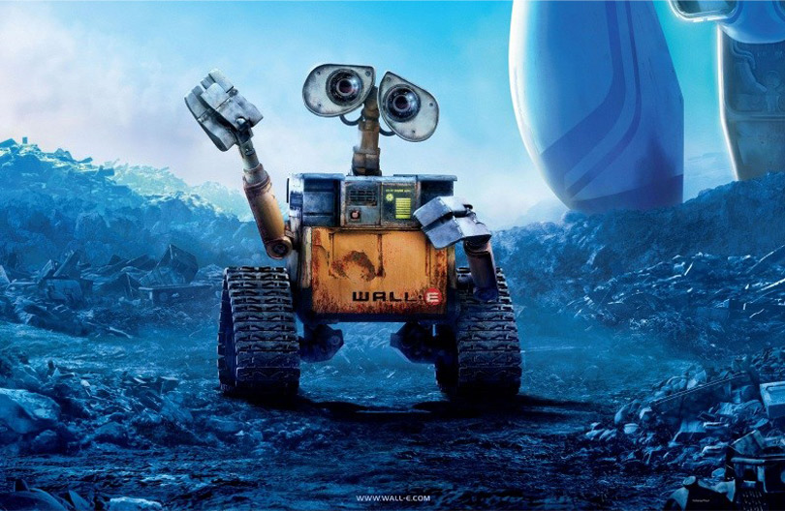
The goal of computer vision

Slide 18
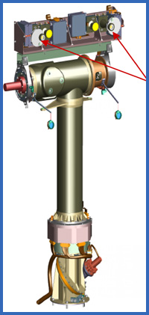
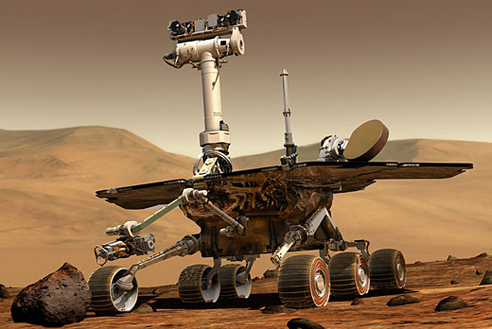
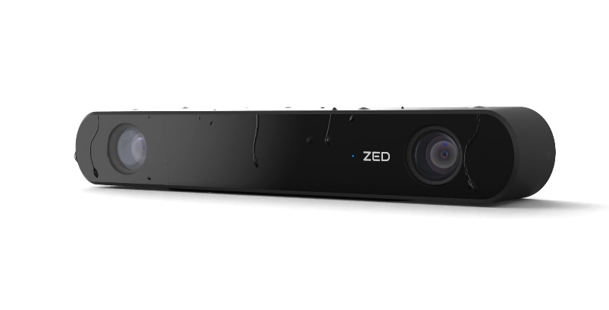
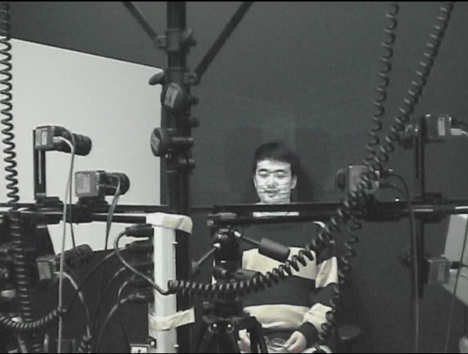
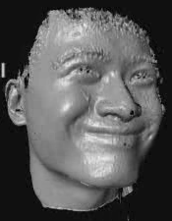
The goal of computer vision
Compute the 3D shape of the world
ZED 2i Camera

Slide 19
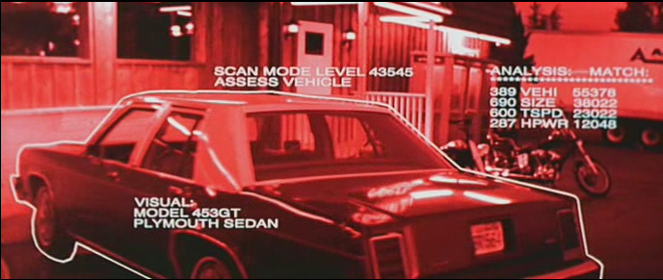
The goal of computer vision
Recognize objects and people
Terminator 2, 1991

Slide 20
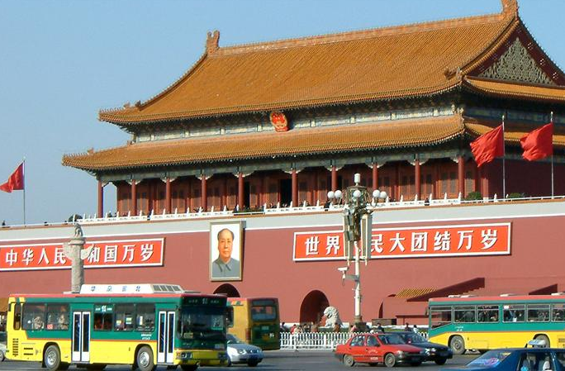
slide credit: Fei-Fei, Fergus & Torralba

Slide 21
sky
building
flag
face
banner
wall
street lamp
bus
bus
cars
slide credit: Fei-Fei, Fergus & Torralba

Slide 22
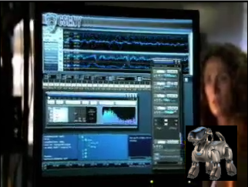
The goal of computer vision
“Enhance” images

Slide 24
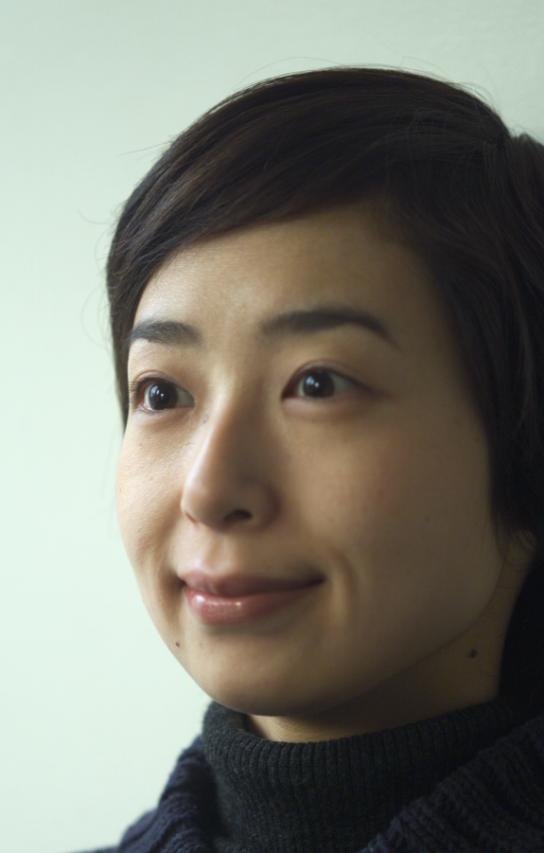
The goal of computer vision
Forensics
Source: Nayar and Nishino, “Eyes for Relighting”

Slide 25
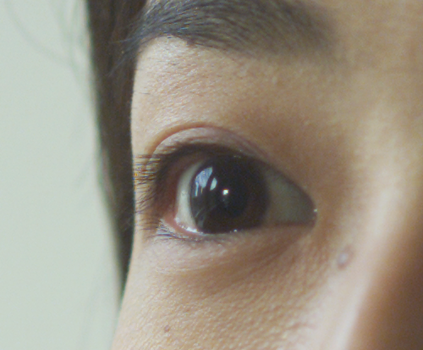
Source: Nayar and Nishino, “Eyes for Relighting”

Slide 26
Source: Nayar and Nishino, “Eyes for Relighting”

Slide 27
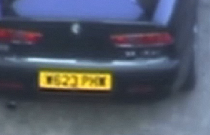
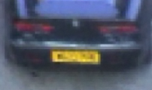
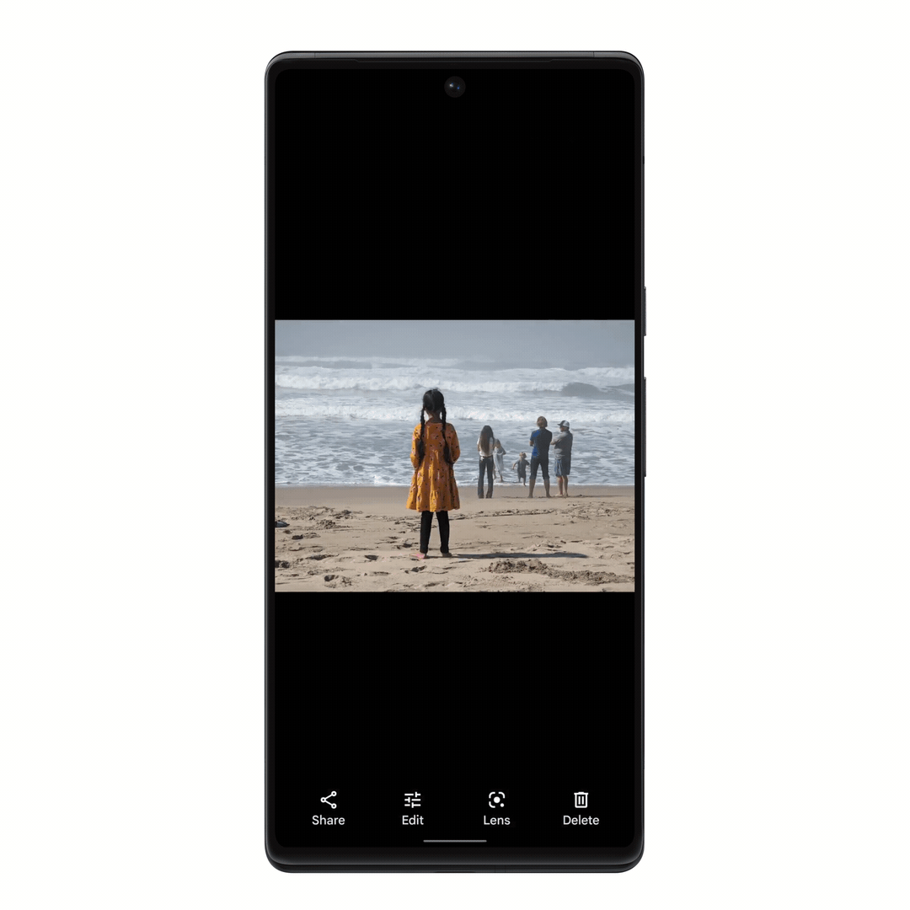
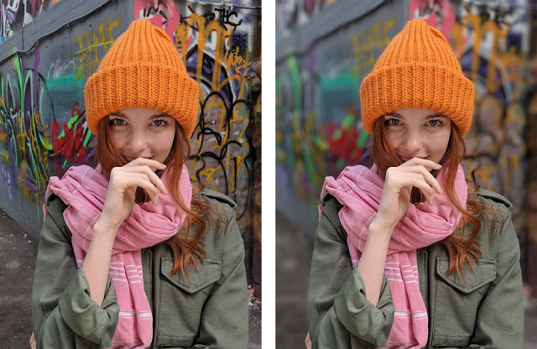
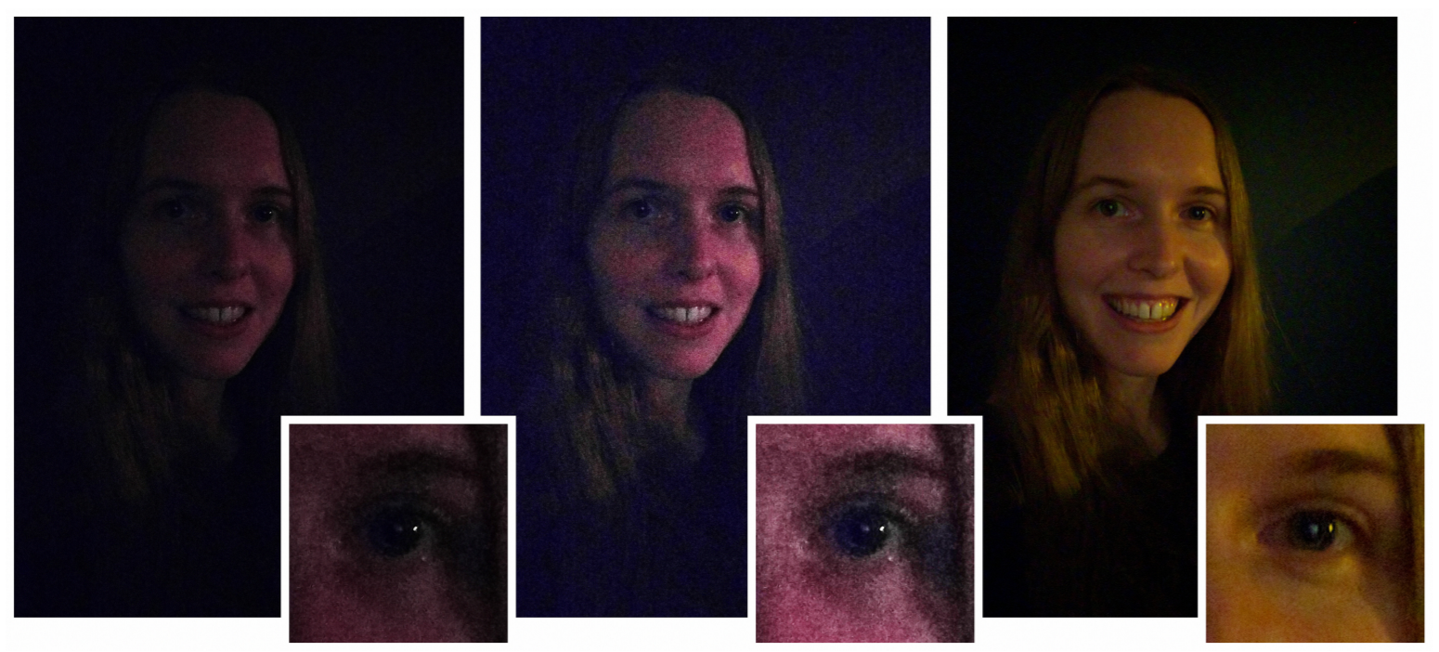
The goal of computer vision
Improve photos (“Computational Photography”)
Super-resolution (source: 2d3)
Depth of field on cell phone camera (source: Google Research Blog)
Removing objects (Google Magic Eraser)
Low-light photography
(credit: Hasinoff et al., SIGGRAPH ASIA 2016)

Slide 28
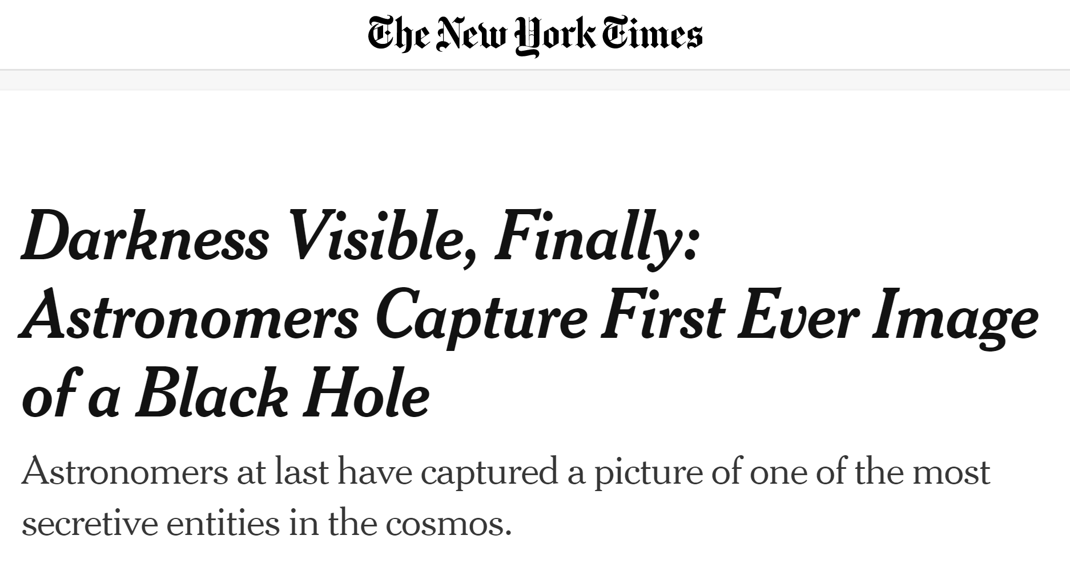
April 10, 2019

Slide 29
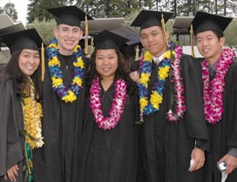
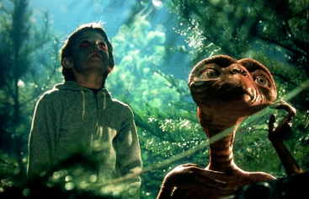
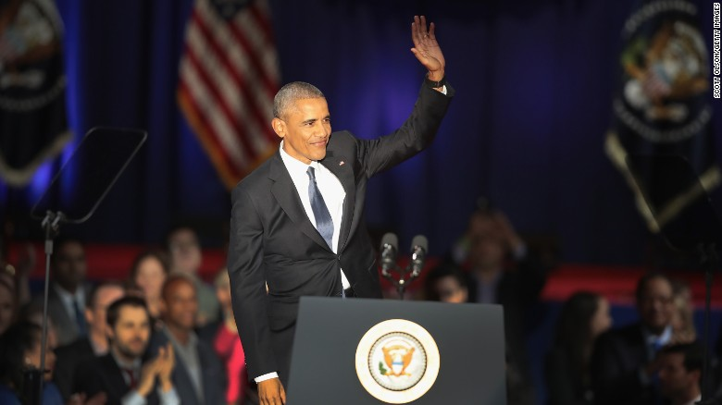
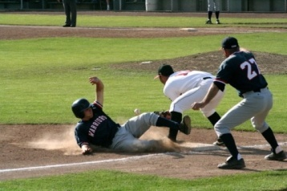
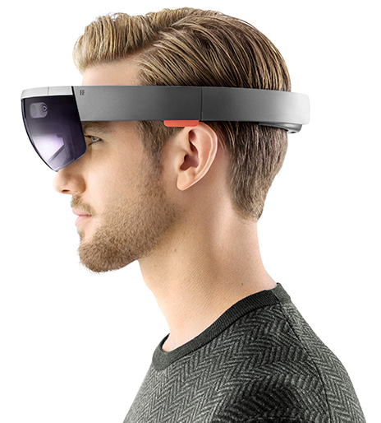
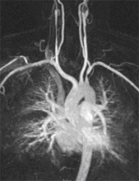
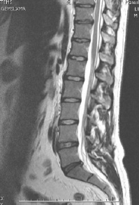
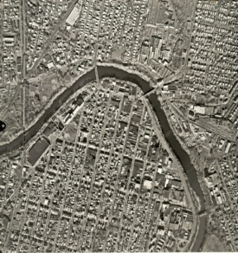
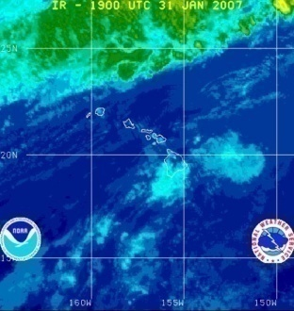
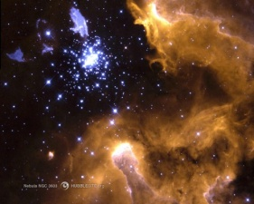
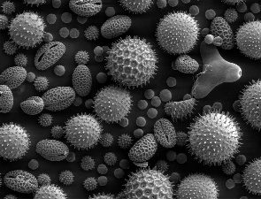
Why study computer vision?
Billions of images/videos captured per day
Huge number of potential applications
The next slides show the current state of the art

Slide 30
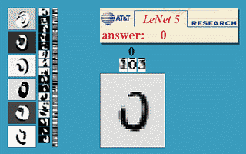
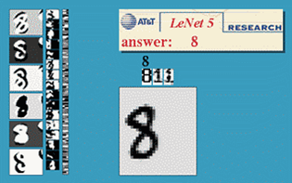
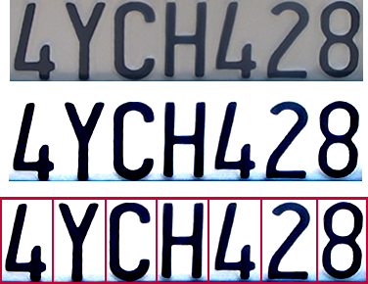
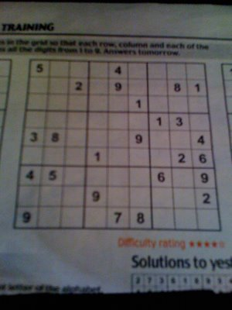
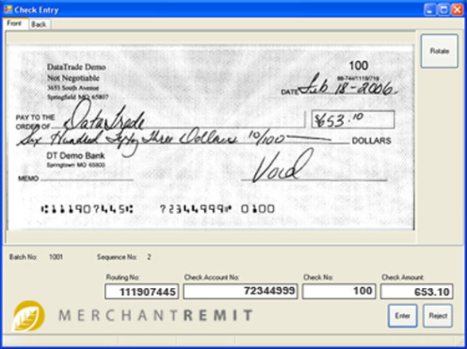
Optical character recognition (OCR)
If you have a scanner, it probably came with OCR software
Digit recognition, AT&T labs (1990’s)
http://yann.lecun.com/exdb/lenet/
License plate readers
http://en.wikipedia.org/wiki/Automatic_number_plate_recognition
Sudoku grabber
http://sudokugrab.blogspot.com/
Automatic check processing

Slide 31
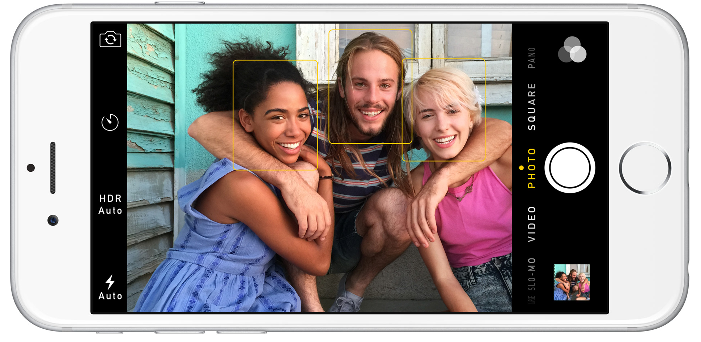
Face detection
Nearly all cameras detect faces in real time
(Why?)
Notes:
Why would this be useful? Main reason is focus. Also enables “smart” cropping.

Slide 32
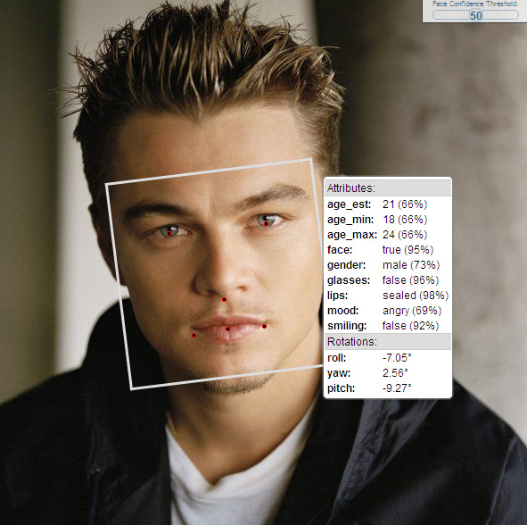
Face analysis and recognition

Slide 33
Vision-based biometrics
Who is she?
Source: S. Seitz

Slide 34
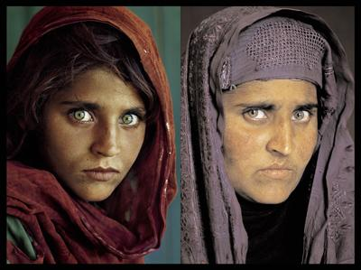
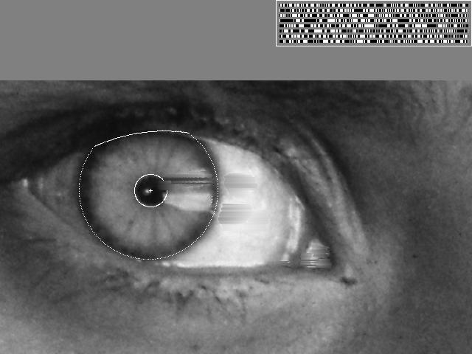
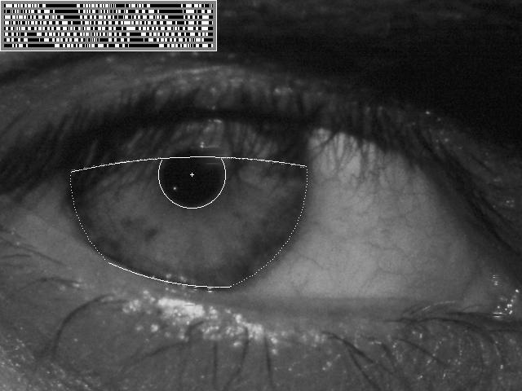
Vision-based biometrics
“How the Afghan Girl was Identified by Her Iris Patterns” Read the story
Source: S. Seitz

Slide 35
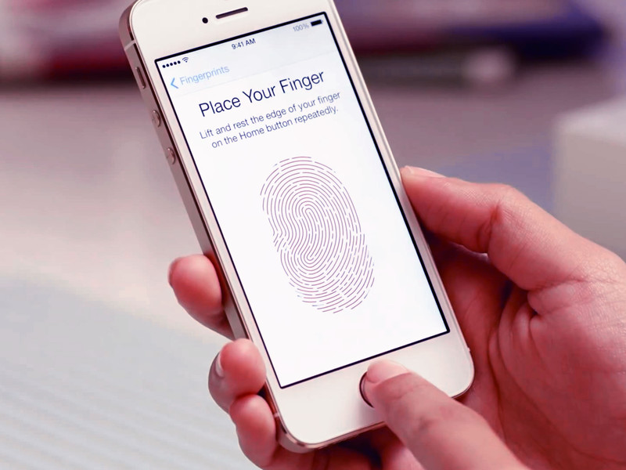
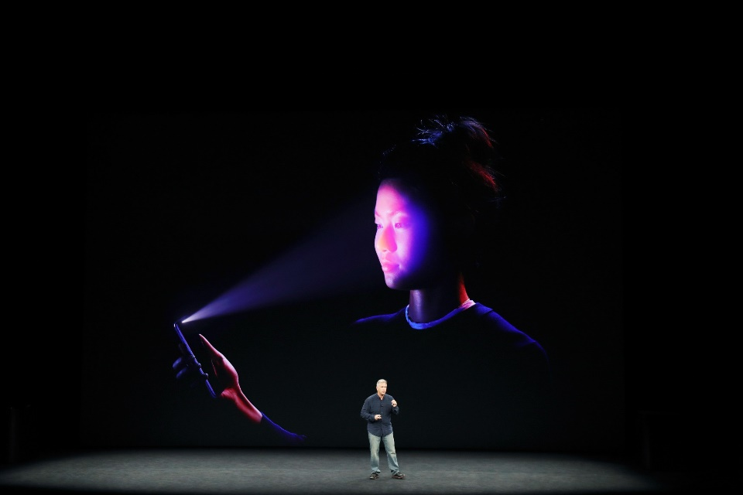
Login without a password
Fingerprint scanners on many new smartphones and other devices
Face unlock on Apple iPhone X See also http://www.sensiblevision.com/

Slide 36
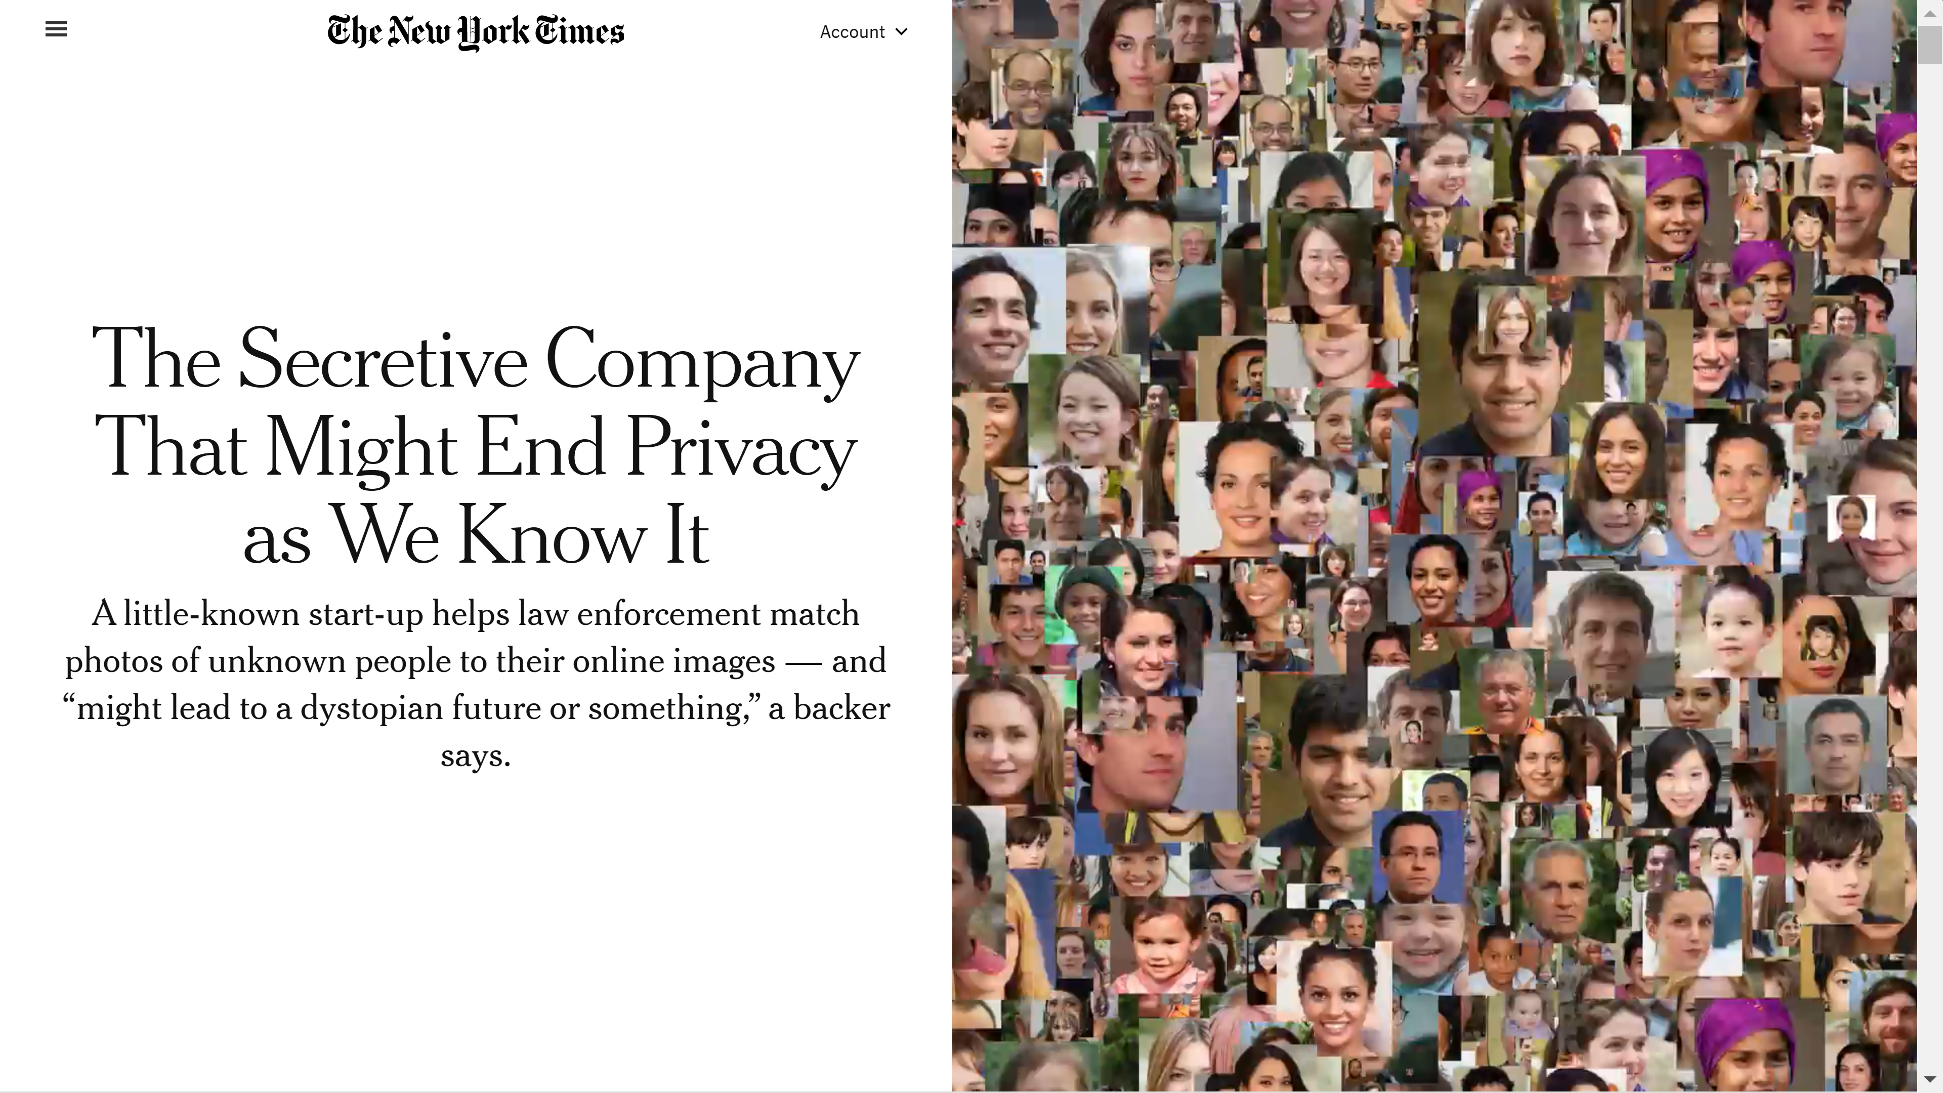
New York Times, Jan. 18, 2020
by Kashmir Hill

Slide 37
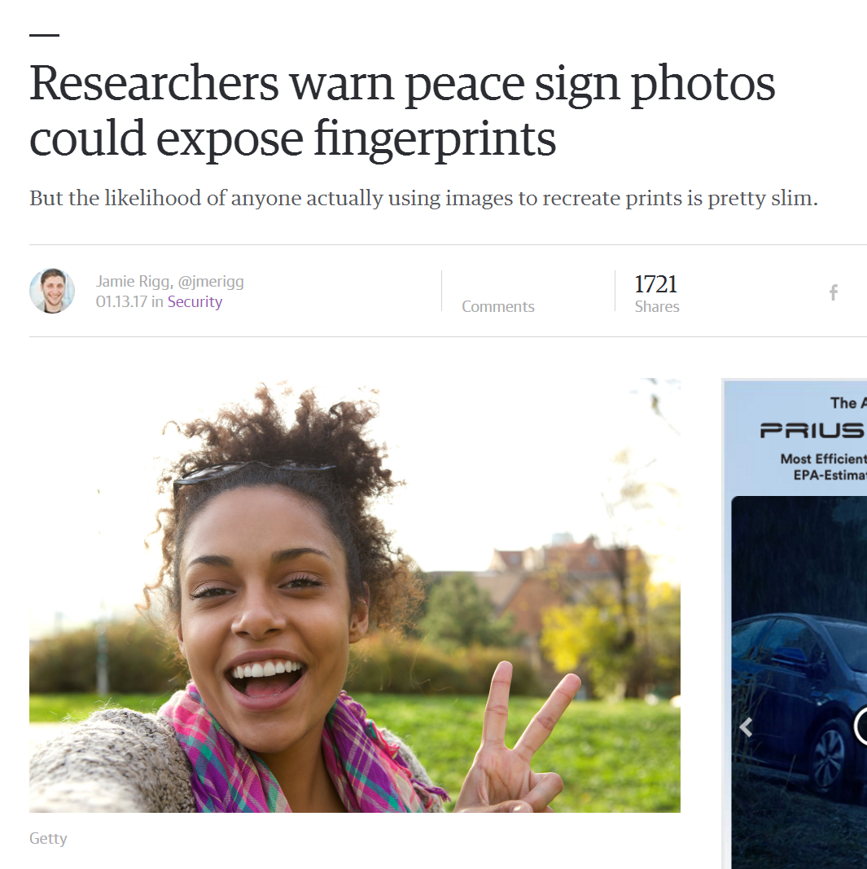

Slide 38
Bird identification
Merlin Bird ID (based on Cornell Tech technology!)

Slide 39
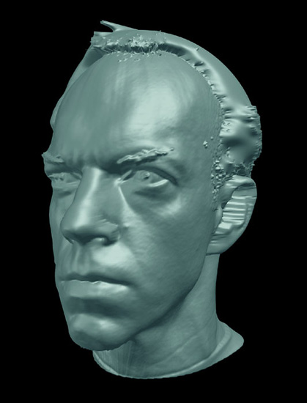
Special effects: shape capture
The Matrix movies, ESC Entertainment, XYZRGB, NRC
Source: S. Seitz

Slide 40
Special effects: motion capture
Pirates of the Carribean, Industrial Light and Magic
Source: S. Seitz

Slide 43
3D face tracking w/ consumer cameras
Snapchat Lenses
Face2Face system (Thies et al.)

Slide 44
Image synthesis
Karras, et al., Progressive Growing of GANs for Improved Quality, Stability, and Variation, ICLR 2018

Slide 45
Which face is real?
https://www.whichfaceisreal.com/

Slide 46
Image synthesis
“An astronaut riding a horse in a photorealistic style” – DALL-E 2
“A photo of a Corgi dog riding a bike in Times Square. It is wearing sunglasses and a beach hat” – Imagen

Slide 47
Sports
Sportvision first down line
Explanation on www.howstuffworks.com
Source: S. Seitz

Slide 48
Smart cars
Mobileye
Tesla Autopilot
Safety features in many cars

Slide 49
Self-driving cars
Waymo

Slide 50
Robotics
NASA’s Mars Curiosity Rover
https://en.wikipedia.org/wiki/Curiosity_(rover)
Amazon Picking Challenge
http://www.robocup2016.org/en/events/amazon-picking-challenge/
Amazon Prime Air
Amazon Scout

Slide 51
Medical imaging
3D imaging (MRI, CT)
Skin cancer classification with deep learning https://cs.stanford.edu/people/esteva/nature/

Slide 52
Notes:
You may have read this headline last year and thought: 2 billion! That’s crazy? What is Virtual Reality? And why is it going to be so big?

Slide 53
Virtual & Augmented Reality
6DoF head tracking
Hand & body tracking
3D scene understanding
3D-360 video capture

Slide 54
Current state of the art
You just saw many examples of current systems.
Many of these are less than 5 years old
Computer vision is an active research area, and rapidly changing
Many new apps in the next 5 years
Deep learning powering many modern applications
Many startups across a dizzying array of areas
Deep learning, robotics, autonomous vehicles, medical imaging, construction, inspection, VR/AR, …

Slide 55
Why is computer vision difficult?
Viewpoint variation
Credit: Flickr user michaelpaul
Scale
Illumination

Slide 56
Why is computer vision difficult?
Motion (Source: S. Lazebnik)
Intra-class variation
Background clutter
Occlusion

Slide 57
Challenges: local ambiguity
slide credit: Fei-Fei, Fergus & Torralba

Slide 58
But there are lots of visual cues we can use…
Source: S. Lazebnik

Slide 59
Bottom line
Perception is an inherently ambiguous problem
Many different 3D scenes could have given rise to a given 2D image
We often must use prior knowledge about the world’s structure
Artist Julian Beever with his anamorphic Coke bottle
Image source: F. Durand

Slide 63
CS5670: Introduction to Computer Vision
Project-based course whose goal is to teach you the basics of computer vision – image processing, geometry, recognition – in a hands-on way

Slide 64
Course requirements
Prerequisites
Data structures
Good working knowledge of Python programming
Linear algebra
Vector calculus
Course does not assume prior imaging experience
computer vision, image processing, graphics, etc.

Slide 65
Course overview (tentative)
Low-level vision
image processing, edge detection, feature detection, cameras, image formation
Geometry and algorithms
projective geometry, stereo, structure from motion, optimization
Recognition
face detection / recognition, category recognition, segmentation

Slide 66
1. Low-level vision
Basic image processing and image formation
*
=
Filtering, edge detection
Feature extraction
Image formation

Slide 67
Project: Hybrid images

Slide 70
Project: Feature detection and matching

Slide 71
2. Geometry
Image credit: IDS Imaging
Projective geometry
Stereo vision
Multi-view stereo
Structure from motion

Slide 72
Project: Creating panoramas

Slide 73
Project: 3D reconstruction

Slide 74
3. Recognition
“dog”
Image classification
Object detection
Convolutional Neural Networks

Slide 75
Project: Neural Radiance Fields (NeRFs)

Slide 76
Lectures
Lectures will be held in person in Bloomberg 131
If there is an instance where you need to attend lecture remotely, please reach out to the instructor for approval

Slide 77
Grading
Approximately weekly short quizzes (typically at the beginning of class on Thursdays)
One midterm (take-home), one final exam (in class)
Grade breakdown (subject to minor tweaks):
Quizzes: 5% (lowest quiz grade dropped)
Midterm: 16%
Programming projects: 63%
Final exam: 16%

Slide 78
Late policy
Four free “slip days” will be available for the semester
A late project will be penalized by 10% for each day it is late (excepting slip days), and no extra credit will be awarded

Slide 79
Academic Integrity
Assignments will be done solo or in pairs (we’ll let you know for each project)
Please do not leave any code public on GitHub (or the like) at the end of the semester!
We will follow the Cornell Code of Academic Integrity (http://cuinfo.cornell.edu/aic.cfm)
We reserve the right to run MOSS (automated code copying service) on submitted code

Slide 80
Questions?

