Slide 3
Announcements
Assignment 3 deadline extended to Friday March 27, 11:59pm EDT
Artifact due at the same time

Slide 4
A Note on COVID-19 Chaos
Everyone is having to do a bit of improvisation…
  We know it’s a stressful time
  We will try to be patient, flexible, and understanding
  Please be patient, flexible, and understanding
Exams will be graded by the end of the week
Lecture videos and slides will go up today or tomorrow
Let us know if you have problems or concerns
  Some details may take a while to work out, but we will do our best to make sure you get the most out of the class

Slide 5
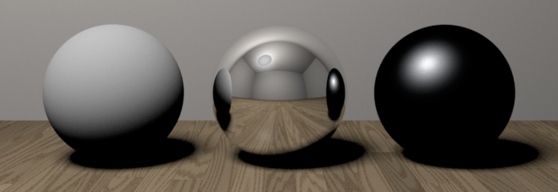
Diffuse and Specular Reflectance
Ideal diffuse (Lambertian)
Ideal Specular (Mirror)
Directional diffuse

Slide 6
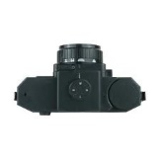
Lambertian Surfaces: Appearance vs Reflected Photons
Appearance is the same from every angle
Radiant Intensity? (how many photons reflected per angle)
Notes:
Emission rate of photons: B0 cos theta
Radiance: (Photons/second)/(area steradian)
Looking down get B0/dA
Looking at angle get B0 cos theta/(dA cos theta)

Slide 7
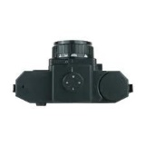
Lambertian Surfaces: Appearance vs Reflected Photons
Appearance is the same from every angle
Radiant Intensity? (how many photons reflected per angle)
Notes:
Emission rate of photons: B0 cos theta
Radiance: (Photons/second)/(area steradian)
Looking down get B0/dA
Looking at angle get B0 cos theta/(dA cos theta)

Slide 8
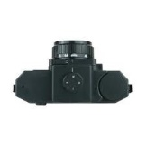
Lambertian Surfaces: Appearance vs Reflected Photons
Appearance is the same from every angle
Radiant Intensity? (how many photons reflected per angle)
Lambert's cosine law:
Notes:
Emission rate of photons: B0 cos theta
Radiance: (Photons/second)/(area steradian)
Looking down get B0/dA
Looking at angle get B0 cos theta/(dA cos theta)
Pixel=\mathbf{B}_{0}\mathbf{A}_{0}\frac{\cos{\theta}}{\cos{\theta}}

Slide 9
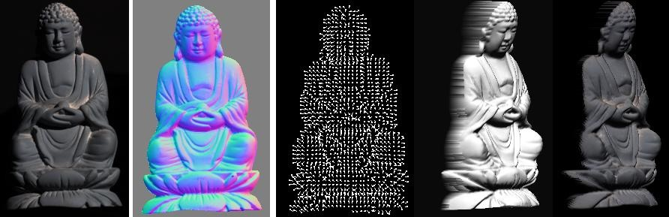
Photometric stereo
CS5670 : Computer Vision
Abe Davis | (most slides from Noah Snavely)

Slide 10
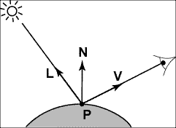
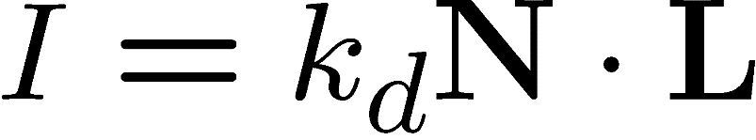
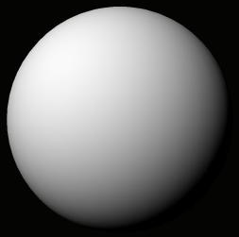
Recap:
Lambertian (Diffuse) Reflectance
I : observed image intensity
k_{d} : object albedo
N : surface normal
L : light source direction
Lambertian sphere with constant albedo lit by a directional light source
Notes:
Appearance is
albedo

Slide 11
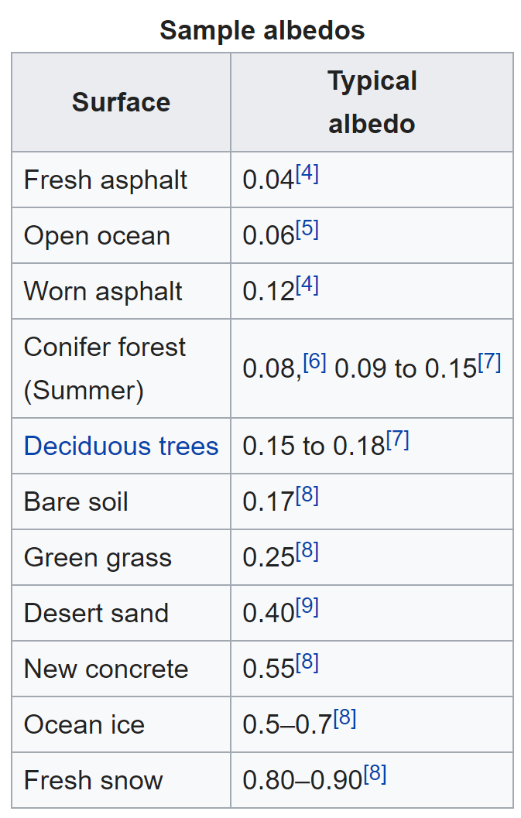
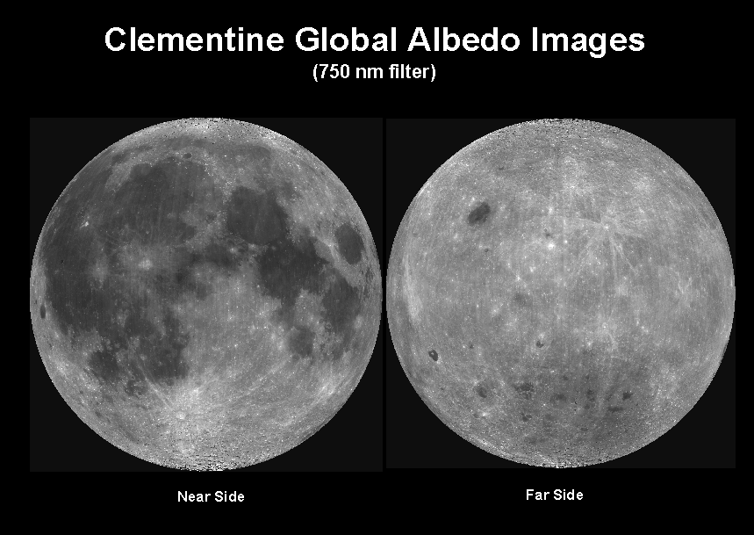
Objects can have varying albedo and albedo varies with wavelength
Source: https://en.wikipedia.org/wiki/Albedo

Slide 12
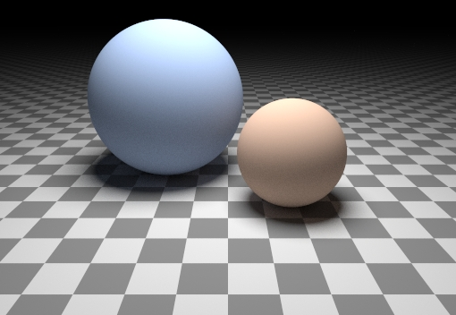
Can we determine shape from lighting?
Are these spheres?
  Or just flat discs painted with varying albedo?

Slide 13



A Single Image: Shape from Shading
Assume is 1 for now.
What can we measure from one image?
  is the angle between N and L
  Add assumptions:
    Constant albedo
    A few known normals (e.g. silhouettes)
    Smoothness of normals
In practice, SFS doesn’t work very well:
assumptions are too restrictive,
too much ambiguity in nontrivial scenes.

Slide 14
Inferring Lambertian Surfaces: Shape from Shading
I : observed image intensity
k_{d} : object albedo
N : surface normal
L : light source direction
Lambertian sphere with constant albedo lit by a directional light source
Notes:
Let’s look at this formula again

Slide 15

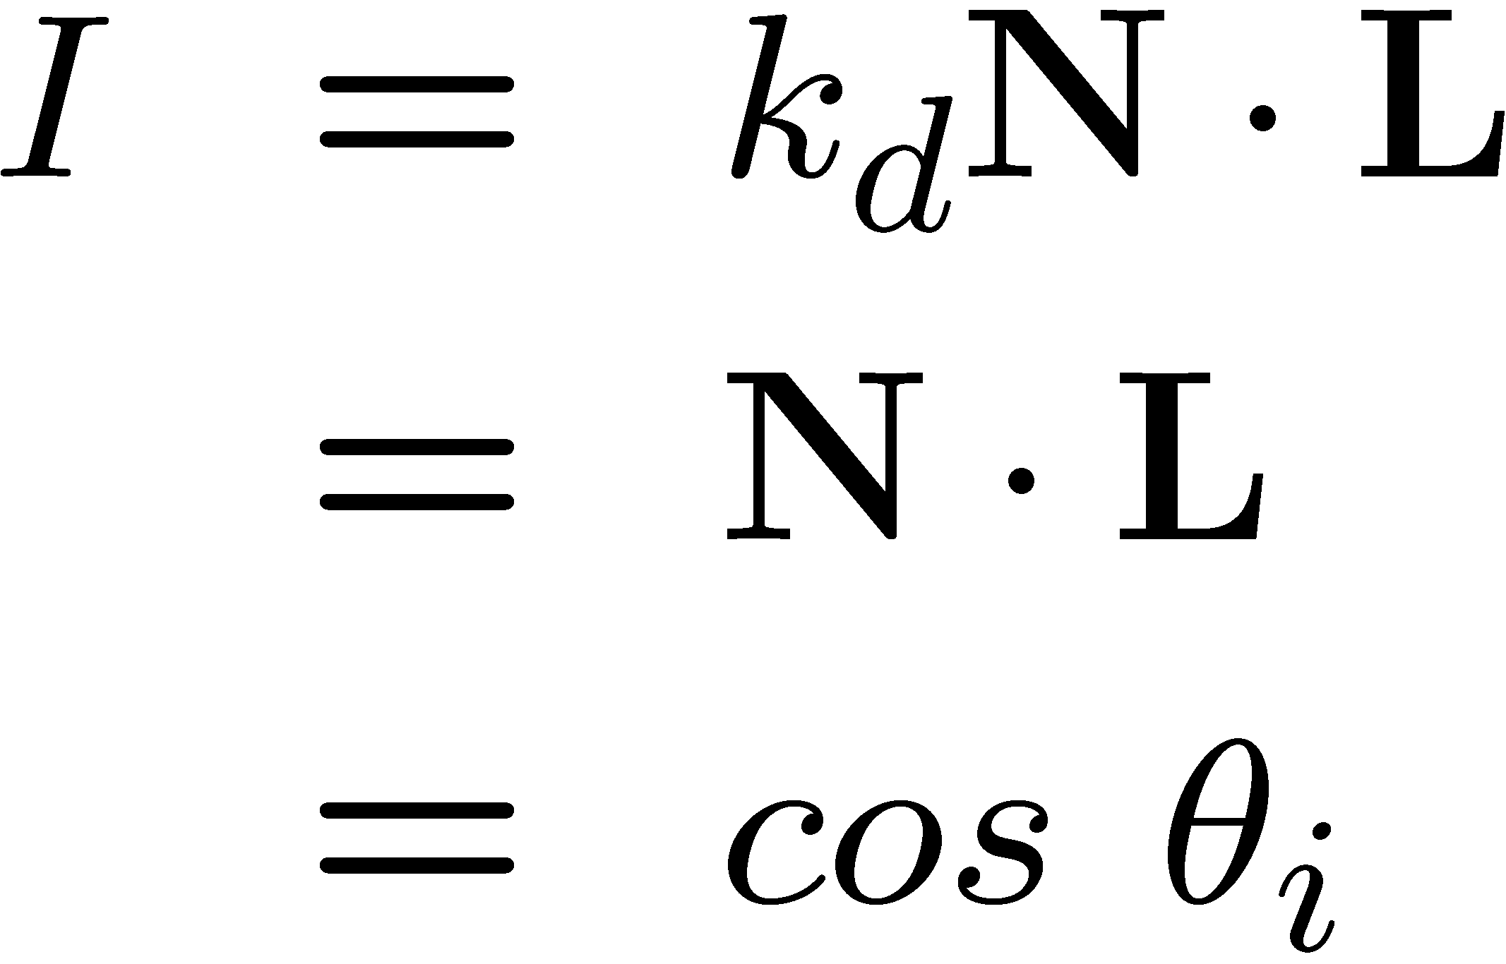


Shape from shading
Suppose
You can directly measure angle between normal and light source
  Not quite enough information to compute surface shape
  But can be if you add some additional info, for example
    assume a few of the normals are known (e.g., along silhouette)
    constraints on neighboring normals—“integrability”
    smoothness
  Hard to get it to work well in practice
    plus, how many real objects have constant albedo?
    But, deep learning can help

Slide 16
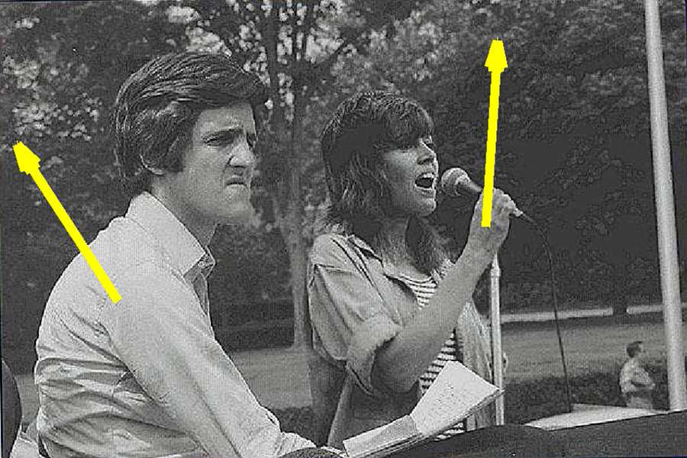
Application: Detecting composite photos
Real photo
Fake photo

Slide 17
Diffuse reflection
Demo
http://www.math.montana.edu/frankw/ccp/multiworld/twothree/lighting/applet1.htm
http://www.math.montana.edu/frankw/ccp/multiworld/twothree/lighting/learn2.htm

Slide 18
Let’s take more than one photo!

Slide 19






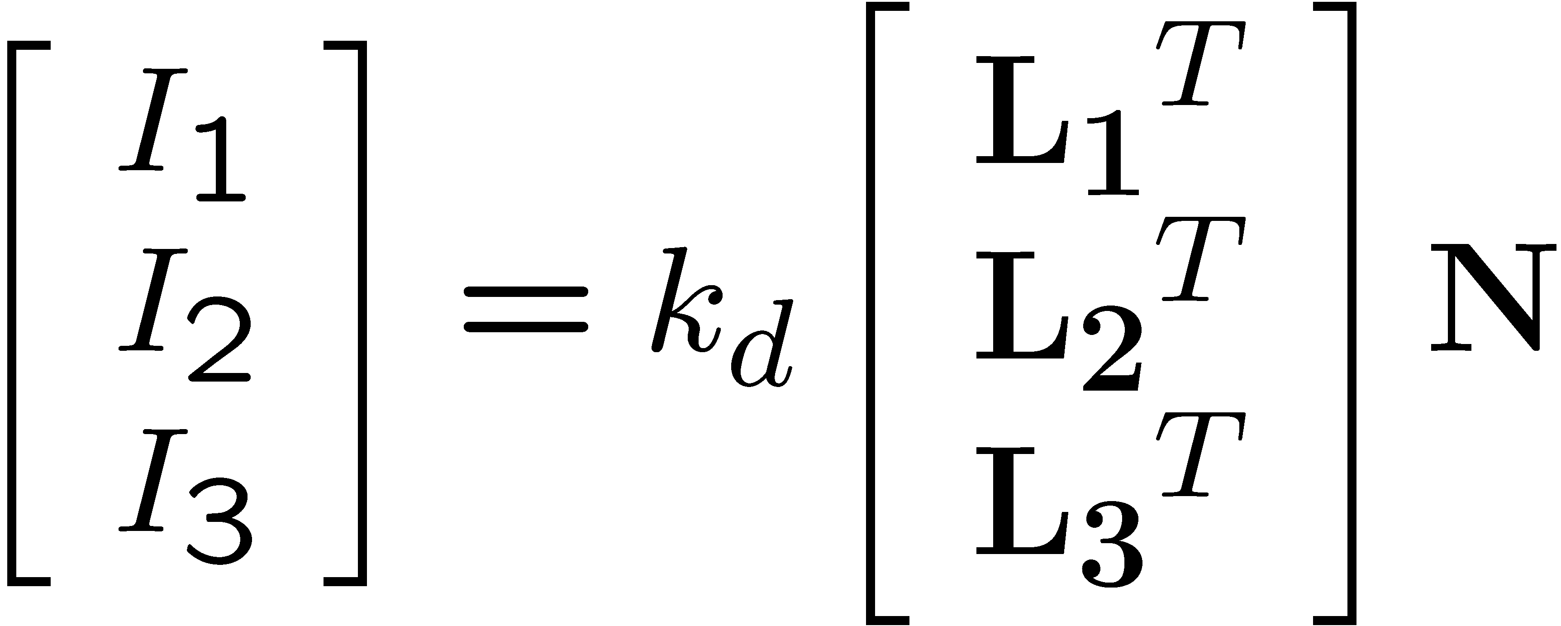
Photometric stereo
N
L₃
L₂
L₁
V
Can write this as a matrix equation:

Slide 20
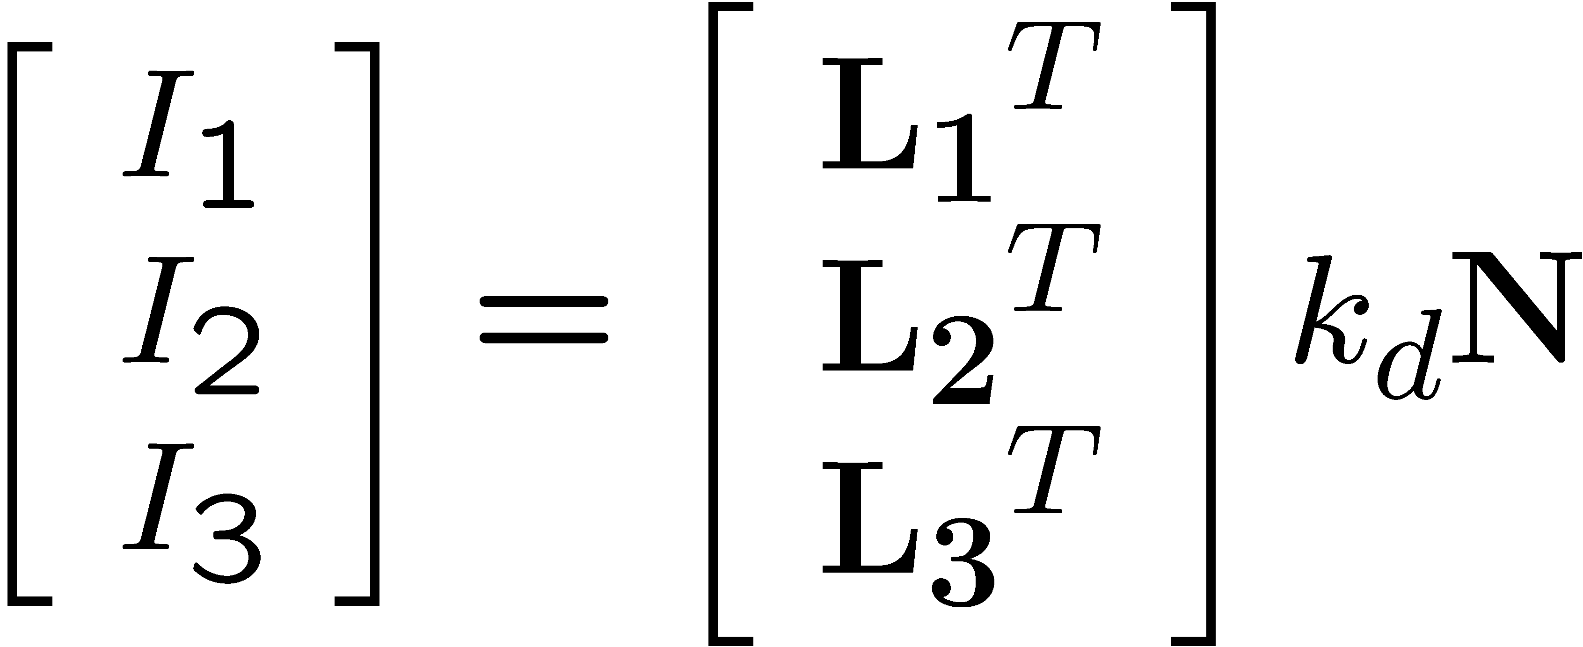







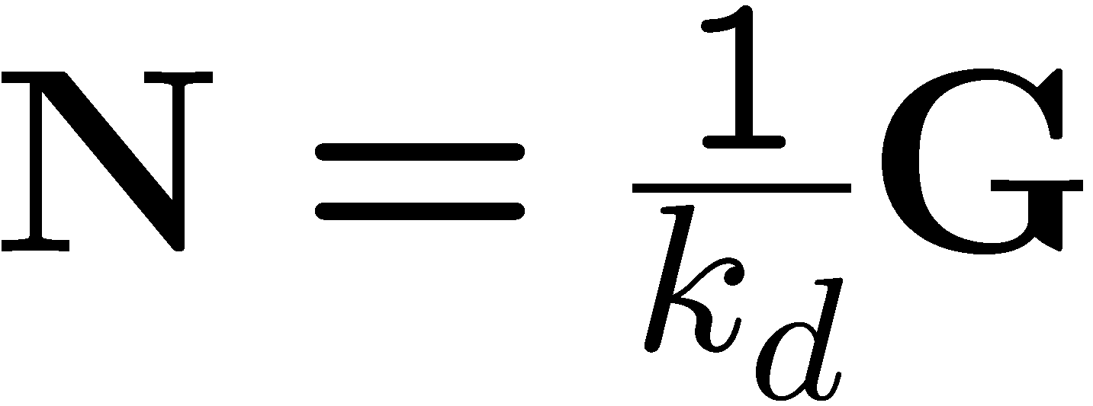
Solving the equations
Solve one such linear system per pixel to solve for that pixel’s surface normal

Slide 21
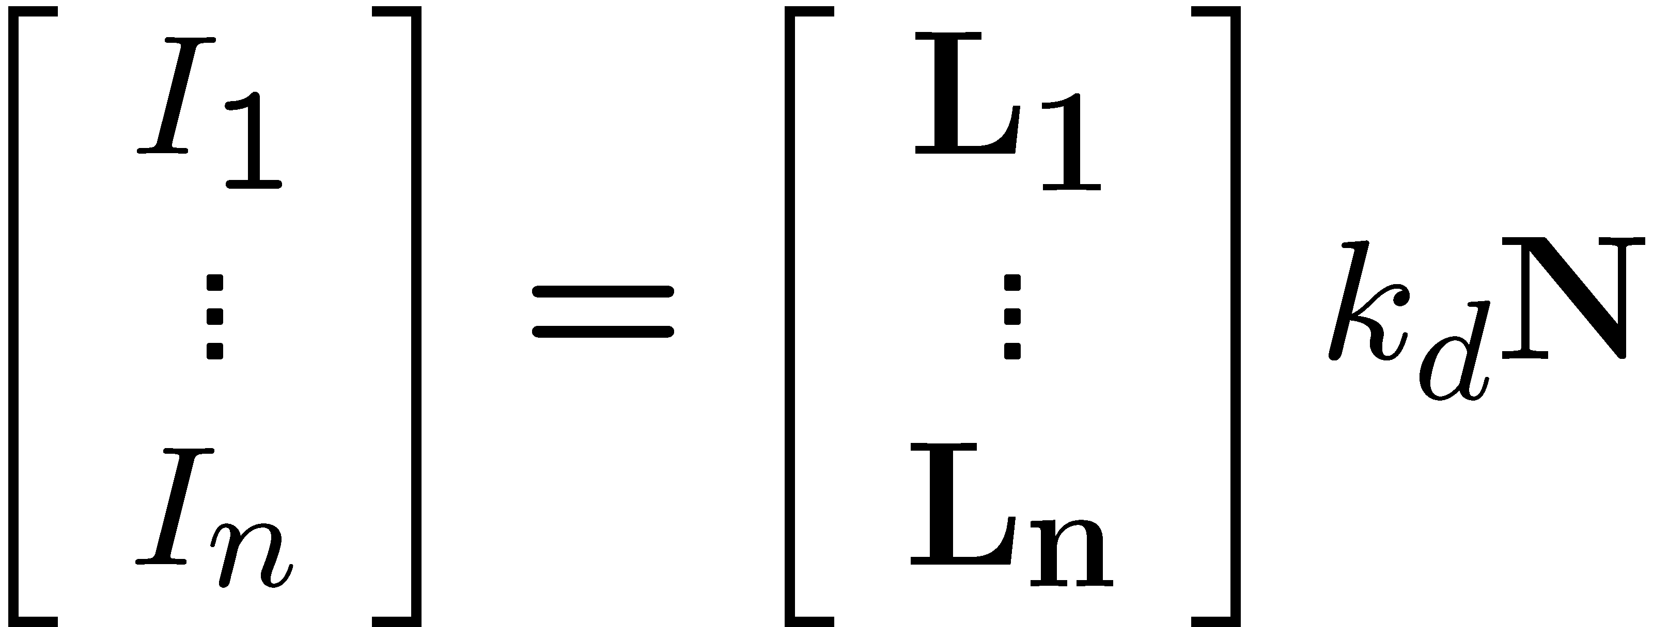
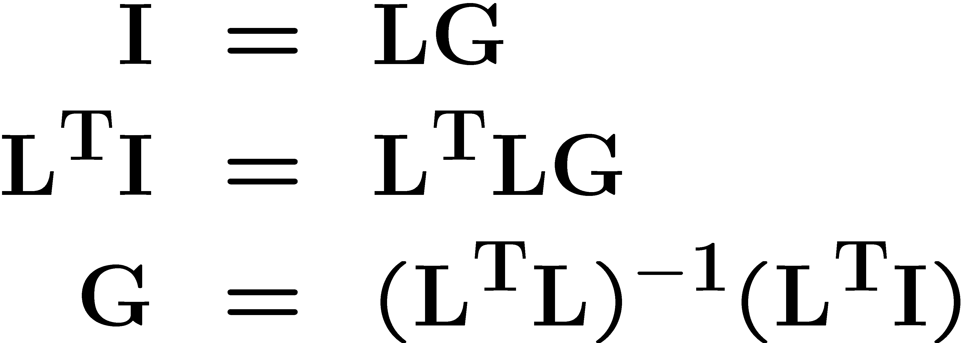
More than three lights
Get better results by using more lights
Least Squares Refresher:
Problem:
Psuedo Inverse:
Least squares solution:
Least Squares Solution
Solve for N, k_{d} as before
What’s the size of L^{T}L?

Slide 22
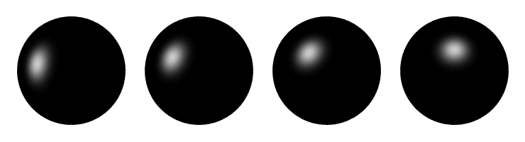
Computing light source directions
Trick: place a chrome sphere in the scene
  the location of the highlight tells you where the light source is

Slide 23





Recall the rule for specular reflection
For a perfect mirror, light is reflected about N
We see a highlight when V = R
  then L is given as follows:

Slide 24
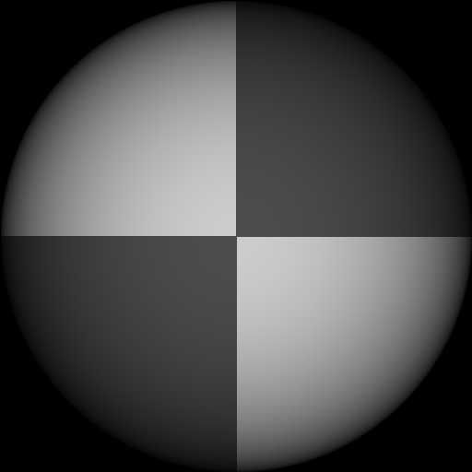
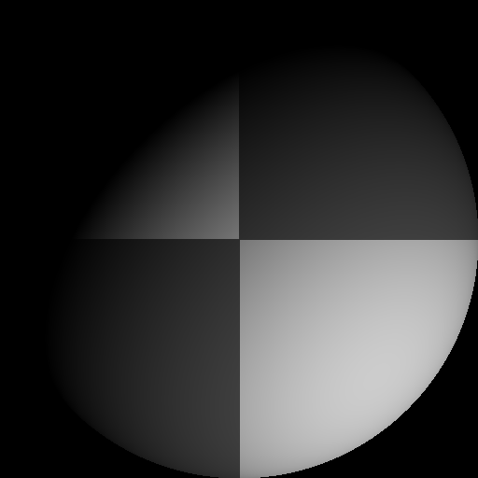
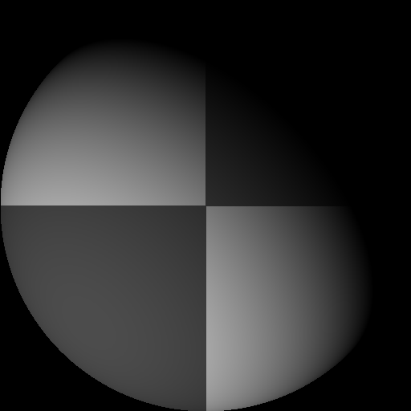
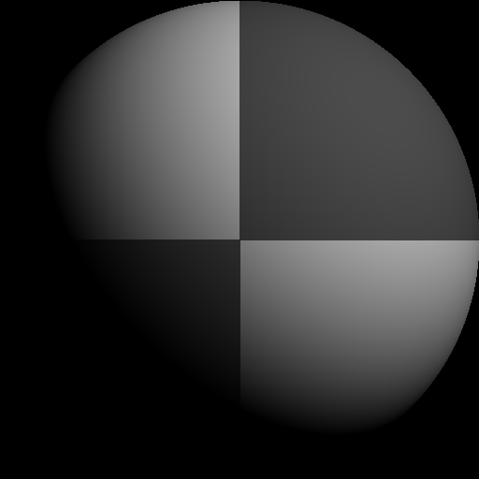
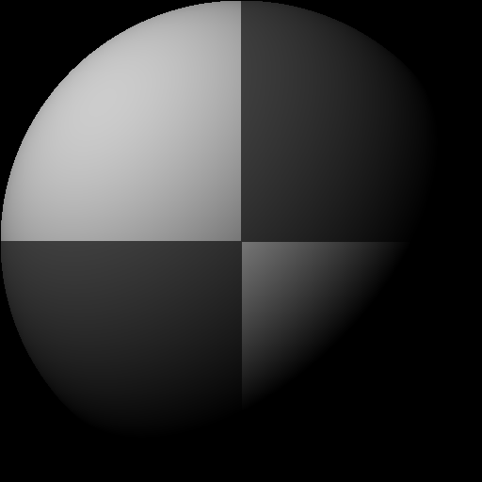
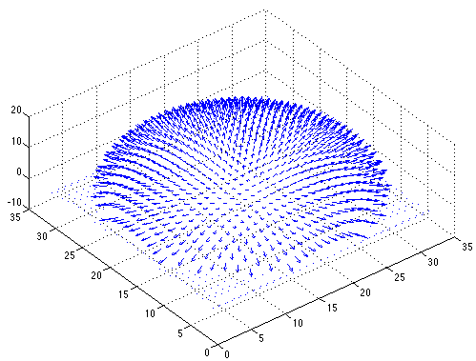

Example
Recovered albedo
Recovered normal field
Forsyth & Ponce, Sec. 5.4

Slide 25

Depth from normals
Solving the linear system per-pixel gives us an estimated surface normal for each pixel
How can we compute depth from normals?
  Normals are like the “derivative” of the true depth
Input photo
Estimated normals
Estimated normals (needle diagram)

Slide 26
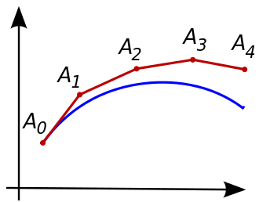
Normal Integration
Integrating a set of derivatives is easy in 1D
  (similar to Euler’s method from diff. eq. class)
Could just integrate normals in each column / row separately
Instead, we formulate as a linear system and solve for depths that best agree with the surface normals

Slide 27

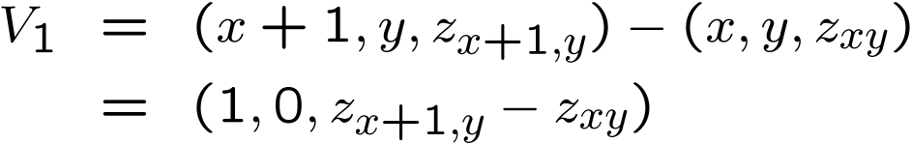


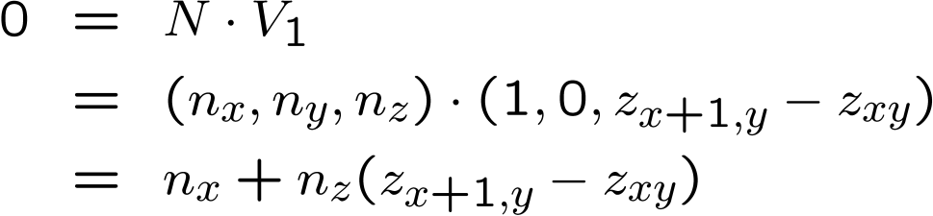

Depth from normals
V₂
V₁
N
Get a similar equation for V₂
  Each normal gives us two linear constraints on z
  compute z values by solving a matrix equation
Notes:
So if we assume we know normals, then we can write out equations that will give us constraints on depth based on adjacent normals

Slide 28
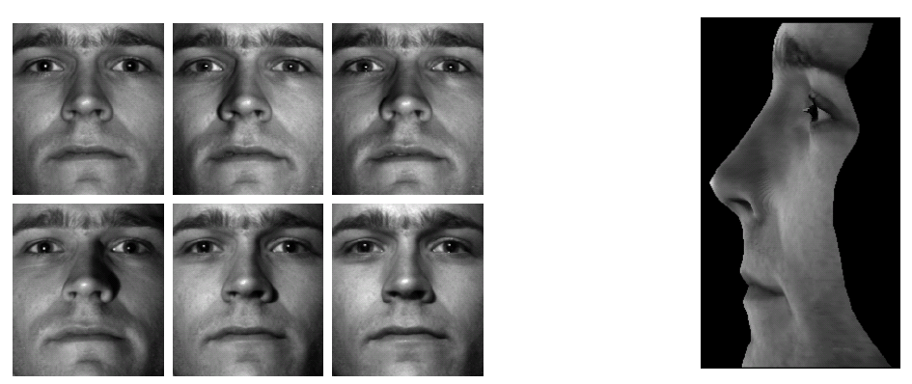
Results
from Athos Georghiades
28

Slide 29
Results

Slide 30
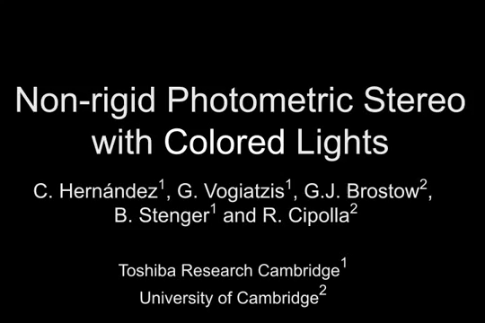
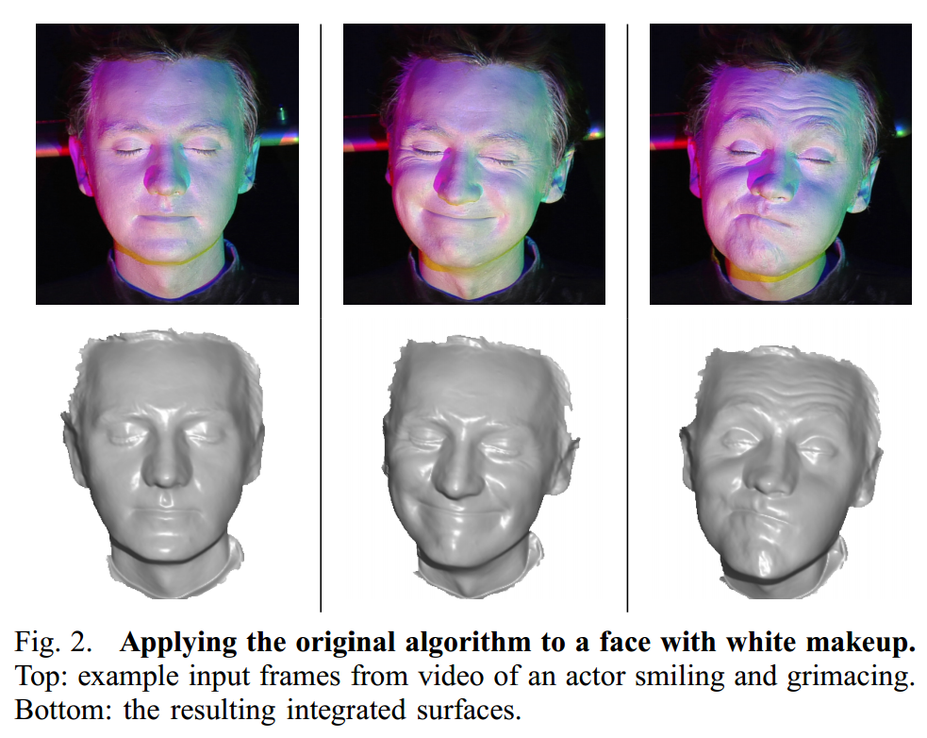
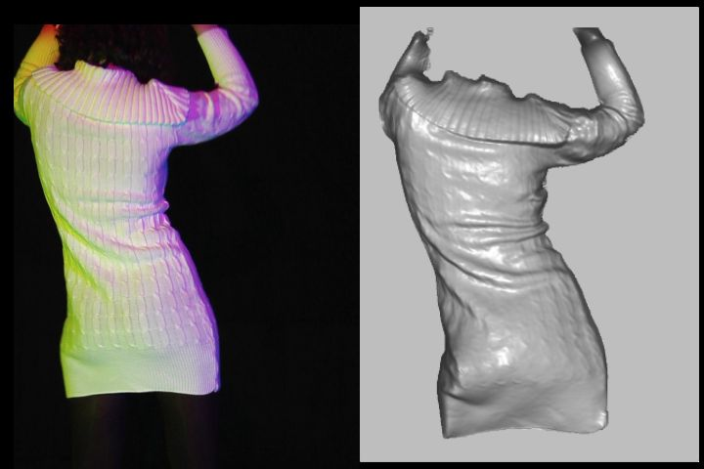
Extension
Photometric Stereo from Colored Lighting
Video Normals from Colored Lights
Gabriel J. Brostow, Carlos Hernández, George Vogiatzis, Björn Stenger, Roberto Cipolla
IEEE TPAMI, Vol. 33, No. 10, pages 2104-2114, October 2011.
Notes:
Stop around 50s

Slide 31
Questions?

Slide 32
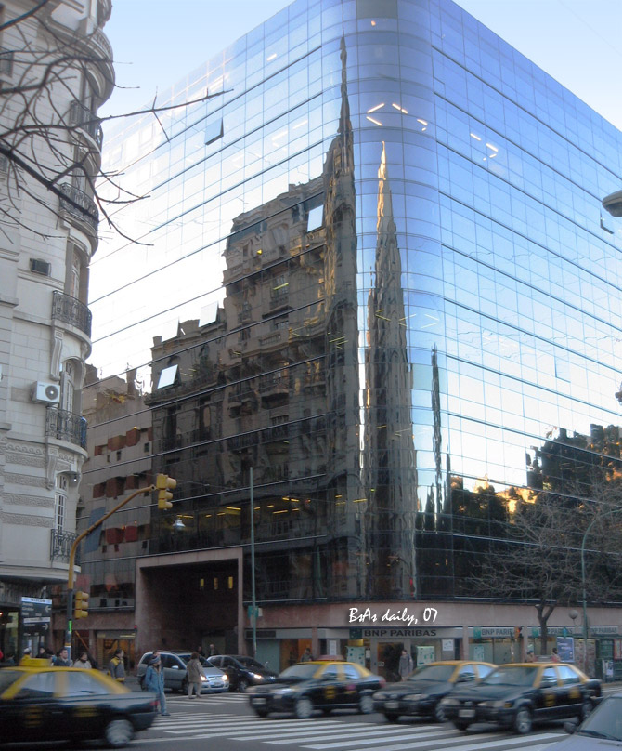
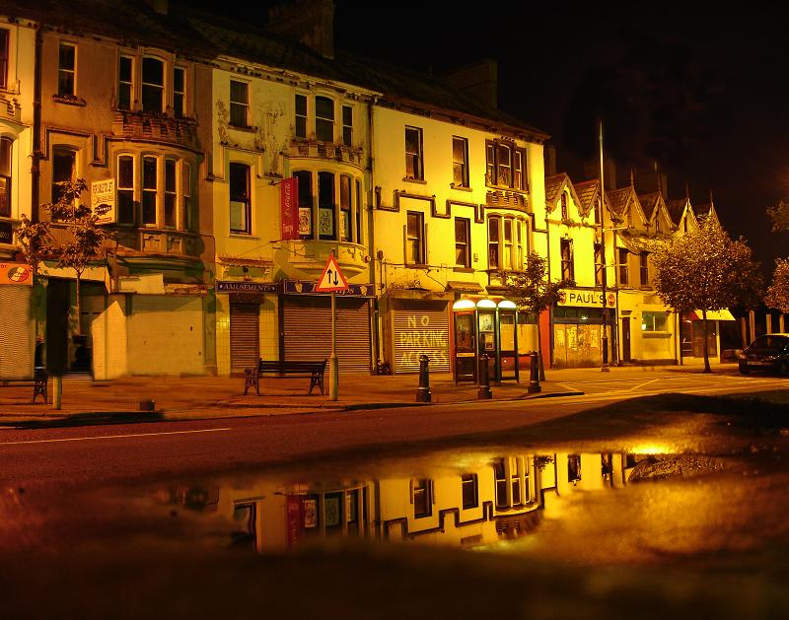
For now, ignore specular reflection
Slides from Photometric Methods for 3D Modeling, Matsushita, Wilburn, Ben-Ezra
Notes:
reflection

Slide 33
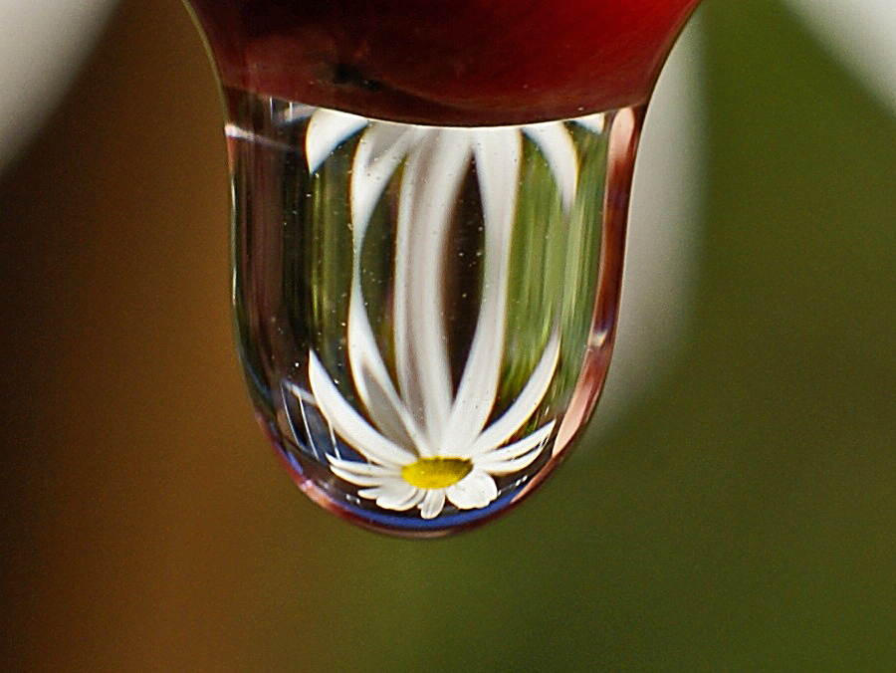
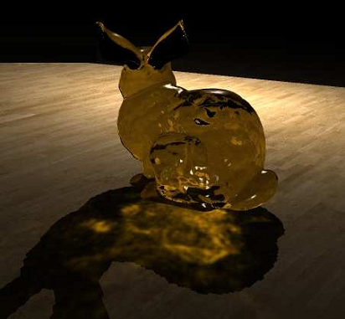
And Refraction…
Slides from Photometric Methods for 3D Modeling, Matsushita, Wilburn, Ben-Ezra

Slide 34
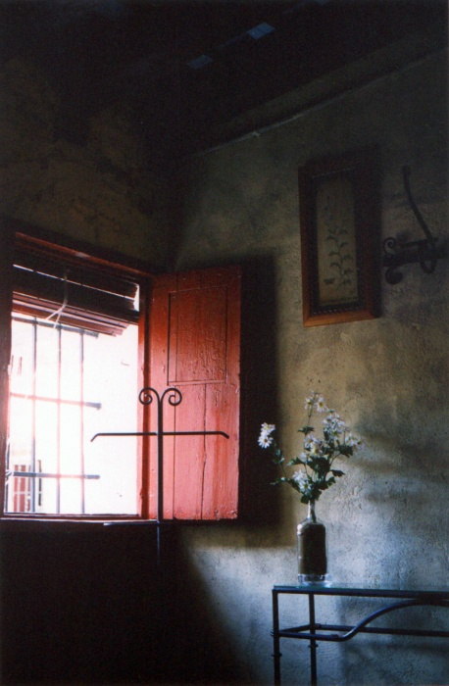
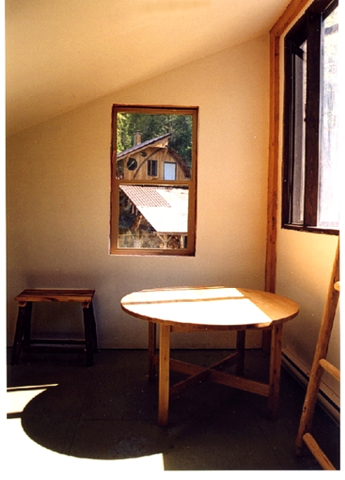
And Interreflections…
Slides from Photometric Methods for 3D Modeling, Matsushita, Wilburn, Ben-Ezra
Notes:
(second bounce)

Slide 35
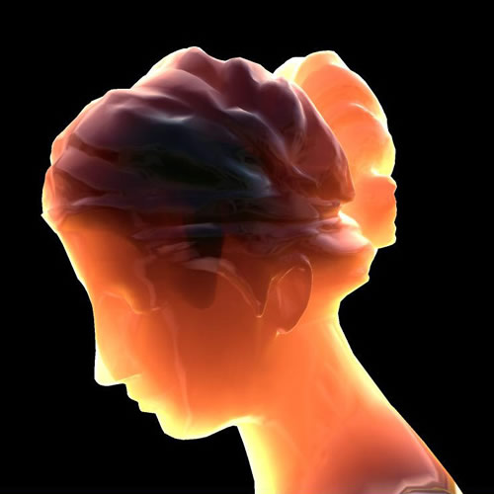
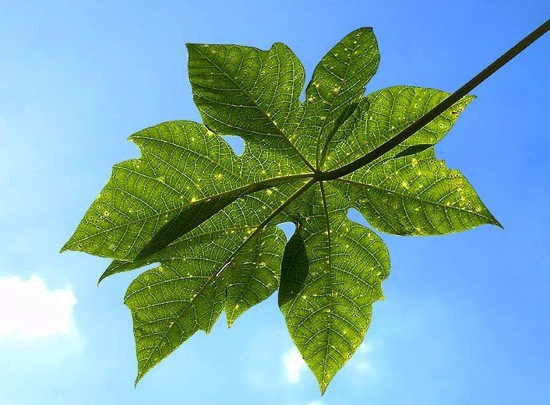
And Subsurface Scattering…
Slides from Photometric Methods for 3D Modeling, Matsushita, Wilburn, Ben-Ezra

Slide 36
Limitations
Bigger problems
  doesn’t work for shiny things, semi-translucent things
  shadows, inter-reflections
Smaller problems
  camera and lights have to be distant
  calibration requirements
    measure light source directions, intensities
    camera response function
Newer work addresses some of these issues
Some pointers for further reading:
  Zickler, Belhumeur, and Kriegman, "Helmholtz Stereopsis: Exploiting Reciprocity for Surface Reconstruction." IJCV, Vol. 49 No. 2/3, pp 215-227.
  Hertzmann & Seitz, “Example-Based Photometric Stereo: Shape Reconstruction with General, Varying BRDFs.” IEEE Trans. PAMI 2005

Slide 37
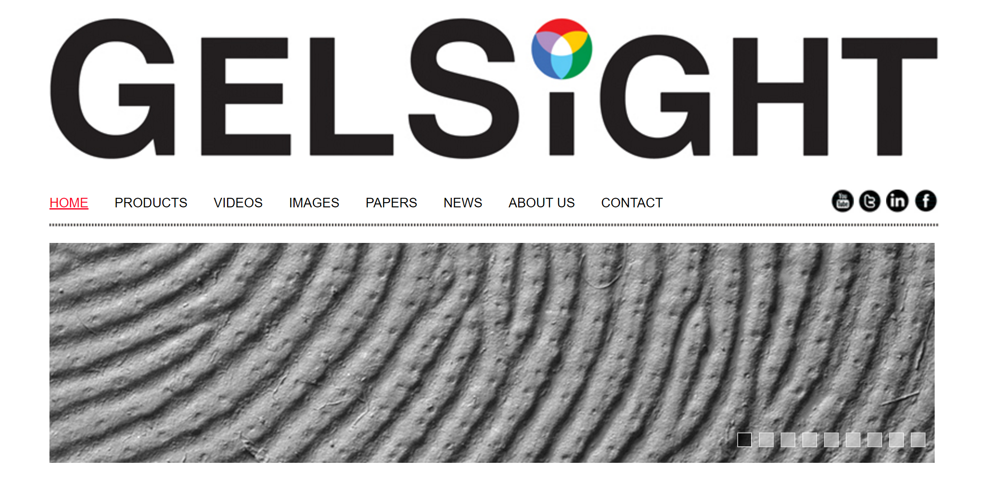
Johnson and Adelson, 2009

Slide 38
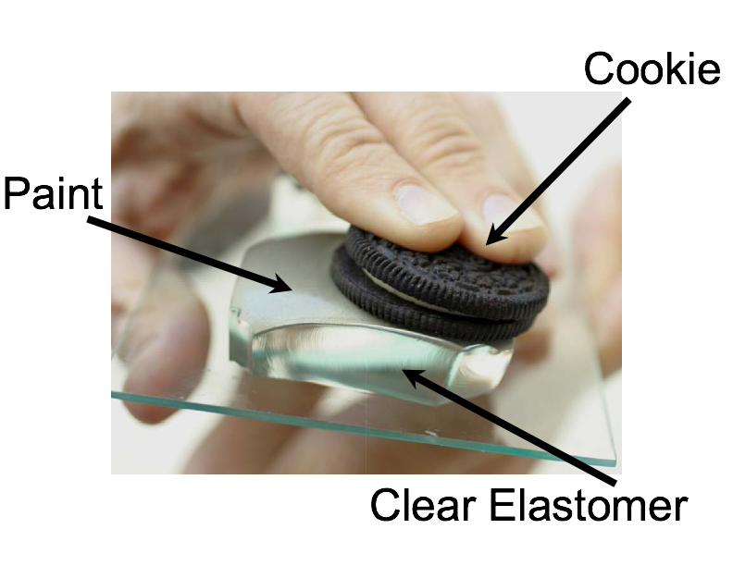
Johnson and Adelson, 2009

Slide 39
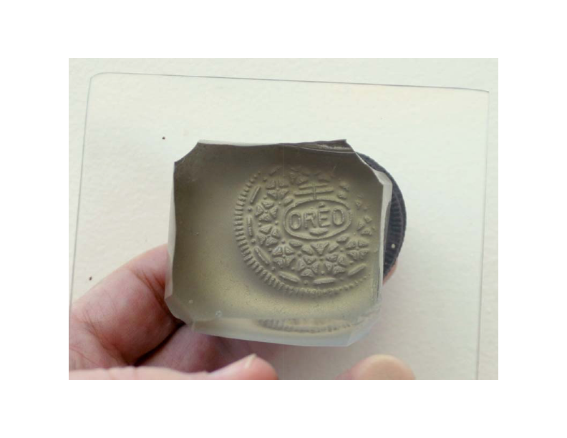

Slide 40
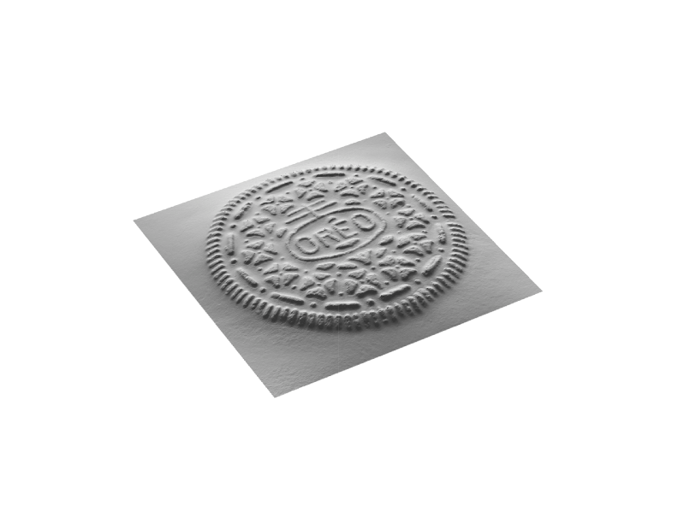

Slide 41
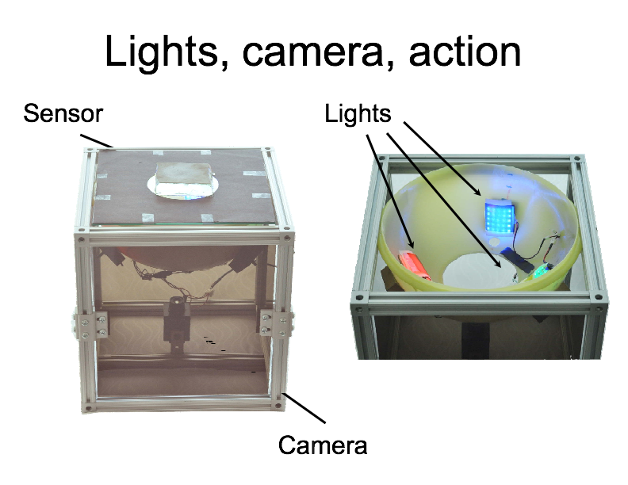

Slide 42
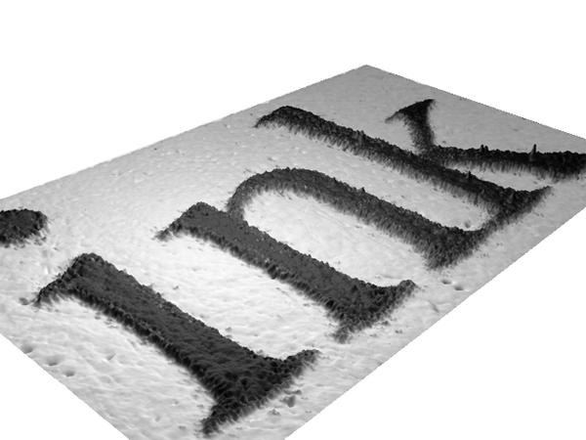

Slide 43
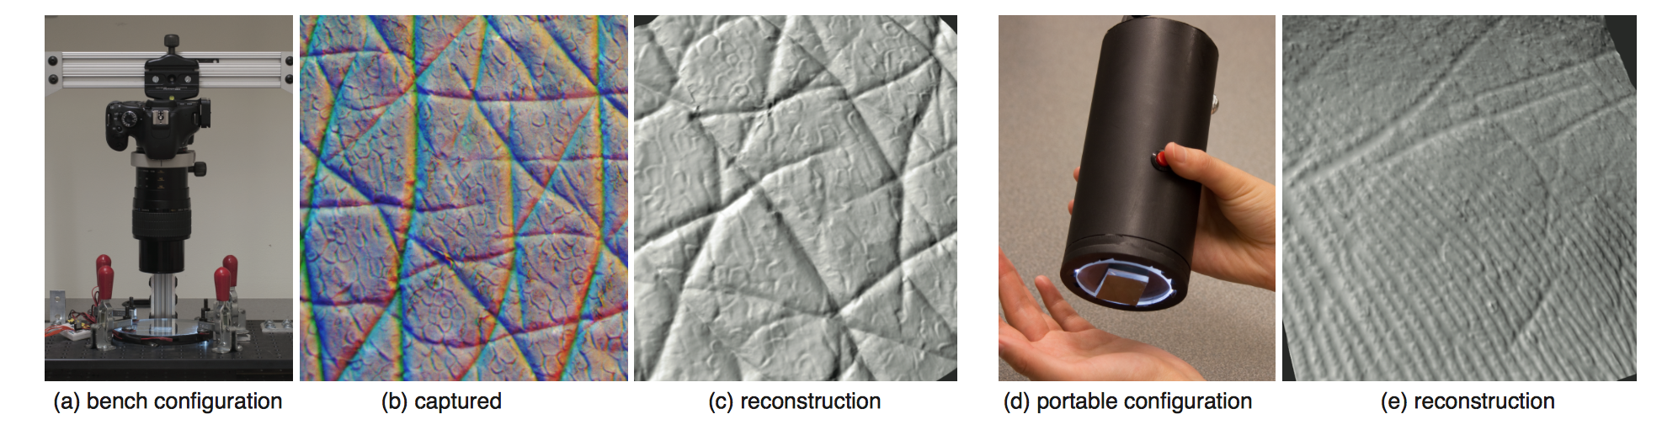
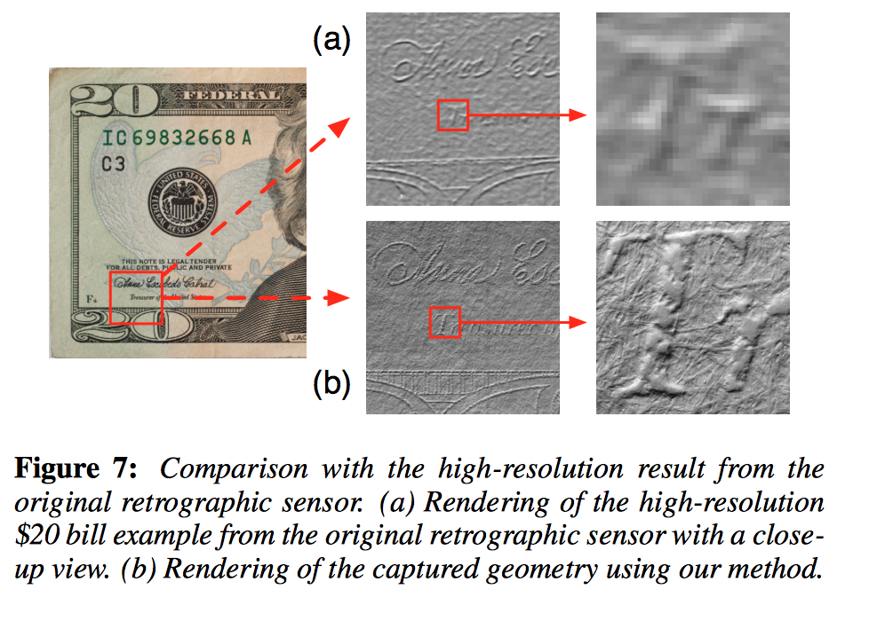

Slide 44
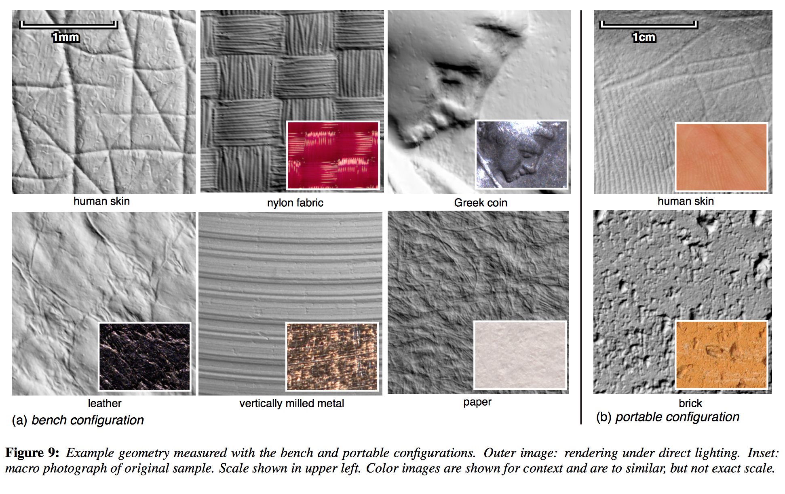

Slide 45
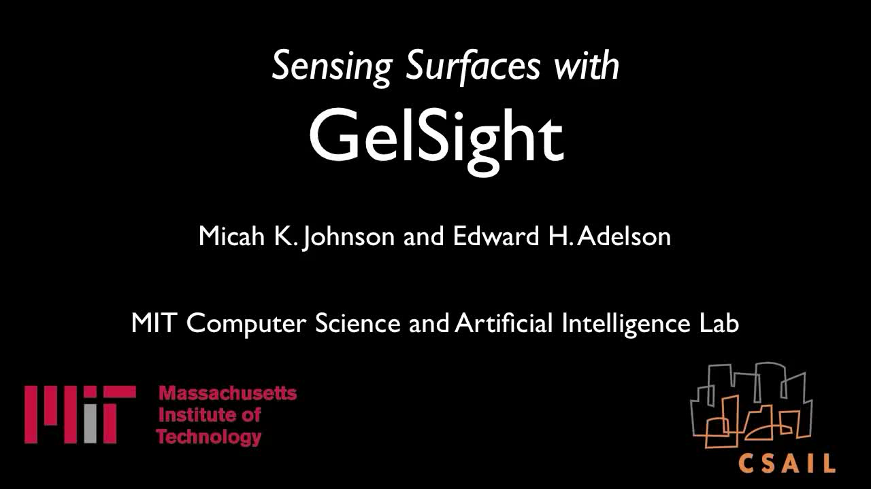

https://www.youtube.com/watch?v=S7gXih4XS7A

Slide 46


Slide 47
Questions?

