Slide 1
Image Manifolds &
Image Synthesis
(including GANs)
By Abe Davis
Some slides from Jin Sun, Phillip Isola

Slide 2
Announcements
Take home final May 11-14
Sample final is online (check Piazza)
Project 5 deadline extended to Friday May 1
Course evaluations are open now through May 8
  We encourage feedback
  Small amount of extra credit for filling out
    What you write is still anonymous, instructors only see whether students filled it out

Slide 3
Dimensionality Reduction
By Abe Davis

Slide 4
Linear Dimensionality Reduction: 2D->1D
Consider a bunch of data points in 2D
Let’s say these points only differ along one line
If so, we can translate and rotate our data so that it is 1D

Slide 5
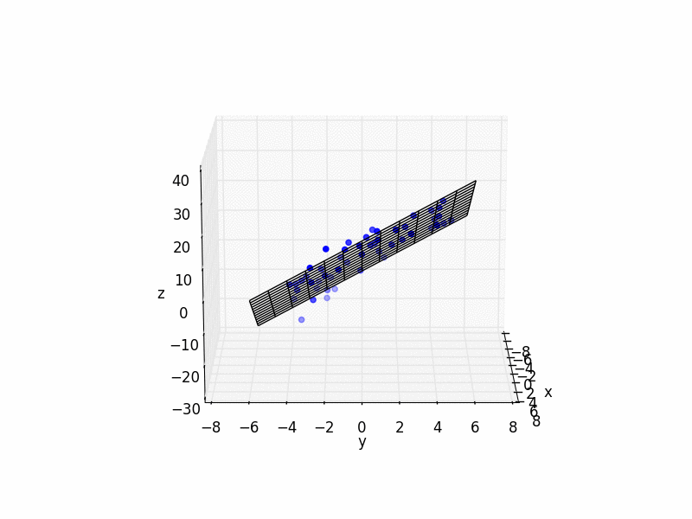

Linear Dimensionality Reduction: 3D->2D
Similar to 1D case, we can fit a plane to the data, and transform our coordinate system so that plane becomes the x-y plane
“Plane fitting”
More generally: look for the 2D subspace that best fits the data, and ignore the remaining dimensions
Think of this as data that sits on a flat sheet of paper, suspended in 3D space. We will come back to this analogy in a couple slides…
Notes:
https://math.stackexchange.com/questions/99299/best-fitting-plane-given-a-set-of-points

Slide 6
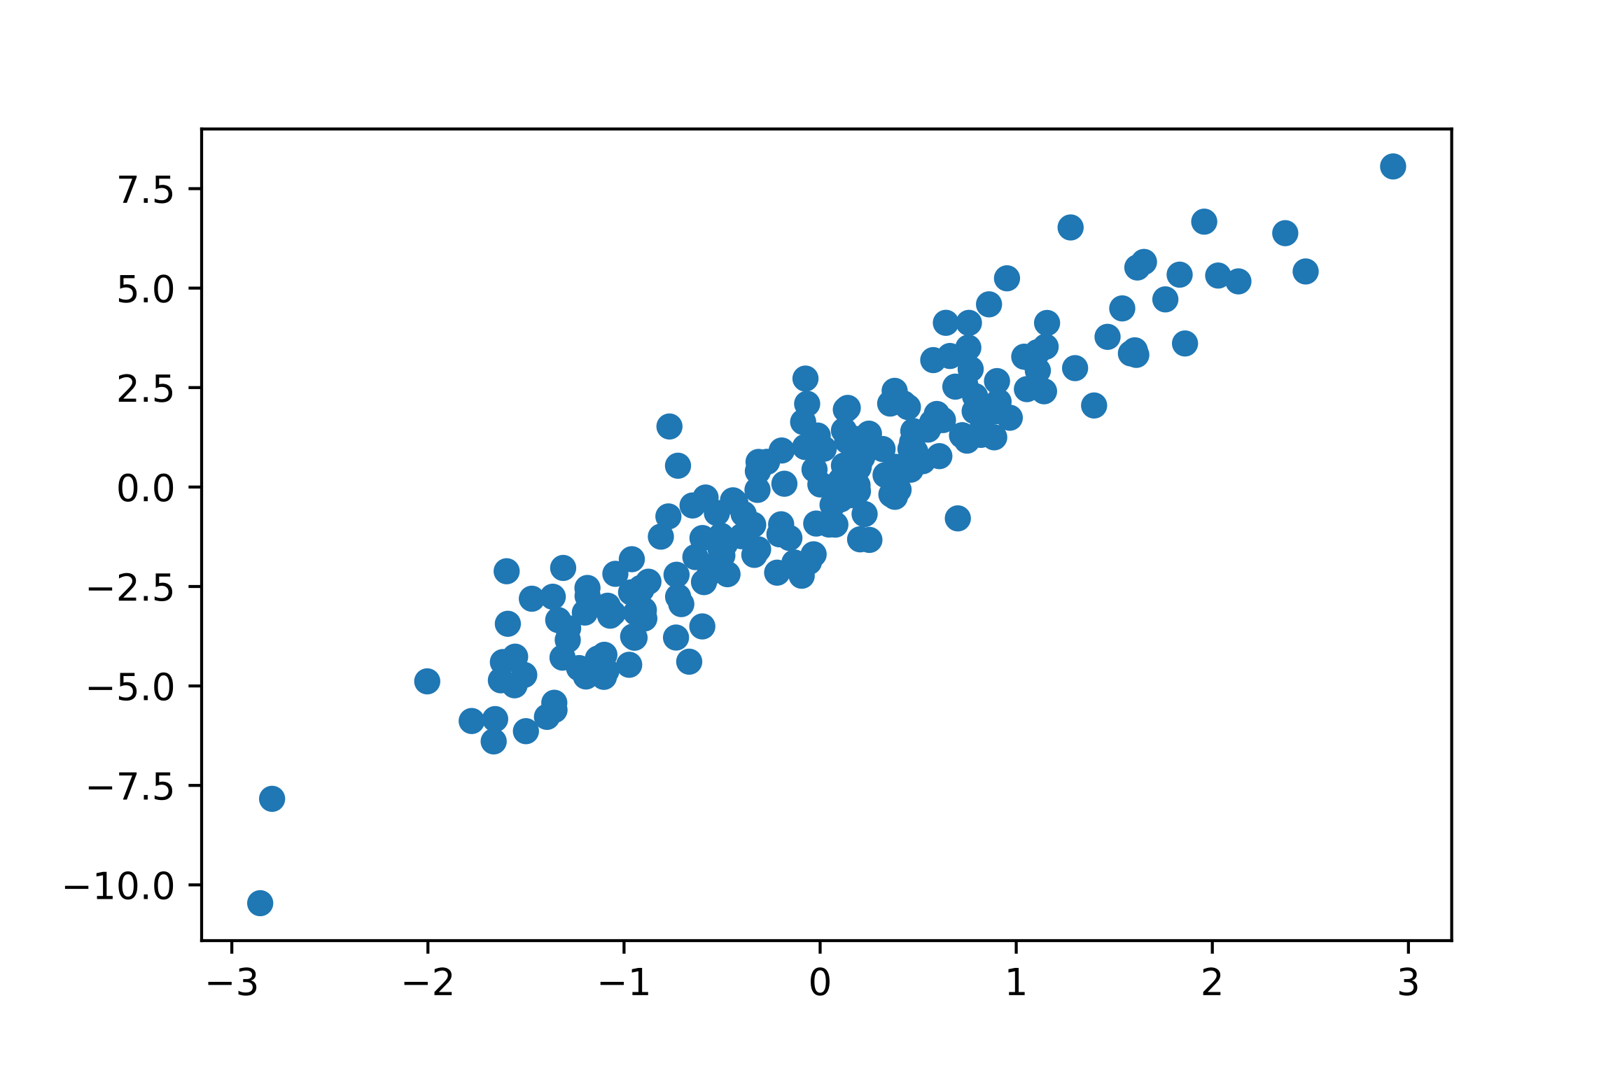
Generalizing Linear Dimensionality Reduction
Principle Component Analysis (PCA): find and order orthogonal axes by how much the data varies along each axis.
The axes we find (ordered by variance of our data) are called principle components.
Dimensionality reduction can be done by using only the first k principle components
Side Note: principle components are closely related to the eigenvectors of the covariance matrix for our data

Slide 7
Manifolds
Think of a piece of paper as a 2D subspace
If we bend and fold that paper, it’s still locally a 2D subspace…
A “manifold” is the generalization of this concept to higher dimensions…

Slide 8
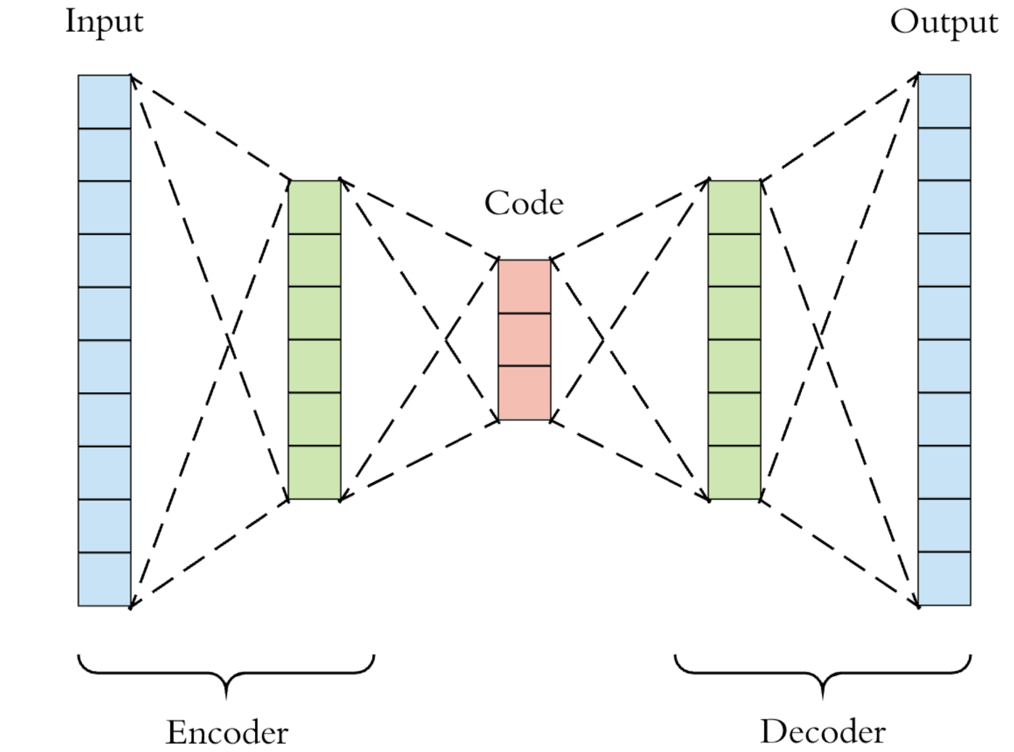
Autoencoders: Dimensionality Reduction for Manifolds
Learn a non-linear transformation into some lower-dimensional space (encoder)
Learn a transformation from lower-dimensional space back to original content (decoder)
Loss function measures the difference between input and output
Unsupervised
  No labels required!
Feature space at bottleneck is often called “latent space”

Slide 9
Autoencoders: Dimensionality Reduction for Manifolds
Transformations that reduce dimensionality cannot be invertible in general
An autoencoder tries to learn a transformation that is invertible for points on some manifold.

Slide 10
Image Manifolds
By Abe Davis

Slide 11

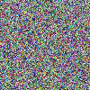
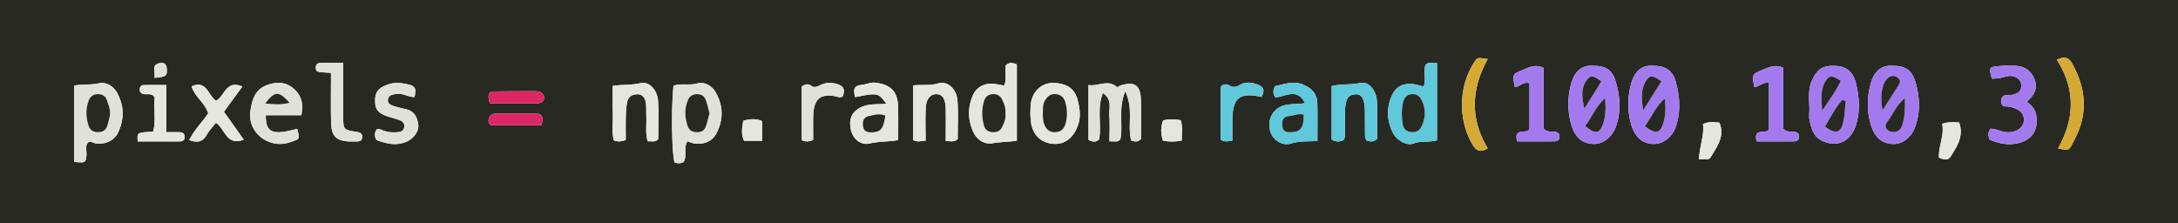
The Space of All Images
Lets consider the space of all 100x100 images
Now lets randomly sample that space…
Conclusion: Most images are noise
Question:
What do we expect a random uniform sample of all images to look like?

Slide 12
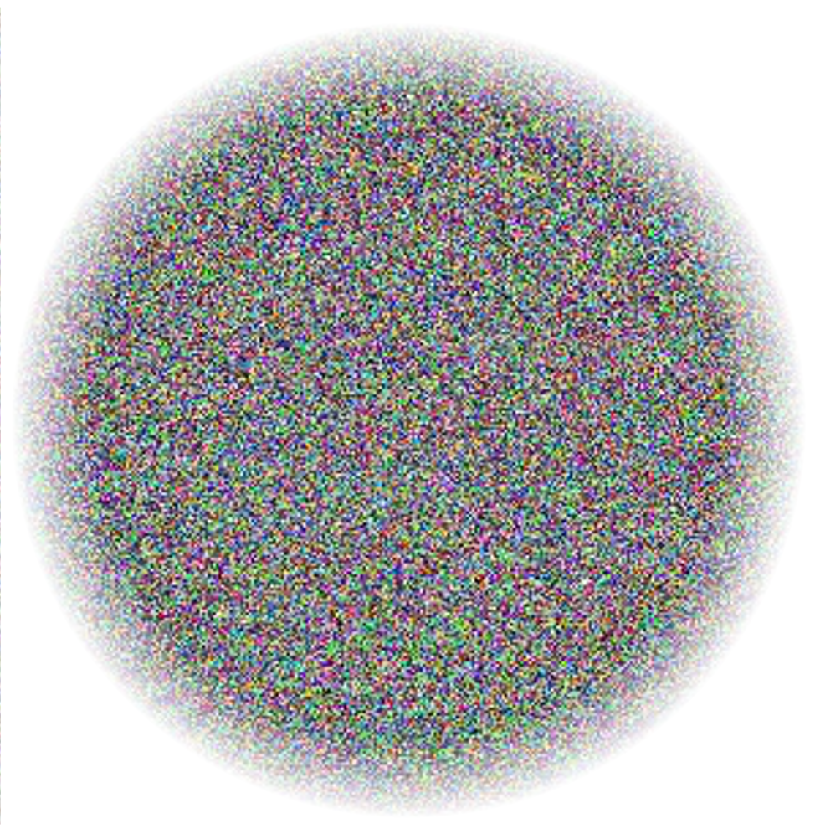
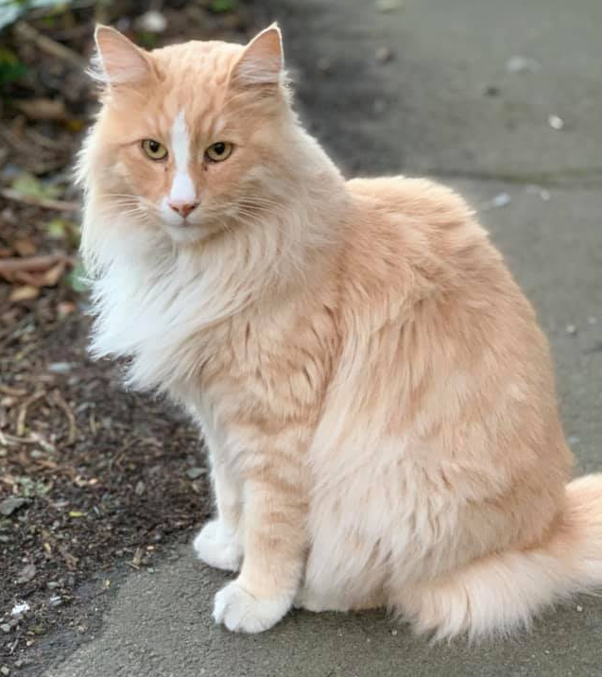
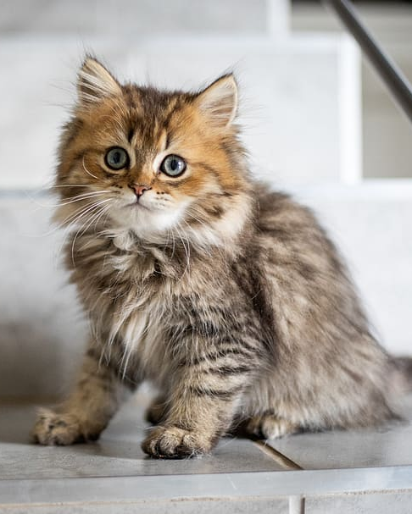
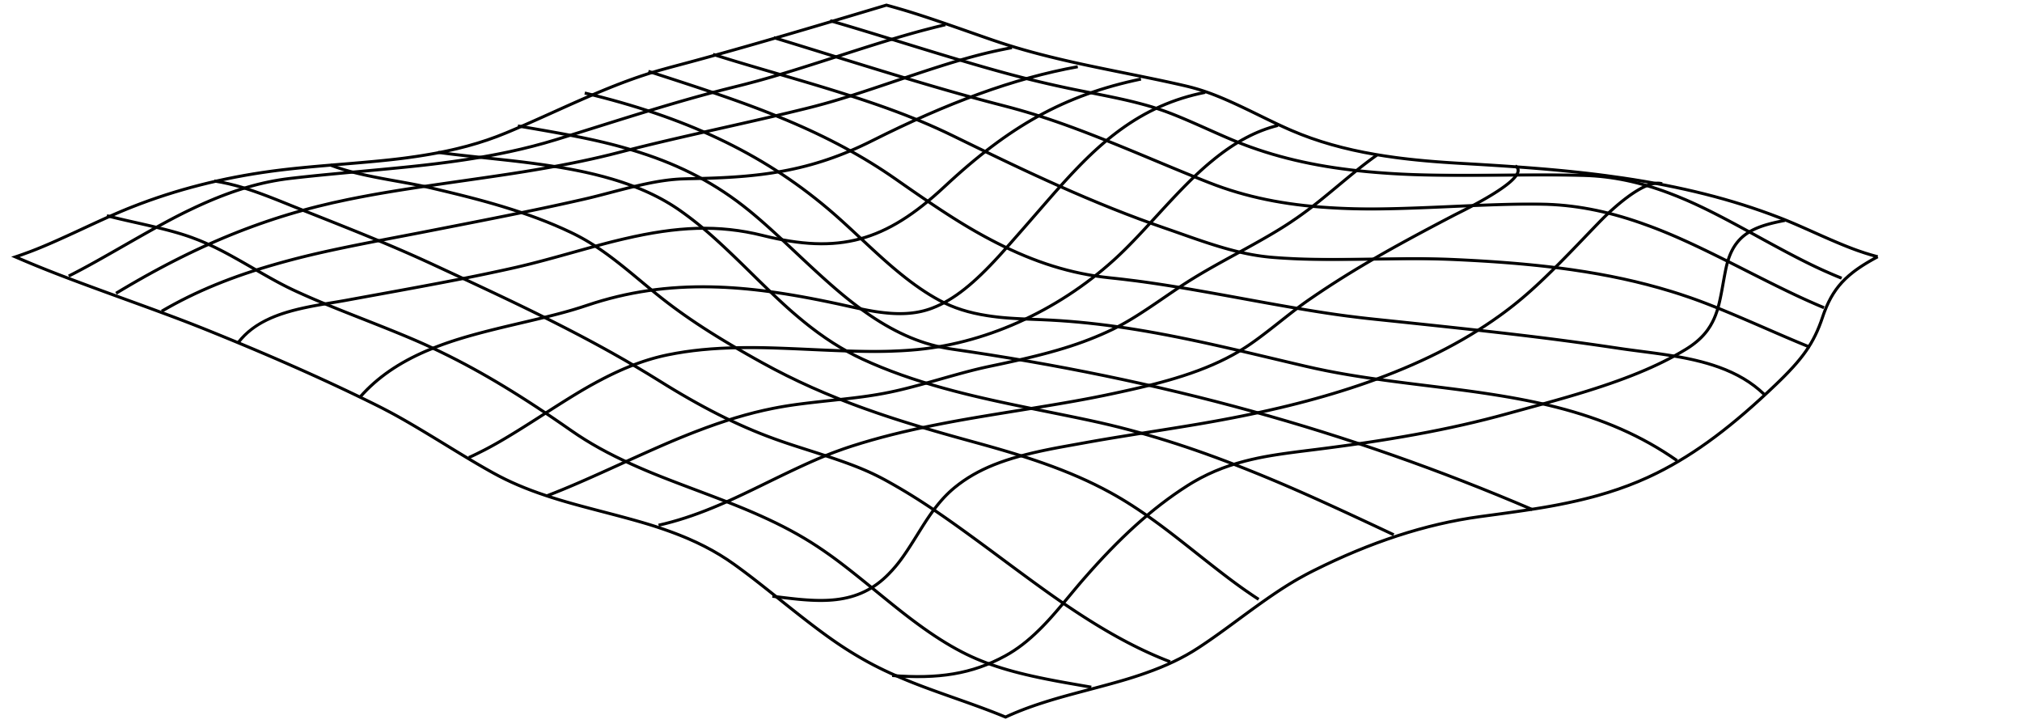
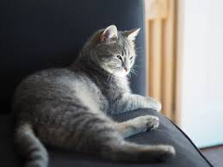
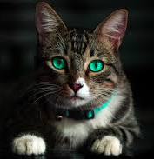
Natural Image Manifolds
Most images are “noise”
“Meaningful” images tend to form some manifold within the space of all images
Images of a particular class fall on manifolds within that manifold…
The Space of All Images

Slide 13


Natural Image Manifolds
Notes:
I want you to just take a moment to meditate on this concept of a manifold of natural images

Slide 14
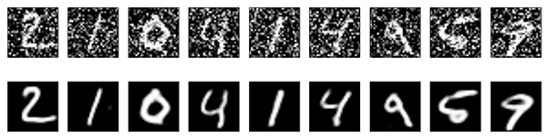
Denoising and the “Null Space” of Autoencoders
The autoencoder tries to learn a dimensionality reduction that is invertible for our data (data on some manifold)
Most noise will be in the non-invertible part of image space (off the manifold)
If we feed noisy data in, we will often get denoised data out
Input
Output
Noisy Input
Output
Examples from: https://blog.keras.io/building-autoencoders-in-keras.html
Notes:
https://blog.keras.io/building-autoencoders-in-keras.html
Examples from:

Slide 15
Question:
Autoencoders are able to compress because data sits on a manifold
This doesn’t mean that every point in the latent space will be on the manifold…
GANs (covered later in this lecture)will learn a loss function that helps with this…
Interpolation
(simple Interpolation)

Slide 16
Image-to-Image Applications
Abe Davis, with slides from Jin Sun, Phillip Isola, and Richard Zhang

Slide 17
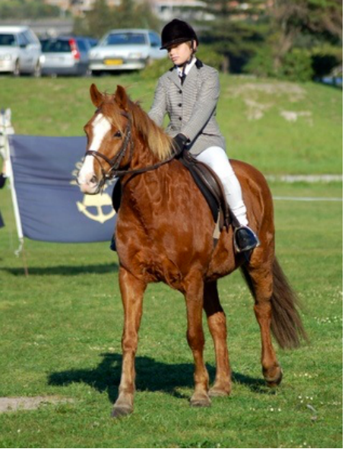
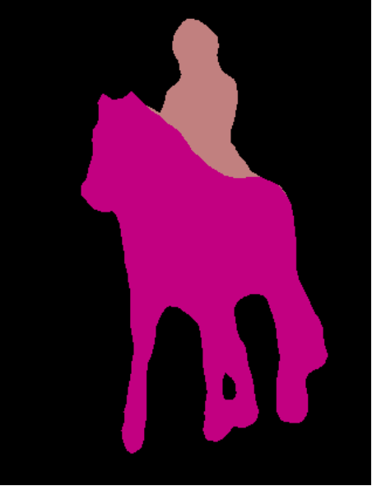
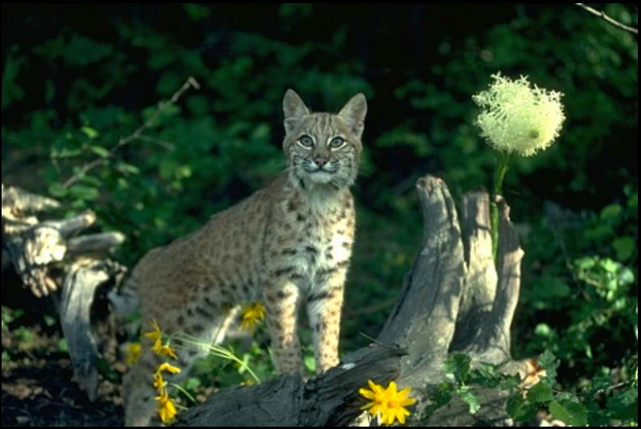
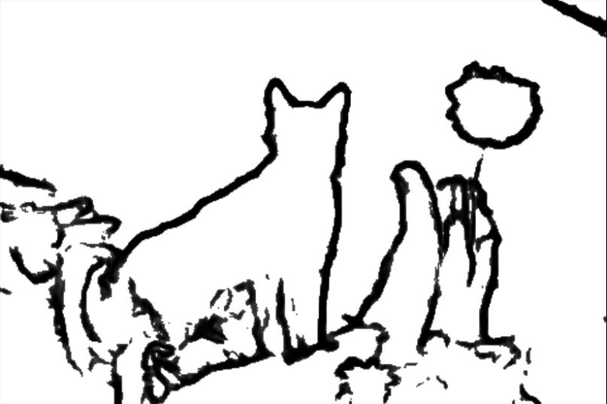
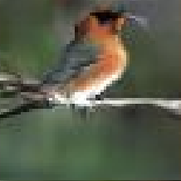
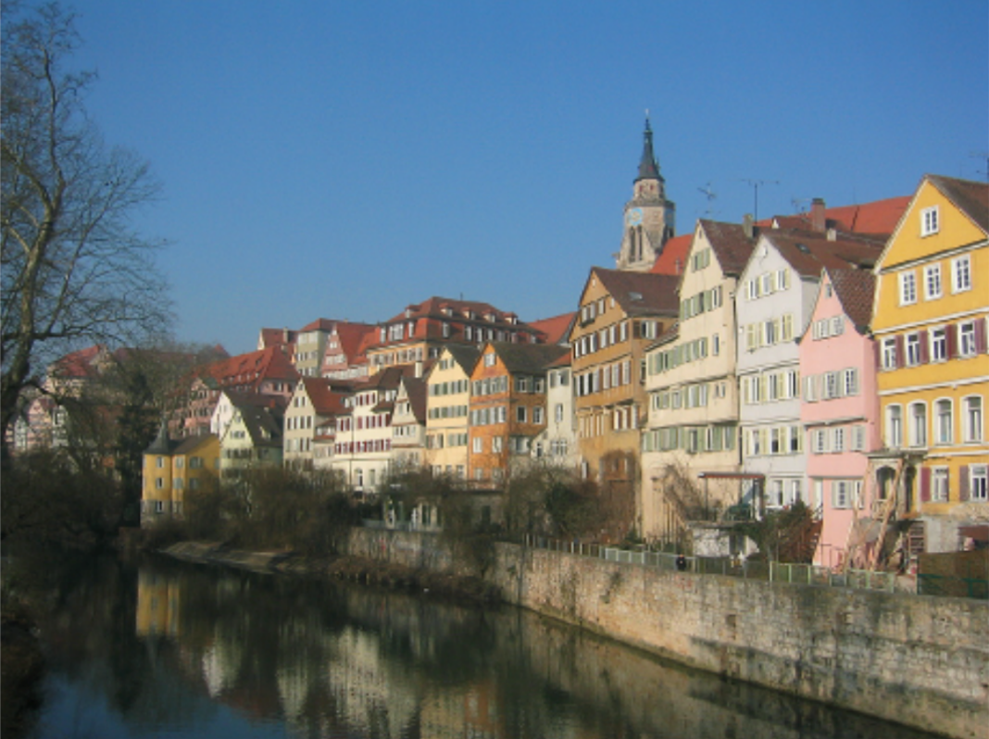
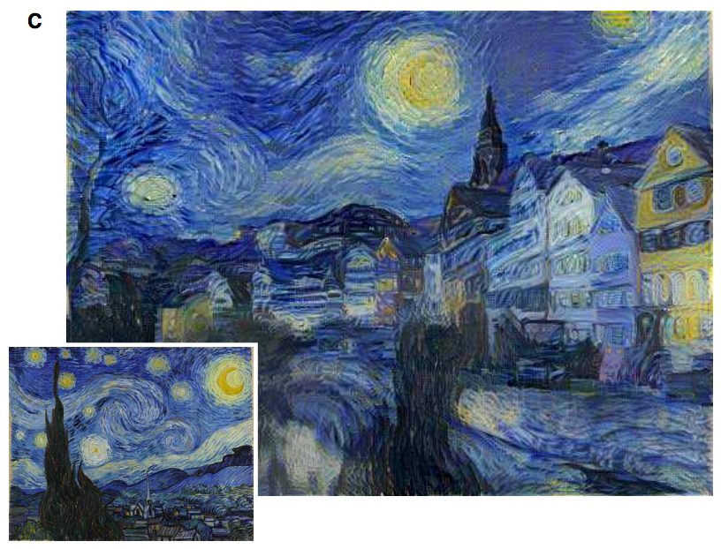
Image prediction (“structured prediction”)
Object labeling:
Edge Detection:
[Long et al. 2015, …]
[Xie et al. 2015, …]
Text-to-photo:
Style transfer:
“this small bird has a pink breast and crown…”
[Reed et al. 2016, …]
[Gatys et al. 2016, …]

Slide 18
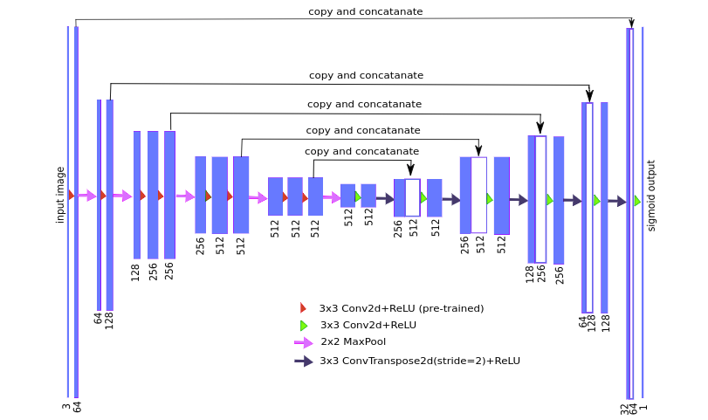
U-Net
A popular network structure to generate same-sized output
Similar to a convolutional autoencoder, but with “skip connections” that concatenate the output of earlier layers onto later layers
Great for learning transformations from one image to another

Slide 19
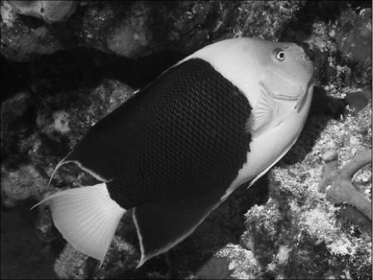
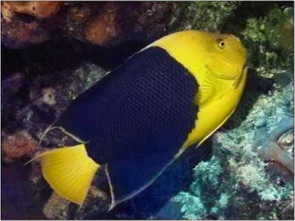

Image Colorization
from Jin Sun, Richard Zhang, Phillip Isola
Notes:
So formally, we are working in the Lab color space. The grayscale information is contained in the L, or lightness channel of the image, and is the input to our system.
The output is the ab, or color channels.
We’re looking to learn the mapping from L to ab using a CNN.
We can then take the predicted ab channels, concatenate them with the input, and hopefully get a plausible colorization of the input image. This is the graphics benefit of this problem.

Slide 20

“What should I do”
“How should I do it?”
from Jin Sun, Richard Zhang, Phillip Isola
Notes:
So formally, we are working in the Lab color space. The grayscale information is contained in the L, or lightness channel of the image, and is the input to our system.
The output is the ab, or color channels.
We’re looking to learn the mapping from L to ab using a CNN.
We can then take the predicted ab channels, concatenate them with the input, and hopefully get a plausible colorization of the input image. This is the graphics benefit of this problem.

Slide 21
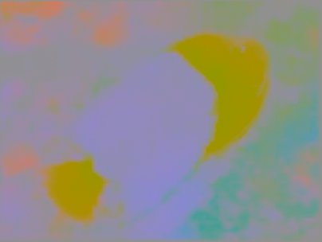

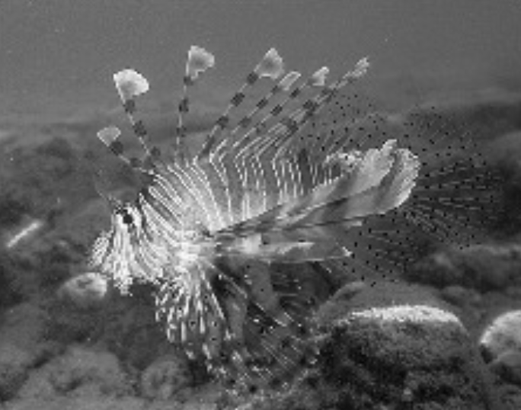
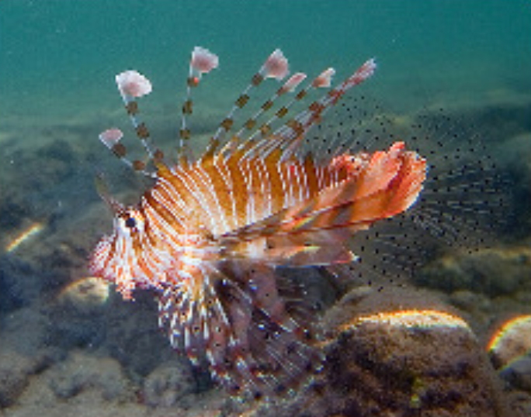
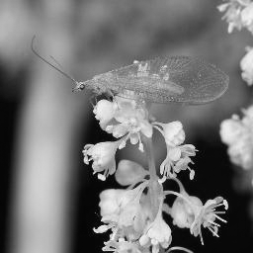
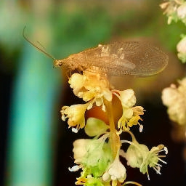
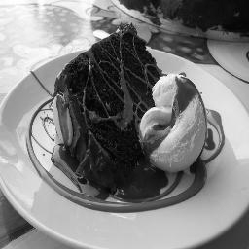
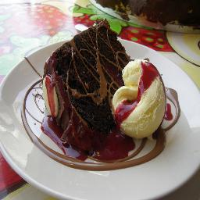
Training data
Grayscale image: L channel
Color information: ab channels
…
Objective function
(loss)
Neural Network
from Jin Sun, Richard Zhang, Phillip Isola
Notes:
So formally, we are working in the Lab color space. The grayscale information is contained in the L, or lightness channel of the image, and is the input to our system.
The output is the ab, or color channels.
We’re looking to learn the mapping from L to ab using a CNN.
We can then take the predicted ab channels, concatenate them with the input, and hopefully get a plausible colorization of the input image. This is the graphics benefit of this problem.

Slide 22
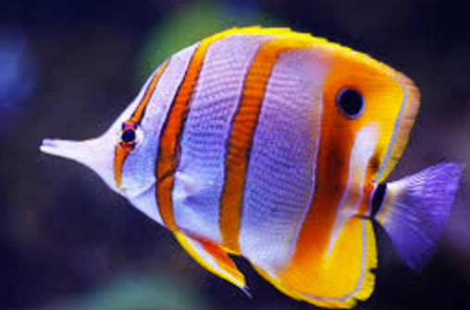
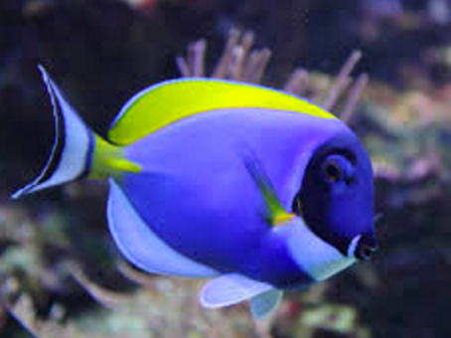
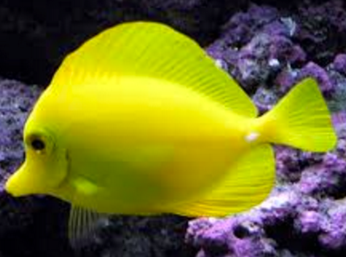
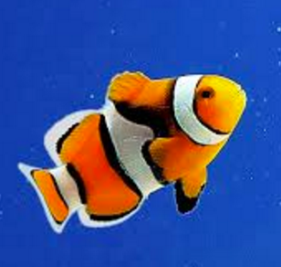
…
“yellow”
from Jin Sun, Richard Zhang, Phillip Isola

Slide 23
…
“black”
from Jin Sun, Richard Zhang, Phillip Isola

Slide 24
…
from Jin Sun, Richard Zhang, Phillip Isola

Slide 25
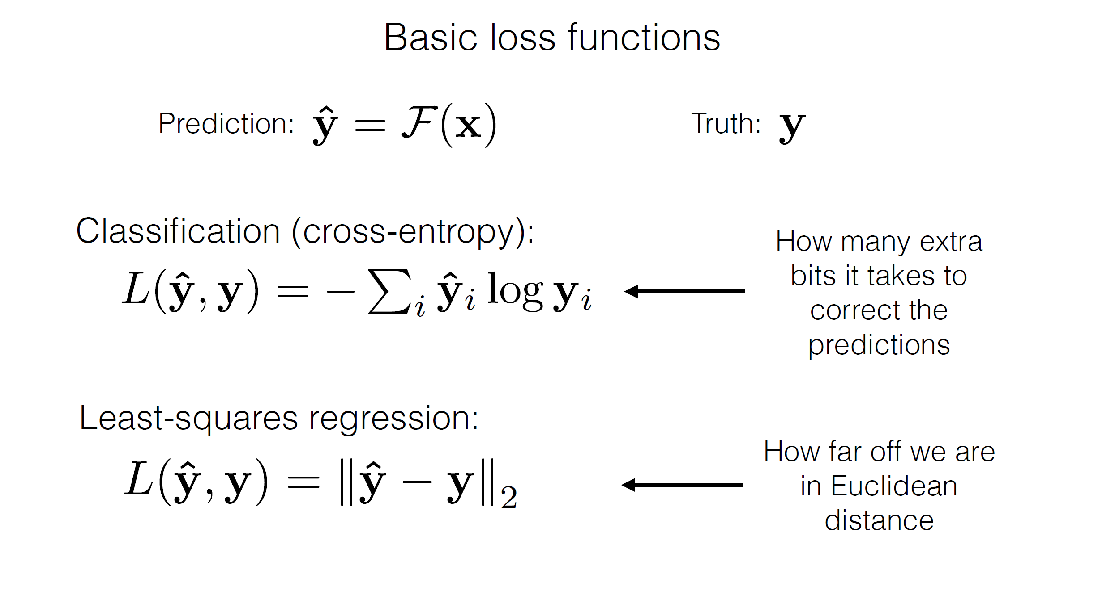
from Jin Sun, Richard Zhang, Phillip Isola

Slide 26
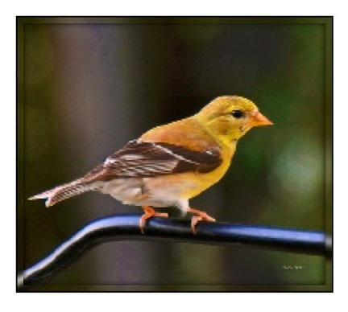
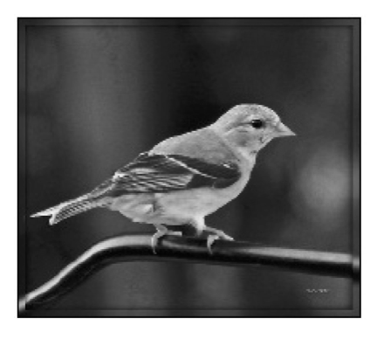
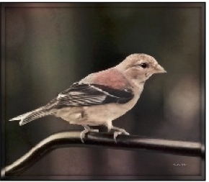

Designing loss functions
Input
Output
Ground truth
Notes:
Sounds reasonable, right?
“Minimize Euclidean distance between each predicted pixel color and its ground truth value.”

Slide 27
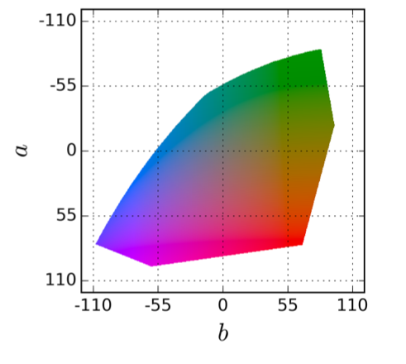
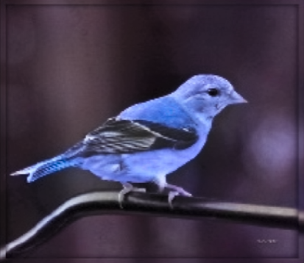
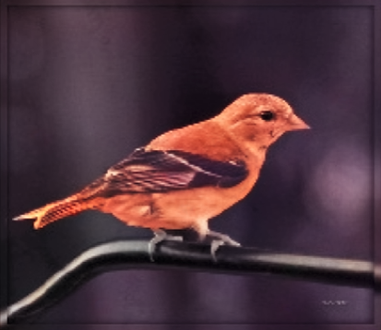
Notes:
Suppose there is an equal chance that the actual color is red or blue. Then the solution that minimizes the L2 norm is to output average of red and blue, which gives a grayish result.

Slide 28
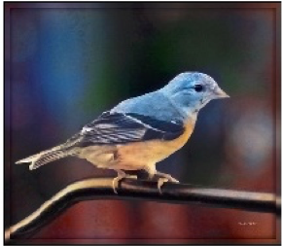
Designing loss functions
Input
Zhang et al. 2016
Ground truth
Color distribution cross-entropy loss with colorfulness enhancing term.
[Zhang, Isola, Efros, ECCV 2016]
Notes:
Required lots of engineering. Choose a color space, discretization scheme, soft-encoding, class-rebalancing with regularization, annealed-mean, etc.
Can we just automatically learn all this?

Slide 29
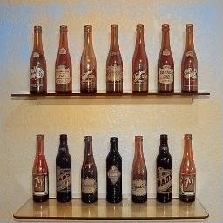
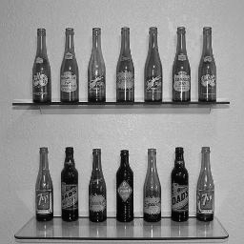

Slide 30
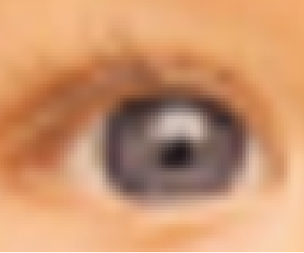
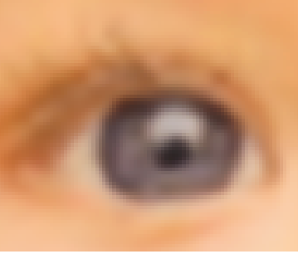
Designing loss functions
Image colorization
L2 regression
[Zhang, Isola, Efros, ECCV 2016]
Super-resolution
L2 regression
[Johnson, Alahi, Li, ECCV 2016]
Notes:
So we can carefully engineer our loss functions

Slide 31
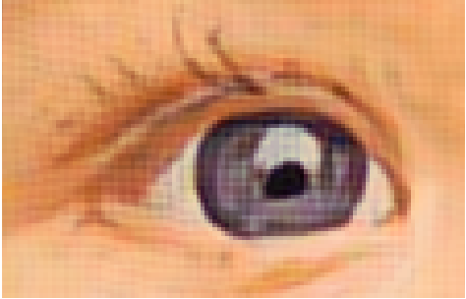
Designing loss functions
Image colorization
Cross entropy objective, with colorfulness term
[Zhang, Isola, Efros, ECCV 2016]
Super-resolution
Deep feature covariance matching objective
[Johnson, Alahi, Li, ECCV 2016]
Notes:
So we can carefully engineer our loss functions

Slide 32
A Better Loss Function: Sticking to the Manifold
How do we design a loss function that penalizes images that aren’t on the image manifold?
Key insight: we will learn our loss function by training a network to discriminate between images that are on the manifold and images that aren’t
Interpolation
(simple Interpolation)
Notes:
All of these are just predicting pixels from pixels, so shouldn’t there be some universal loss?

Slide 33
Part 3: Generative Adversarial Networks (GANs)
Abe Davis, with slides from Jin Sun and Phillip Isola

Slide 34
Generative Adversarial Networks (GANs)
Basic idea: Learn a mapping from some latent space to images on a particular manifold
Example of a Generative Model:
  We can think of classification as a way to compute some P(x) that tells us the probability that image x is a member of a class.
  Rather than simply evaluating this distribution, a generative model tries to learn a way to sample from it

Slide 35
Generative Adversarial Networks (GANs)
Generator network has similar structure to the decoder of our autoencoder
  Maps from some latent space to images
We train it in an adversarial manner against a discriminator network
  Generator tries to create output that is indistinguishable from training data
  Discriminator tries to distinguish between generator output and training data
Training Data
Discriminator Network

Slide 36
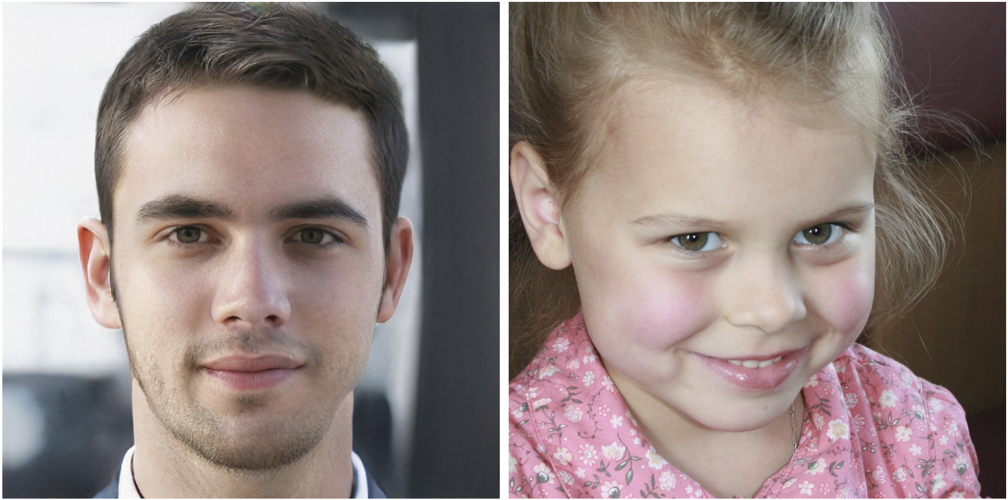
Example: Randomly Sampling the Space of Face Images
(Using Generative Adversarial Networks (GANs)
Which face is real?
Notes:
http://www.whichfaceisreal.com/index.php

Slide 37
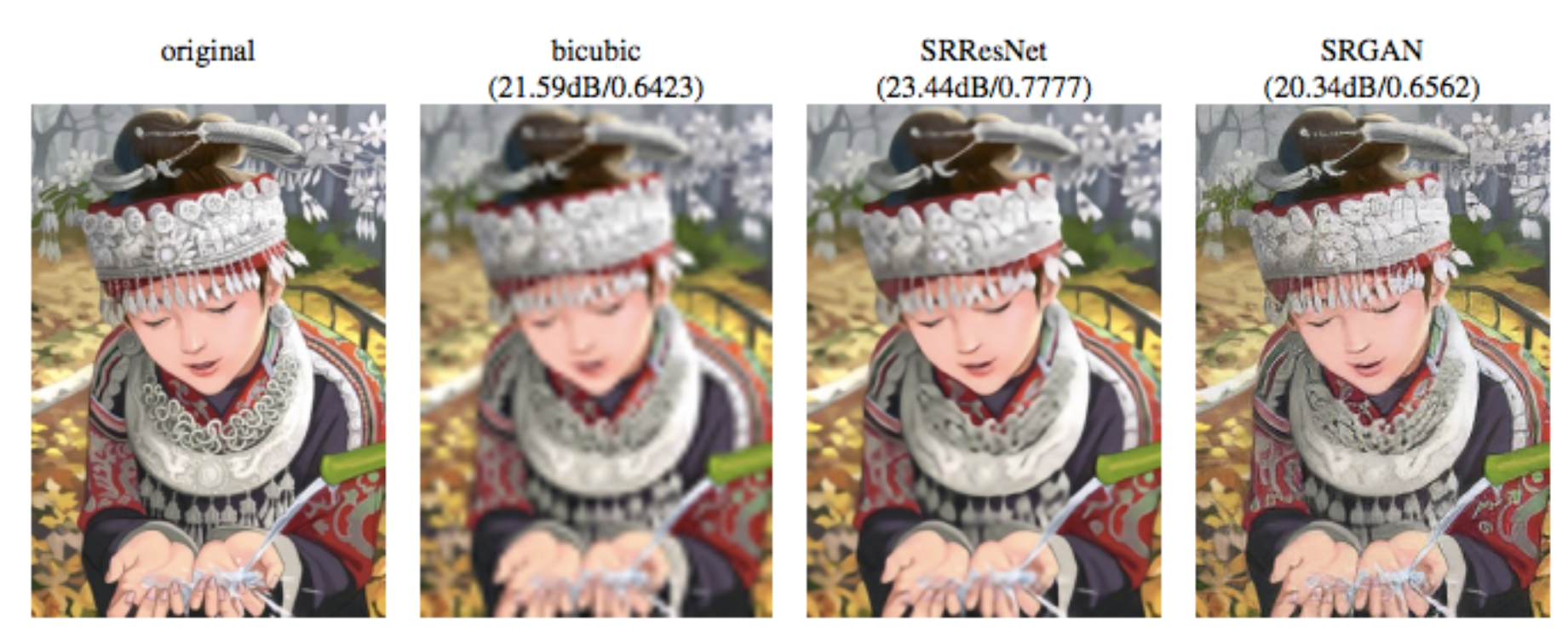
Conditional GANs
Generate samples from a conditional distribution
Example: generate high-resolution image conditioned on low resolution input
[Ledig et al 2016]

Slide 38
Example: Single Image Super-Resolution
Generate natural image, conditioned on a lower–resolution version of the image
[Ledig et al 2016]

Slide 39
Conditional GANs
[Goodfellow et al., 2014]
[Isola et al., 2017]

Slide 40
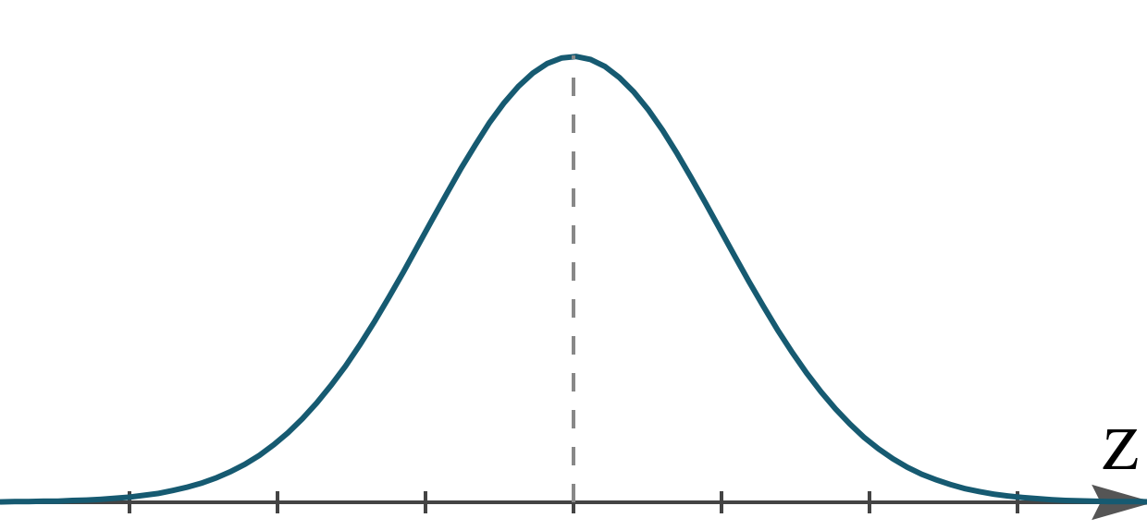
Generative Models: Generate Samples from a Distribution
We can look at classification as a way to compute some P(x) that tells us the probability that image x is a member of a class.
Rather than simply evaluating this distribution, is there some way for us to generate samples from it?

Slide 41
Basic Idea Part 2: Generate Samples from a Conditional Distribution
Can we generate samples from our distribution conditioned on some input?
In other words, can we generate samples from the conditional distribution P(x|c)?

Slide 42

Generator
[Goodfellow et al., 2014]
Notes:
CONDITIONAL

Slide 43
real or fake?
Generator
Discriminator
G tries to synthesize fake images that fool D
D tries to identify the fakes
[Goodfellow et al., 2014]

Slide 44
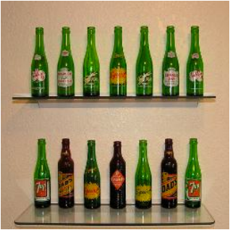



fake (0.9)
real (0.1)
(Identify generated images as fake)
(Identify training images as real)
[Goodfellow et al., 2014]
Notes:
D wants to Maximize objective
Penalize

Slide 45

real or fake?
G tries to synthesize fake images that fool D:
[Goodfellow et al., 2014]
Notes:
G wants to minize objective

Slide 46

real or fake?
G tries to synthesize fake images that fool the best D:
[Goodfellow et al., 2014]

Slide 47
Loss Function
G’s perspective: D is a loss function.
Rather than being hand-designed, it is learned.
[Goodfellow et al., 2014]
[Isola et al., 2017]

Slide 48

real or fake?
[Goodfellow et al., 2014]
Notes:
But what if, given this input, out generator outputs this image? Is it real or is it fake?

Slide 49
real!
(“Aquarius”)
[Goodfellow et al., 2014]

Slide 50
real or fake pair ?
[Goodfellow et al., 2014]
[Isola et al., 2017]

Slide 51
real or fake pair ?
[Goodfellow et al., 2014]
[Isola et al., 2017]

Slide 52
fake pair
[Goodfellow et al., 2014]
[Isola et al., 2017]

Slide 53
real pair
[Goodfellow et al., 2014]
[Isola et al., 2017]

Slide 54
real or fake pair ?
[Goodfellow et al., 2014]
[Isola et al., 2017]

Slide 55

More Examples of Image-to-Image Translation with GANs
We have pairs of corresponding training images
Conditioned on one of the images, sample from the distribution of likely corresponding images
Edges to Image
Segmentation to Street Image
Aerial Photo To Map

Slide 56












BW → Color
Input
Output
Input
Output
Input
Output
Data from [Russakovsky et al. 2015]

Slide 57





Input
Output
Groundtruth
Data from
[maps.google.com]
Notes:
Again, pixels to pixels!
These are 512x512 but you can run it at any resolution, since it’s fully convolutional.

Slide 58



Labels → Street Views
Data from [Wang et al, 2018]

Slide 59












Day → Night
Input
Output
Input
Output
Input
Output
Data from [Laffont et al., 2014]

Slide 60












Edges → Images
Input
Output
Input
Output
Input
Output
Edges from [Xie & Tu, 2015]

Slide 61

Demo
https://affinelayer.com/pixsrv/

Slide 62


Ivy Tasi @ivymyt
Vitaly Vidmirov @vvid

Slide 63

Image Inpainting
Data from [Pathak et al., 2016]​

Slide 64

Pose-guided Generation
Data from [Ma et al., 2018]​

Slide 65
Challenges —> Solutions
Output is high-dimensional, structured object
  Approach: Use a deep net, D, to analyze output!
Uncertainty in mapping; many plausible outputs
  Approach: D only cares about “plausibility”, doesn’t hedge
Lack of supervised training data
  Approach: ?
“this small bird has a pink breast and crown…”

Slide 66

https://junyanz.github.io/CycleGAN/

Slide 67


https://hardikbansal.github.io/CycleGANBlog/

Slide 68


Slide 69

StyleGAN
https://github.com/NVlabs/stylegan

Slide 70
Questions?

