Slide 1
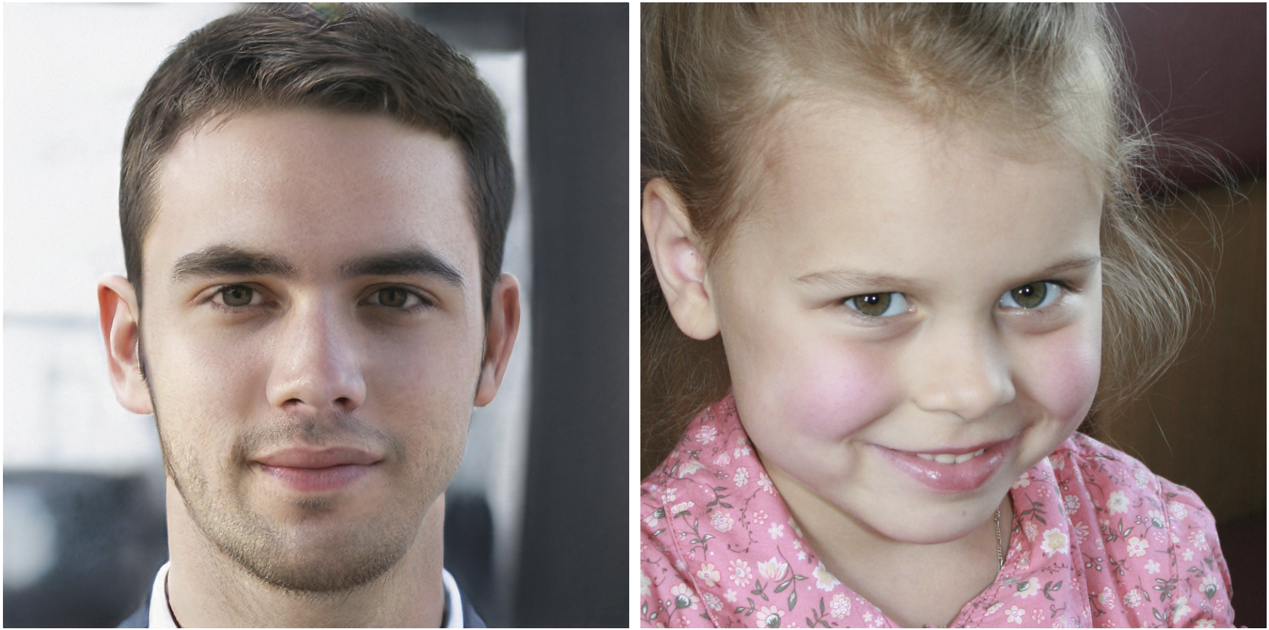
Synthesizing images with generative adversarial networks (GANs)
CS5670: Computer Vision
Guest Lecture - Jin Sun
Which face is real?
Slides from Philipp Isola

Slide 2
Readings
NIPS 2016 Tutorial on GANs
https://arxiv.org/abs/1701.00160

Slide 3
Announcements
Project 5 due Friday, 5/10 at 11:59pm
Course evals (you will receive a few bonus points!)
https://apps.engineering.cornell.edu/CourseEval
Final exam in class next Monday, 5/6
Please arrange yourselves with at least one space between you and the closest person in the same row when you arrive

Slide 4
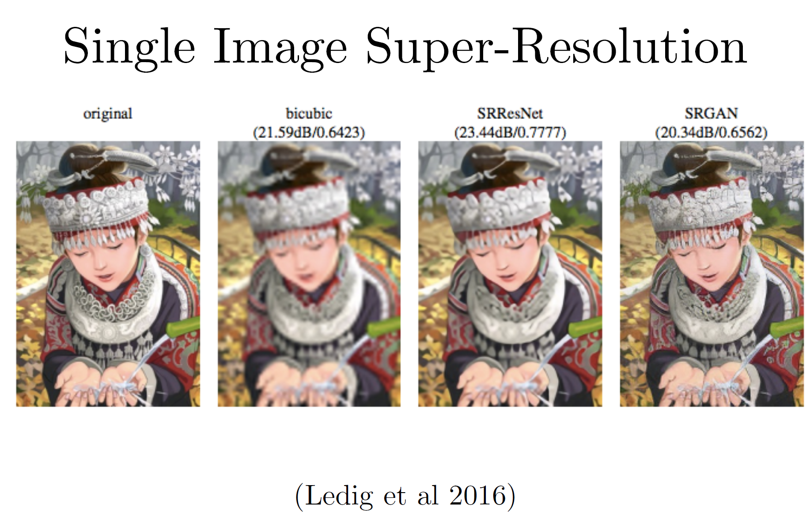
Motivation: Synthesizing images

Slide 5
Motivation: Synthesizing images

Slide 6
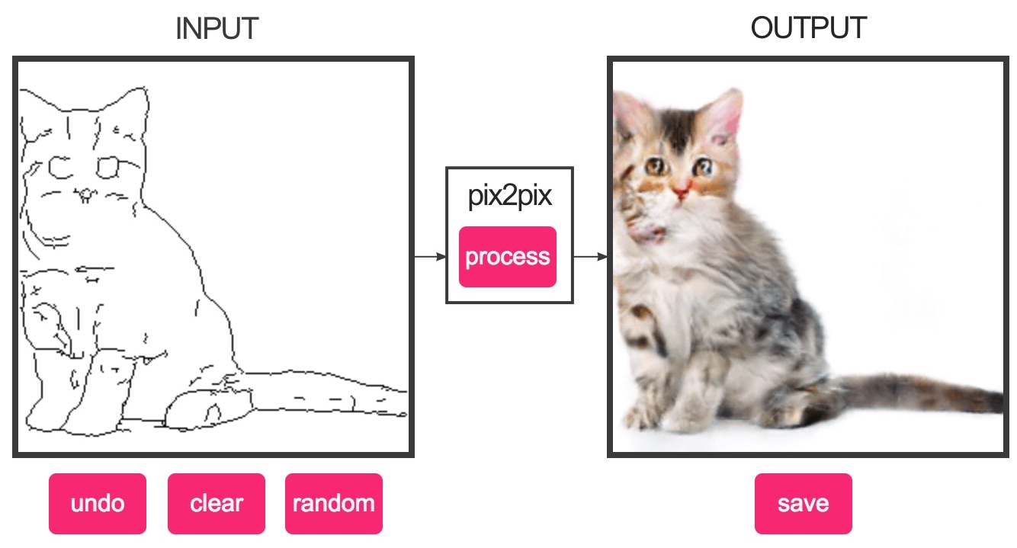
Demo
https://affinelayer.com/pixsrv/

Slide 7
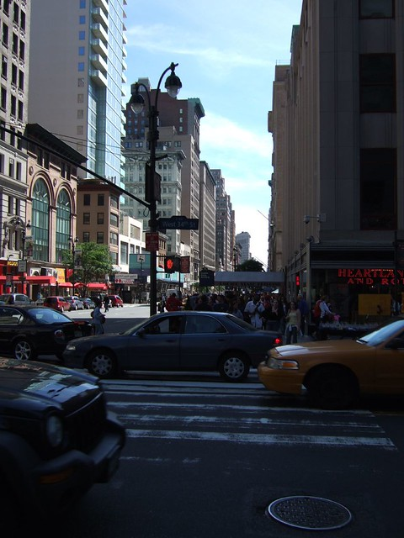
Why Synthesizing Images
Computer vision is all about understanding the world from images
Understand
a busy downtown area with a lot of traffic and buildings. this is a picture of a busy downtown cross walk with several cars in the flow of traffic. cars passing on a street in the city. ...
Synthesize
“What I cannot create, I do not understand.”
—Richard Feynman

Slide 8
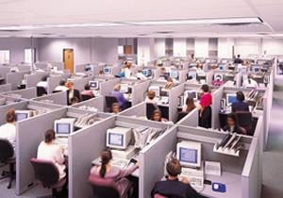
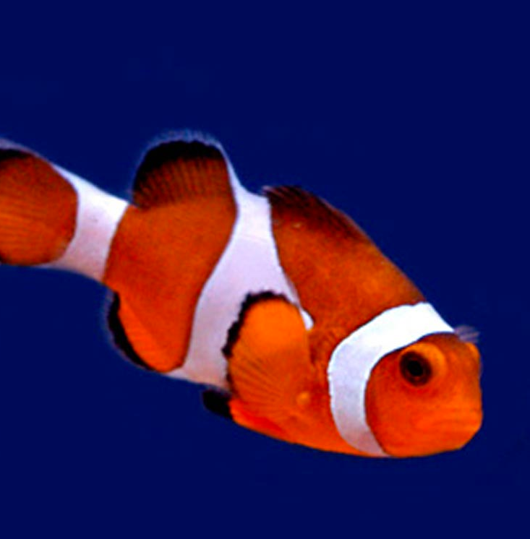
Image classification
Learner
“Fish”
image X
label Y

Slide 9
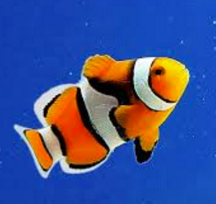
Image classification
Learner
“Fish”
image X
label Y

Slide 10
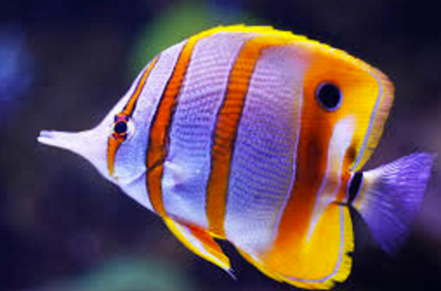
Image classification
Learner
“Fish”
image X
label Y

Slide 11
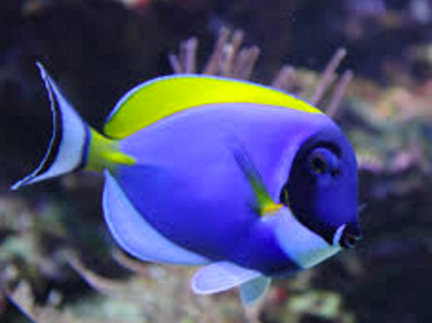
Image classification
Learner
“Fish”
…
image X
label Y

Slide 12
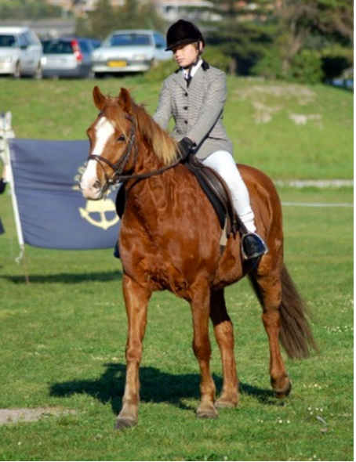
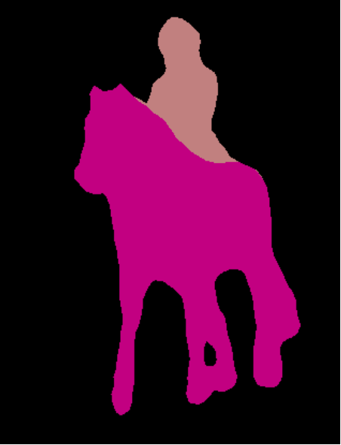
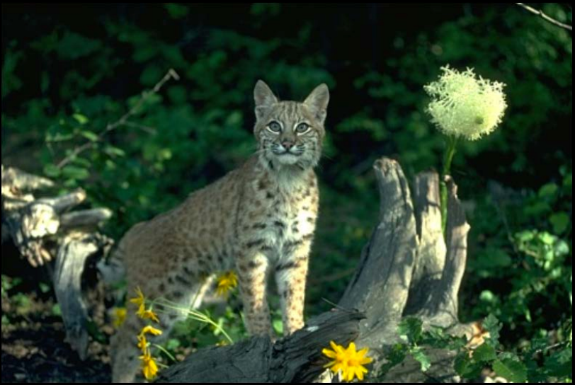
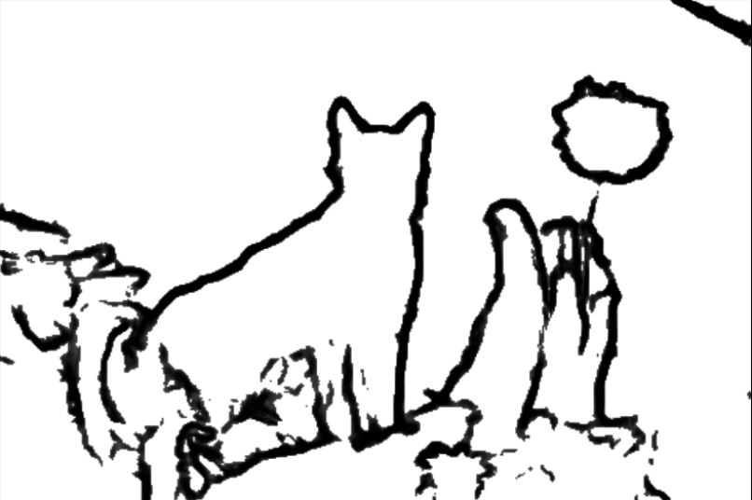
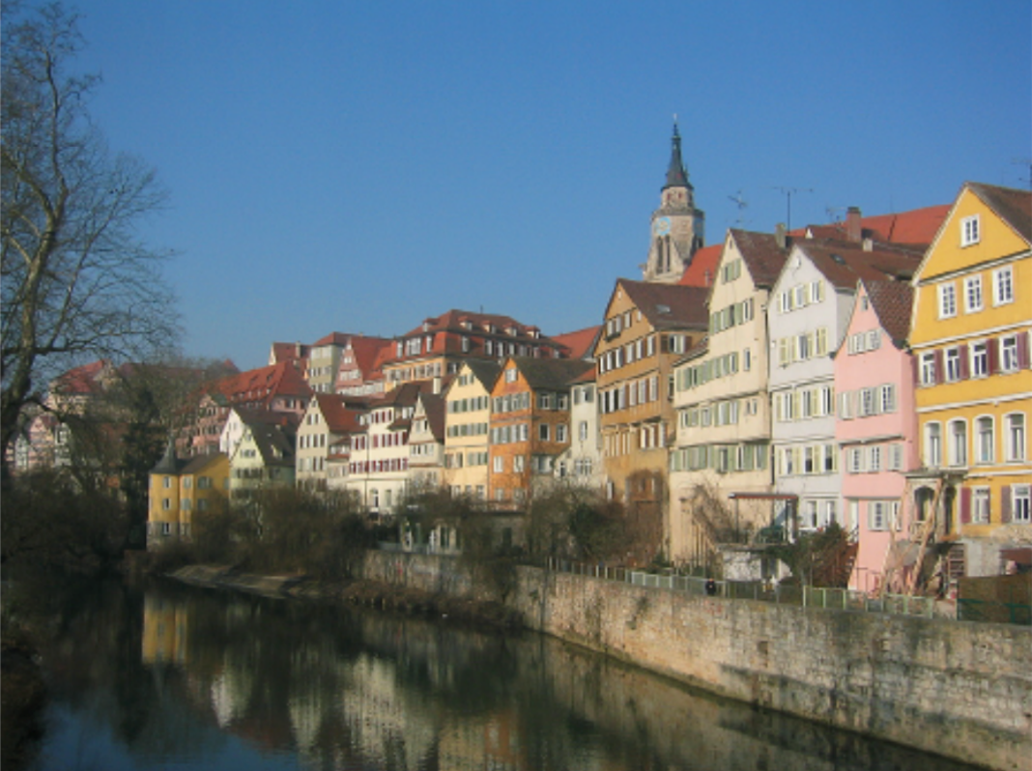
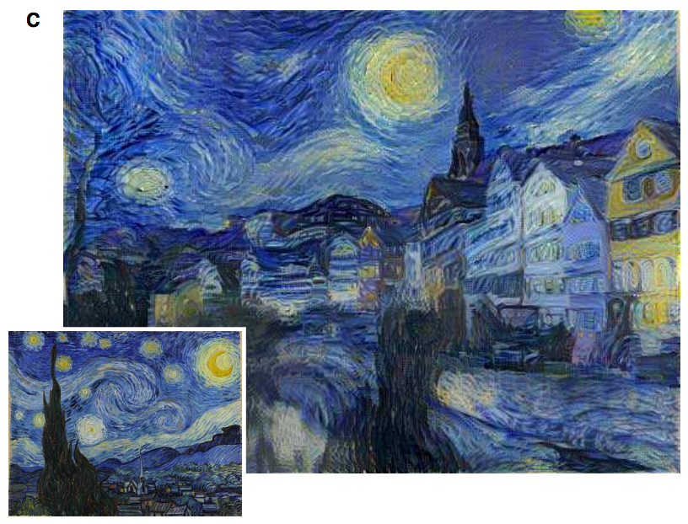
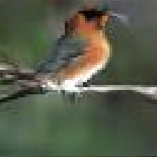
Image prediction (“structured prediction”)
Object labeling
Edge Detection
[Xie et al. 2015, …]
[Long et al. 2015, …]
Text-to-photo
Style transfer
“this small bird has a pink breast and crown…”
[Reed et al. 2014, …]
[Gatys et al. 2016, …]

Slide 13
Challenges
Output is high-dimensional and structured
Uncertainty in mapping; many plausible outputs
Lack of supervised training data
“this small bird has a pink breast and crown…”

Slide 14
A standard CNN for classification
Need new network modules to generate same-sized output!

Slide 15
Deconvolution
Compare to convolution with different params

Slide 16
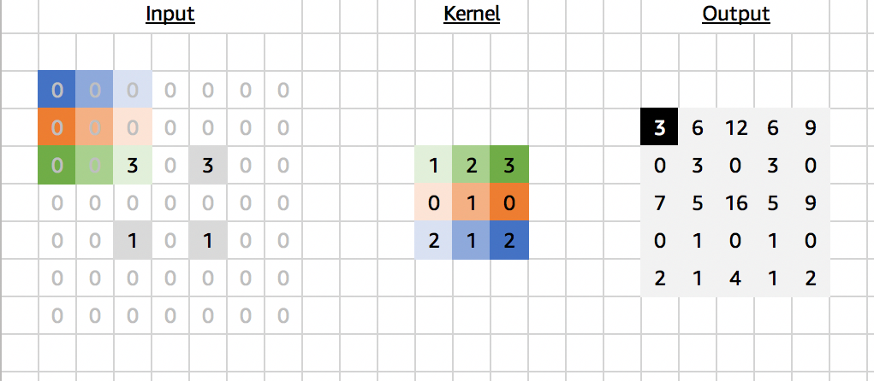
Deconvolution
Also known as: transpose conv, upconv, ...

Slide 17
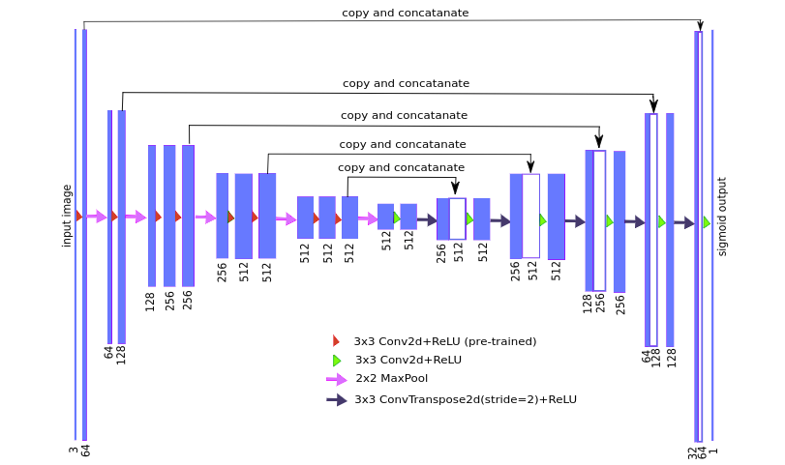
Unet
A popular network structure to generate same-sized output

Slide 18
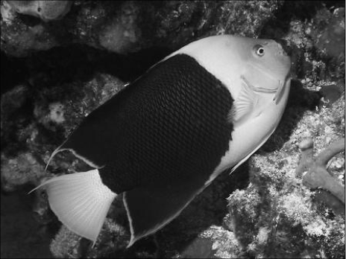
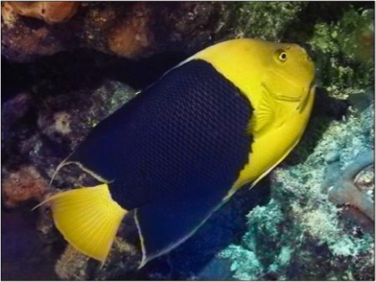
Image Colorization
Notes:
So formally, we are working in the Lab color space. The grayscale information is contained in the L, or lightness channel of the image, and is the input to our system.
The output is the ab, or color channels.
We’re looking to learn the mapping from L to ab using a CNN.
We can then take the predicted ab channels, concatenate them with the input, and hopefully get a plausible colorization of the input image. This is the graphics benefit of this problem.

Slide 19
“What should I do”
“How should I do it?”
Notes:
So formally, we are working in the Lab color space. The grayscale information is contained in the L, or lightness channel of the image, and is the input to our system.
The output is the ab, or color channels.
We’re looking to learn the mapping from L to ab using a CNN.
We can then take the predicted ab channels, concatenate them with the input, and hopefully get a plausible colorization of the input image. This is the graphics benefit of this problem.

Slide 20
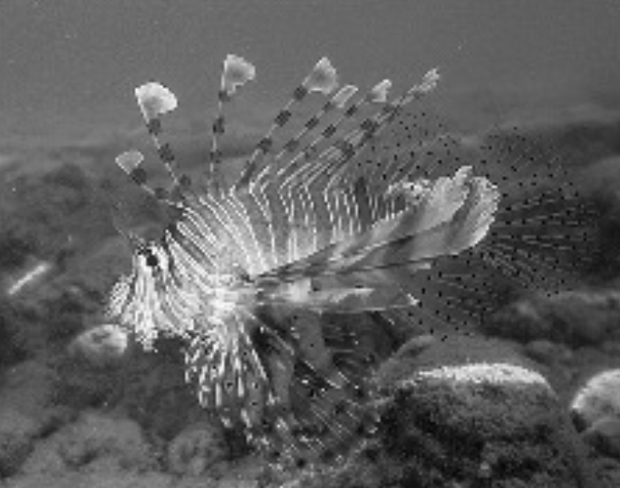
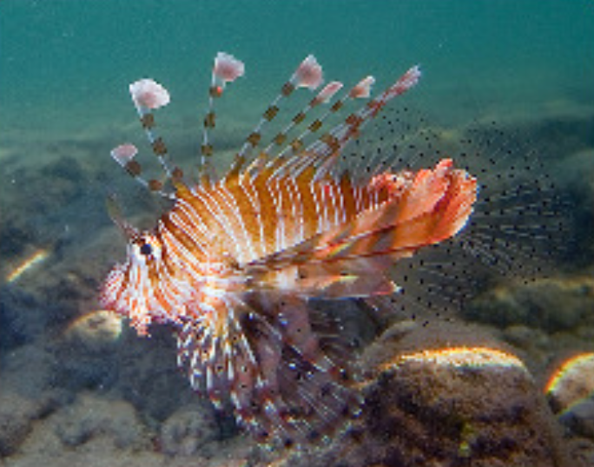
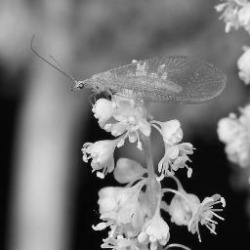
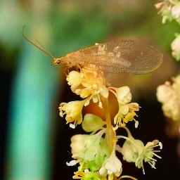
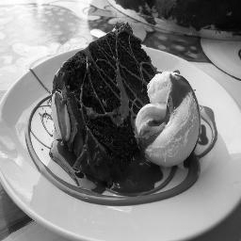
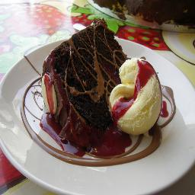
Training data
Grayscale image: L channel
Color information: ab channels
…
Objective function
(loss)
Neural Network
Notes:
So formally, we are working in the Lab color space. The grayscale information is contained in the L, or lightness channel of the image, and is the input to our system.
The output is the ab, or color channels.
We’re looking to learn the mapping from L to ab using a CNN.
We can then take the predicted ab channels, concatenate them with the input, and hopefully get a plausible colorization of the input image. This is the graphics benefit of this problem.

Slide 21
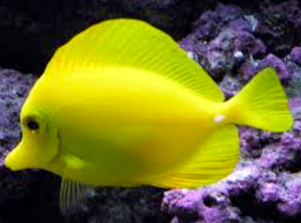
…
“yellow”

Slide 22
…
“black”

Slide 23
…

Slide 25
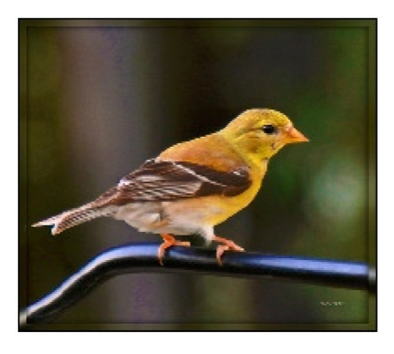
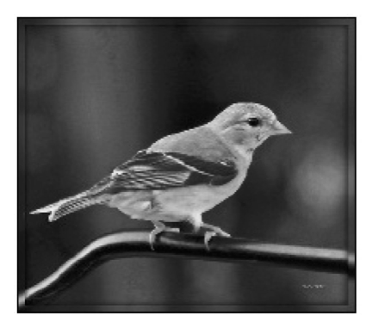
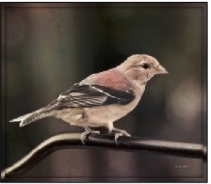
Designing loss functions
Input
Output
Ground truth
Notes:
Sounds reasonable, right?
“Minimize Euclidean distance between each predicted pixel color and its ground truth value.”

Slide 26
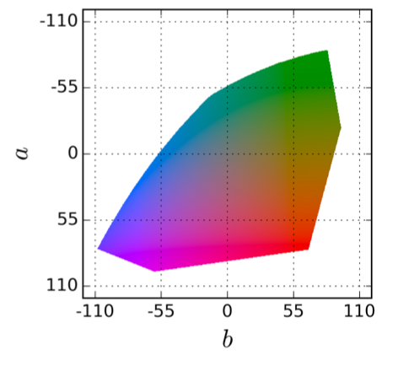
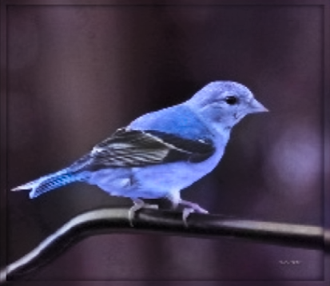
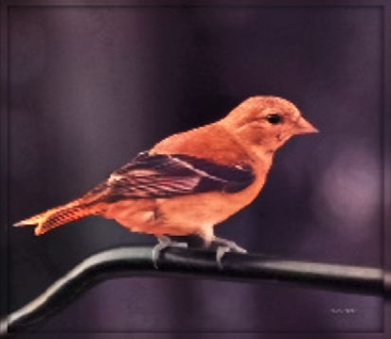
Notes:
Suppose there is an equal chance that the actual color is red or blue. Then the solution that minimizes the L2 norm is to output average of red and blue, which gives a grayish result.

Slide 27
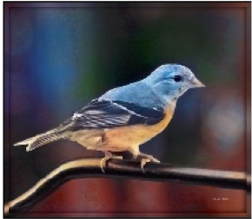
Designing loss functions
Input
Zhang et al. 2016
Ground truth
Color distribution cross-entropy loss with colorfulness enhancing term.
[Zhang, Isola, Efros, ECCV 2016]
Notes:
Required lots of engineering. Choose a color space, discretization scheme, soft-encoding, class-rebalancing with regularization, annealed-mean, etc.
Can we just automatically learn all this?

Slide 28
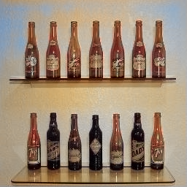
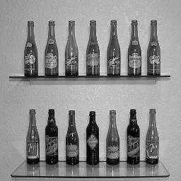

Slide 29
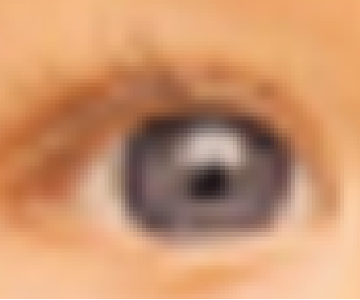
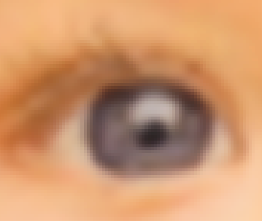
Designing loss functions
Image colorization
L2 regression
[Zhang, Isola, Efros, ECCV 2016]
Super-resolution
L2 regression
[Johnson, Alahi, Li, ECCV 2016]
Notes:
So we can carefully engineer our loss functions

Slide 30
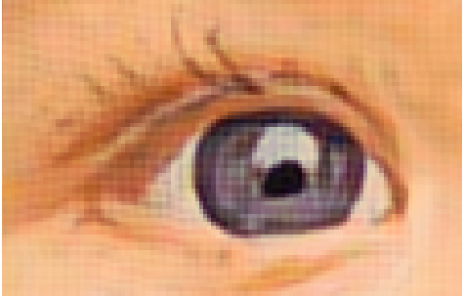
Designing loss functions
Image colorization
Cross entropy objective, with colorfulness term
[Zhang, Isola, Efros, ECCV 2016]
Super-resolution
Deep feature covariance matching objective
[Johnson, Alahi, Li, ECCV 2016]
Notes:
So we can carefully engineer our loss functions

Slide 31
Universal loss?
…
…
Notes:
All of these are just predicting pixels from pixels, so shouldn’t there be some universal loss?

Slide 32
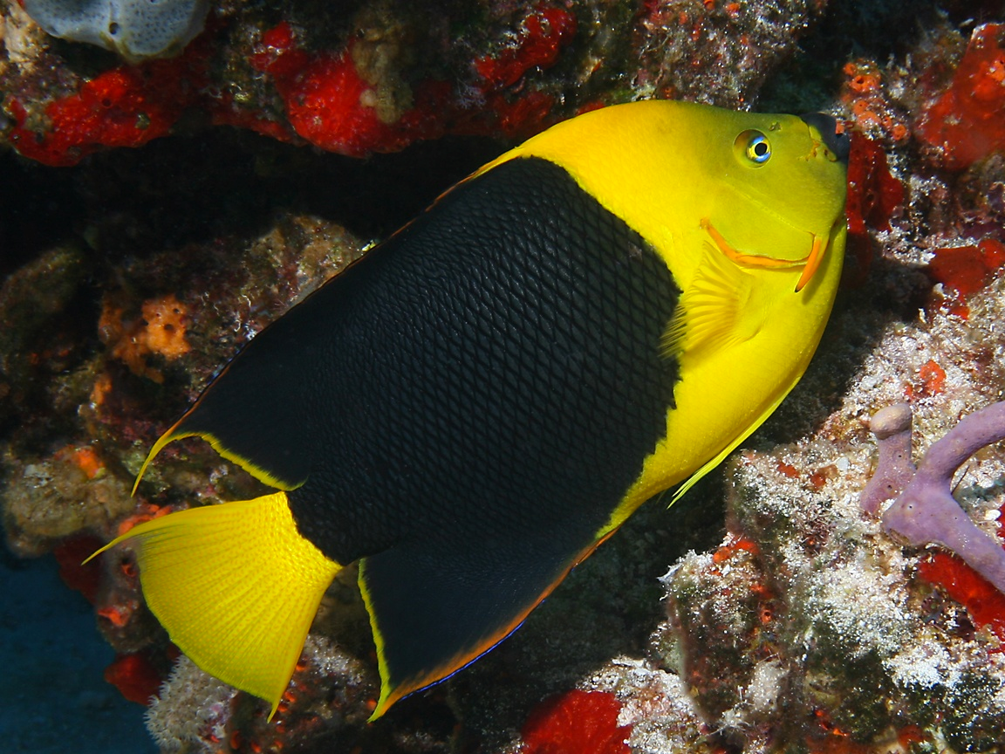
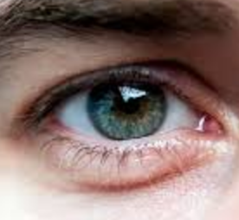
Generated images
“Generative Adversarial Network”
(GANs)
…
…
Generated vs Real
(classifier)
Real photos
[Goodfellow, Pouget-Abadie, Mirza, Xu, Warde-Farley, Ozair, Courville, Bengio 2014]
…
Notes:
motivate with either turk “real vs fake” or graphics
add full citation

Slide 33
Conditional GANs
[Goodfellow et al., 2014]
[Isola et al., 2017]

Slide 34
Generator
[Goodfellow et al., 2014]

Slide 35
real or fake?
Generator
Discriminator
G tries to synthesize fake images that fool D
D tries to identify the fakes
[Goodfellow et al., 2014]

Slide 36
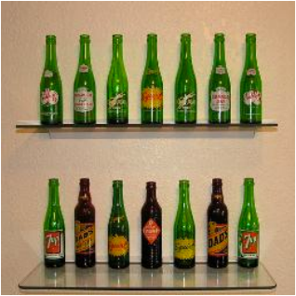
fake (0.9)
real (0.1)
[Goodfellow et al., 2014]

Slide 37
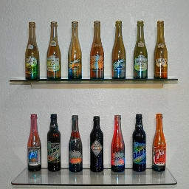
real or fake?
G tries to synthesize fake images that fool D:
[Goodfellow et al., 2014]

Slide 38
real or fake?
G tries to synthesize fake images that fool the best D:
[Goodfellow et al., 2014]

Slide 39
Loss Function
G’s perspective: D is a loss function.
Rather than being hand-designed, it is learned.
[Goodfellow et al., 2014]
[Isola et al., 2017]

Slide 40
real or fake?
[Goodfellow et al., 2014]
Notes:
But what if, given this input, out generator outputs this image? Is it real or is it fake?

Slide 41
real!
(“Aquarius”)
[Goodfellow et al., 2014]

Slide 42
real or fake pair ?
[Goodfellow et al., 2014]
[Isola et al., 2017]

Slide 43
real or fake pair ?
[Goodfellow et al., 2014]
[Isola et al., 2017]

Slide 44
fake pair
[Goodfellow et al., 2014]
[Isola et al., 2017]

Slide 45
real pair
[Goodfellow et al., 2014]
[Isola et al., 2017]

Slide 46
real or fake pair ?
[Goodfellow et al., 2014]
[Isola et al., 2017]

Slide 47
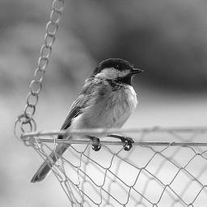
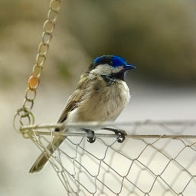
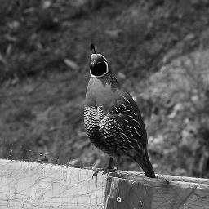
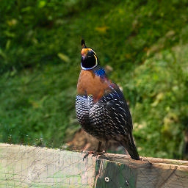
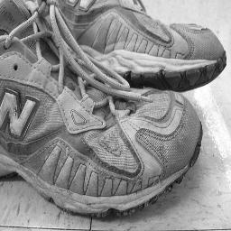
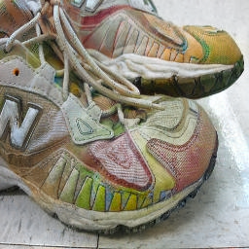
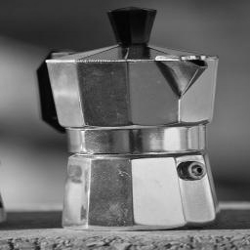
BW → Color
Input
Output
Input
Output
Input
Output
Data from [Russakovsky et al. 2015]

Slide 48
Input
Output
Groundtruth
Data from
[maps.google.com]
Notes:
Again, pixels to pixels!
These are 512x512 but you can run it at any resolution, since it’s fully convolutional.

Slide 49
Labels → Street Views
Data from [Wang et al, 2018]

Slide 50
Day → Night
Input
Output
Input
Output
Input
Output
Data from [Laffont et al., 2014]

Slide 51
Edges → Images
Input
Output
Input
Output
Input
Output
Edges from [Xie & Tu, 2015]

Slide 52
Ivy Tasi @ivymyt
Vitaly Vidmirov @vvid

Slide 53
Image Inpainting
Data from [Pathak et al., 2016]​

Slide 54
Pose-guided Generation
Data from [Ma et al., 2018]​

Slide 55
Challenges —> Solutions
Output is high-dimensional, structured object
Uncertainty in mapping; many plausible outputs
Lack of supervised training data
—> Use a deep net, D, to analyze output!
“this small bird has a pink breast and crown…”
—> D only cares about “plausibility”, doesn’t hedge

Slide 56
Challenges —> Solutions
Output is high-dimensional, structured object
Uncertainty in mapping; many plausible outputs
Lack of supervised training data
—> Use a deep net, D, to analyze output!
“this small bird has a pink breast and crown…”
—> D only cares about “plausibility”, doesn’t hedge

Slide 57
https://junyanz.github.io/CycleGAN/

Slide 58
https://hardikbansal.github.io/CycleGANBlog/

Slide 60
StyleGAN
https://github.com/NVlabs/stylegan

Slide 61
Questions?

