Slide 1
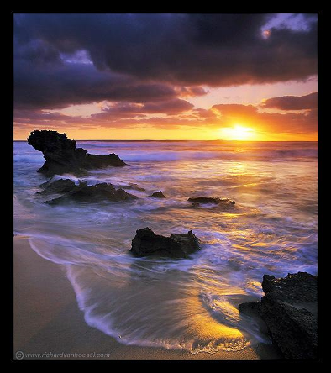
Light & Perception
CS5670: Computer Vision
Noah Snavely

Slide 2


Slide 3
Announcements
Project 4
  To be released on Wednesday
  Groups of 2
Please submit midterm regrade requests by tomorrow (Tuesday, 4/9) by 11:59pm
Project 3 artifact voting open until Friday
Quiz 3 this Wednesday, April 10
  Will cover topics since the midterm was released (single-view modeling, stereo, two-view geometry / Fundamental matrices, and today’s lecture on light)

Slide 4
Road map
Finishing up geometry
Next: deep learning and hot topics in computer vision

Slide 5
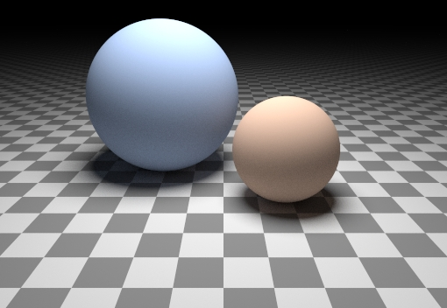
Can we determine shape from lighting?
Are these spheres?
  Or just flat discs painted with varying albedo?
  There is ambiguity between shading and reflectance
  But still, as humans we can understand the shapes of these objects

Slide 6
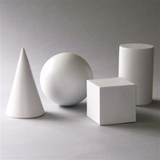
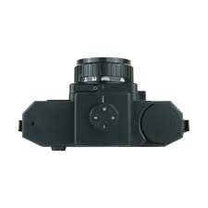
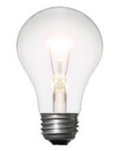
What we know: Stereo
Key Idea: use feature motion to understand shape

Slide 7
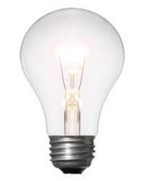
Next: Photometric Stereo
Key Idea: use pixel brightness to understand shape

Slide 8
Next: Photometric Stereo
Key Idea: use pixel brightness to understand shape

Slide 9
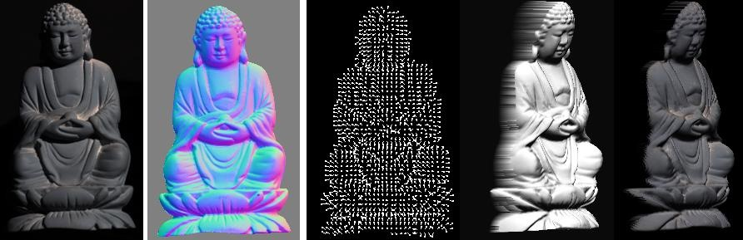
Photometric Stereo
What results can you get?
Input
(1 of 12)
Normals (RGB colormap)
Normals (vectors)
Shaded 3D
rendering
Textured 3D
rendering

Slide 10
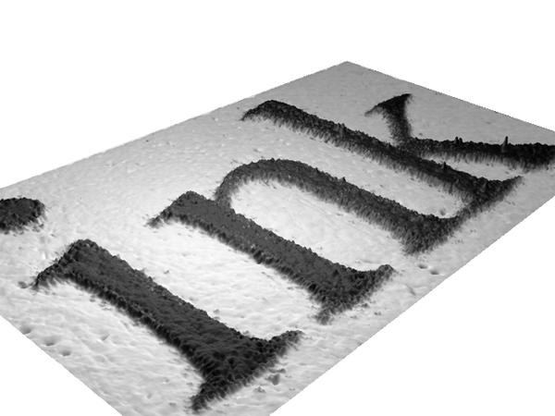

Slide 11
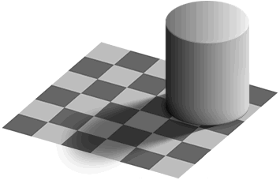
Light
by Ted Adelson
Readings
  Szeliski, 2.2, 2.3.2

Slide 12
Light
by Ted Adelson
Readings
  Szeliski, 2.2, 2.3.2

Slide 13
Properties of light
Today
  What is light?
  How do we measure it?
  How does light propagate?
  How does light interact with matter?

Slide 14
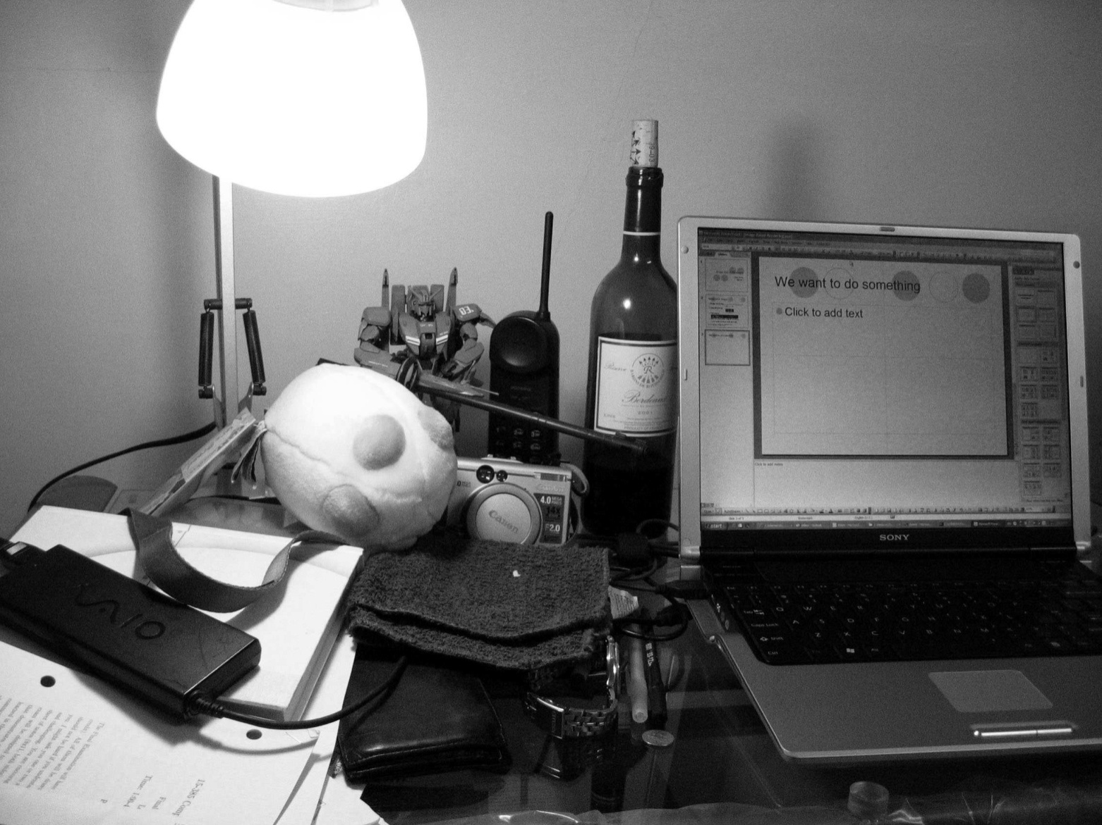
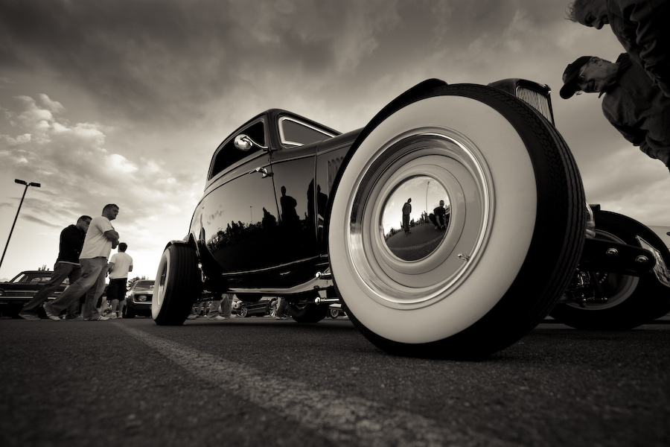
Radiometry
What determines the brightness of a pixel?
Light source properties
Surface properties
Surface properties

Slide 15
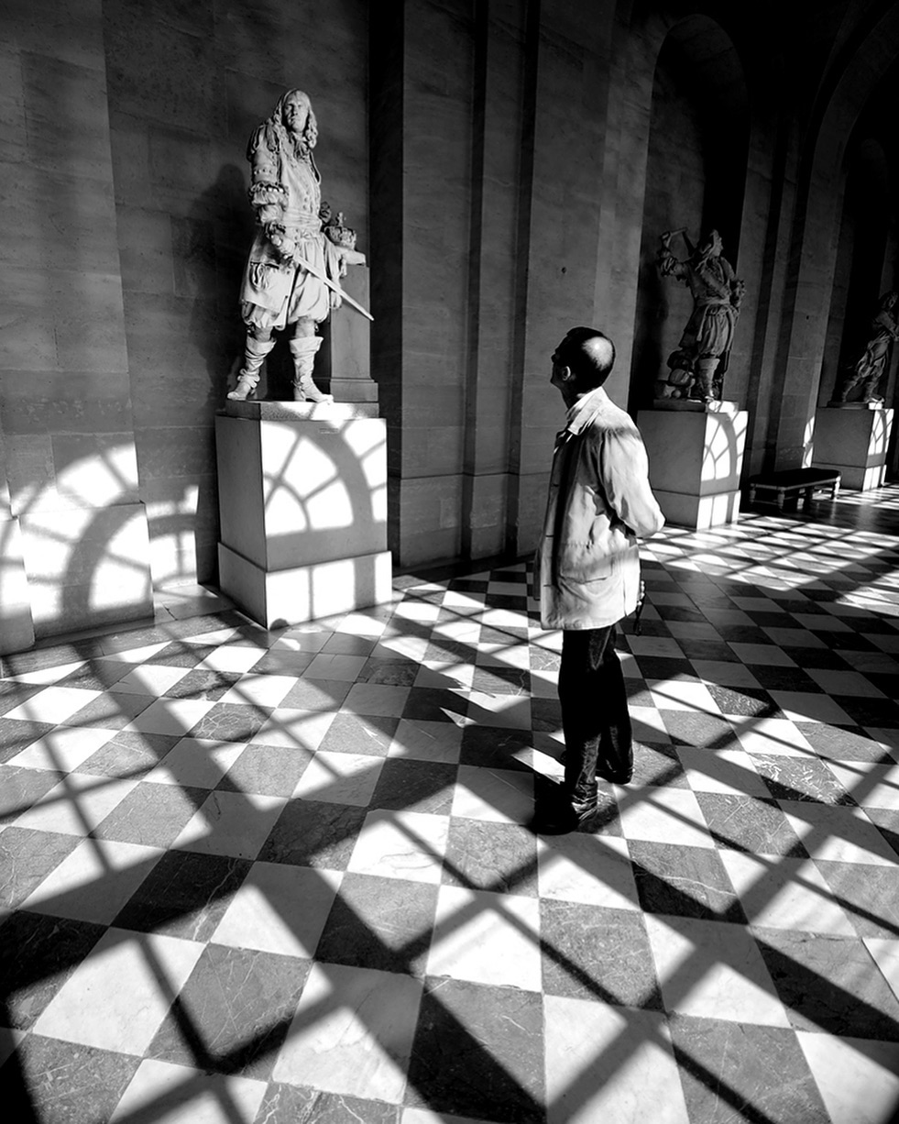
Radiometry
What determines the brightness of a pixel?
@robertwestonbreshears
https://www.instagram.com/p/BtgX55ZBhU-/

Slide 16
Radiometry
What determines the brightness of a pixel?

Slide 17
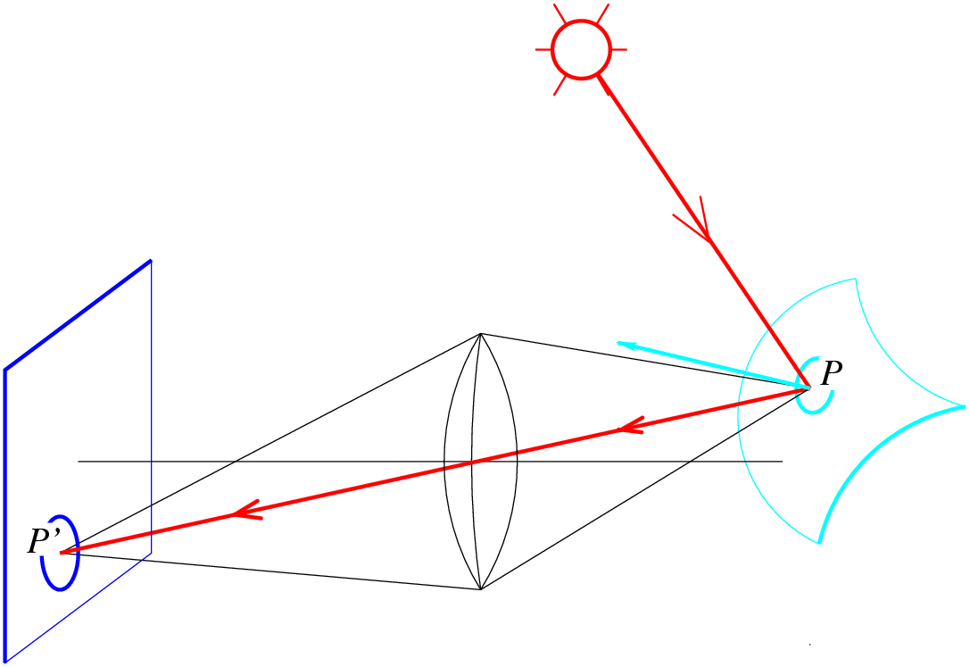
Radiometry
What determines the brightness of an image pixel?
Light source
properties
Sensor characteristics
Surface
shape
Exposure
Surface reflectance
properties
Optics
Slide by L. Fei-Fei

Slide 18

What is light?
Electromagnetic radiation (EMR) moving along rays in space
  R(λ) is EMR, measured in units of power (watts)
    λ is wavelength
Light field
  We can describe all of the light in the scene by specifying the radiation (or “radiance” along all light rays) arriving at every point in space and from every direction

Slide 19
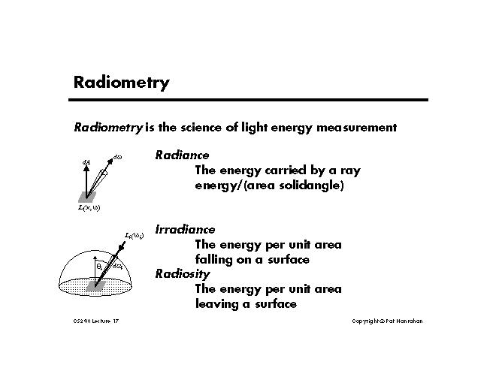

Slide 20



The light field
  Known as the plenoptic function
  If you know R, you can predict how the scene would appear from any viewpoint.
t is not time (different from above t !)
The light field
  Assume radiance does not change along a ray
    what does this assume about the world?
  Parameterize rays by intersection with two planes:
  Usually drop λ and time parameters
  How could you capture a light field?

Slide 21
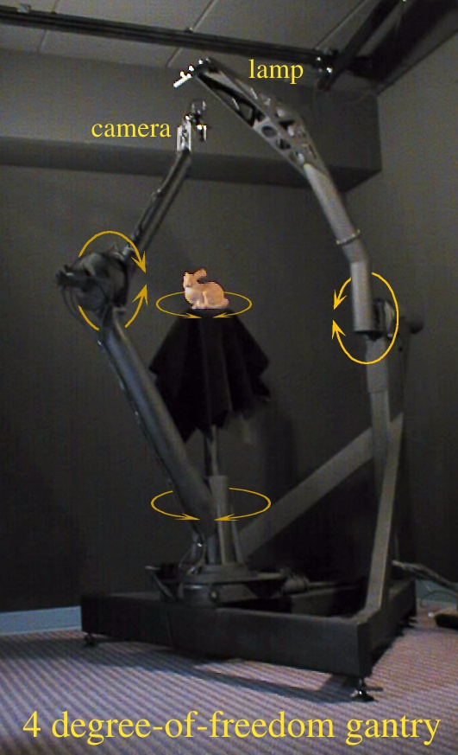
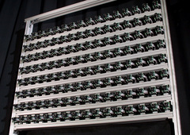
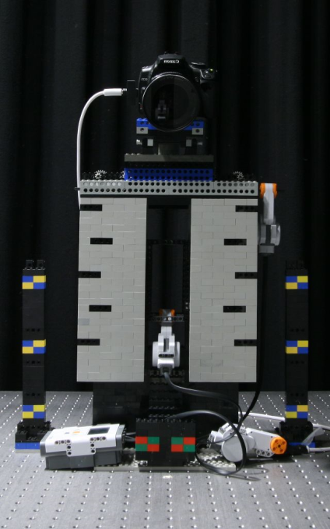
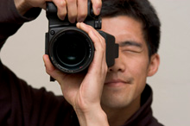
Capturing light fields
Stanford/Cornell spherical gantry
Stanford Multi-Camera Array
Handheld light field camera
Lego Mindstorms Gantry

Slide 22
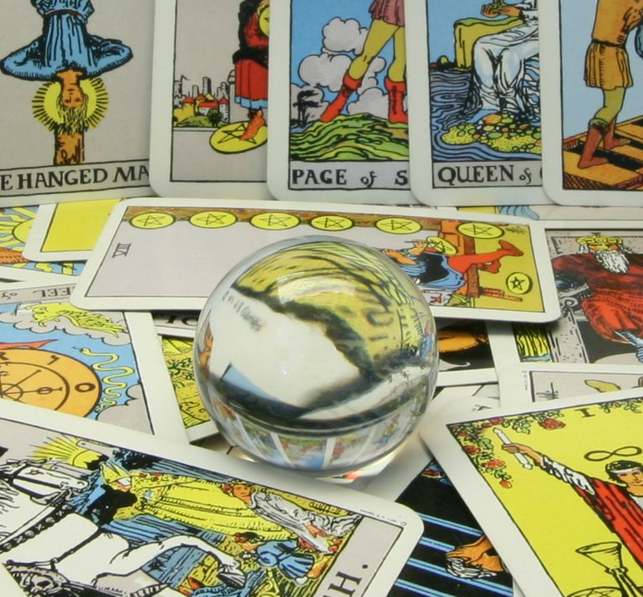
Light field example

Slide 23
More info on light fields
If you’re interested to read more:
The plenoptic function
  Original reference: E. Adelson and J. Bergen, "The Plenoptic Function and the Elements of Early Vision," in M. Landy and J. A. Movshon, (eds) Computational Models of Visual Processing, MIT Press 1991.
  L. McMillan and G. Bishop, “Plenoptic Modeling: An Image-Based Rendering System”, Proc. SIGGRAPH, 1995, pp. 39-46.
The light field
  M. Levoy and P. Hanrahan, “Light Field Rendering”, Proc SIGGRAPH 96, pp. 31-42.
  S. J. Gortler, R. Grzeszczuk, R. Szeliski, and M. F. Cohen, "The lumigraph," in Proc. SIGGRAPH, 1996, pp. 43-54.

Slide 24
Color perception
Electromagnetic radiation (EMR) moving along rays in space
  R(λ) is EMR, measured in units of power (watts)
    λ is wavelength
Perceiving light
  How do we convert radiation into “color”?
  What part of the spectrum do we see?

Slide 25
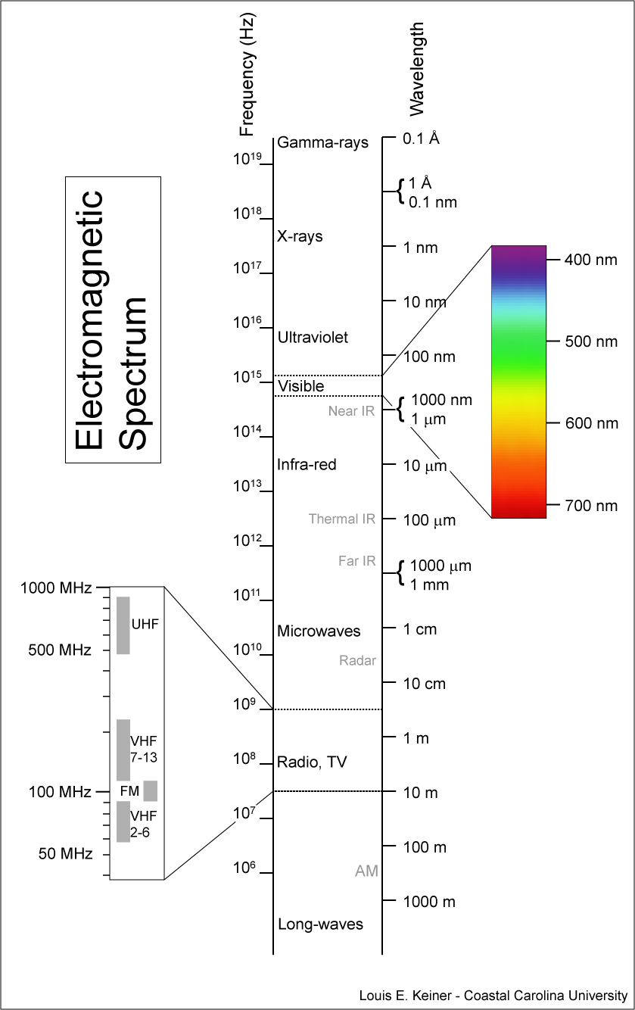
Visible light
We “see” electromagnetic radiation in a range of wavelengths

Slide 26
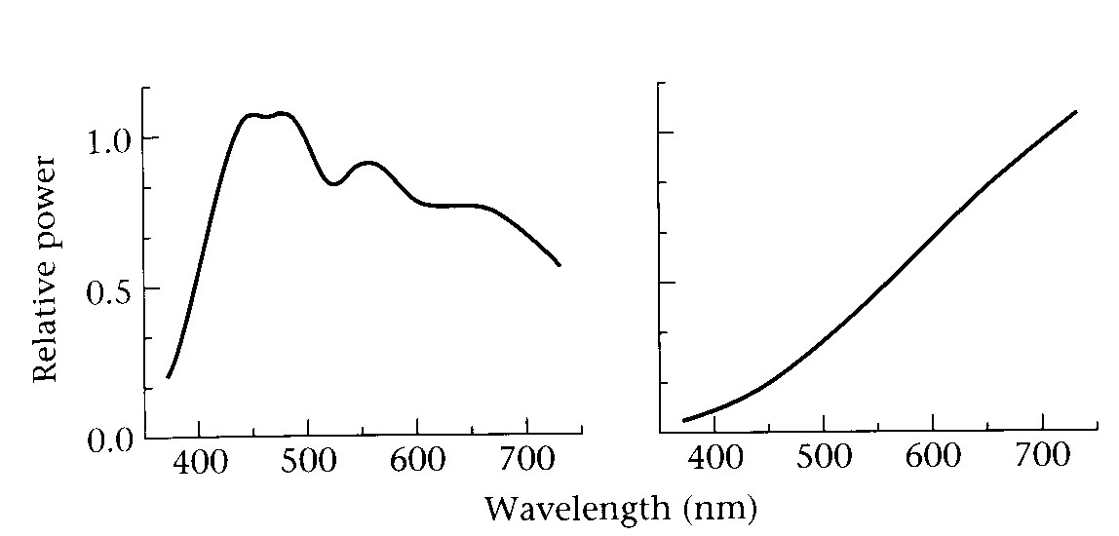
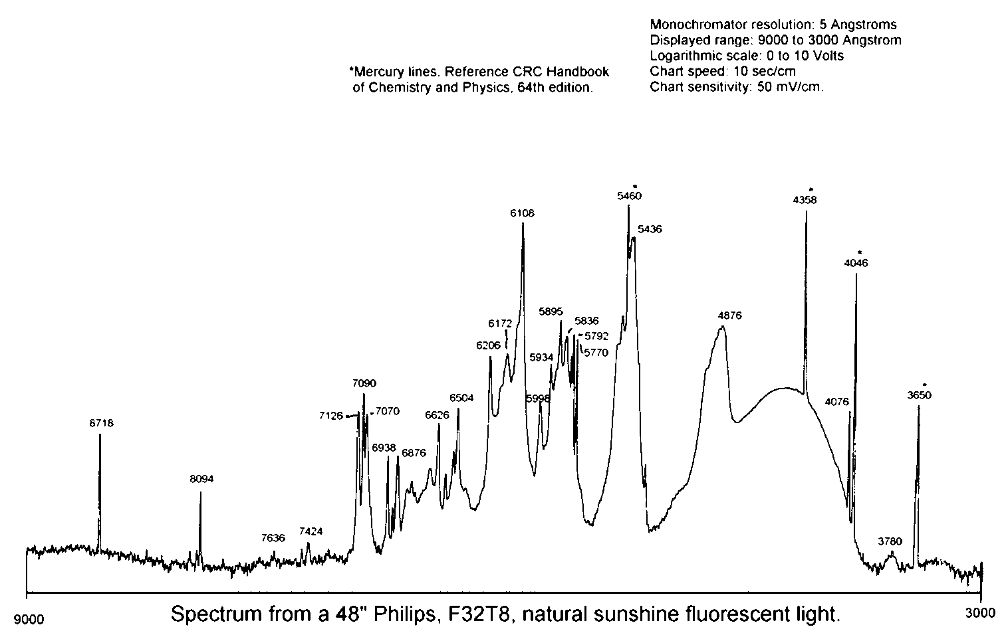
Light spectrum
The appearance of light depends on its power spectrum
  How much power (or energy) at each wavelength
daylight
tungsten bulb
fluorescent bulb
Our visual system converts a light spectrum into “color”
  This is a rather complex transformation

Slide 27
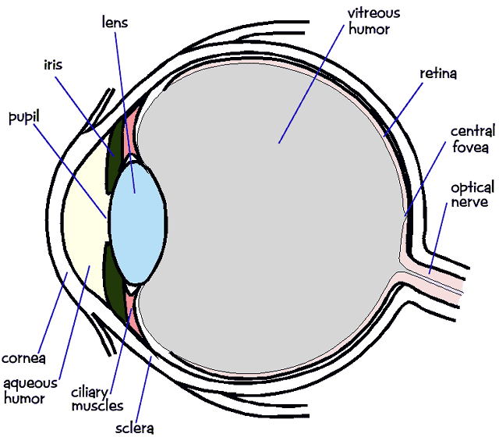
The human visual system
Color perception
  Light hits the retina, which contains photosensitive cells
    rods and cones
  These cells convert the spectrum into a few discrete values

Slide 28
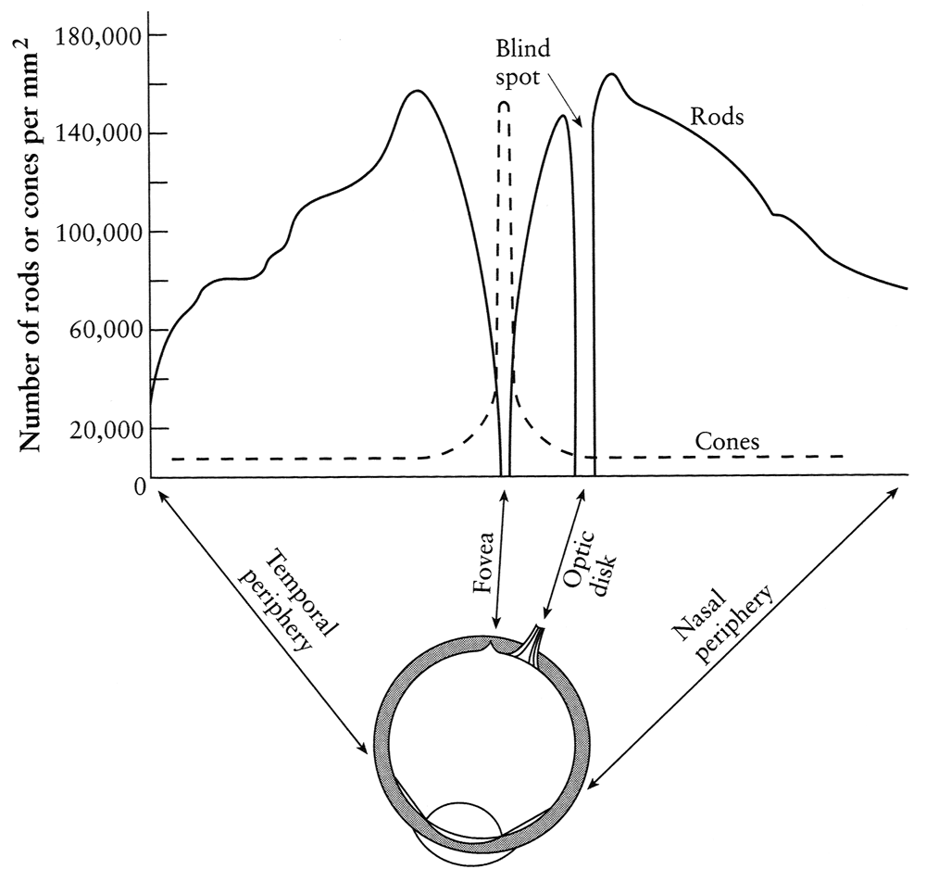
Density of rods and cones
Rods and cones are non-uniformly distributed on the retina
  Rods responsible for intensity, cones responsible for color
  Fovea - Small region (1 or 2°) at the center of the visual field containing the highest density of cones (and no rods).
  Less visual acuity in the periphery—many rods wired to the same neuron

Slide 29
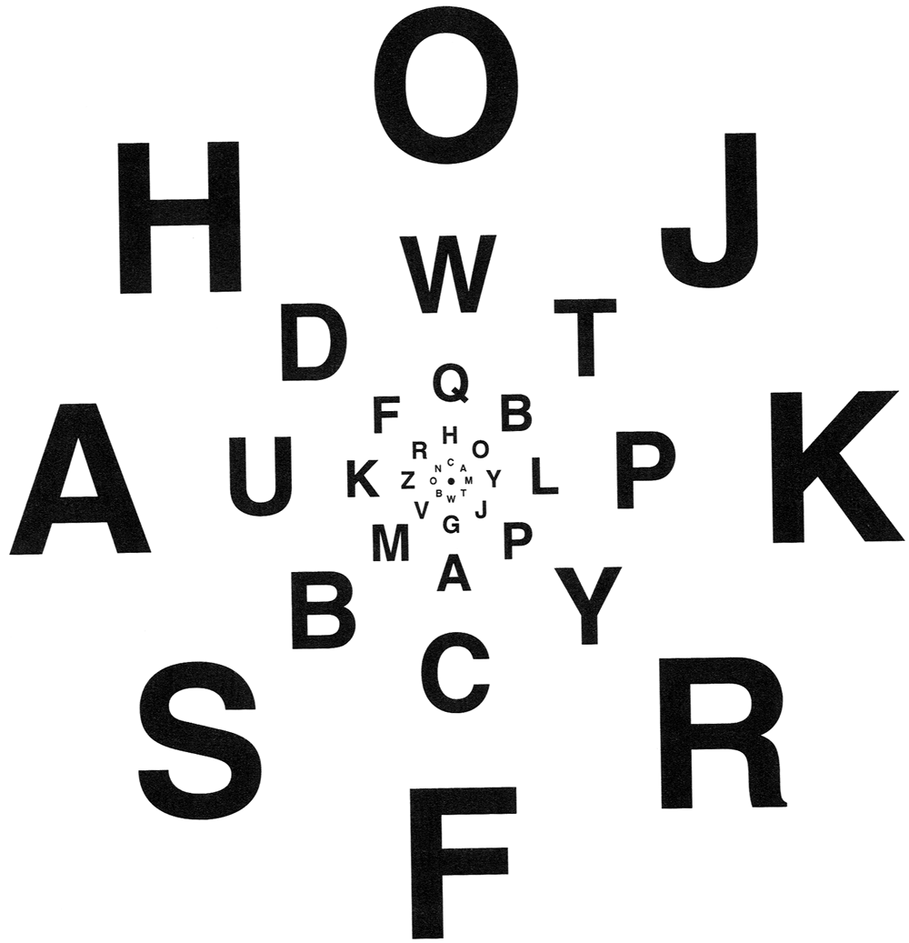
Demonstrations of visual acuity
With one eye shut, at the right distance, all of these letters should appear equally legible (Glassner, 1.7).

Slide 30
Demonstrations of visual acuity
With left eye shut, look at the cross on the left. At the right distance, the circle on the right should disappear (Glassner, 1.8).

Slide 31

Brightness contrast and constancy
The apparent brightness depends on the surrounding region
  brightness contrast: a constant colored region seems lighter or darker depending on the surrounding intensity:
    http://www.sandlotscience.com/Contrast/Checker_Board_2.htm
  brightness constancy: a surface looks the same under widely varying lighting conditions.

Slide 32
Light response is nonlinear
Our visual system has a large dynamic range
  We can resolve both light and dark things at the same time
  One mechanism for achieving this is that we sense light intensity on a logarithmic scale
    an exponential intensity ramp will be seen as a linear ramp
  Another mechanism is adaptation
    rods and cones adapt to be more sensitive in low light, less sensitive in bright light.

Slide 33
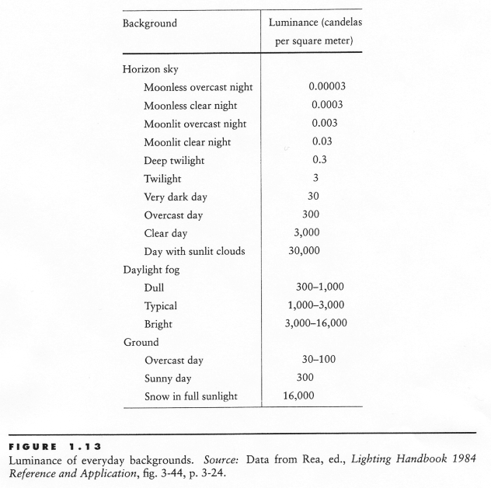
Visual dynamic range
A piece of white paper can be 1,000,000,000 times brighter in outdoor sunlight than in a moonless night.
BUT in a given lighting condition, light ranges over only about two orders of
magnitude.

Slide 34
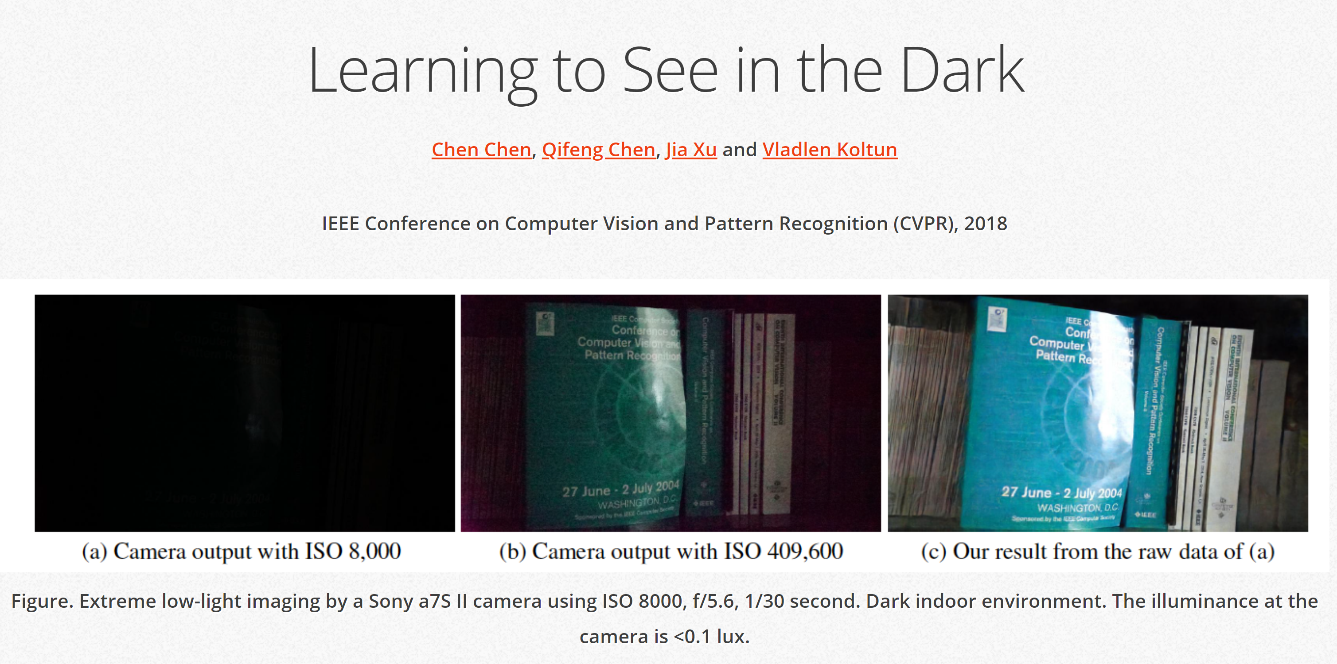
http://cchen156.web.engr.illinois.edu/SID.html

Slide 35



Visual dynamic range
Dark night
Indoor lighting
cloudy day
Sunny day
If we were sensitive to this whole range all the time, we wouldn’t be able to
discriminate lightness levels in a typical scene.
The visual system solves this problem by restricting the ‘dynamic range’ of its
response to match the current overall or ‘ambient’ light level.
Dark night
Indoor lighting
cloudy day
Sunny day
Dark night
Indoor lighting
cloudy day
Sunny day

Slide 36
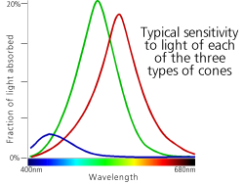
Color perception
L response curve
Three types of cones
  Each is sensitive in a different region of the spectrum
    but regions overlap
    Short (S) corresponds to blue
    Medium (M) corresponds to green
    Long (L) corresponds to red
  Different sensitivities: we are more sensitive to green than red
    varies from person to person (and with age)
  Colorblindness—deficiency in at least one type of cone

Slide 37
Color perception
M
L
Power
S
Wavelength
Rods and cones act as filters on the spectrum
  To get the output of a filter, multiply its response curve by the spectrum, integrate over all wavelengths
    Each cone yields one number
  Q: How can we represent an entire spectrum with 3 numbers?
  A: We can’t! Most of the information is lost.
    As a result, two different spectra may appear indistinguishable
      such spectra are known as metamers
      http://www.cs.brown.edu/exploratories/freeSoftware/repository/edu/brown/cs/exploratories/applets/spectrum/metamers_guide.html

Slide 38
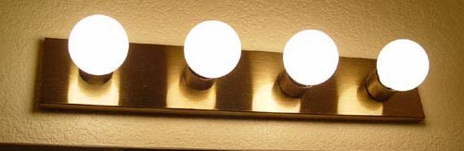
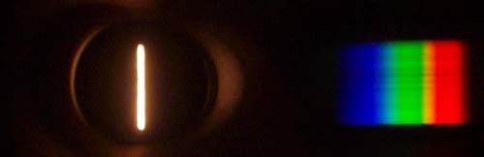
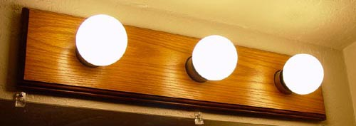
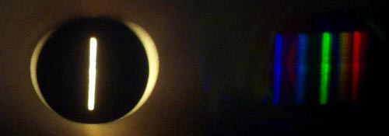
What kind of bulb is it?
http://www.chemistryland.com/CHM107Lab/Exp7/Spectroscope/Spectroscope.html

Slide 39
Perception summary
The mapping from radiance to perceived color is quite complex!
  We throw away most of the data
  We apply a logarithm
  Brightness affected by pupil size
  Brightness contrast and constancy effects
The same is true for cameras
  But we have tools to correct for these effects
    (Computational Photography)

Slide 40
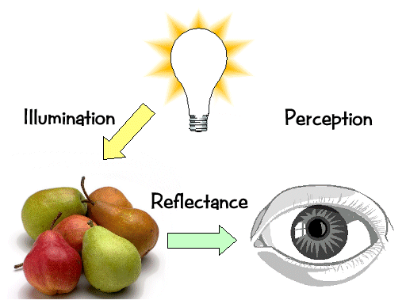
Light transport

Slide 41
Light sources
Basic types
  point source
  directional source
    a point source that is infinitely far away
  area source
    a union of point sources
More generally
  a light field can describe *any* distribution of light sources
What happens when light hits an object?

Slide 42
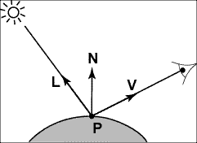
Modeling Image Formation
We need to reason about:
  How light interacts with the scene
  How a pixel value is related to light energy in the world
Track a “ray” of light all the way from light source to the sensor

Slide 43
Directional Lighting
Key property: all rays are parallel
Equivalent to an infinitely distant point source

Slide 44
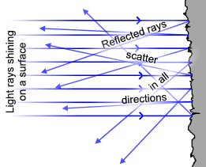
Lambertian Reflectance
Image intensity
Surface normal
Light direction
Image intensity
cos(angle between N and L)

Slide 45
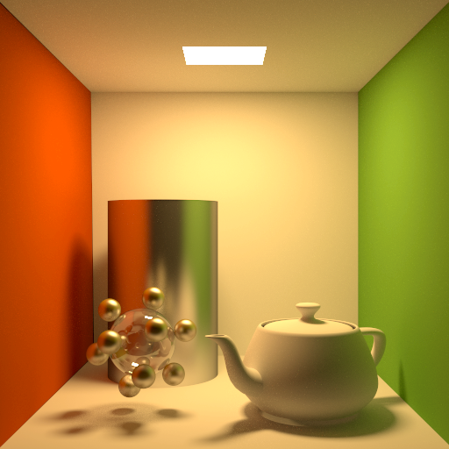
Materials - Three Forms
Ideal diffuse (Lambertian)
Ideal
specular
Directional
diffuse
© Kavita Bala, Computer Science, Cornell University
Notes:
There are several types of surfaces that are assumed to make up the world.
Ideal diffuse. It is similar to the diffuse emitter in that it emits all incident light equally in all outgoing directions. When light hits the surface it is reflected uniformly anywhere in the hemisphere above the surface.
Ideal specular (perfect mirrors). Light is reflected exactly in the mirror direction of the incoming light. A perfect mirror is such a surface.
Directional diffuse (almost all materials in the world). Incoming light is reflected into the hemisphere to different extents. If the object is more glossy then more of the incoming energy reflects close to the mirror direction. If it is more diffuse then the reflection is more uniform.

Slide 46
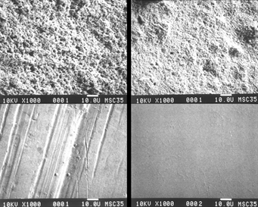
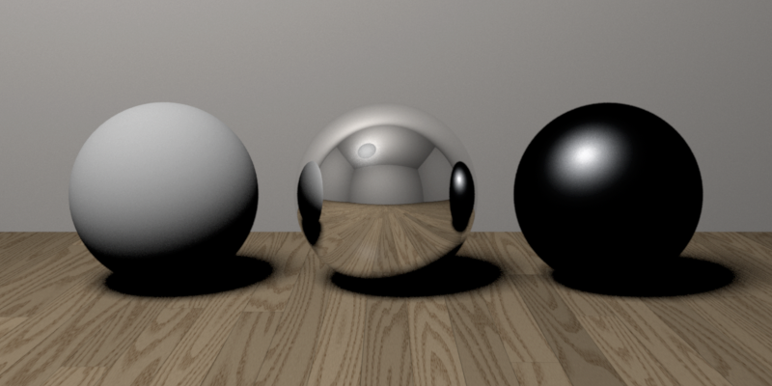
Reflectance—Three Forms
Ideal diffuse (Lambertian)
Ideal
specular
Directional
diffuse
© Kavita Bala, Computer Science, Cornell University
Notes:
Why spheres?!

Slide 47
Ideal Diffuse Reflection
Characteristic of multiple scattering materials
An idealization but reasonable for matte surfaces
© Kavita Bala, Computer Science, Cornell University

Slide 48
Lambertian Reflectance
Reflected energy is proportional to cosine of angle between L and N (incoming)
Measured intensity is viewpoint-independent (outgoing)

Slide 49
Lambertian Reflectance: Incoming
Reflected energy is proportional to cosine of angle between L and N

Slide 50
Lambertian Reflectance: Incoming
Reflected energy is proportional to cosine of angle between L and N

Slide 51
Lambertian Reflectance: Incoming
Reflected energy is proportional to cosine of angle between L and N
Light hitting surface is proportional to the cosine

Slide 52
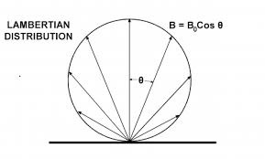
Lambertian Reflectance: Outgoing
Radiance (what we see) is viewpoint-independent

Slide 53
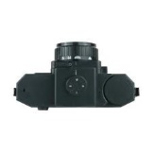
Lambertian Reflectance: Outgoing
Radiance (what the eye sees) is viewpoint-independent
Notes:
Emission rate of photons: B0 cos theta
Radiance: (Photons/second)/(area steradian)
Looking down get B0/dA
Looking at angle get B0 cos theta/(dA cos theta)

Slide 54
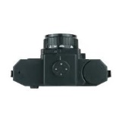
Lambertian Reflectance: Outgoing
Measured intensity is viewpoint-independent

Slide 55
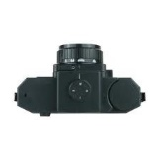

Lambertian Reflectance: Outgoing
Measured intensity is viewpoint-independent
A cos (θ)
Radiance
(what eye sees)

Slide 56
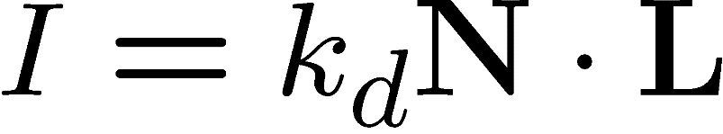

Image Formation Model: Final
Diffuse albedo: what fraction of incoming light is reflected?
  Introduce scale factor
Light intensity: how much light is arriving?
  Compensate with camera exposure (global scale factor)
Camera response function
  Assume pixel value is linearly proportional to incoming energy (perform radiometric calibration if not)

Slide 57
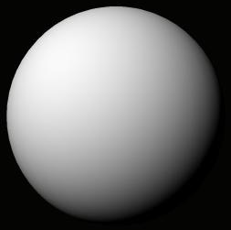


A Single Image: Shape from Shading
Assume is 1 for now.
What can we measure from one image?
  is the angle between N and L
  Add assumptions:
    Constant albedo
    A few known normals (e.g. silhouettes)
    Smoothness of normals
In practice, SFS doesn’t work very well:
assumptions are too restrictive,
too much ambiguity in nontrivial scenes.

Slide 58
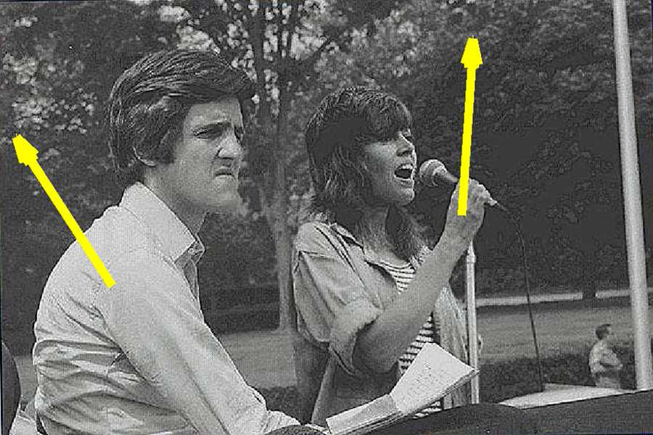
Application: Detecting composite photos
Real photo
Fake photo

Slide 59
Questions?

