Slide 1
Network Analysis
-- Available Bandwidth Estimation Using SoNIC
Junyu Chen, Yicheng Liang, Zhihong Liu
Cornell University
Notes:
25”

Slide 2
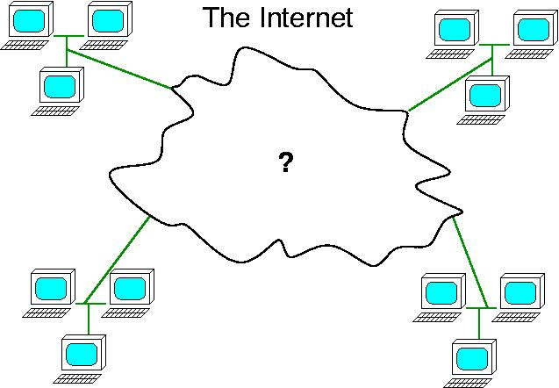
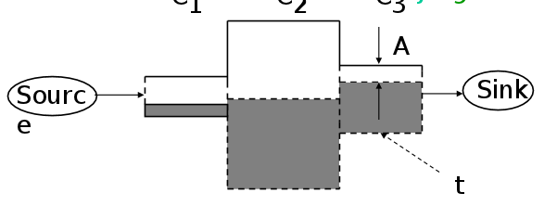
Available Bandwidth Estimation
Current end-to-end estimation
  Intrusive, inaccurate, does not work with bursty cross traffic
Motivation
  Address the above issues
probe
packets

Slide 3
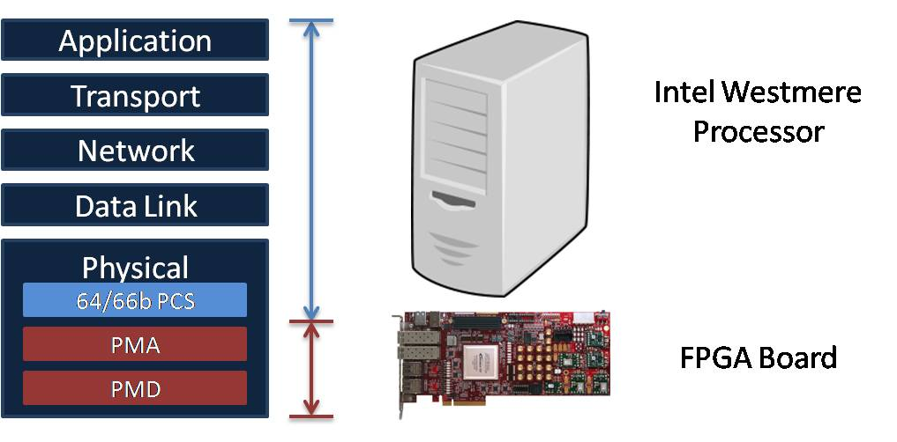
SoNIC
Packet i
Packet i+1
Packet i+2
Physical and data link layer
Idle characters: accurately measure inter-packet delays
  Hardware: hard to access
SoNIC: Software-defined Network Interface Card
Flexible realtime access to physical layer in software
Accurate: control
over idle characters
Notes:
1’20”

Slide 4
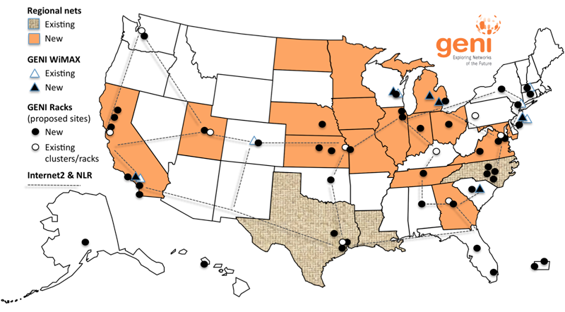
GENI
Global Environment for Network Innovations
Virtual laboratory for networking and distributed system research
Easy to set up different topologies for research
UC Davis &
UNC Chapel Hill

Slide 5
Goal
Use SoNIC to estimate available bandwidth on GENI
Tasks:
  Local machine
    Reproduce the measurements and analysis in paper
    Complete and automate data analysis process
  GENI
    Load script and rerun the above experiments
    Make the process available to others

Slide 6
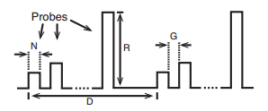
Estimate Available Bandwidth
Generate probe trains pattern
Packet pacing to generate probe packets
  Add idle characters to manipulate rate
Accurate inter-packet delay
Use increasing one-way delay to estimate available bandwidth

Slide 7
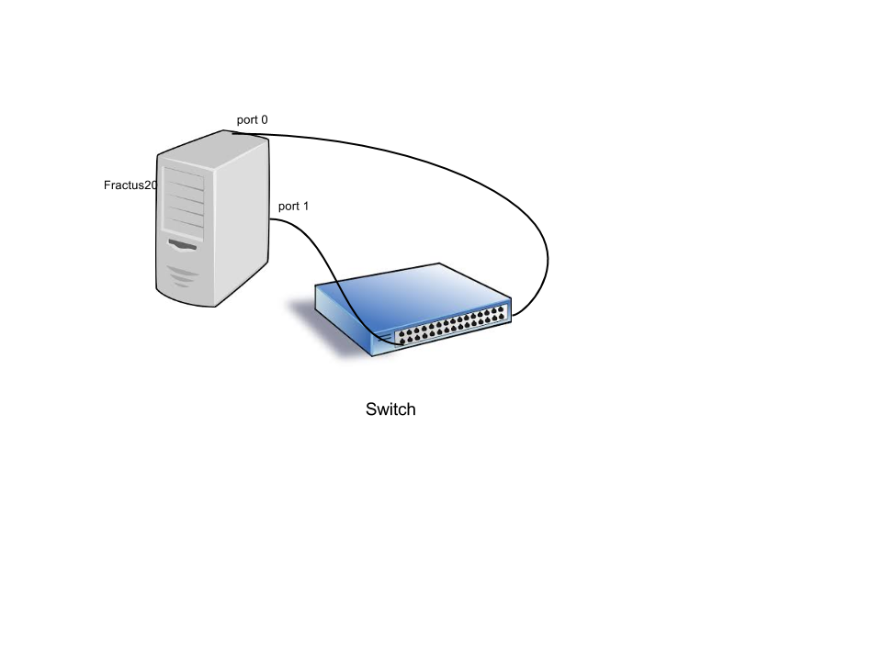
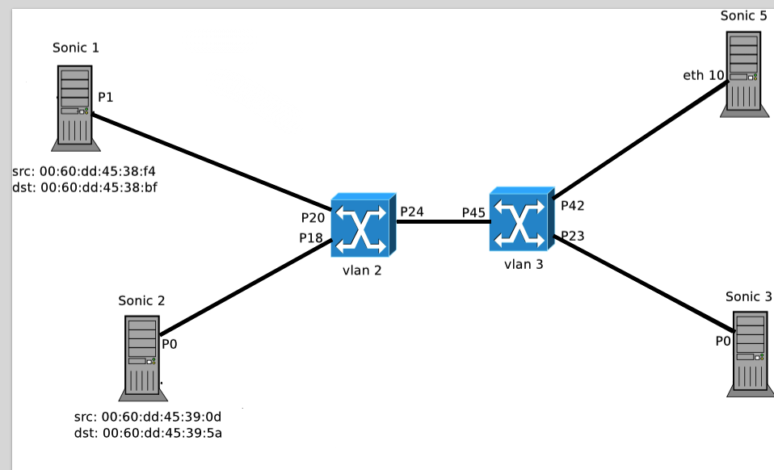

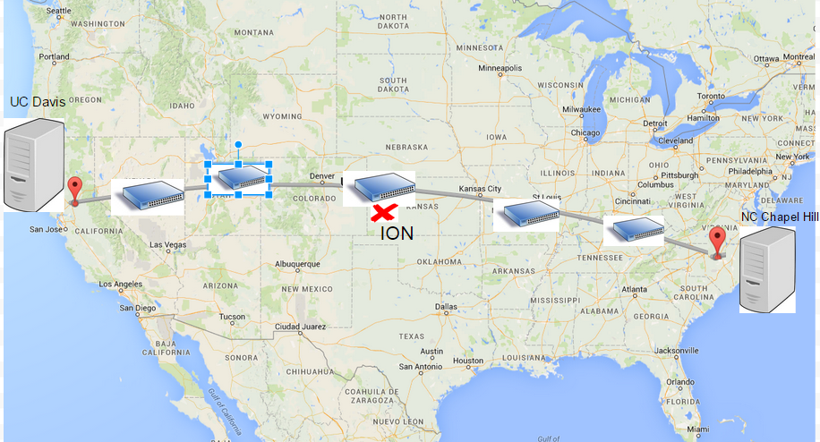
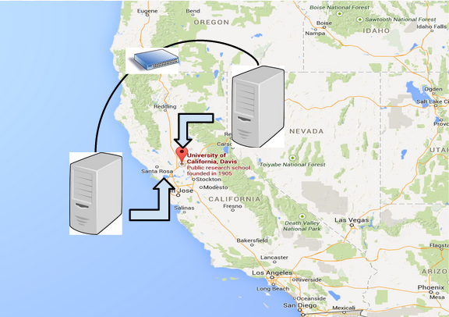
Experiments – Environment set up
Factus loopback topology
Syslab Topology
GENI (UC Davis – UNC Chapel Hill)
GENI (two UC Davis nodes)

Slide 8
Experiments
Algorithm
  Pathload: (N, R, G, D) = (20, [0.1:0.1:9.6]Gbps, 120000B, variable)
  Increasing one-way delay (OWD)
  Difference in the OWD between the first and last packets
  Available bandwidth: lowest probe train rate where queuing delay increases
  Add cross traffic to limit the available bandwidth
Automation
  Automate the process for analyzing the available bandwidth
  Generate cross traffic

Slide 9
Experiment Result on syslab machines
2 Gbps cross traffic
(est: 5.3)
4 Gbps cross traffic
(est: 3.1)
6 Gbps cross traffic (est: 1.5)
8 Gbps cross traffic (est: 0)

Slide 10
Results – with Han’s data
2 Gbps cross traffic
4 Gbps cross traffic
6 Gbps cross traffic
8 Gbps cross traffic

Slide 11
Discussion
SoNIC difficult to deploy
  Kernel version
  Switch configuration
SoNIC unstable
SoNIC script issue
  rpt command
Estimation Measurement Application hard to build without the lower layers working properly

Slide 12
M.Eng portion
Additional Algorithm
  Pathchirp: (N, R, G, D) = (1, [0.1:0.1:9.6]Gbps, exponential decrease, variable)
  IGI: (N, R, G, D) = (60, [0.1:0.1:9.6]Gbps, 30s, 30s)
  Better estimation algorithm

Slide 13
Future Work
More experiments on GENI
Using application packets to address the intrusive issue
User space measurement application

Slide 14
Demo

