Slide 1
CS 5412/Lecture 19:
Making The Cloud Friendlier for Object-Oriented Computing
Ken Birman
Spring, 2021

Slide 2
Today’s main topic
The cloud was built mostly from Linux systems, yet Linux was created to support interactive computing applications in offices and hospitals, databases (big files, but record-oriented), text editing.
As a result, object orientation has turned out to be an awkward match!
In Lecture 18 we talked about LINQ and how it extends the concept of a collection of objects to support SQL inside languages like C++ and Python. Today we will look at how big cloud systems deal with OO costs.

Slide 3


Today’s two Sub-topics
First half of the lecture: The Ceph object oriented
file system. Looks like a normal POSIX file system,
but optimized for object-oriented uses.
Second half: Costs of the object-oriented model in a
real air traffic control system (Ken worked on it…
another bad-news/good-news stories…)

Slide 4
Consider a standard file system, and assume an object-oriented use case
Although many applications are designed to use the normal “POSIX” file system API (operations like file create/open, read/write, close, rename/replace, delete, and snapshot), some modern applications find POSIX inefficient.
Some main issues:
Cloud file systems can handle big files, but as sequences of fixed-size
blocks. Many application are object-oriented
Some lack some of the “file system management” tools big-data needs

Slide 5
… issues
There may be a LOT of files. Linux file systems aren’t so great for this (like a directory with a billion objects in it).
Linux/POSIX lack suitable locking/synchronization API (POSIX had a solution but it was never adopted broadly)
Objects tend to be very small or very large. The Linux file system is optimized for Linux file size distributions and lifetime distributions.

Slide 6
CEPH project
Created by Sage Weihl, a PhD student at U.C. Santa Cruz
Later became a company and then was acquired into Red Hat Linux
Now the “InkStack” portion of Linux offers Ceph plus various tools to
leverage it, and Ceph is starting to replace HDFS worldwide.
Ceph is similar in some ways to any standard cloud file system, but was created separately. Many big data systems are migrating to Ceph.

Slide 7
Key ideas in Ceph
The focus is on two perspectives: object storage for actual data, with much better ways of tracking huge numbers of objects and automatic “striping” over multiple servers for very large files or objects. Fault-tolerance is automatic.
MetaData Management. For any file or object, there is associated meta-data: a kind of specialized object. In Ceph, meta-data servers (MDS) are accessed in a very simple hash-based way using the CRUSH hashing function. This allows direct metadata lookup
Object “boundaries” are tracked in the meta-data, which allows the application to read “the next object.” This is helpful if you store a series of objects.

Slide 8
Why is “object storage” special?
The first thing to know is that Ceph itself doesn’t know how to interpret objects. It just sees serialized byte arrays.
But because the applications are working with objects, we know that they are generally written in a single operation each, the application may have a favorite serialization method it wants to use, concepts like file open/seek/partial write don’t really apply, etc.
Meanwhile, objects might have a history of versions, and their meta-data probably includes type information, memory alignment rules, etc.

Slide 9
Why is “object storage” special?
Objects might also have pointers in them; we would want a way to use these as DHT keys in many cases.
Each application tends to have its own objects. It probably wants them in its own folders. Many will be small – most objects just have a few fields.
And a big-data application could have a lot of objects. Linux file systems assume directories never have huge numbers of files in them.

Slide 10
The main challenge
Ceph encourages users to create file systems with huge numbers of small files.
So they had to implement a new design in which the file system API can run efficiently even if a directory might have a billion files (the names and inodes can’t all be cached in memory).
This one need results in quite a different architecture

Slide 11
Ceph has three “APIS” that matter, but in fact is focused on standard POSIX!
First is the standard POSIX file system API. You can use Ceph in any situation where you might use GFS, HDFS, NFS, etc.
Second, there are extensions to POSIX that allow Ceph to offer better performance in demanding settings, like for supercomputing at CERN.
Finally, Ceph has a lowest layer called RADOS that can be used directly as a key-value object store. People do use this, but rarely.

Slide 12
Why talk directly to RADOS? … after all, the File system API “works” too
When an object is in memory, the data associated with it is managed by the class (or type) definition, and can include pointers, fields with gaps or other “subtle” properties, etc.
Example: a binary tree: the nodes and edges could be objects, but the whole tree could also be one object composed of other objects.
Going through the file system API “turns” your file into blocks before the I/O occurs, which causes extra copying and can double overheads.

Slide 13
Ceph: A Scalable, High-Performance Distributed File System
Original slide set from OSDI 2006
Sage A. Weil, Scott A. Brandt, Ethan L. Miller, Darrel D. E. Long

Slide 14
Contents
Goals
System Overview
Client Operation
Dynamically Distributed Metadata
Distributed Object Storage
Performance

Slide 15
Goals
Scalability
  Storage capacity, throughput, client performance. Emphasis on HPC.
Reliability
  “…failures are the norm rather than the exception…”
Performance
  Dynamic workloads

Slide 16
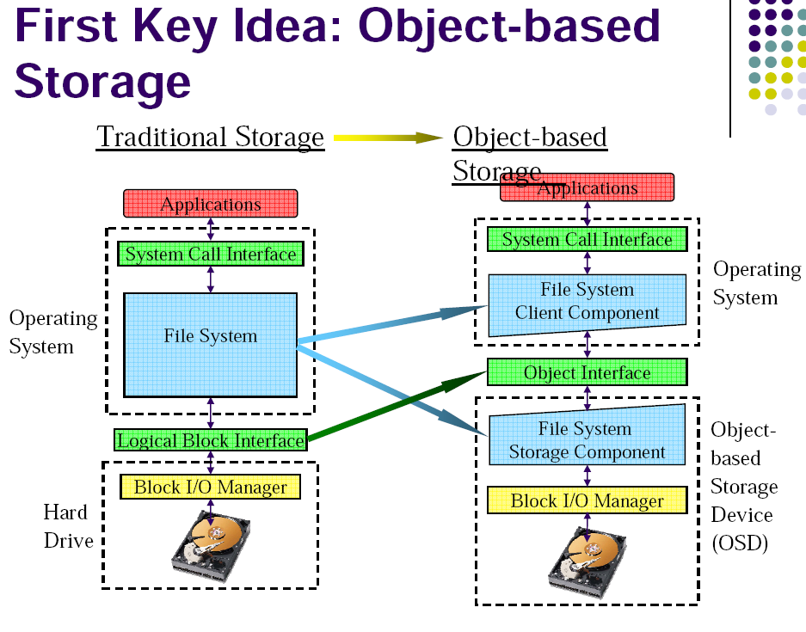

Slide 17
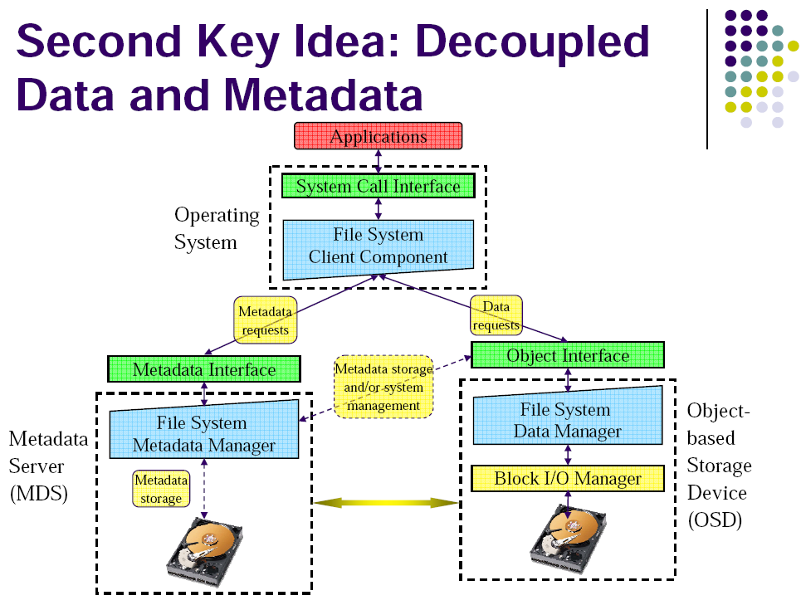

Slide 18
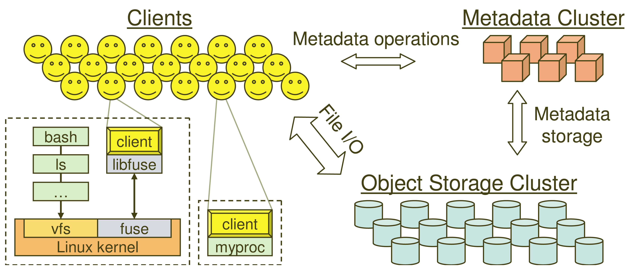
System Overview

Slide 19
Key Features
Decoupled data and metadata
  CRUSH
    Files striped onto predictably named objects
    CRUSH maps objects to storage devices
Dynamic Distributed Metadata Management
  Dynamic subtree partitioning
    Distributes metadata amongst MDSs
Object-based storage
  OSDs handle migration, replication, failure detection and recovery

Slide 20
Client Operation
Ceph interface
  Nearly POSIX
  Decoupled data and metadata operation
User space implementation
  FUSE or directly linked
FUSE is a software allowing to implement a file system in a user space

Slide 21
Client Access Example
Client sends open request to MDS
MDS returns capability, file inode, file size and stripe information
Client read/write directly from/to OSDs
MDS manages the capability
Client sends close request, relinquishes capability, provides details to MDS

Slide 22
Synchronization
Adheres to POSIX
Includes HPC oriented extensions
  Consistency / correctness by default
  Optionally relax constraints via extensions
  Extensions for both data and metadata
Synchronous I/O used with multiple writers or mix of readers and writers

Slide 23
Distributed Metadata
“Metadata operations often make up as much as half of file system workloads…”
MDSs use journaling
  Repetitive metadata updates handled in memory
  Optimizes on-disk layout for read access
Adaptively distributes cached metadata across a set of nodes

Slide 24
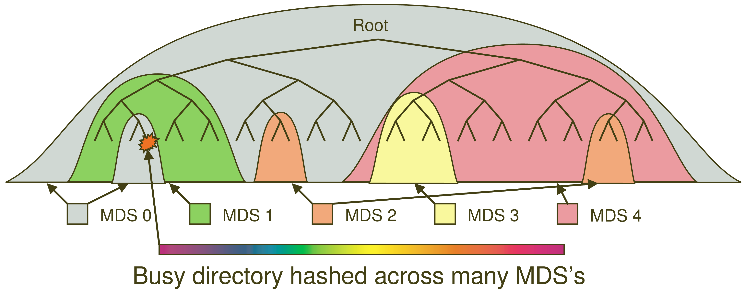
Dynamic Subtree Partitioning

Slide 25
Distributed Object Storage
Files are split across objects
Objects are members of placement groups
Placement groups are distributed across OSDs.

Slide 26
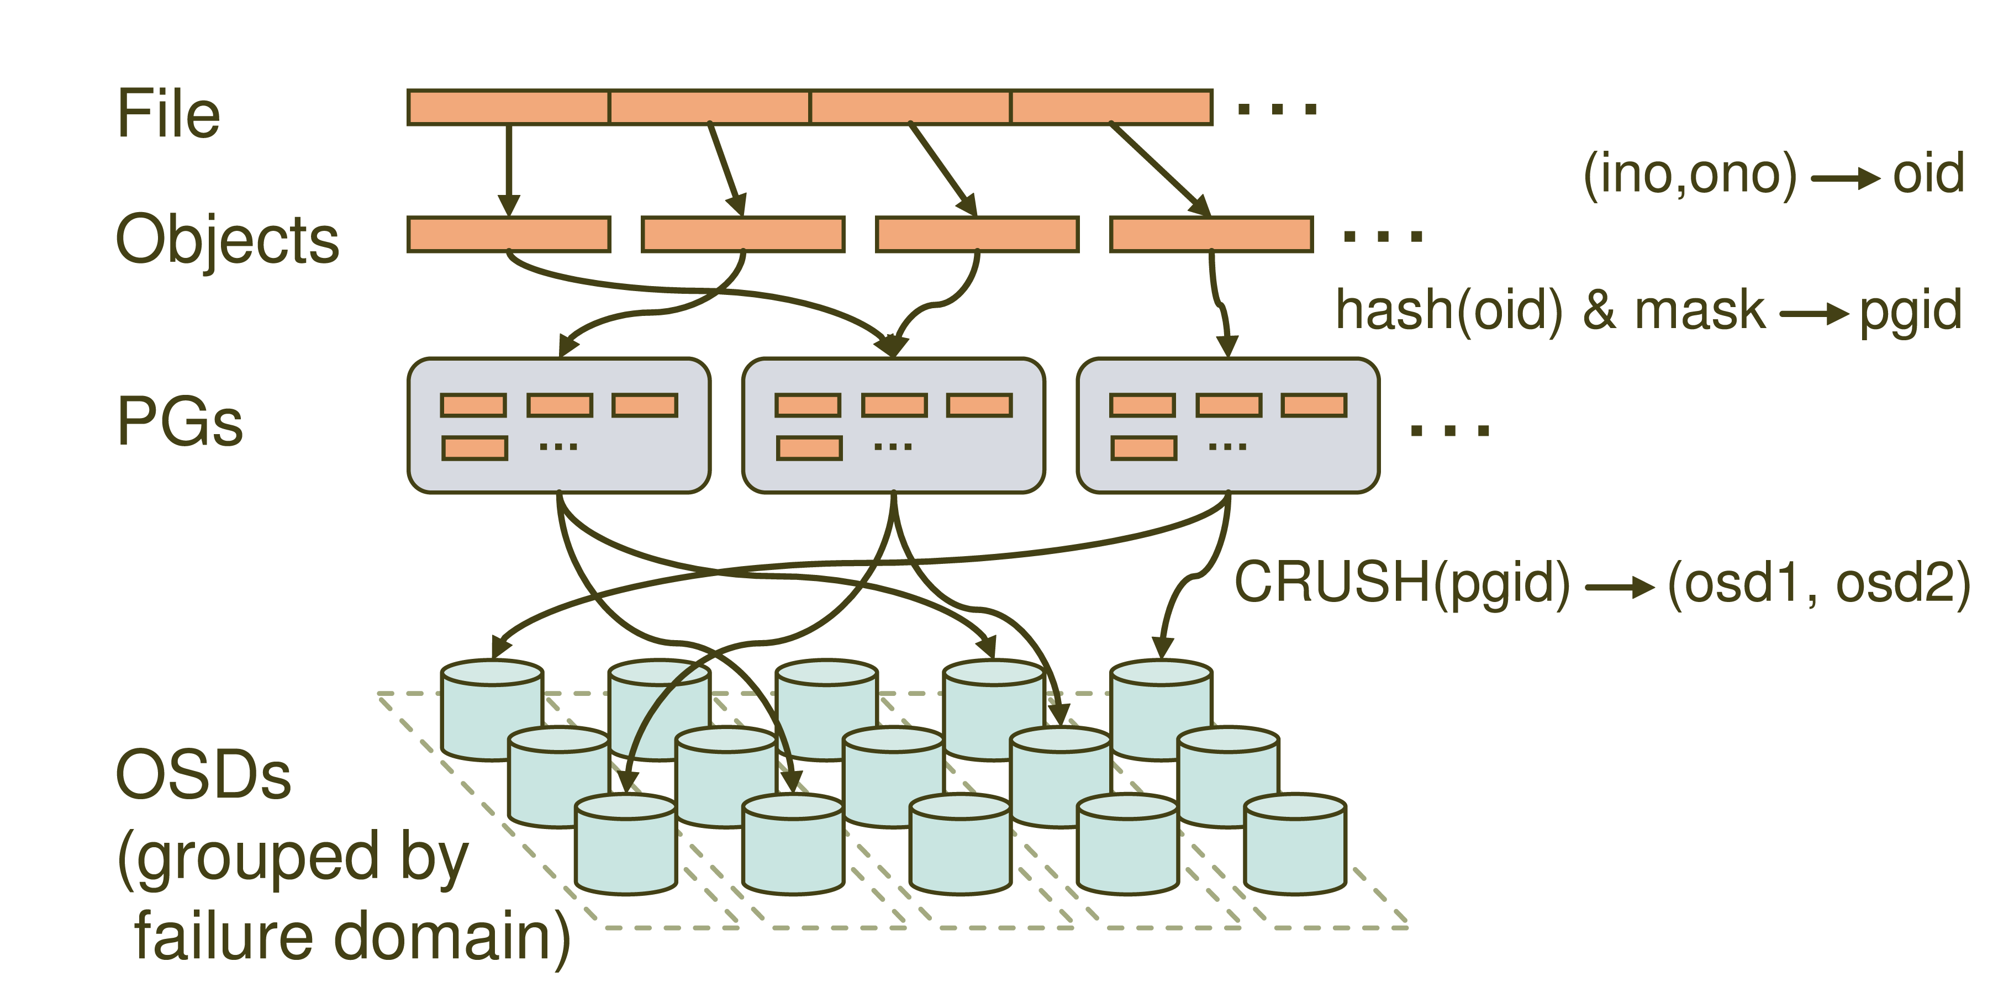
Distributed Object Storage

Slide 27
CRUSH: A specialized Key Hashing Function
CRUSH(x): (osdn1, osdn2, osdn3)
  Inputs
    x is the placement group
    Hierarchical cluster map
    Placement rules
  Outputs a list of OSDs
Advantages
  Anyone can calculate object location
  Cluster map infrequently updated

Slide 28
Data distribution
(not a part of the original PowerPoint presentation)
Files are striped into many objects
(ino, ono) → an object id (oid)
Ceph maps objects into placement groups (PGs)
hash(oid) & mask → a placement group id (pgid)
CRUSH assigns placement groups to OSDs
CRUSH(pgid)→ a replication group, (osd1, osd2)

Slide 29
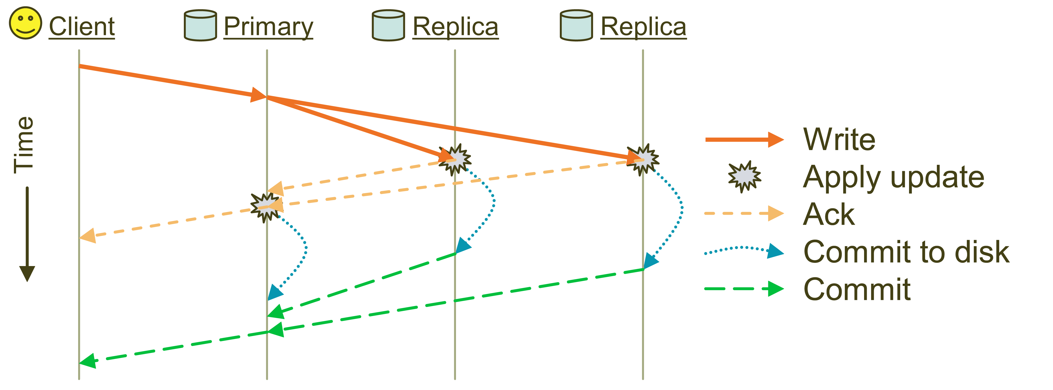
Replication: Reliable but not Paxos
Objects are replicated on OSDs within same PG
  Client is oblivious to replication

Slide 30
Failure Detection and Recovery
Down and Out
Monitors check for intermittent problems
New or recovered OSDs peer with other OSDs within PG

Slide 31
Acronyms Used in Performance Slides
CRUSH: Controlled Replication Under Scalable Hashing
EBOFS: Extent and B-tree based Object File System
HPC: High Performance Computing
MDS: MetaData server
OSD: Object Storage Device
PG: Placement Group
POSIX: Portable Operating System Interface for uniX
RADOS: Reliable Autonomic Distributed Object Store

Slide 32
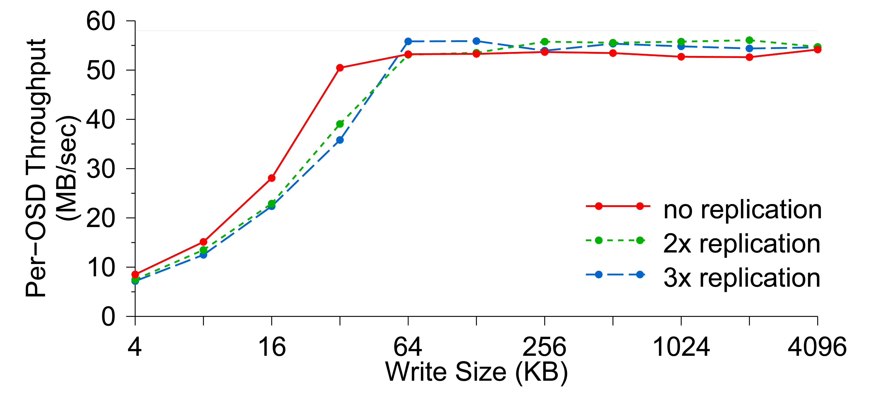
Per-OSD Write Performance

Slide 33
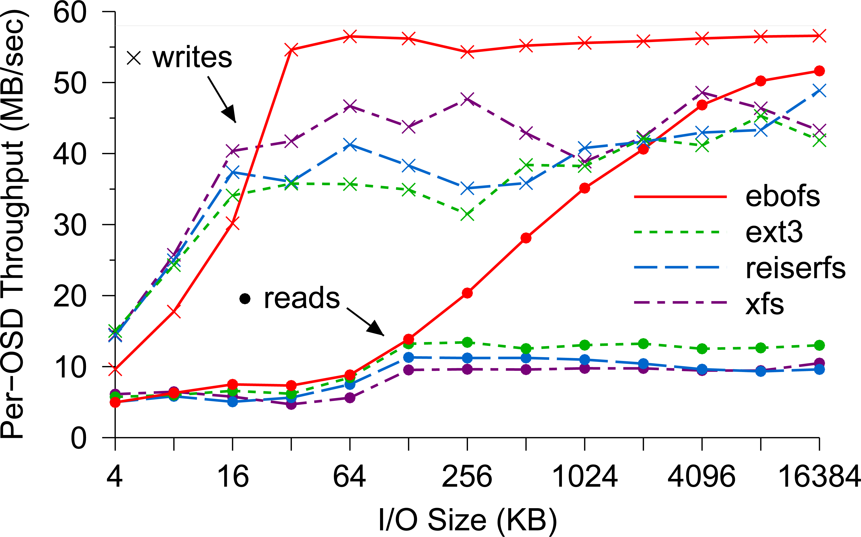
EBOFS Performance

Slide 34
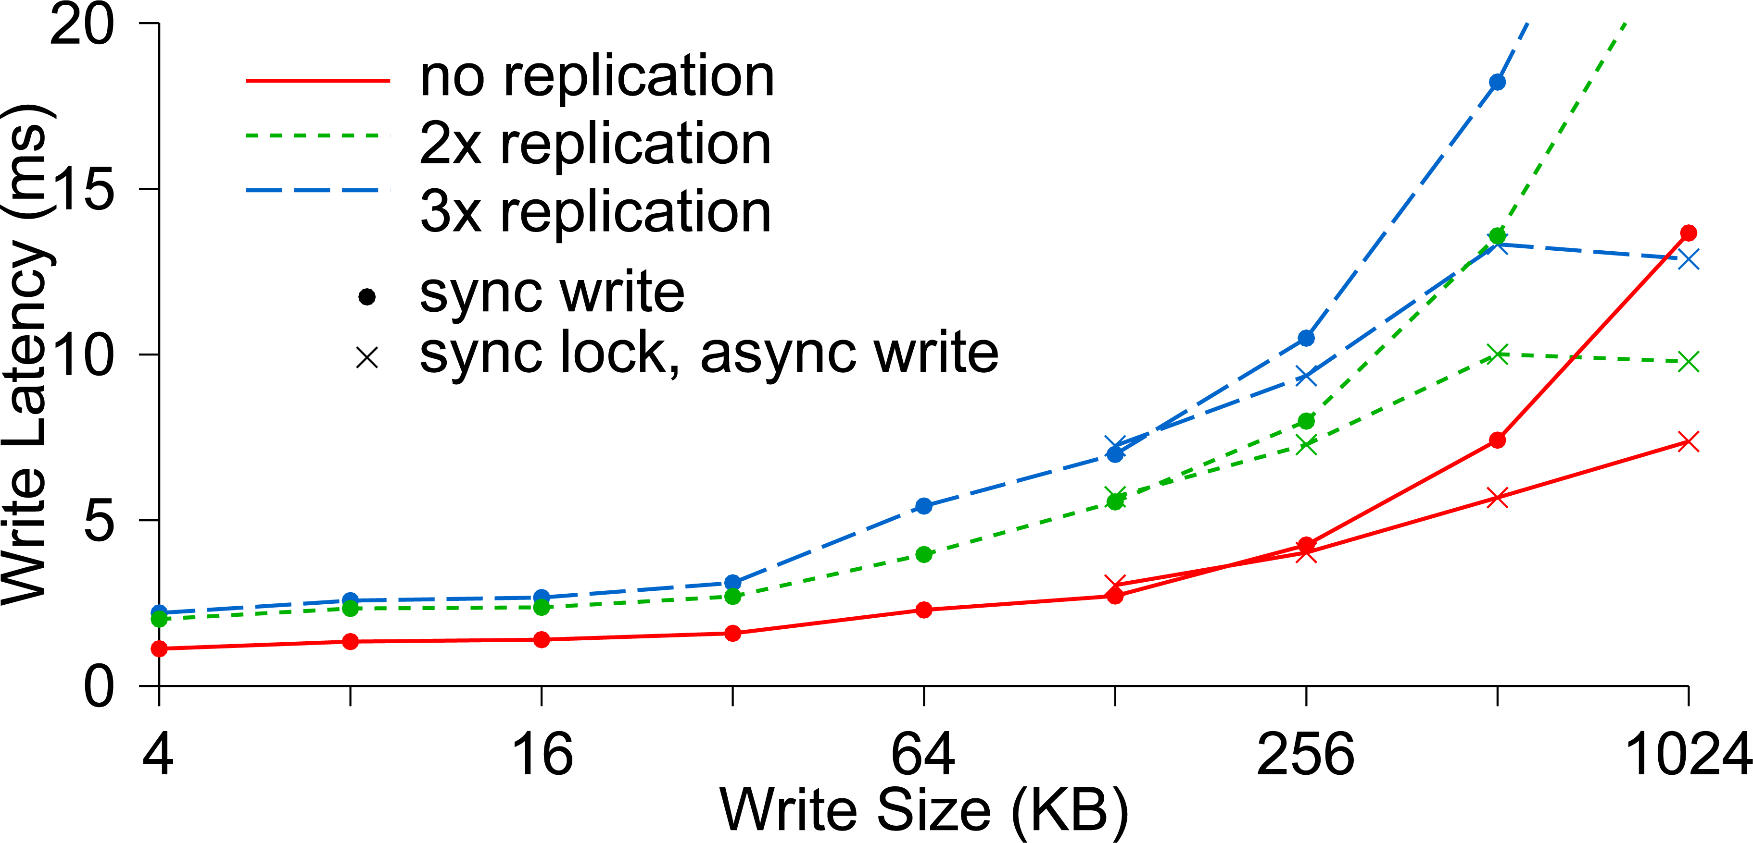
Write Latency

Slide 35
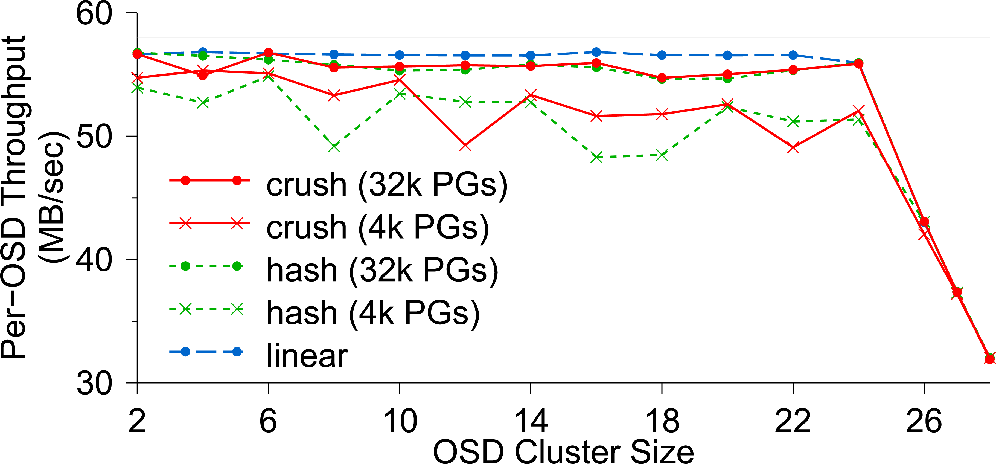
OSD Write Performance

Slide 36
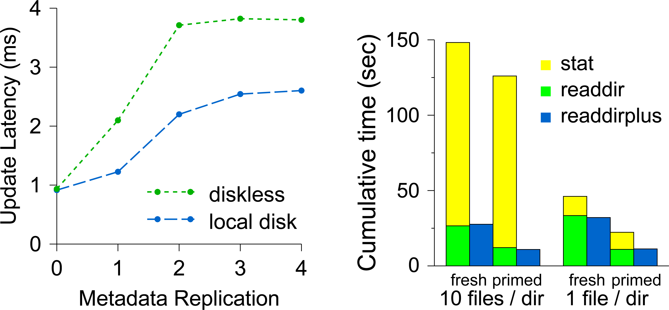
Diskless vs. Local Disk
Compare latencies of (a) a MDS where all metadata are
stored in a shared OSD cluster and (b) a MDS which has a
local disk containing its journaling

Slide 37
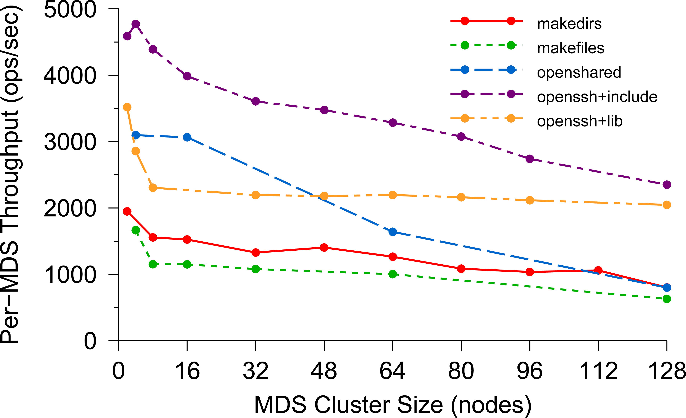
Per-MDS Throughput

Slide 38
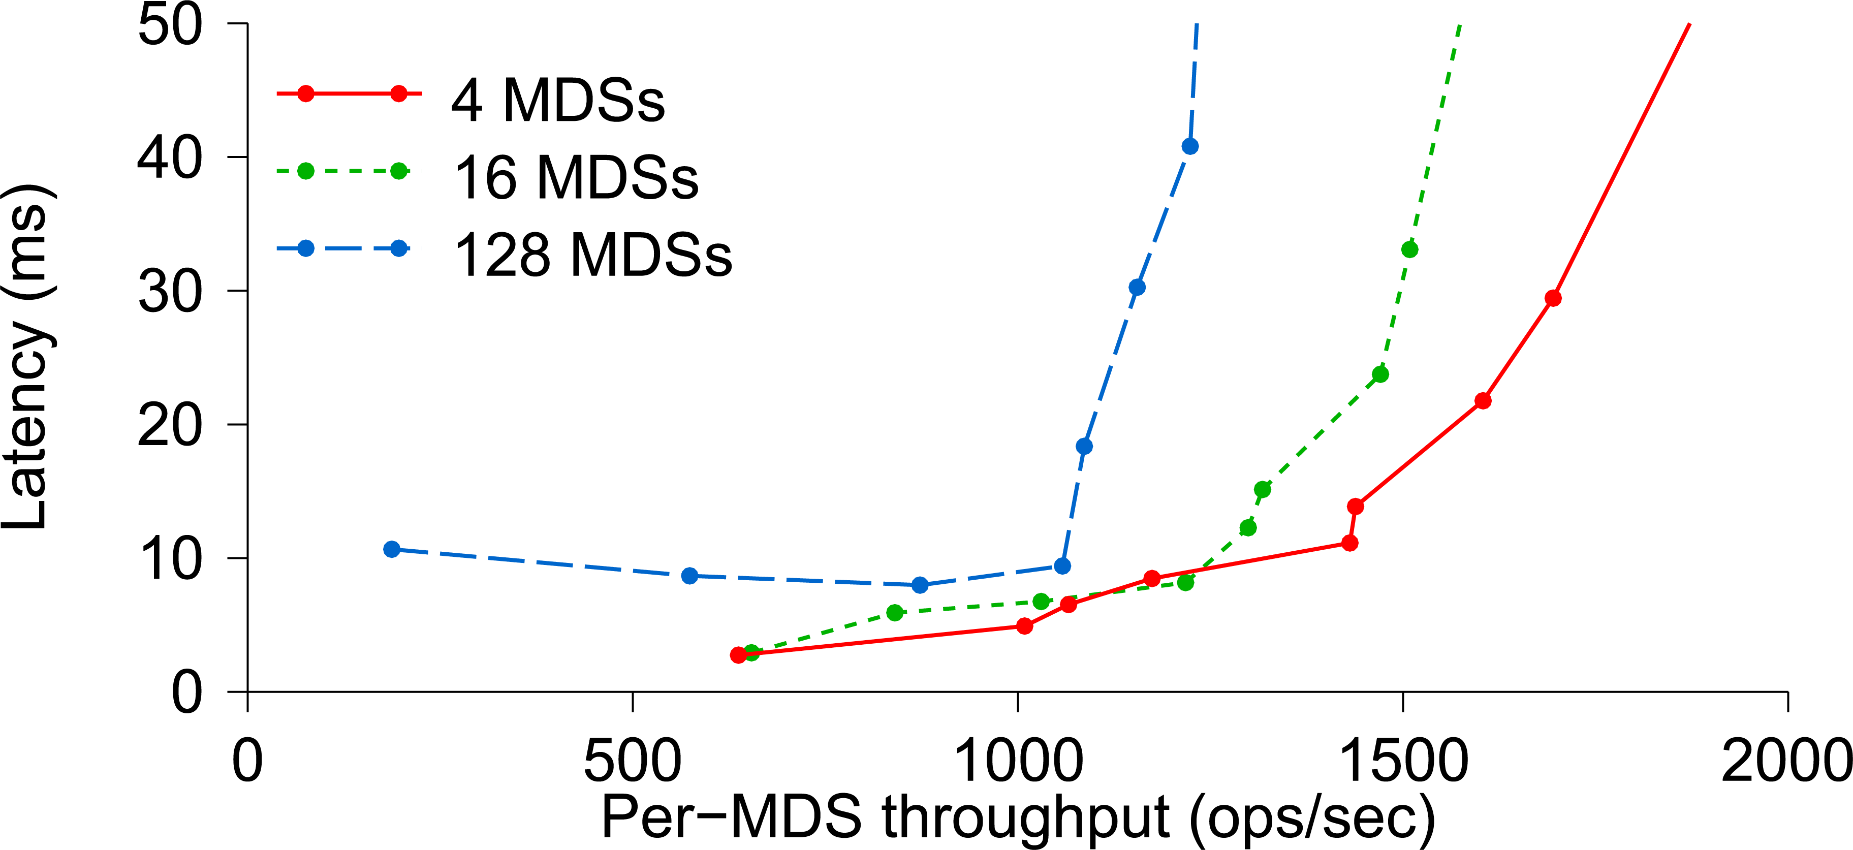
Average Latency

Slide 39
Lessons learned
If applications are object oriented, they will write huge numbers of variable-size records (some extremely large).
POSIX directories are awkward. A B+ tree index works much better.
Treat the records as byte arrays, track meta-data in one service and data in a second one. Both share the RADOS layer for actual data storage.

Slide 40
Let’s Drill down on that remark about doubled overheads
We say that Ceph is more costly when used as a file system, and less so when used directly as a key-value storage layer via RADOS.
This illustrates a cost associated with abstraction. When we adopt the wrong API, the translation between that API and the true one can add overheads.
These costs matter – and we’ll see that now in a second example.

Slide 41
CORBA and OMG
Ceph is really an outgrowth of a consortium called the “Object Management Group” or OMG.
They proposed a standard way to translate between internal representations of objects and byte array external ones. They call this the Common Object Request Broker Architecture or CORBA.
We can think of an application using Ceph as a kind of CORBA use case.

Slide 42


Understanding Costs for CORBA’s universal Representations: ATC System
A modern air traffic control system might have a structure like this:
Flight plan manager tracks current and past flight plan versions
Message bus
. . .
Microservices for various tasks, such as checking future plane separations, scheduling landing times, predicting weather issues, offering services to the airlines
Air traffic controllers
update flight plans
Flight plan update broadcast service
WAN link to other ATC centers

Slide 43
Understanding Costs for CORBA’s universal Representations: ATC System
Notice first that this architecture is actually a lot like Ceph or HDFS:
The meta-data server in Ceph and HDFS is “like” the database of
flight plan versions
The copies near the controllers are “like” the RADOS storage unit or
the HDFS store.
And the message bus is “like” a live notification service for watched files

Slide 44
Understanding Costs for CORBA’s universal Representations: ATC System
Also, think about objects in an ATC system:
Flight plans: these are elaborate objects that might hold 10MB of data
and could have a great many internal fields
Many other kinds of objects are used too. Each microservice probably
has a notifications channel of its own, and uses it to talk to individual
controllers or sets of them about relevant issues
“Attention: In 2h 31m, BA 123 will approach US 654 on approach to CDG.
Plan corrective action to avoid a violation of flight separation rules.”

Slide 45
Understanding Costs for CORBA’s universal Representations: ATC System
An ATC system has many components, far more than were shown.
Often these are based on high-quality legacy versions and hence there can be many programming languages in simultaneous use.
Often we will see C/C++, Java, C#, F#, O’Caml, etc.
Some use of Python and Fortran and Ada.
With CORBA, we can easily integrate many modules into a single system

Slide 46
But how often will we (DE)serialize?
Each time an object is read or written (from disk or network)
Each time an object is passed from one module to another
Time →
ATC controller
Version Mgr
Message Bus
ATC rules checker
. . .
Overhead →
Points at which we might do serialization/deserialization

Slide 47
Universal representations are costly!
It is very easy for a CORBA application to spend all its time on this one action.
Ceph designers were aware of that, and decided it should only be done under application control.
Thus Ceph is “object oriented” and yet reflects a choice not to have the whole system understand every kind of object

Slide 48
How do ATC systems avoid these costs?
The trick is to use “lazy” record access.
The ATC record is the main object being shared. Suppose that we have two versions of an ATC object while in memory:
Version A: The object is fully resident in memory and you can access all
fields, edit it to create a new version, etc.
Version B: All the same methods are offered, but the in-memory data is
limited to a URL pointing to the record in the flight plan database

Slide 49
Why two “identical” object variants?
Notice how easy it is to switch from representation B to A (or back).
In an ATC system most components don’t really look at the data fields and for this reason, most components would be happy with representation B. But a small object with just a URL in it is very cheap to serialize!
With “lazy deserialization”, we would convert from form B to form A only when an application tries to touch the data.

Slide 50
Old Single version approach
Each time an object is read or written (from disk or network)
Each time an object is passed from one module to another
Time →
ATC controller
Version Mgr
Message Bus
ATC rules checker
Wasted work!
. . .
Overhead →
Points at which we might do serialization/deserialization

Slide 51
Dual version approach
We only do a costly action when the component will actually touch the inner data fields!
Time →
ATC controller
Version Mgr
Message Bus
ATC rules checker
Here we fetch the full data for the flight plan from the flight plan database
. . .
Overhead →
Dual scheme reduces overheads!
A A B B B B B B B B B A B B B

Slide 52
How should we store the flight plan records?
The need is for a very simple append-only log managed by the version manager.
It is easy to recognize this as a use case for state machine replication.
This situates the central safety question in one specific component, where we can formalize it and use mathematical tools to prove that each plan has just one sequence of versions, used consistently by all components.

Slide 53
How should we Implement the flight plan manager component?
A (key-value) sharded service built on Derecho would be an ideal choice.
Derecho has been proved correct in several ways: by hand, but also using a machine-verified proof in the Ivy protocol verification tool.
It is also scalable and extremely fast: important because this role is central.

Slide 54
Revisiting the structure
If this one component is correct, the whole system can be proved safe!
A modern air traffic control system might have a structure like this:
Flight plan manager tracks current and past flight plan versions
Message bus
. . .
Microservices for various tasks, such as checking future plane separations, scheduling landing times, predicting weather issues, offering services to the airlines
Air traffic controllers
update flight plans
Flight plan update broadcast service
WAN link to other ATC centers

Slide 55
Summary – CEPH
Ceph is a file system that was created by taking the HDFS model, but then extending it to be better matched to properties of object-oriented code.
This is very popular, although it does bring overheads.
Ceph uses a simple but “weak” form of data replication. It doesn’t guarantee consistency.

Slide 56
Summary – corba
Here we saw a different form of object-oriented overhead, arising in applications that adopt the standard CORBA approach to interoperability.
CORBA buys flexibility but brings steep costs.
Those costs can be managed by understanding the architecture and designing the application to avoid triggering costly serialization/deserialization.

Slide 57
Broader Insight linking these subtopics
Innovation brings challenges.
As the world has shifted towards object oriented languages like Java, C++, Python with its object features, etc., we are finding that they pay steep overheads if you adapt them naively to run on standard platforms.
But with modest effort, they can perform extremely well in the cloud.

