Slide 1
CS 5412/Lecture 17
Leave No Trace Behind
Ken Birman
Spring, 2021

Slide 2
The Privacy puzzle for IoT
We have sensors everywhere, including in very sensitive settings.
They are capturing information you definitely don’t want to share.
… seemingly arguing for brilliant sensors that do all the computing.
But sensors are power and compute-limited.
Sometimes, only cloud-scale datacenters can possibly do the job!

Slide 3
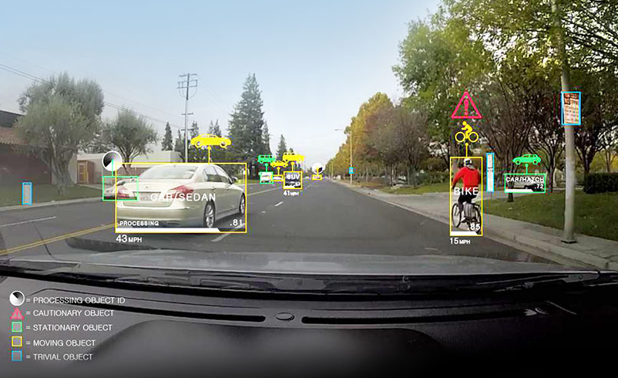
Things that can only be done on the cloud
Training models for high quality image recognition
and tagging. Classifying complex images.
High quality speech, including regional accents and individual styles.
Correlating observations from video cameras with shared knowledge
Example: A smart highway where we are comparing observations of
vehicles with previously computed motion trajectories
Is Bessie the cow likely to give birth soon? Will it be a difficult labor?
What plant disease might be causing this form of leaf damage?
Notes:
The point here is that if you were to convince yourself that everything can be done on the sensors or even in the home, that view can be questioned. There are a lot of situations where you either need very large data sets – too large to keep a copy of, or changing too rapidly to keep up – or where the compute resources themselves are just beyond what you can place in a home or on a sensor.

Slide 4
But the cloud is not good on privacy
Many cloud computing vendors are incented by advertising revenue.
Google just wants to show ads that the user will click on.
Amazon wants to offer products this user might buy.
Consider medications: a big business in America. But to show a relevant ad for a drug to treat mental health, or diabetes, entails knowing the user’s health status.
Even showing the ad could leak information that a third party, like the ISP carrying network traffic, might “steal”.
Notes:
The tension is that sending data to the cloud is scary because so many cloud vendors have a motivation to steal it, because they earn money based on advertising and the better profile they can build, the more they will earn.

Slide 5
The law can’t help (yet)
Lessing: “East code versus West code”.
Main points:
The law is far behind the technology curve, in the United States.
Europe may be better, but is a less innovative technology community.
So our best hope is to just build better technologies here.
Notes:
… and there are few serious legal protections. The law often lags by 25-50 years.

Slide 6
some providers aren’t incented!
We should separate cloud providers into two groups.
One group of cloud providers has an inherent motivation to violate privacy for revenue reasons and will “fight against” constraints.
Here we need to block their effort to spy on the computation.
A second group doesn’t earn their revenue with ads.
These cloud vendors might cooperate to create a secure and private model.

Slide 7
Traffic Analysis attacks
Some attacks don’t actual try to “see” the actual data.
Instead the attacker might just try to monitor the system carefully, as a way to see who is talking to whom, or sending big objects.
A malicious operator can use this as indirect evidence, or try and disrupt the computation at key moments to cause trouble.
Notes:
Continuing our review of concerns to be worried about, there are forms of attack that don’t care much about the data at all. Just seeing that you used a certain feature can reveal data about you.

Slide 8
Subversion attacks
These are exploits that leave a system unchanged, but find ways of extracting keys or other sensitive information during normal interactions
For example, suppose that if I check my account at AFCU, various account information and personal information stays on their (cloud hosted) server.
But then suppose that a negative-length web page “put” operation is done and as part of the error code, the server tries to return the bad argument – but instead sends back a snapshot of its memory, revealing my private data.

Slide 9
Our class looks at deploying ML to the edge. Even an ML model can be inverted
Machine learning systems generally operate in two stages
Given a model, they use labeled data to “train” the model (like fitting a
curve to a set of data points, by finding parameters to minimize error).
Then the active stage takes unlabeled data and “classifies” it by using
the model to estimate the most likely labels from the training set.
The model will look like a vector of numbers. At a glance it doesn’t seem to encode the information it learned.
Notes:
Before we get detailed on SGX we should recognize that not every attack will center on your inputs. Some attacks might center on the model the cloud uses for who you are. A lot of people think of these models as being safer than the raw data used to create them, but that isn’t necessarily the case. The model itself can hold knowledge of private things.

Slide 10
Inverting a machine-learned model
But such a model might encode private data.
For example, a model trained on your activities in your home might “know” all sorts of very private things even if the raw input isn’t retained!
It turns out that for certain input, like data that is all 0’s or all 1’s, or that has all 0’s and a single 1, the classifier output will reveal a (noisy) version of the input it was trained on. The attacker does a legitimate operation but learns your secrets.
Notes:
If a model encodes knowledge that, say, you talk with a particular accent, by feeding it selected data you can get it to reveal this kind of thing. So you can extract information even from a deep neural network parameter set, for example.

Slide 11

UnCooperative provider
The concern arises that the provider of some service might not have done a great job of protecting the data that we send to that service.
So what can we do? If the provider is very cooperative, we could audit their code and design… but few providers are willing to allow that.
Or, we could try and run their cloud platform inside a locked box.
Notes:
The uncooperative provider may not realize that he or she isn’t really being helpful. There is just such a strong desire to shape the advertising that things they think of as safe and reasonable can intrude on privacy from a second person’s point of view. So the Intel idea was to allow you to leverage the compute power of the cloud (like to search one of those giant data sets) while also hiding your inputs to the computation, by running the computation inside a safe space.

Slide 12
Sounds pretty bad!
If our cloud provider wants to game the system, there are a million ways to evade constraints, and they may even be legal!
So realistically, with an uncooperative cloud operator, our best bet is to just not use their cloud.
Even hybrid cloud models seem to be infeasible if you need to protect sensitive user data.

Slide 13
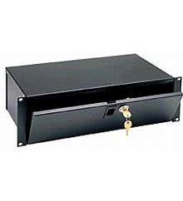
The lockbox model
Intel has created special hardware to assist for this case: iSGX. Stands for Software Guard Extensions.
Basically, they offer a way to run in a “secure context” within a vendor’s cloud. If the operator wanted to, it can’t peek into the execution context.
Let’s look closely at how iSGX works.
Notes:
The uncooperative provider may not realize that he or she isn’t really being helpful. There is just such a strong desire to shape the advertising that things they think of as safe and reasonable can intrude on privacy from a second person’s point of view. So the Intel idea was to allow you to leverage the compute power of the cloud (like to search one of those giant data sets) while also hiding your inputs to the computation, by running the computation inside a safe space.

Slide 14
Deep Dive 1: SGX
Let’s drill down on the concrete options.
First we will look closer at SGX, since this is a product from a major vendor.
Notes:
Which dimensions would Intel’s SGX hardware help on?

Slide 15
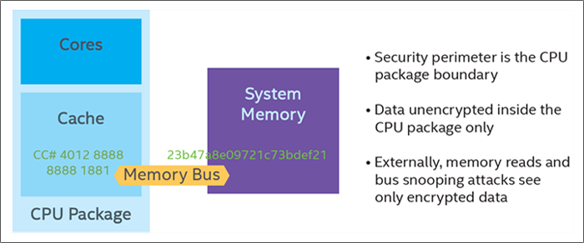
SGX concept
The cloud launches the SGX program, which was supplied by the client.
The program can now read data from the cloud file system or accept a secured TCP connection (HTTPS) from an external application.
The client sends data, and the SGX-secured enclave performs the task and sends back the result. The cloud vendor can only see encrypted information, and never has any access to decrypted data or code.
Notes:
The idea is basically to let you run inside a more trusted computer that even the person operating it can’t break into. Then it can pull in the data sets needed but the computation on your behalf and your inputs to the computation are hidden. The actual computation itself occurs on normal data, unencrypted, using normal logic – you program in a normal way.

Slide 16


SGX example
Drat! I can’t see anything!
Evil cloud operator
External client system, or IoT Sensor
HTTPS connection
(secure!)
Intel.com

Slide 17
SGX limitations
In itself, SGX won’t protect against monitoring attacks.
And it can’t stop someone from disrupting a connection or accosting a user and saying “why are you using this secret computing concept? Tell me or go to jail!”
And it is slow…
Notes:
Even if the HTTPS connection carries encrypted bytes, a watcher can still see that activity is occurring. The only way to hide that would be to communicate continuously. And in some countries even using a system could be illegal. Obviously, they would see that you used something. Then they can basically demand to know what it was.

Slide 18
SGX reception has been mixed
Some adoption, but performance impact is a continuing worry.
There have been some successful exploits against SGX that leverage Intel’s hardware caching and prefetching policies. (“Leaks”)
Using SGX requires substantial specialized expertise. And SGX can’t leverage specialized hardware accelerators, like GPU or TPU or even FPGA (they could have “back channels” that leak data).

Slide 19

Cooperative privacy looks more promising
If the vendor is willing to work with the cloud developer many new options emerge. Such a vendor guarantees: “We won’t snoop, and we will isolate users so that other users can’t snoop”.
A first simple idea is for the vendor to provide
a guaranteed “scrubbing” for container virtualization.
Containers that start in a known and “clean” runtime context.
After the task finishes, they clean up and leave no trace at all.
Notes:
So here the distinction is to imagine a cloud provider who promises in some binding way to be helpful, and promises not to monitor you. But maybe other users of the cloud didn’t make that promise, and anyhow, there can be apps we don’t entirely trust. So can we scrub your runtime environment?

Slide 20

ORAM model
ORAM: Oblivious RAM (multiuser system that won’t leak information)
Idea here is that if the cloud operator can be trusted but “other users” on the same platform cannot, we should create containers that leak no data.
Even if an attacker manages to run on the same server, they won’t learn anything. All leaks are blocked (if the solution covered all issues, that is)
Turns out to be feasible with special design and compilation techniques
Notes:
Elaine Shi is a Cornell professor famous for working on protection against leakage, so that you wouldn’t need SGX (so you wouldn’t experience the extreme slowdowns it can bring), and other people using the same computers can’t sneak peaks at what you are up to.

Slide 21
Enterprise VLAN and Virtually Private Networking (VPN)
If the cloud vendor is able to “set aside” some servers, but can’t provide a private network, these tools let us create a form of VPN in which traffic for application A shares the network with traffic for other platforms, but no leakage occurs.
In practice the approach is mostly via cryptography.
For this reason, “traffic analysis” could still reveal some data.
Notes:
Then inside the data center they can give you a kind of private network capability. Enterprise vlan is one way to do this. VPN protection is another.

Slide 22
Privacy with μ-Services
Vendor or μ-service developer will need to implement a similar “leave no trace” guarantee.
Use cryptography to ensure that data on the wire can’t be interpreted
With FPGA bump-in-the-wire model, this can be done at high speeds.
So we can pass data across the cloud message bus/queue safely as
long as the message tag set doesn’t reveal secrets.
Cloud vendor could even audit the μ-services, although this is hard to
do and might not be certain to detect private data leakage
Notes:
What if our code needs to make use of cloud services, or novel new μ-Services? This poses additional issues because we need to make sure we don’t leave any trace inside the state of the μ-Services itself.

Slide 23
Databases with sensitive content
Many applications turn out to need to create a single database with data from multiple clients, because some form of “aggregated” data is key to what the μ-service is doing.
Most customers who viewed product A want to compare with B.
If you liked that book, you will probably like this one too.
People like you who live in Ithaca love Gola Osteria.
88% of people with this gene variant are descended from Genghis Khan
Notes:
Most people adopt a database model at this stage and say that our goal might be to use a database but not reveal data, and maybe even to save some data into it, and even though it is a shared database product, still not reveal my own private data.

Slide 24
Issue with database queries
Many people assume that we can anonymize databases, or limit users to queries that sum up (“aggregate”) data over big groups.
But in fact it is often surprisingly easy to de-anonymize the data, or use known information to “isolate” individuals.
How many bottles of wine are owned by people in New York State
that have taught large MEng-level cloud computing courses?
Seems to ask about a large population, but actually asks about me!

Slide 25
Best possible? Differential Privacy
Cynthia Dwork has invented a model called “Differential Privacy”.
We put our private database on a trusted server. It permits queries (normally, aggregation operations like average, min, max) but not retrieving individual data. And it injects noise into results.
Noise level can be tuned to limit the rate at which leakage occurs.
Notes:
This is a lovely theoretical (and somewhat practical, although not always) model for what it means to create a genuinely private database. The real guarantee is expressed mathematically but it says that the rate of data leakage can be as small as I ask for it to be, and the database guarantees this by swamping any signal I want it to protect with noise. But the noise can be an issue.

Slide 26
Bottles of wine query
For example, if the aggregation query includes a random extra number in the range [-10000,10000], then an answer like “72” tells you nothing about Ken’s wine cellar.
There are several ways to add noise, and this is a “hot topic”.
But for many purposes, noisy results aren’t very useful.
“I can’t see to the right. How many cars are coming?”

Slide 27


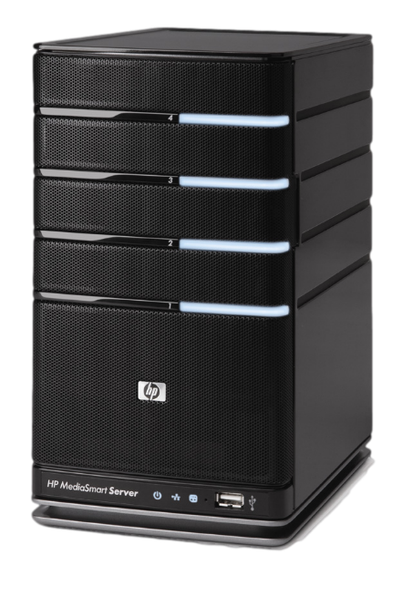
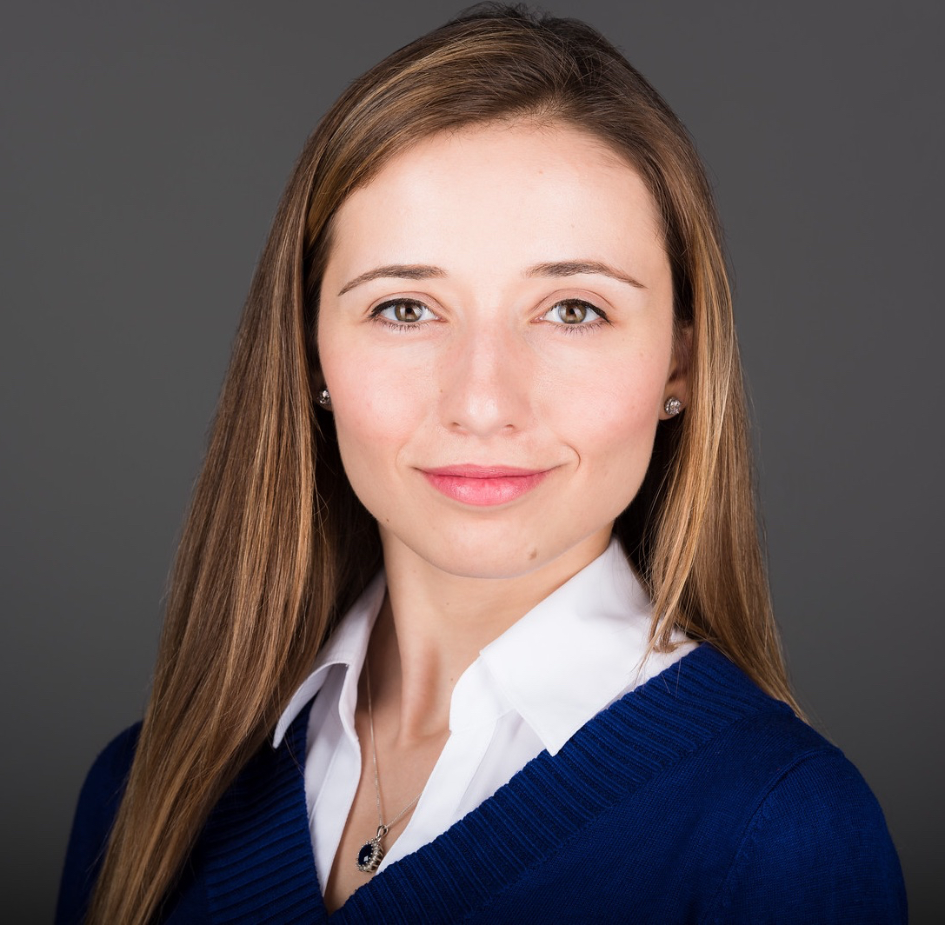
Building systems that compute on encrypted data
?
xd51db5
X9ce568
xab2356
x453a32
xe891a1
X32e1dc
xdd0135
x63ab12
Raluca Ada Popa
MIT PhD, now a professor at Berkeley
Notes:
This will talk about work from the paper cited on the web site. I would recommend reading the paper (it is easy to understand) if you have questions about details. The slides come from Raluca herself and I don’t want to modify her work. But she didn’t include any lecture notes and I won’t be adding any, since that would add my interpretations to her slide deck.

Slide 28
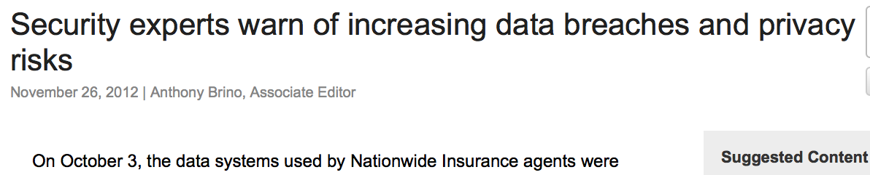
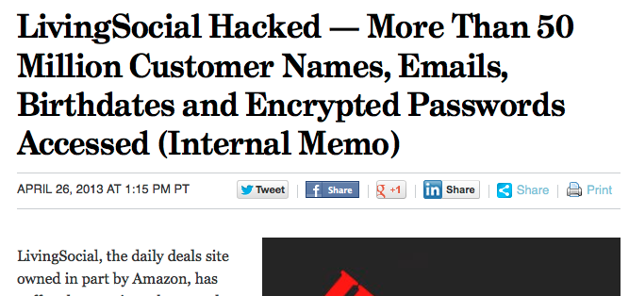
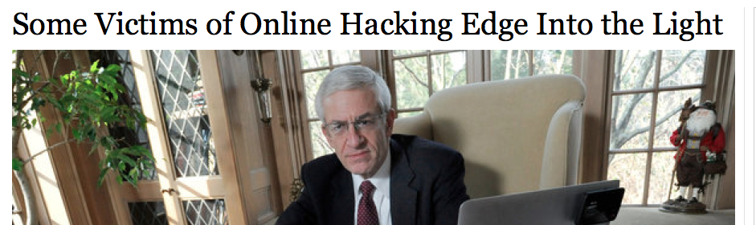
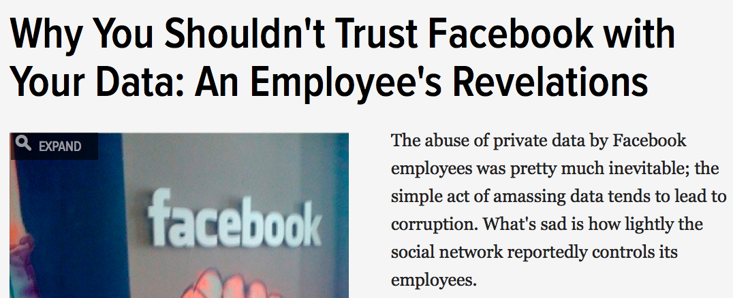
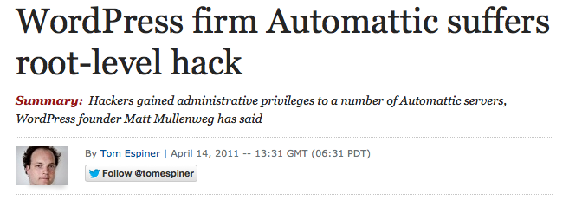
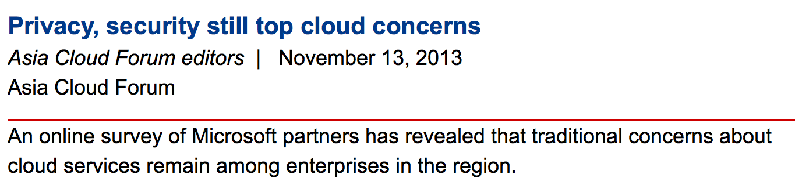
Compromise of confidential data is prevalent

Slide 29






Problem setup
server
clients
Secret
Secret
Secret
(encrypted FS/email)
no computation
computation
storage
databases, web applications, mobile applications, machine learning, etc.
??
encryption

Slide 30
Current systems strategy
server
clients
Secret
Secret
Prevent attackers from breaking into servers

Slide 31
Lots of existing work
Checks at the operating-system level
Language-based enforcement of a security policy
Static or dynamic analysis of application code
Checks at the network level
Trusted hardware
…

Slide 32
Data still leaks even with these mechanisms
because
attackers eventually break in!

Slide 33




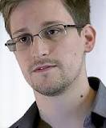
Attacker examples
Attacker:
Reason they succeed:
hackers
software is complex
cloud employees
insiders: legitimate server access!
increasingly many companies store data on external clouds
government
e.g., physical access
accessed private data according to

Slide 34
[Raluca Popa’s] work
Systems that protect confidentiality even against attackers with access to all server data

Slide 35



My approach
Servers store, process, and compute on
encrypted data
in a practical way
server
client
??
Strawman:
Result
Secret
Secret
Result
Secret
Secret

Slide 36

Computing on encrypted data in cryptography
[Rivest-Adleman-Dertouzos’78]
Fully homomorphic encryption (FHE) [Gentry’09]
prohibitively slow, e.g., slowdown
X 1,000,000,000
My work: practical systems
practical systems
large class of real applications
real-world performance
+
+
meaningful security

Slide 37
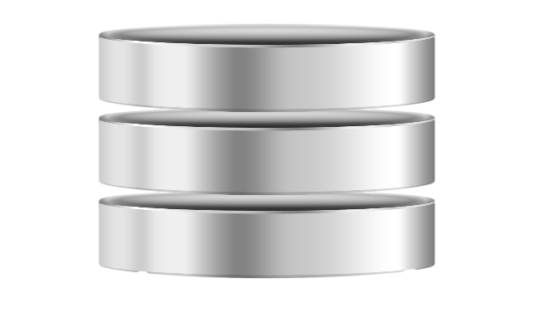
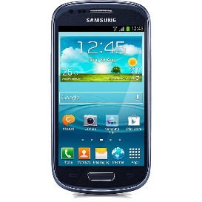
My contributions
System:
Server under attack:
Databases:
CryptDB
[SOSP’11][CACM’12]
mOPE, adjJOIN
DB server
[Oakland’13]
Web apps:
Mylar
[NSDI’14]
web app server
DB server
multi-key search
Mobile
apps:
PrivStats
[CCS’11]
VPriv
mobile app server
[Usenix Security’09]
Theory:
In general:
Functional encryption
[STOC’13] [CRYPTO’13]

Slide 38
Combine systems and cryptography
1. identify core operations needed
strawman:
systems
one generic scheme (FHE)
crypto
3. Design and build system
2. multiple specialized encryption schemes
New schemes:
mOPE, adjJOIN for CryptDB
multi-key search for Mylar

Slide 39
My contributions
System:
Server under attack:
Databases:
CryptDB
DB server
Web apps:
Mylar
web app server
DB server
Mobile
apps:
PrivStats
VPriv
mobile app server
Theory:
In general:
Functional encryption

Slide 40
CryptDB
CDB is really awesome, make sure you emphasize all the cool points
[SOSP’11: Popa-Redfield-Zeldovich-Balakrishnan]
First practical database system (DBMS) to process most SQL queries on encrypted data

Slide 41
Related work
Systems work:
  no formal confidentiality guarantees
  restricted functionality
  client-side filtering
[Hacigumus et al.’02][Damiani et al.’03][Ciriani et al’09]
Theory work:
  General computation: FHE
    very strong security: forces slowdown - many queries must always scan and return the whole DB
    prohibitively slow (10⁹x)
[Gentry’09]
  Specialized schemes
[Amanatidis et al.’07][Song et al.’00][Boldyreva et al.’09]

Slide 42

Setup
trusted client-side
under passive attack
DB server
Application
  Use cases:
  Outsource DB to the cloud (DBaaS)
    e.g. Encrypted BigQuery
  Local cluster: hide DB content from sys. admins.

Slide 43
Setup
Related work is not achieving my purpose, plus robert did not like the yellow box
trusted client-side
under passive attack
transformed query
DB server
process queries to completion on encrypted
DB
Active later and app
Not disclaimers
plain query
Proxy
Application
encrypted DB
decrypted results
encrypted results
Secret
Secret
Stores schema
and master key
No query execution
computation on encrypted data ≈
regular computation

Slide 44
Example
Application
Randomized encryption (RND) - semantic
SELECT * FROM emp
Actual values are not visible to cloud provider
table1/emp
col1/rank
col2/name
col3/salary
Proxy
SELECT * FROM table1
x4be219
60
x95c623
100
x2ea887
800
x17cea7
100

Slide 45

Example
Application
Randomized encryption (RND)
Deterministic encryption (DET)
SELECT * FROM emp WHERE salary = 100
table1/emp
SELECT * FROM table1 WHERE col3 = x5a8c34
col1/rank
col2/name
col3/salary
Proxy
x934bc1
x4be219
60
x5a8c34
100
x95c623
x84a21c
x2ea887
800
x5a8c34
?
?
x5a8c34
x5a8c34
x17cea7
100
x5a8c34
x5a8c34

Slide 46
Example
Application
“Summable”
encryption (HOM) - semantic
Deterministic encryption (DET)
SELECT sum(salary) FROM emp
table1 (emp)
Proxy
SELECT cdb_sum(col3) FROM table1
col1/rank
col2/name
col3/salary
x934bc1
x9eab81
60
x5a8c34
x638e54
100
x84a21c
x122eb4
800
x5a8c34
1060
x72295a
x578b34
100

Slide 47

Techniques
Use SQL-aware set of efficient encryption schemes
(meta technique!)
  Most SQL can be implemented with a few core operations
Adjust encryption of data based on queries
Query rewriting algorithm

Slide 48
1. SQL-aware encryption schemes
Security
Scheme
Construction
Function
SQL operations:
e.g., SELECT, UPDATE, DELETE, INSERT, COUNT
RND
AES in UFE
data moving
≈ semantic security
HOM
Paillier
addition
e.g., SUM, +
SEARCH
Song et al.,‘00
word search
restricted ILIKE
e.g., =, !=, IN, GROUP BY, DISTINCT
reveals only repeat pattern
DET
AES in CMC
equality
JOIN
our new scheme
join
e.g., >, <, ORDER BY, ASC, DESC, MAX, MIN, GREATEST, LEAST
reveals only order
OPE
our new scheme
[Oakland’13]
order
x < y Enc(x) < Enc(y)

Slide 49
How to encrypt each data item?
Goals:
Support queries
Use most secure encryption schemes
Challenge: may not know queries ahead of time
col1-RND
col1-HOM
col1-SEARCH
col1-DET
col1-JOIN
col1-OPE
rank
‘CEO’
ALL?
‘worker’
Leaks order!

Slide 50


Onion

Slide 51
Onion of encryptions
security
+
RND
DET
OPE
value
+
functionality
Adjust encryption: strip off layer of the onion

Slide 52
Onions of encryptions
1 column
3 columns
HOM
int value
RND
RND
Onion Add
each value
DET
JOIN
OPE
OR
value
value
SEARCH
text value
Onion Equality
Onion Order
Onion Search
Same key for all items in a column for same onion layer

Slide 53
Onion evolution
Start out the database with the most secure encryption scheme
If needed, adjust onion level
  Proxy gives decryption key to server
  Proxy remembers onion layer for columns
Lowest onion level is never removed

Slide 54
Example
emp:
Logical table:
rank
name
salary
‘CEO’
‘worker’
Physical table:
table 1:
RND
…
RND
col1-OnionEq
col1-OnionOrder
col1-OnionSearch
col2-OnionEq
DET
…
JOIN
‘CEO’
…
Onion Equality
SELECT * FROM emp WHERE rank = ‘CEO’

Slide 55
Example (cont’d)
table 1
RND
col1-OnionEq
col1-OnionOrder
col1-OnionSearch
col2-OnionEq
…
DET
DET
…
JOIN
‘CEO’
Onion Equality
SELECT * FROM emp WHERE rank = ‘CEO’
UPDATE table1 SET col1-OnionEq =
Decrypt_RND(key, col1-OnionEq)
SELECT * FROM table1 WHERE col1-OnionEq = xda5c0407

Slide 56
Security threshold
Data owner can specify minimum level of security
CREATE TABLE emp (…, credit_card SENSITIVE integer, …)
RND, HOM, DET for unique fields
≈ semantic security

Slide 57
Security guarantee
Columns annotated as sensitive have semantic security (or similar).
Encryption schemes exposed for each column are the most secure enabling queries.
equality repeats
sum semantic
no filter semantic
common in practice
Never reveals plaintext

Slide 58
Limitations & Workarounds
Queries not supported:
More complex operators, e.g., trigonometry
Certain combinations of encryption schemes:
  e.g., salary + raise > 100K
HOM
use query splitting, query rewriting

Slide 59
Implementation
SQL Interface
unmodified DBMS
CryptDB
SQL UDFs
(user-defined functions)
query
CryptDB
Proxy
Application
results
No change to the DBMS!
Largely no change to apps!

Slide 60
Evaluation
Does it support real queries/applications?
What is the resulting confidentiality level?
What is the performance overhead?

Slide 61
Real queries/applications
Application | Encrypted columns
phpBB | 23
HotCRP | 22
grad-apply | 103
TPC-C | 92
sql.mit.edu | 128,840
# cols with queries not supported
0
0
0
0
1,094
apps with sensitive columns
tens of thousands of apps
SELECT 1/log(series_no+1.2) …
… WHERE sin(latitude + PI()) …

Slide 62
Confidentiality level
Final onion state
Application | Encrypted columns
phpBB | 23
HotCRP | 22
grad-apply | 103
TPC-C | 92
sql.mit.edu | 128,840
Min level: ≈semantic
21
18
95
65
80,053
Min level: DET/JOIN
1
1
6
19
34,212
Min level: OPE
1
2
2
8
13,131
Most columns at semantic
Most columns at OPE were less sensitive

Slide 63
Performance
DB server throughput
MySQL:
Application 1
Plain database
Application 2
Latency
CryptDB:
Application 1
CryptDB Proxy
Encrypted DB
CryptDB Proxy
Application 2
Hardware: 2.4 GHz Intel Xeon E5620 – 8 cores, 12 GB RAM

Slide 64
TPC-C performance
Latency (per query): 0.10ms MySQL vs. 0.72ms CryptDB
Throughput loss over MySQL: 26%
Homomorphic addition
No cryptography at the DB server in the steady state!

Slide 65




Adoption
http://css.csail.mit.edu/cryptdb/
Encrypted BigQuery
[http://code.google.com/p/encrypted-bigquery-client/]
“CryptDB was really eye-opening in establishing the practicality of providing a SQL-like query interface to an encrypted database”
“CryptDB was [..] directly influential on the design and implementation of Encrypted BigQuery.”
Úlfar Erlingsson, head of security research, Google
SEEED implemented on top of the SAP HANA DBMS
Encrypted version of the D4M Accumulo NoSQL engine
sql.mit.edu
Users opted-in to run Wordpress over our CryptDB source code

Slide 66
Concerns about CryptDB?
The main criticisms stem from the “strip a layer” step.
Once we reduce the level of protection, we’ve leaked some information and the remaining data is “less protected”. Raluca’s response: if you want to make use of operations like aggregation, you can’t easily avoid releasing some information.
Criticism response to Raluca: attacker might trick my code into doing the operation, and might do so in the future when some flaw in one of the crypto scheme is noticed. The logic wouldn’t protect itself in that case.

Slide 67
Summary
A “leave no trace” model could offer a practical way to leverage the cloud and yet not release private data to the public.
With a trusted vendor willing to audit operations and to “enclave” sensitive data computation, and clean up afterward, there is real hope for privacy without leaks.
SGX, costly but can be used where the vendor is not trusted.
For databases, techniques like CryptDB aren’t perfect but work well. Differential privacy is even better, but only if noise can be tolerated.

