Slide 1
CS 5412/Lecture 24. Ceph: A Scalable High-Performance Distributed File System
Ken Birman
Spring, 2019

Slide 2
HDFS limitations
Although many applications are designed to use the normal “POSIX” file system API (operations like file create/open, read/write, close, rename/replace, delete, and snapshot), some modern applications find POSIX inefficient.
Some main issues:
HDFS can handle big files, but treats them as sequences of fixed-size blocks. Many application are object-oriented
HDFS lacks some of the “file system management” tools big-data needs

Slide 3
CEPH project
Created by Sage Weihl, a PhD student at U.C. Santa Cruz
Later became a company and then was acquired into Red Hat Linux
Now the “InkStack” portion of Linux offers Ceph plus various tools to leverage it, and Ceph is starting to replace HDFS worldwide.
Ceph is similar in some ways to HDFS but unrelated to it. Many big data systems are migrating to the system.

Slide 4
Ceph has three “APIS”
First is the standard POSIX file system API. You can use Ceph in any situation where you might use GFS, HDFS, NFS, etc.
Second, there are extensions to POSIX that allow Ceph to offer better performance in supercomputing systems, like at CERN.
Finally, Ceph has a lowest layer called RADOS that can be used directly as a key-value object store.

Slide 5
Why talk directly to RADOS? Serialization/Deserialization!
When an object is in memory, the data associated with it is managed by the class (or type) definition, and can include pointers, fields with gaps or other “subtle” properties, etc.
Example: a binary tree: the nodes and edges could be objects, but the whole tree could also be one object composed of other objects.
Serialization is a computing process to create a byte-array with the data in the object. Deserialization reconstructs the object from the array.

Slide 6
Good and bad things
A serialized object can always be written over the network or to a disk.
But the number of bytes in the serialized byte array might vary. Why?
… so the “match” to a standard POSIX file system isn’t ideal. Why?
This motivates Ceph.

Slide 7
Key ideas in Ceph
The focus is on two perspectives: object storage (ODS, via RADOS) for actual data, with automatic “striping” over multiple server for very large files or objects. Fault-tolerance is automatic.
MetaData Management. For any file or object, there is associated meta-data: a kind of specialized object. In Ceph, meta-data servers (MDS) are accessed in a very simple hash-based way using the CRUSH hashing function. This allows direct metadata lookup
Object “boundaries” are tracked in the meta-data, which allows the application to read “the next object.” This is helpful if you store a series of objects.

Slide 8
Ceph: A Scalable, High-Performance Distributed File System
Original slide set from OSDI 2006
Sage A. Weil, Scott A. Brandt, Ethan L. Miller, Darrel D. E. Long

Slide 9
Contents
Goals
System Overview
Client Operation
Dynamically Distributed Metadata
Distributed Object Storage
Performance

Slide 10
Goals
Scalability
Storage capacity, throughput, client performance. Emphasis on HPC.
Reliability
“…failures are the norm rather than the exception…”
Performance
Dynamic workloads

Slide 13
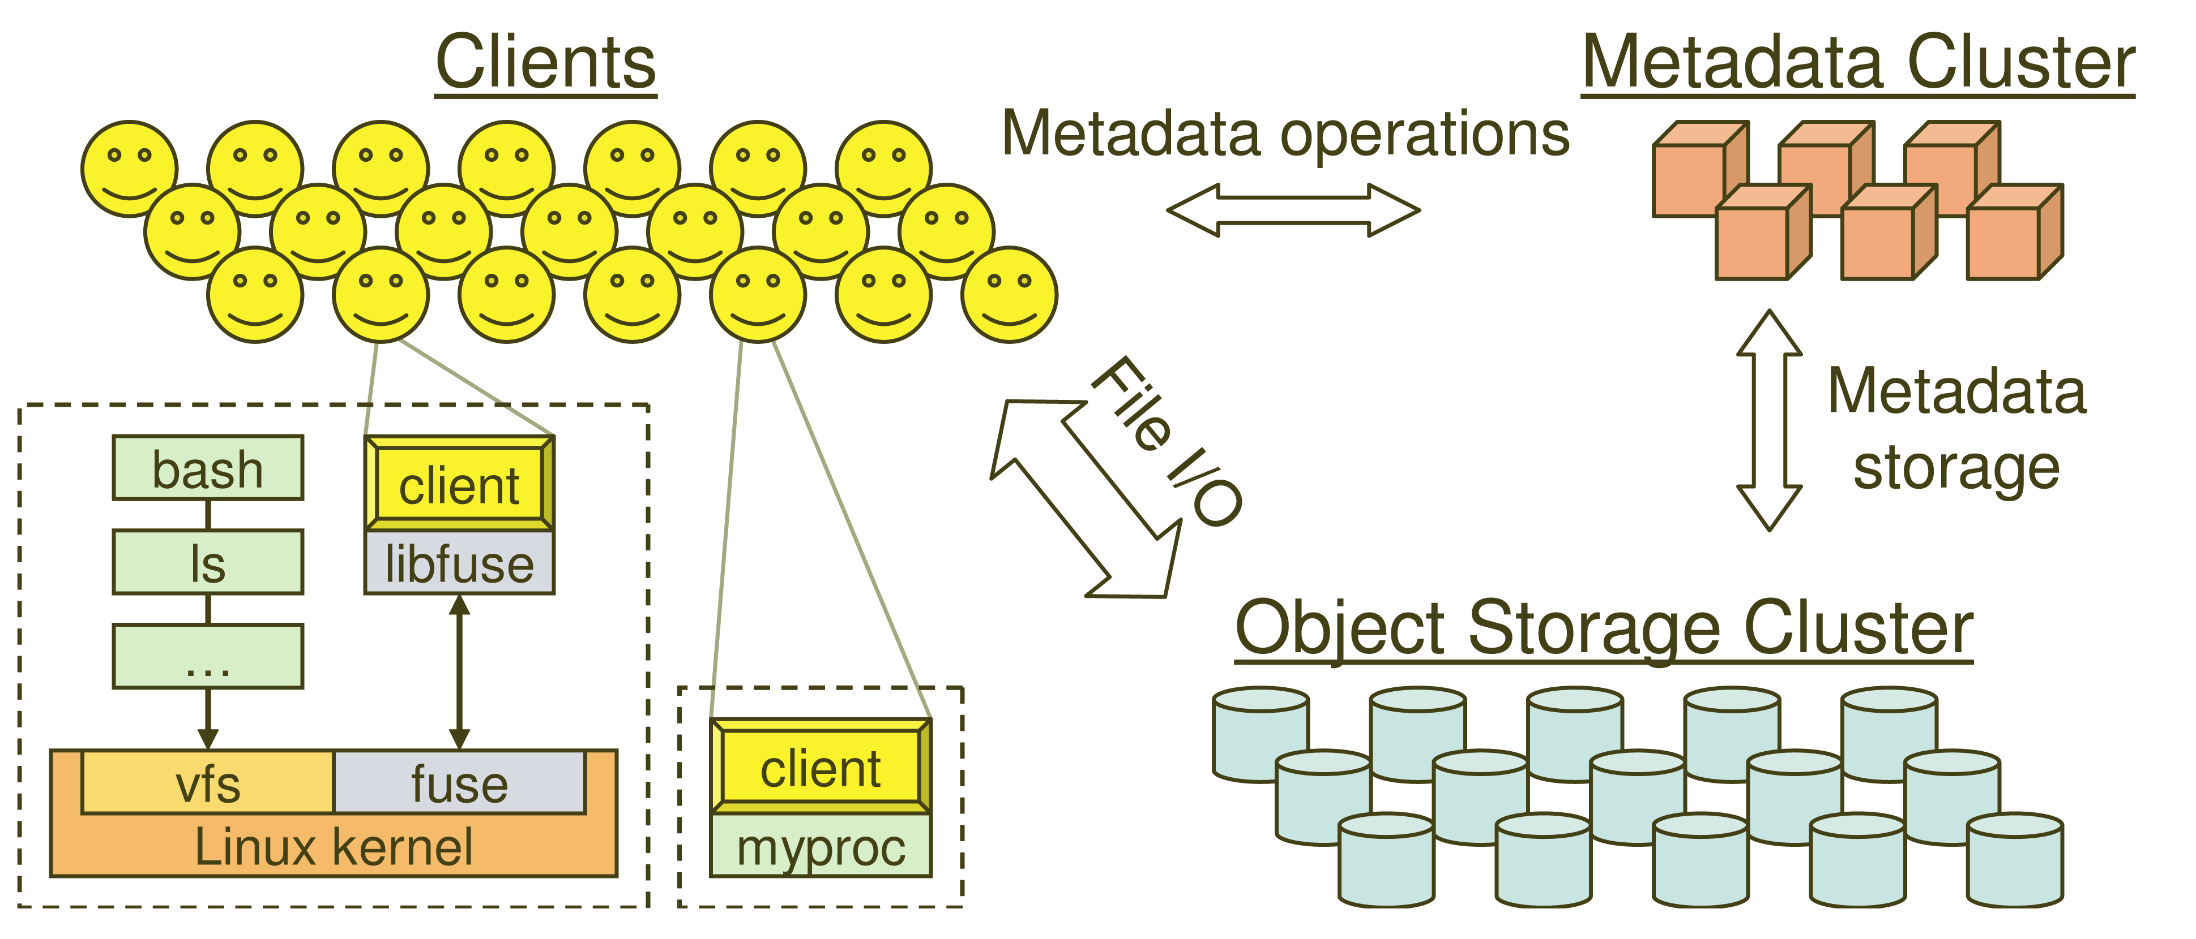
System Overview

Slide 14
Key Features
Decoupled data and metadata
CRUSH
Files striped onto predictably named objects
CRUSH maps objects to storage devices
Dynamic Distributed Metadata Management
Dynamic subtree partitioning
Distributes metadata amongst MDSs
Object-based storage
OSDs handle migration, replication, failure detection and recovery

Slide 15
Client Operation
Ceph interface
Nearly POSIX
Decoupled data and metadata operation
User space implementation
FUSE or directly linked
FUSE is a software allowing to implement a file system in a user space

Slide 16
Client Access Example
Client sends open request to MDS
MDS returns capability, file inode, file size and stripe information
Client read/write directly from/to OSDs
MDS manages the capability
Client sends close request, relinquishes capability, provides details to MDS

Slide 17
Synchronization
Adheres to POSIX
Includes HPC oriented extensions
Consistency / correctness by default
Optionally relax constraints via extensions
Extensions for both data and metadata
Synchronous I/O used with multiple writers or mix of readers and writers

Slide 18
Distributed Metadata
“Metadata operations often make up as much as half of file system workloads…”
MDSs use journaling
Repetitive metadata updates handled in memory
Optimizes on-disk layout for read access
Adaptively distributes cached metadata across a set of nodes

Slide 19
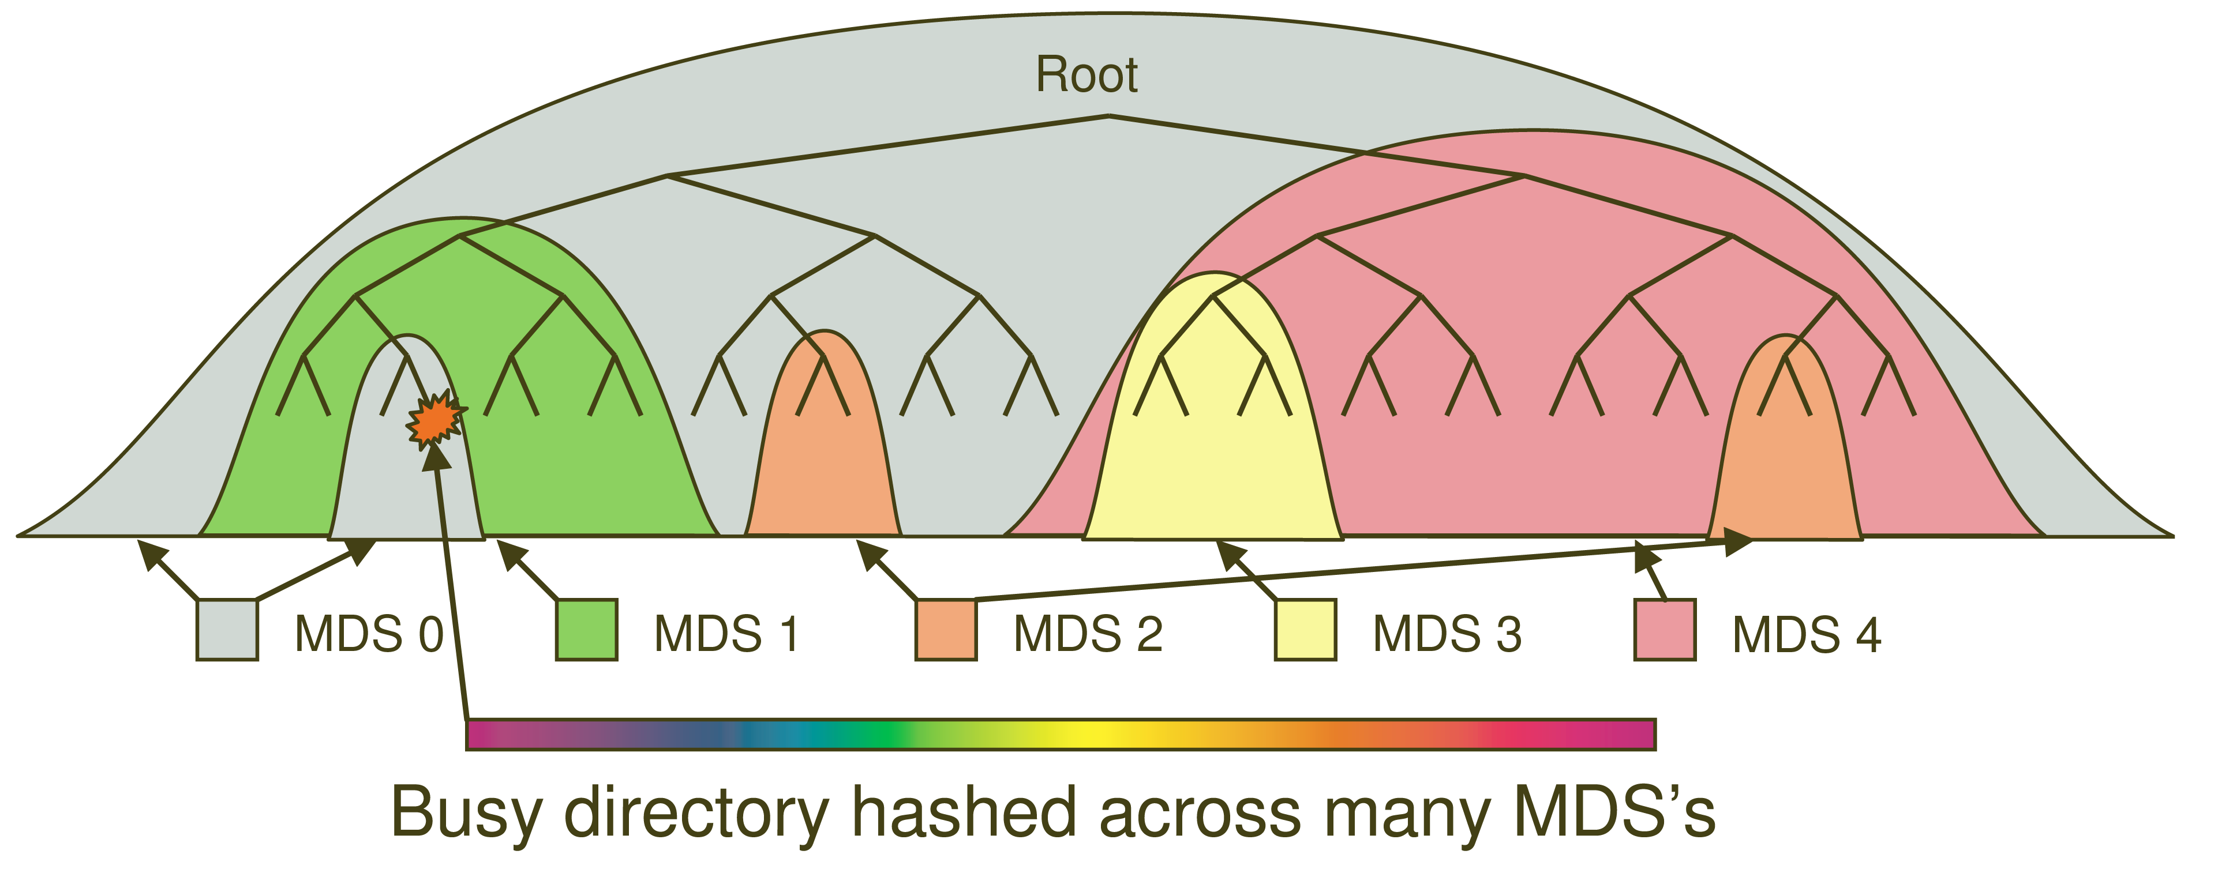
Dynamic Subtree Partitioning

Slide 20
Distributed Object Storage
Files are split across objects
Objects are members of placement groups
Placement groups are distributed across OSDs.

Slide 21
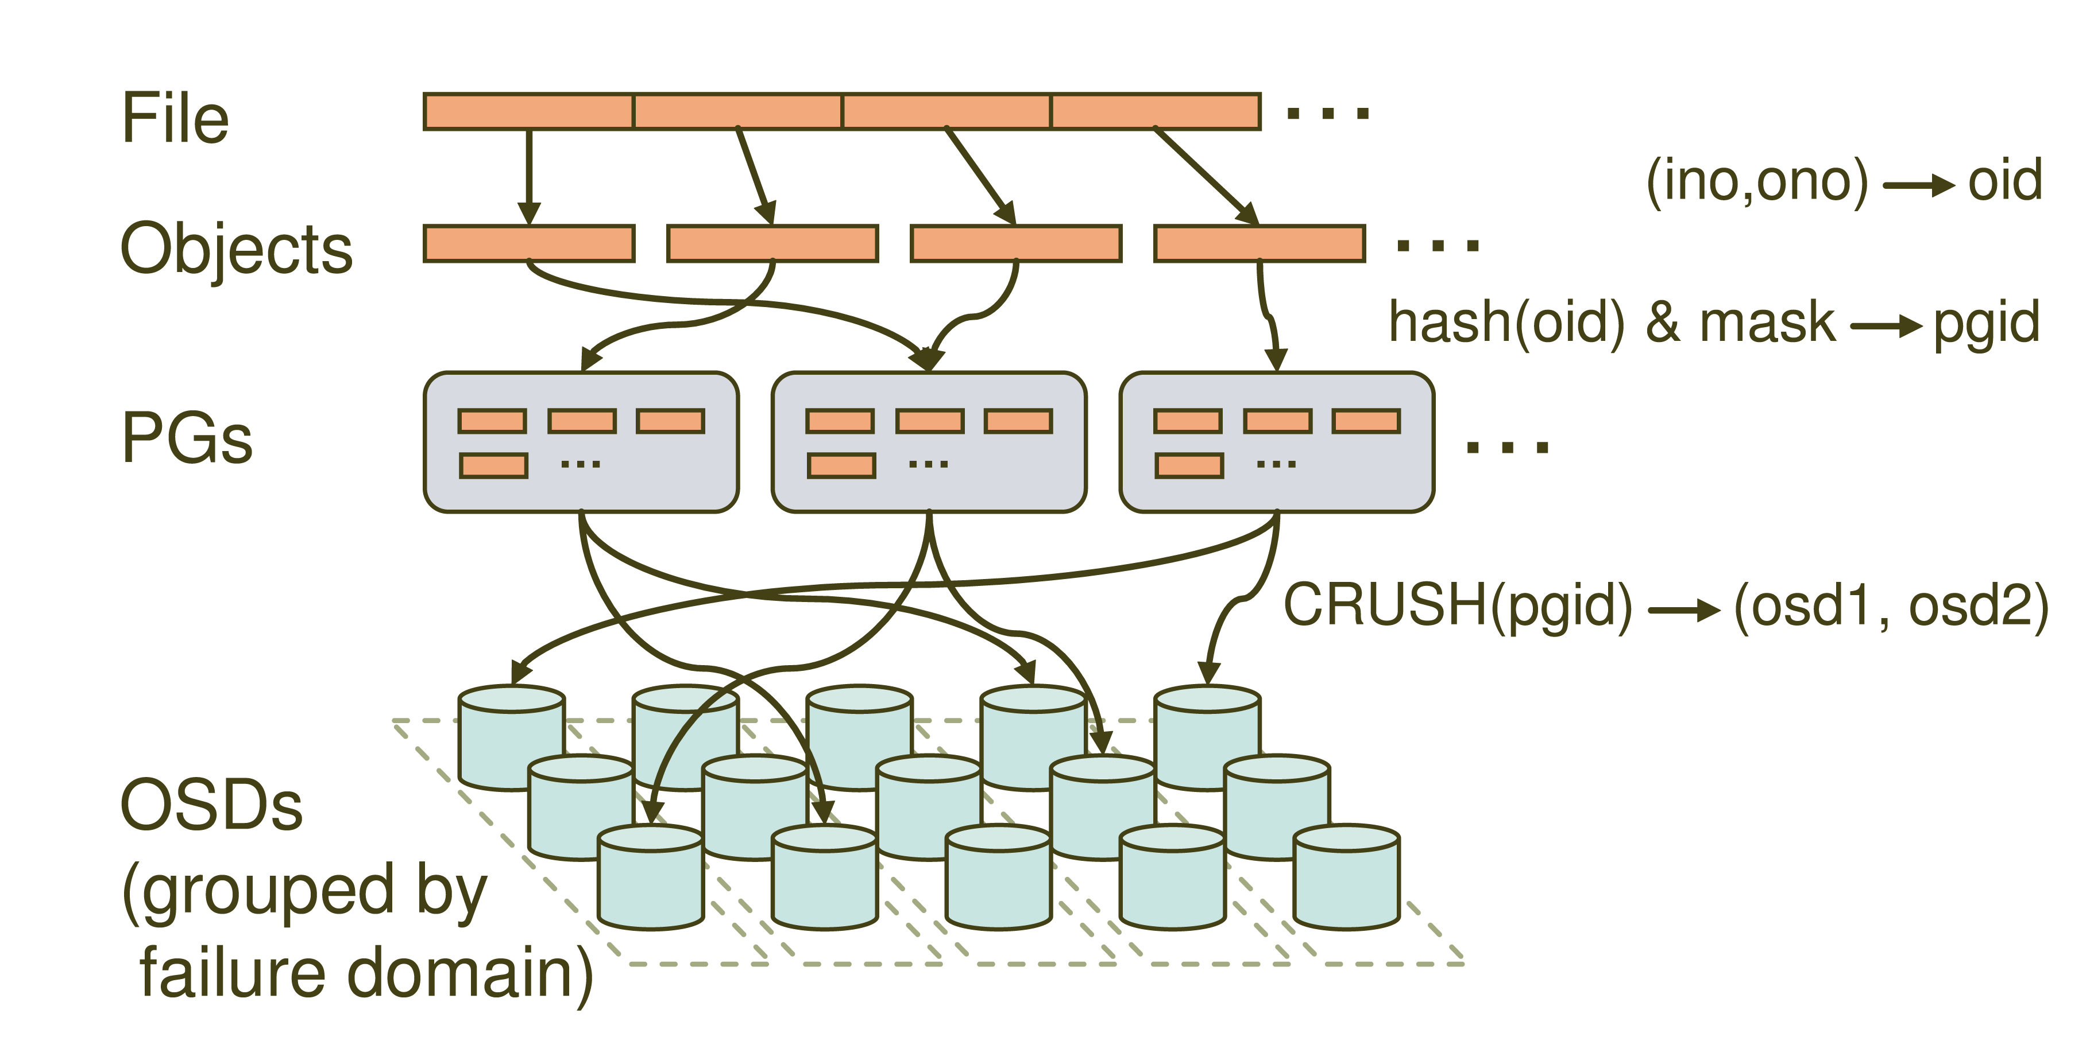
Distributed Object Storage

Slide 22
CRUSH
CRUSH(x): (osdn1, osdn2, osdn3)
Inputs
x is the placement group
Hierarchical cluster map
Placement rules
Outputs a list of OSDs
Advantages
Anyone can calculate object location
Cluster map infrequently updated

Slide 23
Data distribution
(not a part of the original PowerPoint presentation)
Files are striped into many objects
(ino, ono) → an object id (oid)
Ceph maps objects into placement groups (PGs)
hash(oid) & mask → a placement group id (pgid)
CRUSH assigns placement groups to OSDs
CRUSH(pgid)→ a replication group, (osd1, osd2)

Slide 24
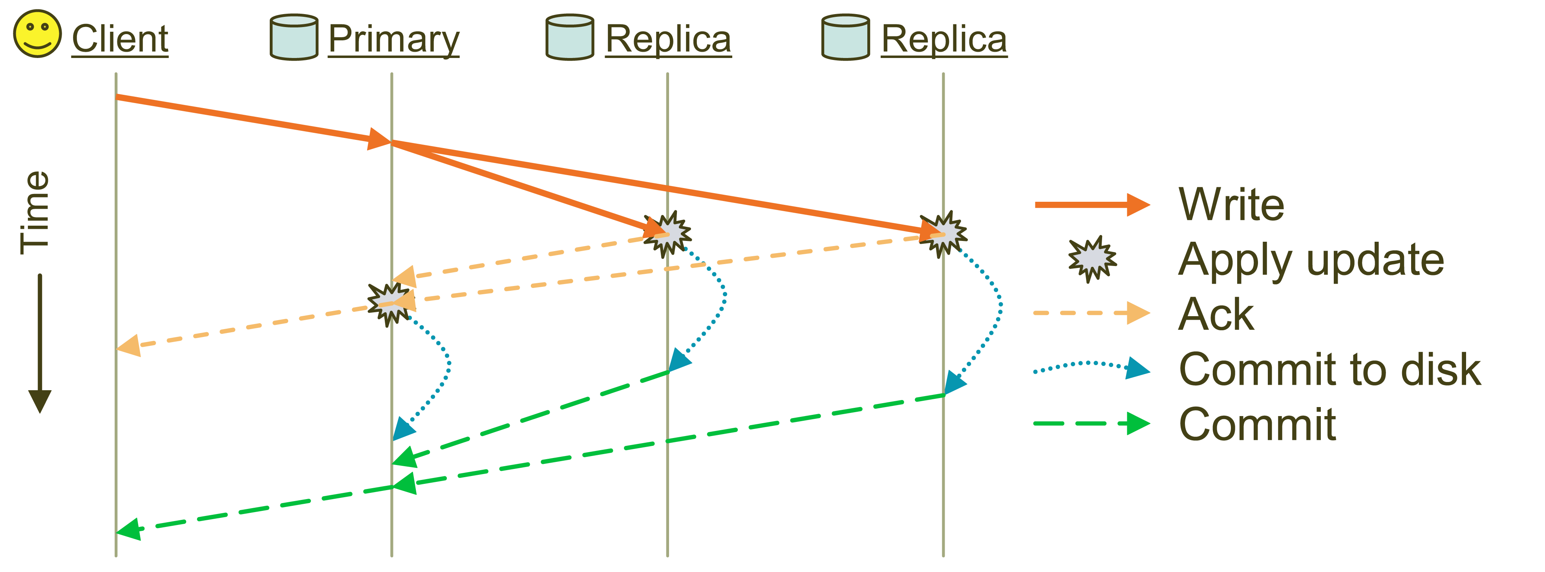
Replication
Objects are replicated on OSDs within same PG
Client is oblivious to replication

Slide 25
Failure Detection and Recovery
Down and Out
Monitors check for intermittent problems
New or recovered OSDs peer with other OSDs within PG

Slide 26
Acronyms Used in Performance Slides
CRUSH: Controlled Replication Under Scalable Hashing
EBOFS: Extent and B-tree based Object File System
HPC: High Performance Computing
MDS: MetaData server
OSD: Object Storage Device
PG: Placement Group
POSIX: Portable Operating System Interface for uniX
RADOS: Reliable Autonomic Distributed Object Store

Slide 27
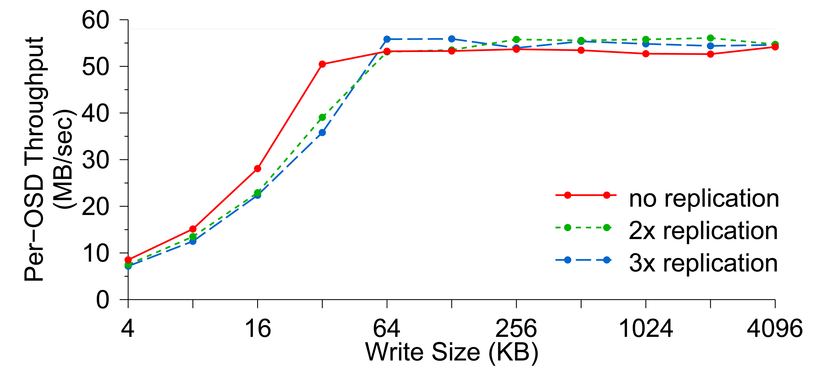
Per-OSD Write Performance

Slide 28
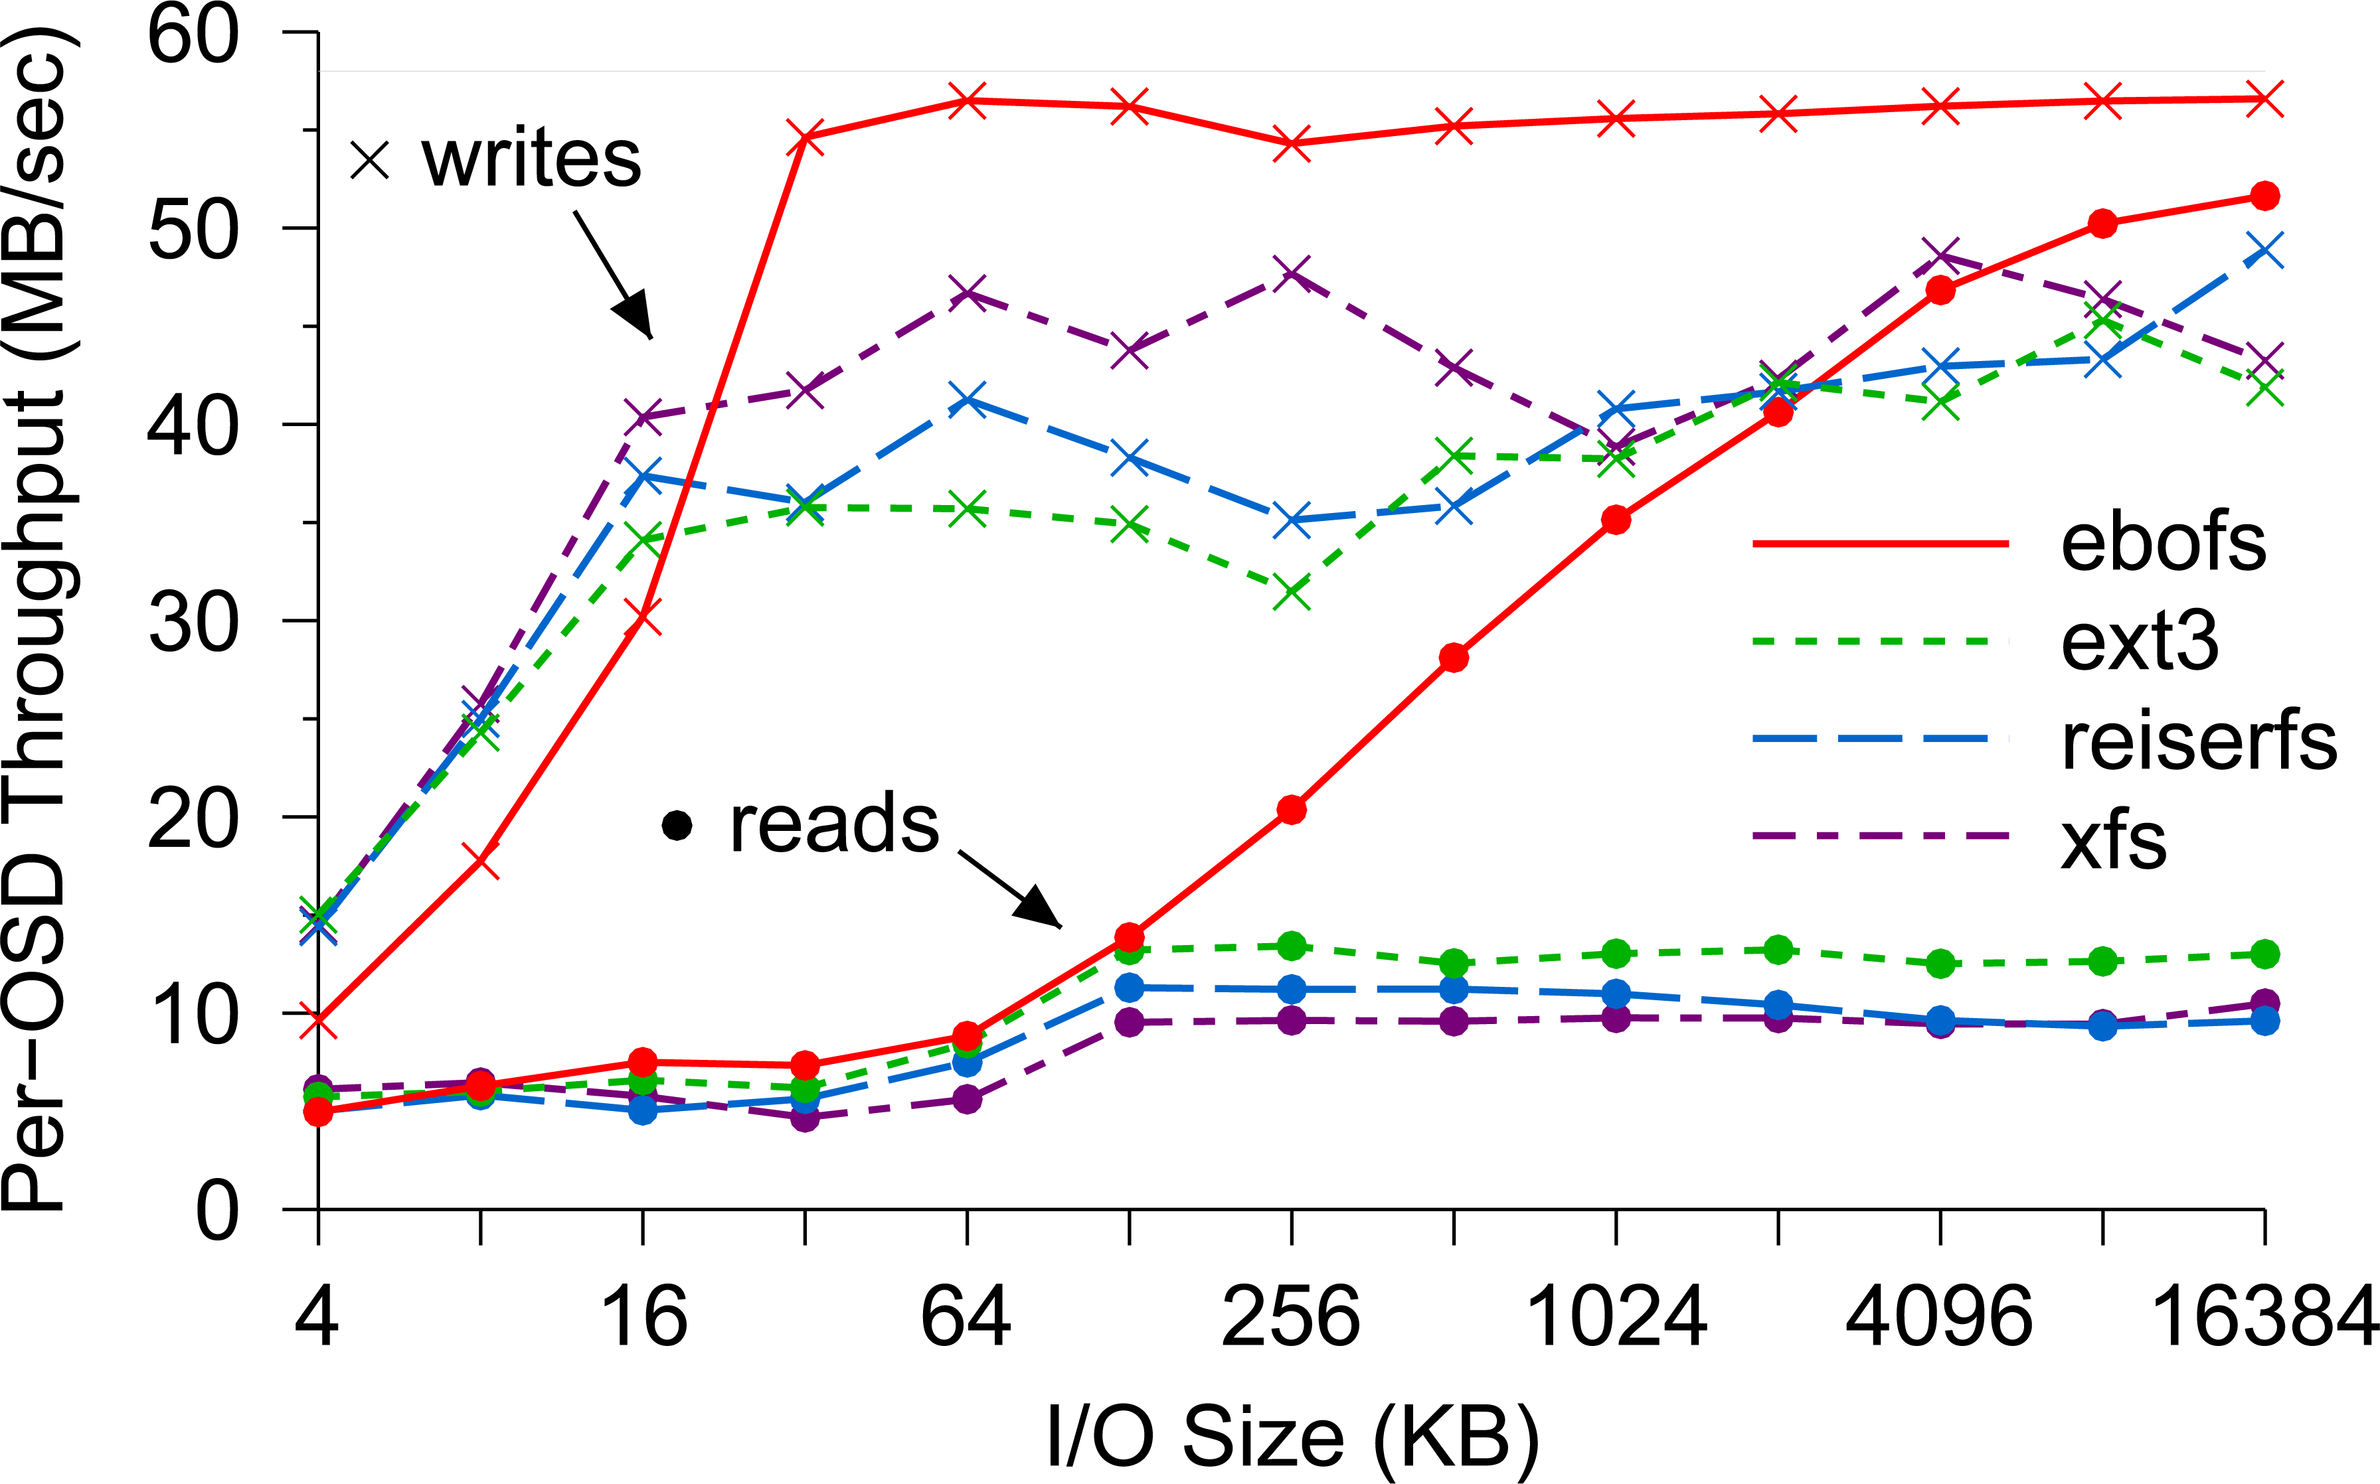
EBOFS Performance

Slide 29
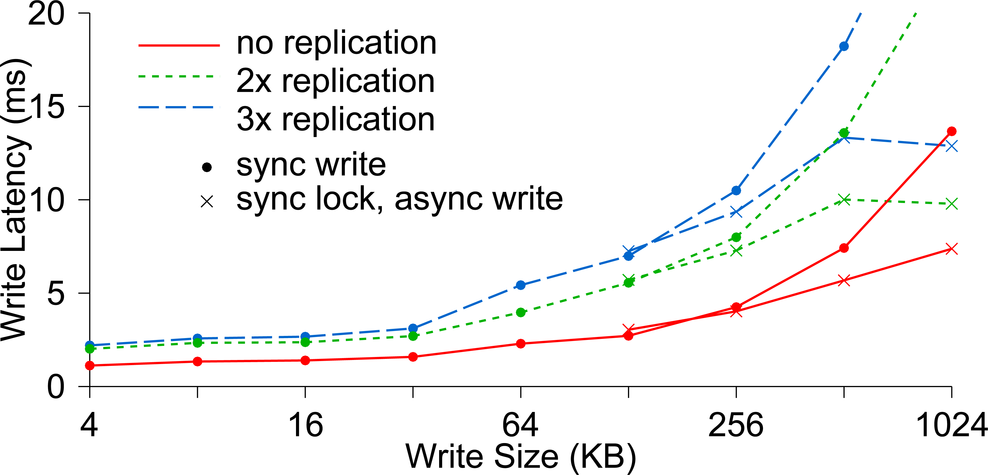
Write Latency

Slide 30
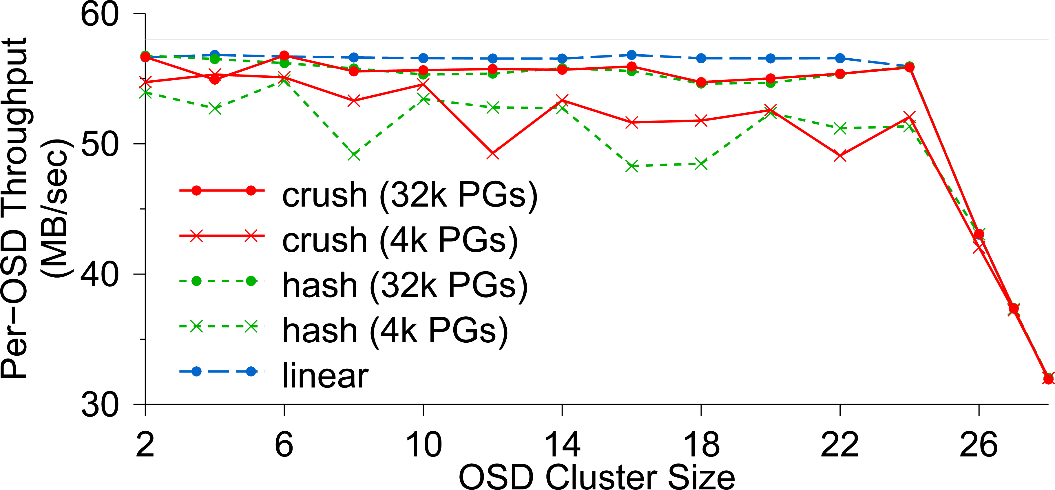
OSD Write Performance

Slide 31
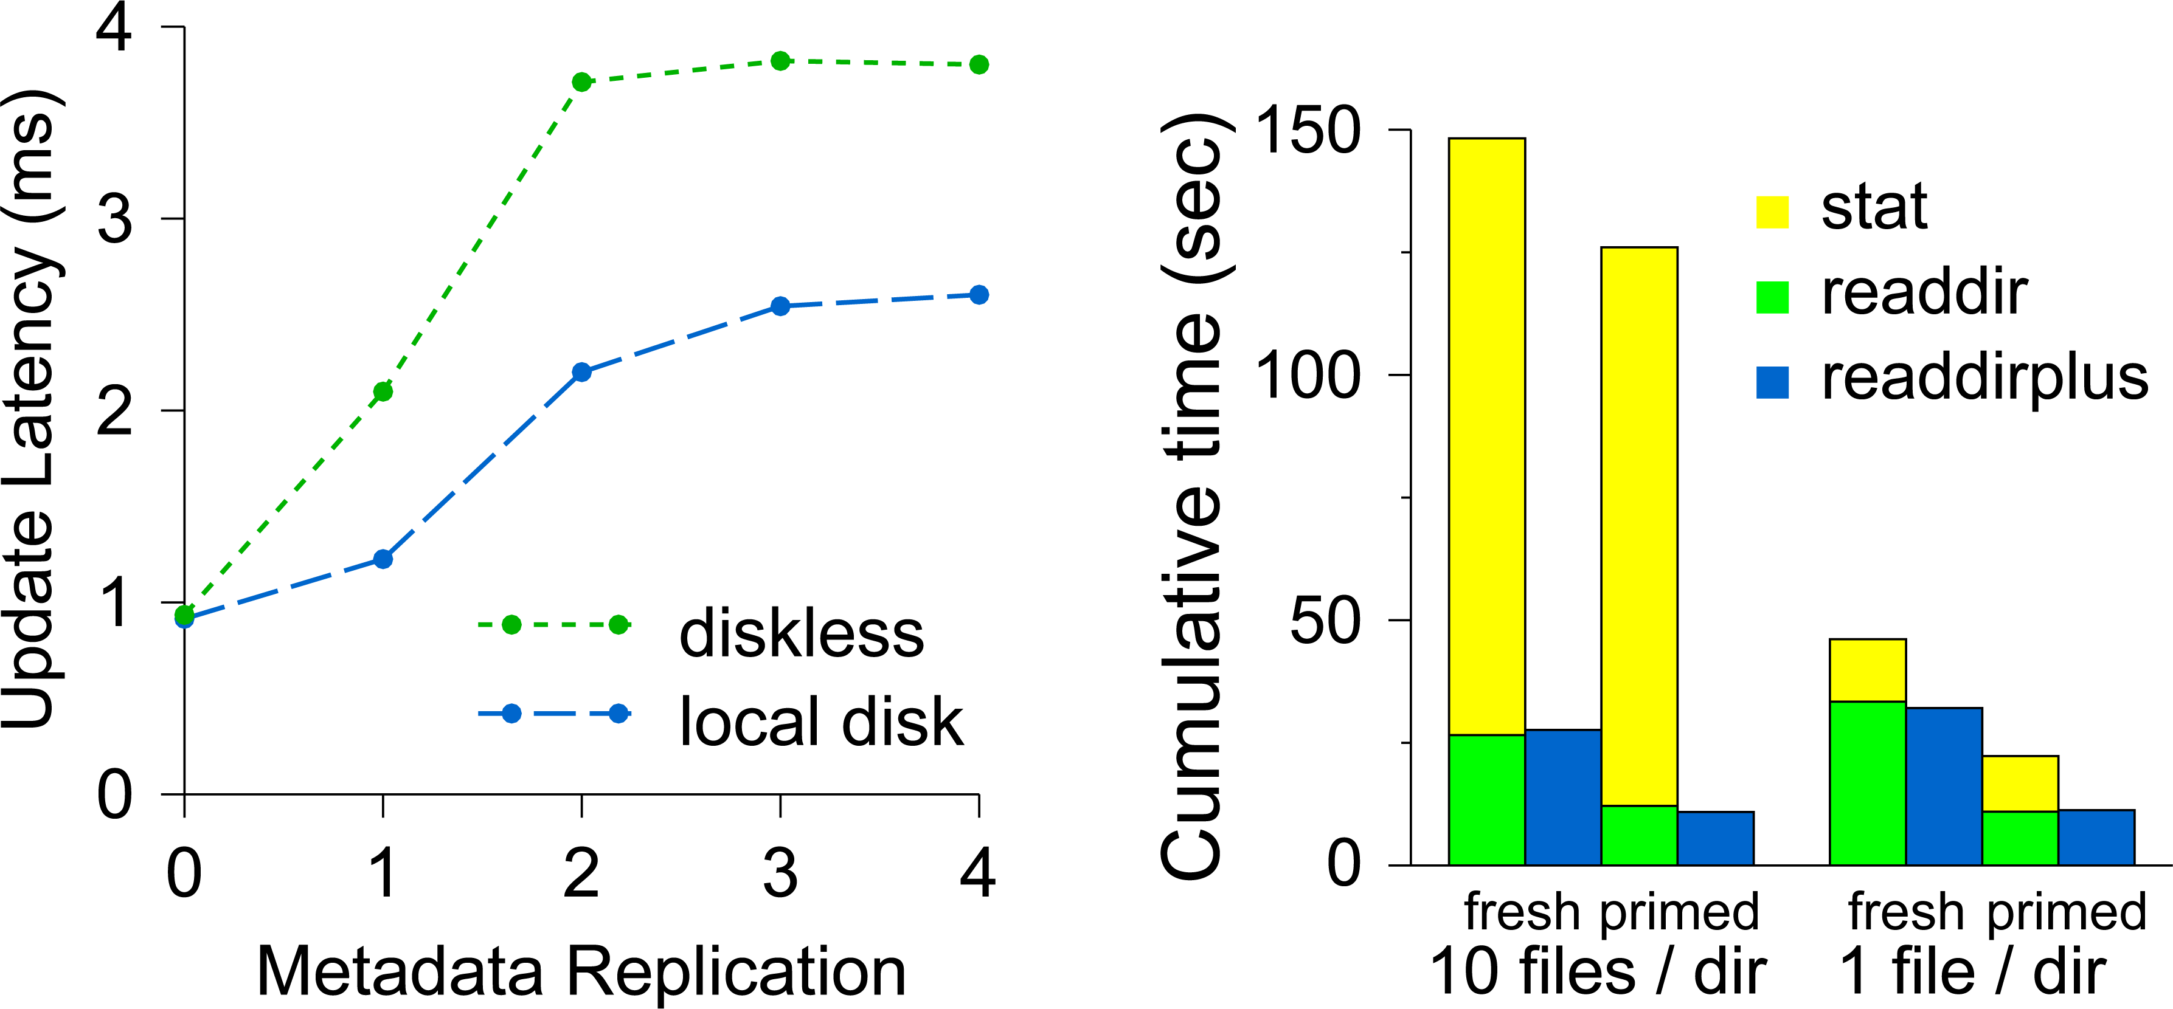
Diskless vs. Local Disk
Compare latencies of (a) a MDS where all metadata are
stored in a shared OSD cluster and (b) a MDS which has a
local disk containing its journaling

Slide 32
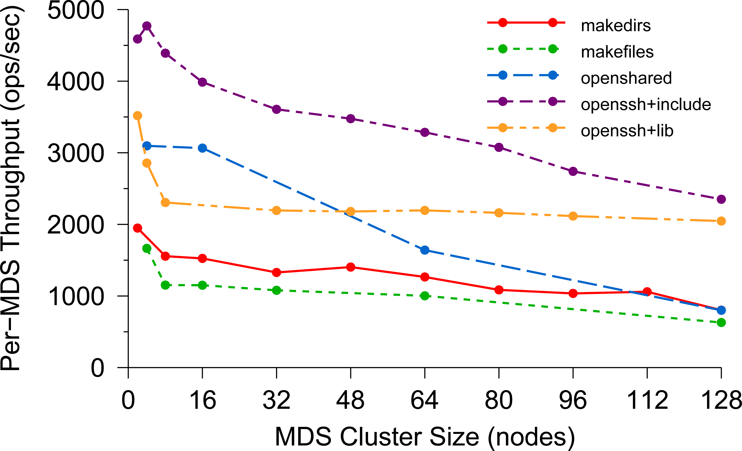
Per-MDS Throughput

Slide 33
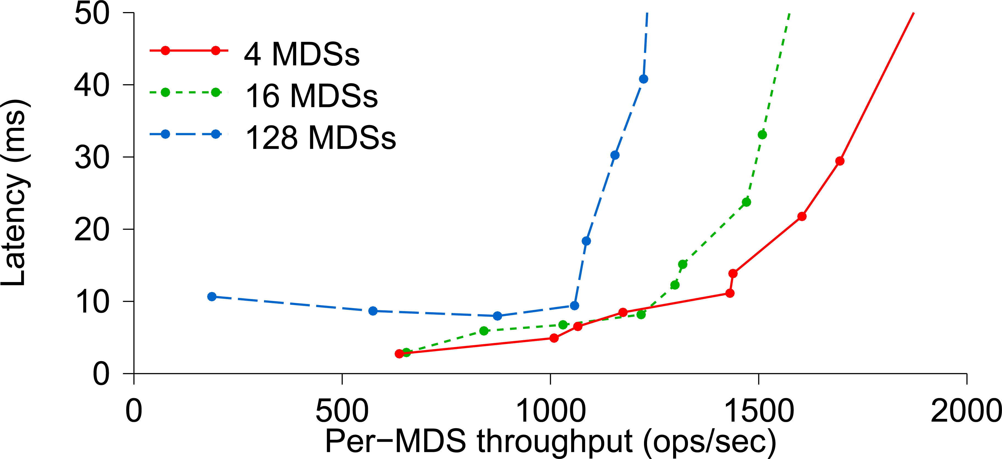
Average Latency

Slide 34
Lessons learned
(not a part of the original PowerPoint presentation)
Replacing file allocation metadata with a globally known distribution function was a good idea
Simplified our design
We were right not to use an existing kernel file system for local object storage
The MDS load balancer has an important impact on overall system scalability but deciding which mtadata to migrate where is a difficult task
Implementing the client interface was more difficult than expected
Idiosyncrasies of FUSE

Slide 35
Conclusion
Scalability, Reliability, Performance
Separation of data and metadata
CRUSH data distribution function
Object based storage (some call it “software defined storage” these days)

Slide 36
Ceph is widely Used!
What has the experience been? These next slides are from a high-performance computing workshop at CERN and will help us see how a really cutting-edge big-data use looks.
CERN is technically “aggressive” and very sophisticated. They invented the World Wide Web!

Slide 38
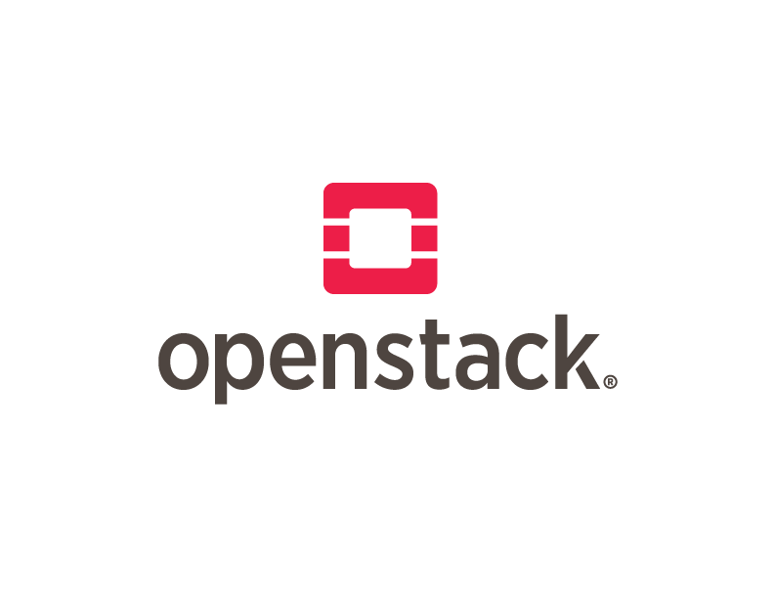
Manila on CephFS at CERN Our way to production
Arne Wiebalck
Dan van der Ster
OpenStack Summit
Boston, MA, U.S.
May 11, 2017

Slide 39
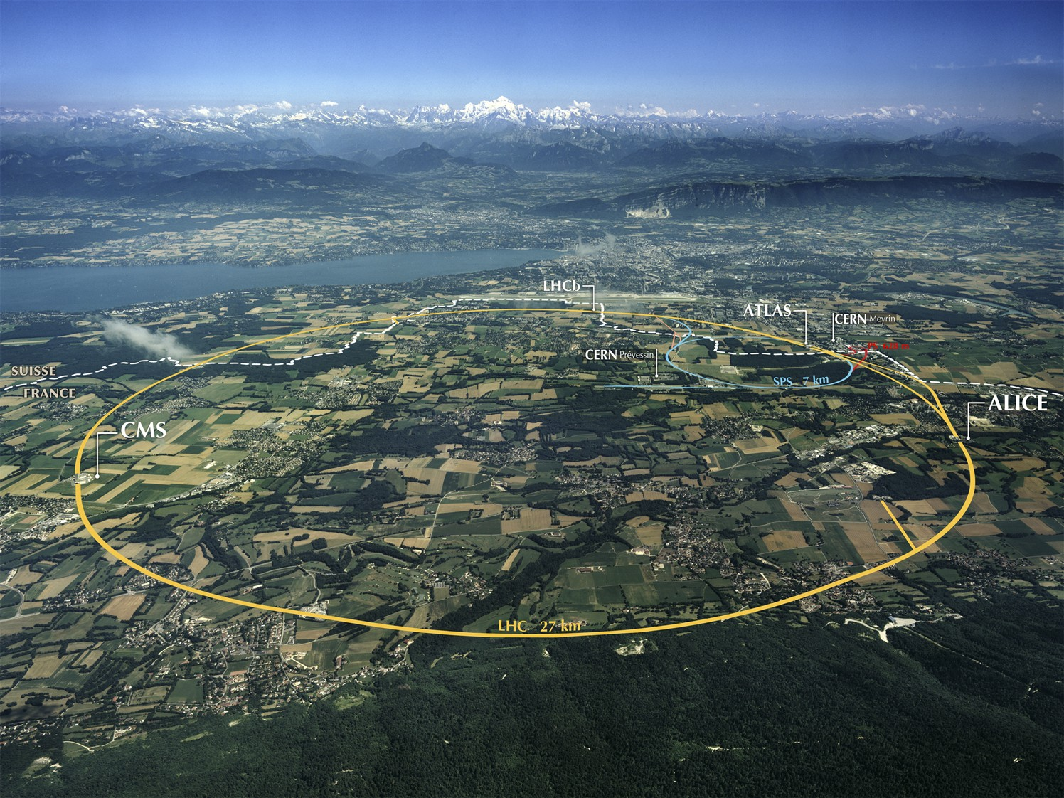
About CERN
European Organization for Nuclear Research (Conseil Européen pour la Recherche Nucléaire)
- Founded in 1954
- World’s largest particle physics laboratory
- Located at Franco-Swiss border near Geneva
- ~2’300 staff members >12’500 users
- Budget: ~1000 MCHF (2016)
Primary mission: Find answers to some of the fundamental questions about the universe!
http://home.cern
http://home.cern
Notes:
European Organization for Nuclear Research (Conseil Européen pour la Recherche Nucléaire)
Founded in 1954, today 22 member states
World’s largest particle physics laboratory
Located at Franco-Swiss border near Geneva
~2’300 staff members, >12’500 users
Budget: ~1000 MCHF (2016)
CERN’s mission
Answer fundamental questions of the universe
Advance the technology frontiers
Train the scientists and engineers of tomorrow
Bring nations together

Slide 40
The CERN Cloud at a Glance
Production service since July 2013
Several rolling upgrades since, now on Newton
Two data centers, 23ms distance
One region, one API entry point
Currently ~220’000 cores
7’000 hypervisors (+2’000 more soon)
~27k instances
50+ cells
Separate h/w, use case, power, location, …

Slide 41
Setting the Scene: Storage
TSM
CERNbox
AFS
CVMFS
NFS
RBD
S3
NFS Filer
HSM Data Archive
Developed at CERN
140PB – 25k tapes
Data Analysis
Developed at CERN
120PB – 44k HDDs
File share & sync
Owncloud/EOS
9’500 users
OpenStack backend
CephFS
Several PB-sized clusters
OpenZFS/RBD/OpenStack
Strong POSIX
Infrastructure Services

Slide 42
NFS Filer Service Overview
NFS appliances on top of OpenStack
Several VMs with Cinder volume and OpenZFS
ZFS replication to remote data center
Local SSD as accelerator (l2arc, ZIL)
POSIX and strong consistency
Puppet, GitLab, OpenShift, Twiki, …
LSF, Grid CE, Argus, …
BOINC, Microelectronics, CDS, …

Slide 43
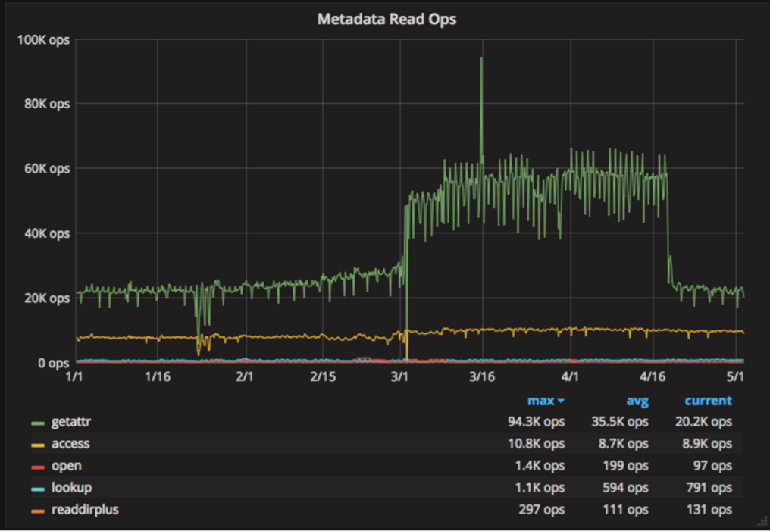
NFS Filer Service Limitations
Scalability
Metadata Operations (read)
Availability
SPoF per NFS volume
‘shared block device’
Emerging use cases
HPC, see next slide

Slide 44
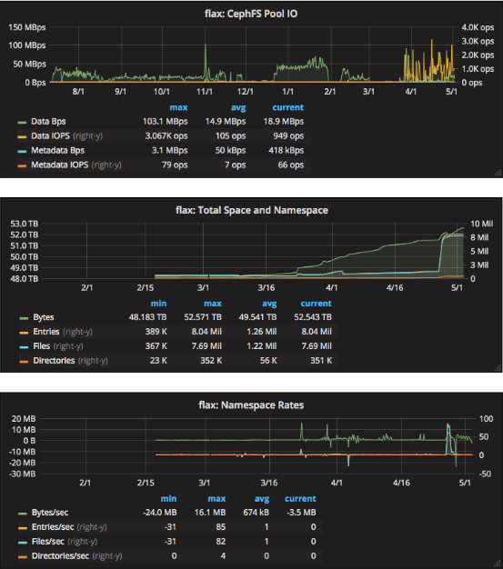
Use Cases: HPC
MPI Applications
Beam simulations, accelerator physics, plasma simulations, computation fluid dynamics, QCD …
Different from HTC model
On dedicated low-latency clusters
Fast access to shared storage
Very long running jobs
Dedicated CephFS cluster in 2016
3-node cluster, 150TB usable
RADOS: quite low activity
52TB used, 8M files, 350k dirs
<100 file creations/sec
Can we converge on CephFS ?
(and if yes, how do we make it available to users?)

Slide 45
Part I: The CephFS Backend

Slide 46
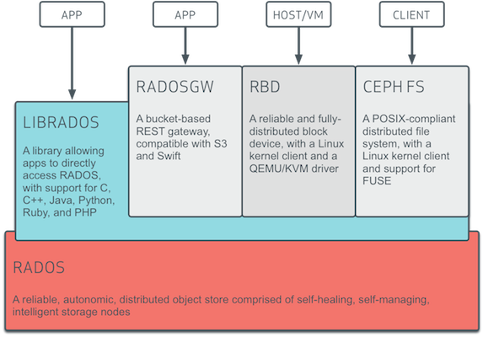
CephFS Overview
POSIX-compliant shared FS on top of RADOS
- Same foundation as RBD
Userland and kernel clients available - ‘ceph-fuse’ and ‘mount -t ceph’
- Features added to ceph-fuse first, then ML kernel
‘jewel’ release tagged production-ready - April 2016, main addition: fsck
- ‘Almost awesome’ before, focus on object and block

Slide 47
CephFS Meta-Data Server (MDS)
Crucial component to build a fast and scalable FS
Creates and manages inodes (persisted in RADOS, but cached in memory)
Tracking client inode ‘capabilities’ (which client is using which inodes)
Larger cache can speed up meta-data throughput
More RAM can avoid meta-data stalls when reading from RADOS
Single MDS can handle limited number of client reqs/sec
Faster network / CPU enables more reqs/sec, but multiple MDSs needed for scaling
MDS keeps nothing in disk, a flash-only RADOS pool may accelerate meta-data intensive workloads

Slide 48
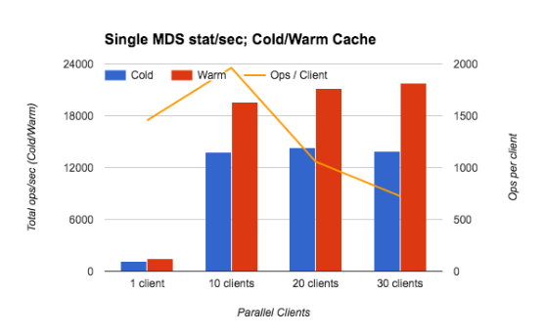
CephFS MDS Testing
Correctness and single-user performance
POSIX compliance: ok! (Tuxera POSIX Test Suite v20090130)
Two-client consistency delays: ok! (20-30ms with fsping)
Two-client parallel IO: reproducible slowdown
Mimic Puppet master
‘stat’ all files in prod env from mutliple clients
20k stats/sec limit
Meta-data scalability in multi-user scenarios
Multiple active MDS fail-over w/ 1000 clients: ok!
Meta-data load balancing heuristics: todo …

Slide 49
CephFS Issues Discovered
‘ceph-fuse’ crash in quota code, fixed in 10.2.5
http://tracker.ceph.com/issues/16066
Bug when creating deep directores, fixed in 10.2.6
http://tracker.ceph.com/issues/18008
Bug when creating deep directores, fixed in 10.2.6
http://tracker.ceph.com/issues/18008
Objectcacher ignores max objects limits when writing large files
http://tracker.ceph.com/issues/19343
Network outage can leave ‘ceph-fuse’ stuck
Difficult to reproduce, have server-side work-around, ‘luminous’ ?
Parallel IO to single file can be slower than expected
If CephFS detects several writers to the same file, it switches clients to unbuffered IO
Desired:
Quotas
- should be mandatory
for userland and kernel
QoS
- throttle/protect users

Slide 50
‘CephFS is awesome!’
POSIX compliance looks good
Months of testing: no ‘difficult’ problems
Quotas and QoS?
Single MDS meta-data limits are close to our Filer
We need multi-MDS!
ToDo: Backup, NFS Ganesha (legacy clients, Kerberos)
‘luminous’ testing has started ...

Slide 51
Part II: The OpenStack Integration

Slide 52
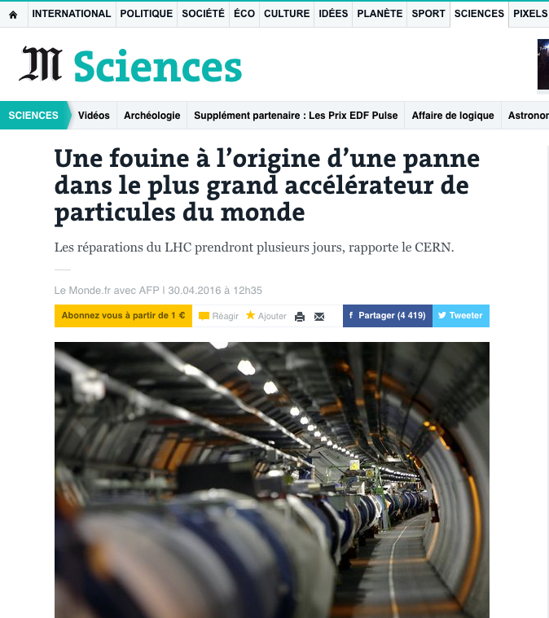
LHC Incident in April 2016

Slide 53
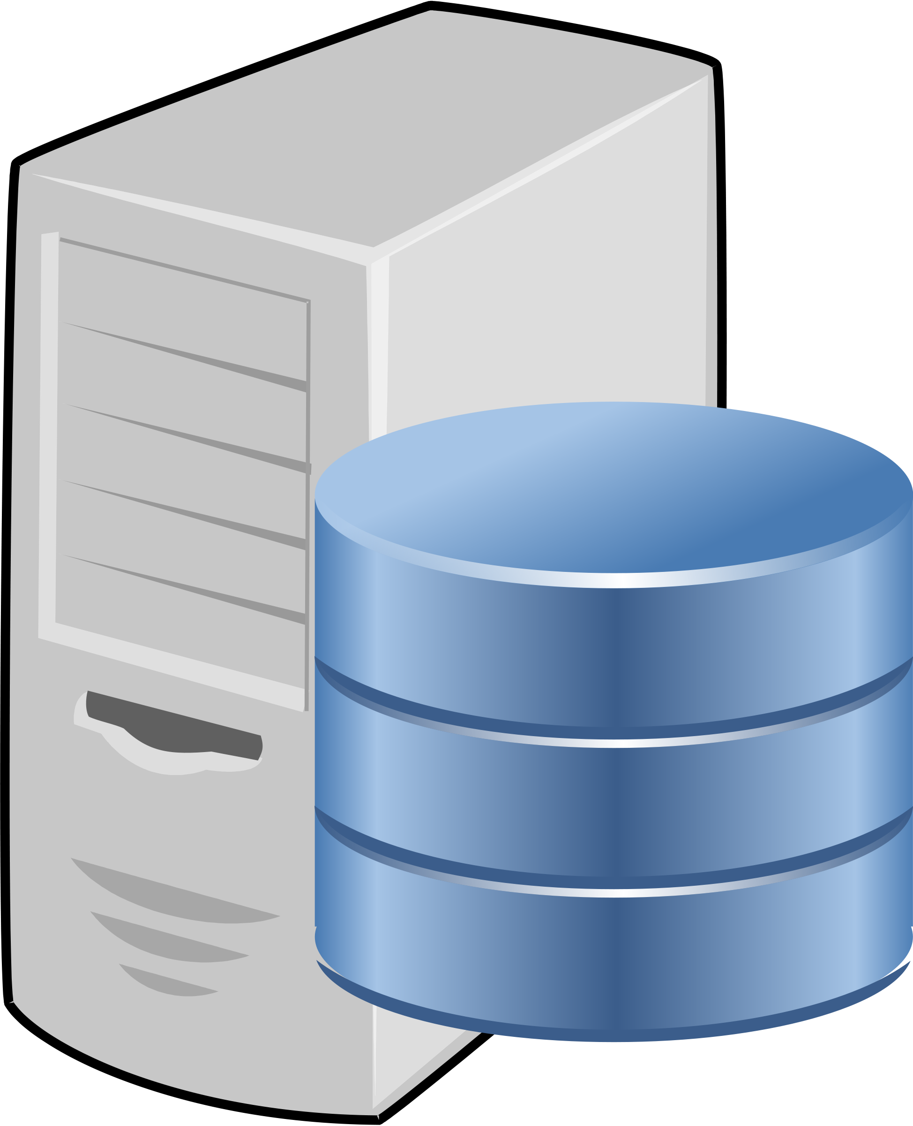
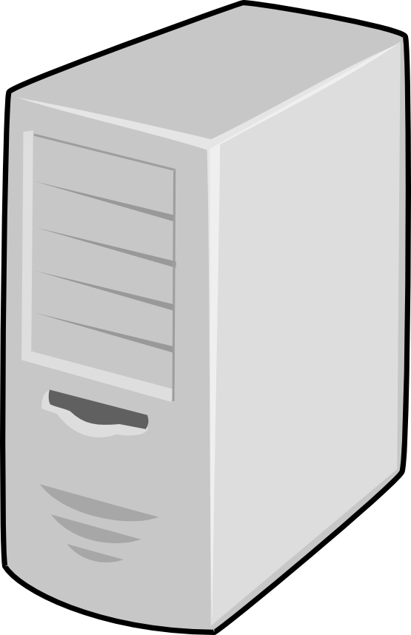
Manila: Overview
File Share Project in OpenStack
Provisioning of shared file systems to VMs
‘Cinder for file shares’
APIs for tenants to request shares
Fulfilled by backend drivers
Acessed from instances
Support for variety of NAS protocols
NFS, CIFS, MapR-FS, GlusterFS, CephFS, …
Supports the notion of share types
Map features to backends
1. Request share
Manila
3. Provide handle
User
instances
2. Create share
Backend
4. Access share

Slide 54
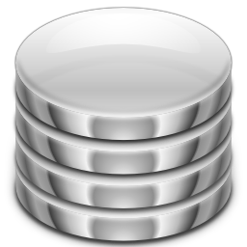
Manila: Components
manila-api:
Receives, authenticates and handles requests
manila-scheduler:
Routes requests to appropriate share service (by filters)
REST API
DB for storage of service data
manila-scheduler
manila-api
DB
Message queue for
inter-component communication
Message Queue (e.g. RabbitMQ)
manila-share:
Manages backends
manila-share
manila-share
manila-share
Driver
Driver
Driver
(Not shown: manila-data: copy, migration, backup)

Slide 55
Manila: Our Initial Setup
Three controllers running m-{api, scheduler, share}
Separate Rabbit cluster
DB from external service
Existing CephFS backend
Set up and ‘working’ in <1h !
m-api
m-api
m-api
DB
m-sched
m-sched
m-sched
m-share
m-share
m-share
RabbitMQ
Driver
Driver
Driver
Our Cinder setup has been changed as well …

Slide 56
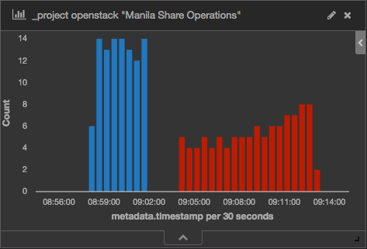
Sequential Share Creation/Deletion: ok!
Create: ~2sec
Delete: ~5sec
“manila list” creates two auth calls
First one for discovery
Cinder/Nova do only one … ?

Slide 57
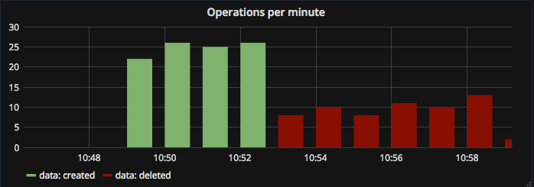
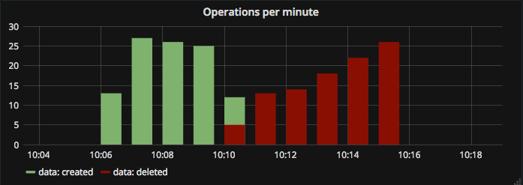
Bulk Deletion of Shares: ok!
Sequentially
manila delete share-01
manila delete share-02
manila delete share-03
…
In parallel
manila delete share-01 share-02 …
Done with 100 shares in parallel
This is what users (and Magnum/Heat/K8s) do … (... and this breaks our Cinder! Bug 1685818).
After successful 24h tests of constant creations/deletions …

Slide 58
Manila testing: #fouinehammer
m-api
m-api
m-api
DB
m-sched
m-share
RabbitMQ
Driver
1 … 500 nodes
1 ... 10k PODs

Slide 59
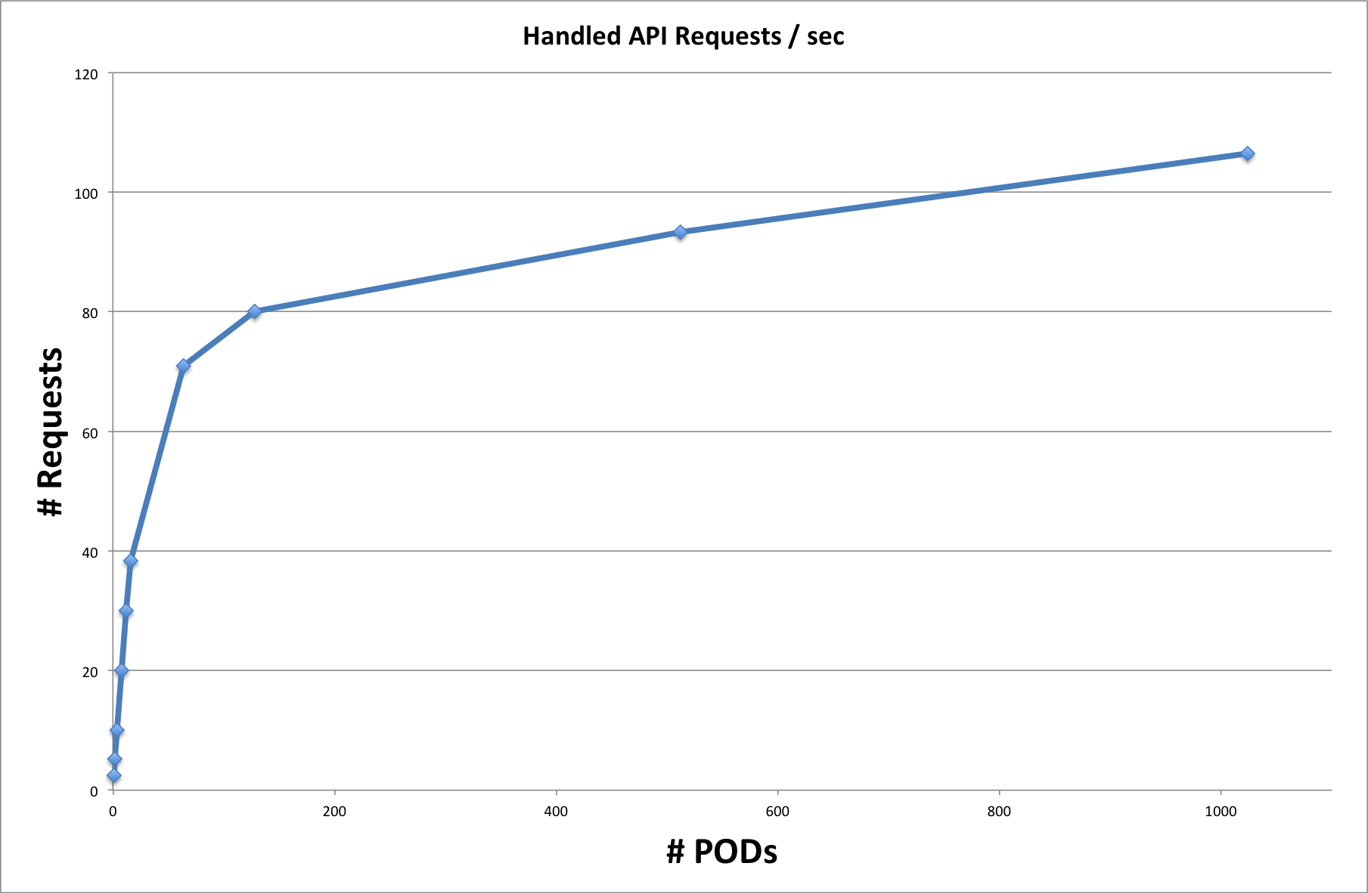
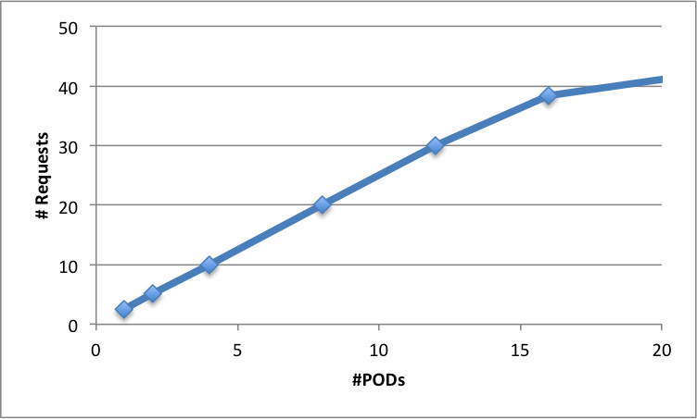
Image registry DDOS
DB connection limits
Connection pool limits
This way →
Stressing
the API (1)
PODs running ‘manila list’
in a loop
~linear until API processes exhausted … ok!
k8s DNS
restarts

Slide 60
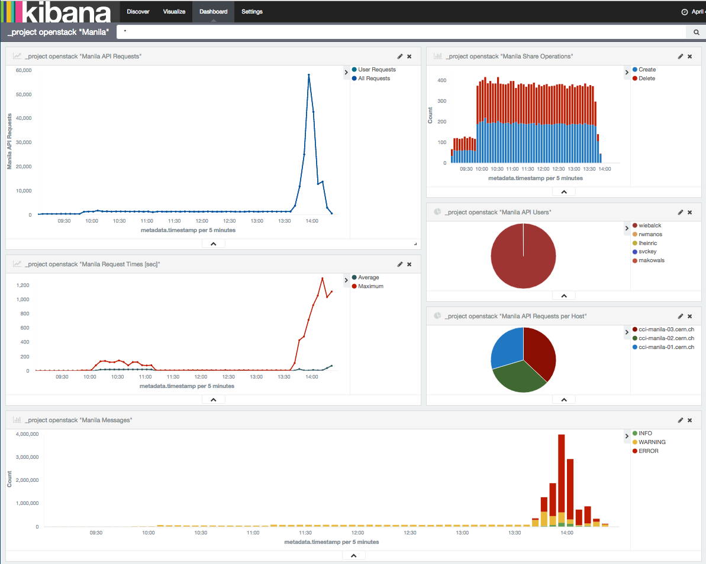
Stressing
the API (2)
PODs running ‘manila create’
‘manila delete’
in a loop
~works until DB limits are reached …
ok!
1 pod
10
100
10
1000
Request time [sec]
Log messages
DB connection
pool exhausted

Slide 61
Components ‘fouined’ on the way
Right away: Image registry (when scaling the k8s cluster)
500 nodes downloading the image …
Increased RAM on image registry nodes
Used 100 nodes
~350 pods: Kubernetes DNS (~350 PODs)
Constantly restarted: Name or service not known
Scaled it out to 10 nodes
~1’000 pods: Central monitoring on Elastic Search
Too many logs messages
~4’000 pods: Allowed DB connections (and the connection pool)
Backtrace in Manila API logs

Slide 62
Manila: Our (Pre-)Prod Setup
Three virtual controllers
4-core, 8GB
Newton
Puppet
3-node RabbitMQ cluster
V3.6.5
Three share types
Test/Prod: Ceph ‘jewel’
Dev: Ceph ‘luminous’
DB
m-api
m-api
m-api
m-sched
m-share
RabbitMQ
RabbitMQ
RabbitMQ
Driver
prod
test
dev

Slide 63
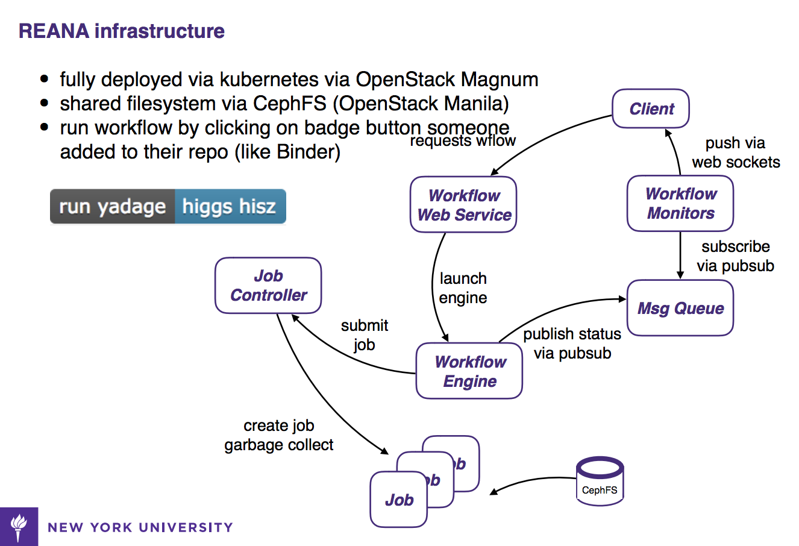
Early user: Containers in ATLAS
Analysis workflows modeled as directed acyclic graphs, built at run-time
Graph’s nodes are containers
Addresses the issue of workflow preservation
Store the parametrized container workload
Built using a k8s cluster
On top of Magnum
Using CephFS to store intermediate job stages
Share creation via Manila
Leverageing CephFS integration in k8s
Lukas Heinrich: Containers in ATLAS

Slide 64
‘Manila is also awesome!’
Setup is straightforward
No Manila issues during our testing
Functional as well as stress testing
Most features we found missing are in the plans
Per share type quotas, service HA
CephFS NFS driver
Some features need some more attention
OSC integration, CLI/UI feature parity, AuthID goes with last share
Welcoming, helpful team!

Slide 65
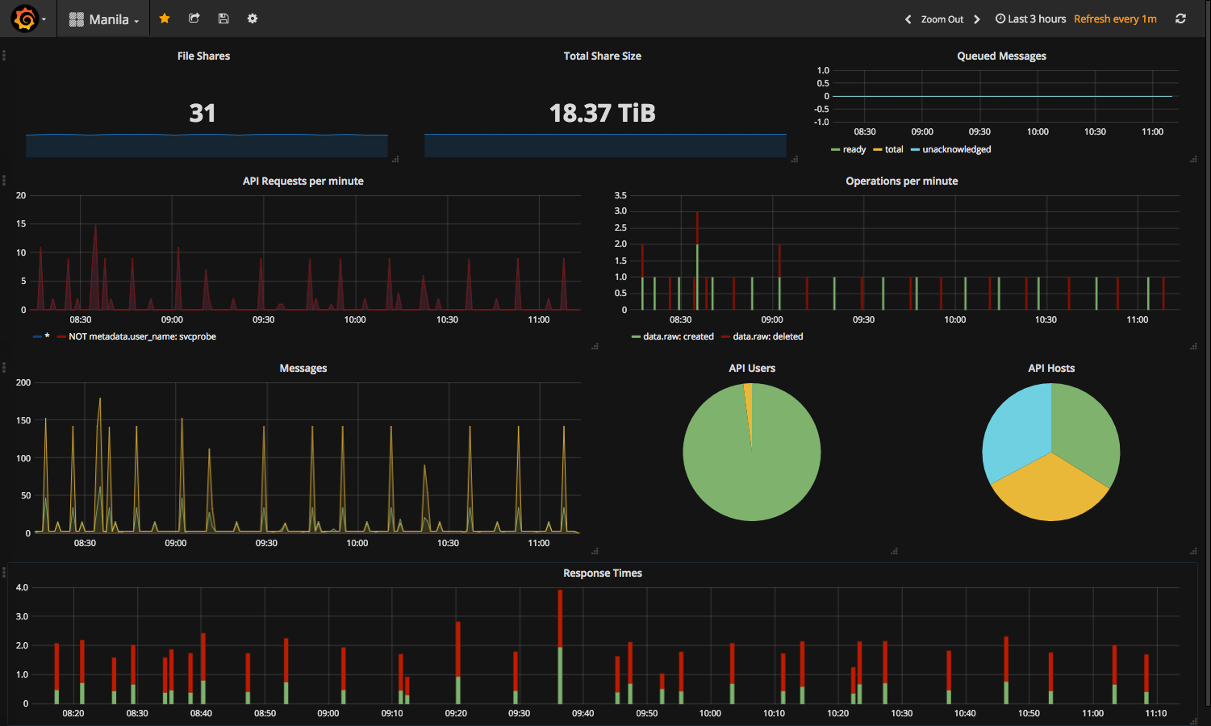
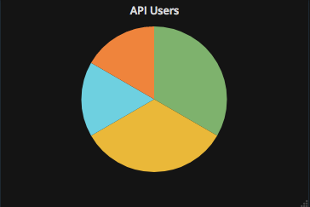
Q
U
E
S
T
I
O
N
S
?
Arne.Wiebalck@cern.ch
@ArneWiebalck

