Slide 1
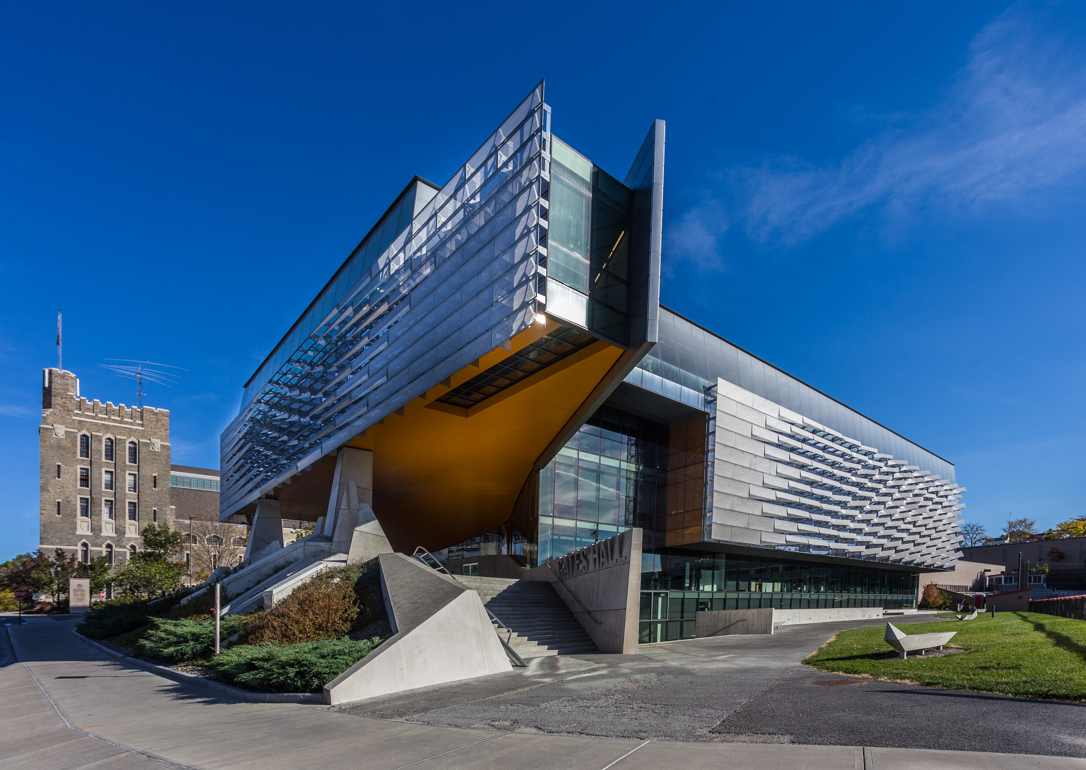

Question
Which of the following two images when subsampled naively is likely to produce aliasing artifacts?

Slide 2


Question
Which of the following two images when subsampled naively is likely to produce aliasing artifacts?

Slide 3
Grouping

Slide 4
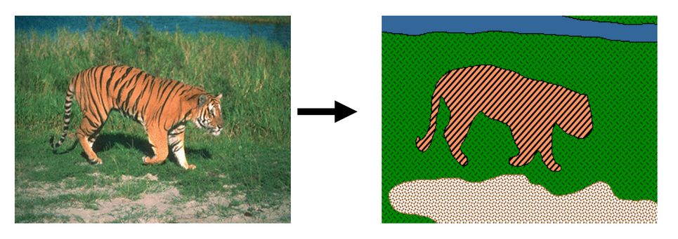
Grouping
Grouping pixels into objects (“perceptual organization”)

Slide 5
Why grouping?
Pixels property of sensor, not world
Reasoning at object level (might) make things easy:
  objects at consistent depth
  objects can be recognized
  objects move as one
"I stand at the window and see a house, trees, sky. Theoretically I might say there were 327 brightnesses and nuances of colour. Do I have "327"? No. I have sky, house, and trees."
Max Wertheimer

Slide 6
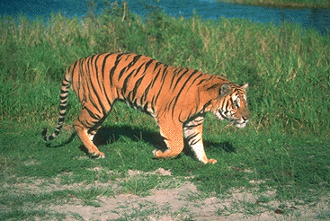
Regions Boundaries

Slide 7
Why edges?
Resilience to lighting and color
  useful for recognition, matching patches across images

Slide 8
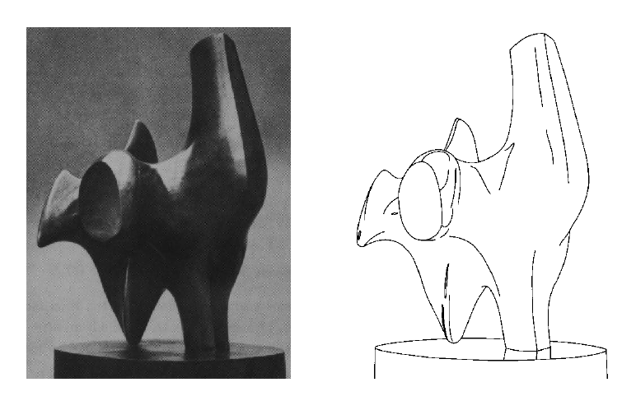
Why edges?
Humans are sensitive to edges
Convert a 2D image into a set of curves
  Extracts salient features of the scene, more compact
TexPoint fonts used in EMF.
Read the TexPoint manual before you delete this box.: AAA

Slide 9
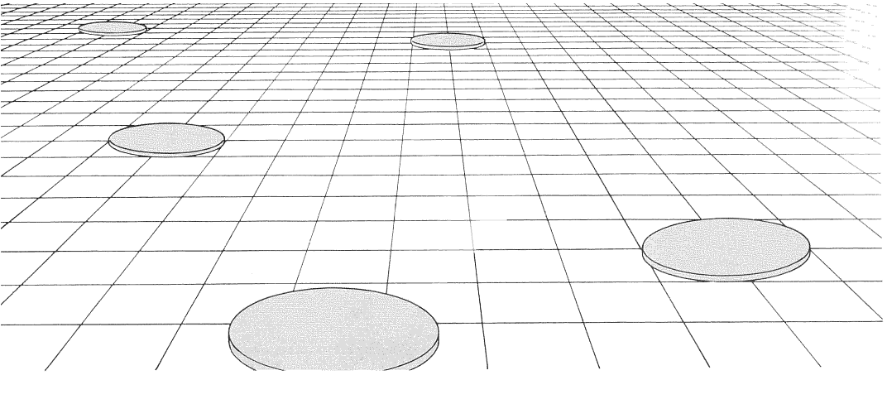
Why edges?
Cue to shape and geometry
  useful for recognition, understanding 3D structure
Credit: Jitendra Malik
Credit: Attneave

Slide 10
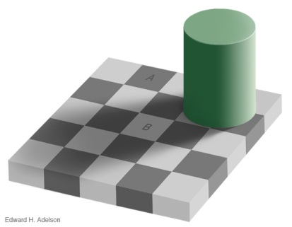
Edges
Edges are curves in the image, across which the brightness changes “a lot”
Corners/Junctions
Different kinds of edges:
  Depth discontinuities
  Normal discontinuities
  Discontinuities in “paint”
  Shadows
Notes:
Reflctance edges
Shadow edges
Depth edges
Normal edges

Slide 11
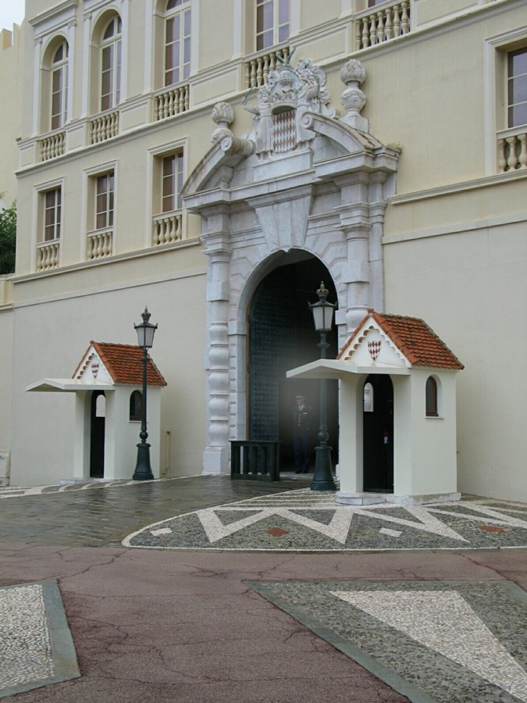
Closeup of edges
Source: D. Hoiem

Slide 12

Closeup of edges
Source: D. Hoiem

Slide 13

Closeup of edges
Source: D. Hoiem

Slide 14

Characterizing edges
An edge is a place of rapid change in the image intensity function
intensity function
(along horizontal scanline)
image
first derivative
edges correspond to
extrema of derivative
Source: L. Lazebnik
Notes:
a

Slide 15
Derivatives and convolution
Differentiation is linear
Differentiation is shift-equivariant
  Derivative of shifted signal is shifted derivative
Hence, differentiation can be represented as convolution!

Slide 16
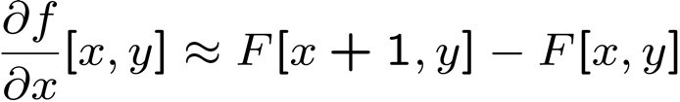




Image derivatives
How can we differentiate a discrete image F[x,y]?
  Option 1: reconstruct a continuous image, f, then compute the derivative
  Option 2: take discrete derivative (finite difference)
How would you implement this as a linear filter?
1 | -1
 | -1
 | 1
:
:
Source: S. Seitz
Notes:
give definition of partial derivative: lim h->0 [f(x+h,y) – f(x,y)]/h

Slide 17
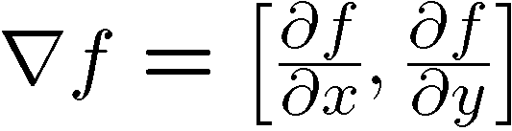
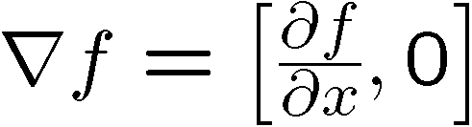
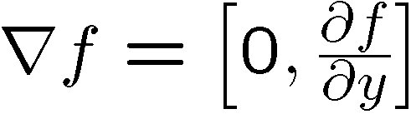
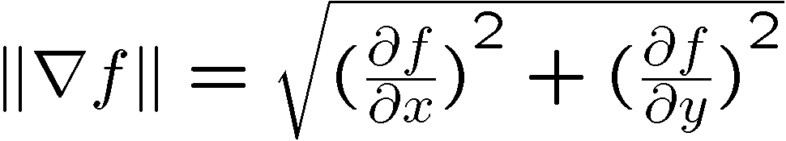
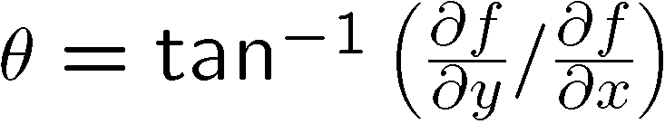
Image gradient
The gradient of an image:
The gradient points in the direction of most rapid increase in intensity
The edge strength is given by the gradient magnitude:
The gradient direction is given by:
  how does this relate to the direction of the edge?
Source: Steve Seitz
Notes:
give definition of partial derivative: lim h->0 [f(x+h,y) – f(x,y)]/h
Gradient direction perpendicular to edge direction

Slide 18
Image gradient
Gradient magnitude
Gradient in x
Gradient in y
Source: L. Lazebnik
Notes:
Top right: gradient magnitude
x, y

Slide 19

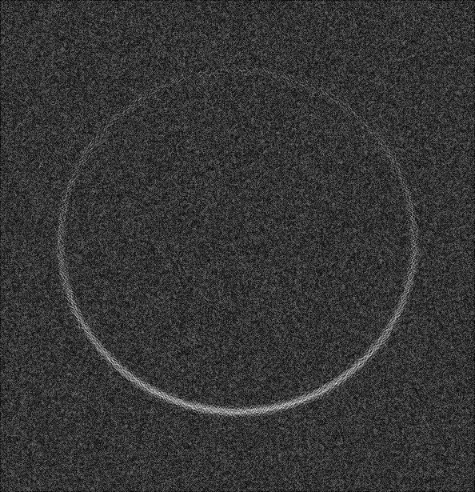
Effects of noise
Input
Gradient magnitude

Slide 20

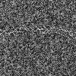
Effects of noise
Input
Gradient magnitude

Slide 21


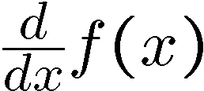
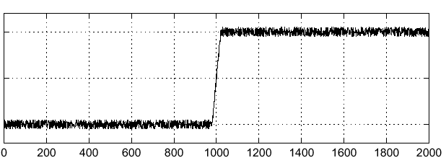
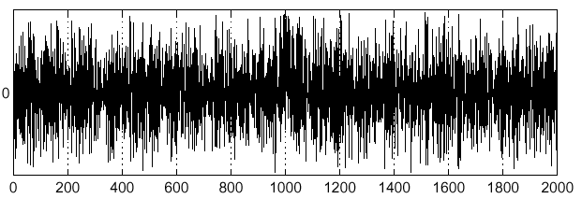
Effects of noise
Noisy input image
Where is the edge?
Source: S. Seitz
Notes:
How to fix?

Slide 22
Effects of noise
Noise is high frequency
Differentiation accentuates noise

Slide 23
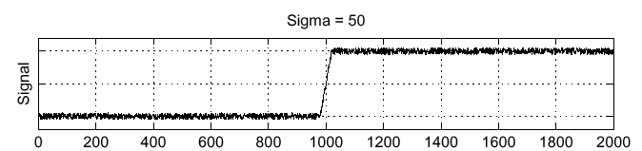
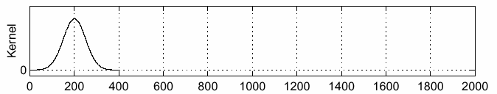
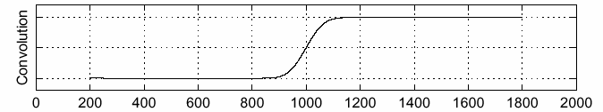
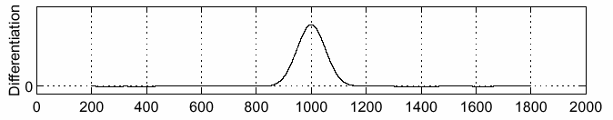
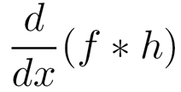
Solution: smooth first
f
h
f * h
To find edges, look for peaks in
Source: S. Seitz

Slide 24
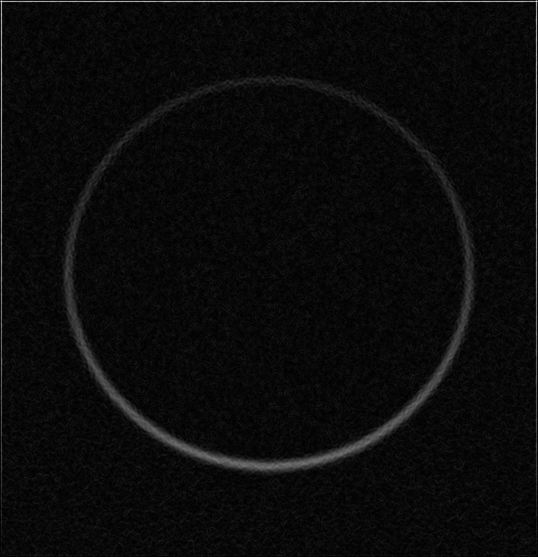
Solution: smooth first
Input
Gradient magnitude

Slide 25
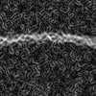
Solution: smooth first
Input
Gradient magnitude

Slide 26
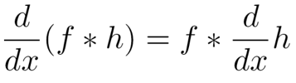
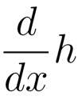
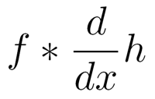
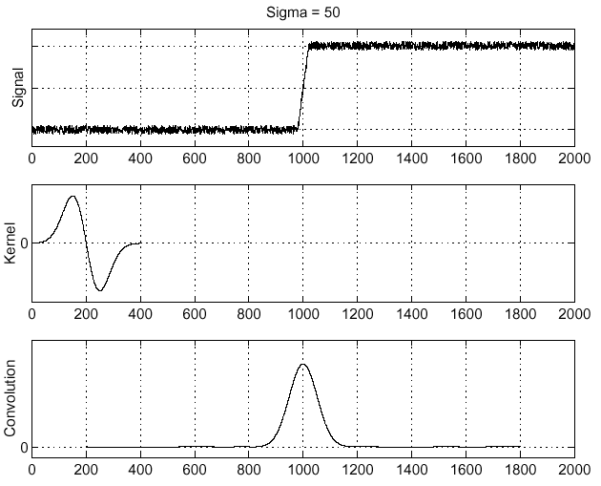
Associative property of convolution
Differentiation is a convolution
Convolution is associative:
This saves us one operation:
f
Source: S. Seitz

Slide 27
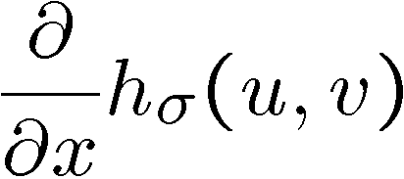
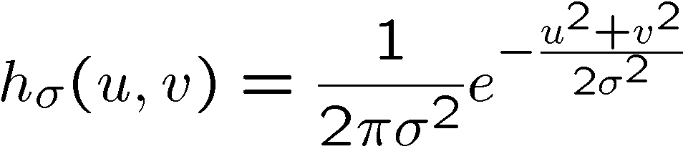
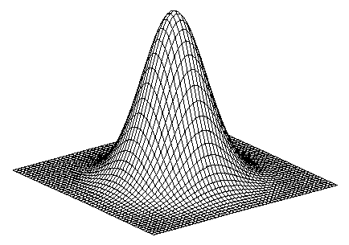
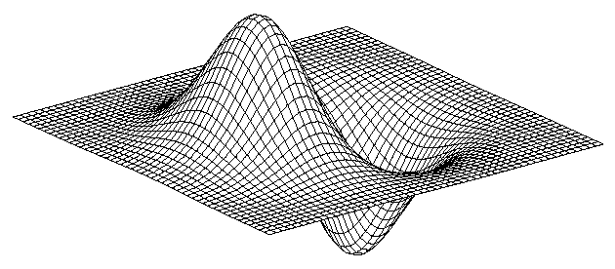
2D edge detection filters
derivative of Gaussian (x)
Gaussian
Notes:
How many 2nd derivative filters are there? There are four 2nd partial derivative filters.
In practice, it’s handy to define a single 2nd derivative filter—the Laplacian

Slide 28
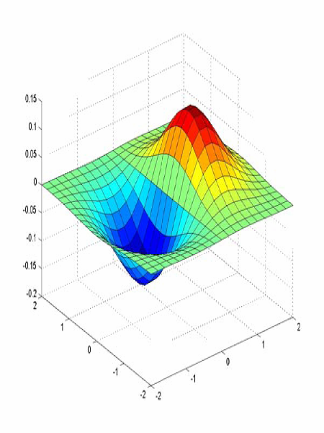
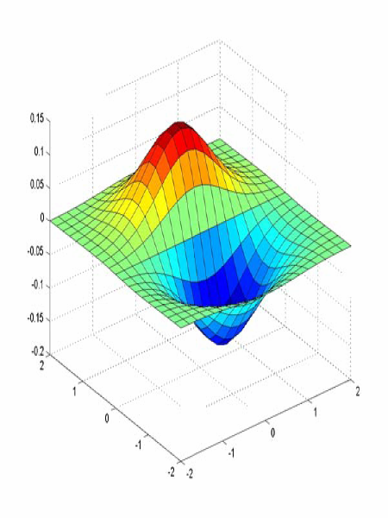
Derivative of Gaussian filter
x-direction
y-direction

Slide 29
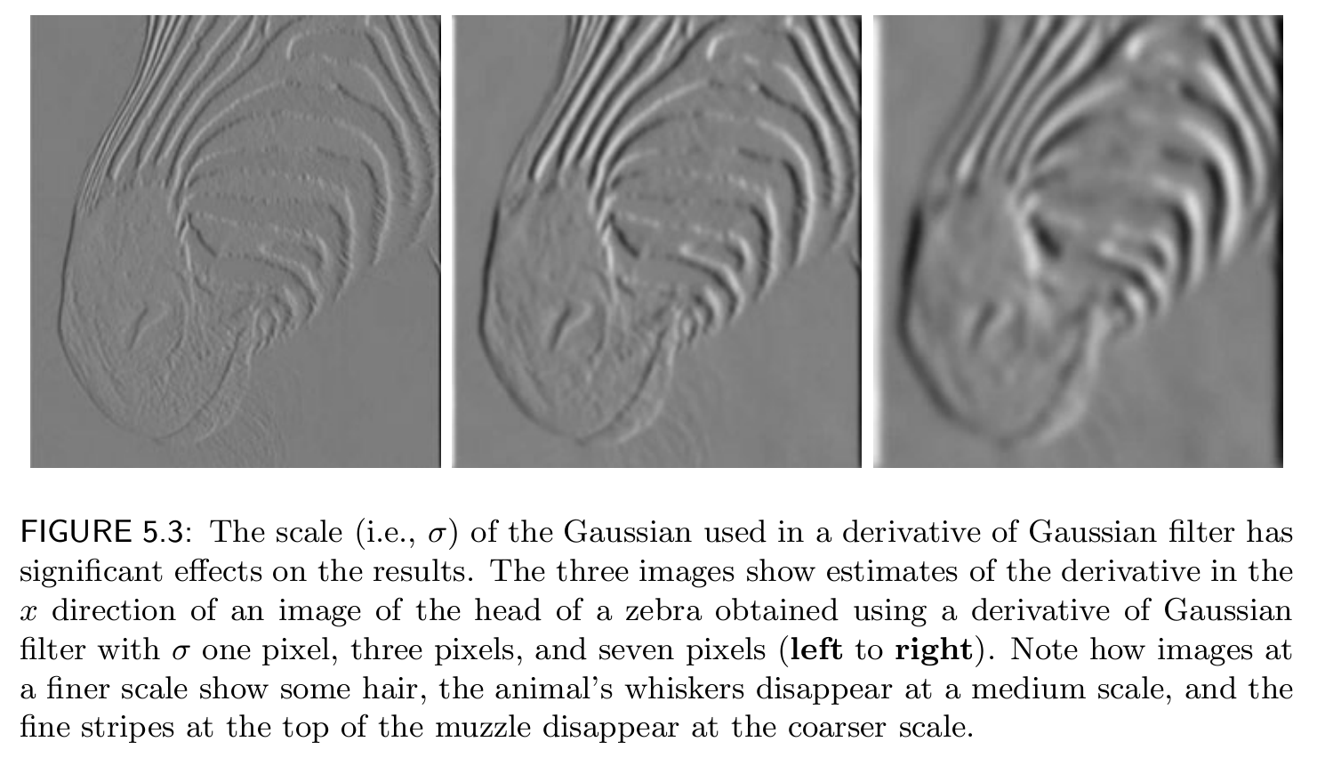

Slide 30
Derivative of Gaussian filter
x-direction
y-direction

Slide 31
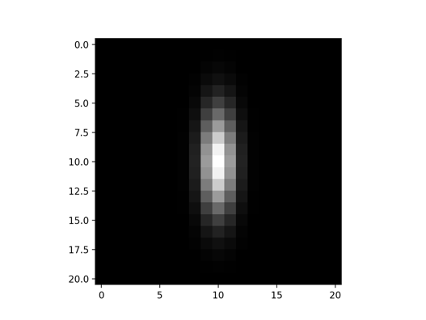
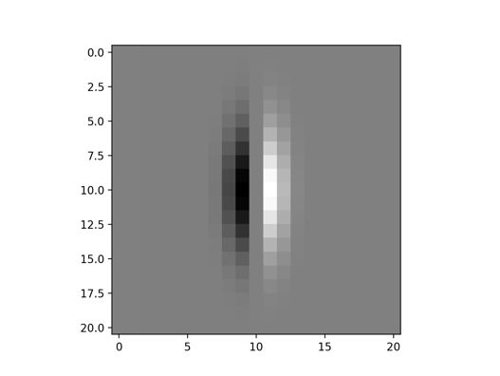
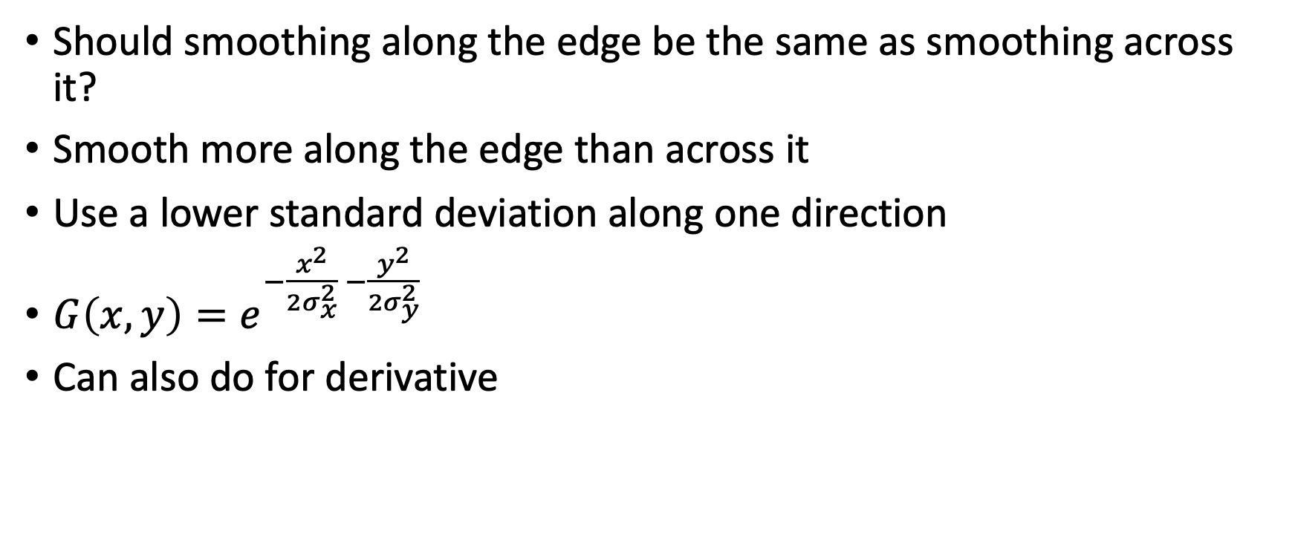
Anisotropic Gaussian
Should smoothing along the edge be the same as smoothing across it?
Smooth more along the edge than across it
Use a lower standard deviation along one direction
$G\left(x,y\right)=e^{−\frac{x^{2}}{{2σ}_{x}^{2}} −\frac{y^{2}}{{2σ}_{y}^{2}}}$
Can also do for derivative

Slide 32
The Sobel filter
A variant of the Anisotropic Gaussian
Smooth only along the edge
X derivative filter:

Slide 33

Oriented Gaussian Derivatives
Instead of just derivative along x and y, can also rotate filter to get derivatives along different directions

Slide 34
Which way does the gradient point?
A
B
D
C

Slide 35
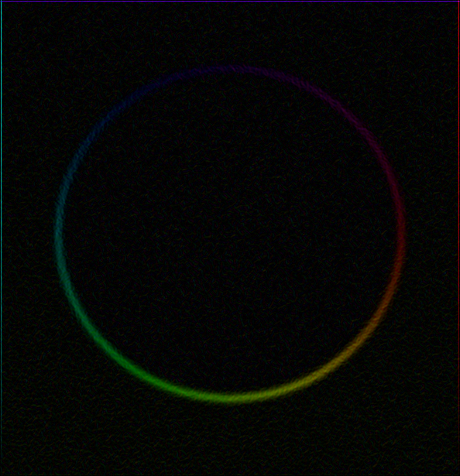
Gradient magnitude and orientation
Input
Gradient Magnitude
Gradient Orientation

Slide 36
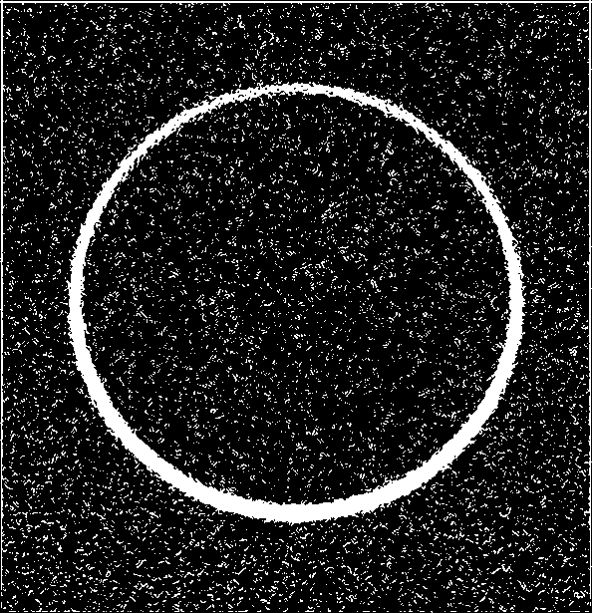


From gradients to boundaries?
Can we threshold the gradient magnitude to get object boundaries?
Three different thresholds:
Gaps
False positives
Thick boundaries

Slide 37
Thick boundaries
Want to find peaks in the gradient magnitude
As one moves across edge, gradient magnitude rises and then falls
Find the peak
intensity function
(along horizontal scanline)
image
first derivative
edges correspond to
extrema of derivative
Source: L. Lazebnik

Slide 38
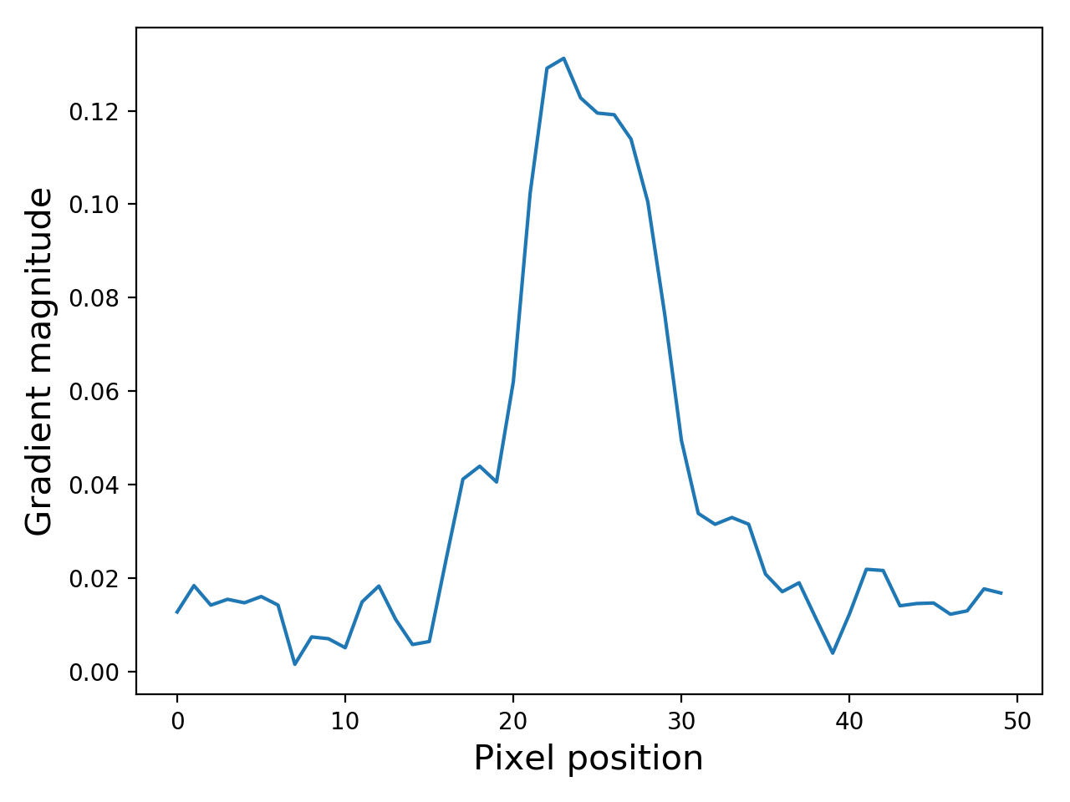
Thick boundaries
Want to find peaks in the gradient magnitude
As one moves across edge, gradient magnitude rises and then falls
Find the peak

Slide 39

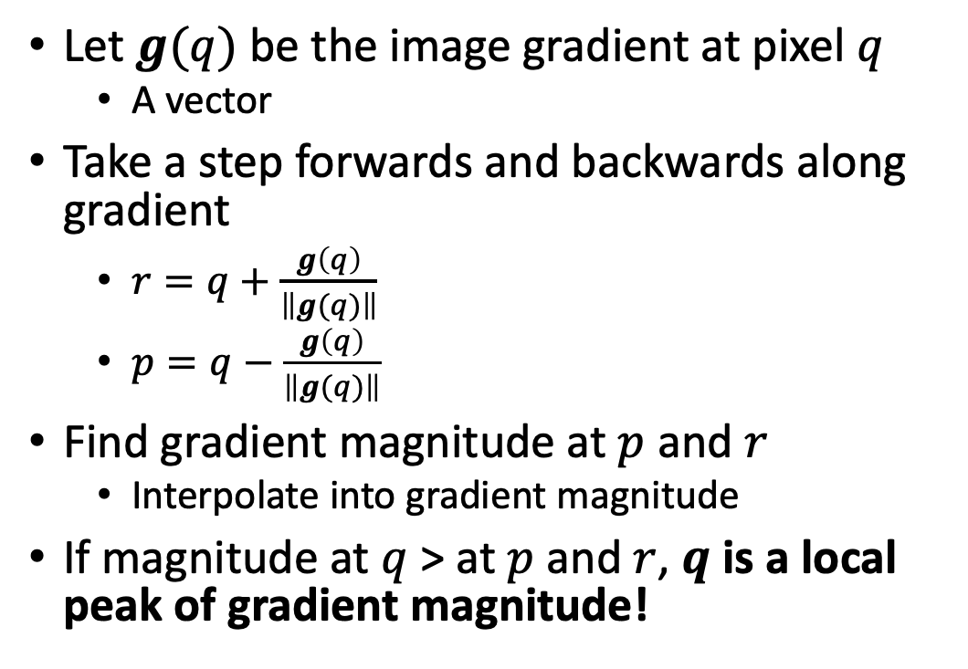
Non-maximum suppression for each orientation
Let $g(q)$ be the image gradient at pixel $q$
  A vector
Take a step forwards and backwards along gradient
  $r=q+\frac{g\left(q\right)}{\left\|g(q)\right\|}$
  $p=q−\frac{g\left(q\right)}{\left\|g(q)\right\|}$
Find gradient magnitude at $p$ and $r$
  Interpolate into gradient magnitude
If magnitude at $q$ > at $p$ and $r$, $q$ is a local peak of gradient magnitude!
Source: D. Forsyth

Slide 40
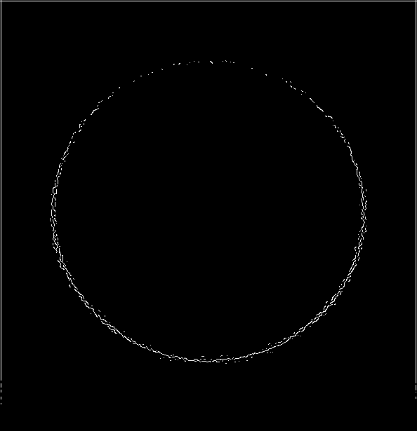
Non-maximum suppression
Before
After

Slide 41
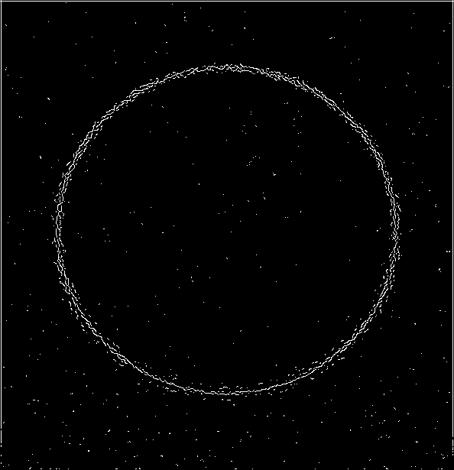
Non-maximum suppression
Before
After

Slide 42
Non-max suppression with various thresholds
High threshold
Low threshold

Slide 43
Hysteresis thresholding
Start with a high threshold
Then grow high threshold edges by looking for neighbors that clear a lower threshold
White: Clears high threshold
Gray: clears low threshold but not high threshold

Slide 44
Hysteresis thresholding
Start with a high threshold
Then grow high threshold edges by looking for neighbors that clear a lower threshold
Mark pixels that clear high threshold as boundary

Slide 45
Hysteresis thresholding
Start with a high threshold
Then grow high threshold edges by looking for neighbors that clear a lower threshold
Mark pixels that clear high threshold as boundary
If there are pixels that clear low threshold and are connected to a boundary, mark them as boundary too

Slide 46
Hysteresis thresholding
Start with a high threshold
Then grow high threshold edges by looking for neighbors that clear a lower threshold
Mark pixels that clear high threshold as boundary
If there are pixels that clear low threshold and are connected to a boundary, mark them as boundary too

Slide 47
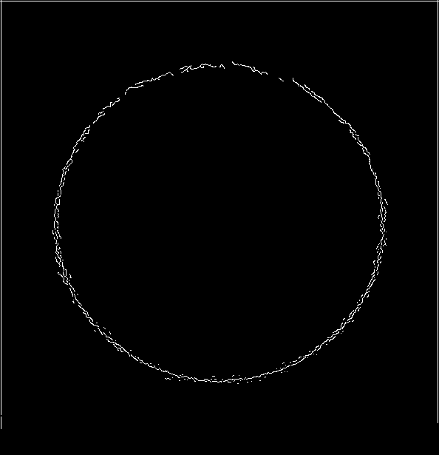
Hysteresis thresholding
High threshold
Low threshold
Hysteresis threshold

Slide 48
Canny edge detector
Filter image with x, y derivatives of Gaussian
Find magnitude and orientation of gradient
Non-maximum suppression:
  Thin multi-pixel wide “ridges” down to single pixel width
Thresholding and linking (hysteresis):
  Define two thresholds: low and high
  Use the high threshold to start edge curves and the low threshold to continue them
Source: D. Lowe, L. Fei-Fei

Slide 49
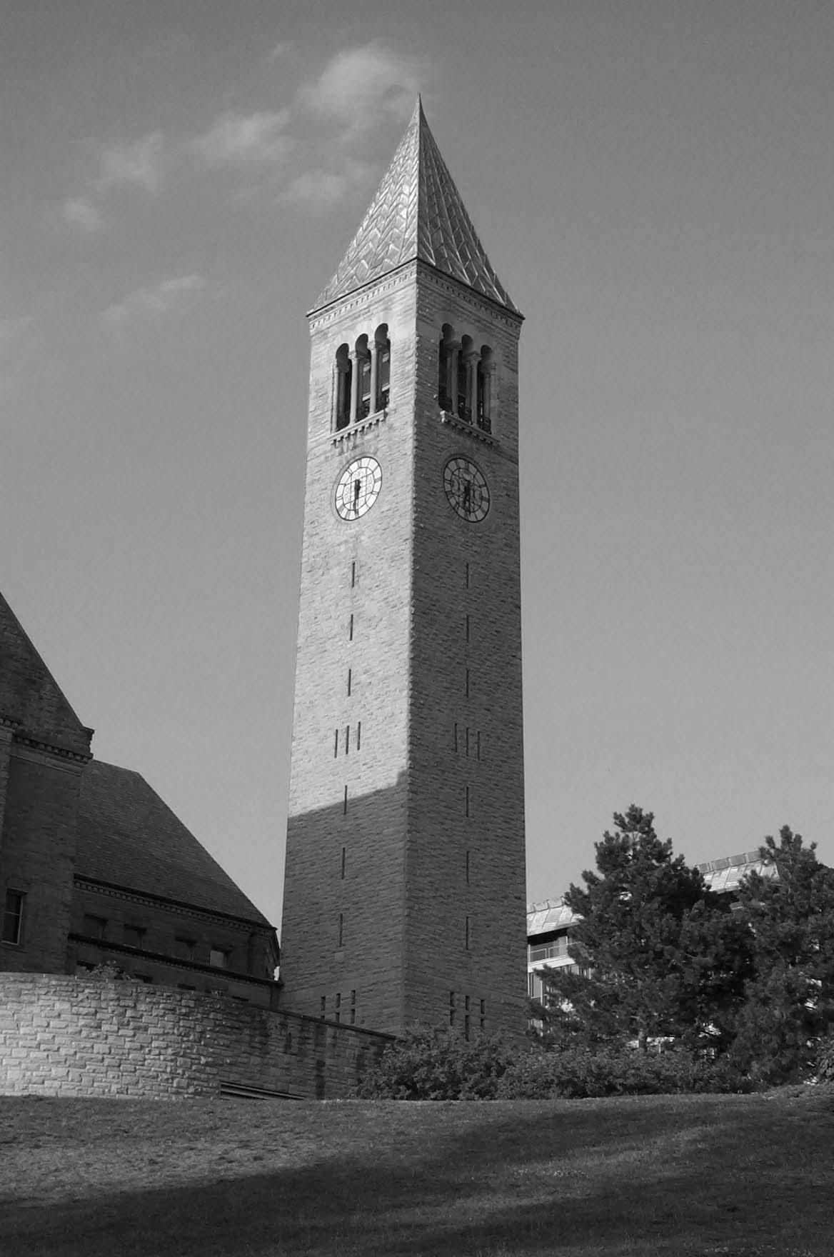
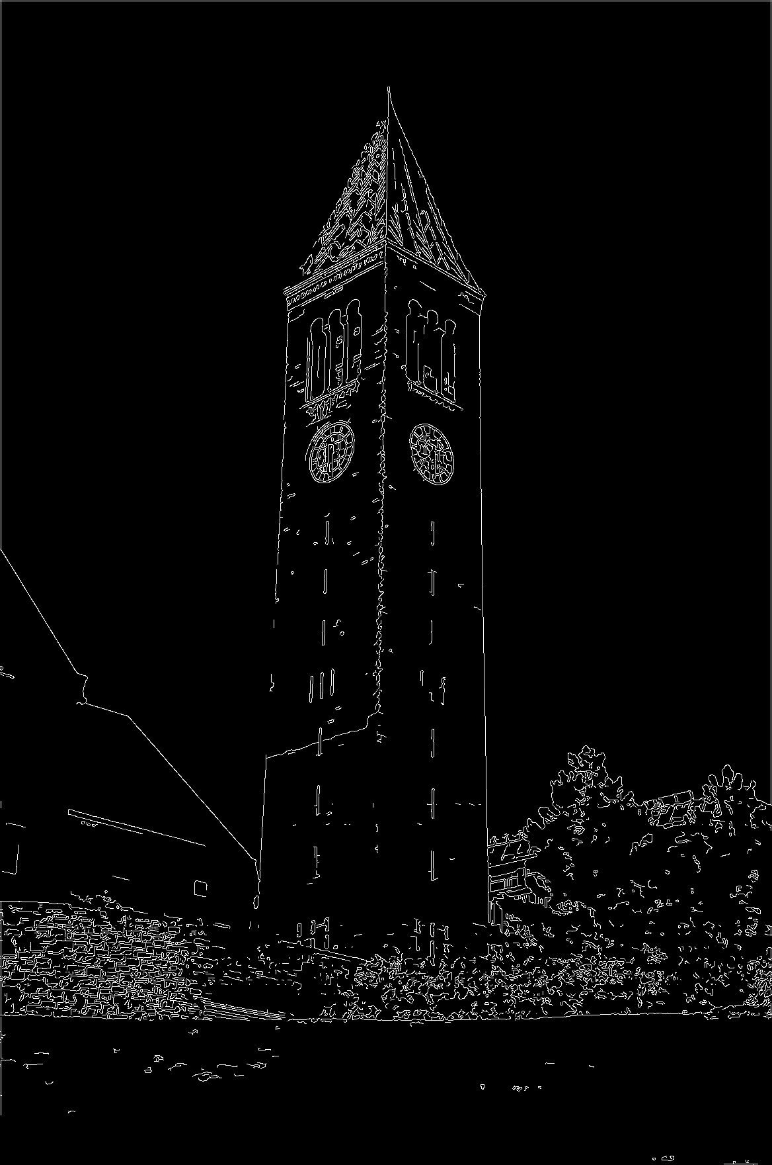
Canny edge detection
Challenge #1: Texture
Challenge #2: Low-contrast edges

