Slide 1
Filtering

Slide 2
Last time: Convolution and cross-correlation
Cross correlation
Convolution

Slide 3
Last time: Boundary conditions
Setup
  m x m image
  k x k kernel
Output size?

Slide 4
Last time: Boundary conditions in practice
“Full convolution”: compute if any part of kernel intersects with image
  requires padding
  Output size = m+k-1
“Same convolution”: compute if center of kernel is in image
  requires padding
  output size = m
“Valid convolution”: compute only if all of kernel is in image
  no padding
  output size = m-k+1

Slide 5
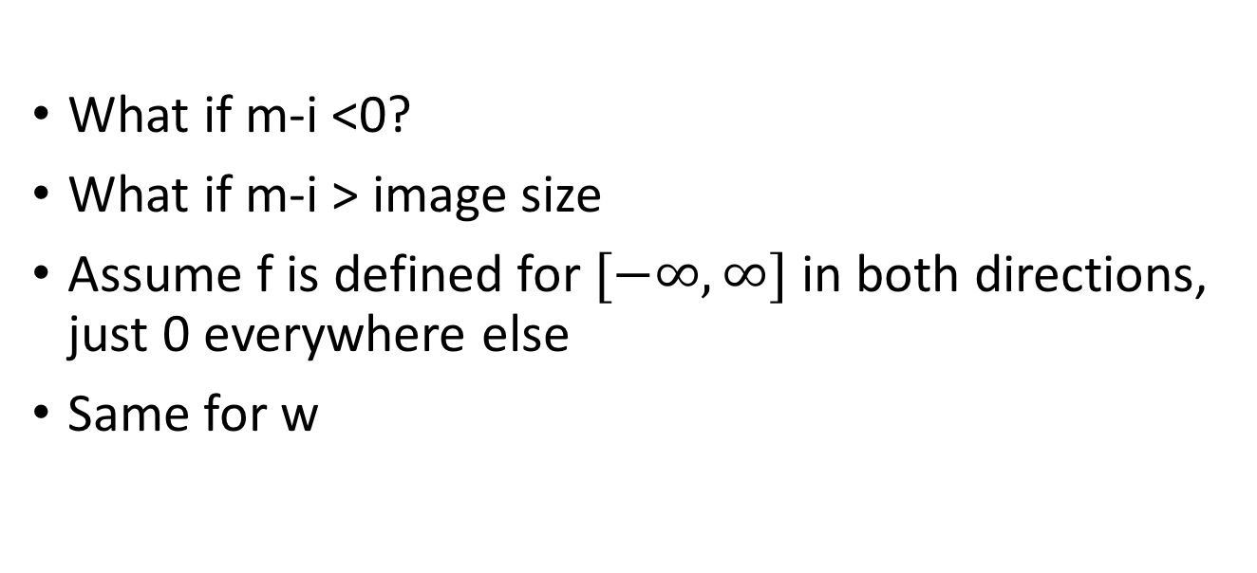
“Full” convolution / cross-correlation
What if m-i <0?
What if m-i > image size
Assume f is defined for $[−∞,∞]$ in both directions, just 0 everywhere else
Same for w

Slide 6
Properties: Linearity

Slide 7
Properties: Linearity

Slide 8
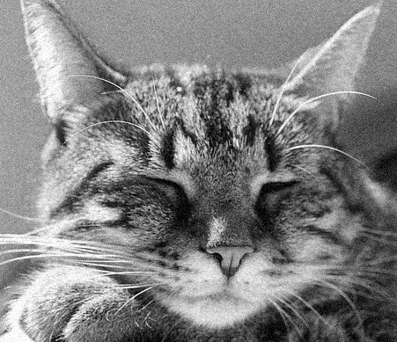
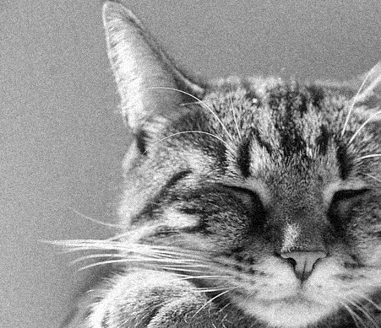
Shift equivariance
Shift, then convolve = convolve, then shift
Output of convolution does not depend on where the pixel is (modulo boundary conditions)
f
f’

Slide 9
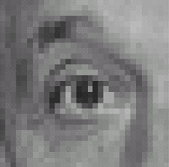
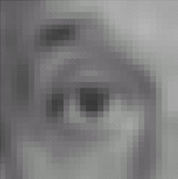

Filters: examples
*
1
1
1
=
1
1
1
1
1
1
Kernel (k)
Original (f)
Blur (with a mean filter) (g)
Source: D. Lowe

Slide 10
Filters: examples
*
0
0
0
=
0
1
0
0
0
0
Kernel (k)
Original (f)
Identical image (g)
Source: D. Lowe

Slide 11
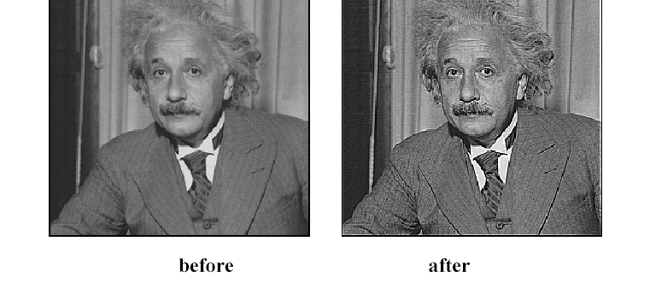
Sharpening
Source: D. Lowe

Slide 12
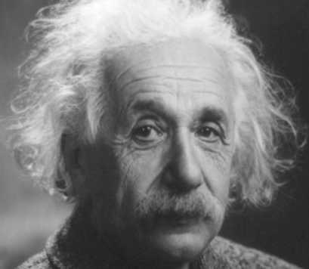
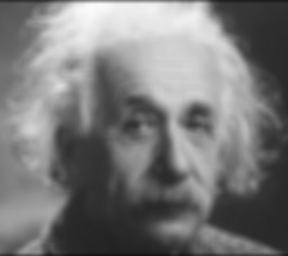
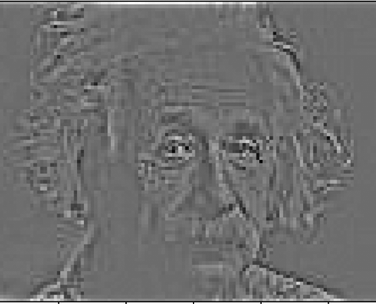
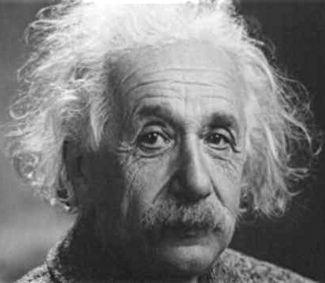
Sharpening
What does blurring take away?
–
=
Let’s add it back:
+ α
=
original
detail

Slide 13
Sharpening

Slide 14
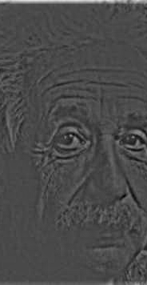
Sharpening
What does blurring take away?
–
=
Let’s add it back:
+ α
=
original
detail

Slide 15
Sharpening
0
0
0
1
1
1
0
1
0
1
1
1
0
0
0
1
1
1

Slide 16
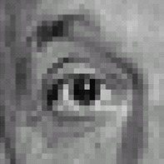



Sharpening filter
*
0
0
0
-
1
1
1
=
0
2
0
1
1
1
0
0
0
1
1
1
Sharpening filter (accentuates edges)
Original
Source: D. Lowe

Slide 17
Another example
-1 | -1 | -1 | -1 | -1 | -1 | -1 | -1 | -1 | -1 | -1
1 | -1 | -1 | -1 | -1 | -1 | -1 | -1 | -1 | -1 | -1
1 | 1 | -1 | -1 | -1 | -1 | -1 | -1 | -1 | -1 | -1
1 | 1 | 1 | -1 | -1 | -1 | -1 | -1 | -1 | -1 | -1
1 | 1 | 1 | 1 | -1 | -1 | -1 | -1 | -1 | -1 | -1
1 | 1 | 1 | 1 | 1 | -1 | -1 | -1 | -1 | -1 | -1
1 | 1 | 1 | 1 | 1 | 1 | -1 | -1 | -1 | -1 | -1
1 | 1 | 1 | 1 | 1 | 1 | 1 | -1 | -1 | -1 | -1
1 | 1 | 1 | 1 | 1 | 1 | 1 | 1 | -1 | -1 | -1
1 | 1 | 1 | 1 | 1 | 1 | 1 | 1 | 1 | -1 | -1
1 | 1 | 1 | 1 | 1 | 1 | 1 | 1 | 1 | 1 | -1

Slide 18
Another example

Slide 19
Another example

Slide 20
More properties of convolution

Slide 21
More properties of convolution
Convolution is linear
Convolution is shift-invariant
Convolution is commutative (w*f = f*w)
Convolution is associative ( v*(w*f) = (v*w)*f )
Every linear shift-invariant operation is a convolution

Slide 22
More convolution filters
1 | 1 | 1 | 1 | 1
1 | 1 | 1 | 1 | 1
1 | 1 | 1 | 1 | 1
1 | 1 | 1 | 1 | 1
1 | 1 | 1 | 1 | 1
Mean filter
But nearby pixels are more correlated than far-away pixels
Weigh nearby pixels more
1/25

Slide 23
Gaussian filter

Slide 24

Gaussian filter
0.003 | 0.013 | 0.022 | 0.013 | 0.003
0.013 | 0.060 | 0.098 | 0.060 | 0.013
0.022 | 0.098 | 0.162 | 0.098 | 0.022
0.013 | 0.060 | 0.098 | 0.060 | 0.013
0.003 | 0.013 | 0.022 | 0.013 | 0.003
Ignore factor in front, instead, normalize filter to sum to 1
5x5, $σ$=1

Slide 25

Gaussian filter
Ignore factor in front, instead, normalize filter to sum to 1
5x5, $σ$=1

Slide 26







Gaussian filter
21x21, $σ$=0.5
21x21, $σ$=1
21x21, $σ$=3

Slide 27
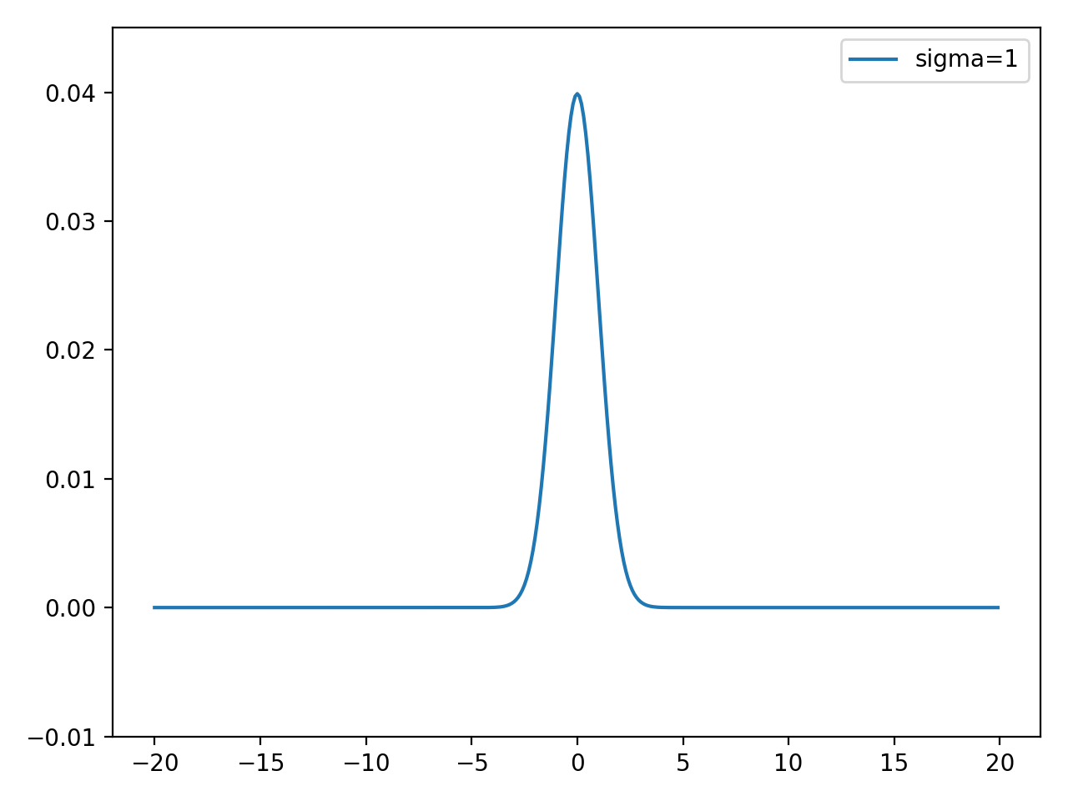
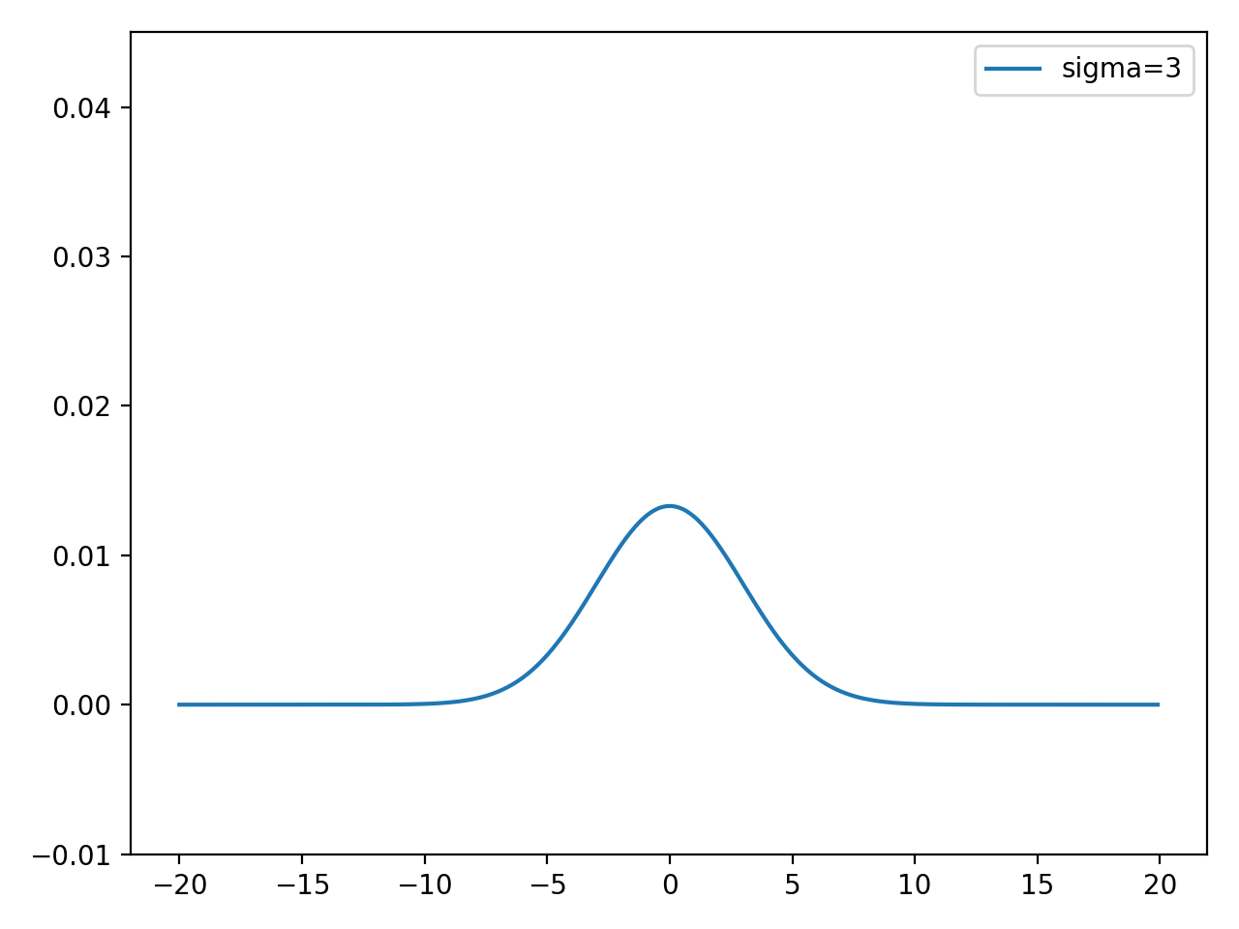
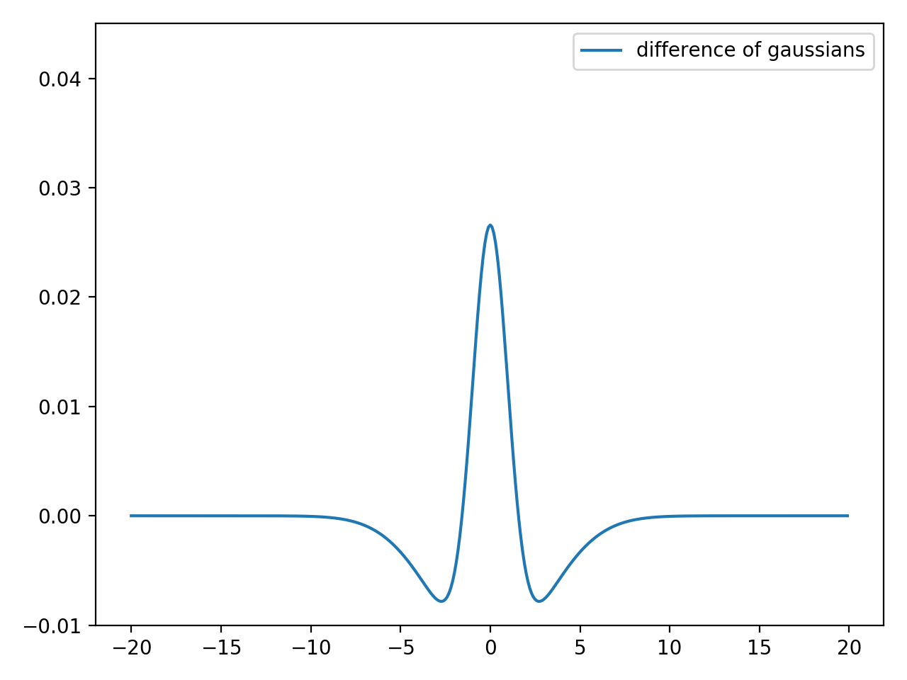
Difference of Gaussians (1D)
-
=

Slide 28
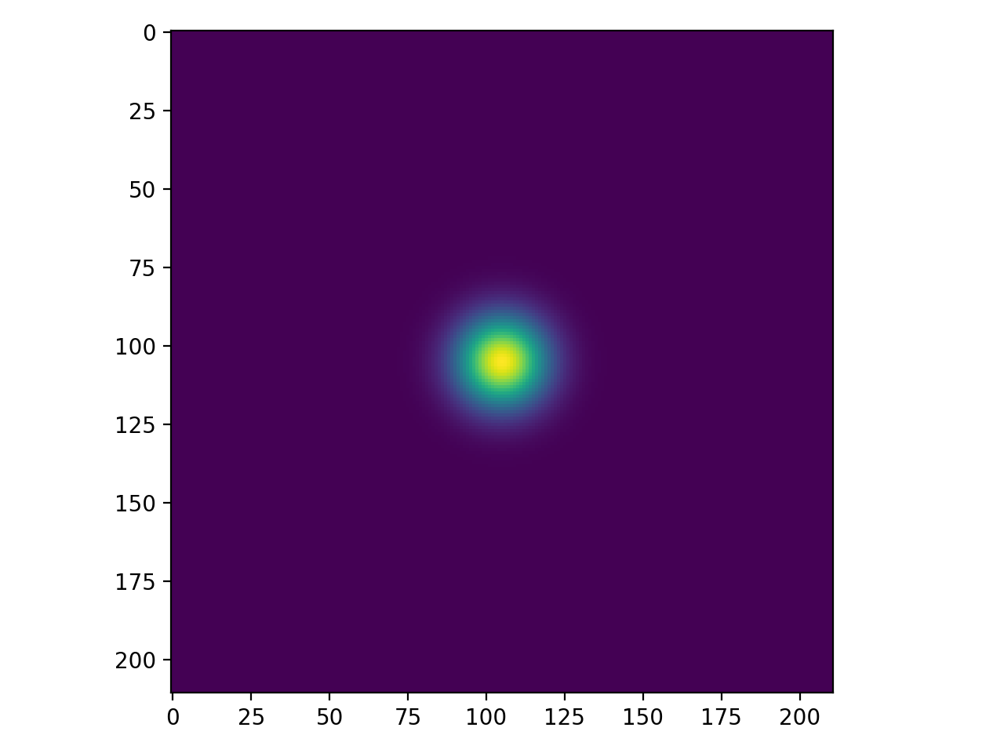
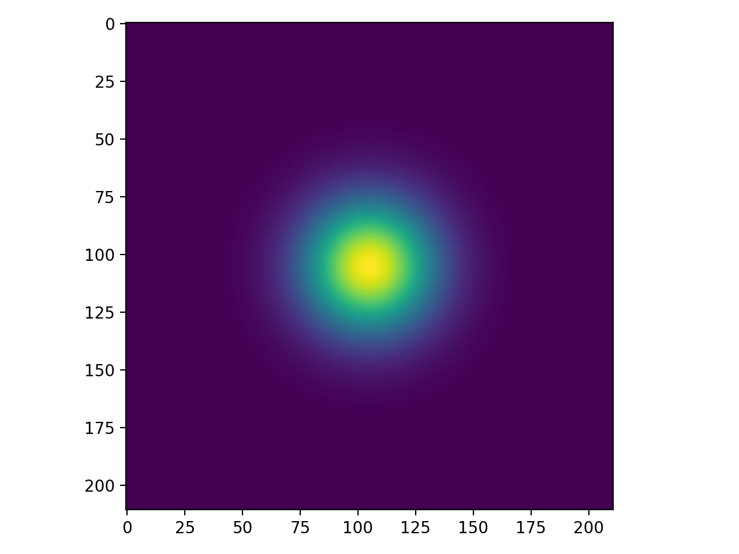
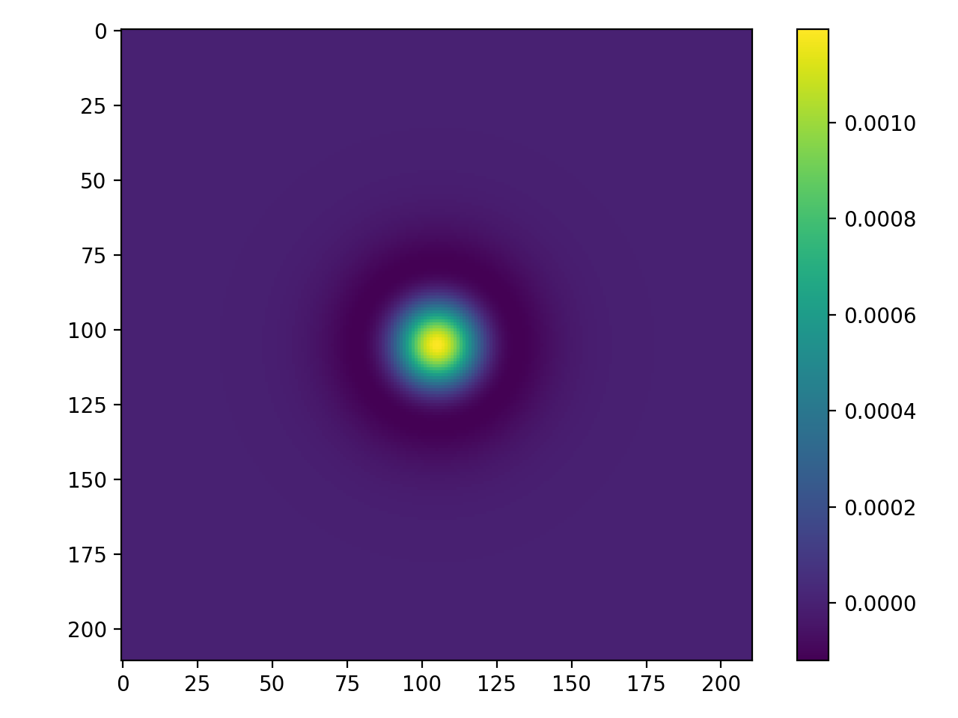
Difference of Gaussians (2D filter)
-
=

Slide 29


Difference of Gaussians
21x21, $σ$=3
21x21, $σ$=1
DoG filter

Slide 30
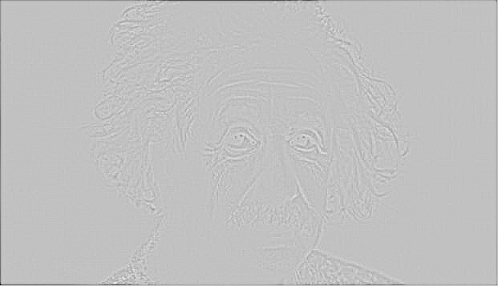
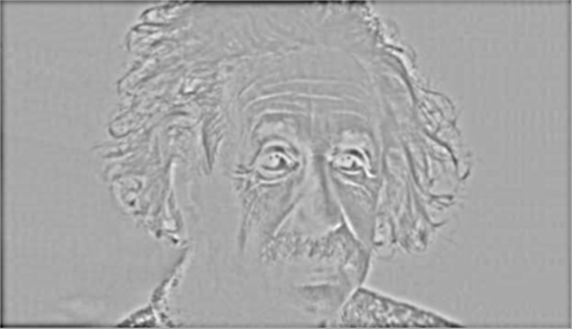
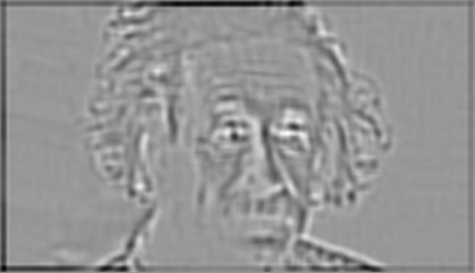
Difference of Gaussians
Different standard deviations capture structures at different scales

Slide 31
Time complexity of convolution
Image is w x h
Filter is k x k
Every entry takes O(k²) operations
Number of output entries:
  (w+k-1)(h+k-1) for full
  wh for same
Total time complexity:
  O(whk²)

Slide 32
Optimization: separable filters
basic alg. is O(r²): large filters get expensive fast!
definition: w(x,y) is separable if it can be written as:
Write u as a k x 1 filter, and v as a 1 x k filter
Claim:

Slide 33
Separable filters
u₁
u₂
u₃
*
v₁ | v₂ | v₃
u₁
u₂
u₃
u₃
u₂
u₁
u₁v₁

Slide 34
Separable filters
u₁
u₂
u₃
*
v₁ | v₂ | v₃
u₁
u₂
u₃
u₃
u₂
u₁
u₁v₁ | u₁v₂

Slide 35
Separable filters
u₁
u₂
u₃
*
v₁ | v₂ | v₃
u₁
u₂
u₃
u₃
u₂
u₁
u₁v₁ | u₁v₂ | u₁v₃

Slide 36
Separable filters
u₁
u₂
u₃
*
v₁ | v₂ | v₃
u₁
u₂
u₃
u₃
u₂
u₁
u₁v₁ | u₁v₂ | u₁v₃
u₂v₁

Slide 37
Separable filters
u₁
u₂
u₃
*
v₁ | v₂ | v₃
u₁
u₂
u₃
u₃
u₂
u₁
u₁v₁ | u₁v₂ | u₁v₃
u₂v₁ | u₂v₂

Slide 38
Separable filters
u₁
u₂
u₃
*
v₁ | v₂ | v₃
u₁
u₂
u₃
u₃
u₂
u₁
u₁v₁ | u₁v₂ | u₁v₃
u₂v₁ | u₂v₂ | u₂v₃

Slide 39
Separable filters
u₁
u₂
u₃
*
v₁ | v₂ | v₃
u₁
u₂
u₃
u₃
u₂
u₁
u₁v₁ | u₁v₂ | u₁v₃
u₂v₁ | u₂v₂ | u₂v₃
u₃v₁

Slide 40
Separable filters
u₁
u₂
u₃
*
v₁ | v₂ | v₃
u₁
u₂
u₃
u₃
u₂
u₁
u₁v₁ | u₁v₂ | u₁v₃
u₂v₁ | u₂v₂ | u₂v₃
u₃v₁ | u₃v₂

Slide 41
Separable filters
u₁
u₂
u₃
*
v₁ | v₂ | v₃
w
u₁
u₂
u₃
u₃
u₂
u₁
u₁v₁ | u₁v₂ | u₁v₃
u₂v₁ | u₂v₂ | u₂v₃
u₃v₁ | u₃v₂ | u₃v₃

Slide 42
Separable filters
Time complexity of original : O(whk²)
Time complexity of separable version : O(whk)

Slide 43
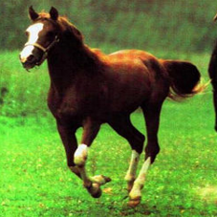
Convolution is everywhere
Horse

Slide 44


Why is convolution important?
Shift equivariance is a crucial property

Slide 45
Why is convolution important?
We like linearity
  Linear functions behave predictably when input changes
  Lots of theory just easier with linear functions
All linear shift-equivariant systems can be expressed as a convolution

Slide 46
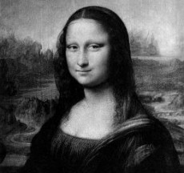
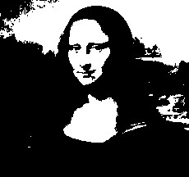

Non-linear filters: Thresholding

Slide 47
Non-linear filters: Rectification
g(m,n) = max(f(m,n), 0)
Crucial component of modern convolutional networks

Slide 48
Non-linear filters
Sometimes mean filtering does not work

Slide 49
Non-linear filters
Sometimes mean filtering does not work

Slide 50
Non-linear filters
Mean is sensitive to outliers
Median filter: Replace pixel by median of neighbors

Slide 51
Non-linear filters

Slide 52
Takeaway
Two general recipes:
  convolution
  cross-correlation
Properties
  Shift-equivariant: a sensible thing to require
  Linearity: convenient
Can be used for smoothing, sharpening
Also main component of CNNs

