Slide 1
Getting Speed in applications with lots of moving parts
Professor Ken Birman
CS4414 Lecture 3

Slide 2
Idea map for today
Our word count scenario had a lot of stuff happening
Reading files from the Linux-managed file system
Scanning them line by line, counting word occurrences
Sorting and printing the output
Revisit the example from lecture 1. C++ was faster because it allowed Ken to leverage parallelism using threads.
Parallelism is a powerful tool, but only gives a speedup if the program itself is parallelizable. Sequential bottlenecks limit achievable speed
There are many “hidden” opportunities for parallelism that can benefit even a sequential program. A good example is prefetching in a cache

Slide 3
What we will (and won’t) cover
This isn’t a programing course, or an intro to operating systems, so I’m going to assume you do basically understand how to code things, and data structures (hash-maps, trees…), file systems…
But I am interested in situations tasks with “lots of moving parts” and multiple options to pick from. What really shapes performance?

Slide 4
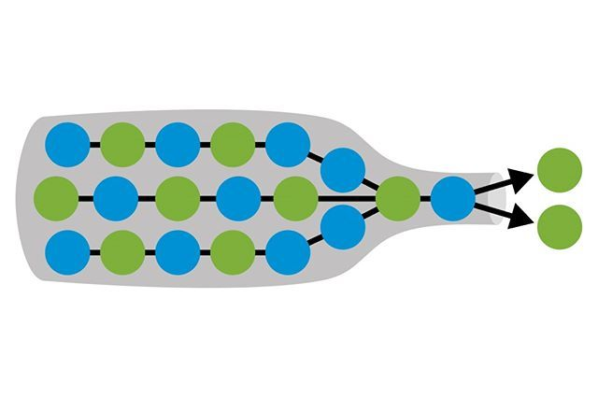
A philosophy of performance
Make your code sleek and elegant and “standard”
Then experiment to find the bottlenecks
Fix them (even if your changes are less elegant). But don’t mess with the rest of your program. If a change wouldn’t help in the larger picture, why destroy that really beautiful code?

Slide 5
Getting the lay of the land…
Linux kernel has about 26M lines of code in 50,000 files.
Start by asking how fast this can possibly be done
Small experiment: time cat {bunch of files} > /dev/null Slightly fancier: in N parallel tasks, read 50,000/N of them
Fastest with 10-15 tasks. Linux needs 4.25s to read all the files!
With N=1 will be sequential. Less “sys time” but takes 2m19s!

Slide 6
Insight
We won’t (can’t) outperform 4.5s on this machine.
New goal: Code should “keep up” with the incoming data.
Count in parallel as Linux file I/O loads files from disk

Slide 7
Splitting lines into “words”
Define a word to be a sequence of A-Z, a-z, 0-9, _
Examples of words:
for, which, if, else, define, int, float, …
n, inode_table, fd
0x61AFF00

Slide 8
Part of a solution in “pure Linux”
1) Find all source files (they end in .c or .h)
2) Print (“cat”) each file
3) Line by line, map non-word-chars to blank, then map all blanks to newline (\012). Long list of words… and blank lines
4) sort, count unique, sort again, print output

Slide 9
How did the programs work?
This version is easy to write but looks horrible:
find . -type f \( -name '*.c' -o –name ‘*.h’\) -exec cat {} \; | tr -c '[A-Za-z0-9_ \012]' ' ' | tr -s '[ ]' '\012' | sort | uniq –c | sort –r –n

Slide 10
How did the programs work?
This version is easy to write but looks horrible:
It uses what Linux calls a “pipe”. A process prints output to stdout (normally, the console) but we “redirect” it to become stdin (input) to another process. This uses 5 pipe operations: |
find . -type f \( -name '*.c' -o –name ‘*.h’\) -exec cat {} \; | tr -c '[A-Za-z0-9_ \012]' ' ' | tr -s '[ ]' '\012' | sort | uniq –c | sort –r –n

Slide 11
Visualizing The pure linux solution
find . -type f \( -name '*.c' -o –name ‘*.h’\) -exec cat {} \; | tr -c '[A-Za-z0-9_ \012]' ' ' | tr -s '[ ]' '\012’ | sort | uniq –c | sort –r -n
…
fd
syscall_open
File
flags
mode
fd
1
syscall_read
fd
buf
size
…
…
mm_segment_t fs = get_fs();
set_fs(KERNEL_DS);
fd = (*syscall_open)(file, flags, mode);
if(fd != -1) {
(*syscall_read)(fd, buf, size);
(*syscall_close)(fd);
}
set_fs(fs);
…
…
fd
syscall_open
file
flags
mode
Fd 1
syscall_read
fd
buf
size
…
…
1
buf
fd
fd
fd file
flags
mode size
syscall_open
syscall_read …
…
1 1
1 buf
3 fd 1 file
1 flags
1 mode 1 size
1 syscall_open
1 syscall_read …

Slide 12
Linux commands are way too slow
It involves a chain of 6 processes linked by pipes.
Even so, quite slow.
… and didn’t even have the output ordering we desire! Sort lacks a “descending, but ascending by name for ties” option
#4: Pure Linux (buggy sort order)
real 2m38.965s
user 2m43.999s
sys 27.084s

Slide 13
Writing a program to do this
Same idea, but with a program, we “take control”
Now we can code for speed… to keep up with Linux file system
A program can fix the issue of wanting our output to be sorted by (count,word) with descending count, but alphabetic for ties

Slide 14
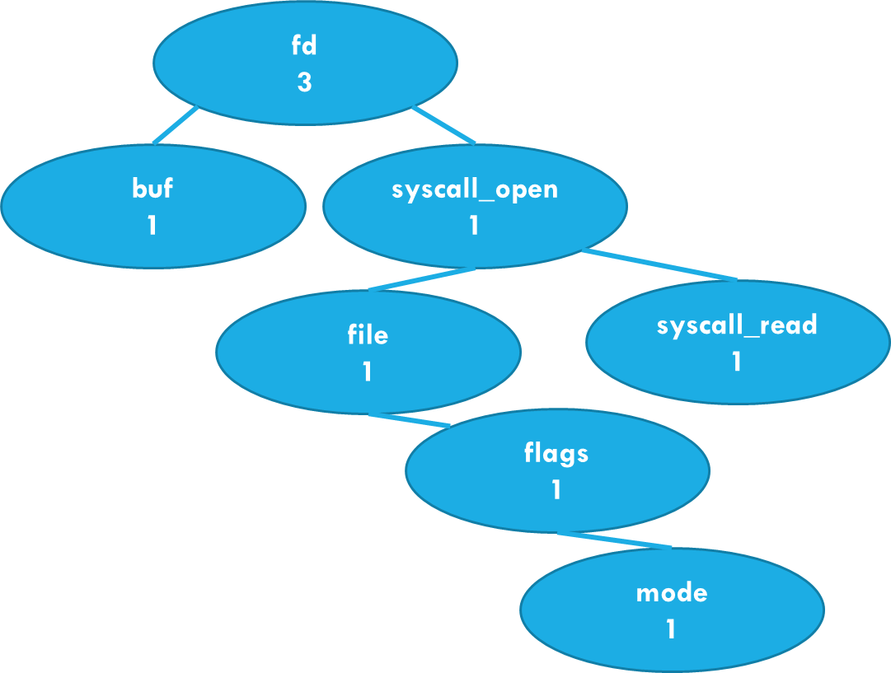
Visualizing this application
…
fd
syscall_open
file
flags
mode
fd
1
syscall_read
fd
buf
size
…
…
mm_segment_t fs = get_fs();
set_fs(KERNEL_DS);
fd = (*syscall_open)(file, flags, mode);
if(fd != -1) {
(*syscall_read)(fd, buf, size);
(*syscall_close)(fd);
}
set_fs(fs);
…
Sorted by name
Phase one: Count words in the file using a tree sorted by name

Slide 15
Why a tree? What about a hash table?
A tree is an O(nLogn) structure. Hash table is O(1).
But for a hash table we need to estimate the approximate size required. With 24M words… maybe 10-20 threads… hash tables (one per thread) could be 2-4 GB of memory. Each.
Trees are more compact, so Ken picked std::map, a tree

Slide 16
Sorting for desired output order
(3, fd)
(1, buf)
Sorted by name
Re-sorted by (count, name)
Word | Count
fd | 3
buf | 1
Output
Phase two: Sort by (count,word), then print output

Slide 17
Python, Java and C++ all turn out to have prebuilt tools for each step
Every one of these steps can just use a standard library.
We end up with very elegant, concise code.
It looks pretty similar for all three languages

Slide 18
Let’s start with Python
Python has a built-in file scanner like find, string splitter, built in vectors, and a vector sort. It doesn’t leverage hardware parallelism.
One of our course staff members (Lucy) coded this up…
#3 Lucy’s Python version
real 1m30.857s
user 1m30.276s
sys 0.572s

Slide 19
What about Java versus C++?
Lucy also created a Java version. It compiles in two stages:
First to Java byte code
Then to machine code (JIT)
Both compilation steps are highly efficient, but there are some situations in which Java can only know the type of an object at runtime. This “runtime polymorphism” slows some libraries down.
#2 Lucy’s Java version (no threads)
real 1m49.373s
user 3m16.950s
sys 8.742s

Slide 20
C++ Version?
#1: C++ using 24 parallel threads on 24 cores
real 4.645s
user 14.779s
sys 1.983s
We created two C++ versions.
Sagar’s was pure and quite fast; we posted the code on the “extra materials” on our schedule web page.
Ken’s dropped into C for file I/O steps and went further than Sagar in leveraging parallelism. This was fastest of all.

Slide 21
quality of machine code
Whether we use Python or Java or C++, at the end of the day the computer executes machine code. We saw some last week.
Python itself is implemented in Java or C++ and compiled.
But Python interprets your code. This causes slowdown.

Slide 22
Runtime types versus static types
With Java “interesting” things (like tree nodes, or strings) are objects.
Java object types are learned at runtime… this is called “reflection”. Reflection has a cost, paid at runtime – programs run slower. There are ways to speed reflection up, but overheads remain an issue.
C++ types are always fully known at compile time (statically). This lets the compiler use type information to do code optimization.

Slide 23
Threads: A big topic for CS4414
Think about a method that has no return value:
do_something(args….);
A thread runs some method in parallel with its parent.
“You set the table… I’ll get some chips and salsa”
“You scan files 1…1000” … “I‘ll scan 1001…2000”

Slide 24
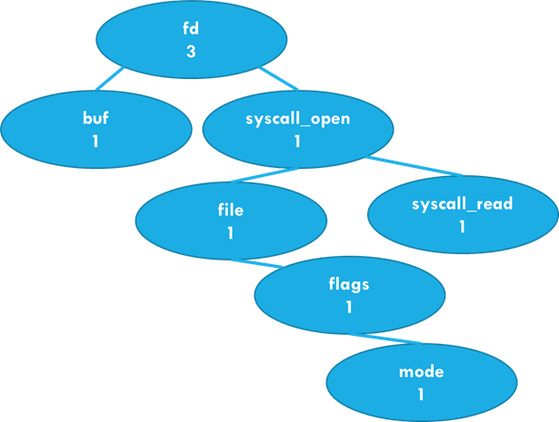
Visualizing task-level Parallelism
. . .
Computational thread 1 processes about 2000 files
Computational thread 2 processes about 2000 files
Computational thread 3 processes about 2000 files
Computational thread 24 processes about 2000 files
File System has 50,000 files in it

Slide 25
Understanding the timer output
In this example, my program will run silently on 8 cores using 16 threads
The “real” (wall clock) time was 18.469 seconds.
This is how long we waited for it to finish
% time taskset 0xFF ./fast-wc -n16 -s
real 0m18.469s
user 0m43.406s
sys 0m18.203s

Slide 26
Understanding the timer output
The “user” time measures compute in my 16 threads. It can be as much as 16*real time!
% time taskset 0xFF ./fast-wc -n16 -s
real 0m18.469s
user 0m43.406s
sys 0m18.203s

Slide 27
Why did I show each thread with its own word-count tree?
A tree node needs to live somewhere in physical memory.
If each core builds its own word-count tree for files it scans, that tree will be entirely in its local memory, and not shared.
We will see that sharing objects involves adding locking that brings costs. Objects used by a single thread don’t need locking.

Slide 28
Down side of having 24 trees…
… we end up with 24x more memory in use!
Linux had 4M “unique” words, but with 24 threads, only 27,000 words are seen by half or more! 3.2M are seen by just 1 or 2 threads.
Suppose an average word-count node requires 64 bytes, and that we end up with 250,000 nodes per thread. With 24 times will require 16MB x 24 = ~400MB. We have enough memory!

Slide 29
Downside of Having 24 Trees…
At the end, we have 24 trees containing sub-counts.
Before sorting, we’ll need to merge them.

Slide 30
With sorted trees, Tree merge is “easy”
For each node in tree B, look up that word in tree A, sum the counts.
C++ is like Java or Python: it has “iterators” for data structures
Just a tiny for loop. But who should run it?

Slide 31
Each thread computes a partial word count on a portion of our data
Visualization: Thread 1 runs the merge step.
… this is linear: 23 merge operations. Can we do better?

Slide 32
Parallel Binary merge
1
Ends at the very top
In this picture, we merge from the bottom to the top
For 24 threads:
Merge [1,2] and [3,4] and … [23,24]
Then [1,3] ……………. [23, 24]
…
Finally: [1, 13]
1
3
Thread 3 terminates
1
2
3
4
Starts at the bottom
Threads 2 and 4 have no more work and terminate

Slide 33
Parallel Binary merge
1
Ends at the very top
Rule: Each thread t has a variable k and initializes k = t (its own thread-id in [1…n]). Initialize s to 1.
do { If (k is even) { thread t terminates. } else { merge tree t + s into tree t; } k >>= 1; s <<= 1; } until (all trees merged into tree 1);
In this picture, we merge from the bottom to the top
For 24 threads:
Merge [1,2] and [3,4] and … [23,24]
Then [1,3] ……………. [23, 24]
…
Finally: [1, 13]
1
3
Thread 3 terminates
1
2
3
4
Starts at the bottom
Threads 2 and 4 have no more work and terminate

Slide 34
Worth implementing?
% time taskset 0xFF ./fast-wc -n16 -s
real 0m18.469s
user 0m43.406s
sys 0m18.203s
Time spent in Linux: File I/O
My program offers parallel merge (-p). It helps… a tiny bit.
Issue: my C++ version was really bottlenecked by file I/O. No matter how fast the threads run, the “sys 18.203s” remains!
C++ tricks can’t reduce runtime below 18.203s without some way of improving the efficiency of parallel file I/O!

Slide 35
Reminder: Tree or hash list?
Now we can answer the question from slides 12/13/14
In fact replacing our tree with a hash list probably wouldn’t help: the file I/O bottleneck wouldn’t be impacted.
The real-time speed limit is ultimately the need to read all the files (unless Linux already had them in the file system cache)

Slide 36
new challenge: keep everything running simultaneously!
Finding the bottleneck can be difficult
Even our little merge program has many moving parts
All those threads, building trees
But also the work Linux is doing when the threads open files and read them.
Which is the limiting stage of our complete “system” (fast-wc + Linux)?
Finding the bottleneck can be difficult

Slide 37
Terminology
bottleneck
A bottleneck: “the limiting factor” for some task… we don’t really use the term for a “balanced” task that has no limiting spot.
Compute-bound: The task is bottlenecked (limited) by the speed of calculations on some kind of in-memory data.
I/O bound: The task is bottlenecked on fetching data from some kind of storage device, or over the network.

Slide 38
Our challenge: Not just data structures and parallelism, but bottlenecks
How can we identify the bottlenecks that limit performance?
Can we even measure the degree of parallelism we are achieving?
In fact Linux has tools we can use for that.
We’ll be learning about them!

Slide 39
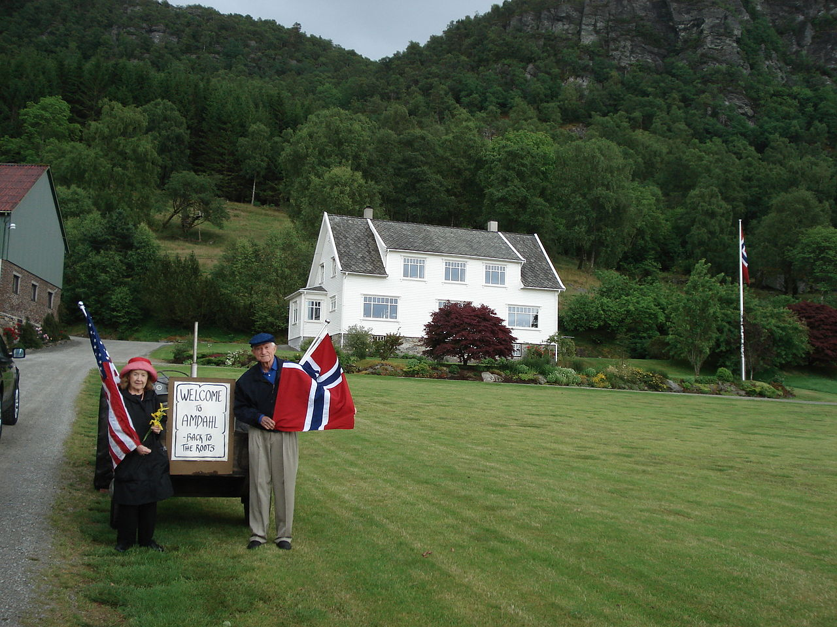
Amdahl’s Law
Gene on the family farm in Norway
Gene Amdahl was a leading research on parallelism and supercomputing in IBM’s HPC division.
He became interested in a basic question. How fast can computations be performed, with infinite parallelism?

Slide 40
A Day Trip to Niagara Falls
You and your friends want to check out Niagara falls.
There are six of you. One option is to rent a plus-sized car (but those big vehicles are slow)

Slide 41
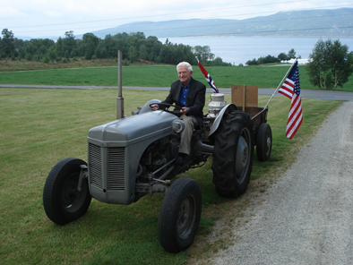
A Day Trip to Niagara Falls
Better plan: You rent three convertible sports cars.
Each holds two people, and these are “insanely fast”.
But as you head north, the narrow road has a bottleneck! Until you all pass this slow tractor, the group will have to wait.
Gene Amdahl’s Tractor in Norway

Slide 42
How Amdahl thought about parallelism
In any computation, we have some parts that are highly parallel, such as scanning our 74,000 different files. Parallelism can speed those up.
But the computation will also have sequential tasks, which could include sequential logic buried in the operating system or the hardware.
The sequential work will limit the speedup due to parallelism!

Slide 43
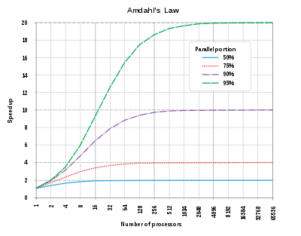
How AmDahl Expressed his law
Suppose that p represents the percentage of the task that can be parallelized.
Then 1/(1-p) is the maximum possible speedup
Insight: The parallel tasks could all be done| simultaneously, yet we would still have to do the sequential parts step by step.

Slide 44
What would be sequential in our word-frequency application?
Each distinct word-count tree is managed by code that does “find or insert” and “increase the count” operations.
Those individual operations will be sequential.

Slide 45
What else would be sequential in our word count application?
Once we have our single tree, we have to re-sort it, because we wanted our printed output to have common words at the top.
Ken and Sagar both needed a second sorted tree for this.
In fact, counting and the final sort both have identical cost!

Slide 46
The file system ends up very busy!
These threads are opening and reading a lot of files
Can the file system keep up?
If not, our threads won’t be active…

Slide 47
The file system ends up very busy!
This is a famous issue with Linux. For example, Google and Facebook have Linux servers holding huge collections of web pages or photos.
They ended up putting images into “strips” to reduce the load on the file system.

Slide 48
File access costs: Two aspects
Each file has to be opened, which is a moment when Linux checks that the user has permission to access the file.
Once the file is open, it takes time to read and process data.
When reading, the fast-wc application does many “system calls”

Slide 49
File access costs: Two aspects
With 24 threads doing concurrent reads, the file system is doing a lot of data fetches from the disk (in “blocks” of 4096 bytes)
If those reads become a bottleneck, our threads will pause and we lose parallelism.

Slide 50
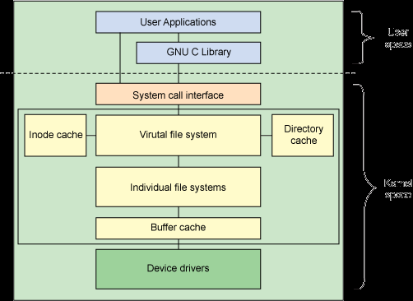
How the Linux file System is structured
User space
Kernel
space
User level programs can’t access files “directly”. They use Linux.
The implementation is modular with multiple layers, but notice the various caches: inodes, buffers and directories.
Virtual File System

Slide 51
Cache: A concept used throughout computing
A pool of memory holding copies of data that “lives” elsewhere.
The Linux buffer pool is a cache of data read from files. Each time data is read, Linux keeps a copy (for a while). If it fills up, Linux will “evict” something else to make room.
If the application re-reads that same data Linux can avoid the need to fetch it from the storage device again.

Slide 52
Prefetching into a cache
Linux also watches for sequential read patterns: you read the first 4096 bytes from a file, then the next 4096, then the next…
Linux will bet that you plan to continue doing this and issues one or two reads ahead of time, saving the data in cache.
Question: In what way is this a form of “parallelism”?

Slide 53
Prefetching into a cache
Linux also watches for sequential read patterns: you read the first 4096 bytes from a file, then the next 4096, then the next…
Linux will bet that you plan to continue doing this and issues one or two reads ahead of time, saving the data in cache.
Question: In what way is this a form of “parallelism”?
Why is prefetching a form of parallelism?
Answer: It lets us overlap the work of finding and reading the next block of the file (the next 4096 bytes) with the word-counting logic for the current block.

Slide 54
Why Prefetching and caching help
Modern disks (SSD and rotating disks!) have large delays compared to memory access. 0.1ms or more delay.
Without a high rate of cache hits, we would spend 1 second (or longer) waiting for disk read requests to complete
With prefetching into the Linux buffer pool, we don’t experience those 0.1ms delays. Our threads keep running

Slide 55
In fact the CPU itself uses caches and prefetching, too!
A modern CPU has multiple caches:
L0: the registers. C++ might “cache” data in them
L1 instruction and data cache: much larger, slightly slower pair of caches used by the the CPU.
L2,L3 data caches: shared by CPUs in one core (L2) or the entire NUMA computer (L3)
Main memory: In modules; largest, but slowest to access

Slide 56
Performance differs enormously!
Accessing L1 cache on the Dell server I used as an example last time: 2 or 3 clock cycles. The clock runs at 3GHz.
Accessing the L2 cache takes 12 or 13 clock cycles
L3 access jumps to perhaps 40-75 clock cycles. The actual delay depends on how heavily loaded the memory bus is.
If we need to go to the memory module, there are two cases: the closest memory module will require125 clock cycles to access. A remote memory module takes 250 clock cycles.

Slide 57
Ideal case
All of our 24 cores are busy (one thread each). But maybe some are busy in the kernel, not in my user code.
Each word-count thread is hard at work counting on the current block
At every level of the memory hierarchy, prefetching is anticipating the next instruction needed, next data needed, next block of file data needed, and already loading it.

Slide 58
Hyperthreading?
No simple, universal answer
In Ken’s word-count, hyperthreading suggests that we should try with 48 cores (2 x 24). But in fact this doesn’t help
In fact hyperthreading helps only for very specific cases, detailed in the CPU user manual.

Slide 59
Summary?
Plenty of opportunities for parallelism….
… yet it didn’t feel embarrassingly easy! In fact it was hard.
This is not an unusual experience.

