Slide 1
Multicore and Parallelism
Prof. Hakim Weatherspoon
CS 3410, Spring 2015
Computer Science
Cornell University
P & H Chapter 4.10, 1.7, 1.8, 5.10, 6

Slide 2

xkcd/619

Slide 3
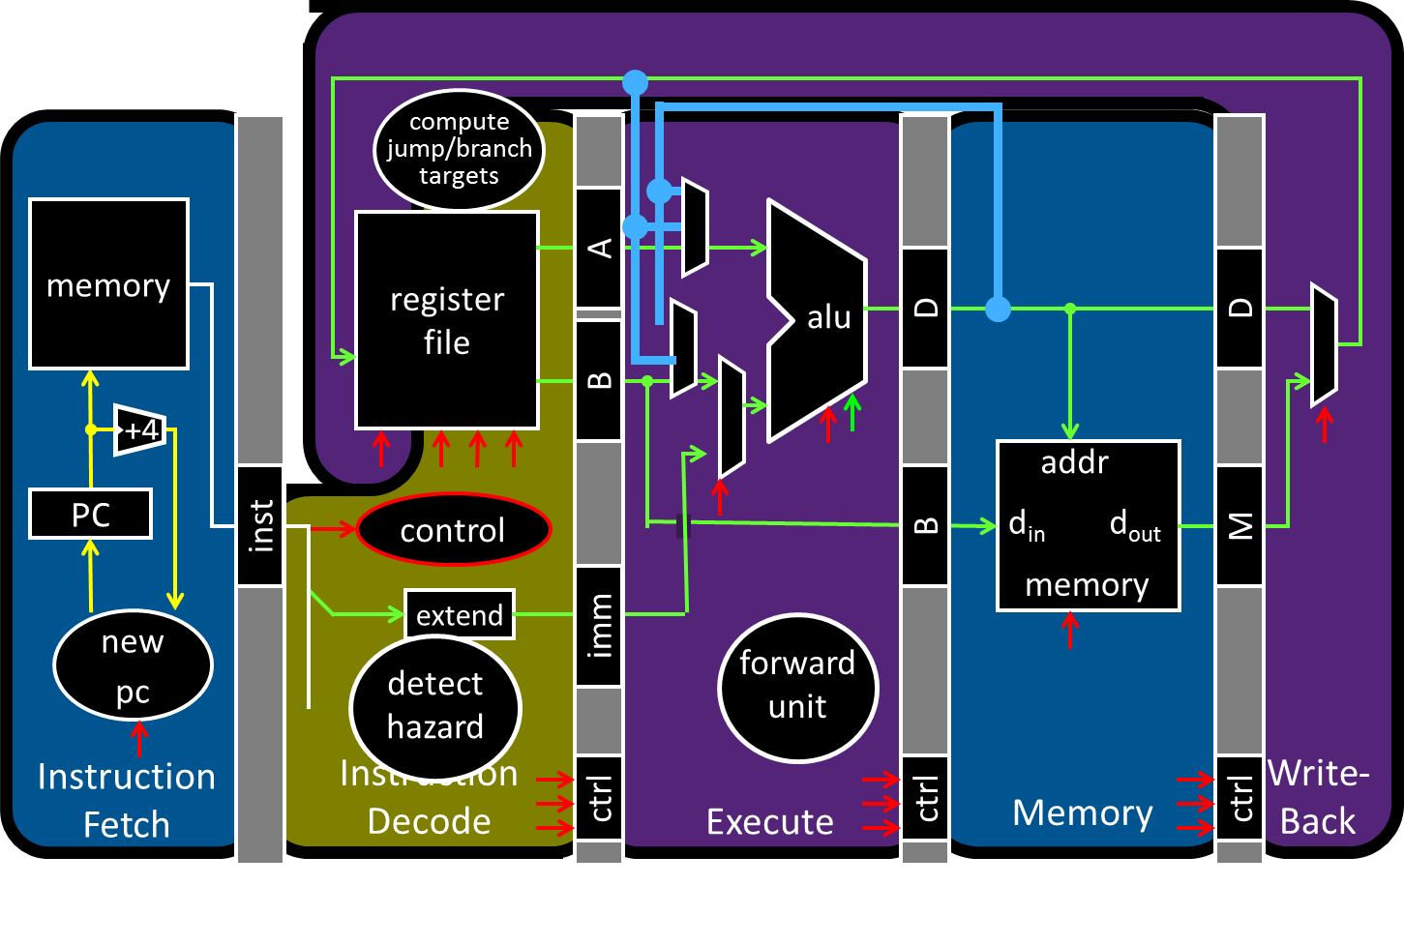
Big Picture: Multicore and Parallelism

Slide 4
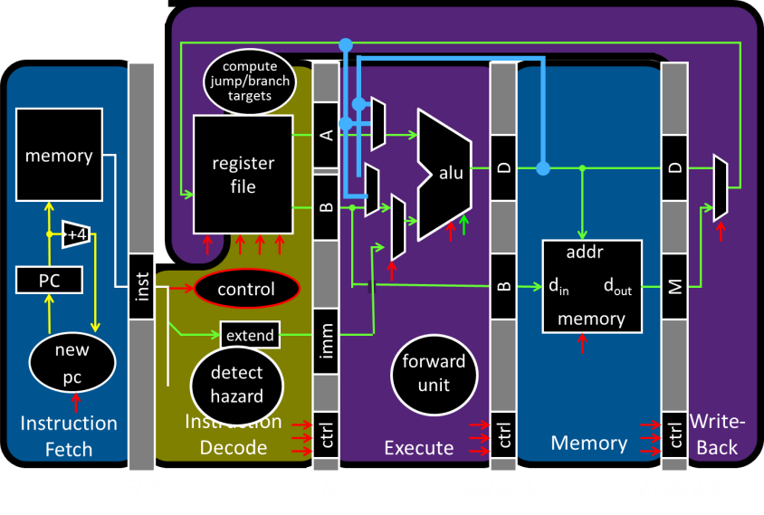
Big Picture: Multicore and Parallelism
Why do I need four computing cores on my phone?!

Slide 5
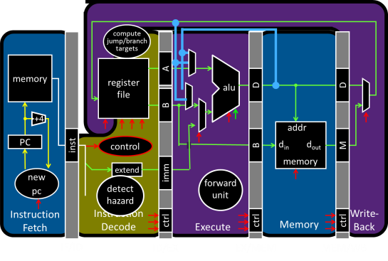
Big Picture: Multicore and Parallelism
Why do I need eight computing cores on my phone?!

Slide 6
Big Picture: Multicore and Parallelism
Why do I need sixteen computing cores on my phone?!

Slide 7
Pitfall: Amdahl’s Law
Execution time after improvement =
affected execution time
amount of improvement
+ execution time unaffected
T_{improved} = $\frac{Taffected}{improvement factor}$+ T_{unaffected}
Notes:
Amdahl’s Law

Slide 8
Pitfall: Amdahl’s Law
Improving an aspect of a computer and expecting a proportional improvement in overall performance
T_{improved} = $\frac{Taffected}{improvement factor}$+ T_{unaffected}
Example: multiply accounts for 80s out of 100s
Multiply can be parallized
How much improvement do we need in the multiply performance to get 5× overall improvement?
(a) 2x (b) 10x (c) 100x (d) 1000x (e) not possible
Notes:
Clicker question

Slide 9

Pitfall: Amdahl’s Law
Improving an aspect of a computer and expecting a proportional improvement in overall performance
T_{improved} = $\frac{Taffected}{improvement factor}$+ T_{unaffected}
Example: multiply accounts for 80s out of 100s
Multiply can be parallized
How much improvement do we need in the multiply performance to get 5× overall improvement?
20 = $\frac{80}{n}$ + 20
  Can’t be done!
Notes:
Clicker question

Slide 10
Scaling Example
Workload: sum of 10 scalars, and 10 × 10 matrix sum
  Speed up from 10 to 100 processors?
Single processor: Time = (10 + 100) × t_{add}
10 processors
  Time = 100/10 × t_{add} + 10 × t_{add} = 20 × t_{add}
  Speedup = 110/20 = 5.5
100 processors
  Time = 100/100 × t_{add} + 10 × t_{add} = 11 × t_{add}
  Speedup = 110/11 = 10
Assumes load can be balanced across processors
Notes:
Pair up question
10 processors
Speedup = 110/20 = 5.5 (55% of potential)
100 processors
Speedup = 110/11 = 10 (10% of potential)

Slide 11
Scaling Example
What if matrix size is 100 × 100?
Single processor: Time = (10 + 10000) × t_{add}
10 processors
  Time = 10 × t_{add} + 10000/10 × t_{add} = 1010 × t_{add}
  Speedup = 10010/1010 = 9.9
100 processors
  Time = 10 × t_{add} + 10000/100 × t_{add} = 110 × t_{add}
  Speedup = 10010/110 = 91
Assuming load balanced
Notes:
10 processors
Speedup = 10010/1010 = 9.9 (99% of potential)
100 processors
Speedup = 10010/110 = 91 (91% of potential)

Slide 12
Takeaway
Unfortunately, we cannot not obtain unlimited scaling (speedup) by adding unlimited parallel resources, eventual performance is dominated by a component needing to be executed sequentially.
Amdahl's Law is a caution about this diminishing return

Slide 13
Announcements
HW2 Review Sessions!
  Saturday, April 18th, Hollister B14@7pm
  Tuesday, April 21st, Hollister B14@7pm
Lab3 is due yesterday!
  Wednesday, April 15th
  In theory, theory and practice are the same. In practice, they are not. –Albert Einstein
PA3 started this week!
  The Lord of the Cache!
  Due Friday, April 24th

Slide 14
Announcements
HW2-P5 (Pre-Lab4) due next week!
  Monday, April 20th
  Don’t forget to submit on CMS!
  Designed for you to look over the code and understand virtual memory before coming to Lab 4.

Slide 15
Announcements
Prelim 2 is on April 30th at 7 PM at Statler Hall!
If you have a conflict e-mail me:
deniz@cs.cornell.edu

Slide 16
Announcements
Next three weeks
  Week 12 (Apr 21): Lab4 due in-class, Proj3 due Fri, HW2 due Sat
  Week 13 (Apr 28): Proj4 release, Prelim2
  Week 14 (May 5): Proj3 tournament Mon, Proj4 design doc due
Final Project for class
  Week 15 (May 12): Proj4 due Wed

Slide 17
Goals for Today
How to improve System Performance?
  Instruction Level Parallelism (ILP)
  Multicore
    Increase clock frequency vs multicore
  Beware of Amdahls Law
Next 2 lectures:
  Cache coherency, synchronization, Concurrency, and programming

Slide 18
How to improve performance?
We have looked at
  Pipelining
To speed up:
  Deeper pipelining
  Make the clock run faster
  Parallelism
    Not a luxury, a necessity

Slide 19
Problem Statement
Q: How to improve system performance?
→ Increase CPU clock rate?
→ But I/O speeds are limited
Disk, Memory, Networks, etc.
Recall: Amdahl’s Law
Solution: Parallelism

Slide 20
Instruction-Level Parallelism (ILP)
Pipelining: execute multiple instructions in parallel
Q: How to get more instruction level parallelism?
A: Deeper pipeline
    E.g. 250MHz 1-stage; 500Mhz 2-stage; 1GHz 4-stage; 4GHz 16-stage
Pipeline depth limited by…
    max clock speed (less work per stage ⇒ shorter clock cycle)
    min unit of work
    dependencies, hazards / forwarding logic
Notes:
Draw pictures: 250MHz 1-stage; 500Mhz 2-stage; 1GHz 4-stage; 4GHz 16-stage

Slide 21
Instruction-Level Parallelism (ILP)
Pipelining: execute multiple instructions in parallel
Q: How to get more instruction level parallelism?
A: Multiple issue pipeline
    Start multiple instructions per clock cycle in duplicate stages
ALU/Br
LW/SW
Notes:
Draw picture; 4 stage, 4-way * 4GHz = 16B inst/cycles
Next: Static issue

Slide 22
Multiple issue pipeline
Static multiple issue
aka Very Long Instruction Word
Decisions made by compiler
Dynamic multiple issue
Decisions made on the fly
Cost: More execute hardware
Reading/writing register files: more ports

Slide 23
Static Multiple Issue
Static Multiple Issue
a.k.a. Very Long Instruction Word (VLIW)
Compiler groups instructions to be issued together
  Packages them into “issue slots”
Q: How does HW detect and resolve hazards?
A: It doesn’t.
→ Simple HW, assumes compiler avoids hazards
Example: Static Dual-Issue 32-bit MIPS
  Instructions come in pairs (64-bit aligned)
    One ALU/branch instruction (or nop)
    One load/store instruction (or nop)
Notes:
show program, decode stage
Ideal CPI = 0.5

Slide 24
MIPS with Static Dual Issue
Two-issue packets
  One ALU/branch instruction
  One load/store instruction
  64-bit aligned
    ALU/branch, then load/store
    Pad an unused instruction with nop
Address | Instruction type | Pipeline Stages
n | ALU/branch | IF | ID | EX | MEM | WB
n + 4 | Load/store | IF | ID | EX | MEM | WB
n + 8 | ALU/branch |  | IF | ID | EX | MEM | WB
n + 12 | Load/store |  | IF | ID | EX | MEM | WB
n + 16 | ALU/branch |  |  | IF | ID | EX | MEM | WB
n + 20 | Load/store |  |  | IF | ID | EX | MEM | WB

Slide 25
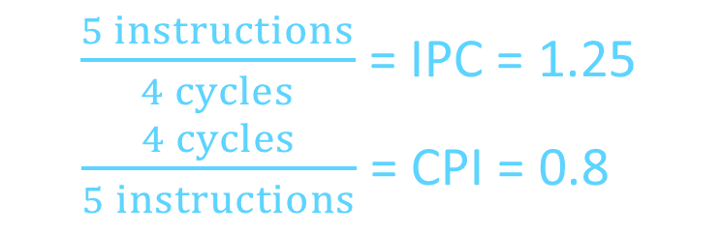
Scheduling Example
Schedule this for dual-issue MIPS
Loop: lw $t0, 0($s1) # $t0=array element
addu $t0, $t0, $s2 # add scalar in $s2
sw $t0, 0($s1) # store result
addi $s1, $s1,–4 # decrement pointer
bne $s1, $zero, Loop # branch $s1!=0
Loop: lw $t0, 0($s1) # $t0=array element
addu $t0, $t0, $s2 # add scalar in $s2
sw $t0, 0($s1) # store result
addi $s1, $s1,–4 # decrement pointer
bne $s1, $zero, Loop # branch $s1!=0
 | ALU/branch | Load/store | cycle
Loop: | nop | lw $t0, 0($s1) | 1
 | addi $s1, $s1,–4 | nop | 2
 | addu $t0, $t0, $s2 | nop | 3
 | bne $s1, $zero, Loop | sw $t0, 4($s1) | 4
$\frac{5 instructions}{4 cycles}$ = IPC = 1.25
$\frac{4 cycles}{5 instructions}$ = CPI = 0.8

Slide 26
Speculation
Reorder instructions
To fill the issue slot with useful work
Complicated: exceptions may occur

Slide 27
Optimizations to make it work
Move instructions to fill in nops
Need to track hazards and dependencies
Loop unrolling

Slide 28
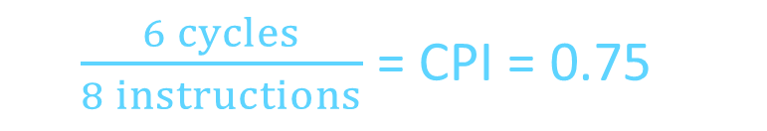
Scheduling Example
Compiler scheduling for dual-issue MIPS…
Loop: lw $t0, 0($s1) # $t0 = A[i]
lw $t1, 4($s1) # $t1 = A[i+1]
addu $t0, $t0, $s2 # add $s2
addu $t1, $t1, $s2 # add $s2
sw $t0, 0($s1) # store A[i]
sw $t1, 4($s1) # store A[i+1]
addi $s1, $s1, +8 # increment pointer
bne $s1, $s3, Loop # continue if $s1!=end
ALU/branch slot Load/store slot cycle
Loop: nop lw $t0, 0($s1) 1
nop lw $t1, 4($s1) 2
addu $t0, $t0, $s2 nop 3
addu $t1, $t1, $s2 sw $t0, 0($s1) 4
addi $s1, $s1, +8 sw $t1, 4($s1) 5
bne $s1, $s3, Loop nop 6
8 cycles
-8
-4
delay slot
6 cycles
$\frac{6 cycles}{8 instructions}$ = CPI = 0.75
Notes:
assume 1 delay slot for loads
can move addi earlier
CPI = 6 cycles / 8 instructions = 0.75
CPI = 5 cycles / 8 instructions = 0.625

Slide 29
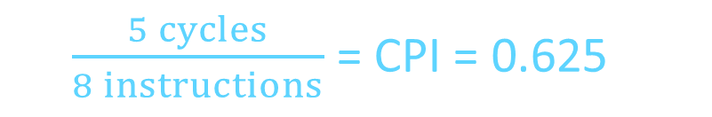
Scheduling Example
Compiler scheduling for dual-issue MIPS…
Loop: lw $t0, 0($s1) # $t0 = A[i]
lw $t1, 4($s1) # $t1 = A[i+1]
addu $t0, $t0, $s2 # add $s2
addu $t1, $t1, $s2 # add $s2
sw $t0, 0($s1) # store A[i]
sw $t1, 4($s1) # store A[i+1]
addi $s1, $s1, +8 # increment pointer
bne $s1, $s3, Loop # continue if $s1!=end
ALU/branch slot Load/store slot cycle
Loop: nop lw $t0, 0($s1) 1
addi $s1, $s1, +8 lw $t1, 4($s1) 2
addu $t0, $t0, $s2 nop 3
addu $t1, $t1, $s2 sw $t0, -8($s1) 4
bne $s1, $s3, Loop sw $t1, -4($s1) 5
8 cycles
-8
-4
5 cycles
$\frac{5 cycles}{8 instructions}$ = CPI = 0.625
Notes:
assume 1 delay slot for loads
can move addi earlier
CPI = 6 cycles / 8 instructions = 0.75
CPI = 5 cycles / 8 instructions = 0.625

Slide 30
Limits of Static Scheduling
Compiler scheduling for dual-issue MIPS…
lw $t0, 0($s1) # load A
addi $t0, $t0, +1 # increment A
sw $t0, 0($s1) # store A
lw $t0, 0($s2) # load B
addi $t0, $t0, +1 # increment B
sw $t0, 0($s2) # store B
ALU/branch slot Load/store slot cycle
nop lw $t0, 0($s1) 1
nop nop 2
addi $t0, $t0, +1 nop 3
nop sw $t0, 0($s1) 4
nop lw $t0, 0($s2) 5
nop nop 6
addi $t0, $t0, +1 nop 7
nop sw $t0, 0($s2) 8
Notes:
Rename registers, move load B up, eliminate delay slot
But! s1 and s2 might be equal => Aliasing!

Slide 31
Limits of Static Scheduling
Compiler scheduling for dual-issue MIPS…
lw $t0, 0($s1) # load A
addi $t0, $t0, +1 # increment A
sw $t0, 0($s1) # store A
lw $t1, 0($s2) # load B
addi $t1, $t1, +1 # increment B
sw $t1, 0($s2) # store B
ALU/branch slot Load/store slot cycle
nop lw $t0, 0($s1) 1
nop nop 2
addi $t0, $t0, +1 nop 3
nop sw $t0, 0($s1) 4
nop lw $t1, 0($s2) 5
nop nop 6
addi $t1, $t1, +1 nop 7
nop sw $t1, 0($s2) 8
Notes:
Rename registers, move load B up, eliminate delay slot
But! s1 and s2 might be equal => Aliasing!

Slide 32
Limits of Static Scheduling
Compiler scheduling for dual-issue MIPS…
lw $t0, 0($s1) # load A
addi $t0, $t0, +1 # increment A
sw $t0, 0($s1) # store A
lw $t1, 0($s2) # load B
addi $t1, $t1, +1 # increment B
sw $t1, 0($s2) # store B
ALU/branch slot Load/store slot cycle
nop lw $t0, 0($s1) 1
nop lw $t1, 0($s2) 2
addi $t0, $t0, +1 nop 3
addi $t1, $t1, +1 sw $t0, 0($s1) 4
nop sw $t1, 0($s2) 5
Problem: What if $s1 and $s2 are equal (aliasing)? Won’t work
Notes:
Rename registers, move load B up, eliminate delay slot
But! s1 and s2 might be equal => Aliasing!

Slide 33
Dynamic Multiple Issue
Dynamic Multiple Issue
a.k.a. SuperScalar Processor (c.f. Intel)
  CPU examines instruction stream and chooses multiple instructions to issue each cycle
  Compiler can help by reordering instructions….
  … but CPU is responsible for resolving hazards
Even better: Speculation/Out-of-order Execution
  Execute instructions as early as possible
  Aggressive register renaming
  Guess results of branches, loads, etc.
  Roll back if guesses were wrong
  Don’t commit results until all previous insts. are retired

Slide 34
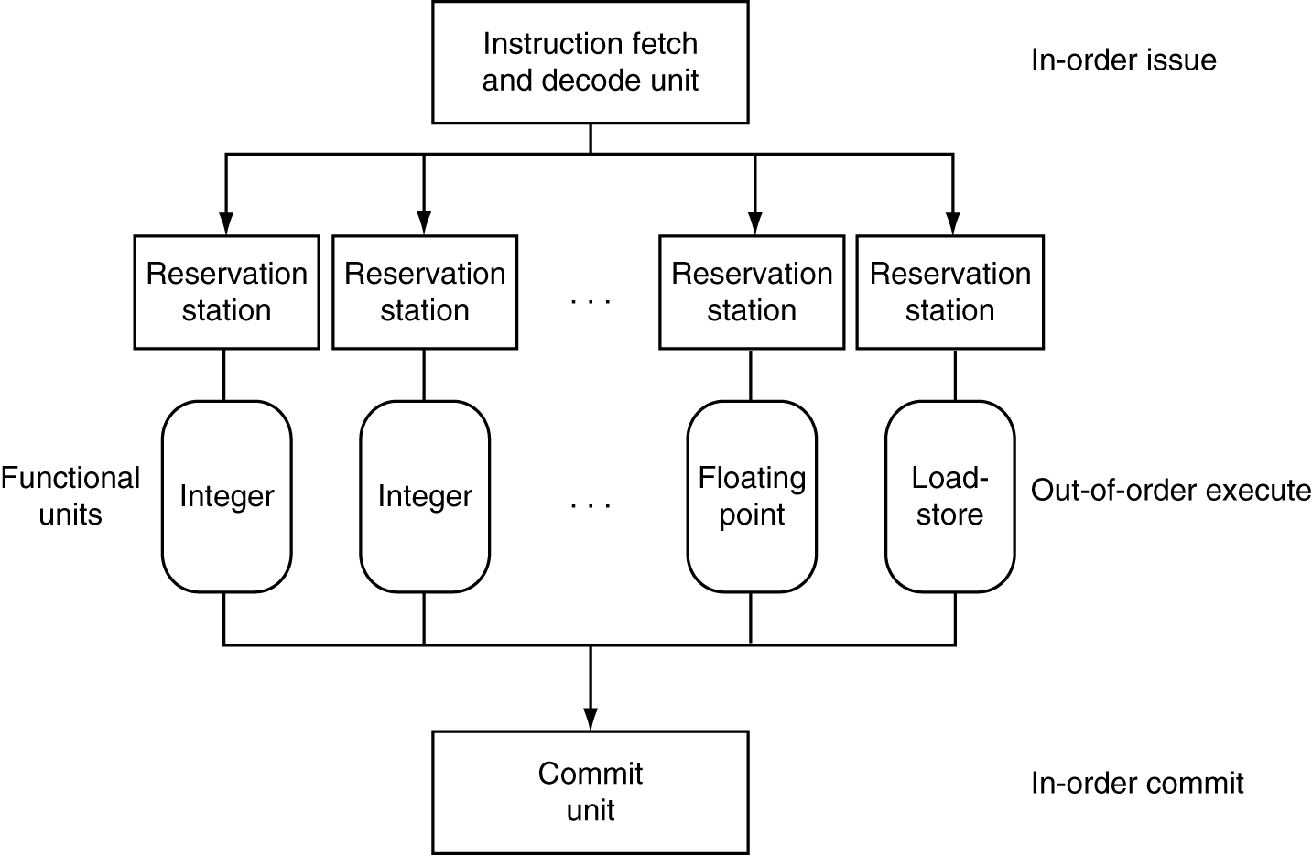
Dynamic Multiple Issue

Slide 35
Does Multiple Issue Work?
Q: Does multiple issue / ILP work?
A: Kind of… but not as much as we’d like
Limiting factors?
  Programs dependencies
  Hard to detect dependencies → be conservative
    e.g. Pointer Aliasing: A[0] += 1; B[0] *= 2;
  Hard to expose parallelism
    Can only issue a few instructions ahead of PC
  Structural limits
    Memory delays and limited bandwidth
  Hard to keep pipelines full

Slide 36
Power Efficiency
Q: Does multiple issue / ILP cost much?
A: Yes.
→ Dynamic issue and speculation requires power
CPU | Year | Clock Rate | Pipeline Stages | Issue width | Out-of-order/ Speculation | Cores | Power
i486 | 1989 | 25MHz | 5 | 1 | No | 1 | 5W
Pentium | 1993 | 66MHz | 5 | 2 | No | 1 | 10W
Pentium Pro | 1997 | 200MHz | 10 | 3 | Yes | 1 | 29W
P4 Willamette | 2001 | 2000MHz | 22 | 3 | Yes | 1 | 75W
UltraSparc III | 2003 | 1950MHz | 14 | 4 | No | 1 | 90W
P4 Prescott | 2004 | 3600MHz | 31 | 3 | Yes | 1 | 103W
Core | 2006 | 2930MHz | 14 | 4 | Yes | 2 | 75W
Core i5 Nehal | 2010 | 3300MHz | 14 | 4 | Yes | 1 | 87W
Core i5 Ivy Br | 2012 | 3400MHz | 14 | 4 | Yes | 8 | 77W
UltraSparc T1 | 2005 | 1200MHz | 6 | 1 | No | 8 | 70W
→ Multiple simpler cores may be better?

Slide 37
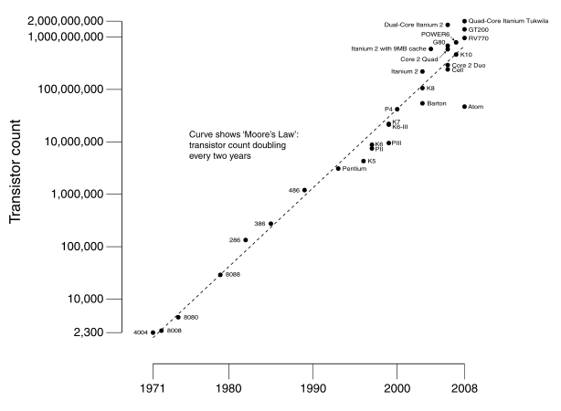
Moore’s Law
Dual-core Itanium 2
K10
Itanium 2
K8
P4
Atom
Pentium
486
386
286
8088
8080
4004
8008
Notes:
NVIDIA GF100 has 3B transistors

Slide 38
Why Multicore?
Moore’s law
  A law about transistors
  Smaller means more transistors per die
  And smaller means faster too
But: Power consumption growing too…

Slide 39
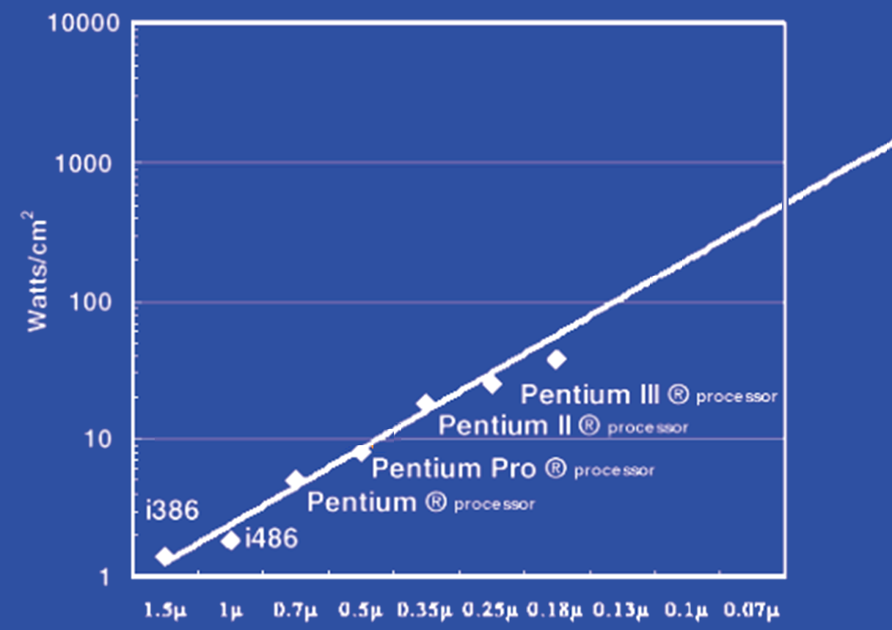
Power Limits
Surface of Sun
Rocket Nozzle
Nuclear Reactor
Xeon
Hot Plate
180nm
32nm
Notes:
Intel Westmere: 32 nm = 0.032u, 130W / 240mm^2 = 54 W/cm^2

Slide 40
Power Wall
Power = capacitance * voltage² * frequency
In practice: Power ~ voltage³
Reducing voltage helps (a lot)
... so does reducing clock speed
Better cooling helps
The power wall
  We can’t reduce voltage further
  We can’t remove more heat
Lower Frequency

Slide 41
Why Multicore?
Performance
1.2x
Single-Core
Overclocked +20%
Power
1.7x
Performance
1.0x
Power
Single-Core
1.0x
Performance
0.8x
1.6x
Single-Core
Underclocked -20%
Dual-Core
Underclocked -20%
Power
0.51x
1.02x

Slide 42
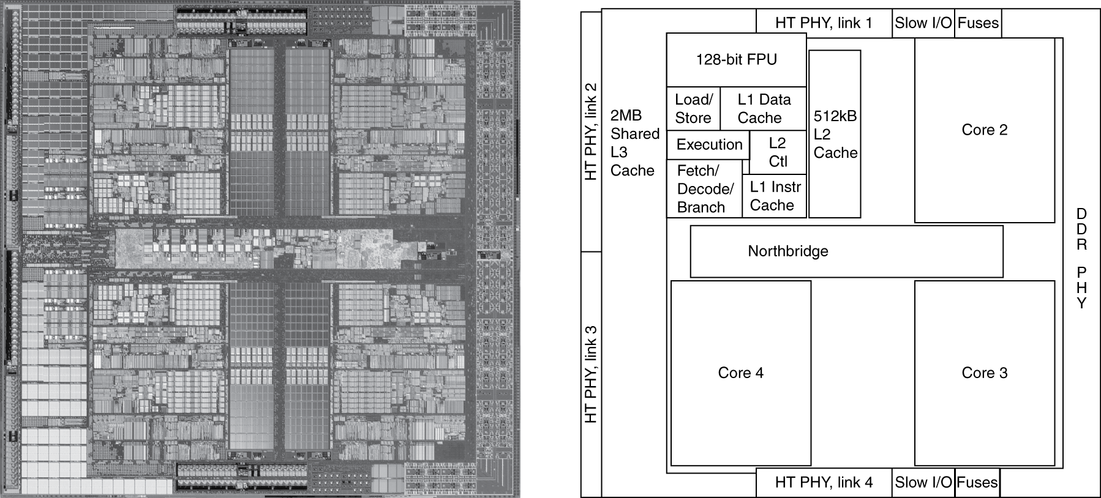
Inside the Processor
AMD Barcelona Quad-Core: 4 processor cores

Slide 43
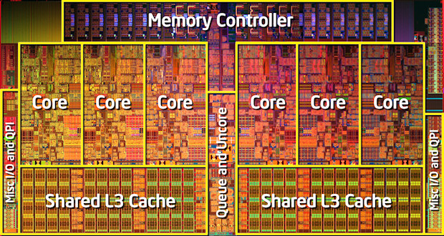
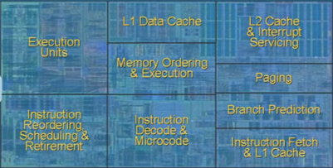
Inside the Processor
Intel Nehalem Hex-Core
4-wide pipeline

Slide 44
Multicore is a necessity. How can we get better performance?

Slide 45
Hardware multithreading
Hardware multithreading
  Increase utilization with low overhead
Switch between hardware threads for stalls

Slide 46
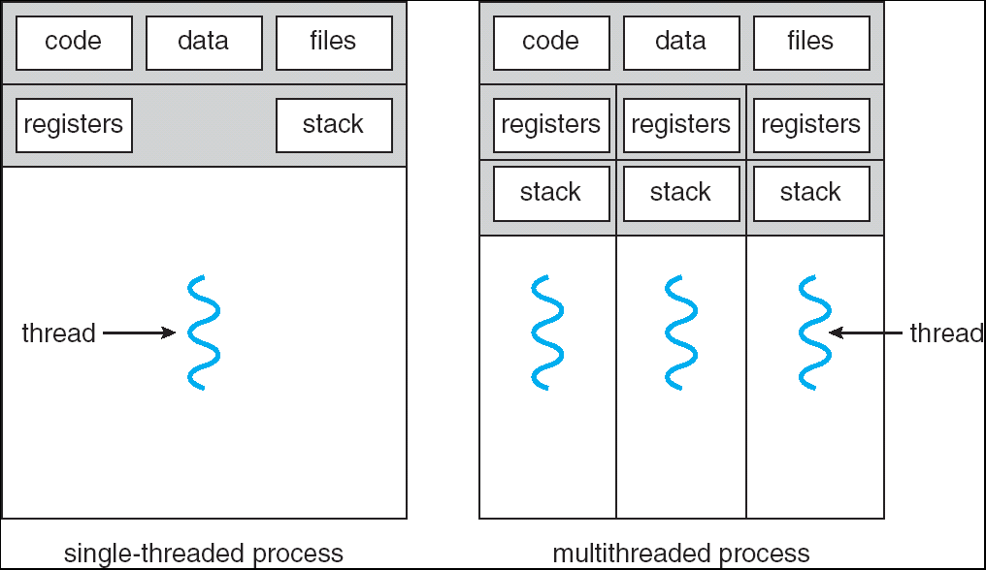
What is a thread?
Process includes multiple threads, code, data and OS state

Slide 47
Hardware multithreading
Fine grained vs. Coarse grained hardware multithreading
Simultaneous multithreading (SMT)
Hyperthreads (Intel simultaneous multithreading)
  Need to hide latency

Slide 48
Hardware multithreading
Fine grained vs. Coarse grained hardware multithreading
Fine grained multithreading
Switch on each cycle
Pros: Can hide very short stalls
Cons: Slows down every thread
Coarse grained multithreading
Switch only on quite long stalls
Pros: removes need for very fast switches
Cons: flush pipeline, short stalls not handled

Slide 49
Simultaneous multithreading
SMT
Leverages multi-issue pipeline with dynamic instruction scheduling and ILP
Exploits functional unit parallelism better than single threads
Always running multiple instructions from multiple threads
  No cost of context switching
  Uses dynamic scheduling and register renaming through reservation stations
Can use all functional units very efficiently

Slide 50
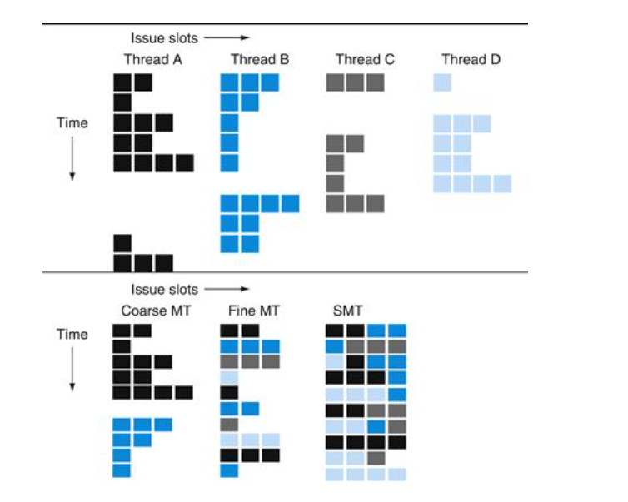

Slide 51
Hyperthreading
vs. HT
Multi-Core vs. Multi-Issue
Programs:
Num. Pipelines:
Pipeline Width:
Hyperthreads
  HT = MultiIssue + extra PCs and registers – dependency logic
  HT = MultiCore – redundant functional units + hazard avoidance
Hyperthreads (Intel)
  Illusion of multiple cores on a single core
  Easy to keep HT pipelines full + share functional units
N | 1 | N
N | 1 | 1
1 | N | N
Notes:
HT = MultiIssue + extra PCs and registers – dependency logic
HT = MultiCore – redundant functional units + hazard avoidance

Slide 52
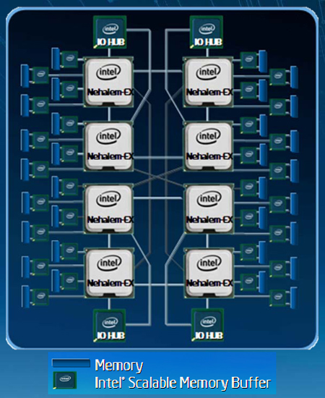
Example: All of the above
8 die (aka 8 sockets)
4 core per socket
2 HT per core
Note: a socket is a processor,
where each processor may
have multiple processing
cores, so this is an example
of a multiprocessor multicore
hyperthreaded system
Notes:
MultiCore: 8 processors dies * 8 cores per processor die
Hyperthreading: 2 HT per core
Dynamic Multi-Issue: 4 issue
Pipeline: 16 stages

Slide 53
Parallel Programming
Q: So lets just all use multicore from now on!
A: Software must be written as parallel program
Multicore difficulties
  Partitioning work
  Coordination & synchronization
  Communications overhead
  Balancing load over cores
  How do you write parallel programs?
    ... without knowing exact underlying architecture?
Notes:
Or hyperthreads

Slide 54
Work Partitioning
Partition work so all cores have something to do

Slide 55
Load Balancing
Load Balancing
Need to partition so all cores are actually working

Slide 56
Amdahl’s Law
If tasks have a serial part and a parallel part…
Example:
step 1: divide input data into n pieces
step 2: do work on each piece
step 3: combine all results
Recall: Amdahl’s Law
As number of cores increases …
  time to execute parallel part?
  time to execute serial part?
  Serial part eventually dominates
goes to zero
Remains the same

Slide 57
Amdahl’s Law
Notes:
Underclocking messes up the ratios completely. Work through a 8x slowdown example.

Slide 58
Parallelism is a necessity
Necessity, not luxury
Power wall
Not easy to get performance out of
Many solutions
Pipelining
Multi-issue
Hyperthreading
Multicore

Slide 59
Parallel Programming
Q: So lets just all use multicore from now on!
A: Software must be written as parallel program
Multicore difficulties
  Partitioning work
  Coordination & synchronization
  Communications overhead
  Balancing load over cores
  How do you write parallel programs?
    ... without knowing exact underlying architecture?
SW
Your
career…
HW
Notes:
Most is software, but hardware can help:
- communications (fast core-to-core interconnect)
- coordination and synchronization primitives (next time)

