Slide 1
Virtual Memory 3
Hakim Weatherspoon
CS 3410, Spring 2012
Computer Science
Cornell University
P & H Chapter 5.4

Slide 2
Administrivia
Project3 available now
  Design Doc due next week, Monday, April 16th
  Schedule a Design Doc review Mtg now for next week
  Whole project due Monday, April 23rd
  Competition/Games night Friday, April 27th, 5-7pm
Prelim3 is in two and a half weeks, Thursday, April 26th
  Time and Location: 7:30pm in Olin Hall room 155
  Old prelims are online in CMS

Slide 3
Goals for Today
Virtual Memory
  Address Translation
    Pages, page tables, and memory mgmt unit
  Paging
  Role of Operating System
    Context switches, working set, shared memory
  Performance
    How slow is it
    Making virtual memory fast
    Translation lookaside buffer (TLB)
  Virtual Memory Meets Caching

Slide 4
Virtual Memory

Slide 5
Big Picture: Multiple Processes
How to Run multiple processes?
Time-multiplex a single CPU core (multi-tasking)
  Web browser, skype, office, … all must co-exist
Many cores per processor (multi-core)
or many processors (multi-processor)
  Multiple programs run simultaneously

Slide 6
Big Picture: (Virtual) Memory
Memory: big & slow vs Caches: small & fast
compute
jump/branch
targets
memory
register
file
A
alu
D
D
B
+4
addr
PC
inst
control
B
d_{in}
d_{out}
M
memory
new
pc
extend
imm
detect
hazard
forward
unit
Instruction
Fetch
Instruction
Decode
Write-
Back
ctrl
ctrl
ctrl
Execute
Memory
IF/ID
ID/EX
EX/MEM
MEM/WB

Slide 7
Big Picture: (Virtual) Memory
Memory: big & slow vs Caches: small & fast
Processor
Cache
Memory
0xfff…f
0x7ff…f
Stack
LB $1 ← M[ 1 ]
LB $2 ← M[ 5 ]
LB $3 ← M[ 1 ]
LB $3 ← M[ 4 ]
LB $2 ← M[ 0 ]
LB $2 ← M[ 12 ]
LB $2 ← M[ 5 ]
LB $2 ← M[ 12 ]
LB $2 ← M[ 5 ]
LB $2 ← M[ 12 ]
LB $2 ← M[ 5 ]
tag data
100
110
1
2
140
Heap
150
Data
0
Text
0
Misses:
Hits:
0x000…0

Slide 8
Processor & Memory
CPU address/data bus...
… routed through caches
… to main memory
  Simple, fast, but…
Q: What happens for LW/SW
to an invalid location?
  0x000000000 (NULL)
  uninitialized pointer
A: Need a memory management unit (MMU)
  Throw (and/or handle) an exception
CPU
0xfff…f
0x7ff…f
Stack
Heap
Data
Text
0x000…0
Memory

Slide 9
Multiple Processes
Q: What happens when another program is executed concurrently on another processor?
A: The addresses will conflict
  Even though, CPUs may take
  turns using memory bus
CPU
0xfff…f
0x7ff…f
Stack
Stack
Heap
Heap
CPU
Data
Data
Text
Text
0x000…0
Memory

Slide 10
Multiple Processes
Q: Can we relocate second program?
CPU
0xfff…f
0x7ff…f
Stack
Stack
Heap
Heap
CPU
Data
Data
Text
Text
0x000…0
Memory

Slide 11
Solution? Multiple processes/processors
Q: Can we relocate second program?
A: Yes, but…
  What if they don’t fit?
  What if not contiguous?
  Need to recompile/relink?
  …
Stack
CPU
Data
Stack
Heap
Heap
CPU
Data
Text
Text
Memory

Slide 12
All problems in computer science can be solved by another level of indirection.
– David Wheeler
– or, Butler Lampson
– or, Leslie Lamport
– or, Steve Bellovin
  paddr = PageTable[vaddr];

Slide 13
Performance

Slide 14
Performance Review
Virtual Memory Summary
PageTable for each process:
  4MB contiguous in physical memory, or multi-level, …
  every load/store translated to physical addresses
  page table miss = page fault
  load the swapped-out page and retry instruction,
  or kill program if the page really doesn’t exist,
  or tell the program it made a mistake

Slide 15
Beyond Flat Page Tables
Assume most of PageTable is empty
How to translate addresses?
Multi-level PageTable
10 bits
10 bits
10 bits
2
vaddr
Word
PTEntry
Page
PDEntry
Page Table
PTBR
Page Directory
* x86 does exactly this
Notes:
Q: Benefits?
A1: Don’t need 4MB contiguous physical memory
A2: Don’t need to allocate every PageTable, only those containing valid PTEs
Q: Drawbacks?
A: Longer lookups.

Slide 16
Page Table Review
x86 Example: 2 level page tables, assume…
32 bit vaddr, 32 bit paddr
4k PDir, 4k PTables, 4k Pages
Q:How many bits for a physical page number?
A: 20
Q: What is stored in each PageTableEntry?
A: ppn, valid/dirty/r/w/x/…
Q: What is stored in each PageDirEntry?
A: ppn, valid/?/…
Q: How many entries in a PageDirectory?
A: 1024 four-byte PDEs
Q: How many entires in each PageTable?
A: 1024 four-byte PTEs
PDE
PTE
PTBR
PDE
PDE
PTE
PDE
PTE
PTE
Notes:
byte offset = 0x44c
PTI = 0x12a
PDI = 0x205

Slide 17
Page Table Review Example
x86 Example: 2 level page tables, assume…
32 bit vaddr, 32 bit paddr
4k PDir, 4k PTables, 4k Pages
PTBR = 0x10005000 (physical)
Write to virtual address 0x7192a44c…
Q: Byte offset in page? PT Index? PD Index?
(1) PageDir is at 0x10005000, so…
Fetch PDE from physical address 0x1005000+(4*PDI)
  suppose we get {0x12345, v=1, …}
(2) PageTable is at 0x12345000, so…
Fetch PTE from physical address 0x12345000+(4*PTI)
  suppose we get {0x14817, v=1, d=0, r=1, w=1, x=0, …}
(3) Page is at 0x14817000, so…
Write data to physical address?
Also: update PTE with d=1
PDE
PTE
PTBR
PDE
PDE
PTE
PDE
PTE
PTE
0x1481744c
Notes:
byte offset = 0x44c
PTI = 0x12a
PDI = (0x719 >> 2) = 0x1c6

Slide 18
Performance Review
Virtual Memory Summary
PageTable for each process:
  4MB contiguous in physical memory, or multi-level, …
  every load/store translated to physical addresses
  page table miss: load a swapped-out page and retry instruction, or kill program
Performance?
  terrible: memory is already slow
  translation makes it slower
Solution?
  A cache, of course
Notes:
4x slower!
Pipelining? No. Parallelization? No.

Slide 19
Making Virtual Memory Fast
  The Translation Lookaside Buffer (TLB)

Slide 20
Translation Lookaside Buffer (TLB)
Hardware Translation Lookaside Buffer (TLB)
A small, very fast cache of recent address mappings
  TLB hit: avoids PageTable lookup
  TLB miss: do PageTable lookup, cache result for later

Slide 21
TLB Diagram
V | R | W | X | D | tag | ppn
V | R | W | X | D
0 |  |  |  |  | invalid
1 |  |  |  | 0
0 |  |  |  |  | invalid
0 |  |  |  |  | invalid
1 |  |  |  | 0
0 |  |  |  | 0
1 |  |  |  | 1
0 |  |  |  |  | invalid
V
0 |  | invalid
0 |  | invalid
0 |  | invalid
1
0 |  | invalid
1
1
0 |  | invalid

Slide 22
A TLB in the Memory Hierarchy
TLB
Lookup
Cache
CPU
Mem
Disk
PageTable
Lookup
(1) Check TLB for vaddr (~ 1 cycle)
(2) TLB Miss: traverse PageTables for vaddr
(3a) PageTable has valid entry for in-memory page
  Load PageTable entry into TLB; try again (tens of cycles)
(3b) PageTable has entry for swapped-out (on-disk) page
  Page Fault: load from disk, fix PageTable, try again (millions of cycles)
(3c) PageTable has invalid entry
  Page Fault: kill process
(2) TLB Hit
  compute paddr, send to cache
Notes:
TLB miss in hardware usually, but not always
PageTable stuff in software

Slide 23
TLB Coherency
TLB Coherency: What can go wrong?
A: PageTable or PageDir contents change
  swapping/paging activity, new shared pages, …
A: Page Table Base Register changes
  context switch between processes
Notes:
Fully transparent

Slide 24
Translation Lookaside Buffers (TLBs)
When PTE changes, PDE changes, PTBR changes….
Full Transparency: TLB coherency in hardware
  Flush TLB whenever PTBR register changes
  [easy – why?]
  Invalidate entries whenever PTE or PDE changes
  [hard – why?]
TLB coherency in software
If TLB has a no-write policy…
  OS invalidates entry after OS modifies page tables
  OS flushes TLB whenever OS does context switch
Notes:
process ID could just be the PTBR for the process

Slide 25
TLB Parameters
TLB parameters (typical)
  very small (64 – 256 entries), so very fast
  fully associative, or at least set associative
  tiny block size: why?
Intel Nehalem TLB (example)
  128-entry L1 Instruction TLB, 4-way LRU
  64-entry L1 Data TLB, 4-way LRU
  512-entry L2 Unified TLB, 4-way LRU

Slide 26
Virtual Memory meets Caching
  Virtually vs. physically addressed caches
  Virtually vs. physically tagged caches

Slide 27
Virtually Addressed Caching
Q: Can we remove the TLB from the critical path?
A: Virtually-Addressed Caches
CPU
TLB
Lookup
Mem
Disk
Virtually
Addressed
Cache
PageTable
Lookup
Notes:
A: have to flush entire cache on context switch
A:
Doing synonym updates requires significant hardware – essentially an associative lookup on the physical address tags to see if you have multiple hits

Slide 28
Virtual vs. Physical Caches
CPU
addr
Cache
SRAM
Memory
DRAM
MMU
data
Cache works on physical addresses
addr
Memory
DRAM
CPU
Cache
SRAM
MMU
data
Cache works on virtual addresses
Q: What happens on context switch?
Q: What about virtual memory aliasing?
Q: So what’s wrong with physically addressed caches?
Notes:
A1: Physically-addressed: nothing; Virtually-addressed: need to flush cache
A2: Physically-addressed: nothing; Virtually-addressed: problems

Slide 29
Indexing vs. Tagging
Physically-Addressed Cache
  slow: requires TLB (and maybe PageTable) lookup first
Virtually-Indexed, Virtually Tagged Cache
  fast: start TLB lookup before cache lookup finishes
  PageTable changes (paging, context switch, etc.)
    → need to purge stale cache lines (how?)
  Synonyms (two virtual mappings for one physical page)
    → could end up in cache twice (very bad!)
Virtually-Indexed, Physically Tagged Cache
  ~fast: TLB lookup in parallel with cache lookup
  PageTable changes → no problem: phys. tag mismatch
  Synonyms → search and evict lines with same phys. tag
Virtually-Addressed Cache

Slide 30
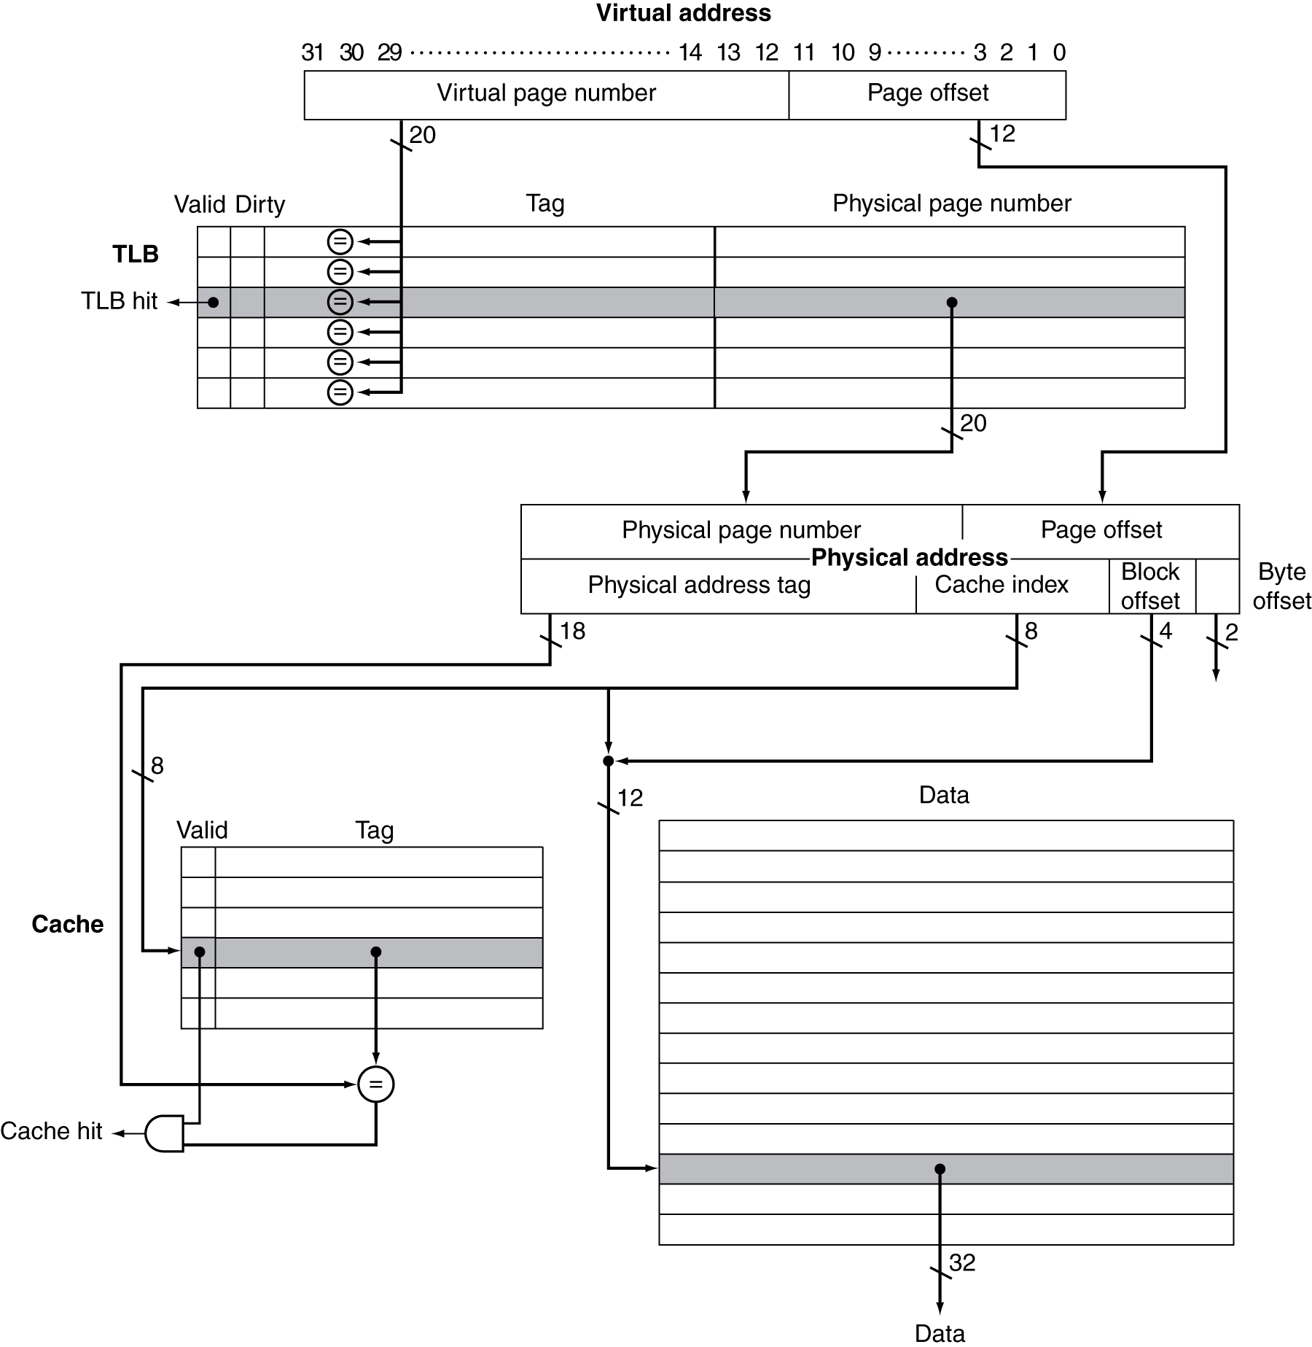
Indexing vs. Tagging

Slide 31
Typical Cache Setup
Memory
DRAM
CPU
addr
L2 Cache
SRAM
L1 Cache
SRAM
MMU
data
TLB SRAM
Typical L1: On-chip virtually addressed, physically tagged
Typical L2: On-chip physically addressed
Typical L3: On-chip …

Slide 32
Summary of Caches/TLBs/VM
Caches, Virtual Memory, & TLBs
Where can block be placed?
  Direct, n-way, fully associative
What block is replaced on miss?
  LRU, Random, LFU, …
How are writes handled?
  No-write (w/ or w/o automatic invalidation)
  Write-back (fast, block at time)
  Write-through (simple, reason about consistency)
Notes:
Where?
Caches: direct/n-way/fa
VM: fa, but with a table of contents to eliminate searches
TLB: fa
Replacement?
varied
Writes?
Caches: usually write-back, or maybe write-through, or maybe no-write w/ invalidation
VM: write-back
TLB: usually no-write

Slide 33
Summary of Caches/TLBs/VM
Caches, Virtual Memory, & TLBs
Where can block be placed?
  Caches: direct/n-way/fully associative (fa)
  VM: fa, but with a table of contents to eliminate searches
  TLB: fa
What block is replaced on miss?
  varied
How are writes handled?
  Caches: usually write-back, or maybe write-through, or maybe no-write w/ invalidation
  VM: write-back
  TLB: usually no-write
Notes:
Where?
Caches: direct/n-way/fa
VM: fa, but with a table of contents to eliminate searches
TLB: fa
Replacement?
varied
Writes?
Caches: usually write-back, or maybe write-through, or maybe no-write w/ invalidation
VM: write-back
TLB: usually no-write

Slide 34
Summary of Cache Design Parameters
 | L1 | Paged Memory | TLB
Size (blocks) | 1/4k to 4k | 16k to 1M | 64 to 4k
Size (kB) | 16 to 64 | 1M to 4G | 2 to 16
Block size (B) | 16-64 | 4k to 64k | 4-32
Miss rates | 2%-5% | 10⁻⁴ to 10⁻⁵% | 0.01% to 2%
Miss penalty | 10-25 | 10M-100M | 100-1000

