Slide 1
Virtual Memory
Hakim Weatherspoon
CS 3410, Spring 2012
Computer Science
Cornell University
P & H Chapter 5.4 (up to TLBs)

Slide 2
Goals for Today
Virtual Memory
  Address Translation
    Pages, page tables, and memory mgmt unit
  Paging
  Role of Operating System
    Context switches, working set, shared memory
  Performance
    How slow is it
    Making virtual memory fast
    Translation lookaside buffer (TLB)
  Virtual Memory Meets Caching

Slide 3
Virtual Memory

Slide 4
Big Picture: Multiple Processes
How to Run multiple processes?
Time-multiplex a single CPU core (multi-tasking)
  Web browser, skype, office, … all must co-exist
Many cores per processor (multi-core)
or many processors (multi-processor)
  Multiple programs run simultaneously

Slide 5
Big Picture: (Virtual) Memory
Memory: big & slow vs Caches: small & fast
compute
jump/branch
targets
memory
register
file
A
alu
D
D
B
+4
addr
PC
inst
control
B
d_{in}
d_{out}
M
memory
new
pc
extend
imm
detect
hazard
forward
unit
Instruction
Fetch
Instruction
Decode
Write-
Back
ctrl
ctrl
ctrl
Execute
Memory
IF/ID
ID/EX
EX/MEM
MEM/WB

Slide 6
Big Picture: (Virtual) Memory
Memory: big & slow vs Caches: small & fast
Processor
Cache
Memory
0xfff…f
0x7ff…f
Stack
LB $1 ← M[ 1 ]
LB $2 ← M[ 5 ]
LB $3 ← M[ 1 ]
LB $3 ← M[ 4 ]
LB $2 ← M[ 0 ]
LB $2 ← M[ 12 ]
LB $2 ← M[ 5 ]
LB $2 ← M[ 12 ]
LB $2 ← M[ 5 ]
LB $2 ← M[ 12 ]
LB $2 ← M[ 5 ]
tag data
100
110
1
2
140
Heap
150
Data
0
Text
0
Misses:
Hits:
0x000…0

Slide 7
Processor & Memory
CPU address/data bus...
… routed through caches
… to main memory
  Simple, fast, but…
Q: What happens for LW/SW
to an invalid location?
  0x000000000 (NULL)
  uninitialized pointer
A: Need a memory management unit (MMU)
  Throw (and/or handle) an exception
CPU
0xfff…f
0x7ff…f
Stack
Heap
Data
Text
0x000…0
Memory

Slide 8
Multiple Processes
Q: What happens when another program is executed concurrently on another processor?
A: The addresses will conflict
  Even though, CPUs may take
  turns using memory bus
CPU
0xfff…f
0x7ff…f
Stack
Stack
Heap
Heap
CPU
Data
Data
Text
Text
0x000…0
Memory

Slide 9
Multiple Processes
Q: Can we relocate second program?
CPU
0xfff…f
0x7ff…f
Stack
Stack
Heap
Heap
CPU
Data
Data
Text
Text
0x000…0
Memory

Slide 10
Solution? Multiple processes/processors
Q: Can we relocate second program?
A: Yes, but…
  What if they don’t fit?
  What if not contiguous?
  Need to recompile/relink?
  …
Stack
CPU
Data
Stack
Heap
Heap
CPU
Data
Text
Text
Memory

Slide 11
All problems in computer science can be solved by another level of indirection.
– David Wheeler
– or, Butler Lampson
– or, Leslie Lamport
– or, Steve Bellovin

Slide 12
Virtual Memory
Virtual Memory: A Solution for All Problems
Each process has its own virtual address space
  Programmer can code as if they own all of memory
On-the-fly at runtime, for each memory access
  all access is indirect through a virtual address
  translate fake virtual address to a real physical address
  redirect load/store to the physical address

Slide 13
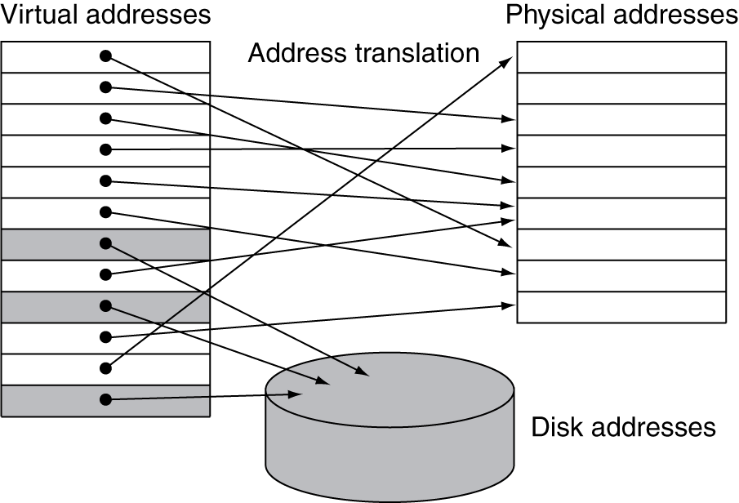
Address Space
wikipedia

Slide 14
Address Space
X
CPU
CPU
A
C
X
B
B
Y
C
Z
Z
MMU
MMU
Y
A
Programs load/store to virtual addresses
Actual memory uses physical addresses
Memory Management Unit (MMU)
  Responsible for translating on the fly
  Essentially, just a big array of integers:
  paddr = PageTable[vaddr];
Notes:
each mmu has own mappings
Easy relocation
Higher memory utilization
Easy sharing

Slide 15
Virtual Memory Advantages
Advantages
Easy relocation
  Loader puts code anywhere in physical memory
  Creates virtual mappings to give illusion of correct layout
Higher memory utilization
  Provide illusion of contiguous memory
  Use all physical memory, even physical address 0x0
Easy sharing
  Different mappings for different programs / cores
And more to come…

Slide 16
Address Translation
Pages, Page Tables, and
the Memory Management Unit (MMU)

Slide 17
Address Translation
Attempt #1: How does MMU translate addresses?
paddr = PageTable[vaddr];
Granularity?
  Per word…
  Per block…
  Variable..…
Typical:
  4KB – 16KB pages
  4MB – 256MB jumbo pages
Notes:
per word … too expensive: 4GB PageTable arrray
per block… ?
Variable … complicated hardware
We will stick to 4kb pages

Slide 18
Address Translation
Virtual page number
Page Offset
vaddr
Lookup in PageTable
Physical page number
Page offset
paddr
Attempt #1: For any access to virtual address:
  Calculate virtual page number and page offset
  Lookup physical page number at PageTable[vpn]
  Calculate physical address as ppn:offset
Notes:
4kb pages = 12 bits for page offset, 20 bits for VPN

Slide 19
Simple PageTable
Read Mem[0x4123B538]
Data
CPU
0xC20A3000
MMU
Q: Where to store page tables?
A: In memory, of course…
Special page table base register
(CR3:PTBR on x86)
(Cop0:ContextRegister on MIPS)
0x90000000
0x4123B000
0x10045000
0x10044000
0x00000000
Notes:
VADDR = 0x00401538
PFN = VADDR/4kb = VADDR>>12 = 0x401
PageTableEntry at 0x90000804 contains 0x4123B000
Data at 0x4123B538

Slide 20
Simple PageTable
 | Physical Page Number
 | 0x10045
 | 0xC20A3
 | 0x4123B
 | 0x10044
0xC20A3000
0x90000000
0x4123B000
vpn | pgoff
vaddr
0x10045000
0x10044000
0x00000000
PTBR

Slide 21
Invalid Pages
V |  | Physical Page Number
0
1 |  | 0x10045
0
0
1 |  | 0xC20A3
1 |  | 0x4123B
1 |  | 0x10044
0
0xC20A3000
0x90000000
0x4123B000
Cool Trick #1: Don’t map all pages
Need valid bit for each
page table entry
Q: Why?
A: now access to NULL will fail
A: we might not have that much physical memory
0x10045000
0x10044000
0x00000000
Notes:
A: now access to NULL will fail
A: we might not have that much physical memory

Slide 22
Page Size Example
Overhead for VM Attempt #1 (example)
Virtual address space (for each process):
  total memory: 2³² bytes = 4GB
  page size: 2¹² bytes = 4KB
  entries in PageTable?
  size of PageTable?
Physical address space:
  total memory: 2²⁹ bytes = 512MB
  overhead for 10 processes?
Notes:
2²⁰ entries in pagetable, so 2²² bytes = 4MB (w/ 4byte entries), so 40MB (25% of total!)
Q: Can we possibly have a “full” pagetable?
A: Not enough physical memory pages – some pagetable entries will be duplicates!

Slide 23
Beyond Flat Page Tables
Assume most of PageTable is empty
How to translate addresses?
Multi-level PageTable
10 bits
10 bits
10 bits
2
vaddr
Word
PTEntry
Page
PDEntry
Page Table
PTBR
Page Directory
* x86 does exactly this
Notes:
Q: Benefits?
A1: Don’t need 4MB contiguous physical memory
A2: Don’t need to allocate every PageTable, only those containing valid PTEs
Q: Drawbacks?
A: Longer lookups.

Slide 24
Beyond Flat Page Tables
Assume most of PageTable is empty
How to translate addresses? Multi-level PageTable
Q: Benefits?
A: Don’t need 4MB contiguous physical memory
A: Don’t need to allocate every PageTable, only those containing valid PTEs
Q: Drawbacks
A: Performance: Longer lookups
Notes:
Q: Benefits?
A1: Don’t need 4MB contiguous physical memory
A2: Don’t need to allocate every PageTable, only those containing valid PTEs
Q: Drawbacks?
A: Longer lookups.

Slide 25
Page Permissions
V | R | W | X |  | Physical Page Number
0
1 |  |  |  |  | 0x10045
0
0
1 |  |  |  |  | 0xC20A3
1 |  |  |  |  | 0x4123B
1 |  |  |  |  | 0x10044
0
0xC20A3000
0x90000000
0x4123B000
Cool Trick #2: Page permissions!
Keep R, W, X permission bits for
each page table entry
Q: Why?
A: can make code read-only, executable;
make data read-write but not executable; etc.
0x10045000
0x10044000
0x00000000
Notes:
A: can make code read-only, executable; make data read-write but not executable; etc.

Slide 26
Aliasing
V | R | W | X |  | Physical Page Number
0
1 |  |  |  |  | 0xC20A3
0
0
1 |  |  |  |  | 0xC20A3
1 |  |  |  |  | 0x4123B
1 |  |  |  |  | 0x10044
0
0xC20A3000
0x90000000
0x4123B000
Cool Trick #3: Aliasing
Map the same physical page
at several virtual addresses
Q: Why?
A: can make different views of same
data with different permissions
0x10045000
0x10044000
0x00000000
Notes:
A: can make different views of same data with different permissions

Slide 27
Paging

Slide 28
Paging
Can we run process larger than physical memory?
  The “virtual” in “virtual memory”
View memory as a “cache” for secondary storage
  Swap memory pages out to disk when not in use
  Page them back in when needed
Assumes Temporal/Spatial Locality
  Pages used recently most likely to be used again soon

Slide 29
Paging
V | R | W | X | D | Physical Page Number
0 |  |  |  |  | invalid
1 |  |  |  | 0 | 0x10045
0 |  |  |  |  | invalid
0 |  |  |  |  | invalid
0 |  |  |  | 0 | disk sector 200
0 |  |  |  | 0 | disk sector 25
1 |  |  |  | 1 | 0x00000
0 |  |  |  |  | invalid
0xC20A3000
0x90000000
0x4123B000
0x10045000
Cool Trick #4: Paging/Swapping
Need more bits:
Dirty, RecentlyUsed, …
0x00000000
200
25
Notes:
A: can make code read-only, executable; make data read-write but not executable; etc.

Slide 30
Summary
Virtual Memory
  Address Translation
    Pages, page tables, and memory mgmt unit
  Paging
Next time
  Role of Operating System
    Context switches, working set, shared memory
  Performance
    How slow is it
    Making virtual memory fast
    Translation lookaside buffer (TLB)
  Virtual Memory Meets Caching

Slide 31
Administrivia
Lab3 is due next Monday
  Extra Lab Help session:
  Saturday, April 7th, 12:00-2:30pm in CSUGLab
HW5 is due next Tuesday
  Download updated version. Use updated version.
  Online Survey available later this evening

