Slide 1
Memory
See: P&H Appendix C.8, C.9

Slide 2
Big Picture: Building a Processor
memory
register
file
inst
alu
+4
+4
addr
=?
PC
d_{in}
d_{out}
control
cmp
offset
memory
new
pc
target
imm
extend
A Single cycle processor

Slide 3
Goals for today
Review
  Finite State Machines
Memory
  Register Files
  Tri-state devices
  SRAM (Static RAM—random access memory)
  DRAM (Dynamic RAM)

Slide 4
Which statement(s) is true
(A) In a Moore Machine output depends on both current state and input
(B) In a Mealy Machine output depends on current state and input
(C) In a Mealy Machine output depends on next state and input
(D) All the above are true
(E) None are true

Slide 5
Mealy Machine
General Case: Mealy Machine
Outputs and next state depend on both
current state and input
Registers
Current State
Comb.
Logic
Output
Input
Next State

Slide 6
Moore Machine
Special Case: Moore Machine
Outputs depend only on current state
Registers
Current State
Comb.
Logic
Output
Comb.
Logic
Input
Next State

Slide 7
Goals for today
Review
  Finite State Machines
Memory
  Register Files
  Tri-state devices
  SRAM (Static RAM—random access memory)
  DRAM (Dynamic RAM)

Slide 8
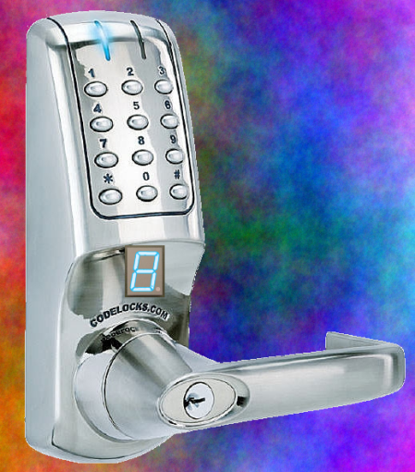
Example: Digital Door Lock
Digital Door Lock
Inputs:
keycodes from keypad
clock
Outputs:
“unlock” signal
display how many keys pressed so far

Slide 9
Door Lock: Inputs
Assumptions:
signals are synchronized to clock
Password is B-A-B
K | A | B | Meaning
0 | 0 | 0 | Ø (no key)
1 | 1 | 0 | ‘A’ pressed
1 | 0 | 1 | ‘B’ pressed
K
A
B

Slide 10
Door Lock: Outputs
Assumptions:
High pulse on U unlocks door
4
LED
dec
8
D₃D₂D₁D₀
U

Slide 11
Door Lock: Simplified State Diagram
Ø
Ø
“A”
“B”
G3
G1
G2
”3”, U
”1”
”2”
“B”
else
else
any
Idle
”0”
Ø
else
any
B1
else
B2
else
B3
”1”
”2”
”3”
Ø
Ø

Slide 12
Door Lock: Simplified State Diagram
Ø
Ø
“A”
“B”
G3
G1
G2
”3”, U
”1”
”2”
“B”
else
else
any
Idle
”0”
else
Ø
else
B1
else
B2
”1”
”2”
Ø
Ø

Slide 13
Door Lock: Simplified State Diagram
Ø
Ø
“A”
“B”
G3
G1
G2
”3”, U
”1”
”2”
“B”
else
else
any
Cur. State | Output
Cur. State | Output
Idle | “0”
G1 | “1”
G2 | “2”
G3 | “3”, U
B1 | “1”
B2 | “2”
Idle
”0”
else
Ø
else
B1
else
B2
”1”
”2”
Ø
Ø

Slide 14
Door Lock: Simplified State Diagram
Ø
Ø
Cur. State | Input | Next State
Cur. State | Input | Next State
Idle | Ø | Idle
Idle | “B” | G1
Idle | “A” | B1
G1 | Ø | G1
G1 | “A” | G2
G1 | “B” | B2
G2 | Ø | B2
G2 | “B” | G3
G2 | “A” | Idle
G3 | any | Idle
B1 | Ø | B1
B1 | K | B2
B2 | Ø | B2
B2 | K | Idle
“A”
“B”
G3
G1
G2
”3”, U
”1”
”2”
“B”
else
else
any
Idle
”0”
else
Ø
else
B1
else
B2
”1”
”2”
Ø
Ø

Slide 15
State Table Encoding
Cur. State | Output
Idle | “0”
G1 | “1”
G2 | “2”
G3 | “3”, U
B1 | “1”
B2 | “2”
S₂ | S₁ | S₀
0 | 0 | 0
0 | 0 | 1
0 | 1 | 0
0 | 1 | 1
1 | 0 | 0
1 | 0 | 1
D₃ | D₂ | D₁ | D₀ | U
0 | 0 | 0 | 0 | 0
0 | 0 | 0 | 1 | 0
0 | 0 | 1 | 0 | 0
0 | 0 | 1 | 1 | 1
0 | 0 | 0 | 1 | 0
0 | 0 | 1 | 0 | 0
Cur. State | Input | Next State
Idle | Ø | Idle
Idle | “B” | G1
Idle | “A” | B1
G1 | Ø | G1
G1 | “A” | G2
G1 | “B” | B2
G2 | Ø | B2
G2 | “B” | G3
G2 | “A” | Idle
G3 | any | Idle
B1 | Ø | B1
B1 | K | B2
B2 | Ø | B2
B2 | K | Idle
K | A | B
0 | 0 | 0
1 | 0 | 1
1 | 1 | 0
0 | 0 | 0
1 | 1 | 0
1 | 0 | 1
0 | 0 | 0
1 | 0 | 1
1 | 1 | 0
x | x | x
0 | 0 | 0
1 | x | x
0 | 0 | 0
1 | x | x
S₂ | S₁ | S₀ |  | S’₂ | S’₁ | S’₀
0 | 0 | 0 |  | 0 | 0 | 0
0 | 0 | 0 |  | 0 | 0 | 1
0 | 0 | 0 |  | 1 | 0 | 0
0 | 0 | 1 |  | 0 | 0 | 1
0 | 0 | 1 |  | 0 | 1 | 0
0 | 0 | 1 |  | 1 | 0 | 1
0 | 1 | 0 |  | 0 | 1 | 0
0 | 1 | 0 |  | 0 | 1 | 1
0 | 1 | 0 |  | 0 | 0 | 0
0 | 1 | 1 |  | 0 | 0 | 0
1 | 0 | 0 |  | 1 | 0 | 0
1 | 0 | 0 |  | 1 | 0 | 1
1 | 0 | 1 |  | 1 | 0 | 1
1 | 0 | 1 |  | 0 | 0 | 0
4
8
State | S₂ | S₁ | S₀
Idle | 0 | 0 | 0
G1 | 0 | 0 | 1
G2 | 0 | 1 | 0
G3 | 0 | 1 | 1
B1 | 1 | 0 | 0
B2 | 1 | 0 | 1
D₃D₂D₁D₀
K | A | B | Meaning
0 | 0 | 0 | Ø (no key)
1 | 1 | 0 | ‘A’ pressed
1 | 0 | 1 | ‘B’ pressed
dec
U
K
A
B

Slide 16
Door Lock: Implementation
4
D₃₋₀
dec
3bit
Reg
S₂₋₀
U
clk
S₂ | S₁ | S₀
0 | 0 | 0
0 | 0 | 1
0 | 1 | 0
0 | 1 | 1
1 | 0 | 0
1 | 0 | 1
D₃ | D₂ | D₁ | D₀ | U
0 | 0 | 0 | 0 | 0
0 | 0 | 0 | 1 | 0
0 | 0 | 1 | 0 | 0
0 | 0 | 1 | 1 | 1
0 | 0 | 0 | 1 | 0
0 | 0 | 1 | 0 | 0
Cur. State | Output
Idle | “0”
G1 | “1”
G2 | “2”
G3 | “3”, U
B1 | “1”
B2 | “2”
S₂₋₀
K
S’₂₋₀
A
B
Strategy:
(1) Draw a state diagram (e.g. Moore Machine)
(2) Write output and next-state tables
(3) Encode states, inputs, and outputs as bits
(4) Determine logic equations for next state and outputs

Slide 17
Door Lock: Implementation
4
Cur. State | Input | Next State
Idle | Ø | Idle
Idle | “B” | G1
Idle | “A” | B1
G1 | Ø | G1
G1 | “A” | G2
G1 | “B” | B2
G2 | Ø | B2
G2 | “B” | G3
G2 | “A” | Idle
G3 | any | Idle
B1 | Ø | B1
B1 | K | B2
B2 | Ø | B2
B2 | K | Idle
K | A | B
0 | 0 | 0
1 | 0 | 1
1 | 1 | 0
0 | 0 | 0
1 | 1 | 0
1 | 0 | 1
0 | 0 | 0
1 | 0 | 1
1 | 1 | 0
x | x | x
0 | 0 | 0
1 | x | x
0 | 0 | 0
1 | x | x
D₃₋₀
S₂ | S₁ | S₀ |  | S’₂ | S’₁ | S’₀
0 | 0 | 0 |  | 0 | 0 | 0
0 | 0 | 0 |  | 0 | 0 | 1
0 | 0 | 0 |  | 1 | 0 | 0
0 | 0 | 1 |  | 0 | 0 | 1
0 | 0 | 1 |  | 0 | 1 | 0
0 | 0 | 1 |  | 1 | 0 | 1
0 | 1 | 0 |  | 0 | 1 | 0
0 | 1 | 0 |  | 0 | 1 | 1
0 | 1 | 0 |  | 0 | 0 | 0
0 | 1 | 1 |  | 0 | 0 | 0
1 | 0 | 0 |  | 1 | 0 | 0
1 | 0 | 0 |  | 1 | 0 | 1
1 | 0 | 1 |  | 1 | 0 | 1
1 | 0 | 1 |  | 0 | 0 | 0
dec
3bit
Reg
S₂₋₀
U
clk
S₂₋₀
K
S’₂₋₀
A
B
Strategy:
(1) Draw a state diagram (e.g. Moore Machine)
(2) Write output and next-state tables
(3) Encode states, inputs, and outputs as bits
(4) Determine logic equations for next state and outputs

Slide 18
Administrivia
Make sure partner in same Lab Section this week
Lab2 is out
Due in one week, next Monday, start early
Work alone
Save your work!
  Save often. Verify file is non-zero. Periodically save to Dropbox, email.
  Beware of MacOSX 10.5 (leopard) and 10.6 (snow-leopard)
Use your resources
  Lab Section, Piazza.com, Office Hours, Homework Help Session,
  Class notes, book, Sections, CSUGLab
No Homework this week

Slide 19
Administrivia
Check online syllabus/schedule
  http://www.cs.cornell.edu/Courses/CS3410/2012sp/schedule.html
Slides and Reading for lectures
Office Hours
Homework and Programming Assignments
Prelims (in evenings):
  Tuesday, February 28th
  Thursday, March 29th
  Thursday, April 26th
Schedule is subject to change

Slide 20
Collaboration, Late, Re-grading Policies
“Black Board” Collaboration Policy
  Can discuss approach together on a “black board”
  Leave and write up solution independently
  Do not copy solutions
  Late Policy
  Each person has a total of four “slip days”
  Max of two slip days for any individual assignment
  Slip days deducted first for any late assignment,
  cannot selectively apply slip days
  For projects, slip days are deducted from all partners
  20% deducted per day late after slip days are exhausted
  Regrade policy
  Submit written request to lead TA,
  and lead TA will pick a different grader
  Submit another written request,
  lead TA will regrade directly
  Submit yet another written request for professor to regrade.

Slide 21
Goals for today
Review
  Finite State Machines
Memory
  Register Files
  Tri-state devices
  SRAM (Static RAM—random access memory)
  DRAM (Dynamic RAM)

Slide 22
Register File
Register File
  N read/write registers
  Indexed by
  register number
Implementation:
  D flip flops to store bits
  Decoder for each write port
  Mux for each read port
Dual-Read-Port
Single-Write-Port
32 x 32
Register File
Q_{A}
D_{W}
32
32
Q_{B}
32
W
R_{W}
R_{A}
R_{B}
1
5
5
5

Slide 23
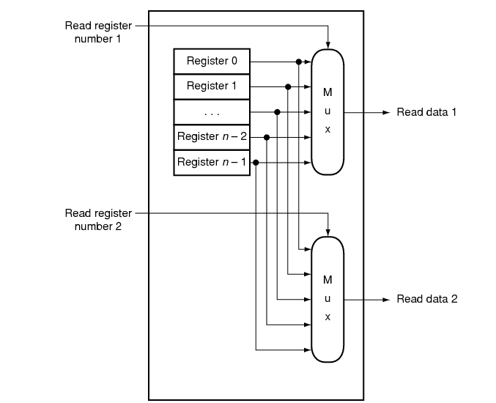
Register File
Register File
  N read/write registers
  Indexed by
  register number
Implementation:
  D flip flops to store bits
  Decoder for each write port
  Mux for each read port
Dual-Read-Port
Single-Write-Port
32 x 32
Register File
Q_{A}
D_{W}
32
32
Q_{B}
32
W
R_{W}
R_{A}
R_{B}
1
5
5
5

Slide 24
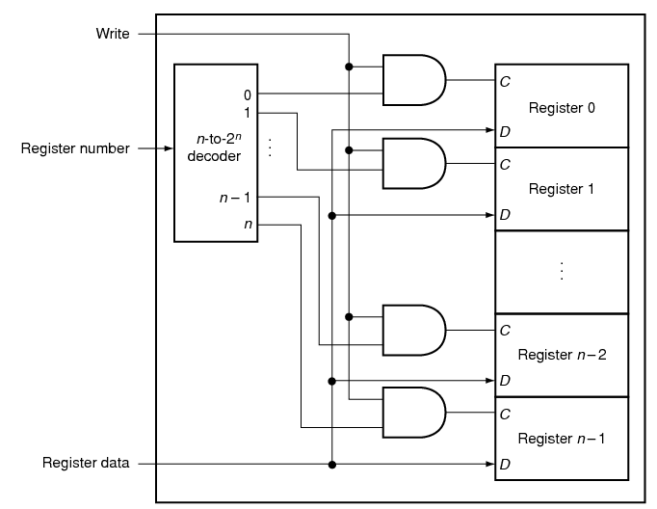
Register File
Register File
  N read/write registers
  Indexed by
  register number
Implementation:
  D flip flops to store bits
  Decoder for each write port
  Mux for each read port
Dual-Read-Port
Single-Write-Port
32 x 32
Register File
Q_{A}
D_{W}
32
32
Q_{B}
32
W
R_{W}
R_{A}
R_{B}
1
5
5
5

Slide 25
Register File
Register File
  N read/write registers
  Indexed by
  register number
Implementation:
  D flip flops to store bits
  Decoder for each write port
  Mux for each read port
What happens if same register read and writtend during same clock cycle?

Slide 26
Tradeoffs
Register File tradeoffs
  + Very fast (a few gate delays for both read and write)
  + Adding extra ports is straightforward
  – Doesn’t scale

Slide 27
Building Large Memories
Need a shared bus (or shared bit line)
Many FFs/outputs/etc. connected to single wire
Only one output drives the bus at a time

Slide 28
Tri-State Devices
Tri-State Buffers
E
E
Vdd
D
Q
D
D
Q
E | D | Q
0 | 0 | z
0 | 1 | z
1 | 0 | 0
1 | 1 | 1
Gnd
Notes:
z, z 0, 1

Slide 29
Tri-State Devices
Tri-State Buffers
E
E
Vdd
D
Q
D
Q
E | D | Q
0 | 0 | z
0 | 1 | z
1 | 0 | 0
1 | 1 | 1
Gnd
Notes:
z, z 0, 1

Slide 30
Shared Bus
D₀
S₀
D₁
S₁
D₂
S₂
D₃
S₃
D₁₀₂₃
S₁₀₂₃
shared line

Slide 31
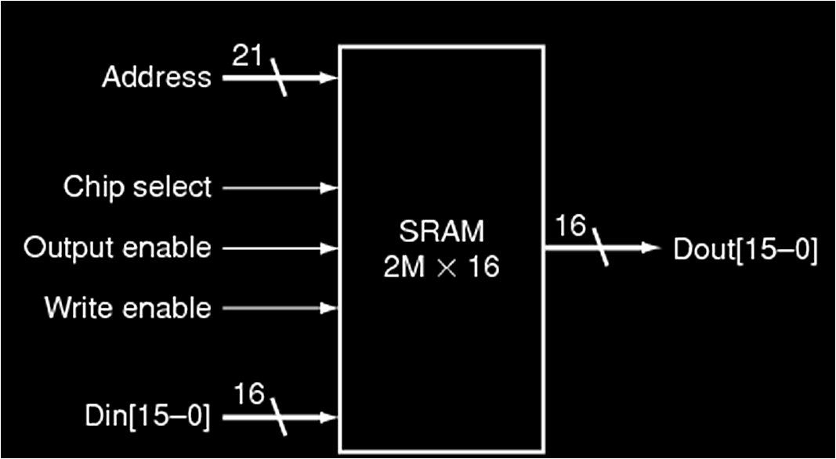
SRAM
Static RAM (SRAM)
  Essentially just SR Latches + tri-states buffers
Notes:
Caption on C.9.1 is incorrect
Output enable is useful for connecting multiple memories to a single-output bus and using Output enable to determine which memory drives the bus.

Slide 32
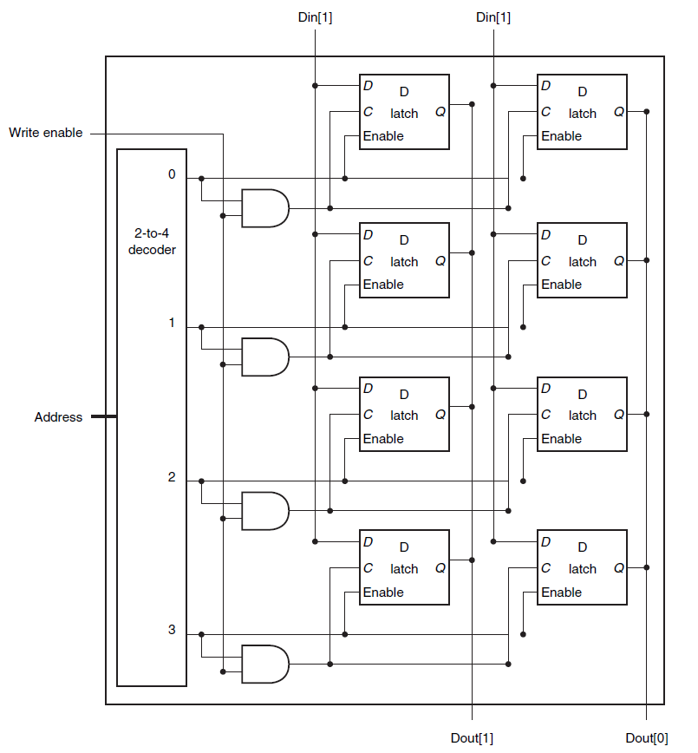
SRAM
Static RAM (SRAM)
  Essentially just SR Latches + tri-states buffers
4 x 2 SRAM
Notes:
Caption on C.9.1 is incorrect
Output enable is useful for connecting multiple memories to a single-output bus and using Output enable to determine which memory drives the bus.

Slide 33
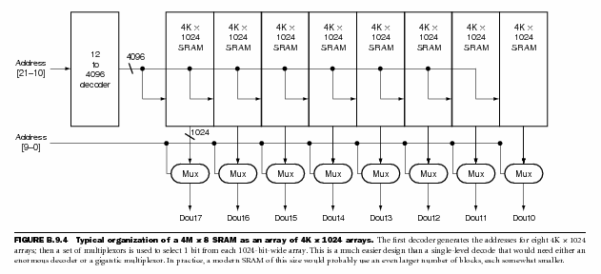
SRAM Chip
Notes:
2 step address decode

Slide 34
SRAM Chip
row decoder
A₂₁₋₁₀
CS
R/W
column selector, sense amp, and I/O circuits
A₉₋₀
Shared Data Bus
Notes:
2 step address decode

Slide 35
SRAM Cell
Typical SRAM Cell
bit line
word line
B
B
Each cell stores one bit, and requires 4 – 8 transistors (6 is typical)
Read:
pre-charge B and B to Vdd/2
pull word line high
cell pulls B or B low, sense amp detects voltage difference
Write:
pull word line high
drive B and B to flip cell
Notes:
Typical
read access times for SRAMs in 2004 varied from about 2–4 ns for the fastest CMOS
parts, which tend to be somewhat smaller and narrower, to 8–20 ns for the typical
largest parts, which in 2004 had more than 32 million bits of data.

Slide 36
SRAM Modules and Arrays
R/W
1M x 4
SRAM
1M x 4
SRAM
1M x 4
SRAM
1M x 4
SRAM
A₂₁₋₀
CS
msb
lsb
CS
Bank 2
CS
Bank 3
CS
Bank 4
Notes:
2, 3, or more step address decode
The first decoder generates the addresses for eight 4M x 4 arrays; then a set of multiplexors is used to select 1 bit from each 4-bit-wide array. This is a much easier design than a single-level decode that would need either an enormous decoder or a gigantic multiplexor. In practice, a modern SRAM of
this size would probably use an even larger number of blocks, each somewhat smaller.

Slide 37
SRAM Summary
SRAM
A few transistors (~6) per cell
Used for working memory (caches)
But for even higher density…

Slide 38
Dynamic RAM: DRAM
bit line
Dynamic-RAM (DRAM)
  Data values require constant refresh
word line
Capacitor
Gnd
Notes:
value kept in a cell is stored as a charge in a capacitor
To refresh the cell, we merely read its contents and write it back.
Because DRAMs store the charge on a capacitor, it cannot be kept indefinitely and must periodically be refreshed. That is why this memory structure is called dynamic, as opposed to the static storage in an SRAM cell.
The pass transistor acts like a switch: when the signal on the word line is asserted, the switch is closed, connecting the capacitor to the bit line. If the operation is a write, then the value to be written is placed on the bit line. If the value is a 1, the capacitor will be charged. If the value is a 0, then the capacitor will be discharged. Reading is slightly more complex, since the DRAM must detect a very small charge stored in the capacitor. Before activating the word line for a read, the bit line is charged to the voltage that is halfway between the low and high voltage. Then, by activating the word line, the charge on the capacitor is read out onto the bit line. This causes the bit line to move slightly toward the high or low direction, and this change is detected with a sense amplifi er, which can detect small changes in voltage.

Slide 39
DRAM vs. SRAM
Single transistor vs. many gates
  Denser, cheaper ($30/1GB vs. $30/2MB)
  But more complicated, and has analog sensing
Also needs refresh
  Read and write back…
  …every few milliseconds
  Organized in 2D grid, so can do rows at a time
  Chip can do refresh internally
Hence… slower and energy inefficient

Slide 40
Memory
Register File tradeoffs
  + Very fast (a few gate delays for both read and write)
  + Adding extra ports is straightforward
  – Expensive, doesn’t scale
  – Volatile
Volatile Memory alternatives: SRAM, DRAM, …
  – Slower
  + Cheaper, and scales well
  – Volatile
  Non-Volatile Memory (NV-RAM): Flash, EEPROM, …
  + Scales well
  – Limited lifetime; degrades after 100000 to 1M writes

Slide 41
Summary
We now have enough building blocks to build machines that can perform non-trivial computational tasks
Register File: Tens of words of working memory
SRAM: Millions of words of working memory
DRAM: Billions of words of working memory
NVRAM: long term storage
(usb fob, solid state disks, BIOS, …)
Next time we will build a simple processor!

