Slide 1
Arithmetic
Hakim Weatherspoon
CS 3410, Spring 2012
Computer Science
Cornell University
See P&H 2.4 (signed), 2.5, 2.6, C.6, and Appendix C.6

Slide 2
Goals for today
Binary (Arithmetic) Operations
  One-bit and four-bit adders
  Negative numbers and two’s compliment
  Addition (two’s compliment)
  Subtraction (two’s compliment)
  Performance

Slide 3
Binary Addition
Addition works the same way regardless of base
  Add the digits in each position
  Propagate the carry
  Unsigned binary addition is pretty easy
  Combine two bits at a time
  Along with a carry
183
+ 254
001110
+ 011100

Slide 4
1-bit Adder
A
B
Half Adder
Adds two 1-bit numbers
Computes 1-bit result and 1-bit carry
C
R
Notes:
Adds two 1-bit numbers,
computes 1-bit result and carry out
Useful for the rightmost binary digit, not much else

Slide 5
1-bit Adder with Carry
A
B
Full Adder
Adds three 1-bit numbers
Computes 1-bit result and 1-bit carry
Can be cascaded
Cout
Cin
R

Slide 6
4-bit Adder
A[4]
B[4]
4-Bit Full Adder
Adds two 4-bit numbers and carry in
Computes 4-bit result and carry out
Can be cascaded
Cout
Cin
R[4]
Notes:
Adds two 1-bit numbers, along with carry-in, computes 1-bit result and carry out
Can be cascaded to add N-bit numbers

Slide 7
4-bit Adder
A₃ B₃
A₂ B₂
A₁ B₁
A₀ B₀
Cout
Cin
R₃
R₂
R₁
R₀
Adds two 4-bit numbers, along with carry-in
Computes 4-bit result and carry out
Carry-out = overflow indicates result does not fit in 4 bits

Slide 8
Arithmetic with Negative Numbers
Negative Numbers Complicate Arithmetic
Recall addition with negatives:

Slide 9
Arithmetic with Negative Numbers
Negative Numbers Complicate Arithmetic
Recall addition with negatives:
  pos + pos → add magnitudes, result positive
  neg + neg → add magnitudes, result negative
  pos + neg → subtract smaller magnitude,
  keep sign of bigger magnitude

Slide 10
First Attempt: Sign/Magnitude
Representation
First Attempt: Sign/Magnitude Representation
1 bit for sign (0=positive, 1=negative)
N-1 bits for magnitude
Notes:
problems? two zeros, circuit still complicated

Slide 11
Two’s Complement Representation
Better: Two’s Complement Representation
Leading 1’s for negative numbers
To negate any number:
    complement all the bits
    then add 1
Notes:
add 1 and *discard carry*

Slide 12
Two’s Complement
Non-negatives
(as usual):
+0 = 0000
+1 = 0001
+2 = 0010
+3 = 0011
+4 = 0100
+5 = 0101
+6 = 0110
+7 = 0111
+8 = 1000
Negatives
(two’s complement: flip then add 1):
Notes:
choose -8 so we have a sign bit
+0 = -0
wraps from +7 to -8
asymmetric: no +8

Slide 13
Two’s Complement
Non-negatives
(as usual):
+0 = 0000
+1 = 0001
+2 = 0010
+3 = 0011
+4 = 0100
+5 = 0101
+6 = 0110
+7 = 0111
+8 = 1000
Negatives
(two’s complement: flip then add 1):
~0 = 1111 -0 = 0000
~1 = 1110 -1 = 1111
~2 = 1101 -2 = 1110
~3 = 1100 -3 = 1101
~4 = 1011 -4 = 1100
~5 = 1010 -5 = 1011
~3 = 1001 -6 = 1010
~7 = 1000 -7 = 1001
~8 = 0111 -8 = 1000
Notes:
choose -8 so we have a sign bit
+0 = -0
wraps from +7 to -8
asymmetric: no +8

Slide 14
Two’s Complement Facts
Signed two’s complement
  Negative numbers have leading 1’s
  zero is unique: +0 = - 0
  wraps from largest positive to largest negative
N bits can be used to represent
  unsigned:
    eg: 8 bits ⇒
  signed (two’s complement):
    ex: 8 bits ⇒

Slide 15
Sign Extension & Truncation
  Copy the leftmost bit into new leading bits
    For positive number, put 0’s in new leading bits
    For negative number, put 1’s in new leading bits
  Drop leading bits so long as sign doesn’t change
Extending to larger size
Truncate to smaller size

Slide 16
Two’s Complement Addition
Addition with two’s complement signed numbers
Perform addition as usual, regardless of sign
(it just works)
Notes:
1 + (-1)
(-3) + (-1)
(-7) + 3
7 + (-3)
7 + 1 : overflow
(-7) + (-3) : overflow
(-7) + (-1)

Slide 17
Two’s Complement Addition
Addition with two’s complement signed numbers
Perform addition as usual, regardless of sign
(it just works)
A₃ B₃
A₂ B₂
A₁ B₁
A₀ B₀
Cout
R₃
R₂
R₁
R₀
Notes:
1 + (-1)
(-3) + (-1)
(-7) + 3
7 + (-3)
7 + 1 : overflow
(-7) + (-3) : overflow
(-7) + (-1)

Slide 18
Overflow
Overflow
  adding a negative and a positive?
  adding two positives?
  adding two negatives?

Slide 19
Overflow
Overflow
  adding a negative and a positive?
  adding two positives?
  adding two negatives?
Rule of thumb:
Overflow happened iff
carry into msb != carry out of msb

Slide 20
Two’s Complement Adder
Two’s Complement Adder with overflow detection
A₃ B₃
A₂ B₂
A₁ B₁
A₀ B₀
over
flow
0
R₃
R₂
R₁
R₀

Slide 21
Binary Subtraction
Two’s Complement Subtraction
Notes:
a – b, where b is so large that –B overflows
B must be -8, so that –B = -8
last bit will change
if a >= 0, will correctly signal overflow
if a < 0, will correctly subtract and not signal overflow

Slide 22
Binary Subtraction
Two’s Complement Subtraction
A – B = A + (-B) = A + (B + 1)
B₃
B₂
B₁
B₀
A₃
A₂
A₁
A₀
over
flow
1
R₃
R₂
R₁
R₀
Q: What if (-B) overflows?
Notes:
a – b, where b is so large that –B overflows
B must be -8, so that –B = -8
last bit will change
if a >= 0, will correctly signal overflow
if a < 0, will correctly subtract and not signa l overflow

Slide 23
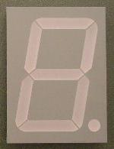
A Calculator
8
A
8
B
8
decoder
S
0=add
1=sub
Notes:
User enters the numbers to be added or subtracted using toggle switches
User selects ADD or SUBTRACT
Muxes feed A and B,
or A and –B, to the 8-bit adder
The 8-bit decoder for the hex display is straightforward (but not shown in detail)

Slide 24
A Calculator
8
A
8
8
adder
decoder
8
8
B
mux
8
S
0=add
1=sub
Notes:
red herring? constants into mux

Slide 25
Efficiency and Generality
  Is this design fast enough?
  Can we generalize to 32 bits? 64? more?
A₃ B₃
A₂ B₂
A₁ B₁
A₀ B₀
C₀
R₃
R₂
R₁
R₀

Slide 26
Performance
Speed of a circuit is affected by the number of gates in series (on the critical path or the deepest level of logic)
inputs
arrive
Combinational
Logic
outputs
expected
t_{combinational}

Slide 27
4-bit Ripple Carry Adder
A3
B3
A2
B2
A1
B1
A0
B0
C3
C2
C1
C4
C0
R3
R2
R1
R0
Carry ripples from lsb to msb
First full adder, 2 gate delay
Second full adder, 2 gate delay
…

Slide 28
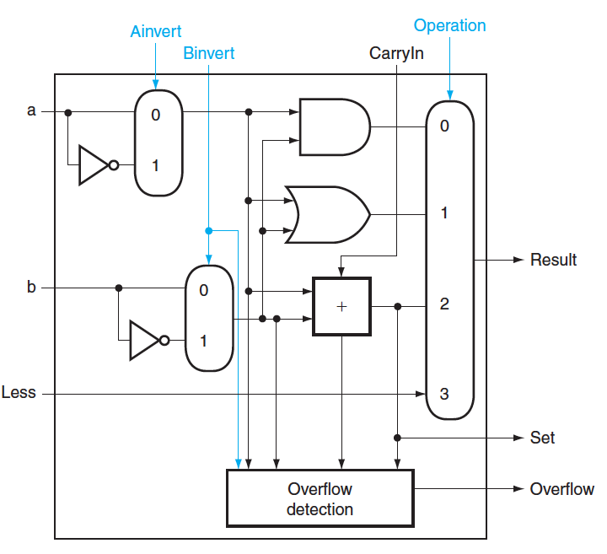
Critical Path
Which operation is the critical path?
A) ADD/SUB
B) AND
C) OR
D) LT

Slide 29
Critical Path
What is the length of the critical path (in gates)?
(counting inverters)
A) 3
B) 5
C) 9
D) 11

Slide 30
Critical Path
What is the length of the critical path for a 32-bit ALU (in gates)? (counting inverters)
A) 11
B) 32
C) 64
D) 71

Slide 31
Recap
We can now implement any combinational (combinatorial) logic circuit
  Decompose large circuit into manageable blocks
    Encoders, Decoders, Multiplexors, Adders, ...
  Design each block
    Binary encoded numbers for compactness
  Can implement circuits using NAND or NOR gates
  Can implement gates using use P- and N-transistors
  And can add and subtract numbers (in two’s compliment)!
  Next, state and finite state machines…

Slide 32
Administrivia
Make sure you are
Registered for class, can access CMS
Have a Section you can go to
Have project partner in same Lab Section
Lab1 and HW1 are out
Both due in one week, next Monday, start early
Work alone
But, use your resources
  Lab Section, Piazza.com, Office Hours, Homework Help Session,
  Class notes, book, Sections, CSUGLab
Homework Help Session
Wednesday and Friday from 3:30-5:30pm
Location: 203 Thurston

Slide 33
Administrivia
Check online syllabus/schedule
  http://www.cs.cornell.edu/Courses/CS3410/2012sp/schedule.html
Slides and Reading for lectures
Office Hours
Homework and Programming Assignments
Prelims (in evenings):
  Tuesday, February 28th
  Thursday, March 29th
  Thursday, April 26th
Schedule is subject to change

Slide 34
Stateful Components
Until now is combinatorial logic
  Output is computed when inputs are present
  System has no internal state
  Nothing computed in the present can depend on what happened in the past!
Need a way to record data
Need a way to build stateful circuits
Need a state-holding device
Finite State Machines
Inputs
Combinational
circuit
Outputs
N
M
Notes:
How are we going to stably store state

Slide 35
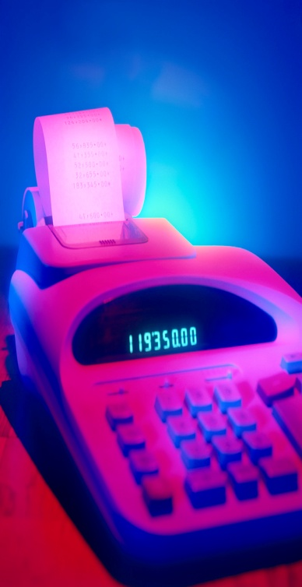
How can we store and change values?
enc
7LED
decode
B
detect
8
3
7
Ballots
How do we create
vote counter
machine
(a)
(b)
(c)
C
A
(d) All the above
(e) None
A
B
Q
R
S
Q

Slide 36
Unstable Devices
B
C
A

Slide 37
Bistable Devices
Stable and unstable equilibria?
A
B
A Simple Device
In stable state, A = B
How do we change the state?
0
1
1
0
A
B
A
B
Notes:
How to create state? Feedback.
Show how the signal works

Slide 38
SR Latch
Set-Reset (SR) Latch
Stores a value Q and its complement Q
S
Q
R
Q
S | R | Q | Q
0 | 0
0 | 1
1 | 0
1 | 1
Q
S
R
Q
Notes:
Start with 0, 1 => 0, 1
then 0, 0 => 0, 1
then 1, 0 => 1, 0
then 0, 0 => 1, 0, better yet “stay”
1, 1 is forbidden, b/c going to 0, 0 after goes haywire

Slide 39
SR Latch
Set-Reset (SR) Latch
Stores a value Q and its complement Q
S
Q
R
Q
S | R | Q | Q
0 | 0
0 | 1
1 | 0
1 | 1
Q
S
R
Q
Notes:
Start with 0, 1 => 0, 1
then 0, 0 => 0, 1
then 1, 0 => 1, 0
then 0, 0 => 1, 0, better yet “stay”
1, 1 is forbidden, b/c going to 0, 0 after goes haywire

Slide 40
Unclocked D Latch
Data (D) Latch
D
S
Q
D | Q | Q
0
1
R
Q
Notes:
Start in 0, 0, 1
Change to D = 1
After NOT gate, R = 0
After OR+NOT gates, /Q = 0 (R is already ready then), Q goes to 1
Problem: No way to hold state

Slide 41
Unclocked D Latch
Data (D) Latch
D
S
Q
D | Q | Q
0 | 0 | 1
1 | 1 | 0
R
Q
Data Latch
  Easier to use than an SR latch
  No possibility of entering an undefined state
When D changes, Q changes
    … immediately (after a delay of 2 Ors and 2 NOTs)
Need to control when the output changes
Notes:
Start in 0, 0, 1
Change to D = 1
After NOT gate, R = 0
After OR+NOT gates, /Q = 0 (R is already ready then), Q goes to 1
Problem: No way to hold state

Slide 42
D Latch with Clock
Level Sensitive D Latch
Clock high:
set/reset (according to D)
Clock low:
keep state (ignore D)
D
S
Q
clk
R
Q
clk
D
Q
Notes:
Any forbidden S=R=1 inputs? no

Slide 43
D Latch with Clock
D
D | Q | Q
0 | 0 | 1
1 | 1 | 0
S
Q
clk
R
Q
S | R | Q | Q
0 | 0 | Q | Q
0 | 1 | 0 | 1
1 | 0 | 1 | 0
1 | 1 | forbidden
clk | D | Q | Q
0 | 0 | Q | Q
0 | 1 | Q | Q
1 | 0 | 0 | 1
1 | 1 | 1 | 0
Notes:
Any forbidden S=R=1 inputs? No
Need both truth tables

Slide 44
D Latch with Clock
D
D | Q | Q
0 | 0 | 1
1 | 1 | 0
S
Q
clk
R
Q
clk | D | Q | Q
0 | 0 | Q | Q
0 | 1 | Q | Q
1 | 0 | 0 | 1
1 | 1 | 1 | 0
clk
D
Q
Notes:
Any forbidden S=R=1 inputs? No
Need both truth tables

Slide 45
Clocks
Clock helps coordinate state changes
  Usually generated by an oscillating crystal
  Fixed period; frequency = 1/period
falling
edge
rising
edge
1
0
period
low
high

Slide 46
Edge-triggering
Can design circuits to change on the rising or falling edge
Trigger on rising edge = positive edge-triggered
Trigger on falling edge = negative edge-triggered
Inputs must be stable just before the triggering edge
input
clock

Slide 47
Clock Methodology
Clock Methodology
Negative edge, synchronous
    Signals must be stable near falling clock edge
Positive edge synchronous
Asynchronous, multiple clocks, . . .
clk
t_{combinational}
t_{setup}
t_{hold}
compute
save
compute
save
compute

Slide 48
Edge-Triggered D Flip-Flop
D Flip-Flop
Edge-Triggered
Data is captured when clock is high
Outputs change only on falling edges
D
D
Q
D
Q
Q
F
clk
L
Q
L
Q
Q
c
c
clk
D
F
Q

Slide 49
Clock Disciplines
Level sensitive
  State changes when clock is high (or low)
Edge triggered
  State changes at clock edge
positive edge-triggered
negative edge-triggered

Slide 50
Registers
D0
Register
D flip-flops in parallel
shared clock
extra clocked inputs:
write_enable, reset, …
D1
D2
D3
4-bit
reg
4
4
clk

Slide 51
An Example: What will this circuit do?
Reset
Run
WE
R
Decoder
32-bit
reg
+1
Clk

