Slide 1
Gates and Logic
Hakim Weatherspoon
CS 3410, Spring 2012
Computer Science
Cornell Universty
See: P&H Appendix C.2 and C.3 (Also, see C.0 and C.1)

Slide 2
What came was Von Neumann Architecture?
The calculator
The Bombe
The Colossus
The ENIAC
All of the above

Slide 3

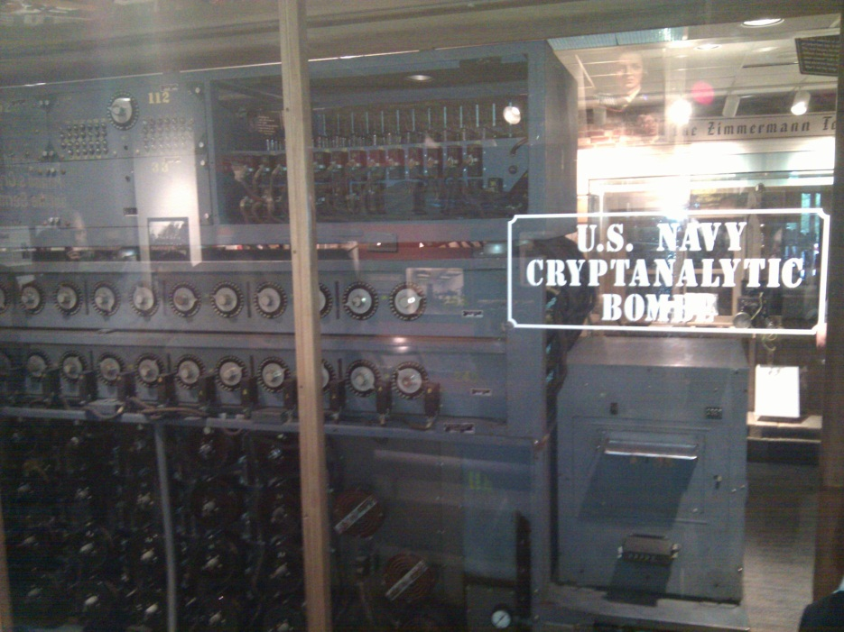
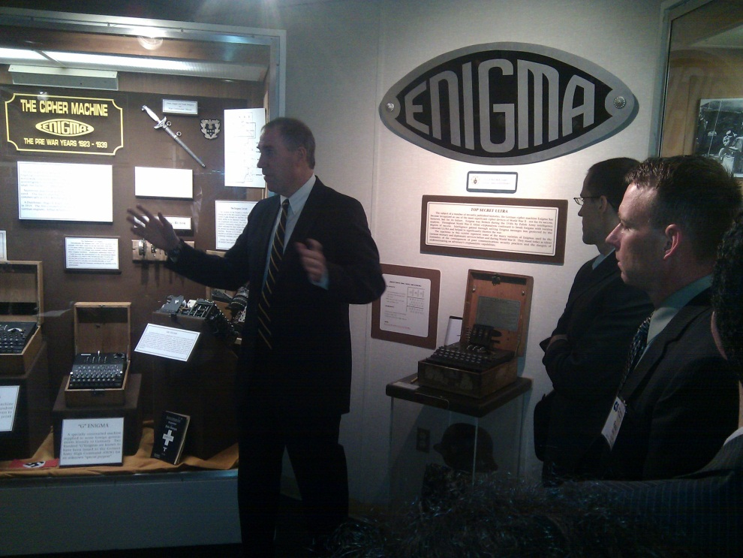
What came was Von Neumann Architecture?
Notes:
All of the above
Pictures show the Bombe built by Alan Turing to break the enigma machine ciphers.
They were Fixed-Program Computers came before stored-program computers (general purpose)
The former required re-wiring (e.g. ENIAC took 3 weeks to “re-wire”).

Slide 4
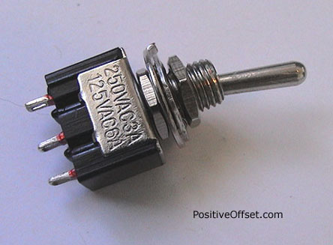
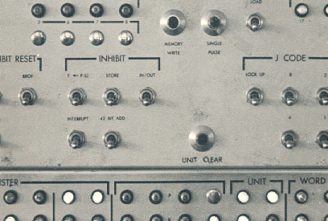

A switch
Acts as a conductor or insulator
Can be used to build amazing things…

Slide 5
Goals for today
To understand how to program,
we will build a processor (i.e. a logic circuit)
Logic circuits
  Use P- and N-transistors to implement NAND or NOR gates
  Use NAND or NOR gates to implement the logic circuits
  Build efficient logic circuits

Slide 6
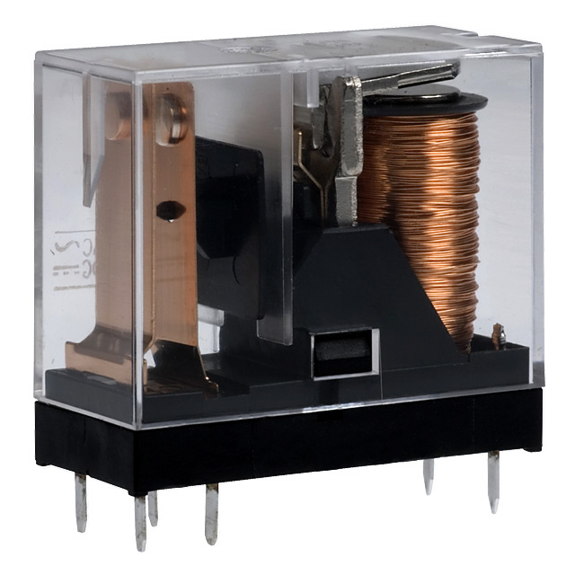
Better Switch
One current controls another (larger) current
Static Power:
  Keeps consuming power when in the ON state
Dynamic Power:
  Jump in power consumption when switching

Slide 7
Atoms
e
e
e
hole
e
e
e
N
e
P
P
N
P
P
P
N
N
N
N
P
P
N
e
e
e
e
e
e
e

Slide 8
Elements
e
e
e
B
e
Si
e
P
e
e
e
e
e
e
e
Boron
Silicon
Phosphorus

Slide 9
Silicon Crystal
Silicon
e
e
e
e
e
e
e
Si
e
Si
e
Si
e
Si
e
Si
e
Si
e
Si
e
e
e
e
e
e
e
e
e
e
e
e
e
e
e
e
e
e
e
e
e
e
Si
e
Si
e
Si
e
Si
e
Si
e
Si
e
Si
e
e
e
e
e
e
e
e
e
e
e
e
e
e
e
e
e
e
e
e
e
e
Si
e
Si
e
Si
e
Si
e
Si
e
Si
e
Si
e
e
e
e
e
e
e
e
e
e
e
e
e
e
e
e
e
e
e
e
e
e
Si
e
Si
e
Si
e
Si
e
Si
e
Si
e
Si
e
e
e
e
e
e
e
e
e
e
e
e
e
e
e
e
e
e
e
e
e
e
Si
e
Si
e
Si
e
Si
e
Si
e
Si
e
Si
e
e
e
e
e
e
e
e
e
e
e
e
e
e
e

Slide 10
Phosphorus Doping
N-Type: Silicon + Phosphorus
e
e
e
e
e
e
e
e
e
e
e
e
e
e
e
e
e
e
e
e
e
e
e
e
e
e
e
e
e
e
e
e
e
e
e
e
e
e
e
P
e
e
e
e
e
e
e
e
e
e
e
e
e
e
e
e
e
e
e
e
e
e
e
e
e
e
e
P
e
e
e
e
e
e
e
e
e
e
e
e
e
e
e
e
e
e
e
e
e
e
e
e
e
e
e
e
e
e
e
e
P
e
e
e
e
e
e
e
e
e
e
e
e
e
e
e
e
e
e
e
e
e
e
e
e
e
e
P
e
e
e
e
e
e
e
e
e
e
e
e
e
e
e
e
e
e
e
e
Notes:
neutral -> conductor
high voltage -> insulator

Slide 11
Boron Doping
P-Type: Silicon + Boron
e
e
e
e
e
e
e
e
e
e
e
e
e
e
e
e
e
e
e
e
e
e
e
e
e
e
e
e
e
e
e
e
e
e
e
e
e
e
e
e
B
e
e
e
e
e
e
e
e
e
e
e
e
e
e
e
e
e
e
e
e
e
e
e
e
B
e
e
e
e
e
e
e
e
e
e
e
e
e
e
e
e
e
e
e
e
e
e
e
e
e
e
e
e
e
B
e
e
e
e
e
e
e
e
e
e
e
e
e
e
e
e
e
e
e
e
e
e
e
e
B
e
e
e
e
e
e
e
e
e
e
e
e
e
e
e
e
e
e
e
Notes:
neutral -> conductor
low voltage -> insulator

Slide 12
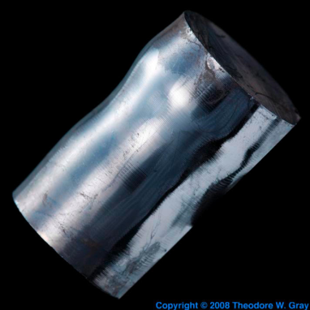



Semiconductors
Insulator
p-type (Si+Boron)
has mobile holes:
n-type (Si+Phosphorus)
has mobile electrons:
low voltage (depleted)
→ insulator
high voltage (mobile holes)
→ conductor
low voltage (mobile electrons)
→ conductor
high voltage (depleted)
→ insulator

Slide 13
Bipolar Junction
P-Type
N-Type
e
e
e
e
e
e
e
e
e
e
e
e
e
e
low v → insulator
high v → conductor
low v → conductor
high v → insulator

Slide 14
Reverse Bias
P-Type
N-Type
e
e
e
e
–
e
e
+
e
e
e
e
e
e
e
e
low v → insulator
high v → conductor
low v → conductor
high v → insulator

Slide 15
Forward Bias
P-Type
N-Type
e
e
e
e
e
e
e
e
e
e
–
+
e
e
e
e
e
e
e
e
e
e
e
e
e
e
e
e
e
e
low v → insulator
high v → conductor
low v → conductor
high v → insulator

Slide 16
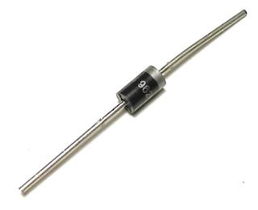
Diodes
PN Junction “Diode”
p-type
n-type
Conventions:
vdd = vcc = +1.2v = +5v = hi
vss = vee = 0v = gnd

Slide 17
PNP Junction
p-type
n-type
p-type

Slide 18
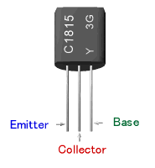
Bipolar Junction Transistors
Solid-state switch: The most amazing invention of the 1900s
Emitter = “input”, Base = “switch”, Collector = “output”
PNP Transistor
NPN Transistor
C
p
n
p
E=vdd
vss=E
n
p
n
C
B
B
vdd
E
C
B
B
C
E
vss

Slide 19
Field Effect Transistors
P-type FET
N-type FET
Drain = vdd
Drain
Gate
Gate
Source
Source = vss
Connect Source to Drain when Gate = lo
Drain must be vdd, or connected to source of another P-type transistor
Connect Source to Drain when Gate = hi
Source must be vss, or connected to drain of another N-type transistor

Slide 20
Multiple Transistors
+5v
Vdd
in
out
0v
t
Vss
Gate delay
transistor switching time
voltage, propagation, fanout, temperature, …
CMOS design
(complementary-symmetry metal–oxide–semiconductor)
  Power consumption =
  dynamic + leakage
In | Out
voltage

Slide 21
Digital Logic
+5v
Vdd
+2v
in
out
+0.5v
0v
Vss
t
In | Out
+5v | 0v
0v | +5v
In | Out
voltage
truth table
Conventions:
vdd = vcc = +1.2v = +5v = hi = true = 1
vss = vee = 0v = gnd = false = 0

Slide 22
NOT Gate (Inverter)
Function: NOT
Symbol:
Vdd
in
out
in
out
Vss
In | Out
0 | 1
1 | 0
Truth table

Slide 23
NAND Gate
Vdd
Vdd
Function: NAND
Symbol:
A
B
out
a
out
b
B
A
A | B | out
0 | 0 | 1
0 | 1 | 1
1 | 0 | 1
1 | 1 | 0
Vss

Slide 24
NOR Gate
Vdd
Function: NOR
Symbol:
A
a
out
B
b
out
A
B
A | B | out
0 | 0 | 1
0 | 1 | 0
1 | 0 | 0
1 | 1 | 0
Vss
Vss

Slide 25
Building Functions
AND:
OR:
NOT:

Slide 26
Universal Gates
NAND is universal (so is NOR)
  Can implement any function with just NAND gates
    De Morgan’s laws are helpful (pushing bubbles)
  useful for manufacturing
E.g.: XOR (A, B) = A or B but not both (“exclusive or”)
Proof: ?

Slide 27
Administrivia
Make sure you have access to CMS and Piazza.com
Lab Sections started this week
  Lab0 turned in during Section
  Bring laptop to section, if possible (not required)
  Lab1 available Monday next week (due following Monday)
  Group projects start in week 4 (partner in same section)
Homework1 available Monday
  Due following Monday
Office hours start next week
  More information available on website by this weekend
Clickers not required, bring to every lecture
  Participation, not attendance

Slide 28
Example: Big Picture
Computer System Organization and Programming platform from 10 years ago
  P- and N-transistors -> NAND and NOR gates -> logic circuit -> processor -> software -> applications (computers, cell phones, TVs, cars, airplanes, buildings, etc).
Notes:
NAND and NOR gates can implement any logic circuit
i.e. a computer processor
Use P- and N-transistors to implement NAND or NOR gates

Slide 29
Big Picture: Abstraction
Hide complexity through simple abstractions
  Simplicity
    Box diagram represents inputs and outputs
  Complexity
    Hides underlying P- and N-transistors and atomic interactions
Vdd
a
in
out
d
out
Vss
b
a
d
out
in
out
b

Slide 30
Logic Equations
Some notation:
constants: true = 1, false = 0
variables: a, b, out, …
operators:
  AND(a, b) = a b = a & b = a ∧ b
OR(a, b) = a + b = a | b = a ∨ b
NOT(a) = ā = !a = ¬a

Slide 31
Identities
Identities useful for manipulating logic equations
  For optimization & ease of implementation
  a + 0 =
  a + 1 =
  a + ā =
  a 0 =
  a 1 =
  a ā =
  (a + b) =
  (a b) =
  a + a b =
  a(b+c) =
  a(b+c) =
  a
  1
  1
  0
  a
  0
  a b
  a + b
  a
  ab + ac
  a + bc
Notes:
Minimization activity

Slide 32
Logic Manipulation
functions: gates ↔ truth tables ↔ equations
Example: (a+b)(a+c) = a + bc
a | b | c
0 | 0 | 0
0 | 0 | 1
0 | 1 | 0
0 | 1 | 1
1 | 0 | 0
1 | 0 | 1
1 | 1 | 0
1 | 1 | 1
Notes:
(a+b)(a+c)
= aa + ab + ac + bc
= a + a(b+c) + bc
= a(1 + (b+c)) + bc
= a + bc

Slide 33
Logic Manipulation
functions: gates ↔ truth tables ↔ equations
Example: (a+b)(a+c) = a + bc
a | b | c
0 | 0 | 0
0 | 0 | 1
0 | 1 | 0
0 | 1 | 1
1 | 0 | 0
1 | 0 | 1
1 | 1 | 0
1 | 1 | 1
 |  |  | a+b | a+c | LHS
 |  |  | 0 | 0 | 0
 |  |  | 0 | 1 | 0
 |  |  | 1 | 0 | 0
 |  |  | 1 | 1 | 1
 |  |  | 1 | 1 | 1
 |  |  | 1 | 1 | 1
 |  |  | 1 | 1 | 1
 |  |  | 1 | 1 | 1
 |  |  |  |  |  | bc | RHS
 |  |  |  |  |  | 0 | 0
 |  |  |  |  |  | 0 | 0
 |  |  |  |  |  | 0 | 0
 |  |  |  |  |  | 1 | 1
 |  |  |  |  |  | 0 | 1
 |  |  |  |  |  | 0 | 1
 |  |  |  |  |  | 0 | 1
 |  |  |  |  |  | 1 | 1
Notes:
(a+b)(a+c)
= aa + ab + ac + bc
= a + a(b+c) + bc
= a(1 + (b+c)) + bc
= a + bc

Slide 34
Notes:
Think-Pair-Share: Why does minimization matter

Slide 35
Predictive – logic minimization
How to standardize minimizing logic circuits?

Slide 36
Logic Minimization
A common problem is how to implement a desired function most efficiently
One can derive the equation from the truth table
How does one find the most efficient equation?
  Manipulate algebraically until satisfied
  Use Karnaugh maps (or K maps)
a | b | c | minterm
0 | 0 | 0 | abc
0 | 0 | 1 | abc
0 | 1 | 0 | abc
0 | 1 | 1 | abc
1 | 0 | 0 | abc
1 | 0 | 1 | abc
1 | 1 | 0 | abc
1 | 1 | 1 | abc
for all outputs
that are 1,
take the corresponding
minterm
Obtain the result in
“sum of products” form

Slide 37
Karnaugh maps
Encoding of the truth table where adjacent cells differ in only one bit
ab
00 01 11 10
a | b | out
0 | 0 | 0
0 | 1 | 0
1 | 0 | 0
1 | 1 | 1
0 | 0 | 1 | 0
Corresponding
Karnaugh map
truth table
for AND

Slide 38
Bigger Karnaugh Maps
a
a
b
4-input
func
3-input
func
y
b
y
c
c
d
ab
c
00 01 11 10
ab
0
cd
00 01 11 10
1
00
01
11
10

Slide 39
Minimization with Karnaugh maps (1)
a | b | c | out
0 | 0 | 0 | 0
0 | 0 | 1 | 1
0 | 1 | 0 | 0
0 | 1 | 1 | 1
1 | 0 | 0 | 1
1 | 0 | 1 | 1
1 | 1 | 0 | 0
1 | 1 | 1 | 0
Sum of minterms yields
  abc + abc + abc + abc

Slide 40
Minimization with Karnaugh maps (2)
a | b | c | out
0 | 0 | 0 | 0
0 | 0 | 1 | 1
0 | 1 | 0 | 0
0 | 1 | 1 | 1
1 | 0 | 0 | 1
1 | 0 | 1 | 1
1 | 1 | 0 | 0
1 | 1 | 1 | 0
Sum of minterms yields
  abc + abc + abc + abc
Karnaugh maps identify which inputs are (ir)relevant to the output
ab
c
00 01 11 10
0
0 | 0 | 0 | 1
1 | 1 | 0 | 1
1

Slide 41
Minimization with Karnaugh maps (2)
a | b | c | out
0 | 0 | 0 | 0
0 | 0 | 1 | 1
0 | 1 | 0 | 0
0 | 1 | 1 | 1
1 | 0 | 0 | 1
1 | 0 | 1 | 1
1 | 1 | 0 | 0
1 | 1 | 1 | 0
Sum of minterms yields
  abc + abc + abc + abc
Karnaugh map minimization
  Cover all 1’s
  Group adjacent blocks of 2^{n} 1’s that yield a rectangular shape
  Encode the common features of the rectangle
    out = ab + ac
ab
c
00 01 11 10
0
0 | 0 | 0 | 1
1 | 1 | 0 | 1
1

Slide 42
Karnaugh Minimization Tricks (1)
ab
c
00 01 11 10
0
0 | 1 | 1 | 1
0 | 0 | 1 | 0
1
ab
c
00 01 11 10
0
1 | 1 | 1 | 1
0 | 0 | 1 | 0
1

Slide 43
Karnaugh Minimization Tricks (1)
ab
c
00 01 11 10
Minterms can overlap
  out = bc + ac + ab
Minterms can span 2, 4, 8 or more cells
  out = c + ab
0
0 | 1 | 1 | 1
0 | 0 | 1 | 0
1
ab
c
00 01 11 10
0
1 | 1 | 1 | 1
0 | 0 | 1 | 0
1

Slide 44
Karnaugh Minimization Tricks (2)
ab
cd
00 01 11 10
00
0 | 0 | 0 | 0
1 | 0 | 0 | 1
1 | 0 | 0 | 1
0 | 0 | 0 | 0
01
11
10
ab
cd
00 01 11 10
00
1 | 0 | 0 | 1
0 | 0 | 0 | 0
0 | 0 | 0 | 0
1 | 0 | 0 | 1
01
11
10

Slide 45
Karnaugh Minimization Tricks (2)
ab
cd
00 01 11 10
00
0 | 0 | 0 | 0
1 | 0 | 0 | 1
1 | 0 | 0 | 1
0 | 0 | 0 | 0
The map wraps around
  out = bd
  out = bd
01
11
10
ab
cd
00 01 11 10
00
1 | 0 | 0 | 1
0 | 0 | 0 | 0
0 | 0 | 0 | 0
1 | 0 | 0 | 1
01
11
10

Slide 46
Karnaugh Minimization Tricks (3)
ab
cd
00 01 11 10
00
0 | 0 | 0 | 0
1 | x | x | x
1 | x | x | 1
0 | 0 | 0 | 0
“Don’t care” values can be interpreted individually in whatever way is convenient
  assume all x’s = 1
  out = d
  assume middle x’s = 0
  assume 4th column x = 1
  out = bd
01
11
10
ab
cd
00 01 11 10
00
1 | 0 | 0 | x
0 | x | x | 0
0 | x | x | 0
1 | 0 | 0 | 1
01
11
10

Slide 47
Multiplexer
A multiplexer selects between multiple inputs
  out = a, if d = 0
  out = b, if d = 1
Build truth table
Minimize diagram
Derive logic diagram
a
b
d

Slide 48
Multiplexer Implementation
a
Build a truth table
  = abd + abd + a bd + a b d
b
d
a | b | d | out
0 | 0 | 0 | 0
0 | 0 | 1 | 0
0 | 1 | 0 | 0
0 | 1 | 1 | 1
1 | 0 | 0 | 1
1 | 0 | 1 | 0
1 | 1 | 0 | 1
1 | 1 | 1 | 1

Slide 49
Multiplexer Implementation
a
Build the Karnaugh map
b
d
ab
d
00 01 11 10
a | b | d | out
0 | 0 | 0 | 0
0 | 0 | 1 | 0
0 | 1 | 0 | 0
0 | 1 | 1 | 1
1 | 0 | 0 | 1
1 | 0 | 1 | 0
1 | 1 | 0 | 1
1 | 1 | 1 | 1
0
0 | 0 | 1 | 1
0 | 1 | 1 | 0
1

Slide 50
Multiplexer Implementation
a
Derive Minimal Logic Equation
  out = ad + bd
b
d
ab
d
00 01 11 10
a | b | d | out
0 | 0 | 0 | 0
0 | 0 | 1 | 0
0 | 1 | 0 | 0
0 | 1 | 1 | 1
1 | 0 | 0 | 1
1 | 0 | 1 | 0
1 | 1 | 0 | 1
1 | 1 | 1 | 1
0
0 | 0 | 1 | 1
0 | 1 | 1 | 0
1

Slide 51
Multiplexer Implementation
a
Derive Minimal Logic Equation
  out = ad + bd
b
d
ab
d
00 01 11 10
a | b | d | out
0 | 0 | 0 | 0
0 | 0 | 1 | 0
0 | 1 | 0 | 0
0 | 1 | 1 | 1
1 | 0 | 0 | 1
1 | 0 | 1 | 0
1 | 1 | 0 | 1
1 | 1 | 1 | 1
0
0 | 0 | 1 | 1
0 | 1 | 1 | 0
1
a
d
out
b

Slide 52
Summary
We can now implement any logic circuit
  Can do it efficiently, using Karnaugh maps to find the minimal terms required
  Can use either NAND or NOR gates to implement the logic circuit
  Can use P- and N-transistors to implement NAND or NOR gates

