Slide 1
Clipper: A Low Latency Online Prediction Serving System
Shreya

Slide 2
The Problem
Machine learning requires real time, accurate, and robust predictions under heavy query load.
Most machine learning frameworks care about optimizing model training not deployment
Current solutions for online predictions focus on a single framework

Slide 3
Clipper
Online prediction system
Modular architecture with two layers
Paying concern to latency, throughput, and accuracy
Written in Rust
Support for multiple ML frameworks such as Spark, scikit-learn, caffe (computer vision), tensorflow, and HTK
written in rust and has support for spark, scikit-learn, caffe (computer vision), tensorflow, and htk(speech recognition)
Notes:
Caffe – computer vision
Htk – speech recognition

Slide 4
Architecture
Notes:
Two layers model selection layer, model abstraction layer, connected to individual containers.
Communicate through RPC
Remote Procedure Call (RPC) is a protocol that one program can use to request a service from a program located in another computer on a network without having to understand the network's details. A procedure call is also sometimes known as a function call or a subroutine call.

Slide 5
Model Selection Layer
Selects and combine predictions across competing models for more accuracy.
Most ML networks are optimized for offline batch processing not single input prediction latency
Solution: batching with limits
Receive a query: dispatches to certain models based on previous feedback
Notes:
Dispatches to models using rest api
Straggler mitigation technique: render predictions without waiting for slow models. Requires no modifications for frameworks

Slide 6
Selection Strategies
Costly A/B online testing. It grows exponentially in number of candidate models.
Select, combine, observe
Select the best: Exp3
Ensemble select: Exp4

Slide 7
Selection Strategies
Exp3:
associate a weight si for each model.
Select that model with probability si/sum of all other weights
Updates the weight based on accuracy of prediction
where the loss function is absolute loss ∈[0,1]
η determines how quickly Clipper responds to feedback
Notes:
Multi armed bandit problem
Speech recognition and computer vision in automatic captioning
lightweight algorithm
that requires only a single model evaluation for each pre-
diction and thus performs well under heavy loads
Strong theoretical guarantees

Slide 8
Selection Strategy
Use linear ensemble methods which compute a weighted average of the base model predictions
Exp4
Additional model containers increase the chance of stragglers.
Solution: wait according to latency requirement and confidence reflects uncertainty
If confidence is too low uses default setting.
Notes:
Bootstrap aggregation: bagging: used to reduce variance and thereby improve generalization performance
While exp3 is bounded by best algorithm, exp4 increases performance with additional models

Slide 9
Exp3 and Exp4 Recovery
Notes:
After 5K queries the performance of the lowest-error model is
severely degraded, and after 10k queries performance recovers.
Exp3 and Exp4 quickly compensate for the failure and achieve
lower error than any static model selection

Slide 10
Model Abstraction Layer
Caches predictions on a per model basis and implements adaptive batching to maximize throughput given a query latency target
Each queue has a latency target
Optimal batch size: maximizes throughput under latency constraint. Uses AIDM
Reduce by 10% as optimal batch size doesn’t fluctuate too much
Dispatched via RPC system
Notes:
batching amortizes cost of RPC calls and internal framework overheas like copying inputs to gpu memory
batching enables machine learning data parallel optimizations by performig batch inference???? On many inputs simultaneously
tensorflow has fixed batch sizes to fully exploit gpu parallelism
SVM can do 30 k qps while svm is limited to 200 qps. Application developers manually tune the batch size for each model

Slide 11
Model Abstraction Layer
Prediction cache for query and model used,
LRU
Bursty workloads often results in less than max batch size. Could be beneficial to wait a little longer to queue up
Delayed batching
Notes:
for Spark SVM does nothing because it is fast and handles several queries well, sci-kit learn svm benefits from this

Slide 12
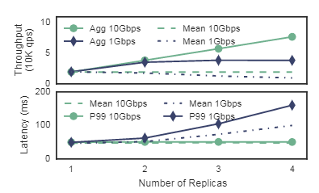
Machine Learning Frameworks
Each model is contained in a Docker container.
Working on immature framework doesn’t interfere with performance of others
Replication: resource intensive frameworks can get more than one container
Could have very different performance across cluster
Notes:
Conclusion: network is the bottle neck

Slide 13
Machine Learning Frameworks
Adding support for a framework takes < 25 lines of code
To support context specific model selection (diatlect), model selection layer can instantiate a unitue model selection state for each user/context/session.
Managed in external database (Redis)

Slide 14
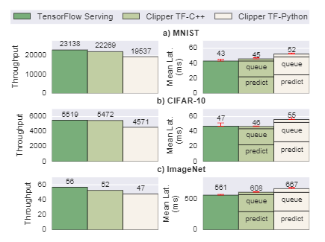
Testing
Tested against TensorFlow
Employs static sized batching to optimize parallelization
Used two containers one with the python and c++ api.
Python was slow but
c++ was near identical performance
Notes:
Use MNIST, CIFAR-10 and Imagenet as data sets to see how well done. First is common baseline. Second two are good
TIMIT speech corpus [24] andthe HTK [63] machine learning framework. Dataset. Randomly drew from their 8 dialects
on three TensorFlow object recognition deep networks of varying computational cost: a 4-layer convolutional neural network trained on the MNIST dataset [42], the 8-layer AlexNet [33]architecture trained on CIFAR-10 [32], and Google’s 22-layer Inception-v3 network [58] trained on ImageNet.
Not too much overhead

Slide 15
Limitations
Doesn’t talk about system requirements
Replicating containers with same algorithm could do some optimization with this to minimize latency (half in one and half to other to minimize batch size)
Also doesn’t mention not double counting the same algorithm

Slide 16
Related Work
Amazon Redshift: shared nothing, can work with semi-structured data, time travel
BigQuery: JSON and nested data support, has own SQL language, tables are append only,
Microsoft SQL Data Warehouse: separates storage and compute, similar abstraction Data Warehouse Units, concurrency cap, no support for semi structured
Notes:
Amazon pay hour per node, higher compute per dollar
Snowflake is vws per hour
Big query pay for each query and data stored.
Amazon is not acid,
Snowflake: is good for sotpping and starting warehouses. Faster than redshift and it’s automatically done. Decoupled compute and storae unlike reshift.
Big query can just run your query and not worry about allocating to specific cluster it wil scale “under the hood”. It also integrates with a lot of google’s tools, analytics, g suite etc

Slide 17
Future Work
Make Snowflake a full self service model, without developer involvement.
If a query fails it is entirely rerun, which can be costly for a long query.
Each worker node has a cache of table data that currently uses LRU, but the policy could be improved.
Snowflake also doesn’t handle the situation if an availability zone is unavailable. Currently it requires reallocating the query to another VW.
Performance isolation might not be necessary so sharing a query among worker nodes could increase utilization.

